Slide 1
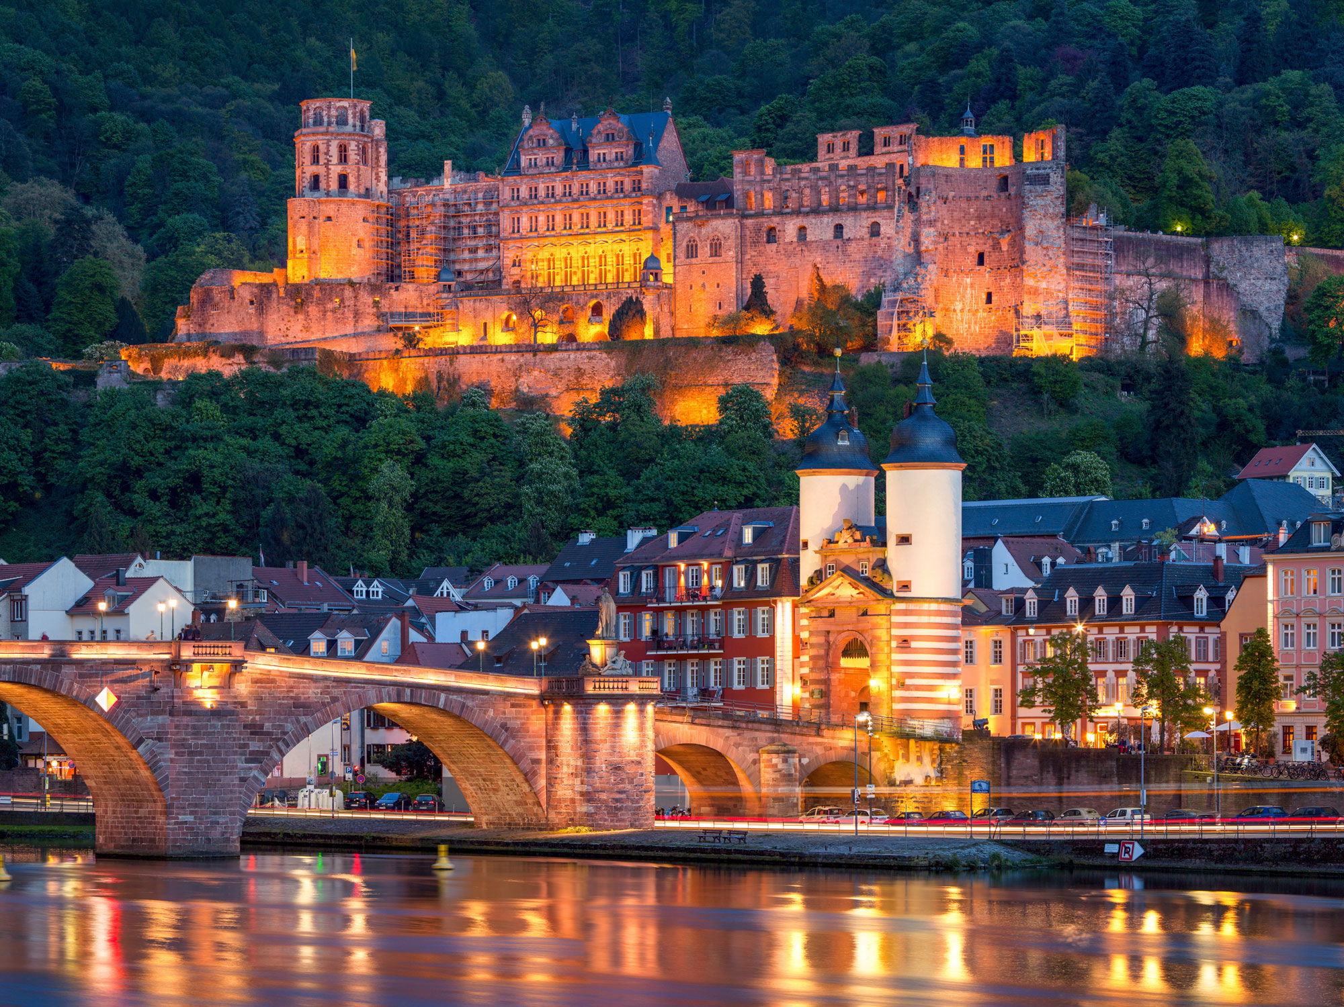
Neutrinos: What are they and why should you care?
Neutrino 2018, Heidelberg
Art McDonald
Queen’s University, Kingston, Canada

Slide 2
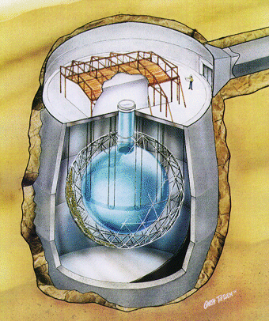
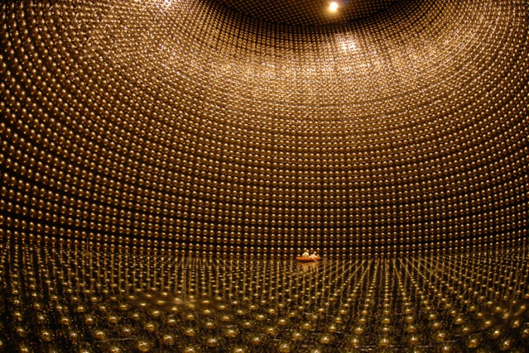
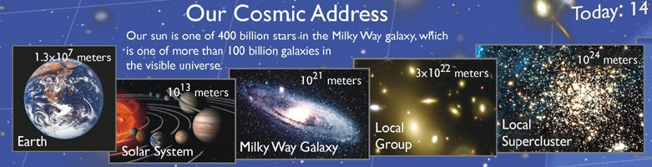
What can you learn from Neutrinos?
Examples: Deep Underground Detectors of Neutrinos from the Sun
SNO
SUPERKAMIOKANDE
BOREXINO

Slide 3
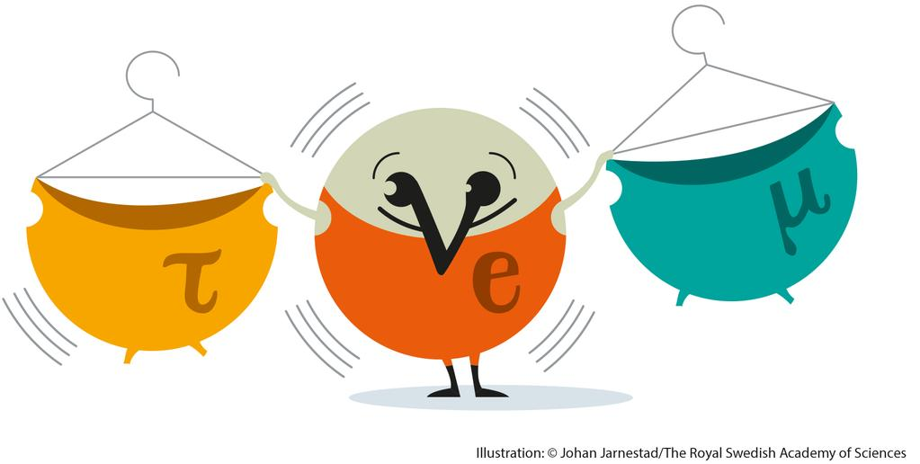
Neutrino facts:
Neutrinos, along with electrons and quarks, are basic particles of nature that we do not know how to sub-divide further.
Neutrinos come in three “flavours” (electron, mu, tau).
They only feel the Weak Force. Therefore, they only stop if they hit the nucleus of an atom or an electron head-on and can pass through 10 trillion kilometers of lead without stopping. They are produced extensively in the center of the sun and can penetrate out with ease.
But they are very difficult to detect and their properties have been the least known among the basic particles.
The Standard Model for Elementary Particles said that they have zero mass and should not change their flavor or oscillate between flavors. If they do oscillate, it implies that they have a rest mass greater than zero.

Slide 4
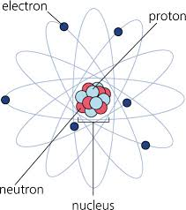
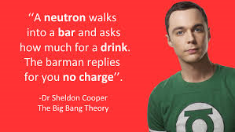
Inside an atom
Electron:
Charge -1
Proton:
2 up (+2/3) + 1 down (-1/3) Quark:
Charge +1
Neutron:
1 up (+2/3) + 2 down (-1/3) Quark:
No Charge

Slide 5
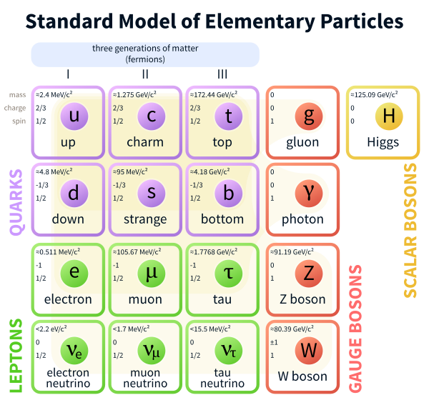
OUR CURRENT UNDERSTANDING OF “ORDINARY” MATTER
- Three up and/or down
Quarks are combined
to make a proton or
neutron.
An atom is composed
of electrons circling
a nucleus containing
protons and neutrons.
+ GRAVITY

Slide 6
OUR CURRENT UNDERSTANDING OF “ORDINARY” MATTER
+ GRAVITY
- Neutrinos feel only the weak force (and gravity) and are produced in some forms of radioactivity or in nuclear or particle reactions in the stars or at accelerators.

Slide 7
OUR CURRENT UNDERSTANDING OF “ORDINARY” MATTER
ANTI MATTER:
Every particle has an equivalent anti-particle. If they encounter each other, they annihilate leaving just energy. Example:
Positron Emission Tomography (PET) used in medicine.
+ GRAVITY
- Neutrinos feel only the weak force (and gravity) and are produced in some forms of radioactivity or in nuclear or particle reactions in the stars or at accelerators.
Three “flavors” of each particle.
Force Carriers

Slide 8
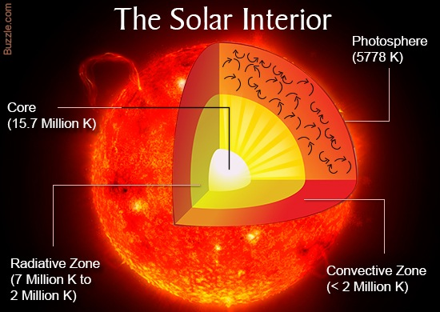
The middle of the sun is so hot that the centers of the atoms (nuclei)
fuse together, giving off lots of energy and neutrinos.

Slide 9
SOLAR FUSION CHAIN (PP Cycle)
Studied with enormous neutrino detectors deep underground

Slide 10
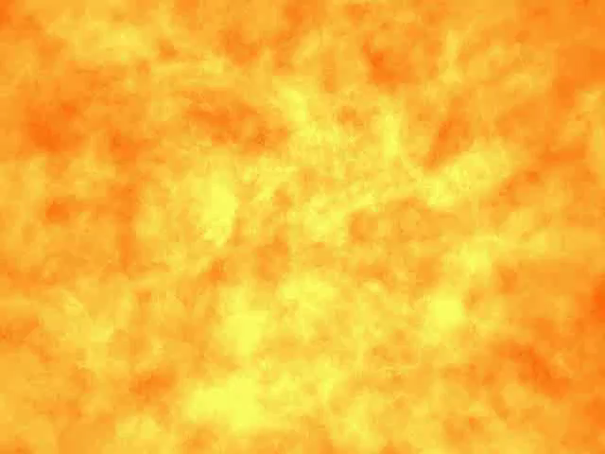

Slide 11
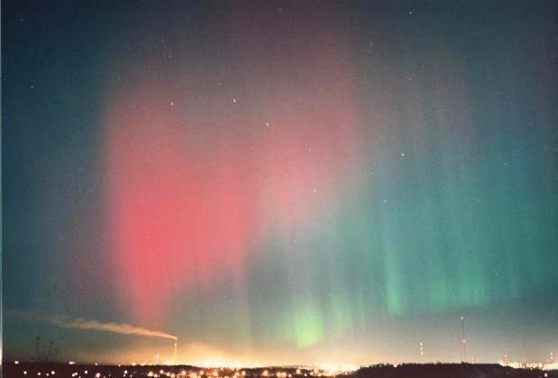
If SNOLAB were not 2 km underground the cosmic rays would make our detector glow like the Northern Lights (Aurora Borealis)
Sudbury during a solar storm

Slide 12
Neutrino Properties From Recent Experiments
A number of experiments have observed neutrinos from the sun and we have learned:
  The highest energy neutrinos produced in the core of the sun change their flavour before reaching our detectors. (SNO, Borexino, SuperKamiokande + others)
  This observation, combined with other measurements of neutrinos from the atmosphere and accelerators here on earth implies that neutrinos have a small but finite mass and requires change to the Standard Model.
  The calculations of how the sun burns are very accurate.
  (Numbers of neutrinos match calculations within 10%).

Slide 13
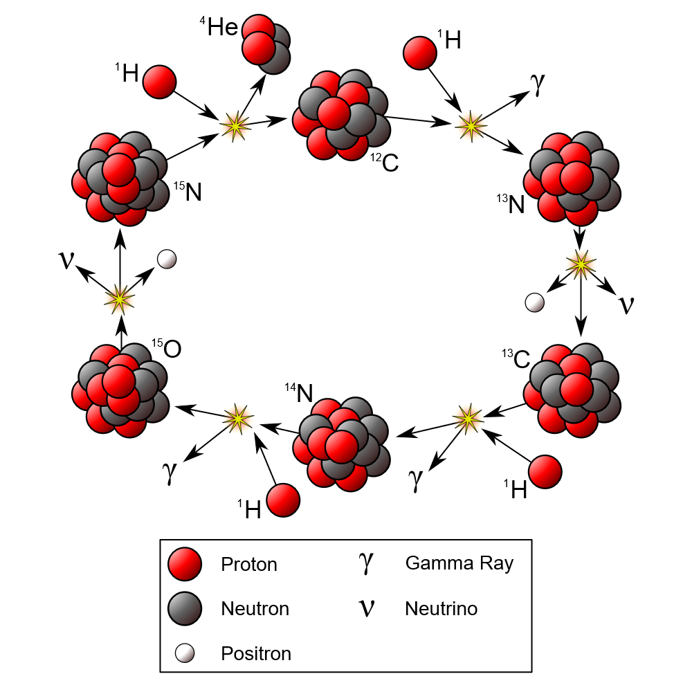
The CNO Cycle in the Sun
Why is it important for us to know these details about the sun & neutrinos?
1. Understanding Our Origins: Most of the elements from which we are made (C, N, O) were produced in the nuclear processes in the center of stars like the sun or in collapsing stars called supernovae.

Slide 14
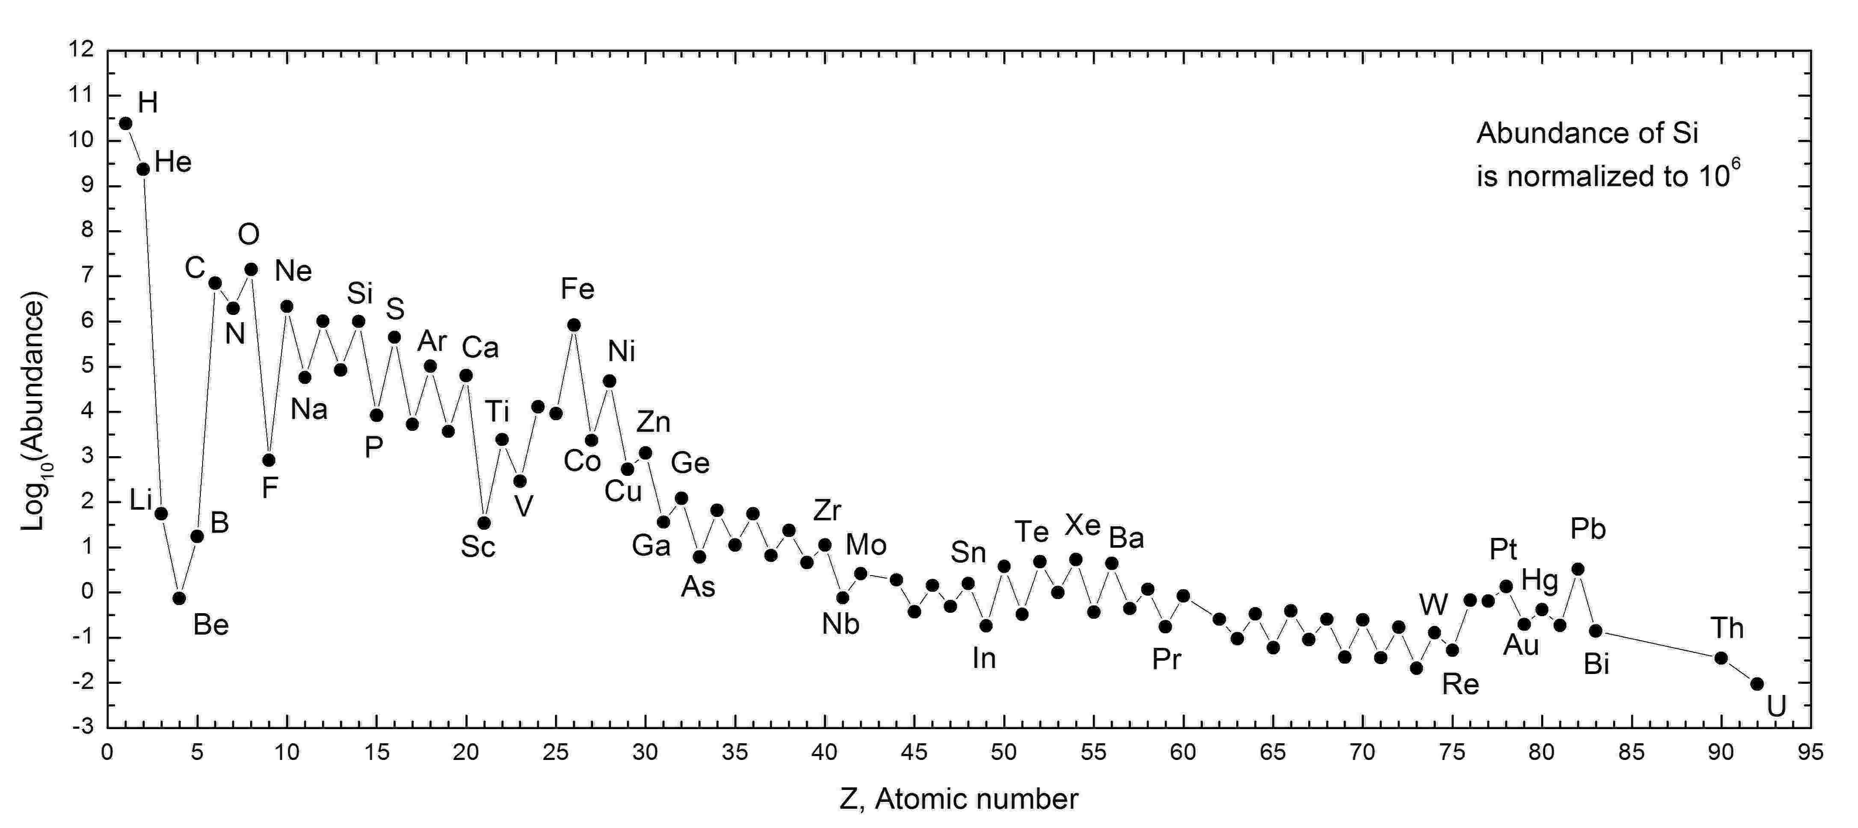
Atomic elements are created in the Big Bang, by nuclear reactions in stars like the sun, in supernovae explosions and in the collisions of neutron stars.
It is now possible to calculate the abundances of each of the elements within a factor of two up to iron even though they differ by factors of more than 10,000. Confirming how the sun burns validates this theory.

Slide 15
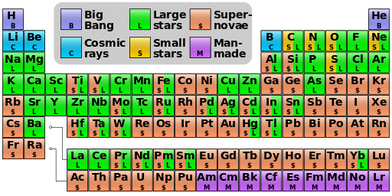
The lighter elements are principally made in slowly burning stars whereas the heavier ones are made in supernovae and neutron stars.
So, understanding how our sun burns is an important initial part of understanding how all of the elements in our world are produced, including particularly the carbon, nitrogen and oxygen important for human life.

Slide 16
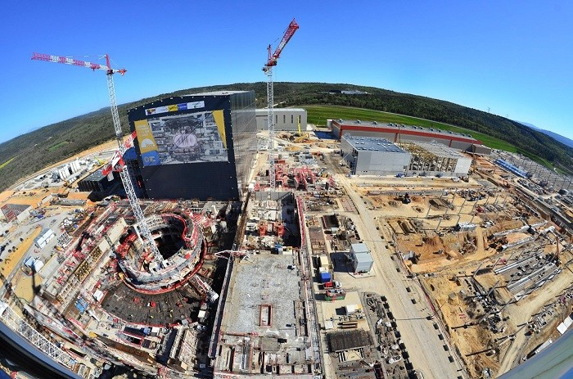
Why is it important for us to know these details about the sun & neutrinos?
2. The Sun: People are trying to reproduce the sun’s energy generation here on earth, confined by magnetic fields instead of gravity. It is called a fusion power source and it could have a limitless energy supply from deuterium in the oceans. We have proven that calculations of sun are very accurate, and they are very similar to the calculations needed for fusion power here on earth.
International Thermonuclear Experimental Reactor (ITER)
Saint Paul-lez-Durance in southern France.
35 countries in collaboration.
Scheduled first operation 2025

Slide 17
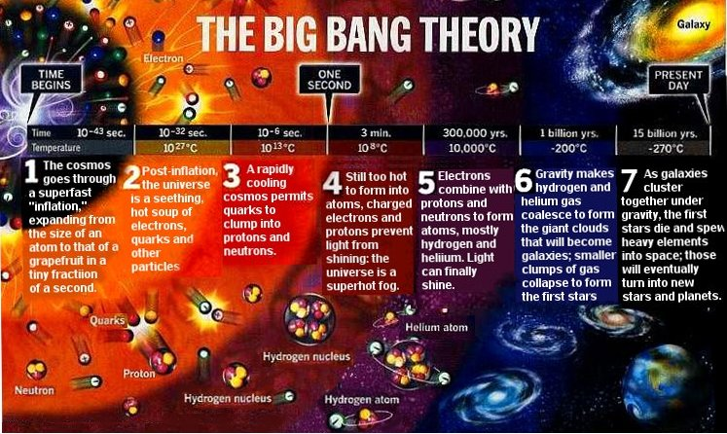
Why is it important for us to know these details about the sun & neutrinos?
3. Basic Properties of Neutrinos (Mass, flavor change): Neutrinos are produced extensively in the Big Bang and depending on their mass, can have a significant influence on how the Universe evolves.

Slide 18
What is the Absolute Neutrino Mass? It influences formation of stars, galaxies (KATRIN, Double Beta Decay)
Where did all the Anti-matter go?
(Neutrino Properties: Double Beta Decay, Acccelerators)

Slide 19
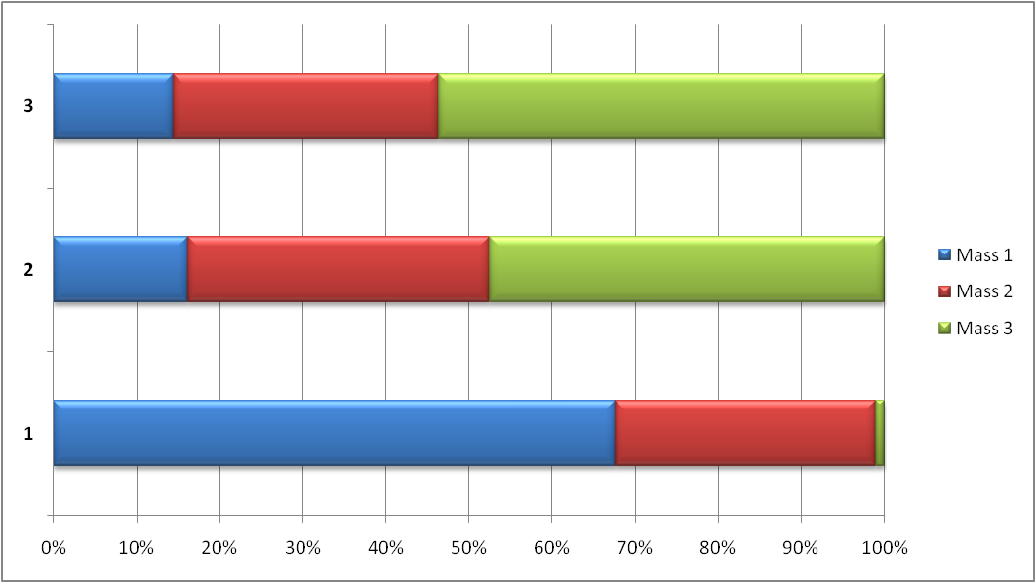
NEUTRINO OSCILLATIONS AND NEUTRINO MASS
Neutrino Flavors (Electron, Muon, Tau) can be expressed as combinations of Masses (1,2,3)
Neutrino Flavors (Electron, Muon, Tau) can be expressed as combinations of Masses (1,2,3)
Tau
Neutrino
Tau
Neutrino
Muon
Neutrino
QUANTUM MECHANICS STATES
Electron
Neutrino
The mass fractions change as the neutrino travels
After traveling there is a finite probability to be detected as a different flavor type
Created in a unique Flavor State

Slide 20
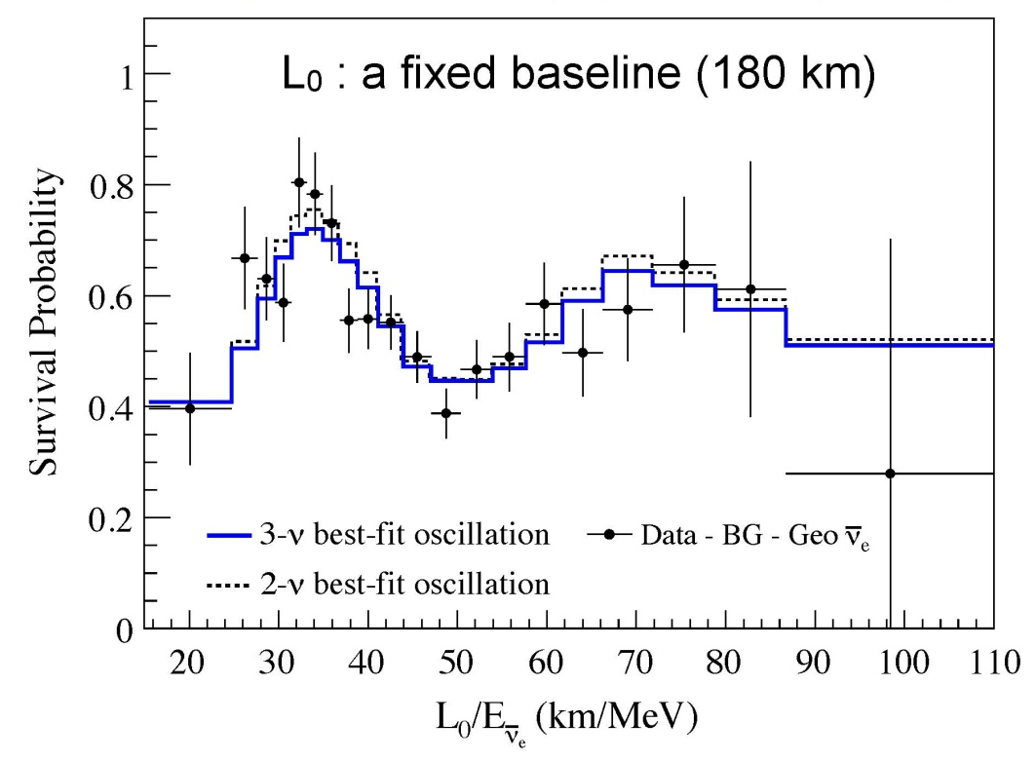
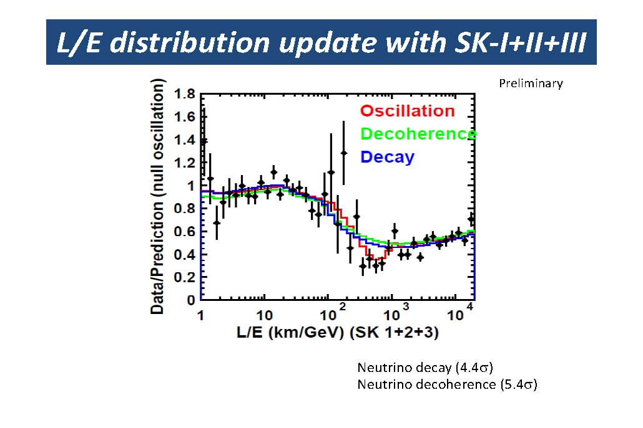
Oscillation Patterns (Various Neutrino Sources)
KamLAND Reactor Neutrinos
Atmospheric Neutrinos: SuperKamiokande, Oscillation reported 1998. Co-winner of Nobel Prize 2015: Takaaki Kajita
Such oscillations in vacuum can only occur if neutrinos have the ability to “sense” elapsed time in their rest frame and change flavor as time evolves. If they can do that, Einstein’s theory of relativity requires that they travel at slightly less than the speed of light and thus have a small finite rest mass.
Oscillations only tell us differences between masses, not the absolute mass.

Slide 21

This Hour Has 22 Minutes: Canadian Comedy Show

Slide 22
Oscillation Patterns (Various Neutrino Sources)
KamLAND Reactor Neutrinos
Atmospheric Neutrinos: SuperKamiokande, Oscillation reported 1998. Co-winner of Nobel Prize 2015: Takaaki Kajita
Such oscillations in vacuum can only occur if neutrinos have the ability to “sense” elapsed time in their rest frame and change flavor as time evolves. If they can do that, Einstein’s theory of relativity requires that they travel at slightly less than the speed of light and thus have a small finite rest mass.
Oscillations only tell us differences between masses, not the absolute mass.

Slide 23
How to measure the absolute mass of a neutrino?:
On June 11, in Karlsruhe, there will be the Inauguration of the KATRIN experiment, using the tritium reserves stored for the ITER project for a very sensitive measurement.
t -> ³He + e⁻ + ν
2 million times smaller than an electron.

Slide 24
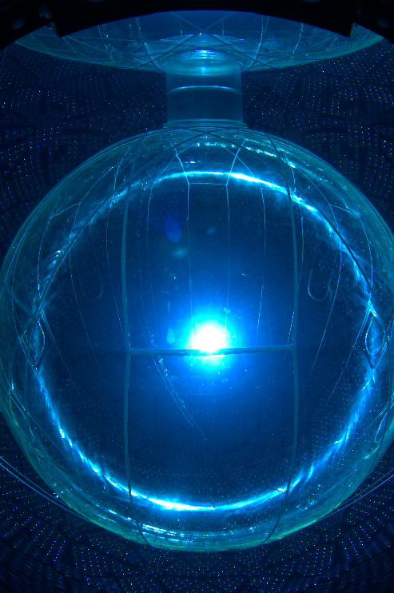
How to measure the absolute mass of a neutrino?:
There is a certain form of very rare radioactive decay called Neutrino-less Double Beta Decay that can answer several fundamental questions about neutrinos if observed.
For a certain neutrino matter/anti-matter symmetry, measuring the lifetime can provide a measure of the masses.
Since the lifetimes are in excess of 10²⁶ years, it is necessary to use many times 10²⁶ atoms and observe for many years to observe such decays. Only limits are obtained so far.
Experiments: Kamland-Zen, Cuore, SNO+, Majorana/Gerda, EXO

Slide 25
Numbers of Neutrinos at the Earth as a function of Energy
Accelerators can be used to prepare beams of neutrinos with well defined energies and types
Supernova occasionally produce an intense burst of neutrinos
hep solar neutrinos
Relic Supernova Neutrinos
Neutrinos at much higher energies are produced by acceleration mechanisms in supernova, black holes etc.

Slide 26
Accelerator-based experiment to observe oscillations over 1300 km.
One of the objectives, could neutrinos influence the decay of anti-matter after Big Bang?

Slide 27
ASTRONOMY FROM VERY DISTANT OBJECTS

Slide 29
(KM3NET)
These telescopes observe very high energy neutrinos from far distant sources. The rates are small but they are building up a catalogue of events across the sky to look for distinct astronomical sources.

Slide 30
Neutrinos are now part of an International Astronomical Network (AMON)
There is also a Supernova Neutrino Early Warning System (SNEWS) for quick response for a Supernova in our Galactic region.

Slide 31
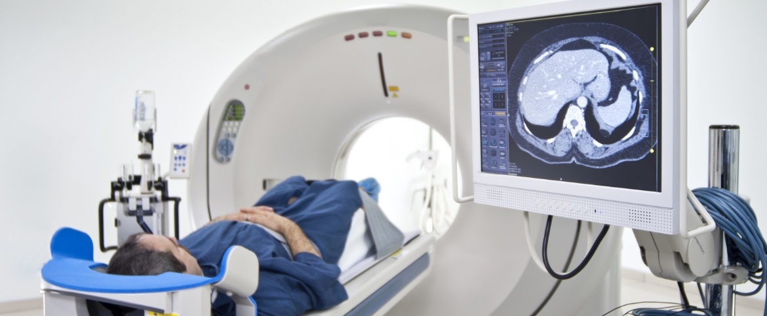
IMPROVEMENTS IN TECHNOLOGY FOR GENERAL USE
Neutrino experiments, like all particle physics experiments are continually developing new technologies.
  Light detection devices such as photomultipliers and now Silicon photomultipliers are essential parts of radiation detection for nuclear medicine.
  Silicon photomultipliers, together with liquid Xenon and Argon gamma ray detectors can lead to significant improvements in Positron Emission Tomography (PET) scanners – better resolution, lowering of the required dosage.

Slide 32

IMPROVEMENTS IN TECHNOLOGY FOR GENERAL USE
Neutrino experiments, like all particle physics experiments are continually developing new technologies.
  Pushing the boundaries of underground excavation tests new methods for mining (SNO).
  External monitoring of neutrinos from reactors provides data on internal operation (WATCHMAN, Coherent Neutrino Scattering)
  New approaches in the
  development of acrylic
  technology leads to
  massive new aquaria
  for the general public:

Slide 33

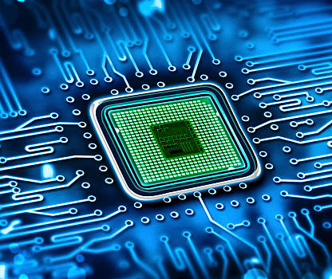
IMPROVEMENTS IN TECHNOLOGY FOR GENERAL USE
  These experiments push the boundaries of communication and data transmission. Did you know that the World Wide Web was invented by a particle physicist at CERN?
  Simulation techniques on Supercomputers, and Grid computing are driven by particle physics work. This has broad application in medicine, cancer treatment, weather forecasting, economics….
  Development of ultra-sensitive measurement devices for trace amounts of radioactivity and radioactivity-free materials have application in computer chip fabrication.

Slide 34
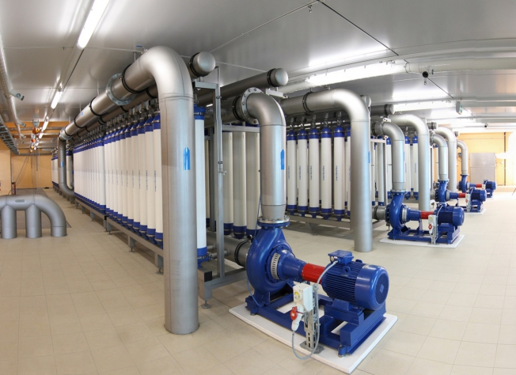
IMPROVEMENTS IN TECHNOLOGY FOR GENERAL USE
  Development of ultra-clean water for neutrino experiments has led to systems for provision of pure water to communities through the application of the similar technology.

Slide 35
Neutrinos: What are they
and why should you care?
Understanding our Origins and the evolution of the Universe.
Full scale tests of nuclear fusion in the sun is of value for energy projects on earth.
New astronomical instruments based on neutrinos are capable of reaching far into the Universe
Continual push to new technology with “spin-off” technology for general use. The way in which we progress is with a balance between fundamental science and technological development.

Slide 36
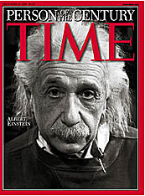
TIME magazine chose Albert Einstein as the Person of the Twentieth Century.
This was not because he invented the computer, the laser, the GPS or other parts of the technological revolution that characterized that century, but because his insights in fundamental science early in the century formed the basis for these technologies to be developed.
Understanding our physical world and the basic laws of physics enables our technology in the future.

Slide 37
END

