Slide 1
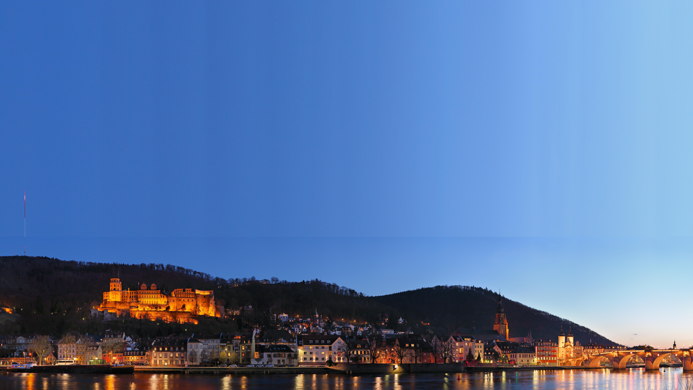
June 4-9, 2018, Heidelberg
Closing
Guido Drexlin

Slide 2
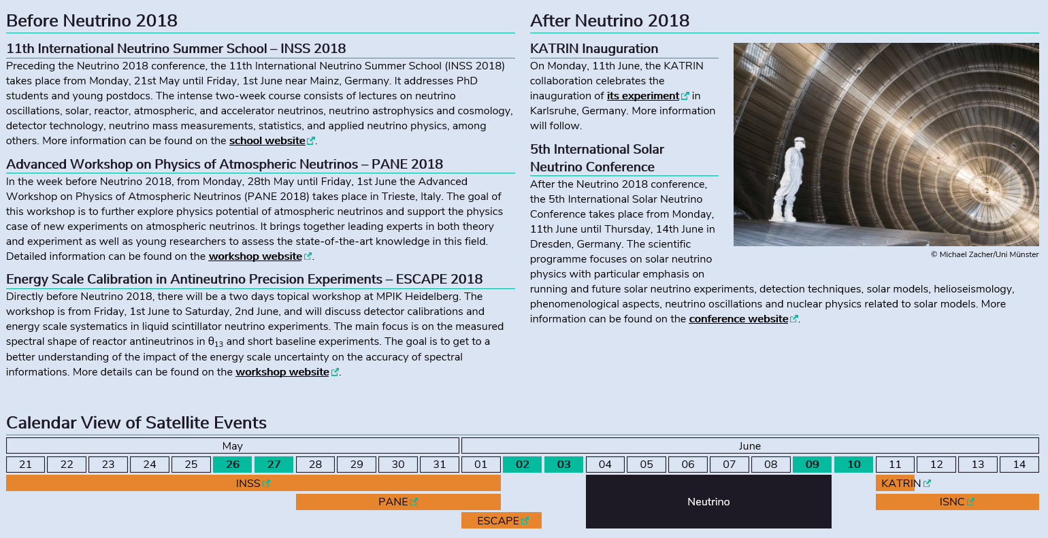
Environment: Satellite Workshops & other Conferences

Slide 3
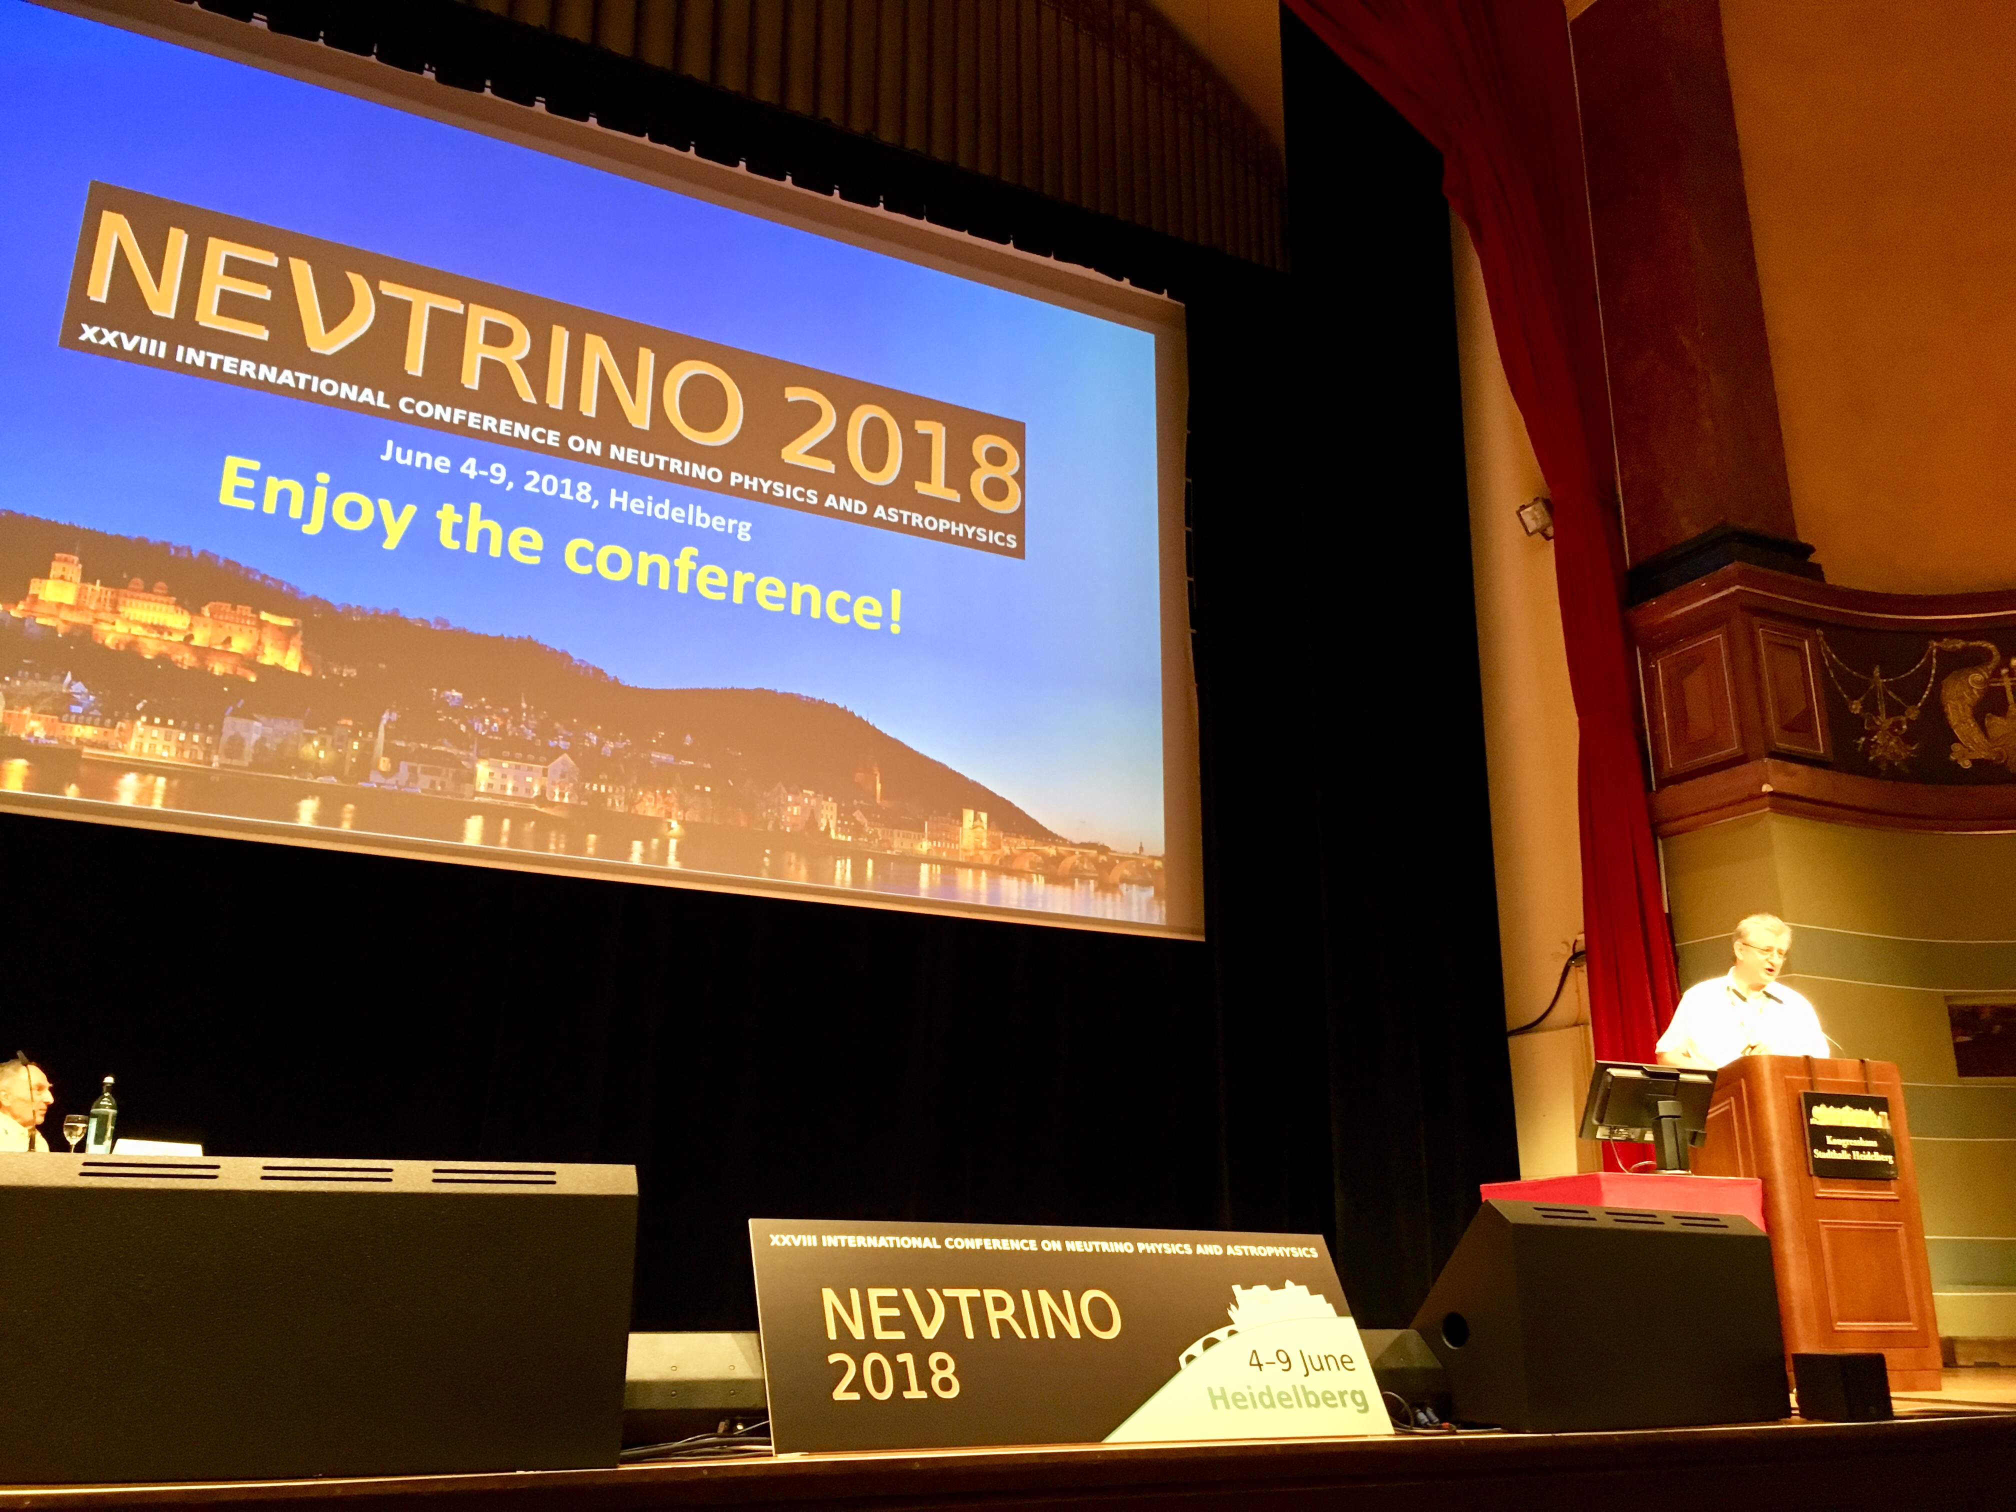
Thank you to all speakers, session chairs & poster presenters!
67 scientific talks (+ 5 further) plus 405 poster submissions
From the Welcome
to the ν-fireworks
by Manfred
by Eligio

Slide 4
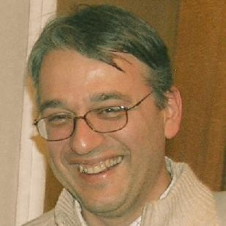
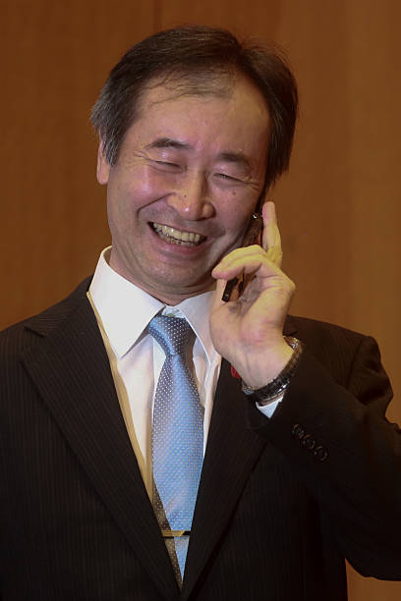
Thank you to all speakers, session chairs & poster presenters!
67 scientific talks (+ 5 further) plus 405 poster submissions
to messages from a theorist
to the experimental outlook
thank you, Francesco
thank you, Takaaki
I will be very brief!

Slide 5
Thank you to the

Slide 6
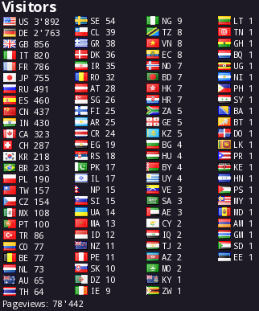
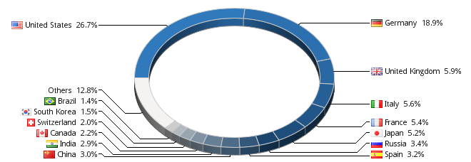
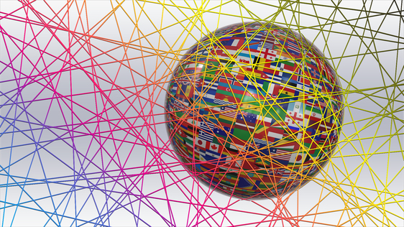
Statistics: Neutrino Conferences are truly international
Website access: visits until May 30, 2018: total of ~80.000 page views
97 countries

Slide 7
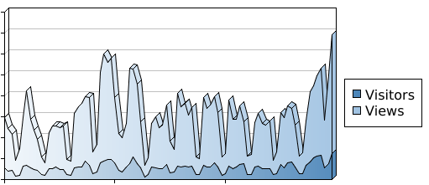
Statistics: Neutrino 2018 is truly international
Website access: visits until May 30, 2018: total of ~80.000 page views
1600
1400
1200
1000
800
600
400
200
0
Visitors
Views
March April
97 countries, ν´s are
truly international

Slide 8
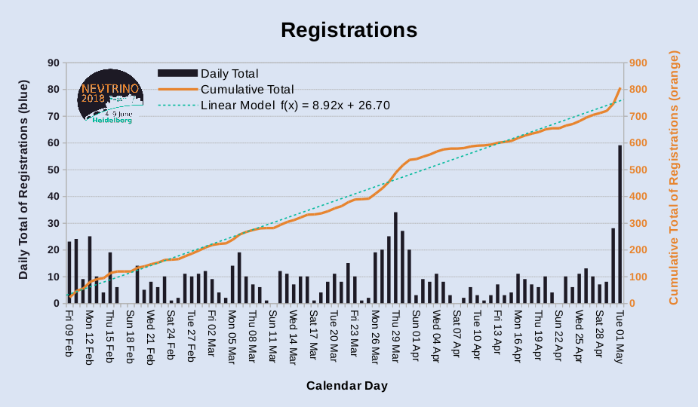
registration
deadline May, 1
Registrations
90
80
70
60
50
40
30
20
10
0
900
800
700
600
500
400
300
200
100
0
daily total
cumulative total
linear model f(t) = 8.92·t + 26.7
Daily Registrations
Cumulative number
Standard fee
deadline April, 1
Feb 09
Mar 02
Apr 01
May 01
Calendar Day

Slide 9
Registrations: Early – Regular – Late
90
80
70
60
50
40
30
20
10
0
900
800
700
600
500
400
300
200
100
0
34.0%
ν18
20.5%
35.5%
Daily Registrations
ν18
Cumulative number
ν18
@90% CL
(Cash Level)
Feb 09
Mar 02
Apr 01
May 01
Calendar Day

Slide 10
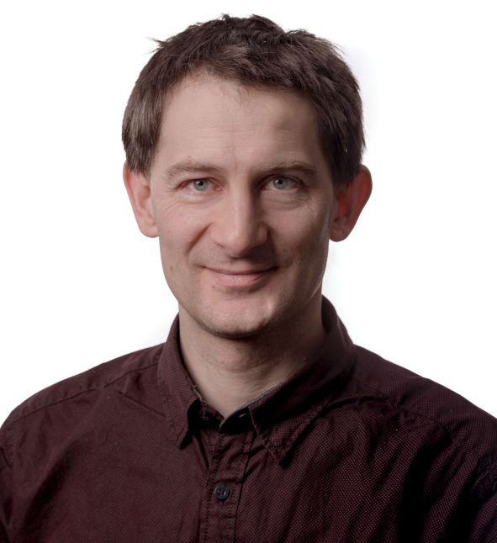
Registrations – LOC estimates
TSM
90
80
70
60
50
40
30
20
10
0
900
800
700
600
500
400
300
200
100
0
daily total
cumulative total
linear model f(t) = 8.92·t + 26.7
?
Daily Registrations
Cumulative number
Feb 09
Mar 02
Apr 01
May 01
Calendar Day

Slide 11
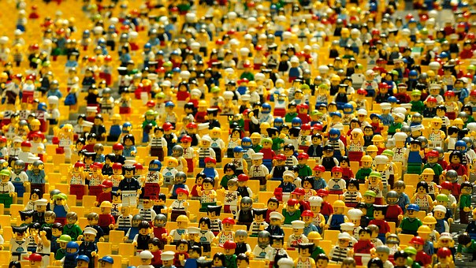
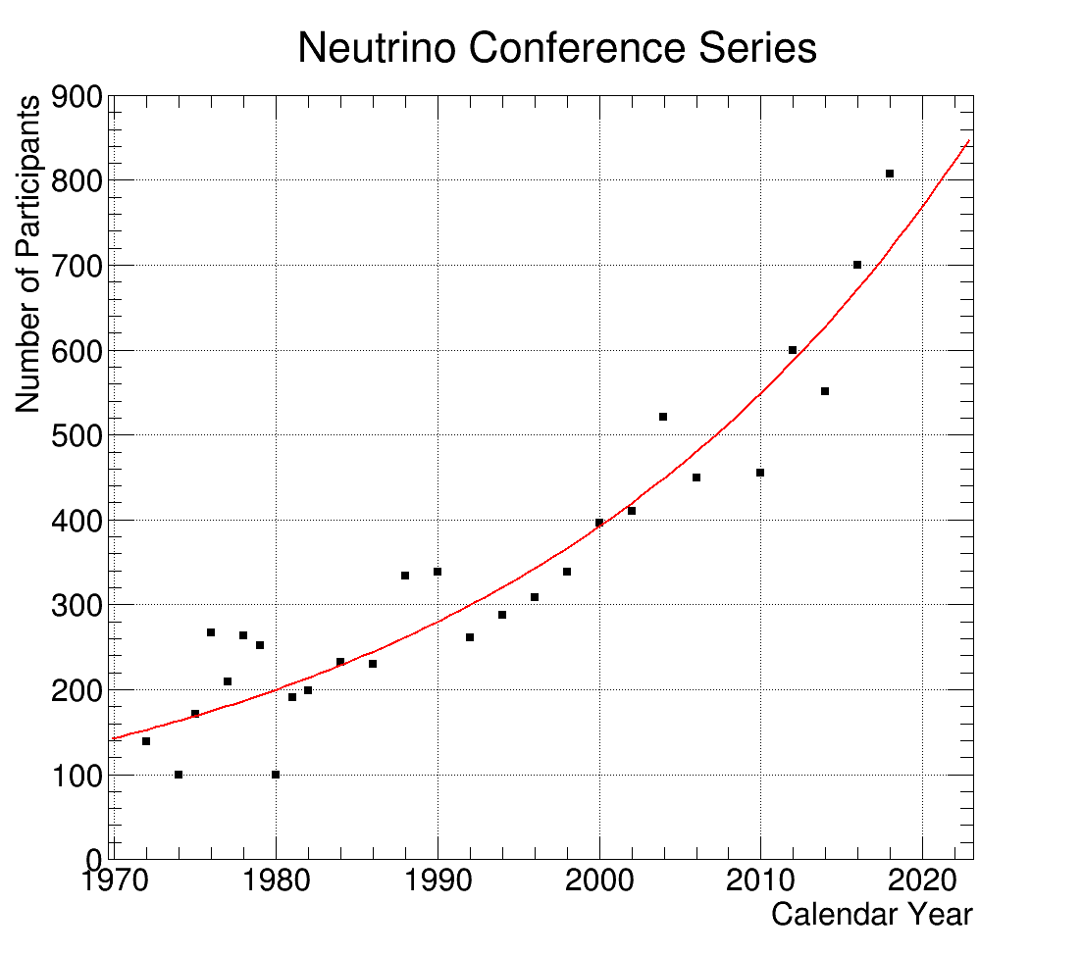
Neutrino Conference Series
900
800
700
600
500
400
300
200
100
0
Number of Participants
Year
1970 1980 1990 2000 2010 2020

Slide 12
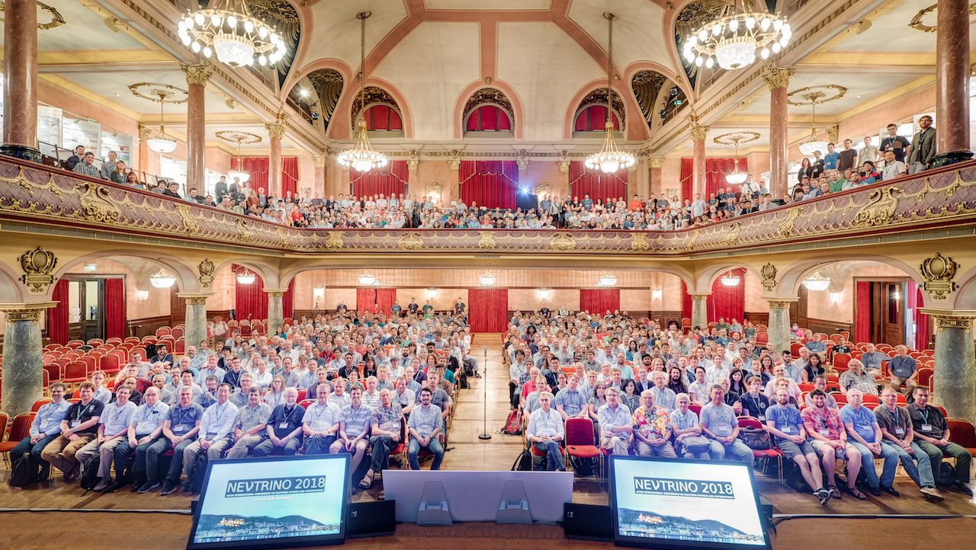
Neutrino 2018 – Conference Photo

Slide 13
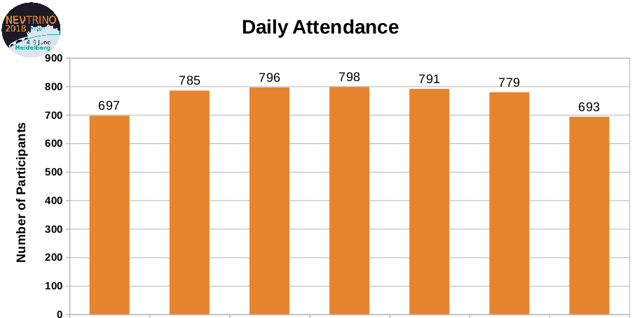
Daily Attendance- Thank you for staying!
900
800
700
600
500
400
300
200
100
0
785
796
798
791
779
697
693
Participants
Sunday Monday Tuesday Wednesday Thursday Friday Saturday

Slide 14
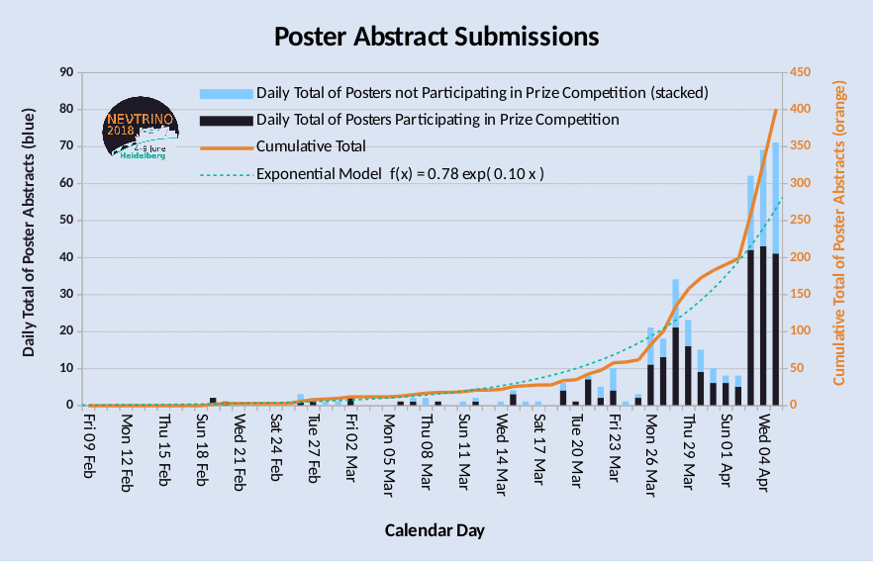
Poster Abstract Submission
90
80
70
60
50
40
30
20
10
0
450
400
350
300
250
200
150
100
50
0
Daily Submission, no Competition in Prize
Daily Submission, with Competition in Prize
Sum
Exponential Model f(t) = 0.78 exp (0.1·t)
Cumulative number
Daily Total of Poster Abstracts
Feb 09
Mar 02
Apr 01

Slide 15
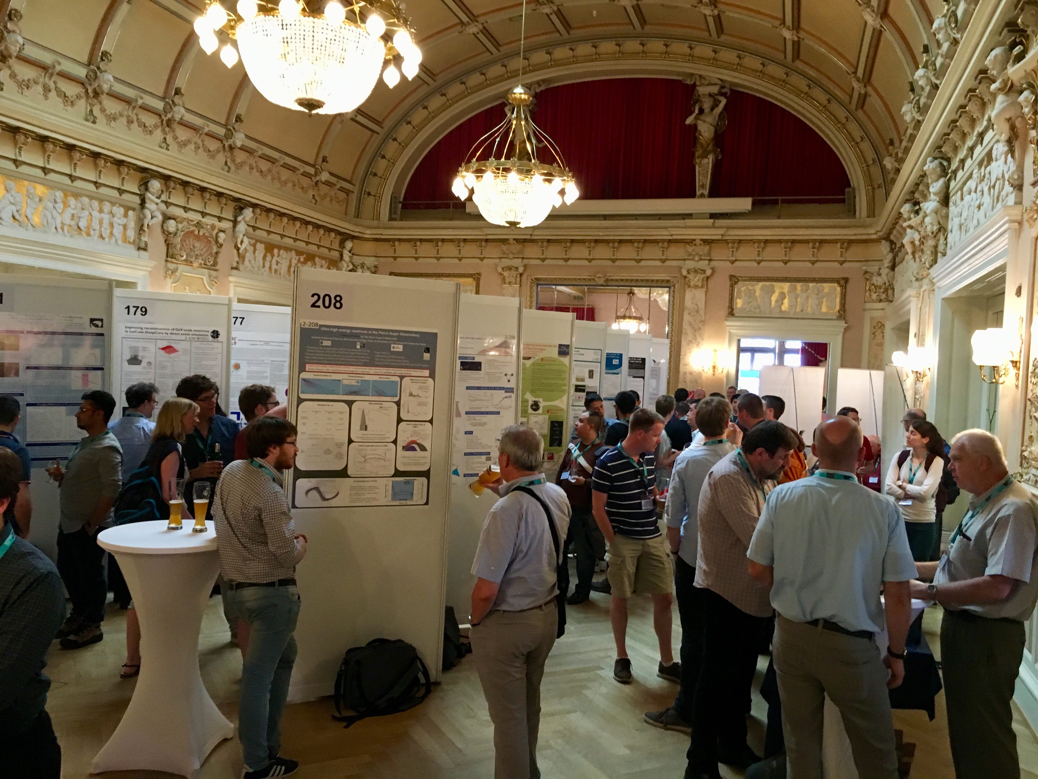
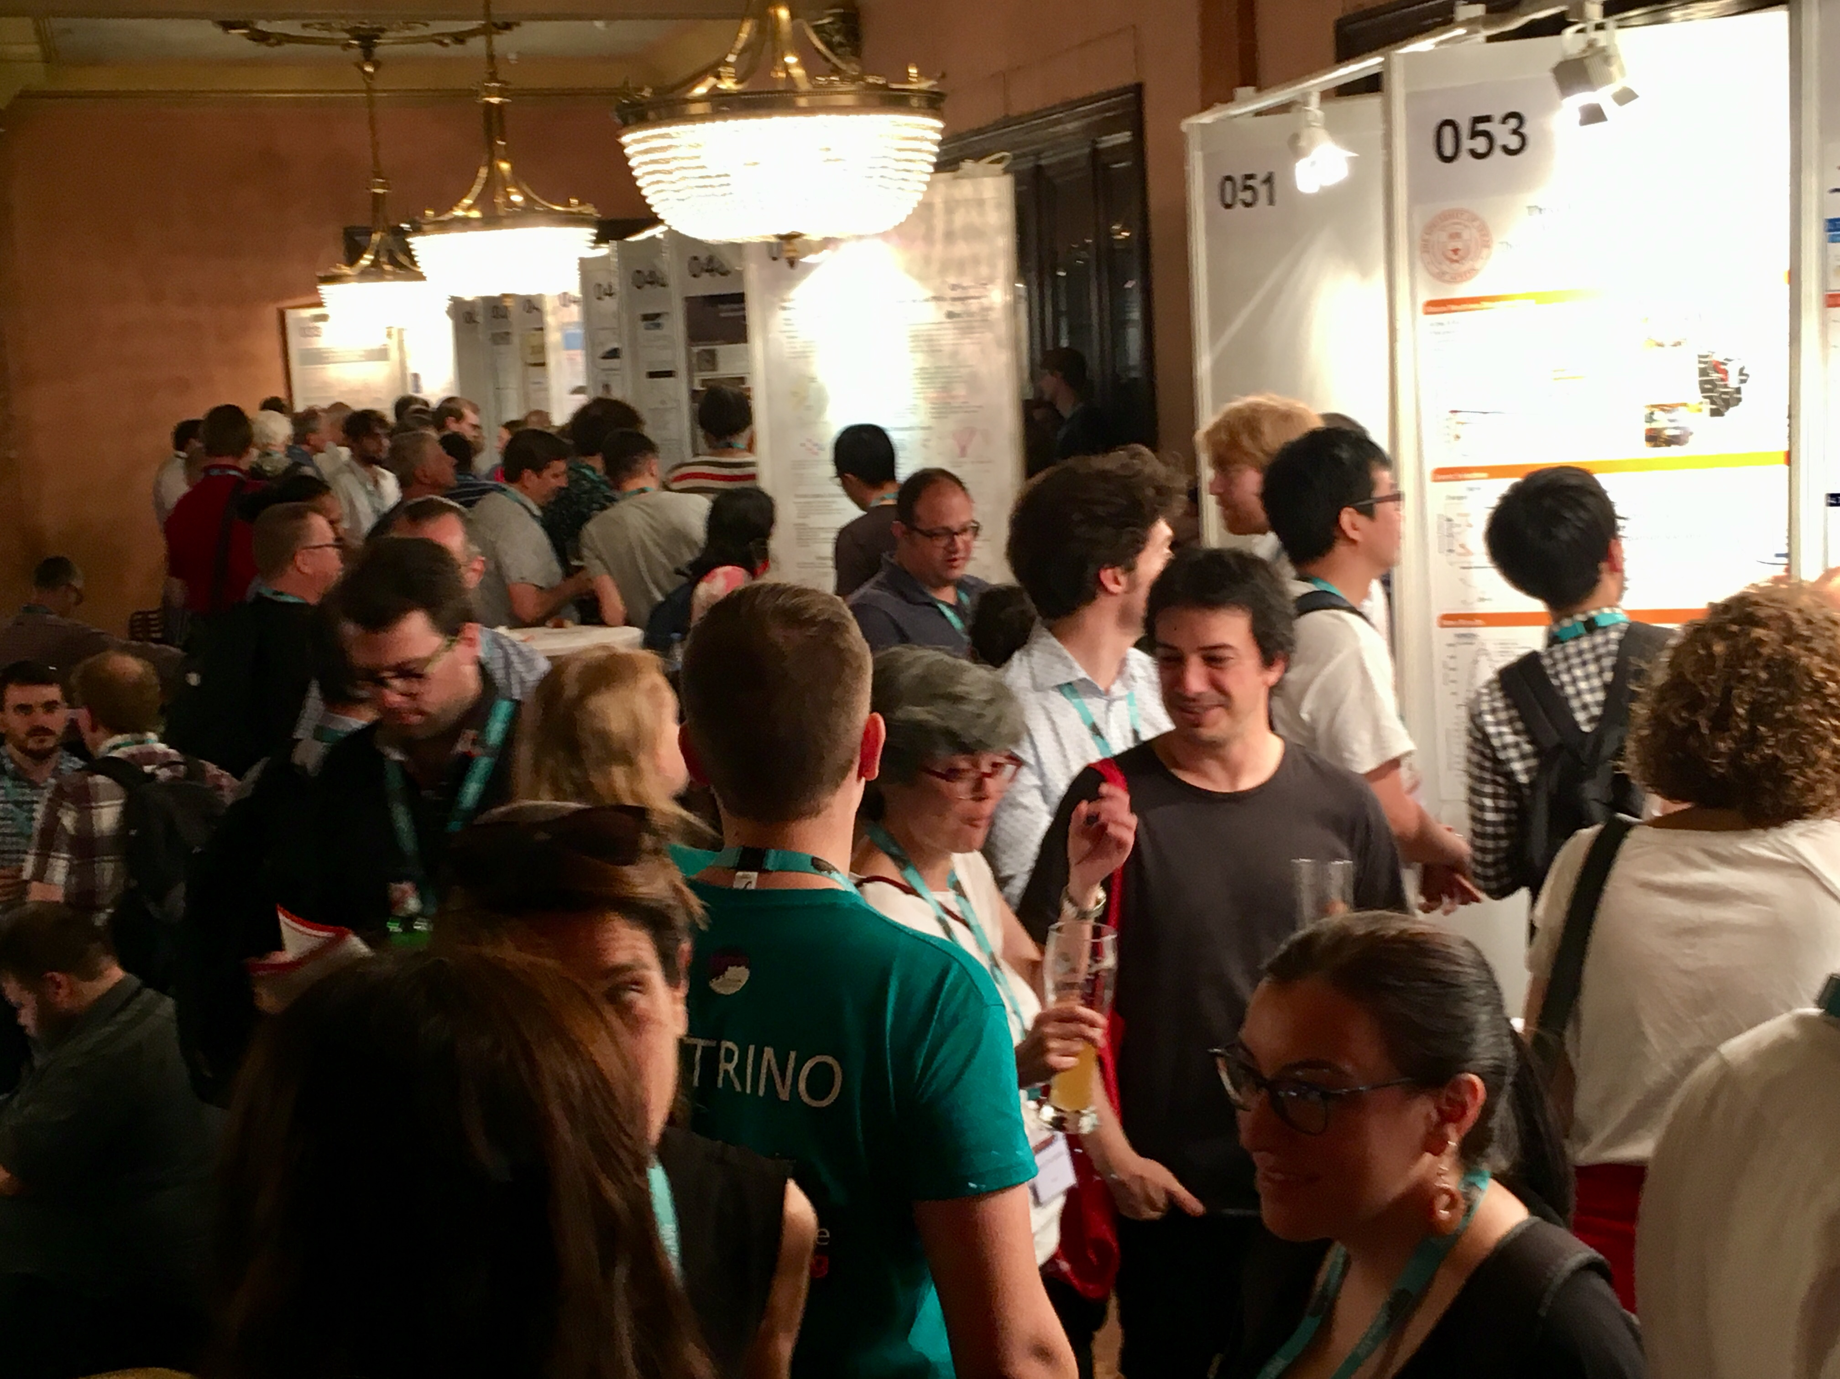
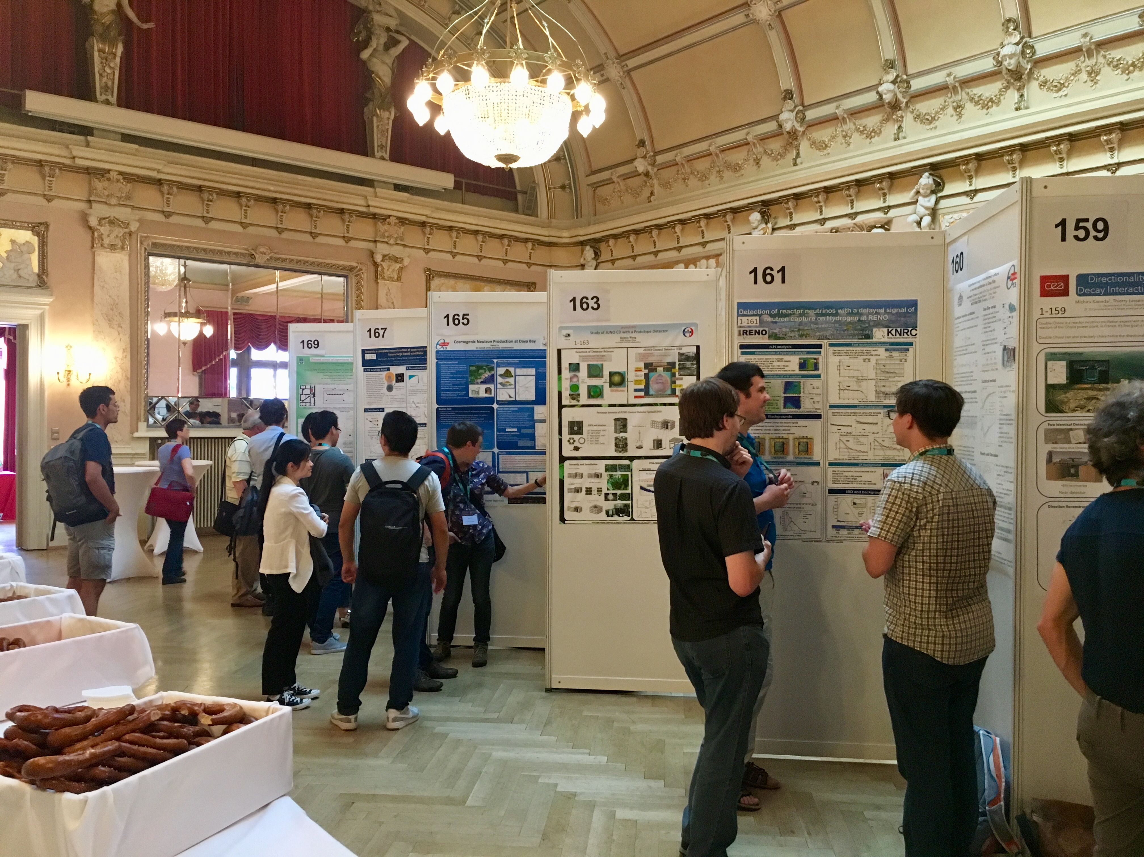
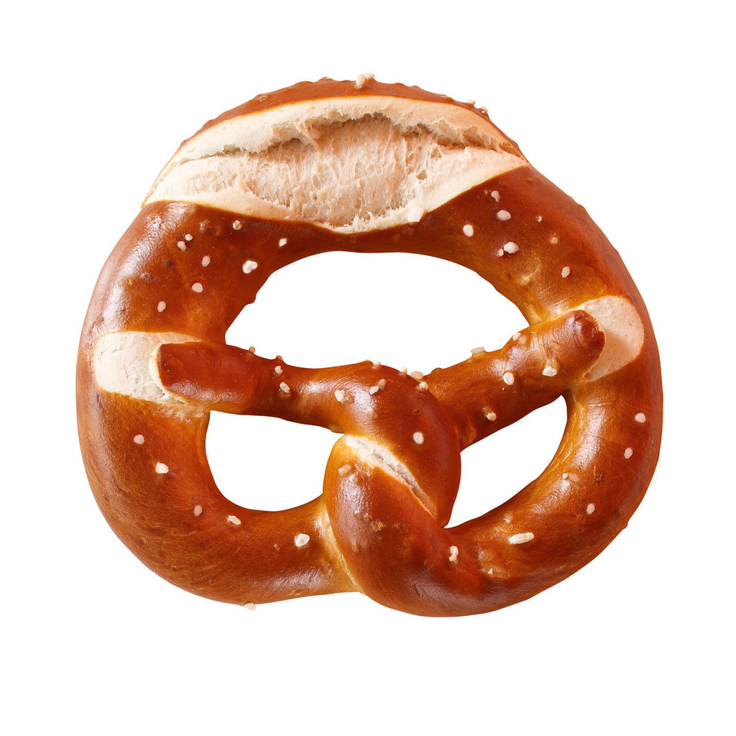
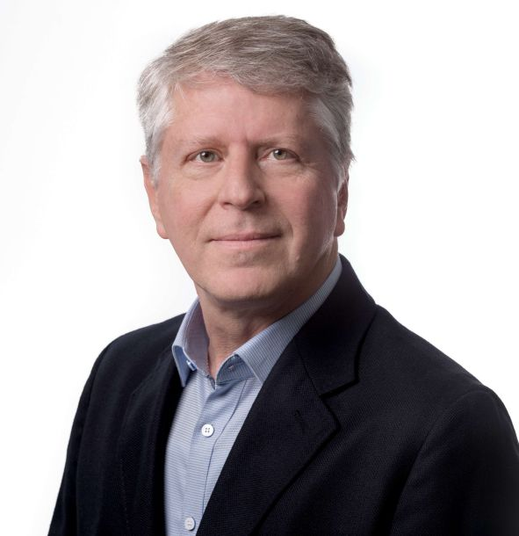
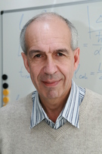
Neutrino 2018 – thank you to all Poster presenters
Thank you, Klaus, Thomas and
Evgeny

Slide 16
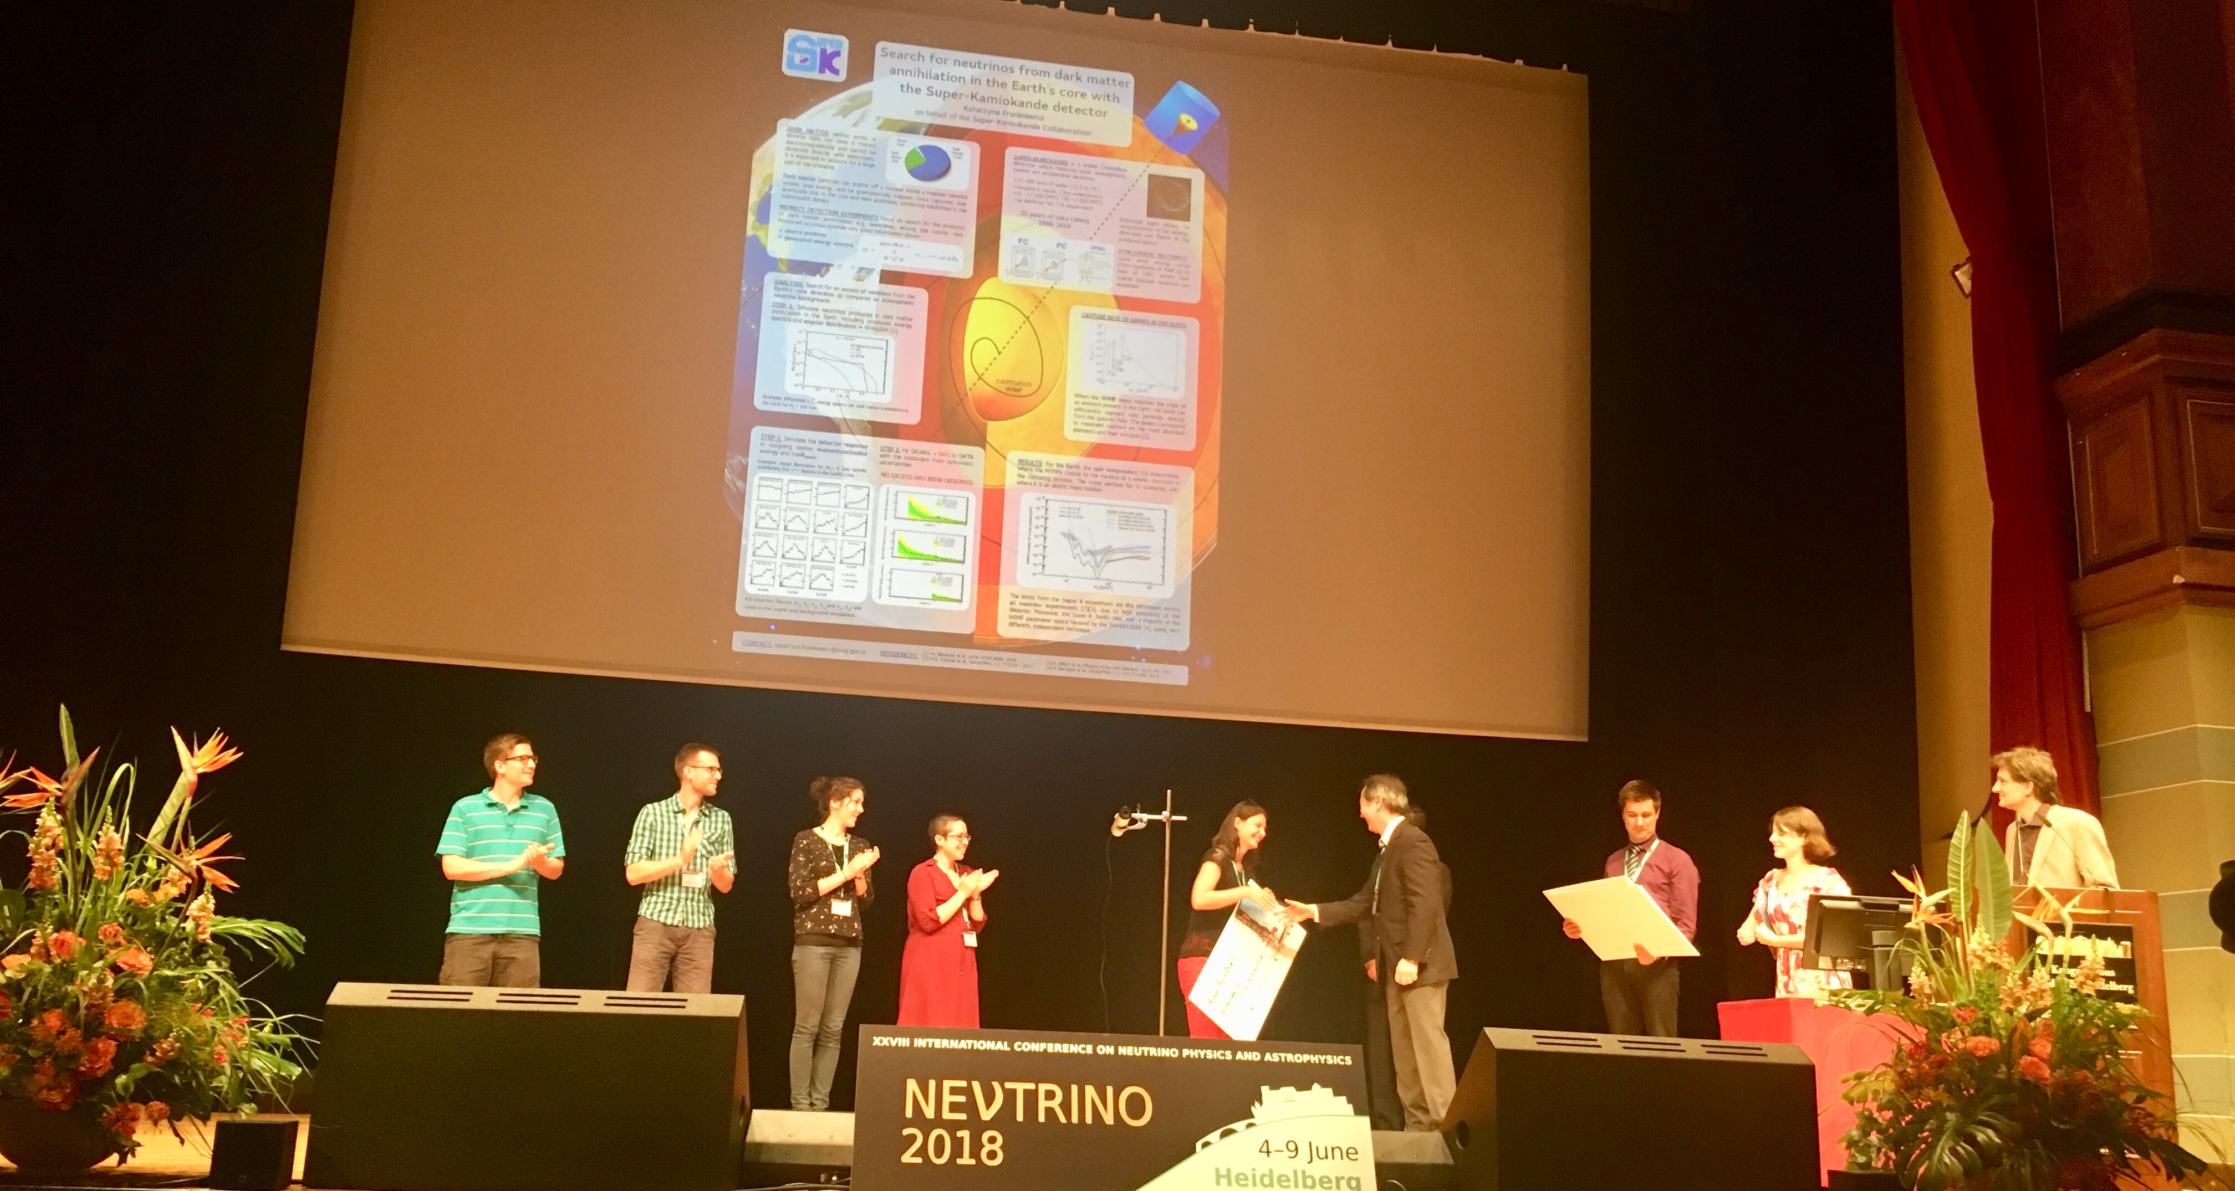
Thank you to the Poster Prize Committee & Congratulations to the Winners
Aurelie BONHOMME (DPhN/IRFU/CEA-Saclay) “Measurement of the neutrino rates in the STEREO experiment”
Katarzyna FRANKIEWICZ (National Center for Research) “Search for neutrinos from dark matter annihilation in the Earth core with the Super-Kamiokande detector”
Julieta GRUSZKO (MIT) “NuDot: Double-Beta Decay with Direction Reconstruction in Liquid Scintillator”
Joseph JOHNSTON (MIT) „Prospects for Exploring New Physics in Coherent Elastic Neutrino-Nucleus Scattering Experiments”
Tom KIECK (U Mainz) “Production, Separation and Implantation of ¹⁶³Ho for Neutrino Mass Measurements”
8 LOC Team Members + 9 Conference Participants

Slide 17
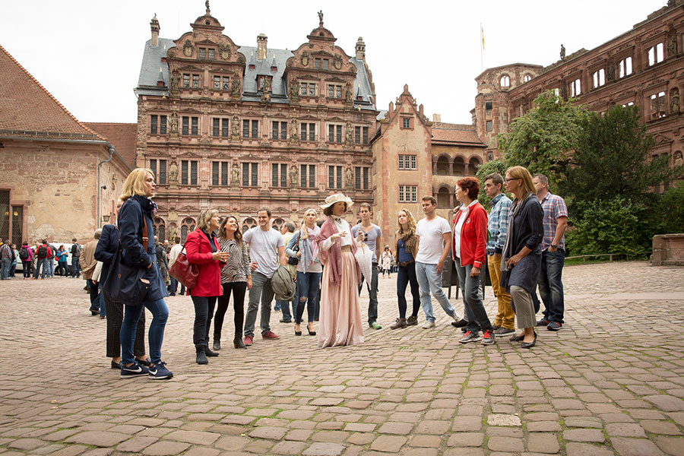
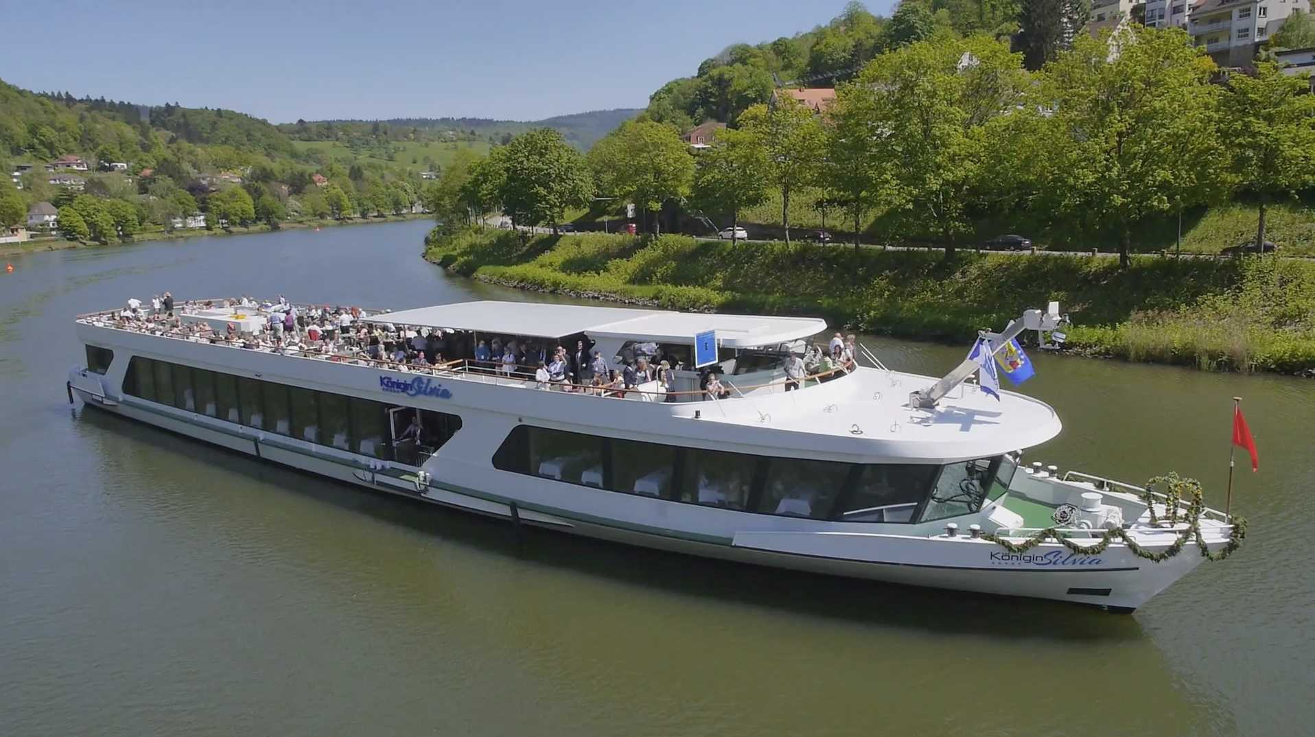
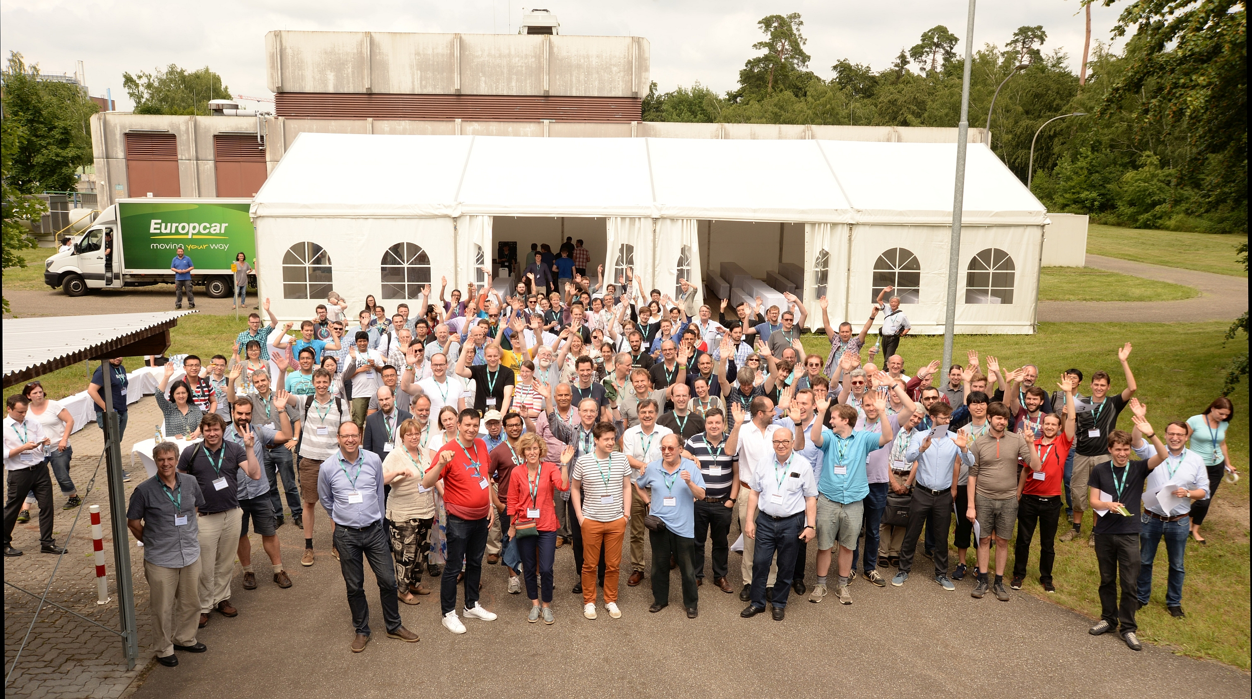
Conference Excursions: Thank you to all tour guides
Guided City Tour of Heidelberg
River Cruise on the Neckar
KATRIN tour at KIT
Schloß Heidelberg
136 (cap. 140)
Participants
MS Königin Silvia
No Excursion
277 (cap. 310)
156 (cap. 150)
Meeting, Paper,Funds…
242 (cap. limitless)

Slide 18
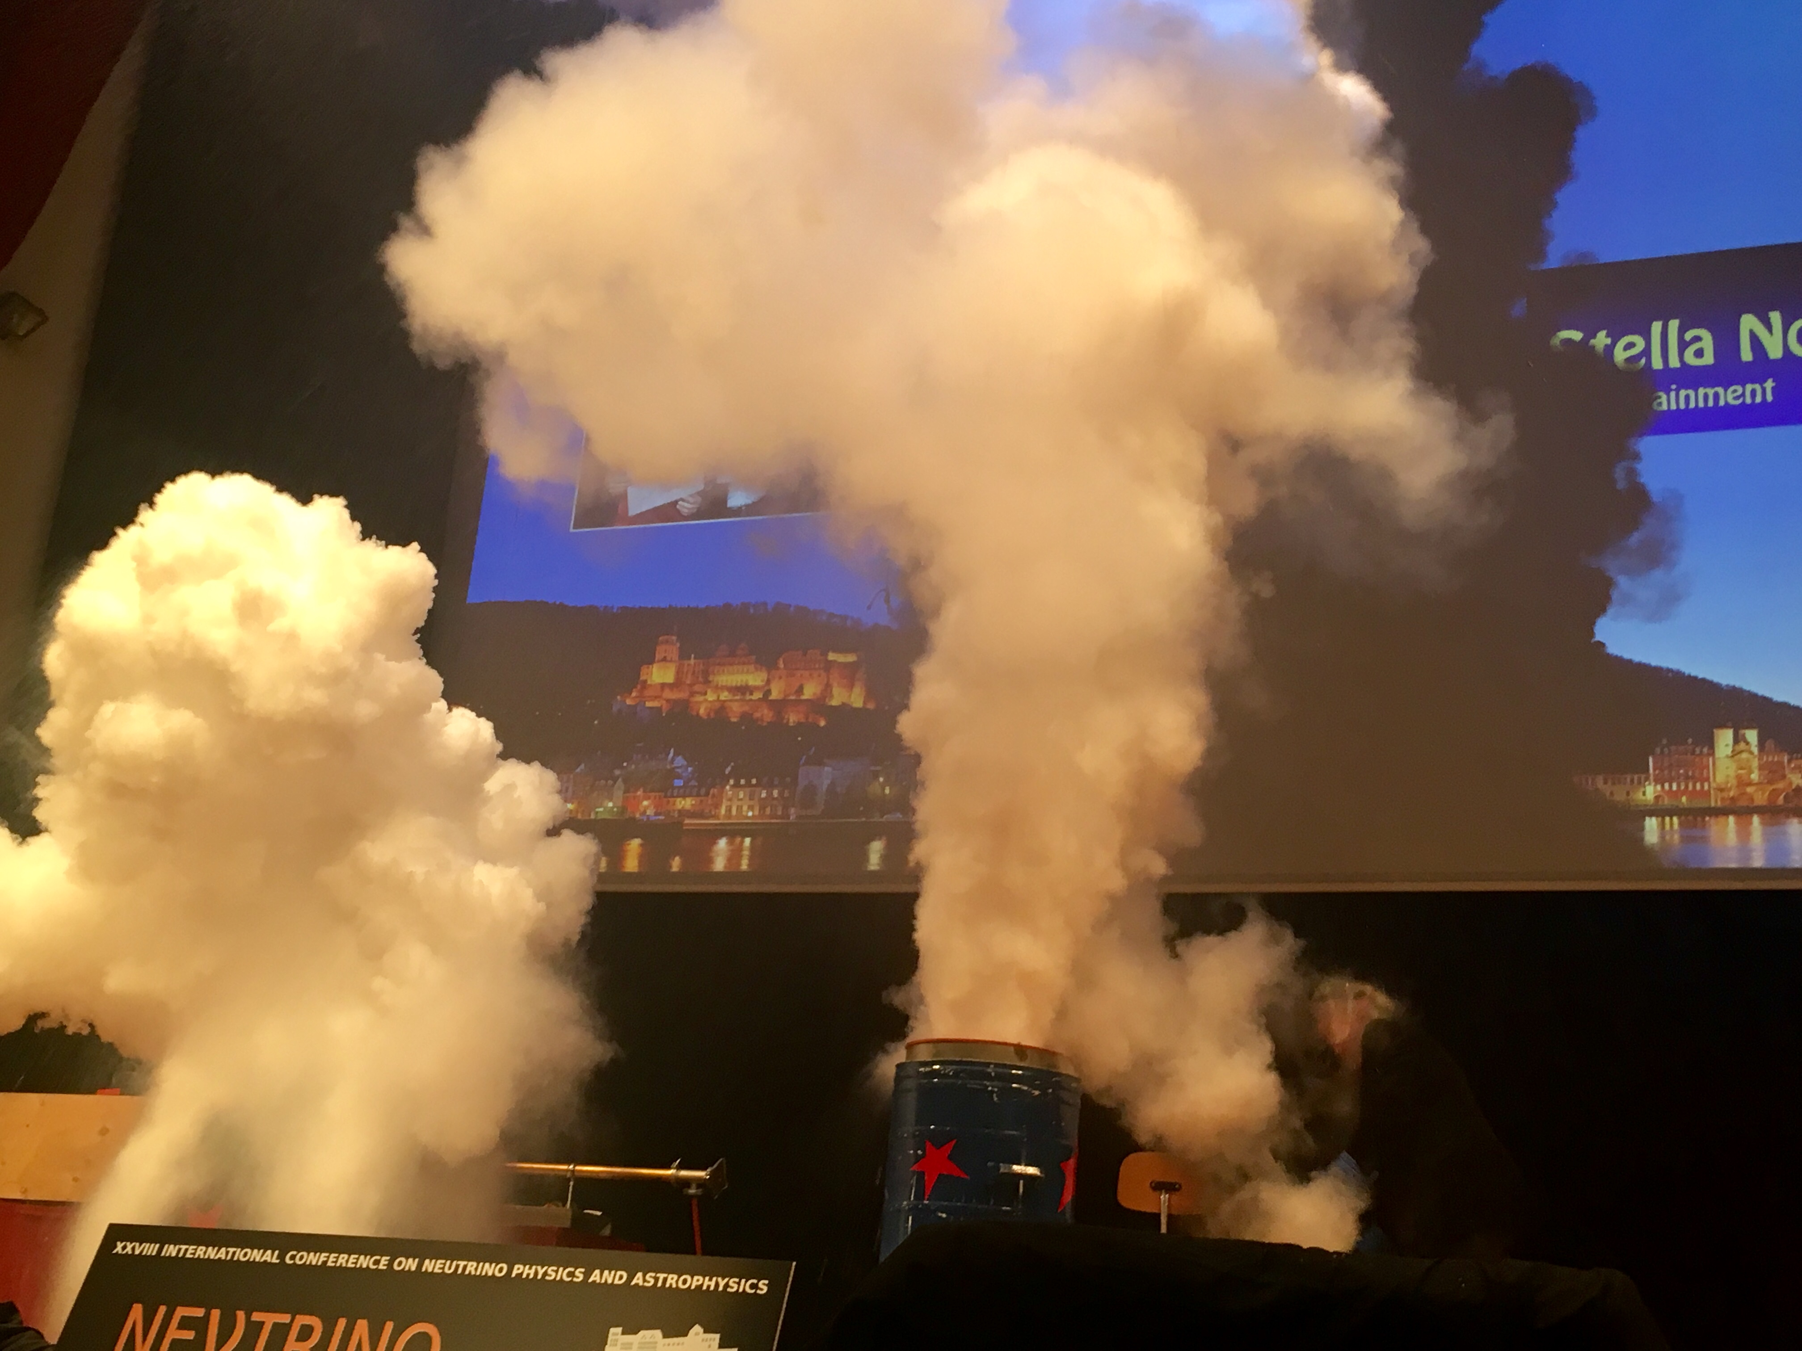
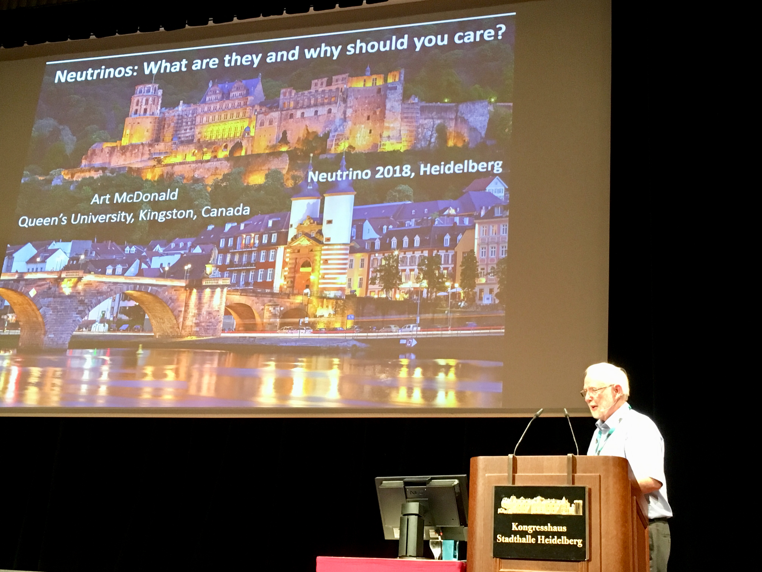
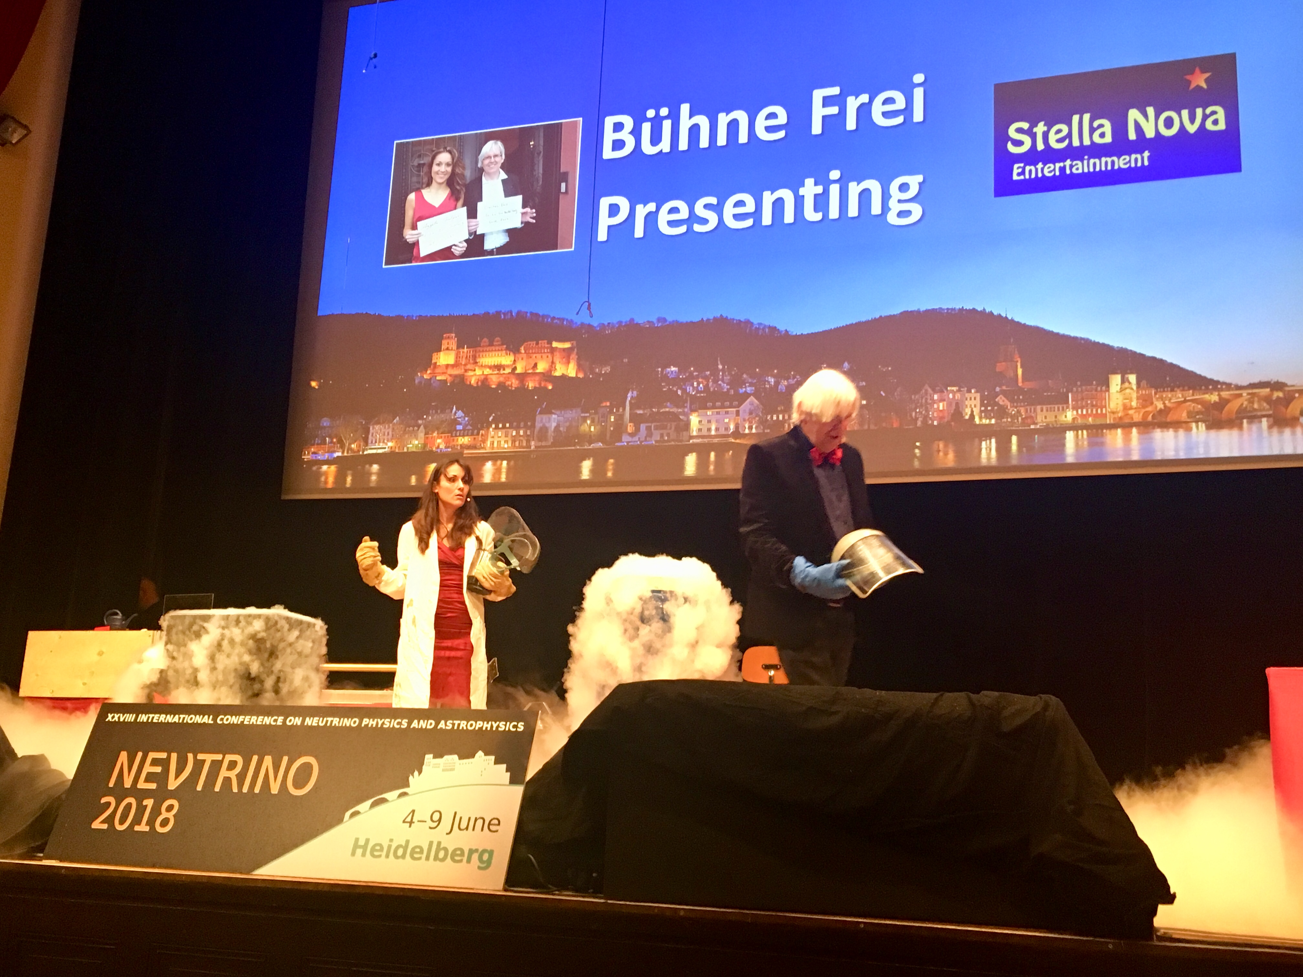
Thank you to Art and Christian
Public Lecture Physics Show
Tuesday
Neutrinos and You:
What are they and
why should you care?
Stella Nova
Christian Enss (ECHo)
Angela Halfar

Slide 19
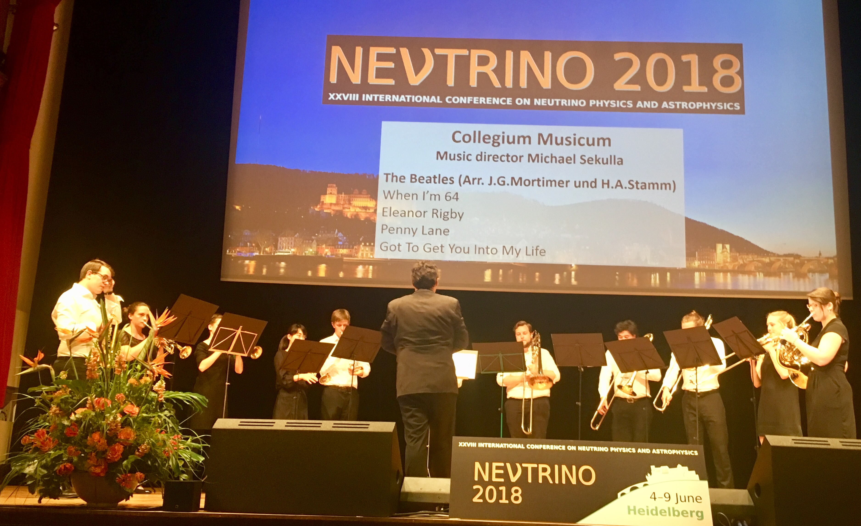
Thank you to UniBrass ensemble of Collegium Musicum
Thank you, UMD Michael Sekulla et al. , for the
musical support during the Conference Dinner

Slide 20
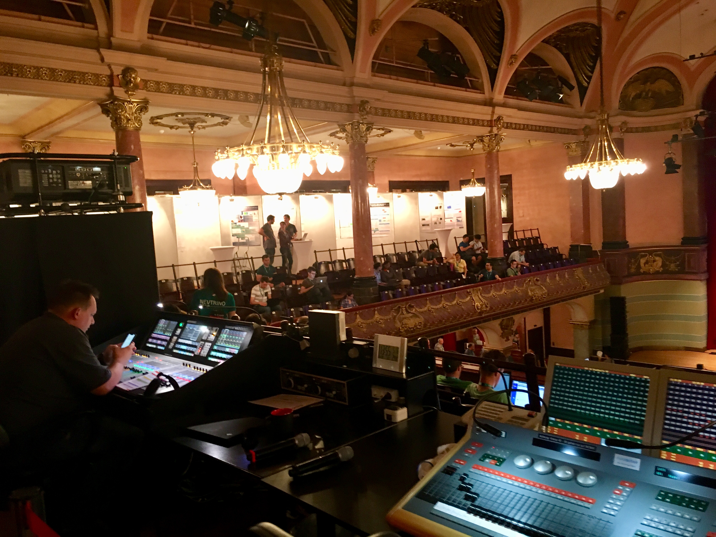
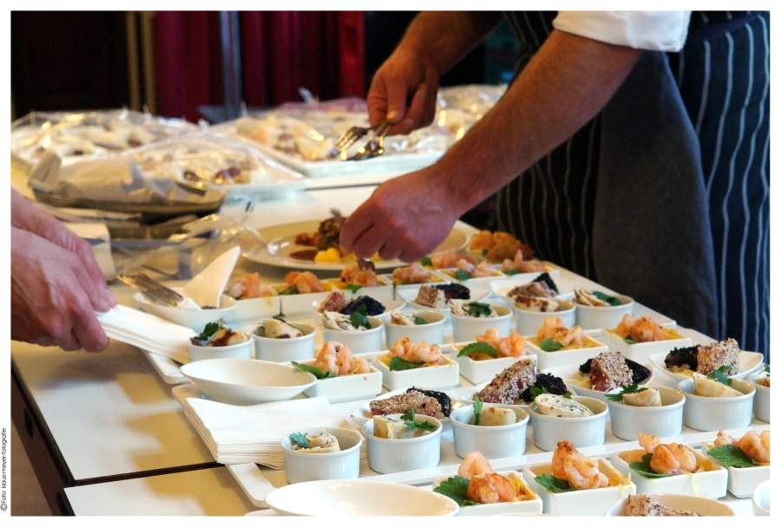
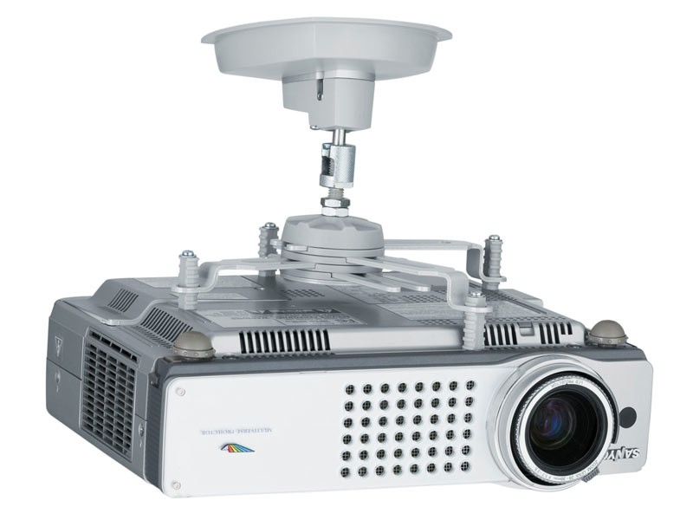
Thank you to the Kongresshaus Stadthalle,
its Catering Team and Heidelberg Marketing
- Thank you as well to the technical support team
Catering
Coordination:
Marsiah
Akrami et al.
Martin
Waschner
Lisa
Gallo

Slide 21
Thank you to all sponsors of Neutrino 2018

Slide 22
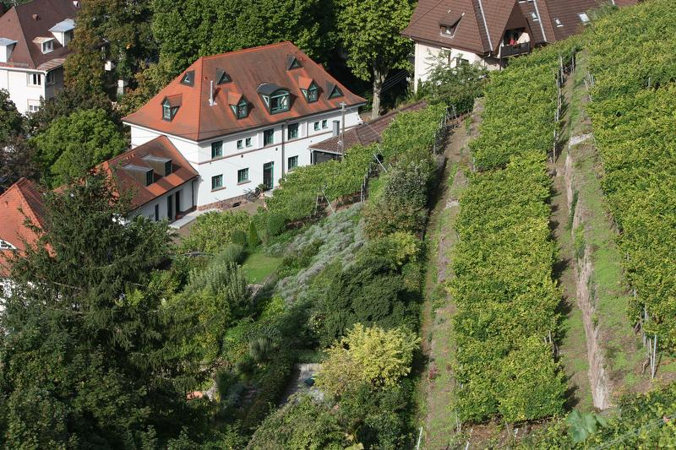
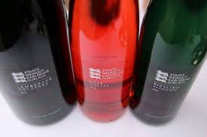
Durlacher
Staatsweingut
Thank you to the members of the
The inspiration
for KM3NeT…

Slide 23
Thank you, Anja!
B. Schwarz (MPIK)

Slide 24
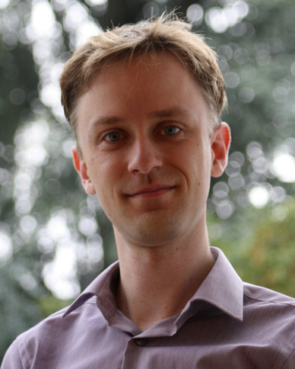
Thank you, Stefan!
ν18

Slide 25
Thank you to the student helper team from MPIK & KIT
Luisa Hoetsch, Stefan Bruenner, Tobias Schierhuber, Christiane Klein, Natascha Rupp, Thomas Hugle, Christian Doering, Susan van der Woude, Carlos Jaramillo, Sophie Klett, Helena Almazan, Christian Roca, Veronica Pizzella, Ingolf Bischer, Thomas Rink, Dominick Cichon, Moritz Platscher, Florian Joerg, Lena Salfenmoser, Johannes Heizmann, Dominic Hinz, Annika Holland-Cunz, Julia Thomas, Julia Handl, Chenran Xu, Philippe Bruder, Thea Moosmayer, Marius Götz, Jan-Ole Gosewisch, Carsten Röttele

Slide 26
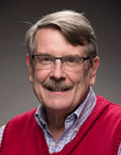
Thank you to the INC
for having selected Heidelberg 2018
next:
Report from the INC
Stephen Parke, Fermilab

Slide 27
Goodbye, Heidelberg 2018
Hello, Chicagoland 2020!!!

