Slide 1
IUPAP Neutrino Panel

Slide 2
Provenance:
A little history: the ICFA Neutrino Panel
IUPAP Neutrino Panel

Slide 3

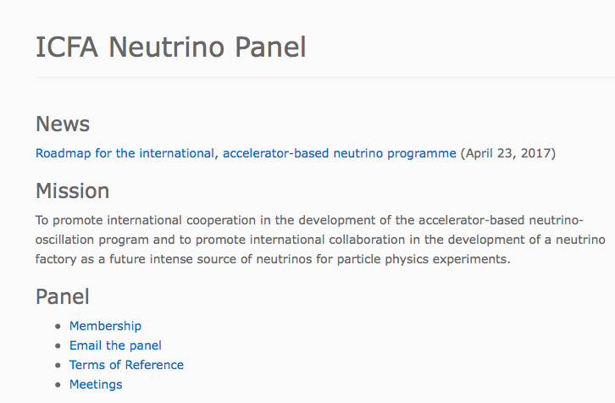
http://icfa.fnal.gov/panels/neutrino_panel/
Established:
Summer 2013
Three-year mandate

Slide 4
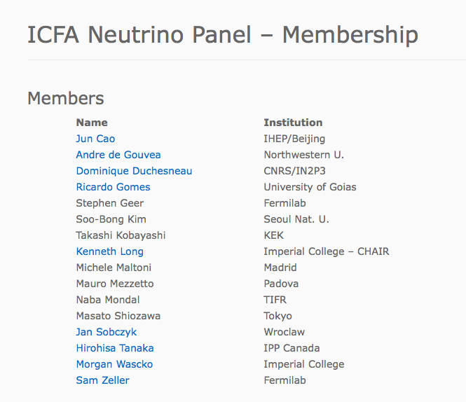
http://icfa.fnal.gov/panels/neutrino_panel/

Slide 5
ICFA Neutrino Panel’s contributions
Initial consultation with the neutrino community:
  Asia: Kavli IPMU, Kashiwa, Japan on the 13th November 2013
  Europe: University of Paris Diderot on the 8th to 10th January 2014
  Americas: FNAL, 30th January 2014 to the 1st February 2014
International Meetings for Large Neutrino Infrastructures
  Jointly organised with APPEC, APPIC (and Neutrino Panel)
    23—24 June 2014, Paris
    20—21 April 2015, FNAL
    30—31 May 2016, KEK
Presentations to peers at:
  Neutrino 2014: to explain activities of the Panel
  Neutrino 2016: to solicit input on the roadmap discussion document
And, of course, presentations to stakeholders (ICFA, ECFA, …)

Slide 6
ICFA Neutrino Panel’s contributions
Initial report from the ICFA Neutrino Panel
1405.7052v1
  Made the case for an energetic future programme and pointed out the opportunities
  Recorded the peer-group consultation carried out the Americas, Asia and Europe (roadmap foundations)
On the complementarity of Hyper-K and LBNF
1501.03918
  Reviewed the complementarity of the J-PARC/Hyper-K andn LBNF/DUNE programmes
  Made the case for the scientific benefits of mounting the two experiments
Roadmap for the international, accelerator-based neutrino programme:
Discussion document
2016: http://icfa.fnal.gov/wp-content/uploads/2016-05-07-nuPanel-roadmap-Final.pdf
  Reviewed the accelerator-based neutrino programme,
  including the supporting experimental, R&D and theory programmes
  Presented interim conclusions and recommendation for discussion by peers and stakeholders
Roadmap for the international, accelerator-based neutrino programme
1704.08181
  Revised the Roadmap discussion document in line with comments received
  Presented final conclusions and recommendations

Slide 7
The accelerator programme; part of the field of neutrino-physics
Eloquently argued by neutrino-physics community
  Consensus:
    Also argued by funding agency representatives and ‘decision makers’
Essentially the same point was made in:
  KEK (3rd Large Neutrino Infrastructure meeting)
  ECFA
  Neutrino (’14) ‘16
  And in discussions within the Panel
ICHEP’16 discussion with IUPAP C11 Chair & co-chair:
  Develop proposal for a new ‘neutrino Panel’ to take an ‘holistic’ view:
    Consider synergy/impact of particle, astroparticle and nuclear physics

Slide 8
Neutrinos: synergies and impact
Examples … not an exhaustive list
Physics programme of large “far” detectors:
  Neutrino oscillations (accelerator and non-accelerator); astroparticle physics
Accelerator-based long-baseline and short-baseline oscillations:
  Impact on astrophysics and cosmology (MH, CPiV, mixing parameters)
  Requires sufficiently precise knowledge of nuclear physics of neutrino-nucleus scattering
Astroparticle physics experiments, e.g. ICECUBE, ANTARES, …
  Exploit knowledge of properties of neutrinos from terrestrial measurements
  Deliver measurements of oscillation parameters, PINGU, ORCA sensitivity to MH
Reactor, solar and atmospheric neutrinos:
  Give best constraints on, e.g. θ₁₂, θ₁₃
Direct mass measurements and neutrinoless double-beta decay:
  Nature of the neutrino; clear impact on particle physics and cosmology
  Require good understanding of nuclear matrix elements
  Next generation likely to require very large detectors (with commensurate scale of investment)
Growing interest in nuclear-physics aspects of neutrino-nucleus interactions:
  International collaboration, NuSTEC:
    NuSTEC White Paper: Status and Challenges of Neutrino-Nucleus Scattering
    1706.03621
  PP/NP theory/phenomenology/experiment discussions in, e.g., Spain, UK …
…

Slide 9
Conceived as cross-commissionne Panel:
C4: Astroparticle-physics
C11: Particles-and-fields
C12: Nuclear-physics

Slide 10
IUPAP Neutrino Panel
IUPAP Neutrino Panel

Slide 11
Proposal to IUPAP

Slide 12
Setting up the IUPAP Neutrino Panel
H. Schellman (Oregan State), Chair IUPAP C11:
  Leading on setting up the new panel
In consultation, nominated co-chairs of the panel are:
  Takaaki Kajita (ICRR)
  Manfred Lindner (MPIK, Heidelberg)
  Nigel Smith (SNOLAB)
Next steps:
  Co-chairs will consult with IUPAP and the neutrino community to:
    Nominate panel members;
    Define terms of reference and modus operandi for the new panel
This is our Panel: critical to engage with the co-chairs:
  Make the success of the Panel a vehicle to enhance our field!

