Slide 1
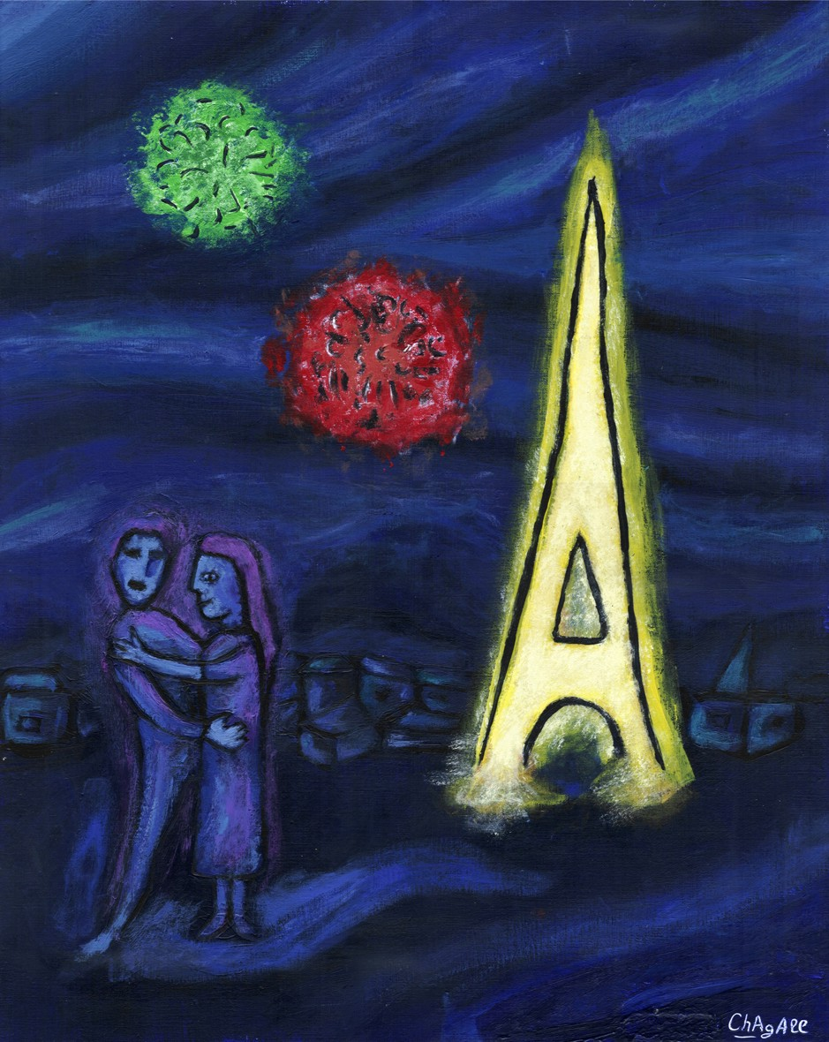
Axions
Georg Raffelt
Max Planck Institute for Physics
Munich
xions
Theoretical Motivation
Cosmological Role
Experimental Searches

Slide 2
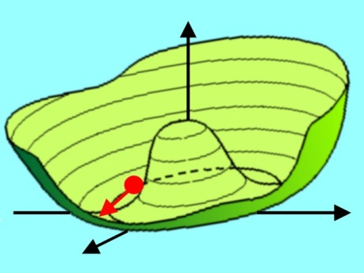
Axion Physics in a Nut Shell
Particle-Physics Motivation
Solar and Stellar Axions
CP conservation in QCD by
Peccei-Quinn mechanism
Axions thermally produced in stars,
e.g. by Primakoff production
γ
γ
a
→ Axions a ~ π⁰
a
m_{π}f_{π} ≈ m_{a}f_{a}
Limits from avoiding excessive
energy drain
Solar axion searches (CAST, Sumico)
γ
For f_{a} ≫ f_{π} axions are “invisible”
and very light
Cosmology
Search for Axion Dark Matter
In spite of small mass, axions are born
non-relativistically
(non-thermal relics)
Microwave resonator
(1 GHz = 4 μeV)
N
a
γ
Primakoff
conversion
Cold dark matter
candidate
m_{a} ~ 10 μeV or even smaller
B_{ext}
S
ADMX (Seattle)
New CARRACK (Kyoto)

Slide 3
Axions
xions
Particle-Physics Origins

Slide 4
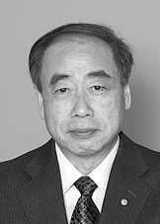
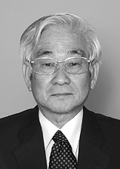
CP Violation in Particle Physics
Discrete symmetries in particle physics
C – Charge conjugation, transforms particles to antiparticles
violated by weak interactions
P – Parity, changes left-handedness to right-handedness
violated by weak interactions
T – Time reversal, changes direction of motion (forward to backward)
CPT – exactly conserved in quantum field theory
CP – conserved by all gauge interactions
violated by three-flavor quark mixing matrix
All measured CP-violating effects derive
from a single phase in the quark mass matrix
(Kobayashi-Maskawa phase),
i.e. from complex Yukawa couplings
Cosmic matter-antimatter asymmetry
requires new ingredients
M. Kobayashi
T. Maskawa
Physics Nobel Prize 2008

Slide 5
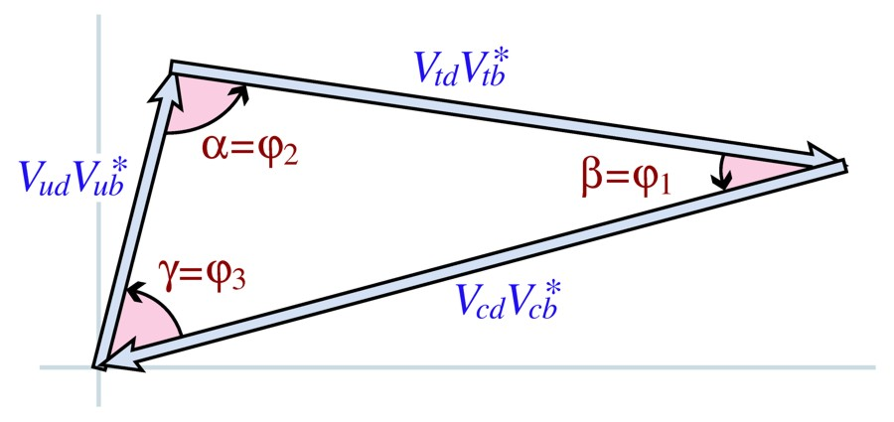
Cabbibo-Kobayashi-Maskawa (CKM) Matrix
Quark interaction with W boson
(charged-current electroweak interaction)
$$\frac{g}{\sqrt{2}} {\overline{Ψ}}_{uL}γ^{μ}V_{CKM}Ψ_{dL} W_{μ}^{+}+h.c.$$
$Ψ_{u}=(u,c,t)$ $Ψ_{d}=(d,s,b)$
Unitary Cabbibo-Kobayashi-Maskawa matrix
relates mass eigenstates
to weak interaction eigenstates
V_{CKM} depends on three mixing angles and one phase δ,
explaining all observed CP-violation
Precision tests use “unitarity triangles” consisting of products of measured
components of V_{CKM}, for example:
$$V_{CKM}=\left(\begin{matrix}V_{ud} & V_{us} & V_{ub} \\ V_{cd} & V_{cs} & V_{cb} \\ V_{td} & V_{ts} & V_{tb}\end{matrix}\right)$$

Slide 6
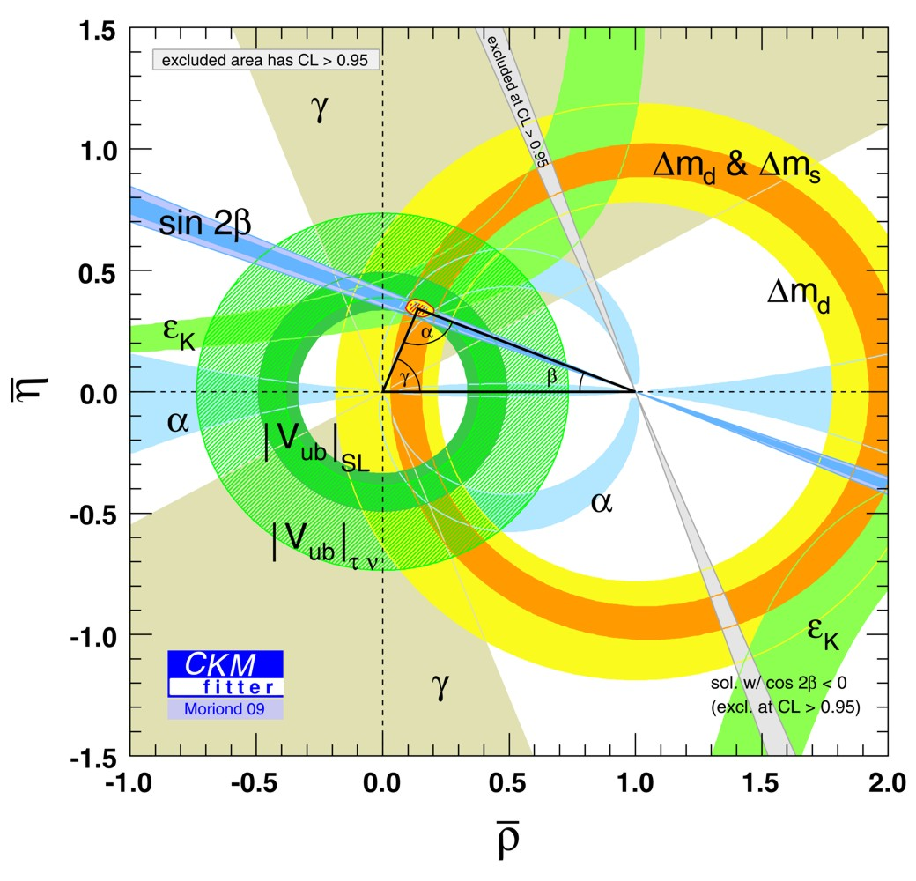
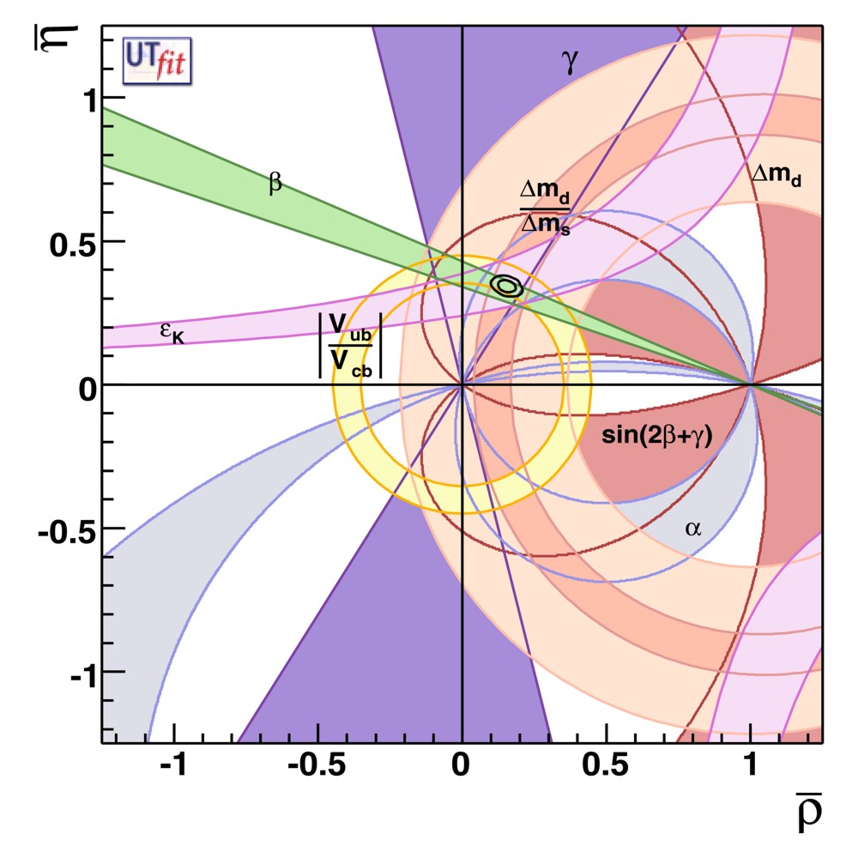
Measurements of CKM Unitarity Triangle
CKMfitter Group
http://ckmfitter.in2p3.fr
UTfit Collaboration
http://www.utfit.org

Slide 7
Kobayashi and Maskawa

Slide 8
The CP Problem of Strong Interactions
Real quark
mass
Phase from
Yukawa coupling
Angle
variable
CP-odd
quantity $∼E⋅B$
$$ℒ_{QCD}=\sum_{q}{{\overline{ψ}}_{q}\left(iD−m_{q}e^{iθ_{q}}\right)ψ_{q}−\frac{1}{4}}G_{μνa}G_{a}^{μν}−Θ\frac{α_{s}}{8π}G_{μνa}{\tilde{G}}_{a}^{μν}$$
Remove phase of mass term by chiral transformation of quark fields
$$ψ_{q}→e_{}^{−iγ_{5}θ_{q}/2}ψ_{q}$$
$$ℒ_{QCD}=\sum_{q}{{\overline{ψ}}_{q}\left(iD−m_{q}\right)ψ_{q}−\frac{1}{4}}GG−\underset{−π ≤\overline{Θ}≤+π}{\underbrace{\left(Θ−\text{arg} \text{det} M_{q}\right)}} \frac{α_{s}}{8π}G\tilde{G}$$
$\overline{Θ}$ can be traded between quark phases and $G\tilde{G}$ term
No physical impact if at least one $m_{q}=0$
Induces a large neutron electric dipole moment (a T-violating quantity)
Experimental limits: $\left|\overline{Θ}\right|<{10}^{−11}$ Why so small?

Slide 9
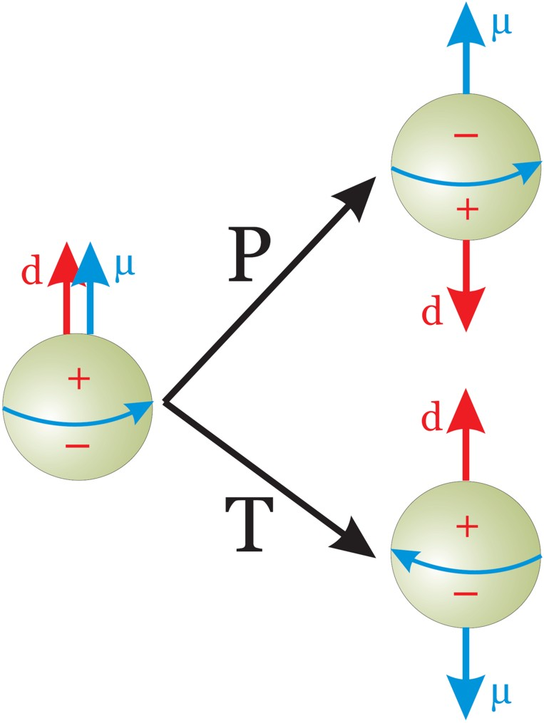
Neutron Electric Dipole Moment
Violates time reversal (T) and
space reflection (P) symmetries
Natural scale
$$\frac{e}{2m_{N}}=1.06 ×{10}^{−14}e cm$$
Experimental limit
$$\left|d\right|=0.63 ×{10}^{−25}e cm$$
Limit on coefficient
$$\overline{Θ}\frac{m_{q}}{m_{N}}≲{10}^{−11}$$

Slide 10
Strong CP Problem
QCD vacuum energy $V(Θ)$
$$Λ_{QCD}^{4}$$
Equivalent
Equivalent
$$Θ$$
$$−2π$$
$$−π$$
$$+π$$
$$+2π$$
• CP conserving vacuum has $Θ=0$ (Vafa and Witten 1984)
• QCD could have any $−π≤Θ≤+π$, is “constant of nature”
• Energy can not be minimized: $Θ$ not dynamical
Peccei-Quinn solution:
Make $Θ$ dynamical, let system relax to lowest energy

Slide 11
Dynamical Solution
Peccei & Quinn 1977, Wilczek 1978, Weinberg 1978
• Re-interpret $\overline{Θ}$ as a dynamical variable (scalar field)
$$ℒ_{CP}=−\frac{α_{s}}{8π} \overline{Θ} \text{Tr}\left(G\tilde{G}\right)→−\frac{α_{s}}{8π} \frac{a(x)}{f_{a}} \text{Tr}\left(G\tilde{G}\right)$$
$a(x)$ is pseudoscalar axion field, $fa$ axion decay constant (Peccei-Quinn scale)
Axions generically couple to two gluons and mix with, $π0$, $η$, $η^{′}$ mesons,
inducing a mass (potential) for $a(x)$
$$m_{a}f_{a}=\frac{\sqrt{m_{u}m_{d}}}{m_{u}+m_{d}} m_{π}f_{π}$$
$$\left(\begin{matrix}\text{A}\text{xion} \text{mass} \\ \text{\& }\text{couplings}\end{matrix}\right)∼\left(\begin{matrix}Pion \text{mass} \\ \text{\& }\text{couplings}\end{matrix}\right)×\frac{f_{π}}{f_{a}}$$
Potential (mass term) induced by $ℒ\text{CP}$ drives $a(x)$ to CP-conserving minimum
$$V(a)$$
CP-symmetry
dynamically
restored
$$a$$
$$\overline{Θ}=0$$

Slide 12
The Pool Table Analogy (Pierre Sikivie 1996)
Gravity
Pool table
Symmetric
relative
to gravity
Axis
Symmetry
broken
Floor
inclined
f_{a}
New degree
of freedom
→ Axion
$$\overline{Θ}$$
Symmetry
dynamically
restored
(Weinberg 1978, Wilczek 1978)
(Peccei & Quinn 1977)

Slide 13
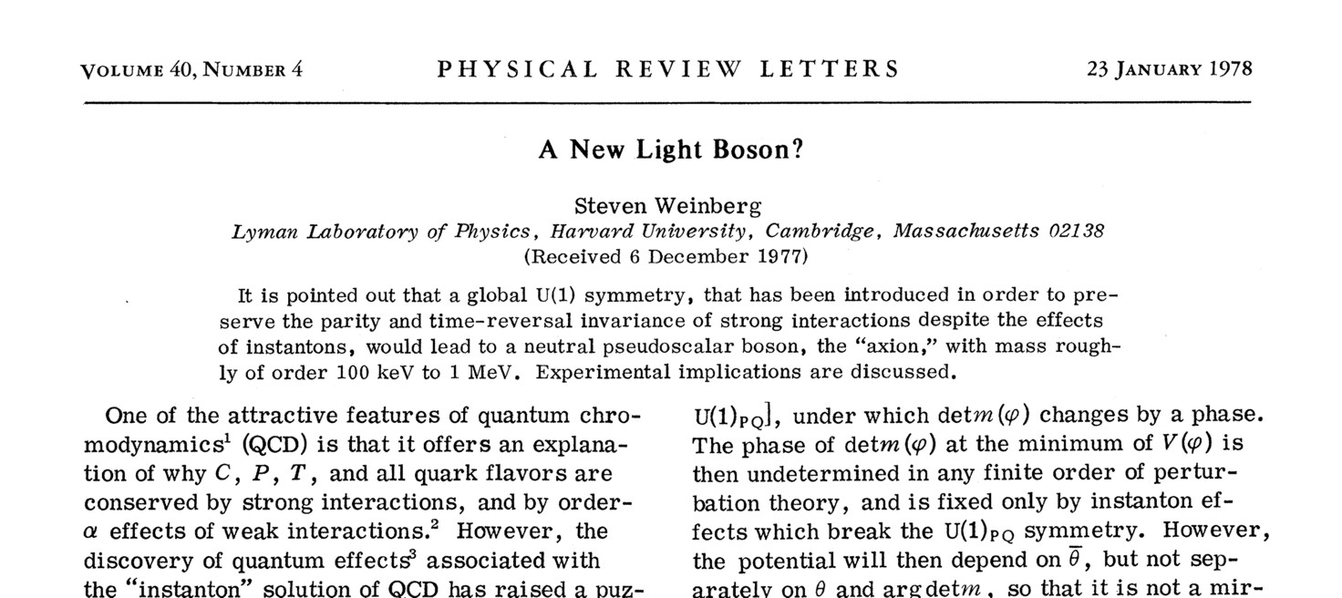
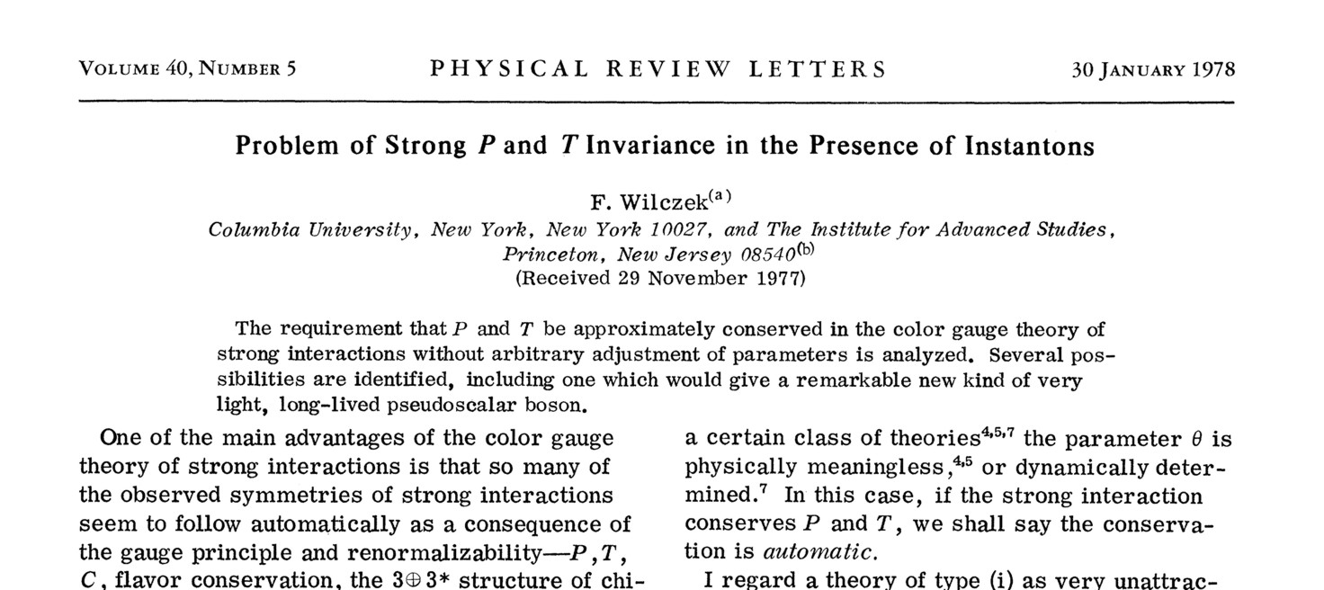
33 Years of Axions

Slide 14
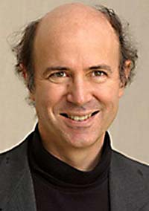
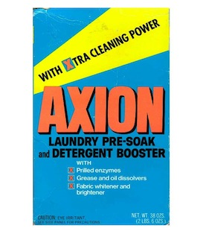
The Cleansing Axion
Frank Wilczek
“I named them after a laundry
detergent, since they clean up
a problem with an axial current.”
(Nobel lecture 2004)

Slide 15
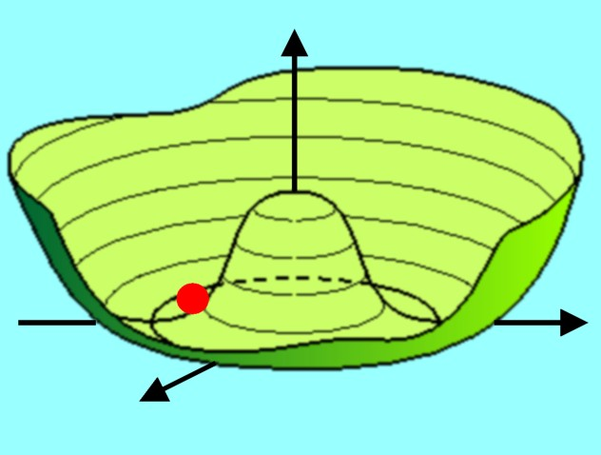
Axion as a Nambu-Goldstone Boson
$$ℒ_{\text{CP}}=\frac{α_{s}}{8π}\overline{Θ}G_{a}{\tilde{G}}_{a}→\frac{α_{s}}{8π}\underset{ }{\underbrace{\left(\overline{Θ}−\frac{a(x)}{f_{a}}\right)}}G_{a}{\tilde{G}}_{a}$$
Periodic variable (angle)
$$Φ=\frac{f_{a}+ρ\left(x\right)}{\sqrt{2}} e^{\frac{ia\left(x\right)}{f_{a}}}$$
New U(1) symmetry, spontaneously broken at a large scale $fa$
Axion is “phase” of new Higgs field: angular variable $a(x)/f_{a}$
By construction couples to $G\tilde{G}$ term with strength $αs/8π$,
e.g. triangle loop with new heavy quark (KSVZ model)
Mixes with $π0$-$η$-$η^{′}$ mesons
Axion mass
(vanishes if $mu$ or $md = 0$)
$$m_{a}=\frac{\sqrt{m_{u}m_{d}}}{m_{u}+m_{d}} \frac{m_{π}}{f_{π}f_{a}}$$

Slide 16
From Standard to Invisible Axions
Standard Model
“Standard Axion”
Weinberg 1978, Wilczek 1978
Invisible Axion
Kim 1979, Shifman,
Vainshtein, Zakharov 1980,
Dine, Fischler, Srednicki 1981
Zhitnitsky 1980
All Higgs degrees of
freedom are used up
Peccei-Quinn scale
f_{a} = f_{EW}
(electroweak scale)
Two Higgs fields,
separately giving mass
to up-type quarks and
down-type quarks
Additional Higgs with
f_{a} ≫ f_{EW}
Axions very light and
and very weakly
interacting
No room for Peccei-Quinn
symmetry and axions
Standard axions quickly
ruled out experimentally
New scale required
Axions can be
cold dark matter
Can be detected

Slide 17
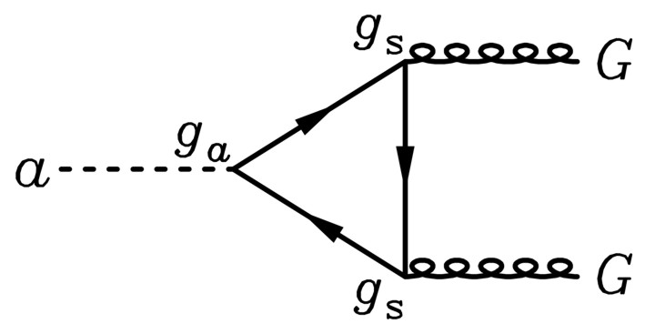
Simplest Invisible Axion: KSVZ Model
Ingredients: Scalar field $Φ$, breaks U(1)_{PQ} spontaneously
Very heavy colored quark with coupling to $Φ$, provides $aG\tilde{G}$ term
$$ℒ_{KSVZ}=\left(\frac{i}{2}\overline{Ψ}∂_{μ}γ^{μ}Ψ+h.c.\right)+∂_{μ}Φ^{†}∂^{μ}Φ−V\left(\left|Φ\right|\right)−h\left({\overline{Ψ}}_{L}Ψ_{R}Φ+h.c.\right)$$
Invariant under chiral phase transformations (Peccei Quinn symmetry)
$Φ→e^{iα}Φ$, $Ψ_{L}→e^{iα/2}Ψ_{L}$, $Ψ_{R}→e^{−iα/2}Ψ_{R}$
Mexican hat potential $V(\left|Φ\right|)$, expand fields as
$$Φ(x)=\frac{f_{a}+ρ(x)}{\sqrt{2}} e^{ia(x)/f_{a}}$$
Low-energy Lagrangian
$ℒ_{KSVZ}=\left(\frac{i}{2}\overline{Ψ}∂_{μ}γ^{μ}Ψ+h.c.\right)+\frac{1}{2}{\left(∂_{μ}a\right)}^{2}−m\overline{Ψ}e^{\frac{iγ_{5}a}{f_{a}}}Ψ$, where $m=hf_{a}/\sqrt{2}$
Lowest-order interaction term induces $aG\tilde{G}$ term
$$ℒ_{aG}=−\frac{α_{s}}{8π}\frac{a}{f_{a}}G\tilde{G}$$
Couples axion to QCD sector

Slide 18
Axion Properties
Gluon coupling
(generic)
$$L_{aG}=\frac{α_{s}}{8πf_{a}} G\tilde{G}a$$
G
a
G
Mass (generic)
$$m_{a}=\frac{\sqrt{m_{u}m_{d}}}{m_{u}+m_{d}} \frac{m_{π}}{f_{π}f_{a}}≈\frac{6 μeV}{{f_{a}}/{{10}^{12}}GeV}$$
Photon coupling
$$L_{aγ}=−\frac{g_{aγ}}{4} F\tilde{F}a=g_{aγ} E⋅B a$$
$$g_{aγ}=\frac{α}{2πf_{a}}\left(\frac{E}{N}−1.92\right)$$
γ
a
γ
Pion coupling
$$L_{aπ}=\frac{C_{aπ}}{f_{π}f_{a}}\left(π^{0}π^{+}∂_{μ}π^{−}+…\right)∂^{μ}a$$
π
π
π
a
Nucleon coupling
(axial vector)
$$L_{aN}=\frac{C_{N}}{2f_{a}} {\overline{Ψ}}_{N}γ^{μ}γ_{5}Ψ_{N}∂_{μ}a$$
N
a
N
Electron coupling
(optional)
$$L_{ae}=\frac{C_{e}}{2f_{a}} {\overline{Ψ}}_{e}γ^{μ}γ_{5}Ψ_{e}∂_{μ}a$$
e
a
e

Slide 19
Axions
xions
Astrophysical Bounds

Slide 20
Axion Emission Processes in Stars
Nucleons
$$\frac{C_{N}}{2f_{a}} {\overline{Ψ}}_{N}γ_{μ}γ_{5}Ψ_{N}∂^{μ}a$$
Nucleon
Bremsstrahlung
Photons
$$C_{γ}\frac{α}{2πf_{a}}\frac{1}{4}F_{μν}{\tilde{F}}^{μν}a$$
Primakoff
Electrons
$$\frac{C_{e}}{2f_{a}} {\overline{Ψ}}_{e}γ_{μ}γ_{5}Ψ_{e}∂^{μ}a$$
Compton
Pair
Annihilation
Electromagnetic
Bremsstrahlung

Slide 21
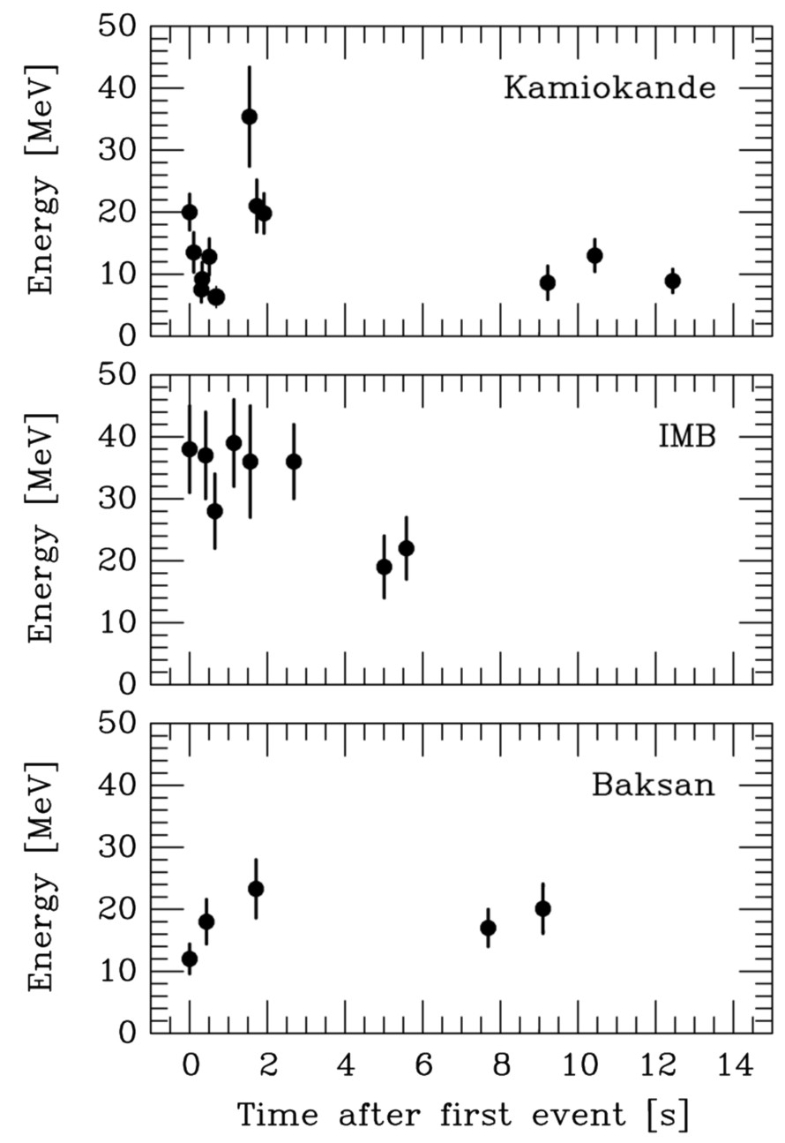
Supernova 1987A Energy-Loss Argument
SN 1987A neutrino signal
Neutrino
sphere
Volume emission
of new particles
Neutrino
diffusion
Emission of very weakly interacting
particles would “steal” energy from the
neutrino burst and shorten it.
(Early neutrino burst powered by accretion,
not sensitive to volume energy loss.)
Late-time signal most sensitive observable

Slide 22
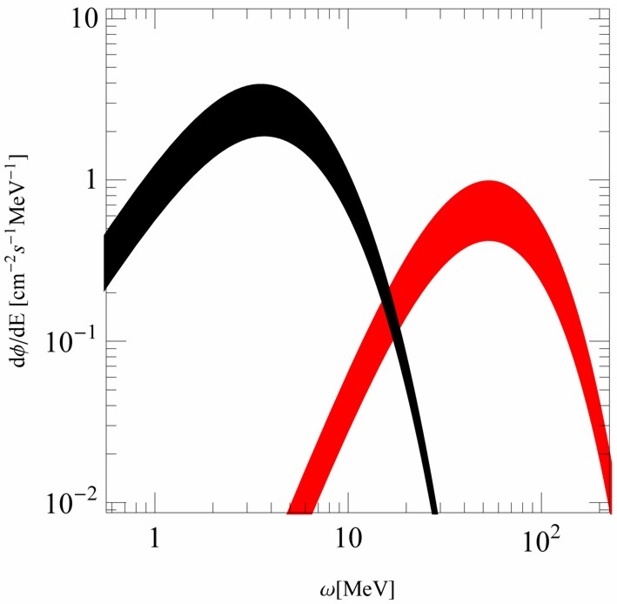
Diffuse Supernova Axion Background (DSAB)
Neutrinos from all core-collapse SNe comparable to photons from all stars
Diffuse Supernova Neutrino Background (DSNB) similar energy density as
extra-galactic background light (EBL), approx 10% of CMB energy density
DSNB probably next astro neutrinos to be measured
Axions with $ma \sim \text{10 }\text{meV}$
near SN 1987A energy-loss limit
Provide DSAB with compable
energy density as DSNB and EBL
No obvious detection channel
Raffelt, Redondo & Viaux
work in progress (2011)

Slide 23
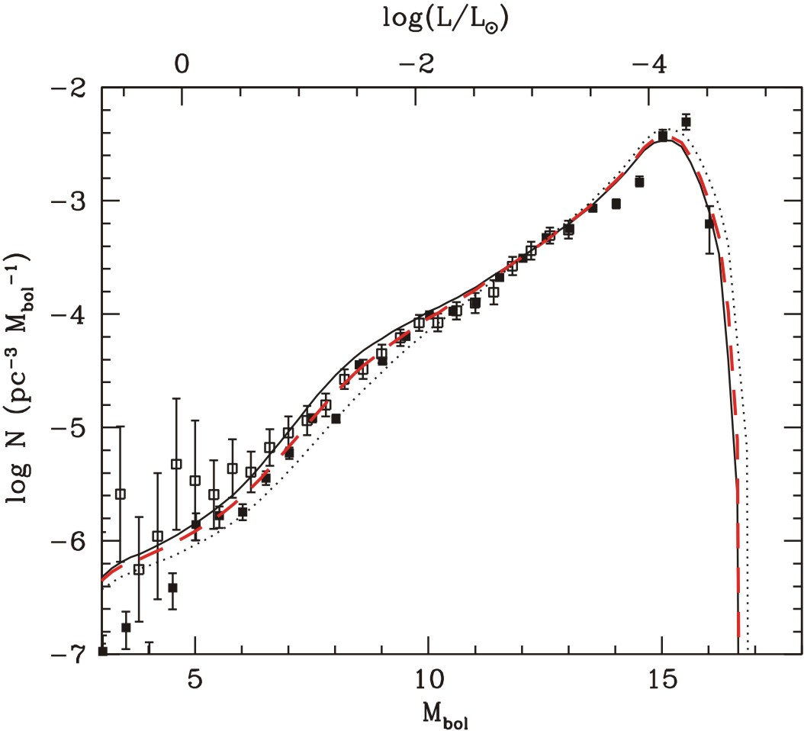
Do White Dwarfs Need Axion Cooling?
White dwarf
luminosity function
(number of WDs per
brightness interval)
No axions
With axion cooling
($m_{a} \sim \text{5 }\text{meV}$
near SN1987A limit)
Isern, Catalán,
García-Berro & Torres
arXiv:0812.3043

Slide 24
Axion Bounds
[GeV] f_{a}
10³
10⁶
10⁹
10¹²
10¹⁵
keV
eV
meV
μeV
neV
m_{a}
Experiments
Tele
scope
CAST
search range
ADMX
search range
Too much
hot dark matter
Too much cold dark matter
(classic scenario)
Globular clusters
(a-γ-coupling)
Classic
region
Anthropic
region
Too many
events
Too much
energy loss
SN 1987A (a-N-coupling)

Slide 25
Axions
xions
As Dark Matter

Slide 26
Lee-Weinberg Curve for Neutrinos and Axions
Axions
Non-Thermal
Relics
$$log⁡(Ωa)$$
Thermal Relics
CDM
HDM
$$ΩM$$
$$log⁡(ma)$$
10 μeV
10 eV
Neutrinos
& WIMPs
$$log⁡(Ωa)$$
Thermal Relics
HDM
CDM
$$ΩM$$
$$\log{(m_{ν})}$$
10 eV
10 GeV

Slide 27
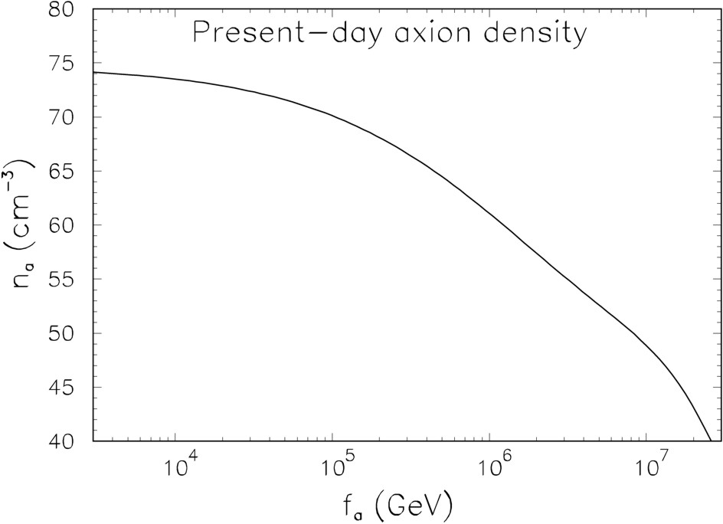
Axion Hot Dark Matter from Thermalization after Λ_{QCD}
π
π
$$L_{aπ}=\frac{C_{aπ}}{f_{a}f_{π}}\left(π^{0}π^{+}∂_{μ}π^{−}+π^{0}π^{−}∂_{μ}π^{+}−2π^{+}π^{−}∂_{μ}π^{0}\right)∂^{μ}a$$
π
a
Chang & Choi, PLB 316 (1993) 51
Hannestad, Mirizzi
& Raffelt,
hep-ph/0504059

Slide 28
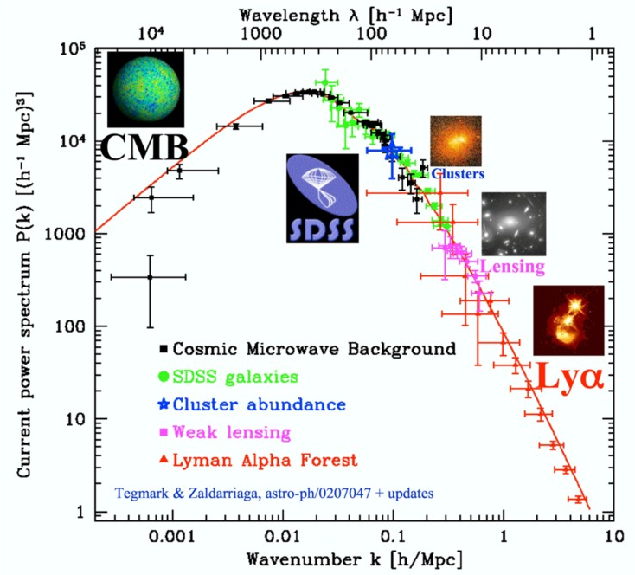
Power Spectrum of Cosmic Density Fluctuations
Tegmark, TAUP 2003

Slide 29
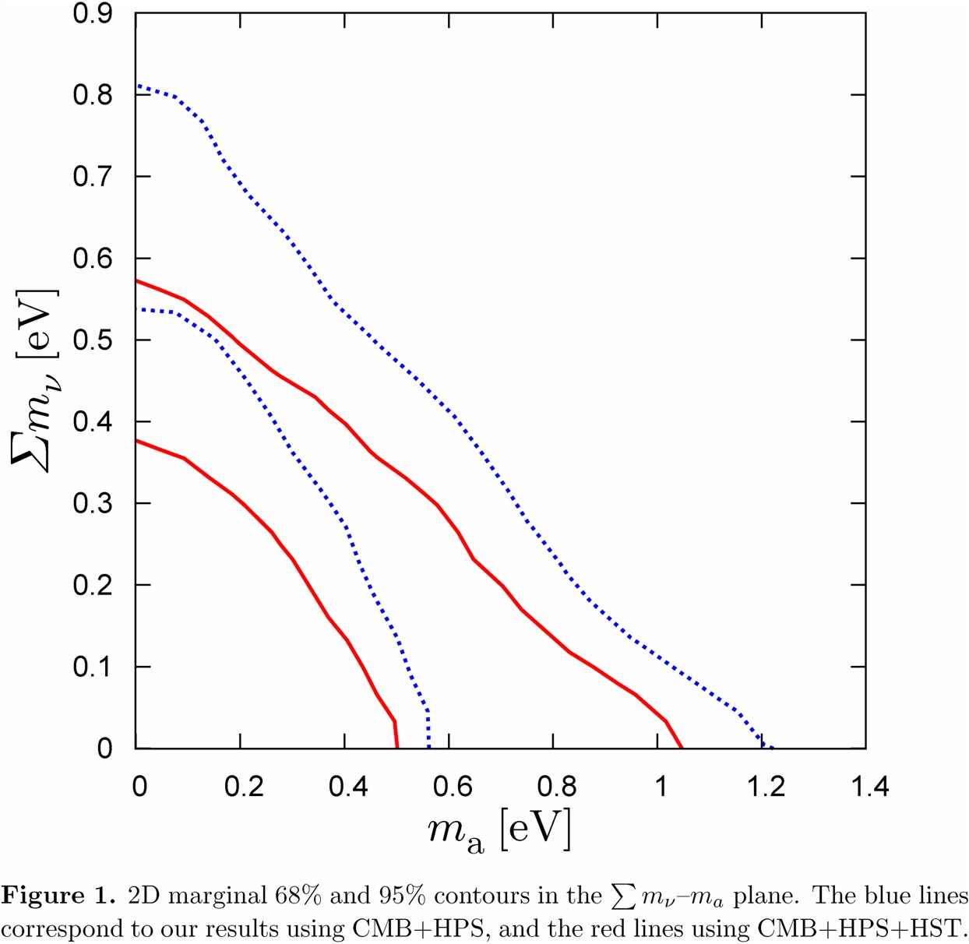
Neutrino and Axion Hot Dark Matter Limits
Credible regions for neutrino plus
axion hot dark matter
(WMAP-7, SDSS, HST)
Hannestad, Mirizzi, Raffelt & Wong
[arXiv:1004.0695]
Marginalizing over neutrino
hot dark matter component
$ma<0.7$eV (95% CL)
Assuming no axions
$∑mν<0.4$eV (95% CL)
68%
95%

Slide 30
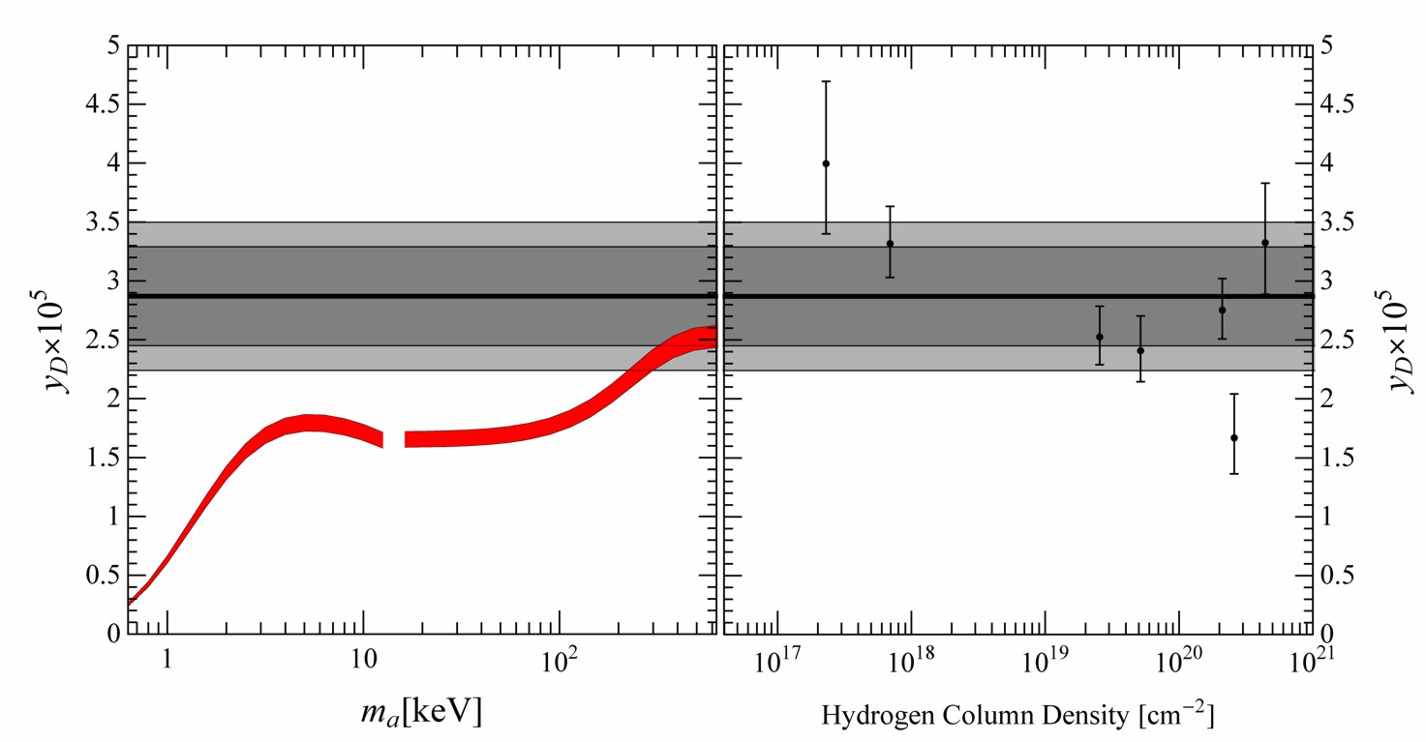
New BBN limits on sub-MeV mass axions
Axions essentially in thermal equilibrium throughout BBN
e⁺e⁻ annihilation partly heats axions → missing photons
Reduced photon/baryon fraction during BBN
Reduced deuterium abundance, using WMAP baryon fraction
Cadamuro, Hannestad, Raffelt & Redondo, arXiv:1011.3694 (JCAP)

Slide 31
Axion Bounds
[GeV] f_{a}
10³
10⁶
10⁹
10¹²
10¹⁵
keV
eV
meV
μeV
neV
m_{a}
Experiments
Tele
scope
CAST
search range
ADMX
search range
Too much
hot dark matter
Too much cold dark matter
(classic scenario)
Globular clusters
(a-γ-coupling)
Classic
region
Anthropic
region
Too many
events
Too much
energy loss
SN 1987A (a-N-coupling)

Slide 32
Axions
xions
As Cold Dark Matter

Slide 33
Creation of Cosmological Axions
$T \sim f_{a}$ (very early universe)
$$V(a)$$
U_{PQ}(1) spontaneously broken
Higgs field settles in
“Mexican hat”
Axion field sits fixed at
$ai =Θi f_{a}$
$$a$$
$T \sim 1 \text{GeV}$ ($H \sim {10}^{−9}$ eV)
$$V(a)$$
Axion mass turns on quickly
by thermal instanton gas
Field starts oscillating when
$ma ≳ 3H$
Classical field oscillations
(axions at rest)
$$a$$
$$\overline{Θ}=0$$
Axions are born as nonrelativistic, classical field oscillations
Very small mass, yet cold dark matter

Slide 34
Cosmic Axion Field Evolution (1)
Scalar field evolution in the expanding universe, physical wave number $k$
$$\ddot{Φ}+3H\dot{Φ}+\underset{ω^{2}}{\underbrace{\left(k^{2}+m^{2}\right)}}Φ=0$$
Axion initially in $k=0$ mode, so $ω^{2}=m^{2}$. For $3H≫m$ no motion, for $3H≪m$
$$Φ\left(t\right)=Ψ\left(t\right)\sin{(mt)}$$
with slowly changing amplitude $Ψ\left(t\right)$.
Insert in EoM, keep only fastest-moving terms
$2m\dot{Ψ}+3HmΨ=0$ or $\frac{d}{dt}\underset{\begin{aligned}number \\ density\end{aligned}}{\underbrace{\left(\frac{1}{2}mΨ^{2}\right)}}=−3H\left(\frac{m}{2}Ψ^{2}\right)$
A number density evolves with cosmic scale factor as $n∝R^{−3}$, so $\dot{n}=−3Hn$
Field amplitude decreases as
$$Ψ=Θf_{a}∝R^{−3/2}$$
Our galaxy:
$$ρ∼300 Me\text{V}\text{/}cm^{3}=2.3×{10}^{−6} eV^{4}=\frac{1}{2}m_{a}^{2}Θ^{2}f_{a}^{2}∼\frac{1}{2}Θ^{2}m_{π}^{2}f_{π}^{2}$$
$$Θ∼2×{10}^{−19}\sin\left(m_{a}t\right)$$

Slide 35
Searching for Axions in the Anthropic Window
Assume axions are galactic dark matter: $ρ_{a} \sim$ 300 MeV/cm³
$ρ_{a}=m_{a}^{2}Φ_{a}^{2}=m_{a}^{2}{\left(Θf_{a}\right)}^{2}∼Θ^{2}{\left(m_{π}f_{π}\right)}^{2}∼Θ^{2}Λ_{\text{QCD}}^{4}$
Independently of $fa$ expect
$Θ\left(t\right)∼3×{10}^{−19} cos\left(m_{a}t\right)$
Expect time-varying neutron EDM, MHz frequency for $fa \sim 1016$ GeV
$${ d}_{n}∼\frac{e}{2m_{n}} \frac{m_{q}}{m_{N}}Θ∼3×{10}^{−34} e\text{−}\text{cm} cos(m_{a}t)$$
Experimental limit on static EDM
$d_{n}<0.63×{10}^{−25}$ $e\text{−}\text{cm}$
Use much larger electric fields within atoms, small energy shifts within
polarized molecules: Molecular interferometry techniques may work,
a factor $\sim$ 100 off at present. Best in kHz-MHz regime (anthropic window).
Graham & Rajendran, arXiv:1101.2691

Slide 36
Cosmic Axion Field Evolution (2)
Today: Epoch 0. Axion field starts oscillating: Epoch 1.
Present-day axion number density in terms of cosmic scale factors
$$n_{0}={\left(\frac{R_{1}}{R_{0}}\right)}^{3}n_{1}$$
\
Axion field starts oscillating when $m_{1}∼3H_{1}$ and $Ψ_{1}=Θ_{1}f_{a}$
$$n_{1}=\frac{1}{2} m_{1}Θ_{1}^{2}f_{a}^{2}=\frac{3H_{1}}{2} Θ_{1}^{2}f_{a}^{2}$$
Present-day mass density inversely proportional to axion mass
$$ρ_{0}=m_{a}n_{0}={\left(\frac{R_{1}}{R_{0}}\right)}^{3}\frac{3H_{1}}{2}Θ_{1}^{2}\frac{f_{a}^{2}m_{a}^{2}}{m_{a}}∼{\left(\frac{R_{1}}{R_{0}}\right)}^{3}\frac{3H_{1}}{2}Θ_{1}^{2}\frac{f_{π}^{2}m_{π}^{2}}{m_{a}}∝\frac{Θ_{1}^{2}}{m_{a}}$$
Adiabatic cosmic evolution: Comoving entropy conserved: $g_{∗S}T^{3}R^{3}=const.$
$${\left(\frac{R_{1}}{R_{0}}\right)}^{3}=\frac{g_{∗S,0}T_{0}^{3}}{g_{∗S,1}T_{1}^{3}}$$
From dilute instanton gas calulation at high T, estimate $m_{a}\left(T\right)$
$T_{1}∼0.92 GeV {\left({10}^{12}GeV\text{/}f_{a}\right)}^{0.184}$ and $H_{1}∼1 neV$

Slide 37
Cosmic Axion Density
Modern values for QCD parameters and temperature-dependent axion mass
imply (Bae, Huh & Kim, arXiv:0806.0497)
$$Ω_{a}h^{2}=0.195 Θ_{i}^{2} {\left(\frac{f_{a}}{{10}^{12}\text{GeV}}\right)}^{1.184}=0.105 Θ_{i}^{2}{\left(\frac{10 μ\text{eV}}{m_{a}}\right)}^{1.184}$$
If axions provide the cold dark matter: $Ωah2 = \text{0.11}$
$$Θ_{i}=0.75 {\left(\frac{{10}^{12}\text{GeV}}{f_{a}}\right)}^{0.592}=1.0{\left(\frac{m_{a}}{10 μ\text{eV}}\right)}^{0.592}$$
• $Θ_{i}∼1$ implies $f_{a}∼{10}^{12}$ GeV and $ma \sim 10$μeV
(“classic window”)
• $f_{a}∼{10}^{16}$ GeV (GUT scale) or larger (string inspired) requires $Θ_{i}≲0.003$
(“anthropic window”)

Slide 38
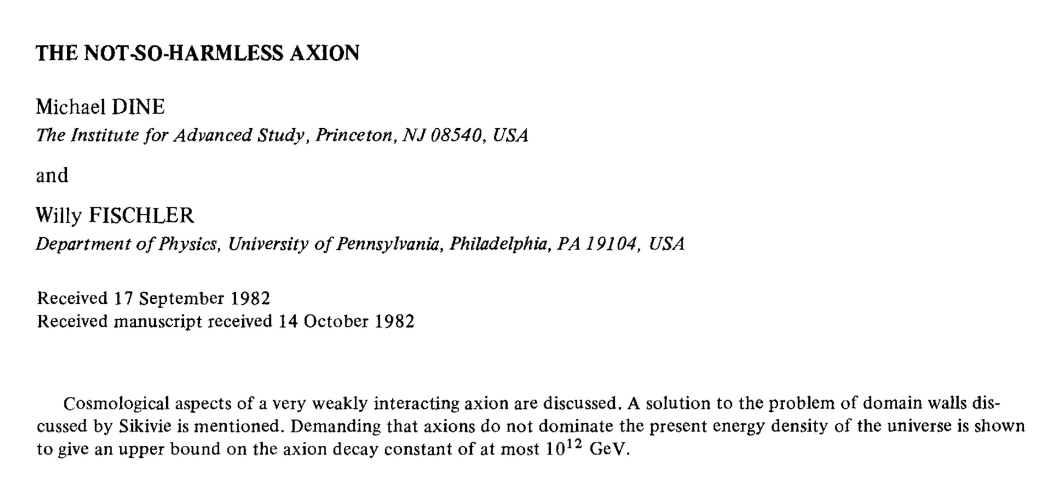
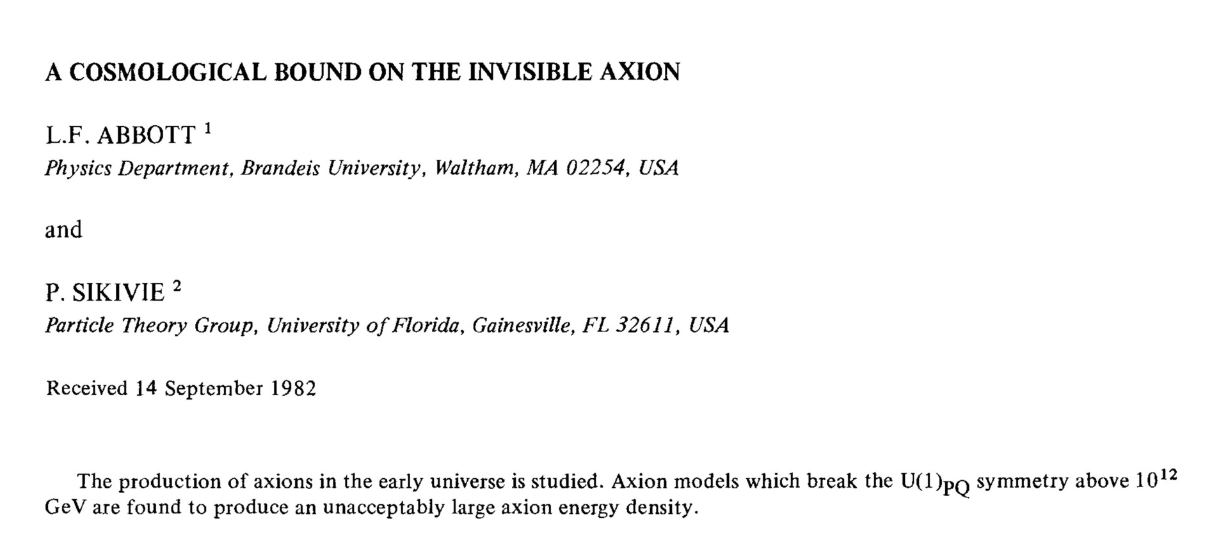
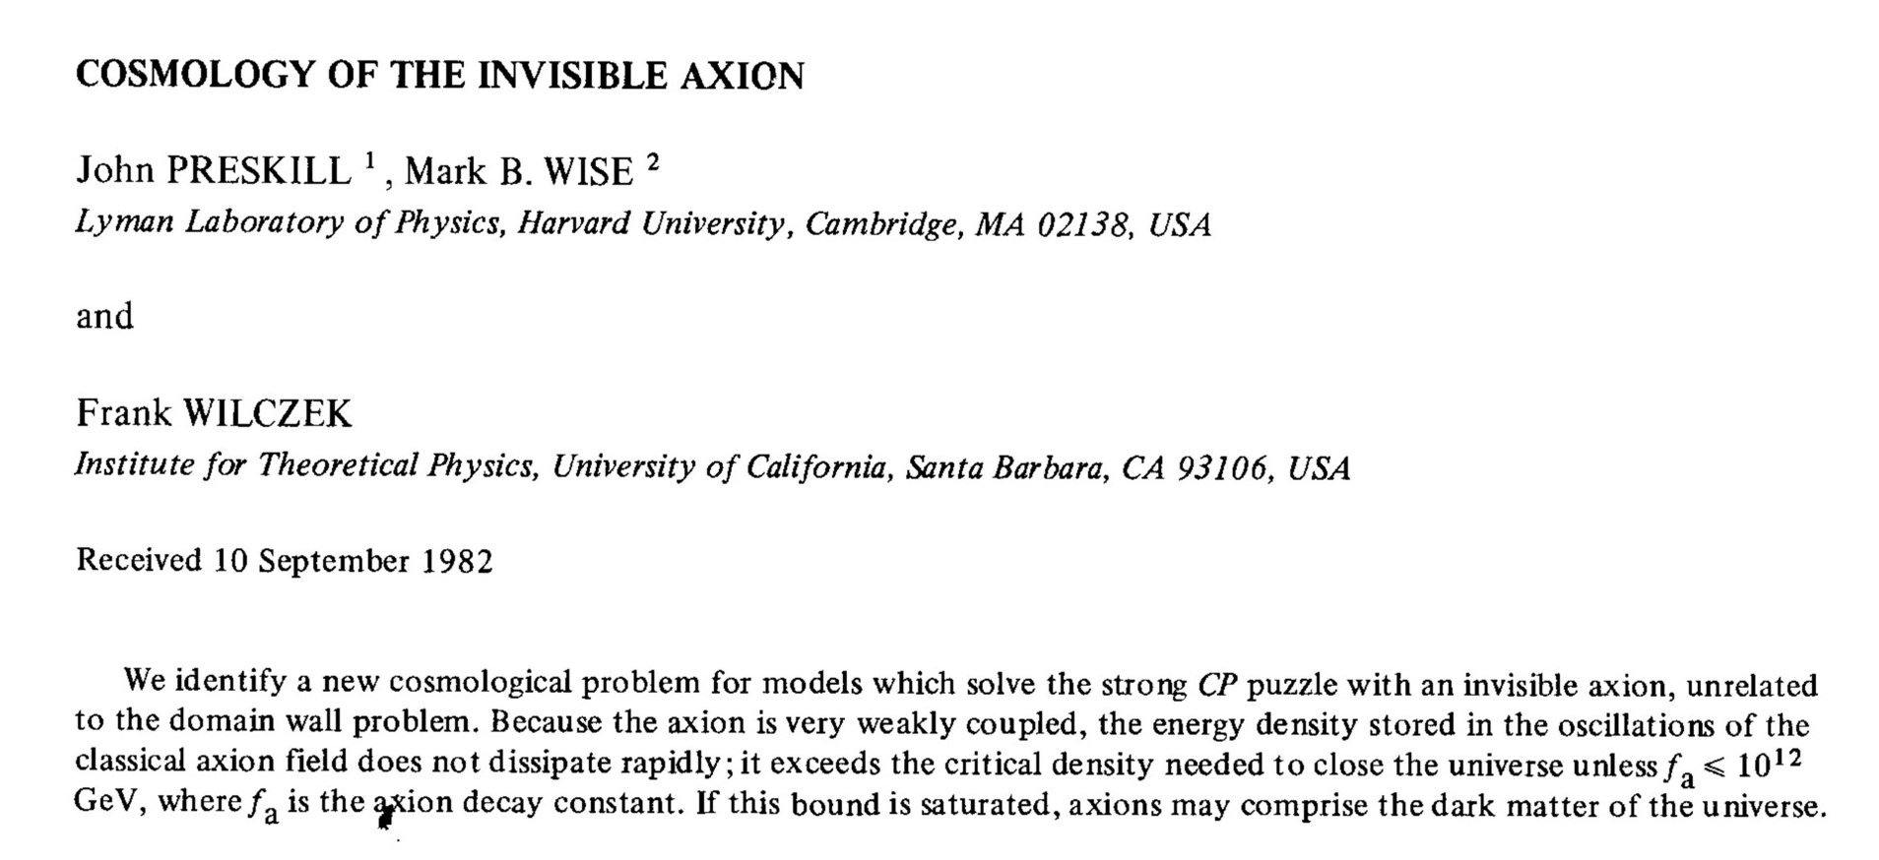
Axion Cosmology in PLB 120 (1983)

Slide 39
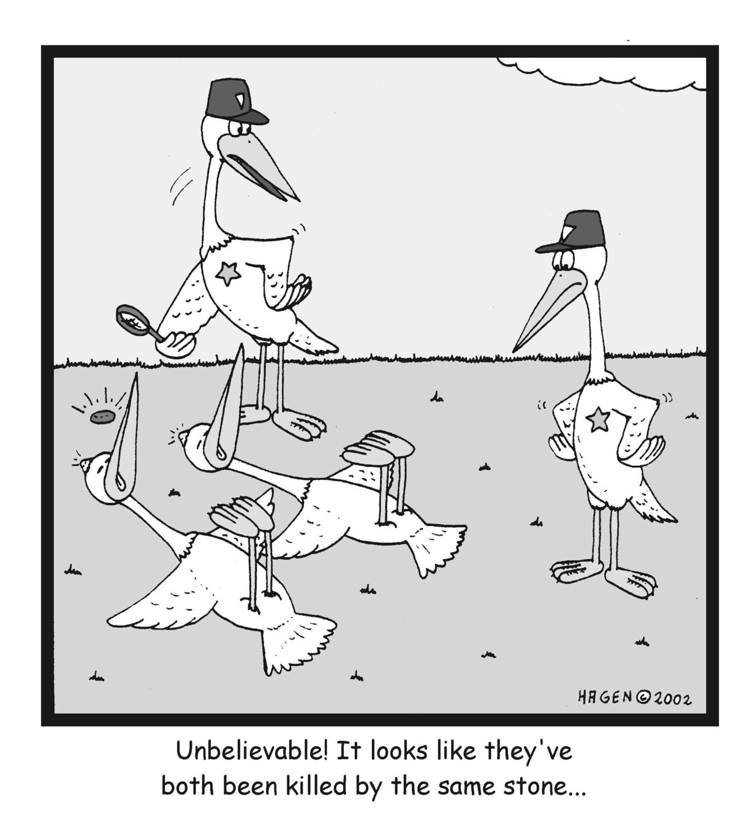
Killing Two Birds With One Stone
Peccei-Quinn mechanism
Solves strong CP problem
May provide dark matter
in the form of axions

Slide 40
Cold Axion Populations
Case 1:
Inflation after PQ symmetry breaking
Case 2:
Reheating restores PQ symmetry
Homogeneous mode oscillates after
$T ≲Λ\text{QCD}$
Dependence on initial misalignment
angle $Ω_{a}∝Θ_{i}^{2}$
Cosmic strings of broken U_{PQ}(1)
form by Kibble mechanism
Radiate long-wavelength axions
$Ωa$ independent of initial conditions
$N=1$or else domain wall problem
Dark matter density a cosmic random
number (“environmental parameter”)
Isocurvature fluctuations from large
quantum fluctuations of massless
axion field created during inflation
Strong CMB bounds on isocurvature
fluctuations
Scale of inflation required to be small
Inhomogeneities of axion field large,
self-couplings lead to formation of
mini-clusters
Typical properties
Mass $\sim {10}^{−12} M\text{s}\text{un}$
Radius $\sim 1010$cm
Mass fraction up to several 10%

Slide 41
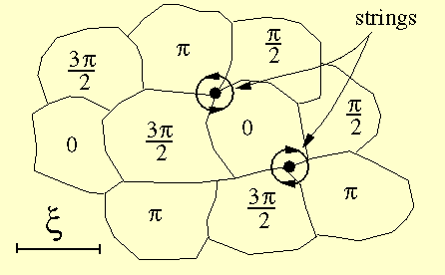
Axions from Cosmic Strings
Strings form by Kibble mechanism after break-down of U_{PQ}(1)
Paul Shellard
Small loops form by self-intersection

Slide 42
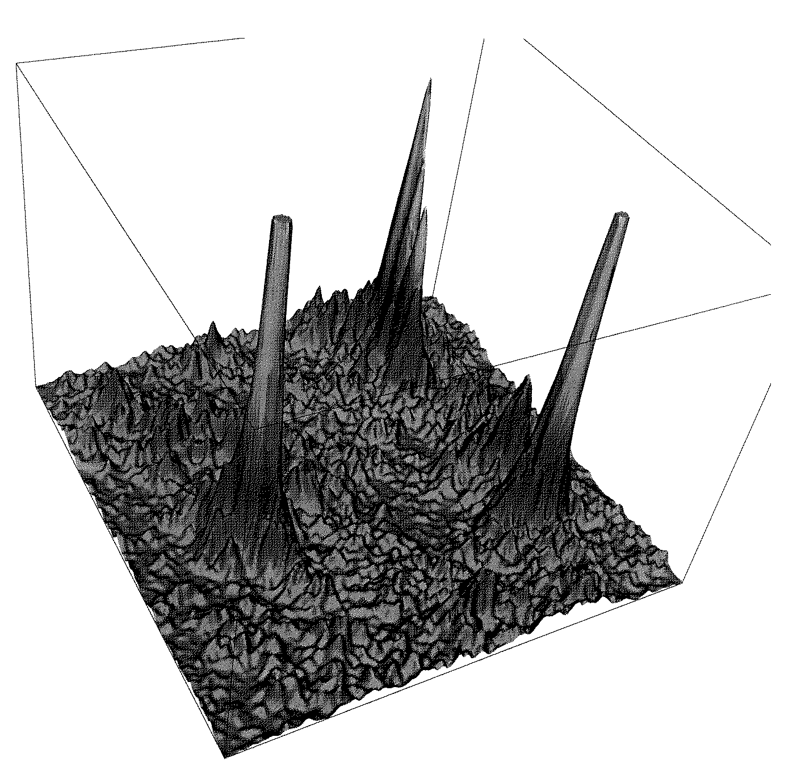
Axion Mini Clusters
The inhomogeneities of the axion field are large, leading to bound objects,
“axion mini clusters”. [Hogan & Rees, PLB 205 (1988) 228.]
Self-coupling of axion field crucial for dynamics.
Typical mini cluster properties:
Mass ~ 10⁻¹² M_{sun}
Radius ~ 10¹⁰ cm
Mass fraction up to several 10%
Potentially detectable with
gravitational femtolensing
Distribution of axion energy density.
2-dim slice of comoving length 0.25 pc
[Kolb & Tkachev, ApJ 460 (1996) L25]

Slide 43
Inflation, Axions, and Anthropic Selection
If PQ symmetry is not restored after inflation
Axion density determined by initial random number $−π<Θi<+π$
Different in different patches of the universe
Our visible universe, after inflation, from a single patch
Axion/photon ratio a cosmic random number,
chosen by spontaneous symmetry breaking process
Allows for small $Θ_{i}≲ \text{0.003}$ and thus for $f_{a}$ at the GUT or string scale
Is this “unlikely” or “unnatural” or “fine tuned”?
Should one design experiments for very small-mass axion dark matter?
Difficult to form baryonic structures if baryon/dark matter density is too low,
posterior probability for small $Θ_{i}$ not necessarily small
Linde, “Inflation and axion cosmology,” PLB 201:437, 1988
Tegmark, Aguirre, Rees & Wilczek,
“Dimensionless constants, cosmology and other dark matters,”
PRD 73:023505, 2006 [astro-ph/0511774]

Slide 44
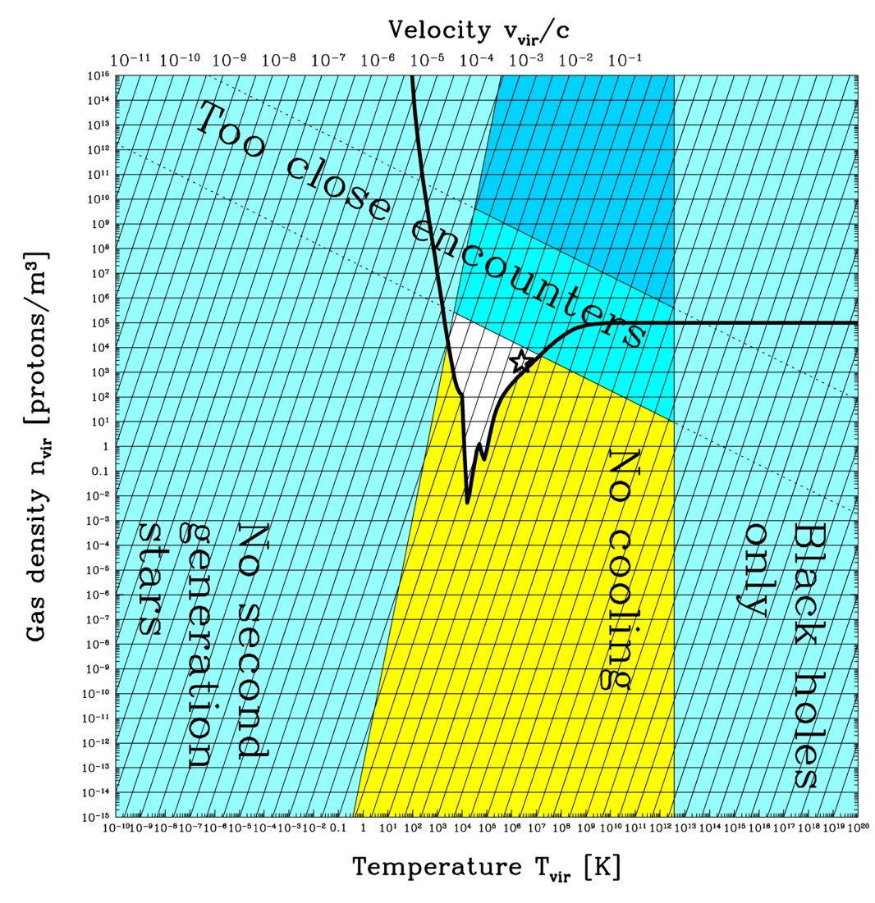
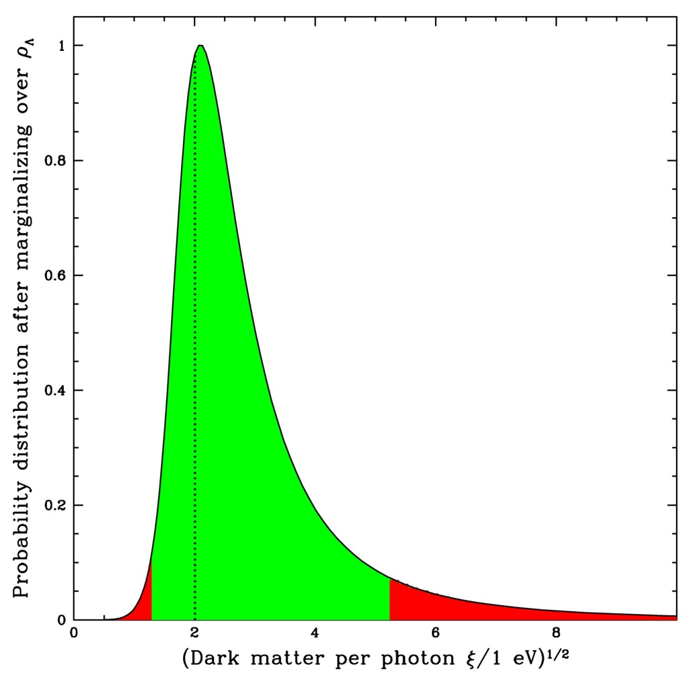
Posterior Dark Matter Probability Distribution
Tegmark, Aguirre, Rees & Wilczek,
“Dimensionless constants, cosmology and other dark matters,”
PRD 73:023505, 2006 [astro-ph/0511774]

Slide 45
Axions
xions
Isocurvature Fluctuations

Slide 46
Creation of Adiabatic vs. Isocurvature Perturbations
Inflaton field
Axion field
De Sitter expansion imprints
scale invariant fluctuations
De Sitter expansion imprints
scale invariant fluctuations
Slow roll
Reheating
Inflaton decay → matter & radiation
Both fluctuate the same:
Adiabatic fluctuations
Inflaton decay → radiation
Axion field oscillates late → matter
Matter fluctuates relative to radiation:
Entropy fluctuations

Slide 47
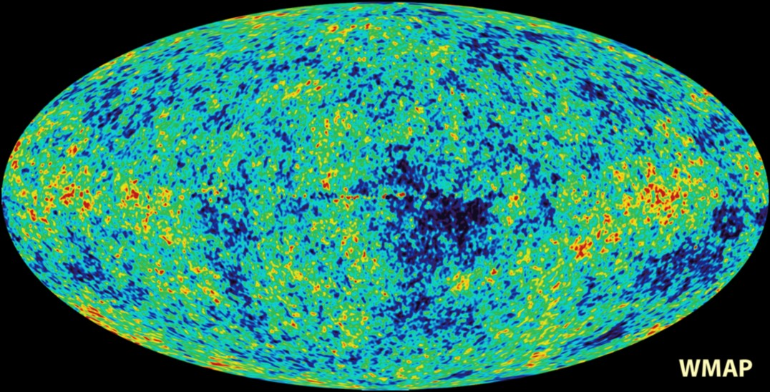
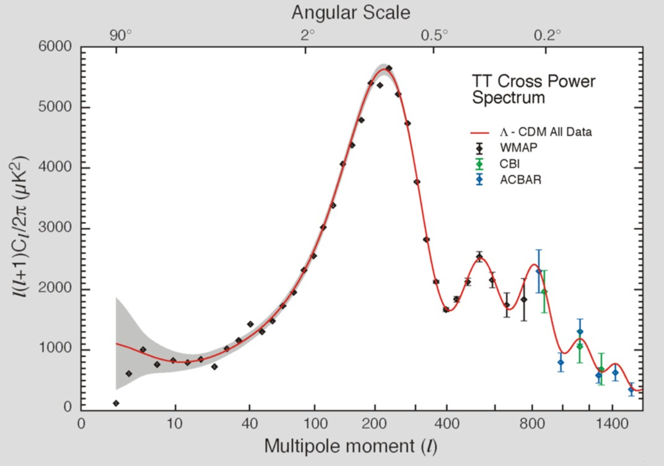
Power Spectrum of CMB Temperature Fluctuations
Sky map of CMBR temperature
fluctuations
$$Δ\left(θ,φ\right)=\frac{T\left(θ,φ\right)−〈T〉}{〈T〉}$$
Multipole expansion
$$Δ\left(θ,φ\right)=\sum_{ℓ=0}^{∞}{ \sum_{m=−ℓ}^{ℓ}{a_{ℓm}Y_{ℓm}\left(θ,φ\right)}}$$
Acoustic Peaks
Angular power spectrum
$$C_{ℓ}=〈a_{ℓm}^{∗}a_{ℓm}〉=\frac{1}{2ℓ+1}\sum_{m=−ℓ}^{ℓ}{a_{ℓm}^{∗}a_{ℓm}}$$

Slide 48
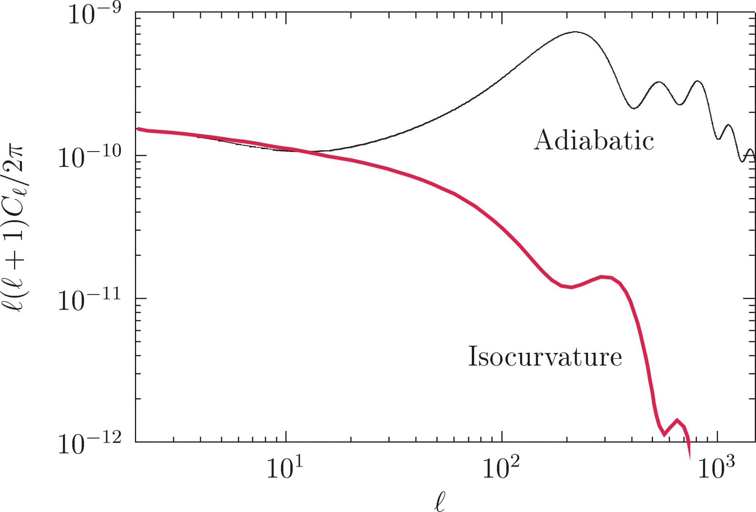
Adiabatic vs. Isocurvature Temperature Fluctuations
Adapted from Fox, Pierce & Thomas, hep-th/0409059

Slide 49
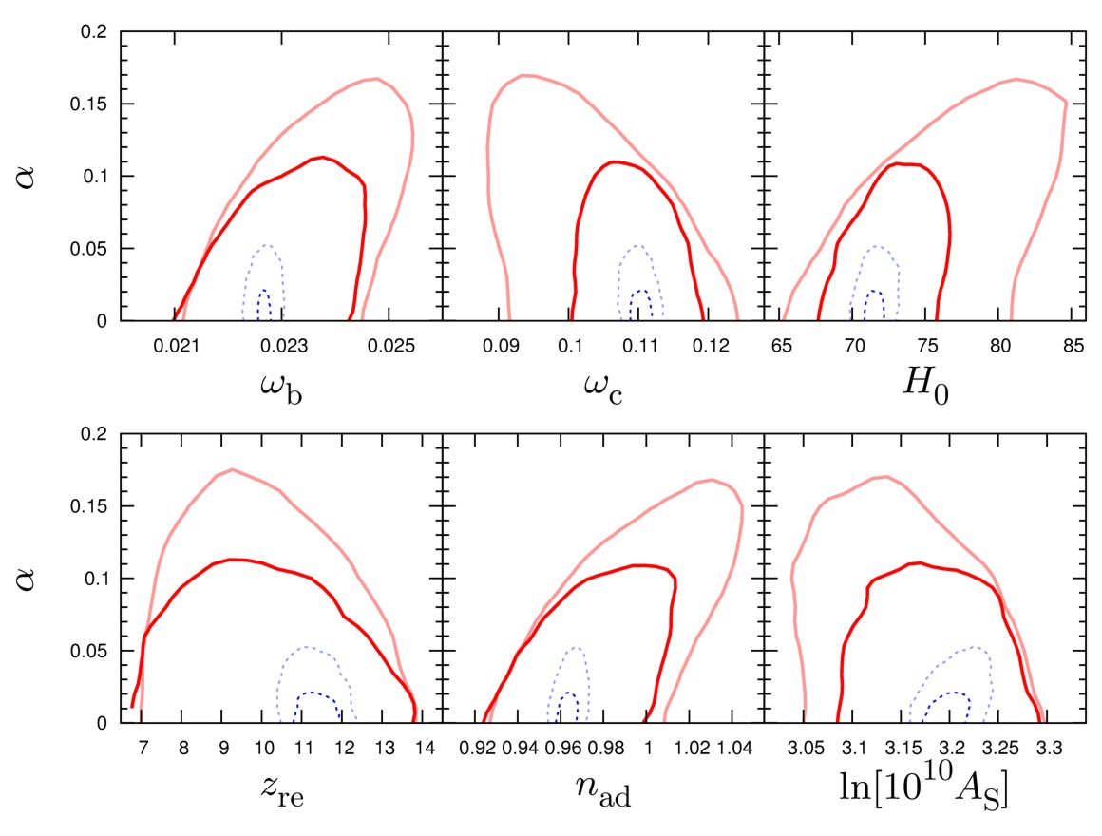
Parameter Degeneracies
WMAP-5
WMAP-5 + LSS
Planck forecast
Cosmic Variance
Limited (CVL)
Hamann, Hannestad, Raffelt & Wong, arXiv:0904.0647

Slide 50
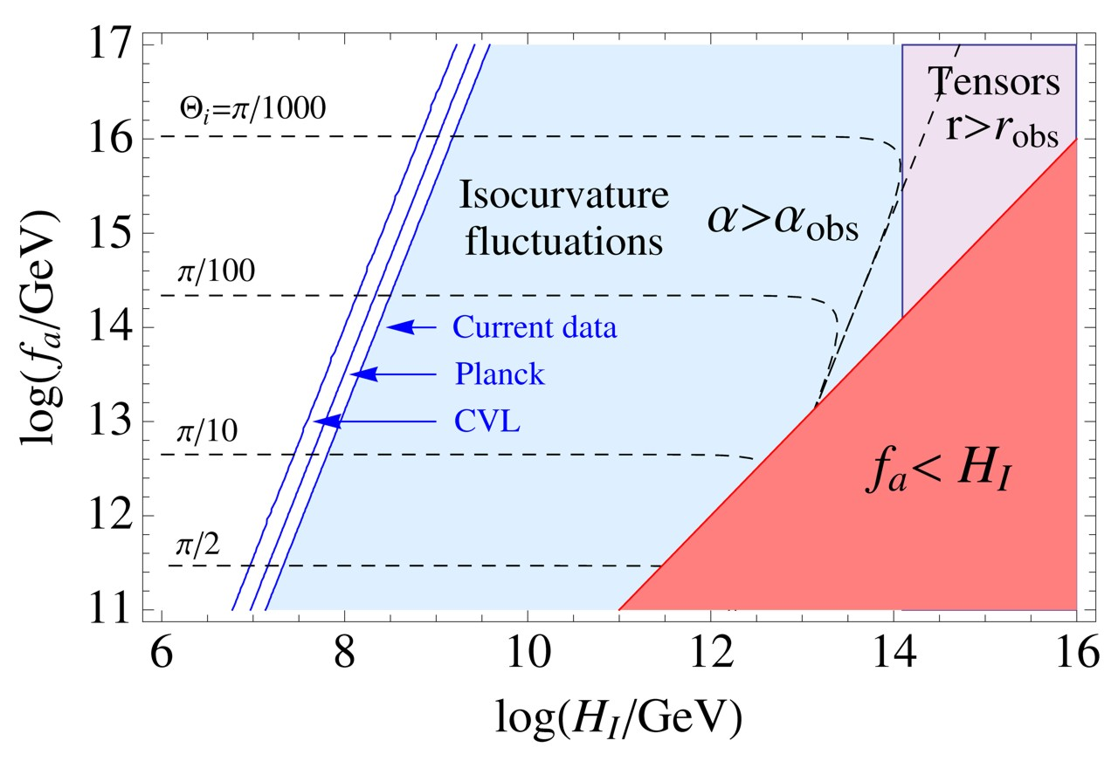
Isocurvature Forecast
Hubble scale during inflation
Axion decay constant
Hamann, Hannestad, Raffelt & Wong, arXiv:0904.0647

Slide 51
Axions
xions
Solar Axion Searches

Slide 52
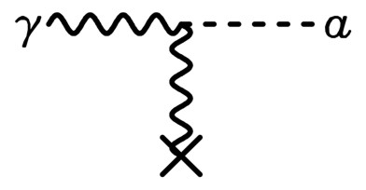
Experimental Tests of Invisible Axions
Primakoff effect:
Axion-photon transition in external
static E or B field
(Originally discussed for $π^{0}$
by Henri Primakoff 1951)
Pierre Sikivie:
Macroscopic B-field can provide a
large coherent transition rate over
a big volume (low-mass axions)
Axion helioscope:
Look at the Sun through a dipole magnet
Axion haloscope:
Look for dark-matter axions with
A microwave resonant cavity

Slide 53
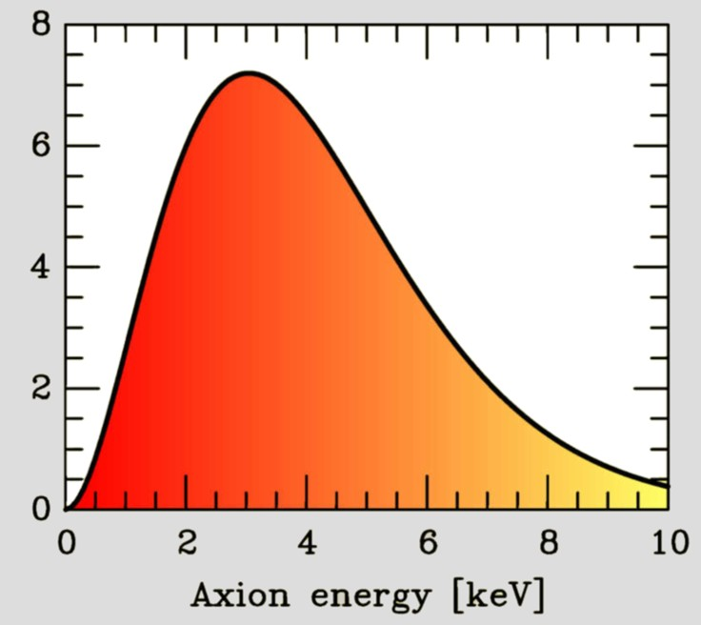
Search for Solar Axions
Axion Helioscope
(Sikivie 1983)
Primakoff
production
Axion flux
N
γ
a
a
γ
Magnet S
Axion-Photon-Oscillation
Sun
Tokyo Axion Helioscope (“Sumico”)
(Results since 1998, up again 2008)
CERN Axion Solar Telescope (CAST)
(Data since 2003)
Alternative technique:
Bragg conversion in crystal
Experimental limits on solar axion flux
from dark-matter experiments
(SOLAX, COSME, DAMA, CDMS ...)

Slide 54
Axion-Photon-Transitions as Particle Oscillations
Raffelt & Stodolsky, PRD 37 (1988) 1237
Photon refractive and birefringence effects
(Faraday rotation, Cotton-Mouton-effect)
$$\left[ω^{2}+∇^{2}+2ω^{2}\left(\begin{matrix}n_{⊥}−1 & n_{F} & 0 \\ n_{F} & n_{∥} & \frac{g_{aγ}B}{2ω} \\ 0 & \frac{g_{aγ}B}{2ω} & −\frac{m_{a}^{2}}{2ω^{2}}\end{matrix}\right)\right]\left(\begin{matrix}A_{⊥} \\ A_{∥} \\ a\end{matrix}\right)=0$$
Stationary Klein-Gordon
equation
for coupled
a-γ-system
Axion-photon transitions
Axions roughly like another photon polarization state
In a homogeneous or slowly varying B-field, a photon beam
develops a coherent axion component

Slide 55
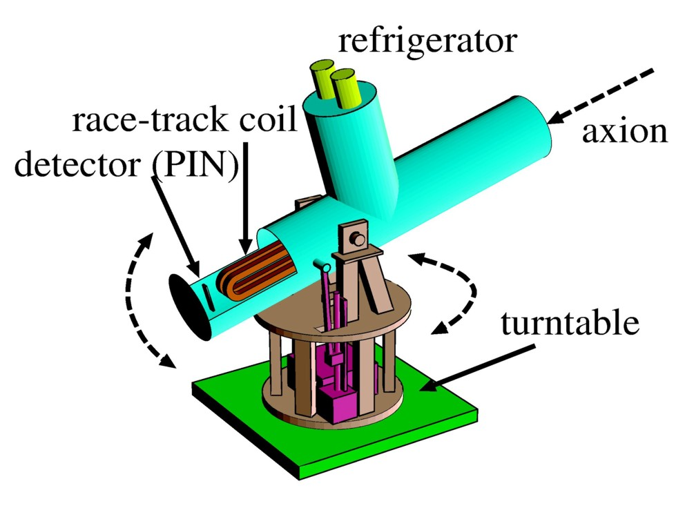
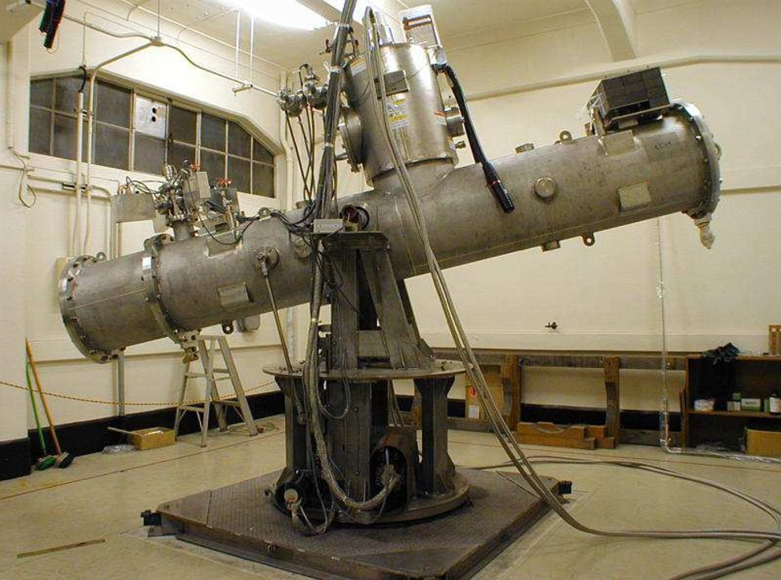
Tokyo Axion Helioscope (“Sumico”)
$\sim \text{3}$ m
Moriyama, Minowa, Namba, Inoue, Takasu & Yamamoto
PLB 434 (1998) 147
Inoue, Akimoto, Ohta, Mizumoto, Yamamoto & Minowa
PLB 668 (2008) 93

Slide 56
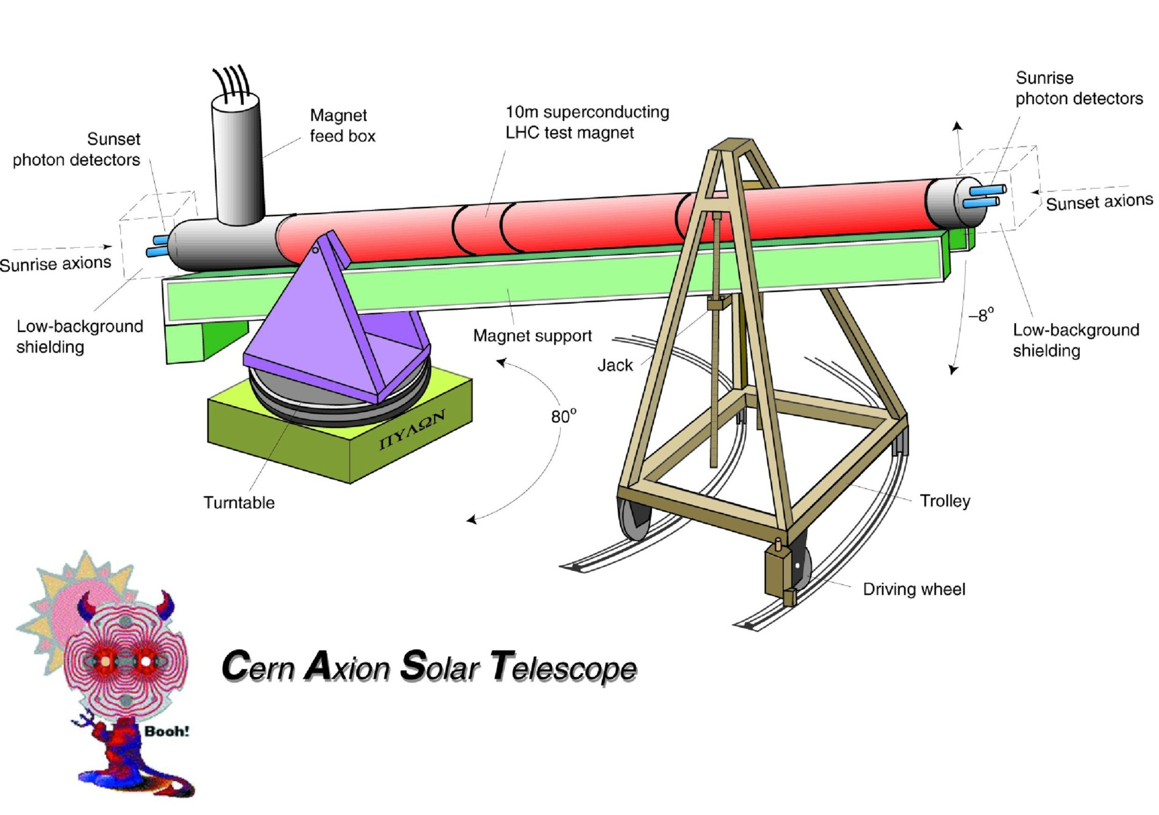
LHC Magnet Mounted as a Telescope to Follow the Sun

Slide 57
CAST at CERN

Slide 58
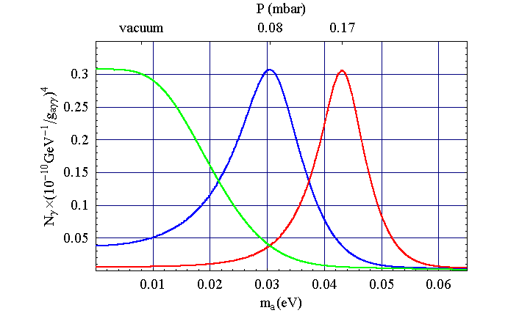
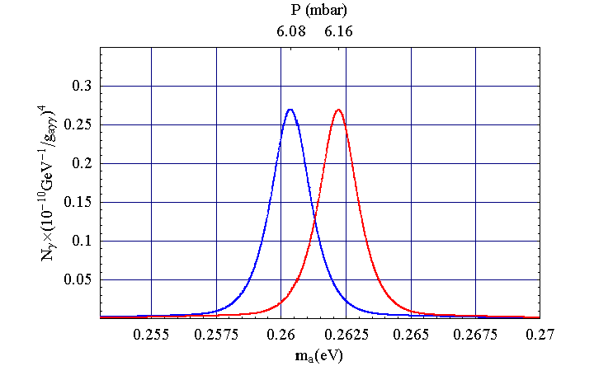
Extending to higher mass values with gas filling
Axion-photon transition probability
$${ P}_{a→γ}={\left(\frac{g_{aγ}B}{q}\right)}^{2}\sin^{2}\left(\frac{qL}{2}\right)$$
Axion-photon momentum transfer
$$q=\left|\frac{m_{a}^{2}−m_{γ}^{2}}{2E}\right|$$
Transition is suppressed for $qL≳1$
Gas filling: Give photons a refractive mass
to restore full transition strength
$${ m}_{γ}^{2}=\frac{4πα}{m_{e}} n_{e}$$
$$m_{γ}=28.9 eV {\left(\frac{Z}{A} ρ_{gas}\right)}^{1/2}$$
He-4 vapour pressure at 1.8 K is
$$ρ≈0.2×{10}^{−3} g cm^{−3}$$
$${ m}_{γ}=0.26 eV$$

Slide 59
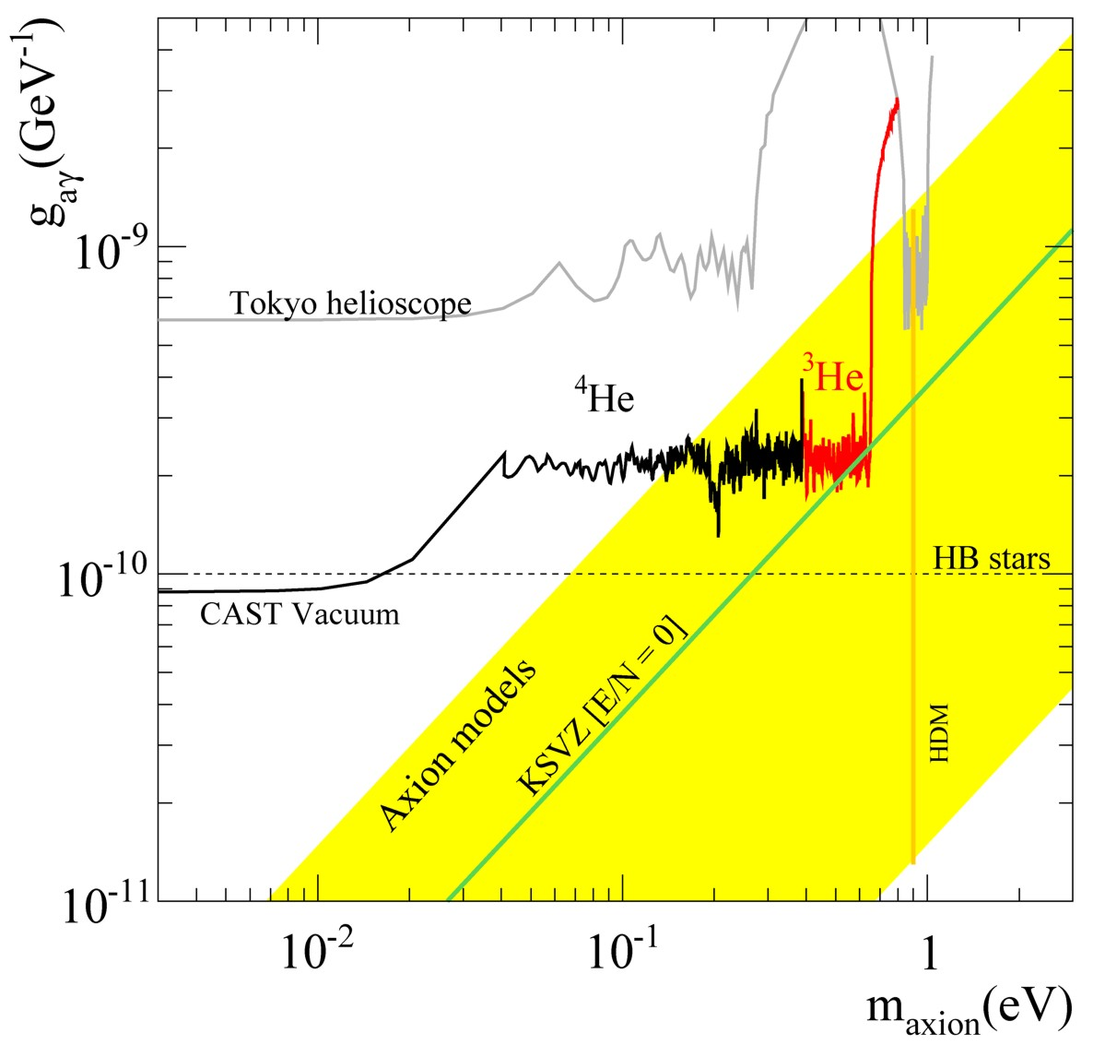
Helioscope Limits
First experimental
crossing of the KSVZ line
CAST-I results: PRL 94:121301 (2005) and JCAP 0704 (2007) 010
CAST-II results (He-4 filling): JCAP 0902 (2009) 008
CAST-II results (He-3 filling): arXiv:1106.3919

Slide 60
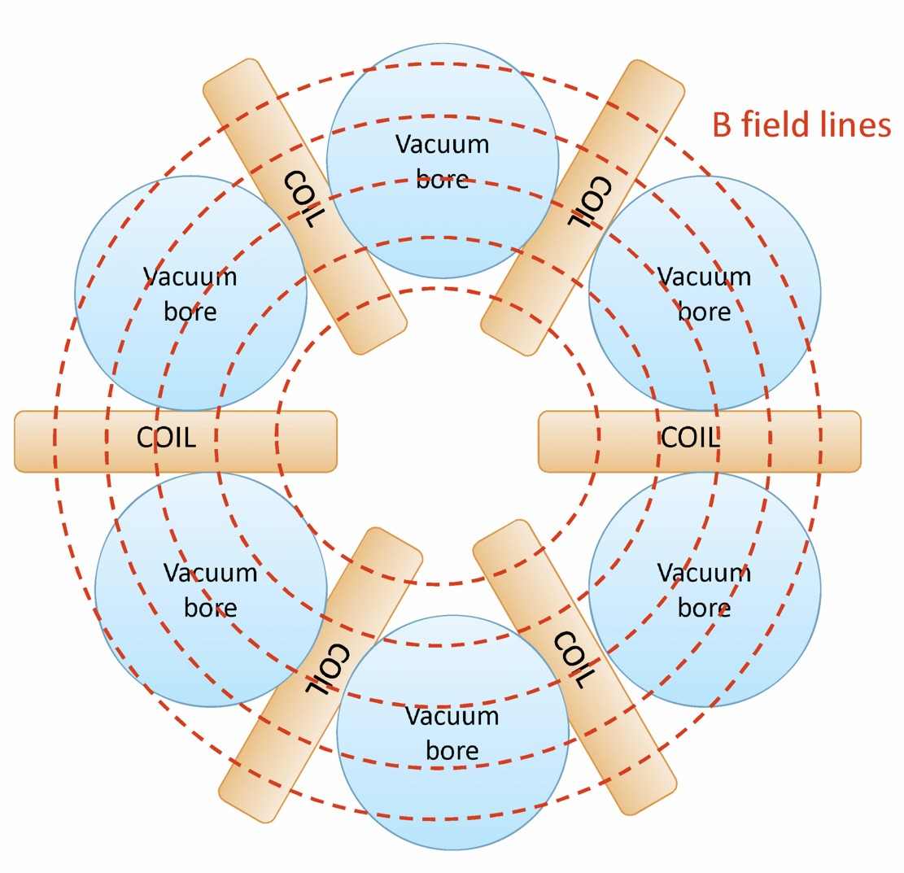
Next Generation Axion Helioscope
CAST has one of the best existing
magnets that one could “recycle”
for axion physics (LHC test magnet)
Only way forward is building a new magnet,
especially conceived for this purpose
Work ongoing, but best option
up to now is a toroidal configuration:
– Much bigger aperture than CAST:
$\sim 1 \text{m}2$ per bore
– Lighter than a dipole (no iron yoke)
– Bores at room temperature
I. Irastorza et al., “Towards a new generation axion helioscope”, arXiv:1103.5334

Slide 61
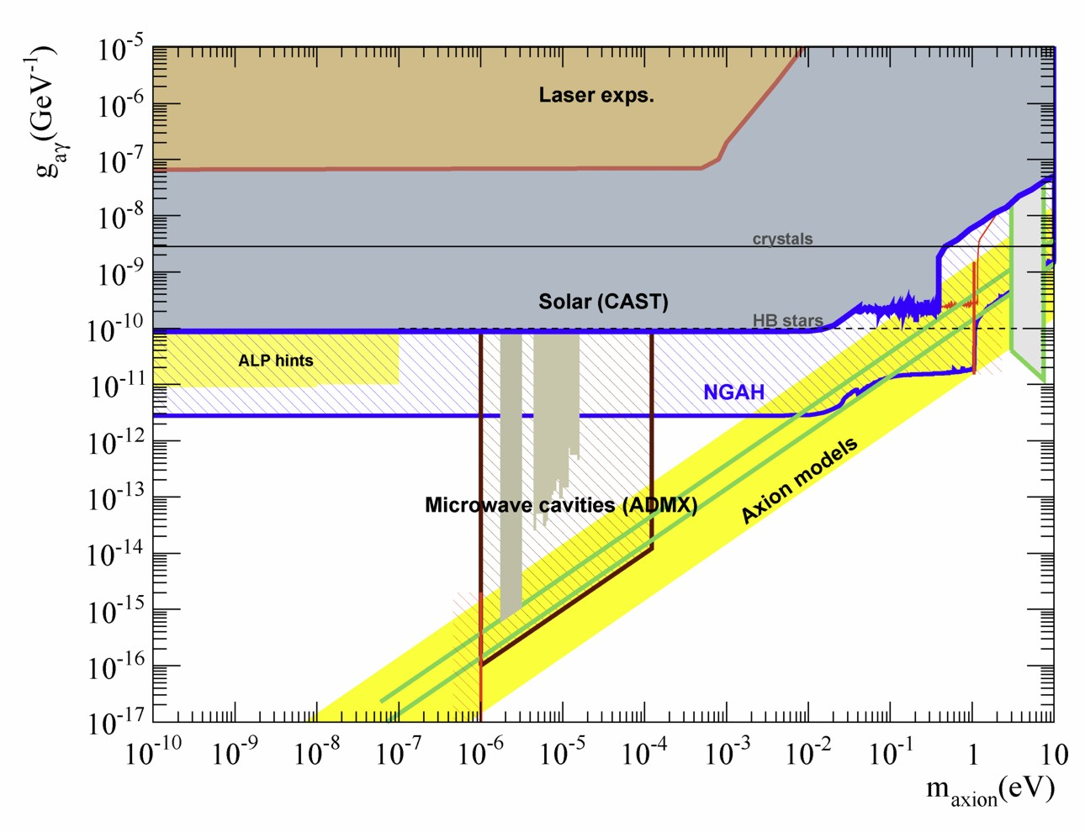
Helioscope Prospects
SN 1987A
Limits

Slide 62
Axions
xions
Cavity Search Experiments

Slide 63
Experimental Tests of Invisible Axions
Magnet — N
Axion field homogeneous on these scales
Primakoff effect:
Axion-photon transition in external
static E or B field
Use cavity to achieve large overlap integral
between photon and axion waves
S

Slide 64
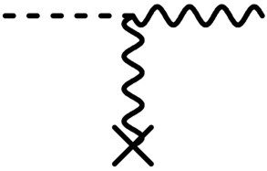
Search for Galactic Axions (Cold Dark Matter)
Dark matter axions
Velocities in galaxy
Energies therefore
m_{a} = 1−100 μeV
v_{a} ≈ 10⁻³ c
E_{a} ≈ (1 ± 10⁻⁶) m_{a}
Microwave Energies
(1 GHz ≈ 4 μeV)
Axion Haloscope (Sikivie 1983)
Axion Signal
Power
B_{ext} ≈ 8 Tesla
Thermal noise of
cavity & detector
Microwave
Resonator
Q ≈ 10⁵
Frequency
m_{a}
Power of galactic axion signal
Primakoff Conversion
a
γ
$$4×{10}^{−21}\text{W} \frac{V}{0.22 {\text{m}}^{3}} {\left(\frac{B}{8.5 \text{T}}\right)}^{2}\frac{Q}{{10}^{5}}×\left(\frac{m_{a}}{2π \text{GHz}}\right) \left(\frac{ρ_{a}}{5×{10}^{−25} {\text{g}\text{/}\text{cm}}^{3}}\right)$$
Cavity
overcomes
momentum
mismatch
B_{ext}

Slide 65
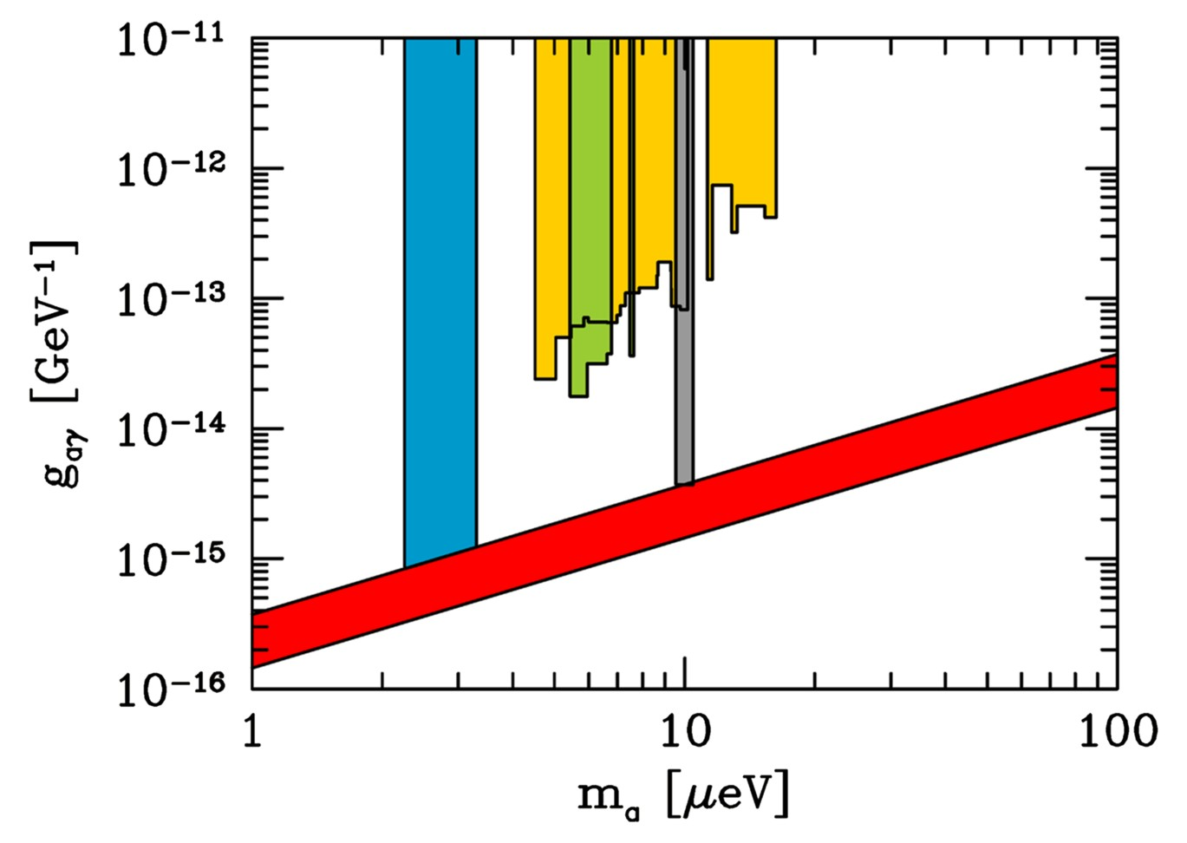
Axion Dark Matter Searches
Limits assuming axions are the galactic dark matter with standard halo
1. Rochester-Brookhaven-
Fermilab,
PRD 40 (1989) 3153
3
2
1
2. University of Florida
PRD 42 (1990) 1297
KSVZ
4
3. US Axion Search
ApJL 571 (2002) L27
DFSZ
4. CARRACK I (Kyoto)
hep-ph/0101200

Slide 66
ADMX Hardware
Gianpaolo Carosi, Talk at Fermilab (May 2007)

Slide 67
SQUID Microwave Amplifiers in ADMX
Gianpaolo Carosi, Talk at Fermilab (May 2007)

Slide 68
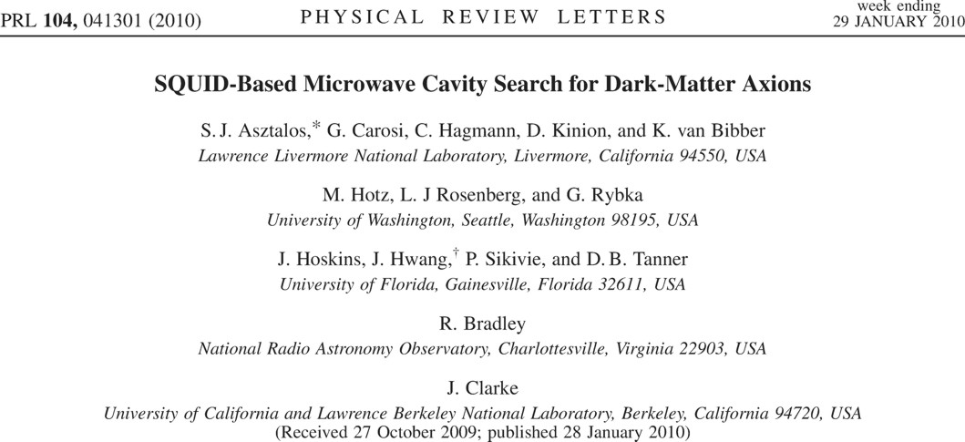
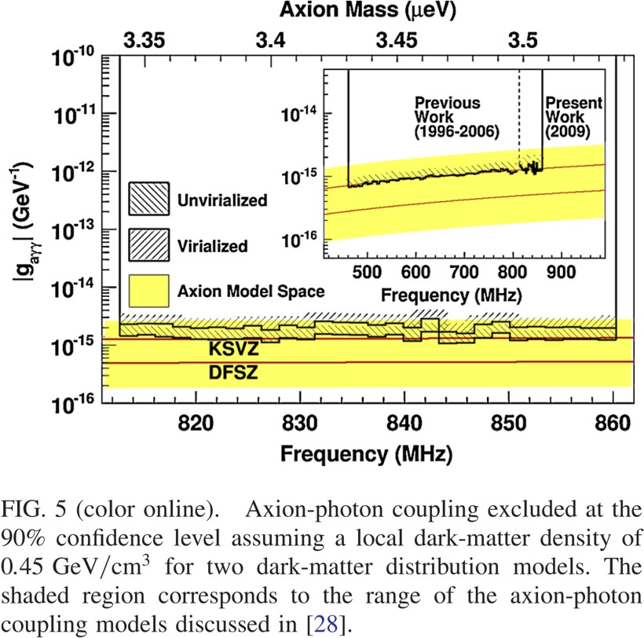
ADMX phase I: First-year science data (2009)

Slide 69
ADMX Moves to University of Washington

Slide 70
ADMX Schedule

Slide 71
ADMX Reach

Slide 72
Axion Dark Matter Searches
Limits assuming axions are the galactic dark matter with standard halo
1. Rochester-Brookhaven-
Fermilab,
PRD 40 (1989) 3153
3
2
1
2. University of Florida
PRD 42 (1990) 1297
KSVZ
4
3. US Axion Search
ApJL 571 (2002) L27
DFSZ
4. CARRACK I (Kyoto)
hep-ph/0101200
ADMX search range (2015+)

Slide 73
Axion Bounds
[GeV] f_{a}
10³
10⁶
10⁹
10¹²
10¹⁵
keV
eV
meV
μeV
neV
m_{a}
Experiments
Tele
scope
CAST
search range
ADMX
search range
Too much
hot dark matter
Too much cold dark matter
(classic scenario)
Globular clusters
(a-γ-coupling)
Classic
region
Anthropic
region
Too many
events
Too much
energy loss
SN 1987A (a-N-coupling)

Slide 74
R & D for Higher-Frequency Cavities

Slide 75
And if the axion be found?
Karl van Bibber
at IDM 2008

Slide 76
Axion Infall
Karl van Bibber
at IDM 2008

Slide 77
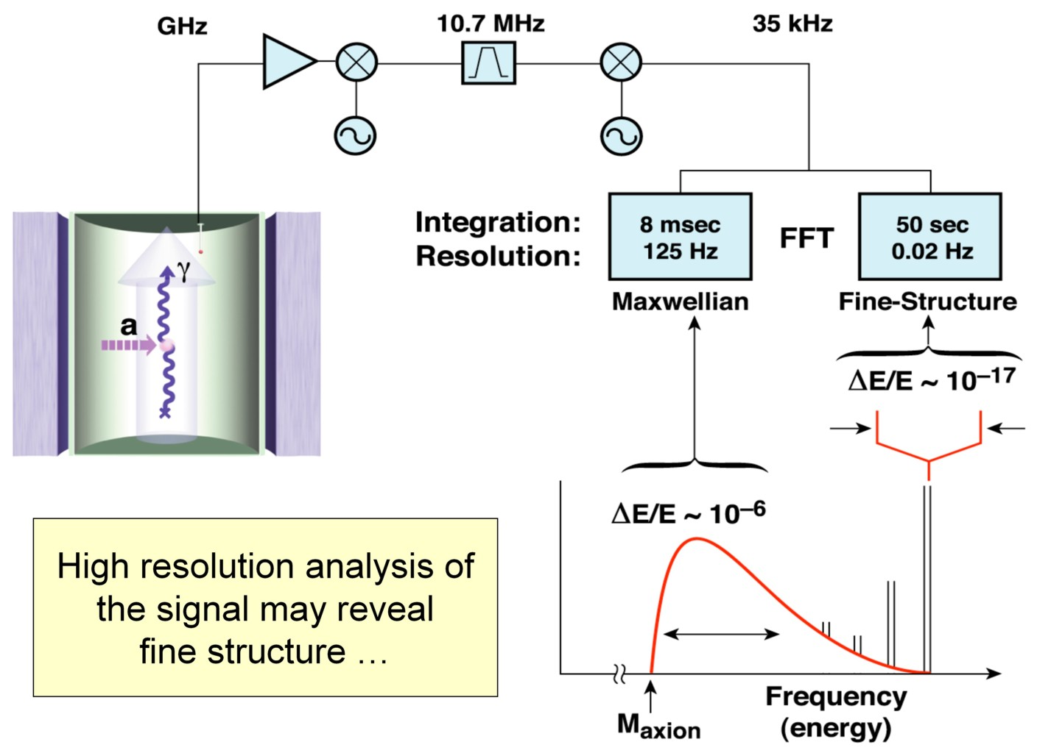
Fine Structure in the Axion Spectrum
Axion distribution on a 3-dim sheet in 6-dim phase space
Is “folded up” by galaxy formation
Velocity distribution shows narrow peaks that can be resolved
More detectable information than local dark matter density
P.Sikivie
& collaborators

Slide 78
Summary
Peccei-Quinn dynamical CP symmetry restoration is better
motivated than ever and provides an excellent CDM candidate
Realistic full-scale search in “classic window” ($ma \sim$1−100 μeV)
is finally beginning (ADMX and New CARRACK)
Isocurvature fluctuations could still show up
(Planck, future CVL probe)
CAST solar axion search almost complete and has crossed into
hot dark matter region. No axions found, new limits.
Hint for additional cooling in white dwarfs by axions?
Leads to significant diffuse supernova axion background (DSAB).
Parameters testable with Next Generation Helioscope?

Slide 79
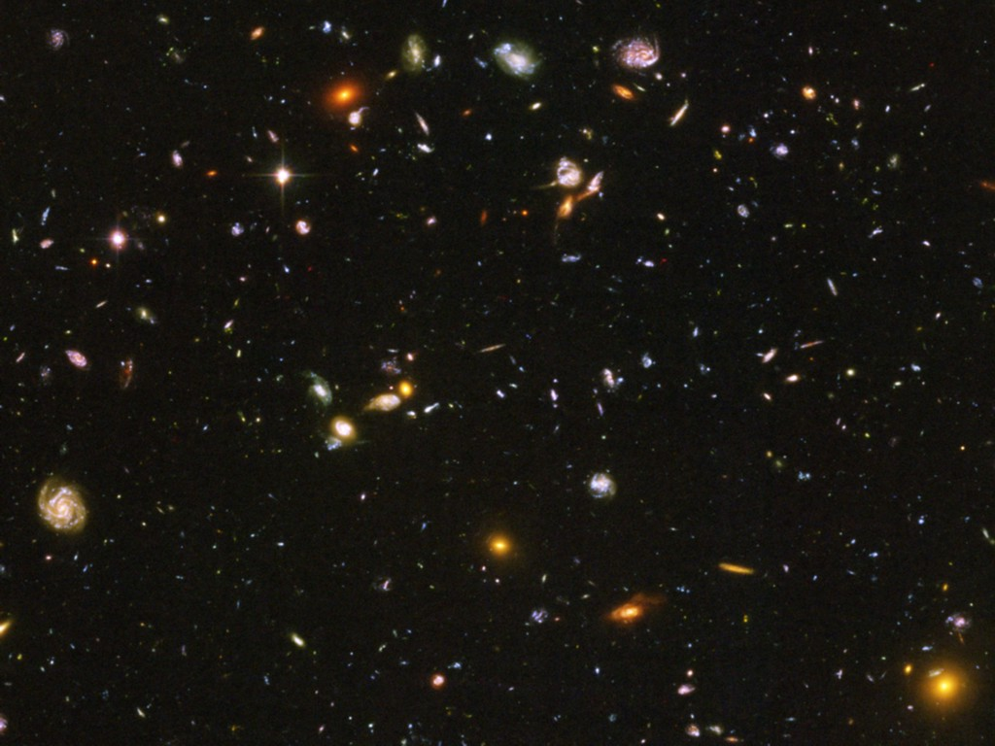
Pie Chart of Dark Universe
Dark Energy 73%
(Cosmological Constant)
Neutrinos
0.1−2%
Ordinary Matter 4%
(of this only about
10% luminous)
Dark Matter
23%

