Slide 1
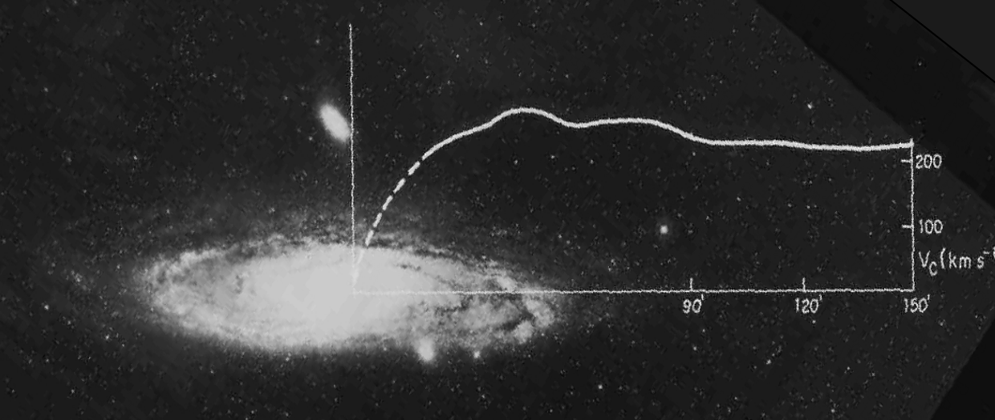
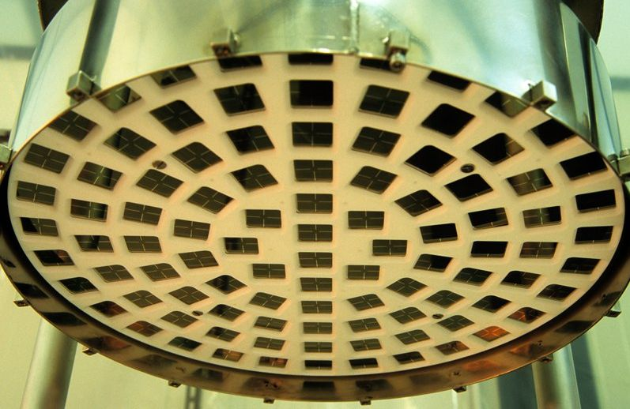
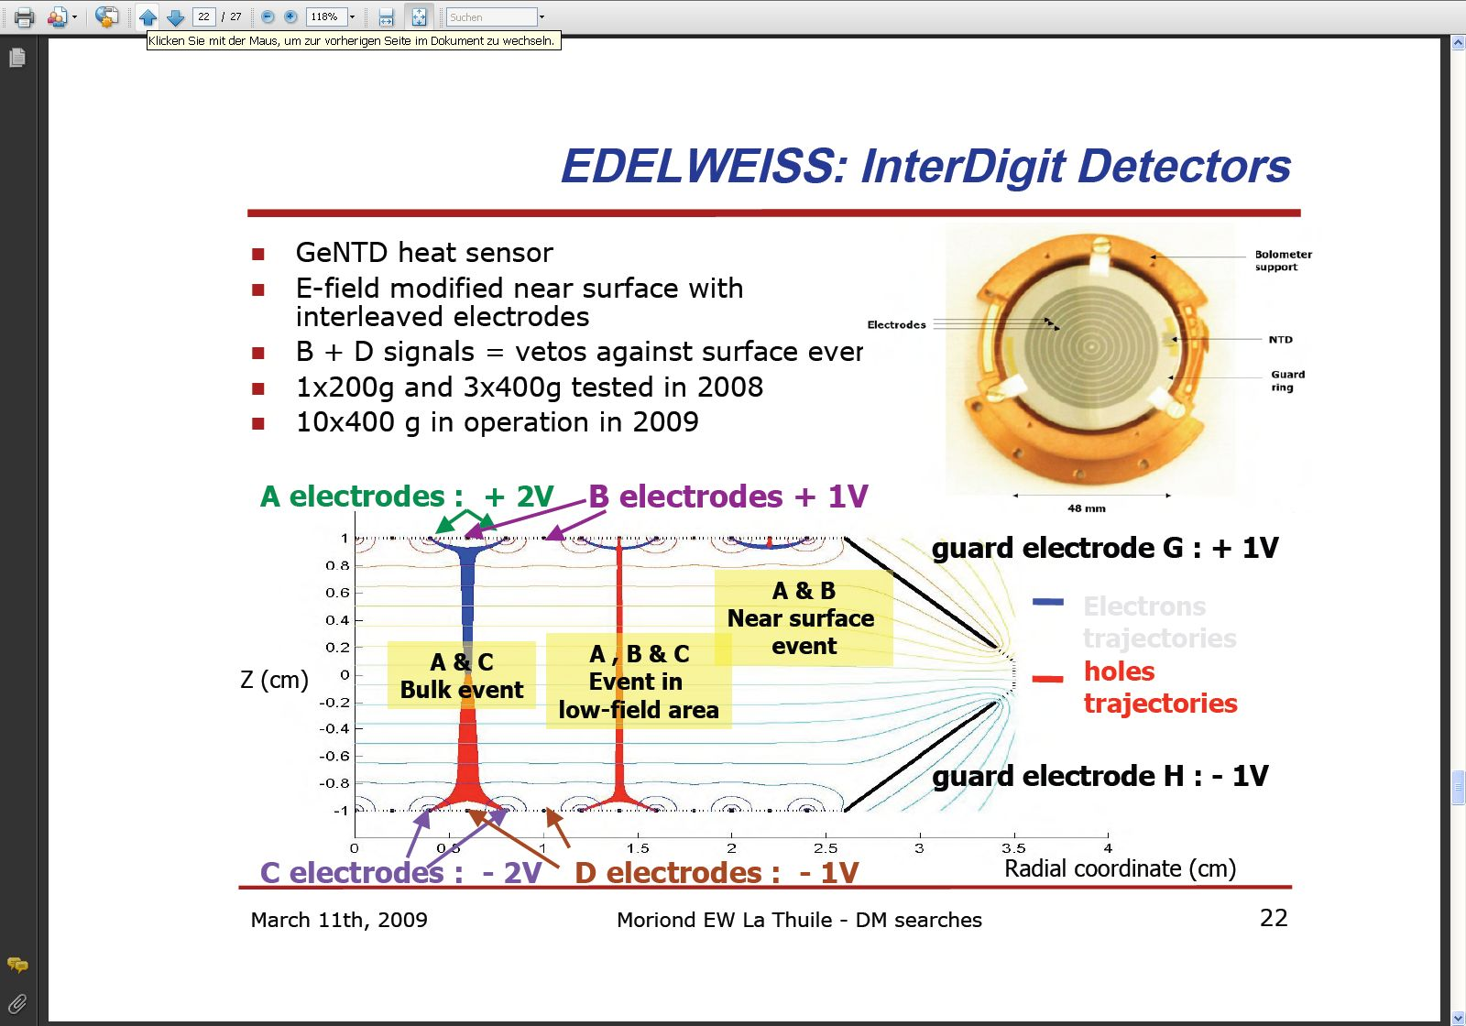
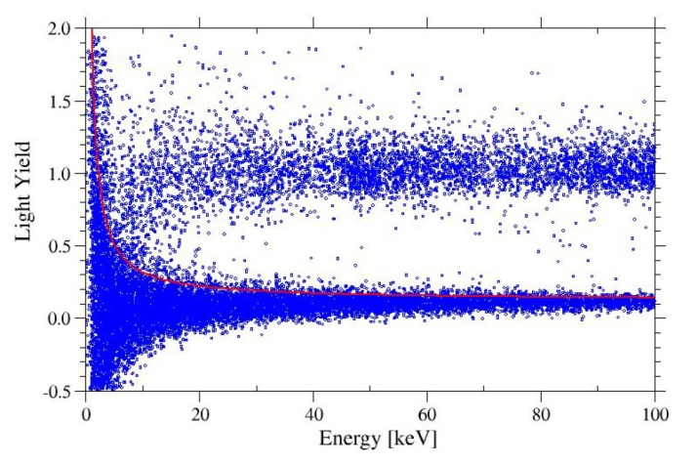
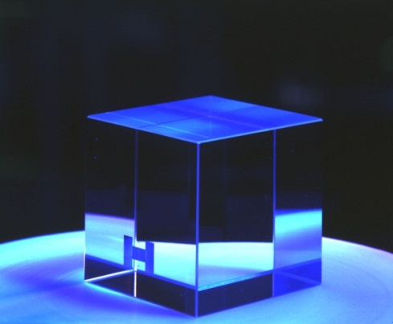
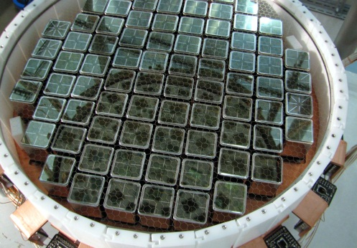
Direct Search for Particle Dark Matter
χ

Slide 2
Direct Search for Particle Dark Matter
Dark Matter - Physics beyond the Standardmodel
Direct Searches - Basics
Detection Methods - Ionisation early DM projects, 2β0ν Exp.
- Scintillation DAMA / LIBRA
- Calorimetry CRESST
The Background Challenge
Charge - Phonon - CDMS
- EDELWEISS
Light - Phonon - CRESST
Charge - Light - XENON
- other Xenon and Argon projects
Superheated Droplets
Dark Matter – Status – Future - Summary
χ

Slide 3
Direct Search for Particle Dark Matter
Dark Matter - Physics beyond the Standardmodel
Direct Searches - Basics
Detection Methods - Ionisation early DM projects, 2β0ν Exp.
- Scintillation DAMA / LIBRA
- Calorimetry CRESST
The Background Challenge
Charge - Phonon - CDMS
- EDELWEISS
Light - Phonon - CRESST
Charge - Light - XENON
- other Xenon and Argon projects
Superheated Droplets
Dark Matter – Status – Future - Summary
χ

Slide 4
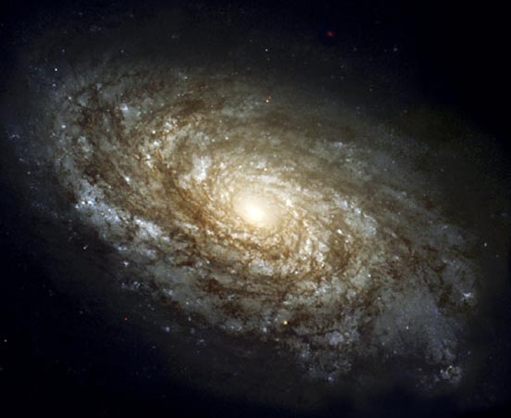
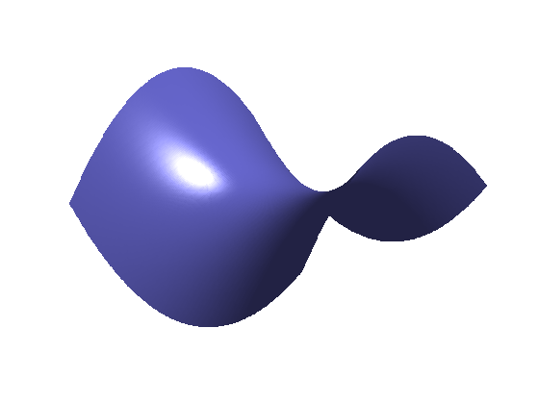
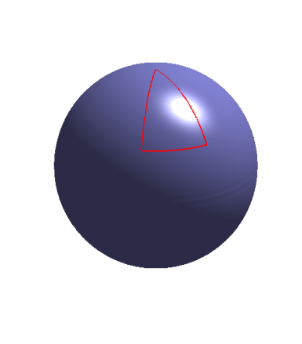
Suche nach der Dunklen Materie
im Universum
Mass- (Energy-) Density Ω of the Universe ?
= 1 critical density
flat universe
(euklidian geometry)
Size of the Universe
Ω < 1
Ω > 1
Time
Time
5 GeV / m³
5 protons / m³
5 keV / cm³
curved universe (space)
visible matter Ω_{visible}~ 0.01
curvature ~ Ω -1

Slide 5
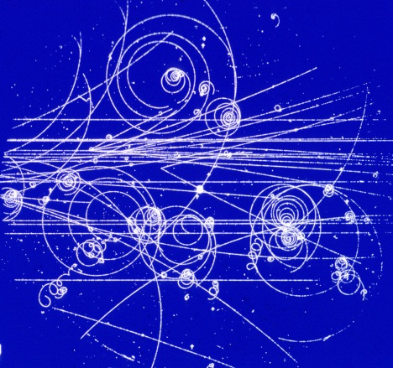
‘Standardmodel’ of Cosmology
Dark Energy Ω_{vac} = 73 %
Dark Matter Ω_{mat} = 23 %
normal Matter Ω_{mat} = 4%
How does it fit to the
Standardmodel of Particle Physics

Slide 6
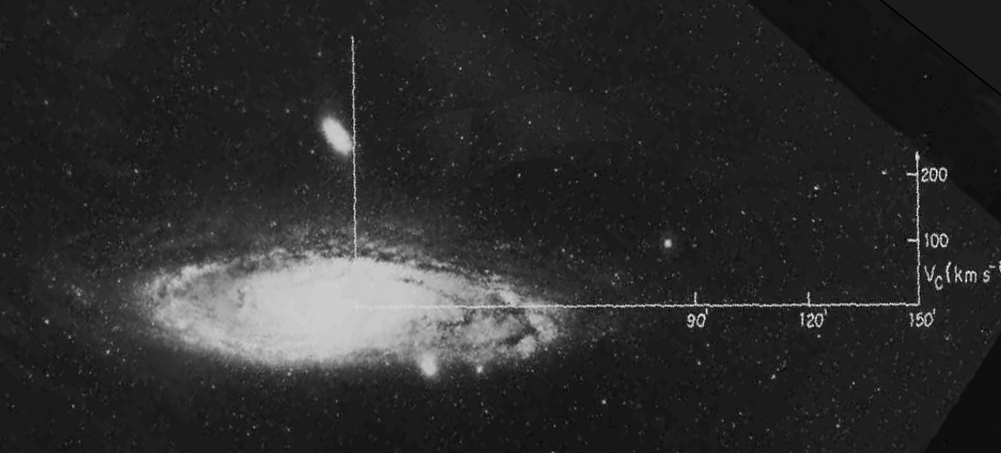

Dark Matter - Evidence
rotation curves
(orbital speed vs radius)
of galaxies
orbital
velocity
Keplers‘s Law
~
1
a
distance to center
=> Dark Matter halo in galaxy
Ω _{Mat} >
there must be more matter in the universe than we see

Slide 7
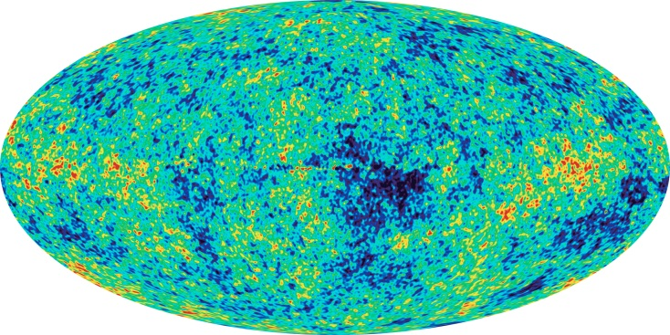
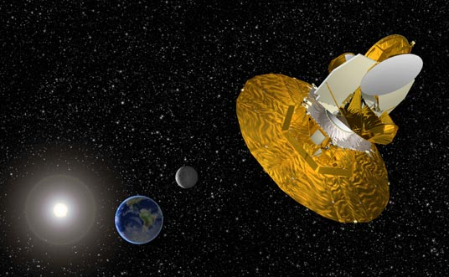
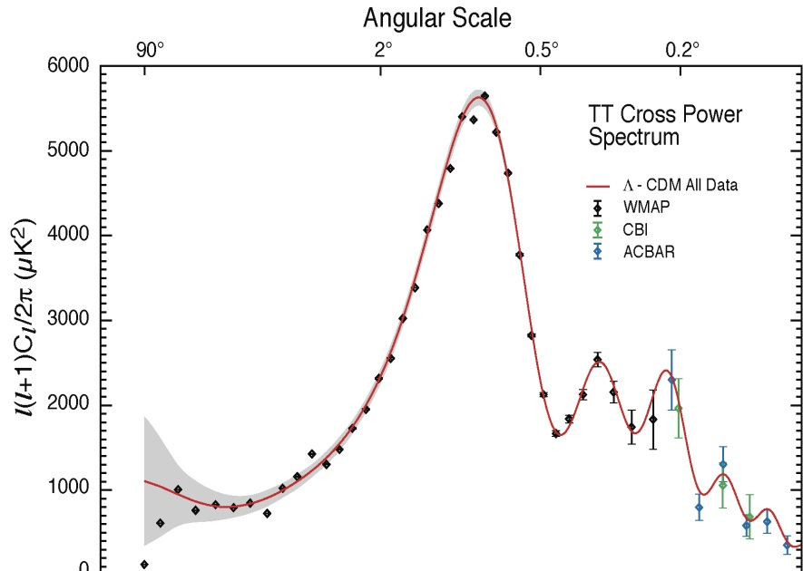
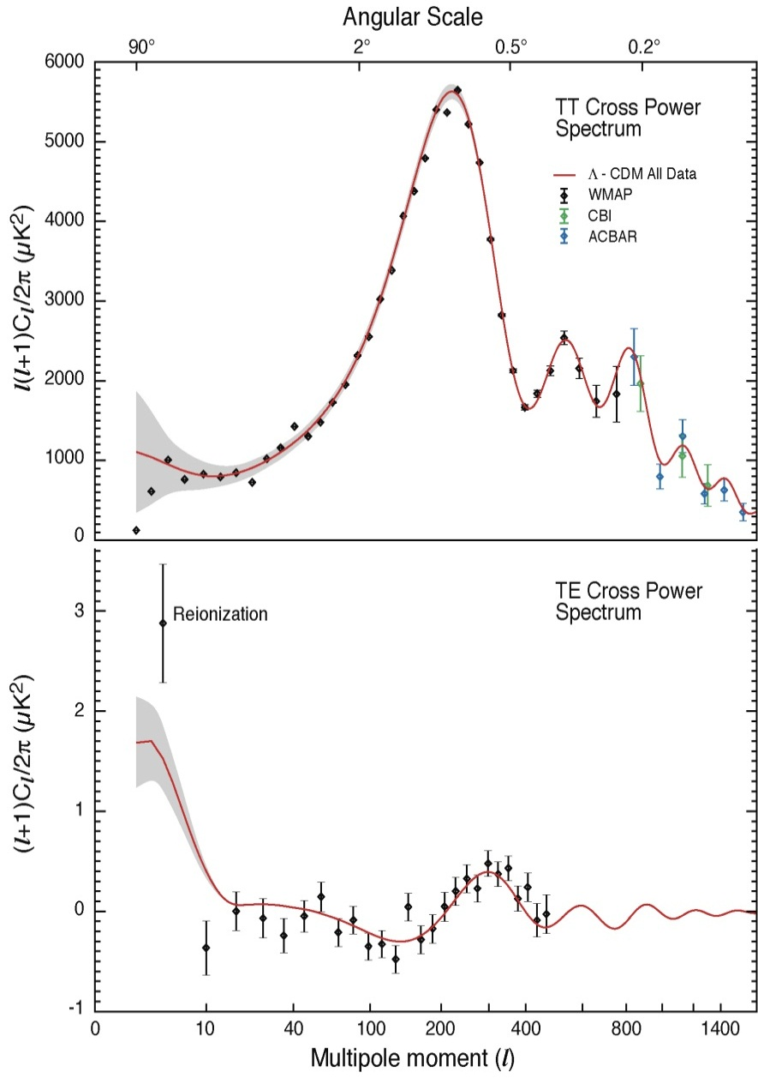
Cosmic Microwave Background – Matter-Density Ω_{matter}
Anisotropy:
Angular scale => geometry, Ω_{tot}
Intensities => gravitational potentials,
matter densities
Wilkinson
- gravitation Ω_{matter}
- coupling to radiation Ω_{baryon}
Microwave
Anisotropy
Probe
Ω_{matter} = 0.27
Ω_{tot}=1
=> Ω_{matter} >Ω_{lum} ̰ ~ 0.01
mostly Dark Matter
Ω_{baryon} = 0.044
u
d
e
=> Ω_{matter} >> Ω_{baryon}

Slide 8
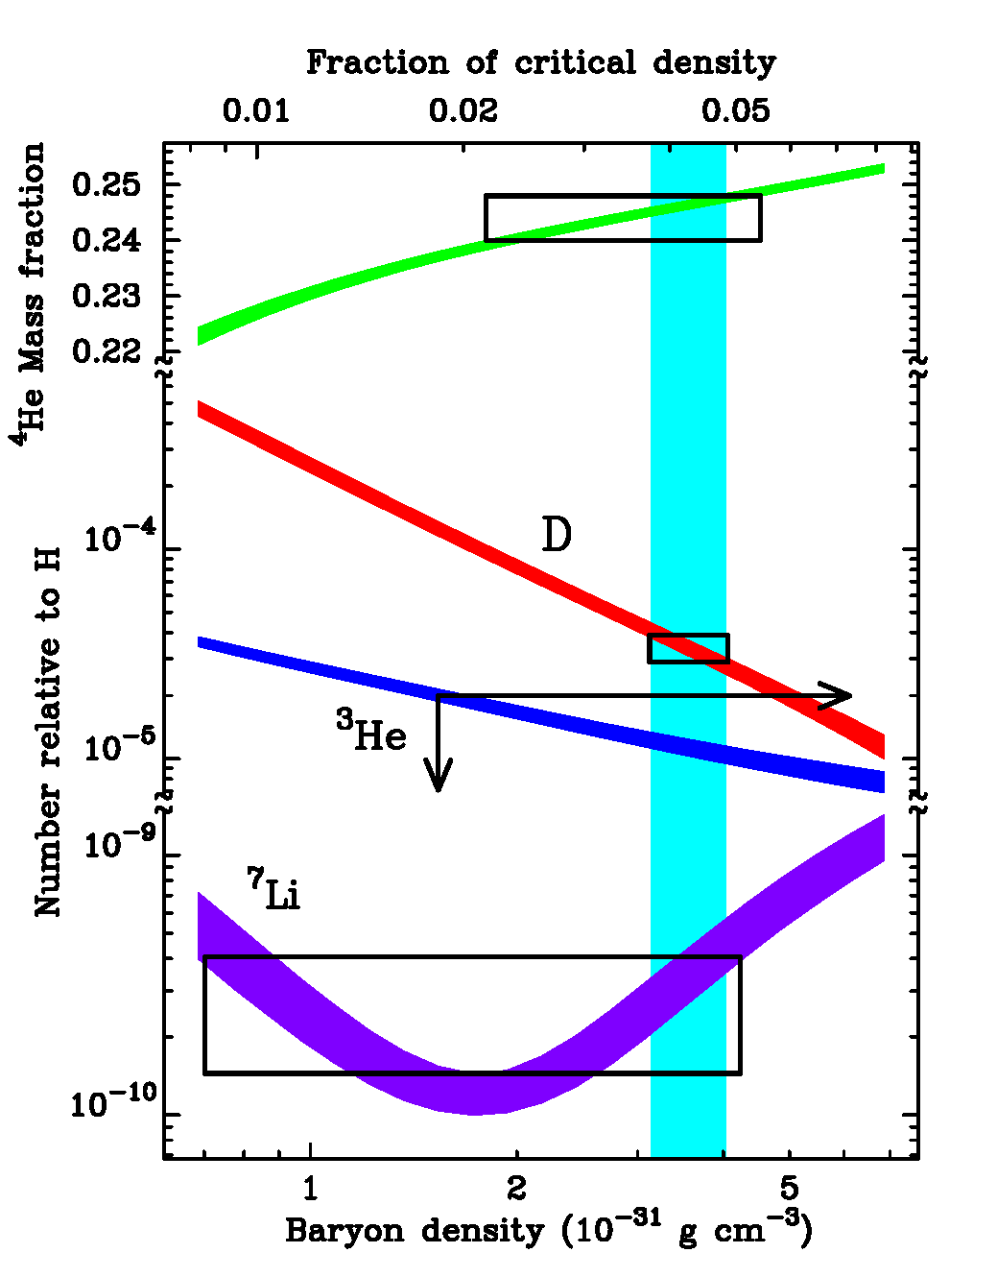


Dark Matter is (mostly) NOT Baryons
todays ratio between
neutron-and proton-density
= n/p-ratio at the time
nuclei formed
depends on baryon (p&n)-density
→ light element abundance
(He, D, 3He) → n/p-ratio
He
light elements → baryon density
(0.01)
(0.30)

Slide 9
Formation of Structure in the Universe
an overdense
cloud collapses
by Gravity
if sound travels
through cloud
faster
than collapse time
Oscillations,
but not collapse
structure formation
needs a minimum
cloud size
Jeans mass
time
Scale
for
collapse
free fall time
as lighter particles making up a cloud,
as larger is Jeans mass, as more are small scales suppressed

Slide 10
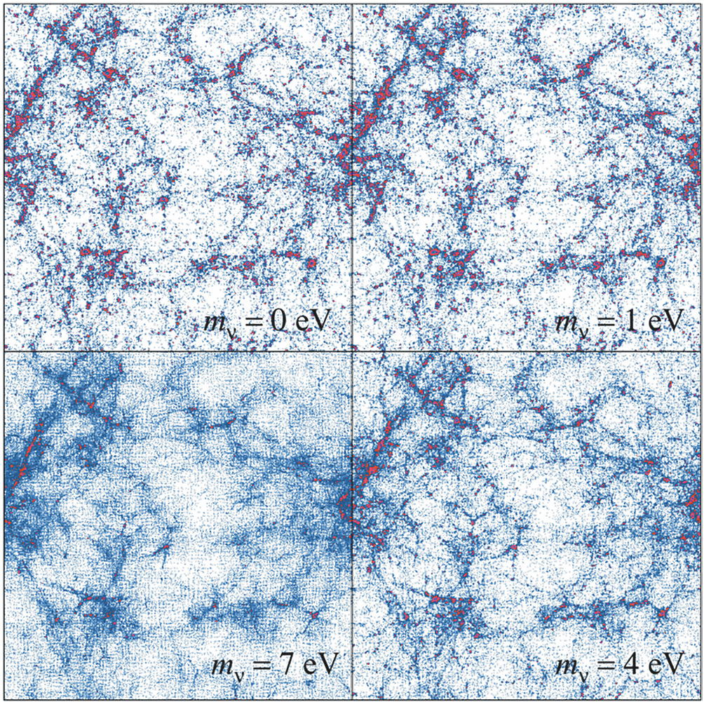
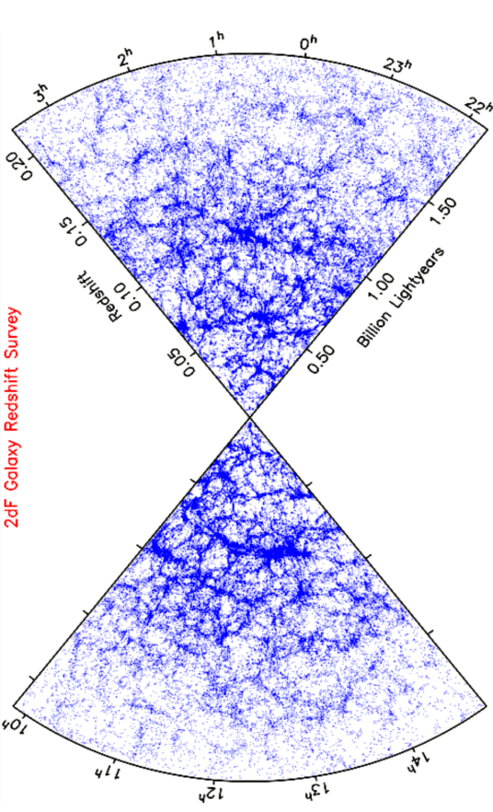
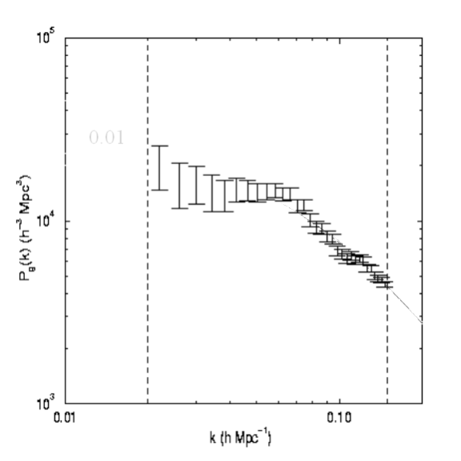
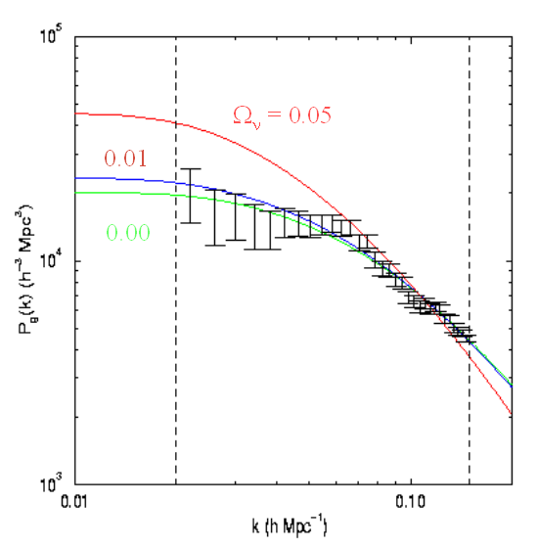
Dark Matter is (mostly) NOT Neutrinos
Why
not
Neutrinos ?
Ω_{matter} ~ 0.30
Ω_{ν} < 0.02
Ω_{ν}
< 0.02
mν_{i} < 1.2eV

Slide 11
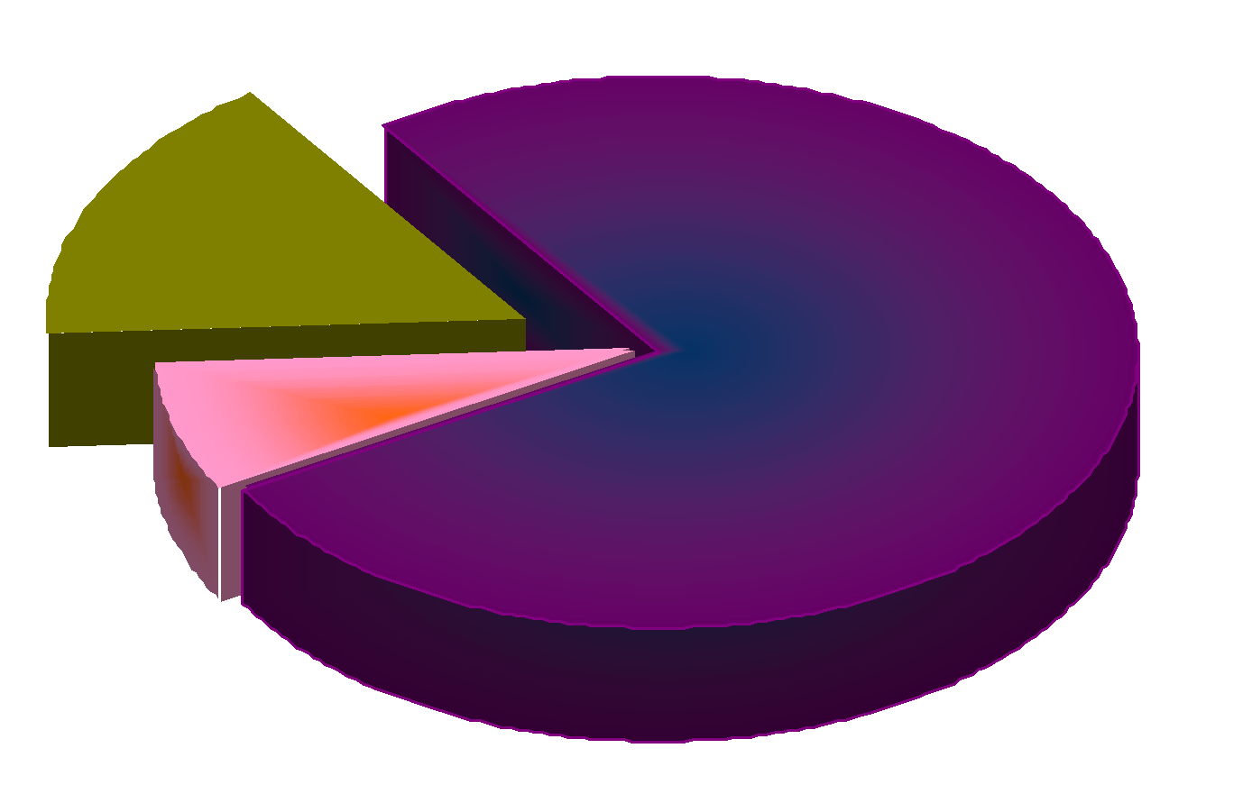
Dark Matter – Standardmodel is running out of Particles
‘ν too light‘ =>
most of the
Dark Matter
is cold
of so far unknown
weakly interacting,
massive particles
WIMPs
(50GeV~1000GeV
Neutralino?)
or
AXIONs
Ω_{mat} = 0.27
u
‘normal‘
baryonic matter
0.04
d
e
?
0.001 < ν < 0.02
(HDM)
ν_{e}
cold
Dark Matter
(CDM)
0.23
from ν−oscillations
=> Σm_{ν} > 0.05eV

Slide 12
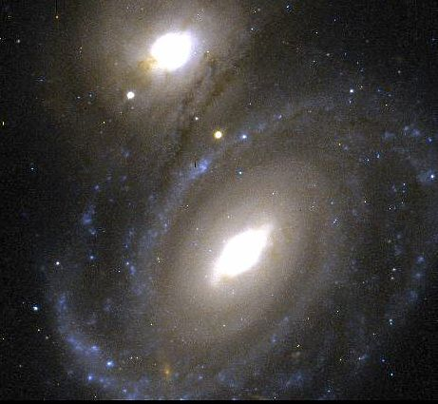
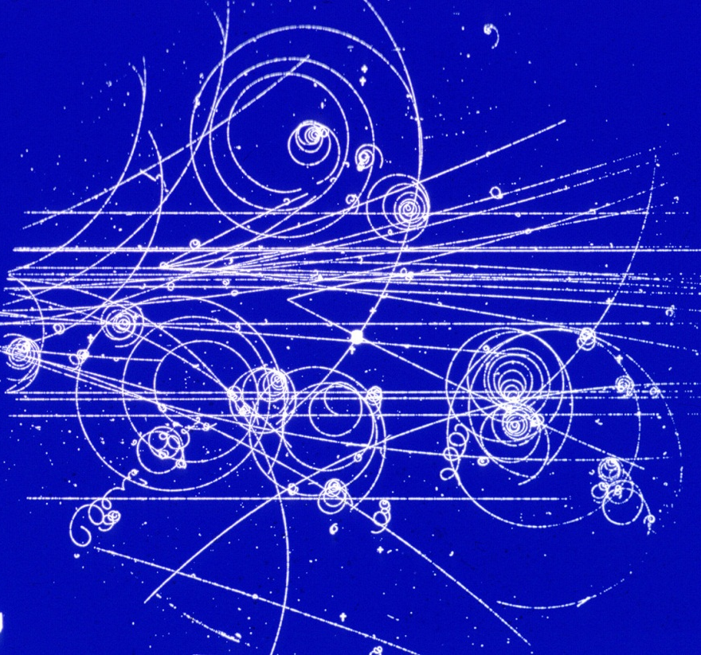

Dark
Matter
search for
physics beyond
the Standard Model
~85% of the mass Ω_{mat} of the
universe is unknown
non-baryonic
observations in
Cosmology
Particle Physics
new elementary particles
QCD: Axions
supersymmetry: Neutralinos
Gravitino
→ perfect particle Dark Matter candidates (WIMP)

Slide 13


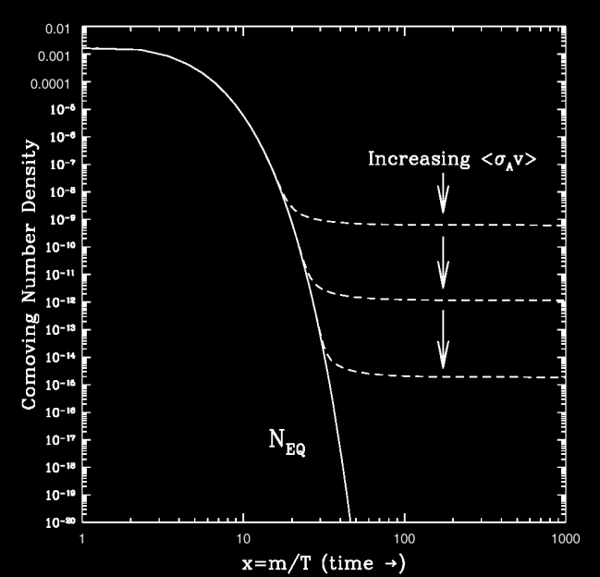

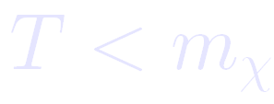

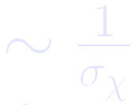


Elementary Particles in the early Universe – Thermal Relics
as long as
:
density
is constant
as soon as
:
density
falls exponentially
if expansion rate of the universe
grows larger than
annihilation rate
´Freeze Out´density
for
=>
of the order of weak interaction

Slide 14
Direct Search for Particle Dark Matter
Dark Matter - Physics beyond the Standardmodel
Direct Searches - Basics
Detection Methods - Ionisation early DM projects, 2β0ν Exp.
- Scintillation DAMA / LIBRA
- Calorimetry CRESST
The Background Challenge
Charge - Phonon - CDMS
- EDELWEISS
Light - Phonon - CRESST
Charge - Light - XENON
- other Xenon and Argon projects
Superheated Droplets
Dark Matter – Status – Future - Summary
χ

Slide 15
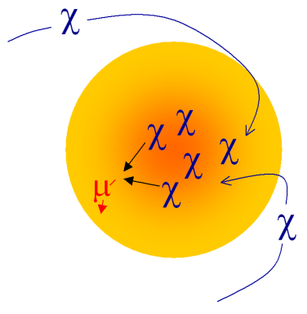
WIMP Detection
χ
direct detection
indirect detection

Slide 16

WIMP Indirect Detection
WIMP over-density in
sun, earth or galactic center
χ
ν_{μ}
χ
χ
χ
χ
search high energy products
from WIMP anihilation
μ
χ
χ

Slide 17
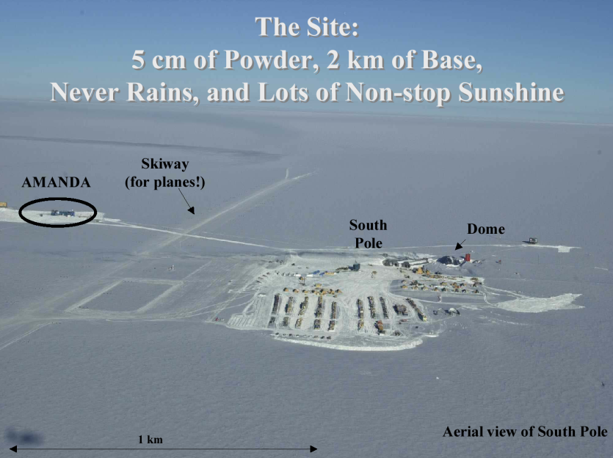
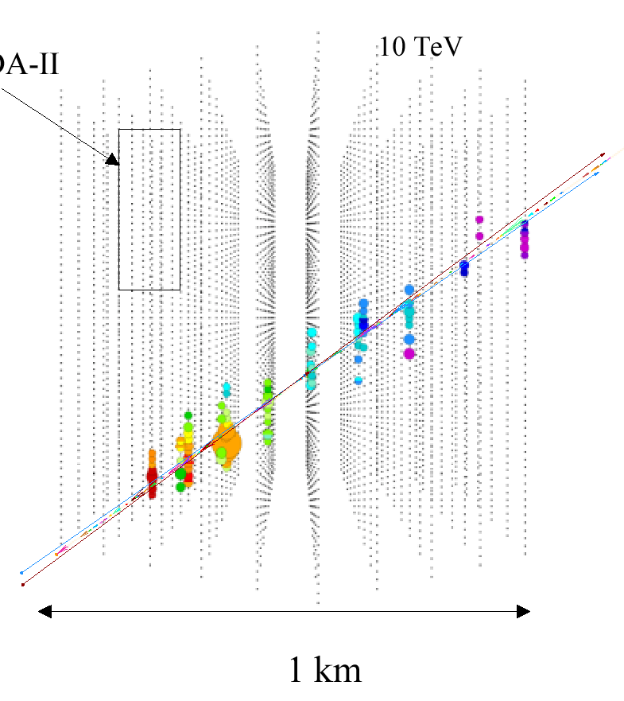
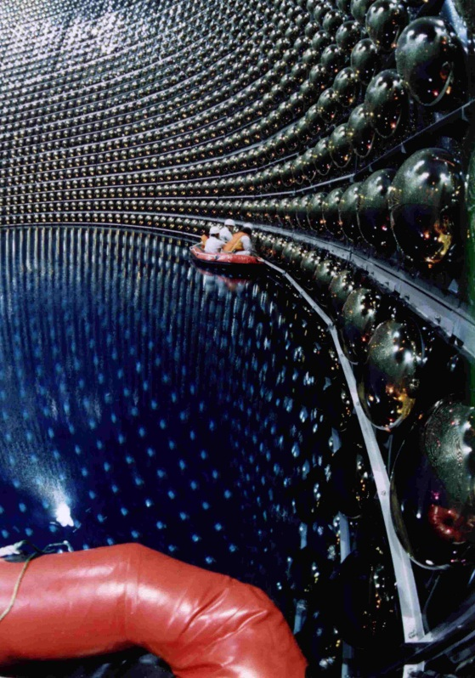
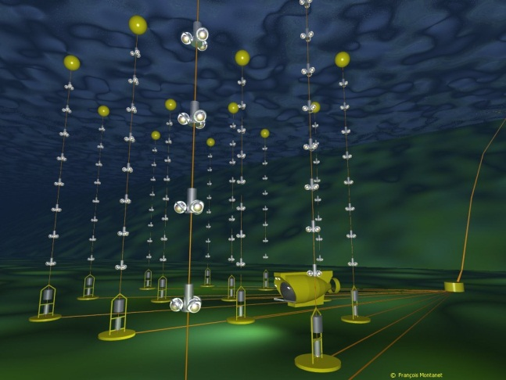
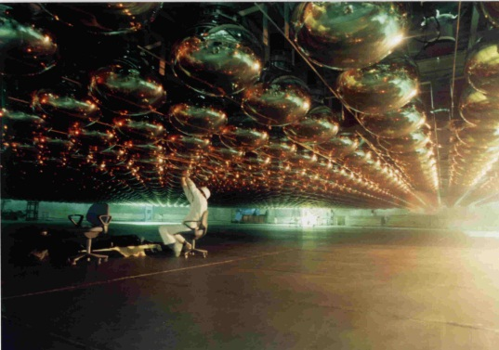
WIMP Indirect Detection
- Neutrino Telescopes
in ice
AMANDA at the South pole
μ
SuperK
upward-going
muons
ANTARES; NESTOR
in the Mediterranean
in water
ν_{μ}

Slide 18
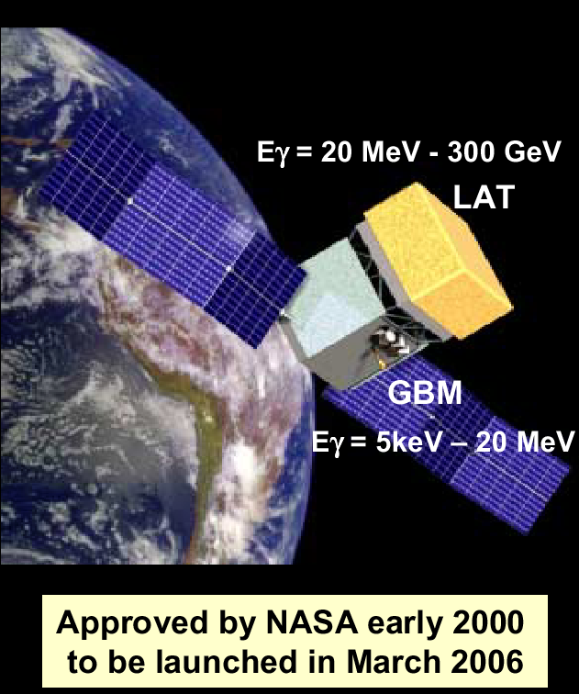
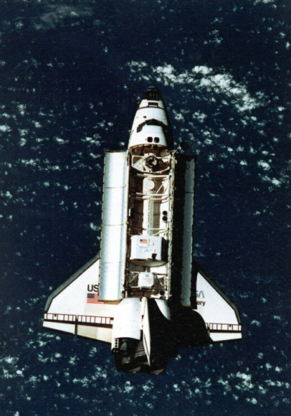
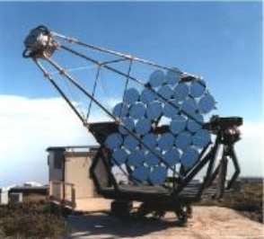
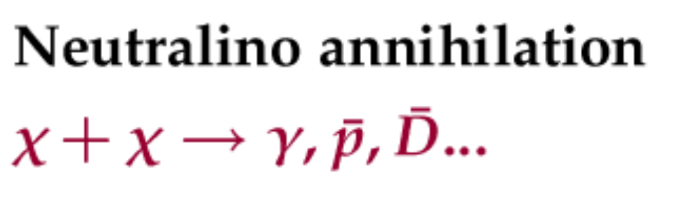
High Energy γ-Rays from the Galactic Center, or high energy gamma background
γ-ray satellites: EGRET, GLAST, ...
GLAST
γ-ray telescopes: HESS, MAGIC, ...
Anti-Matter from WIMP annihilation:
Antimatter (Anti-Deuteron)
Searches: AMS, PAMELA, ...

Slide 19

WIMP - Direct Detection
Weakly Interacting Massive Particles = WIMPs
elastic scattering on nuclei
if WIMP annihilates to fermions, it will scatter on fermions
may be even coherently on all quarks in a nucleus
nuclear recoils:
WIMP from galactic halo
relative speed ~ 270 km/sec
χ
nucleus in your detector

Slide 20
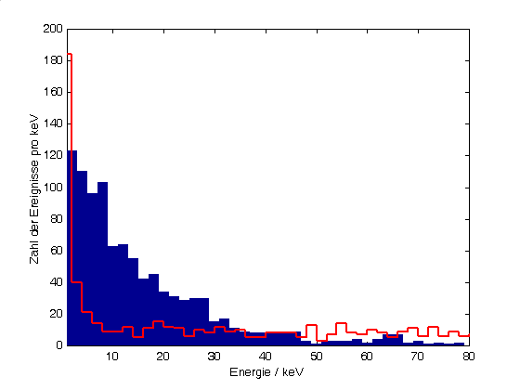
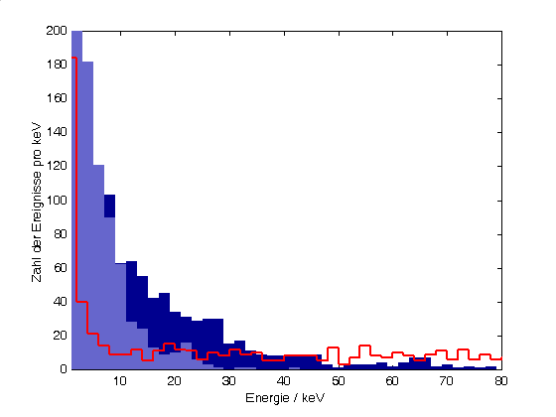
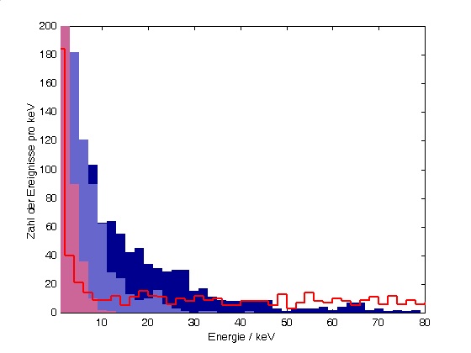
WIMP recoil spectrum
Quenchingfaktor = 0.3 (Ge-Ionisation)
background signals
detector energy threshold

Slide 21
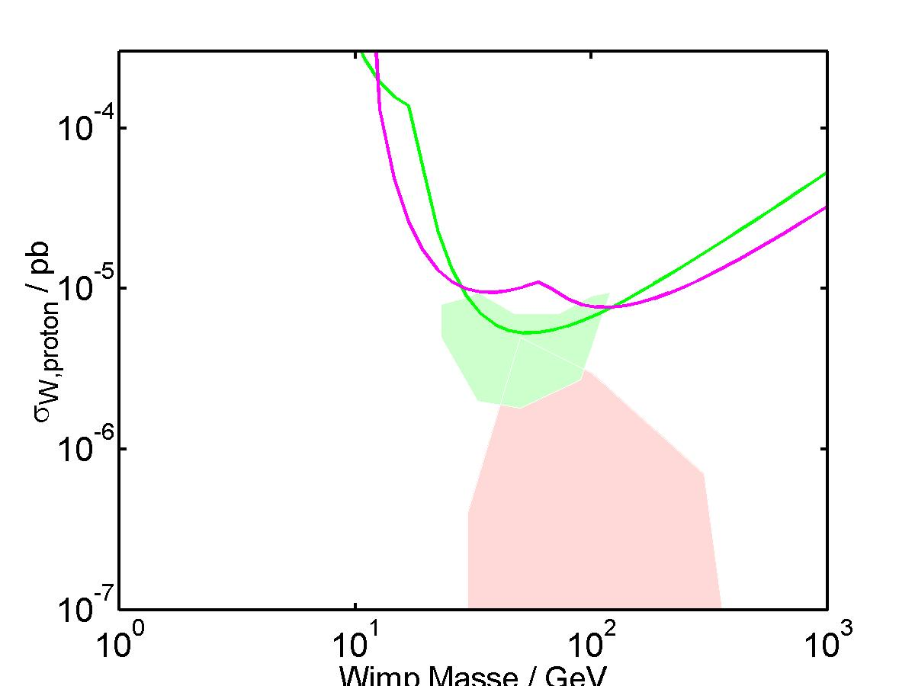
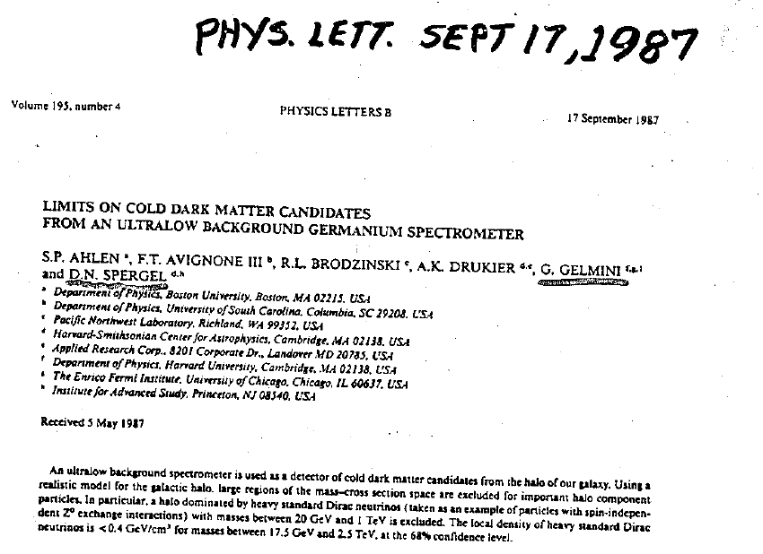
Direct WIMP Search - Sensitivity
Quenchingfaktor = 0.3 (Ge-Ionisation)
lower threshold
background signals
nreduce background
detector energy threshold

Slide 22

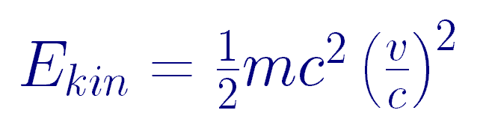
WIMP - Direct Detection
Weakly Interacting Massive Particles = WIMPs
elastic scattering on nuclei
in a detector
nuclear recoils:
Mass 50 GeV - ~ 1000 GeV
speed relative to earth 270 km/s
( ~ our orbital speed around galactic center )
χ
WIMP and nuclei have similar mass
=> ist like billiard: maximum energy transfer ~ WIMP kinetic energy
some
some

Slide 23
Direct Search for Particle Dark Matter
Dark Matter - Physics beyond the Standardmodel
Direct Searches - Basics
Detection Methods - Ionisation early DM projects, 2β0ν Exp.
- Scintillation DAMA / LIBRA
- Calorimetry CRESST
The Background Challenge
Charge - Phonon - CDMS
- EDELWEISS
Light - Phonon - CRESST
Charge - Light - XENON
- other Xenon and Argon projects
Superheated Droplets
Dark Matter – Status – Future - Summary
χ

Slide 24
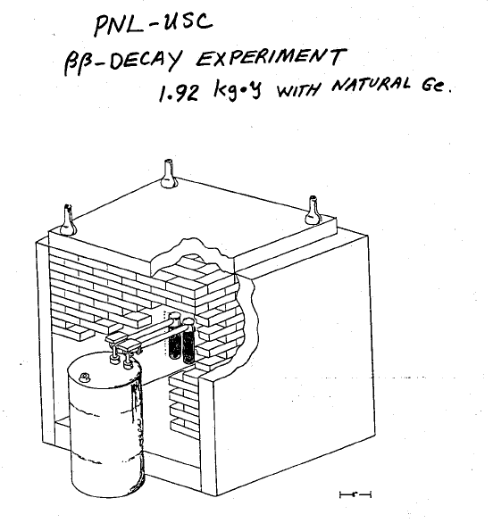
Ionisation-Detectors
Ge Detectors, set up in low background environment for double beta decay search

Slide 25
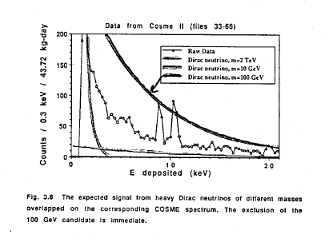
Ionisation-Detectors
Ge Detectors, set up in low background environment for double beta decay search

Slide 26
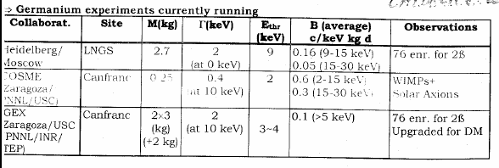
Ionisation-Detectors
Ge Detectors, set up in low background environment for double beta decay search
energies are
electron equivalent, not recoil !!
Experiments:
COSME, IGEX: USA, Spain, Russia
Heidelberg-Moscow, HDMS: Germany, Russia

Slide 27
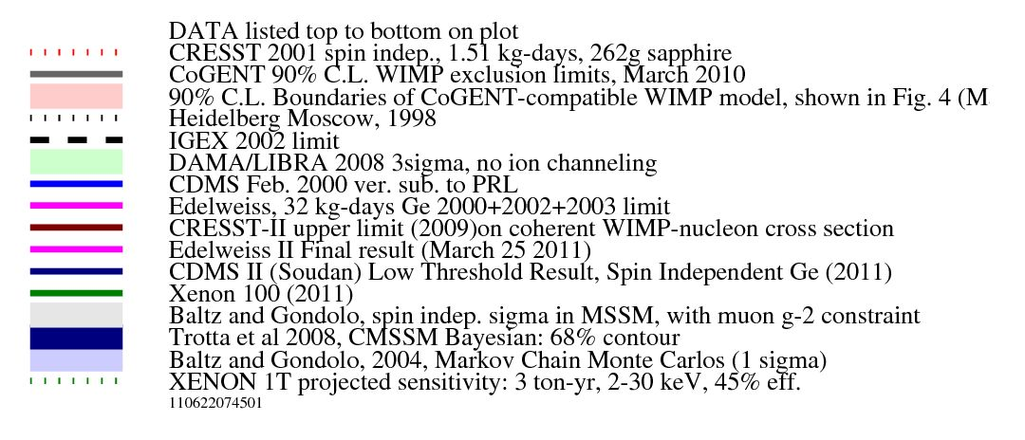
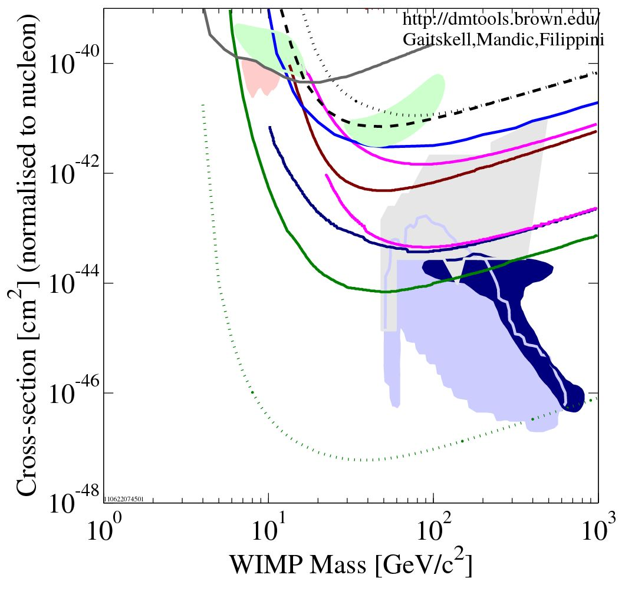
Heidelberg Moscow 1996
http://dmtools.brown.edu
Gaitskell, Mandic, Filippini
IGEX 1998
DAMA 1996 / LIBRA 2008
CDMS 2000
EDELWEISS 2002
CRESST 2009
WIMP – Nucleon Cross Section / cm²
EDELWEISS 2011
CDMS 2011
XENON 2011
goal 1t projects
Baltz, Gondolo MSSM 2001
Baltz, Gondolo 2004
Trotta et al CMSSM 2008
WIMP Mass / GeV/c²

Slide 28
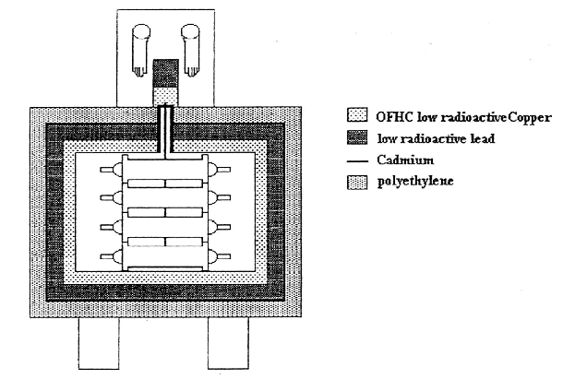
NaI-Scintillation Detectors
DAMA
in Gran Sasso Underground-Lab 3600mwe, italian and chinese groups
9 x 9.70kg NaI in Cu-housing
in DAMA set up 1991 – 2003
later 2003 upgrade to DAMA /LIBRA
with a total of 250kg NaI
NaI
NaI
each detectorr:
2 radio-pure PM
in coincidence
2keV software threshold
(2keVee = 20keV nuclear recoil !)
PMT
PMT
NaI
NaI
shielding against α, β, γ and neutrons from outside to inside:
paraffine / polyethylen / Cd foil / Pb / Cu
gastight box, flushed with radio-pure
nitrogene (to avoid radon from air)

Slide 29
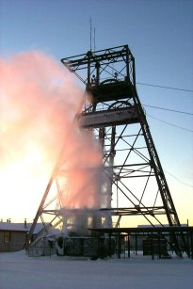
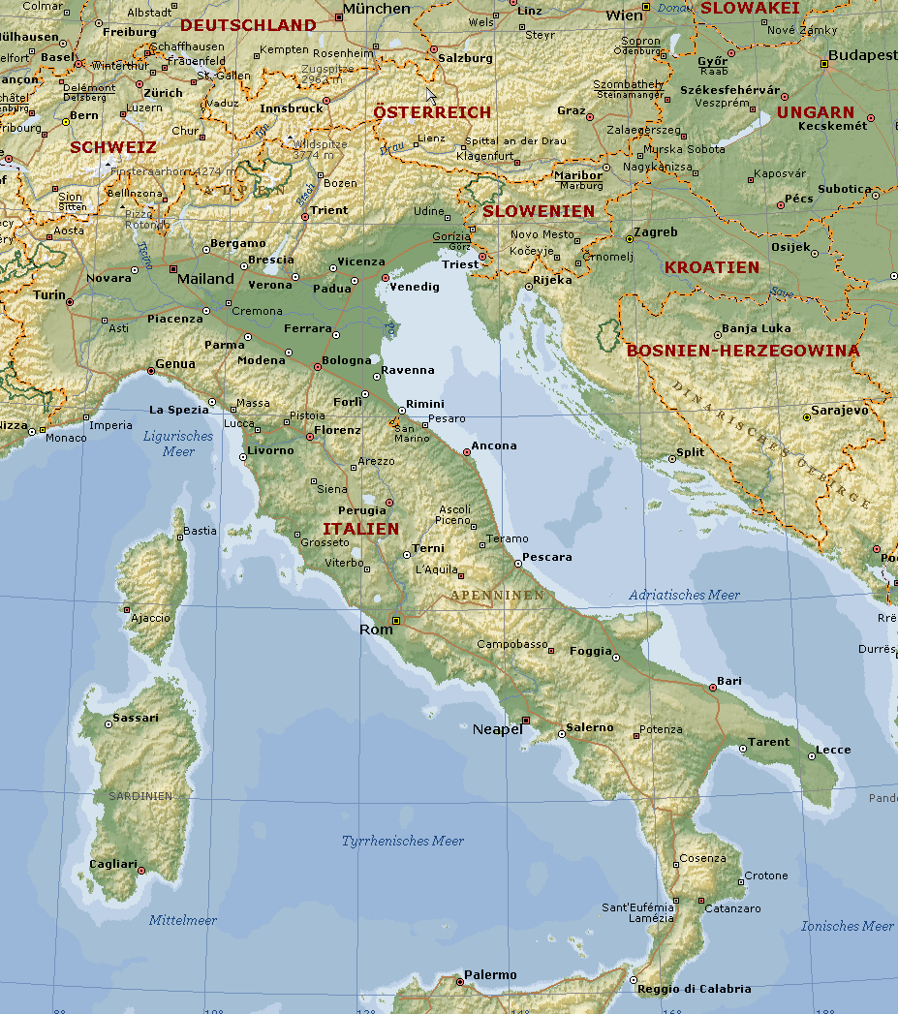

Underground-Labs
for rare event
searches
(Dark Matter search
Neutrino-detection
trace element contamination
...)
Soudan Mine USA
Gran Sasso Lab
shielded by
1.5km rock

Slide 30

NaI-Scintillation Detectors – Large Target Mass possible !
DAMA: Dark Matter signature by annual modulation
modulation of
recoil-spectrum
60º
summer
Counts / keV/Tag
230 km/s
winter
our speed
relative to WIMP-halo
30 km/s
recoil - energy
(230 ± 15) km/s

Slide 31





NaI-Scintillation Detectors – Large Target Mass possible !
DAMA - experiment:
first indication to WIMPs ?
(1998) by annual modulation
Data after 7 years of data taking ( ~ 300.000 kg x days)
modulation 6.3s confidence
Riv.N.Cim. 26/1 (2003), 1-73

Slide 32
Model Independent Annual Modulation Result
DAMA/NaI (7 years) + DAMA/LIBRA (4 years) Total exposure: 300555 kg×day = 0.82 ton×yr
experimental single-hit residuals rate vs time and energy
ROM2F/2008/07
Acos[ω(t-t₀)] ; continuous lines: t₀ = 152.5 d, T = 1.00 y
2-4 keV
A=(0.0215±0.0026) cpd/kg/keV
χ²/dof = 51.9/66 8.3 σ C.L.
Absence of modulation? No
χ²/dof=117.7/67 ⇒ P(A=0) = 1.3×10⁻⁴
2-5 keV
A=(0.0176±0.0020) cpd/kg/keV
χ²/dof = 39.6/66 8.8 σ C.L.
Absence of modulation? No
χ²/dof=116.1/67 ⇒ P(A=0) = 1.9×10⁻⁴
2-6 keV
A=(0.0129±0.0016) cpd/kg/keV
χ²/dof = 54.3/66 8.2 σ C.L.
Absence of modulation? No
χ²/dof=116.4/67 ⇒ P(A=0) = 1.8×10⁻⁴
The data favor the presence of a modulated behavior with proper features at 8.2σ C.L.

Slide 33
Heidelberg Moscow 1996
http://dmtools.brown.edu
Gaitskell, Mandic, Filippini
IGEX 1998
DAMA 1998 / LIBRA 2008
CDMS 2000
EDELWEISS 2002
CRESST 2009
WIMP – Nucleon Cross Section / cm²
EDELWEISS 2011
CDMS 2011
XENON 2011
goal 1t projects
Baltz, Gondolo MSSM 2001
Baltz, Gondolo 2004
Trotta et al CMSSM 2008
WIMP Mass / GeV/c²

Slide 34


WIMP recoil - Signal Quenching
Quenchingfaktor = 0.3 (Ge-Ionisation)
quenchingfactor = 0.3 (Ge-Ionisation)
quenchingfactor = 0.1 (NaI-Szintillation)
electromagnetic
interaction
background signals
scattering and recoil
detector energy threshold

Slide 35



Calorimetry – measure total energy (heat- or phonon- signal)
sehr sensitiv auf Kernrückstöße
auch ohne Wechselwirkung mit Atomhülle
Energy deposition
by scattering
thermometer
coupling to
heat sink
target crystal
niedrige
Energieschwelle
=> temperature rise
incident
particle
(WIMP)
at very low temperature (~20mK)
=> high sensitivity, small C
große Freiheit bei der
Wahl des Detektormaterials
thermometer:
superconducting
phase-transition-thermometer
NTD semicondutors
Notes:
TÜ

Slide 36


Calorimeters – Phase Transition Thermometers
SPT
superconducting phase-
transition-thermometer
TES
transition edge sensor
heat capacitance sapphire 250gr
3.4 MeV / K @ 25mK
220 GeV / K @ 1K
tungsten Tc≈15mK
Sapphire- or CaWO4 -absorber
250gr, 4cm x 4cm x 4cm
small change in temperature
=> large change in resistance
CRESST-collaboration
(Cryogenic Rare Event Search with Superconducting Thermometers)
Max-Planck-Institut München, TU München
Universität Tübingen, Oxford University, Gran Sasso Labor
signal-read out by SQUID

Slide 37
Calorimetry – measure total energy (heat- or phonon- signal)
very sensitive to nuclear recoils
no quenching
thermometer
coupling to
heat sink
target crystal
low energy threshold
300 eV in 300gr target
incident
particle
(WIMP)
possibility for a large
variety of target materials
all dielectric crystals
Notes:
TÜ

Slide 38

Calorimetry – measure total energy (heat- or phonon- signal)
energy threshold, a few 100eV !
Tungsten Thermometer
Tc 15mK
Sapphire- Absorber
250gr, 4cm x 4cm x 4cm
Notes:
TÜ

Slide 39

Heidelberg Moscow 1996
http://dmtools.brown.edu
Gaitskell, Mandic, Filippini
IGEX 1998
DAMA 1998 / LIBRA 2008
CRESST 2002
CDMS 2000
EDELWEISS 2002
CRESST 2009
WIMP – Nucleon Cross Section / cm²
EDELWEISS 2011
CDMS 2011
XENON 2011
Calorimetry only
very good in threshold
very bad in background
goal 1t projects
Baltz, Gondolo MSSM 2001
Baltz, Gondolo 2004
Trotta et al CMSSM 2008
WIMP Mass / GeV/c²

Slide 40
Direct Search for Particle Dark Matter
Dark Matter - Physics beyond the Standardmodel
Direct Searches - Basics
Detection Methods - Ionisation early DM projects, 2β0ν Exp.
- Scintillation DAMA / LIBRA
- Calorimetry CRESST
The Background Challenge
Charge - Phonon - CDMS
- EDELWEISS
Light - Phonon - CRESST
Charge - Light - XENON
- other Xenon and Argon projects
Superheated Droplets
Dark Matter – Status – Future - Summary
χ

Slide 41
Direct WIMP Search - Sensitivity
Quenchingfaktor = 0.3 (Ge-Ionisation)
lower threshold
background signals
nreduce background
detector energy threshold

Slide 42


χ
WIMP Scattering
scalar coupling: σ_{tot} ~ A² ×σ_{WIMP-Nucleon}
coherent on all nucleons
=> Enhanced sensitivity to σ_{WIMP-Nucleon}
axial coupling:
σ_{tot} ~ I(I+1) ×σ_{WIMP-Nucleon}
I nuclear spin
=> sensitivity to σ_{WIMP-Nucleon}
_{not enhanced}
WIMP – Nucleon Cross Section / cm²
WIMP Mass / GeV/c²

Slide 43

WIMP – direct detection
elastic scattering on nuclei in a detector
nuclear recoils: reduced efficiency for charge and/or light production
mass 50 GeV - ~ 1000 GeV
speed relative to earth 270 km/s
( ~ our speed going around the galaxy)
χ
a few keV of energy only
cross section
locale WIMP-density
σ_{χ} < 10⁻³⁶cm²
ρ_{χ} =0.3 GeV / cm³
corresp. 3 WIMPs^{(100GeV)} / Liter
75000 /s /cm²
very very very rare scattering events (< 1 / week / kg)
sensitivity today < 1 / few month / kg

Slide 44
Environmental Radioactivity
Potassium
Uranium
Radon
Detector
etc, ...
Thorium
count rate
spectrum
Cesium
required sensitivity ~ 1 event / kg / month,year (even 100 x less in future)
radioactivity from environment: > 1Hz/kg ~ 10⁶ events /kg /week
=> ‘clean‘ shielding: (old) Pb, Cu

Slide 45

Background - Examples
we need a lot of shielding against gammas
gammas of highest energy determine shielding
highest gamma energy from U / Th chains:
2.6 MeV, ²⁰⁸Tl, ~30% branching
T^{Th}_{1/2} = 1.4 * 10¹⁰y => 1 g Th = 1.3*10¹¹ decays / y
=> 4*10¹⁰ cts / y in 2.6 MeV gammas
( = 1300 cts / sec)

Slide 46
Background - Examples
1 g Th
4*10¹⁰ cts / y
in 2.6 MeV gammas
contaminations: rock ~ 10⁻⁶ g_{Th}/g
Aluminum ~ 10⁻⁷ g_{Th}/g
steel ~ 10⁻⁹ g_{Th}/g
Laboratory 10m x 10m x 10m => 600m² surface
2.6MeV gamma in rock ~ 5cm
=> 600m² x 0.05m
= 30m³ rock ‘visible’ in the gamma light

Slide 47

Background - Examples
30m³ rock ‘visible’ in the gamma light
~ 100 t of rock * 10⁻⁶ => 100 gTh
=> 4*10¹² cts / y
~ 10¹⁰ – 10¹¹ towards the experiment
need a reduction by a factor 10⁹, ln(10⁹) ~ 20
20 times mean free path, 2.6MeV in water ~ 25cm
need (4-5)m water !!! or ~ 40cm Pb !!!

Slide 48
Background - Examples
detector holders
Aluminum ~ 10⁻⁷ g_{Th}/g
1 g Th => 4*10¹⁰ cts / y in 2.6 MeV gammas
to stay below 1000 cts / y
max 10⁻⁷ g Th
max. 1 g Alu
only selected materials, as little as possible

Slide 49

Background - Examples
Photomultipliers
PM – glass => ⁴⁰K : 1460 keV, contam. 10⁻⁶ gK / g
1g ^{nat}K => 5 cts / sec, 1.4* 10⁸ cts / y
2 kg glass => 2*10⁻³ g K => 300000 cts/y
need more than factor 1000 reduction => ln(1000) ~ 7
=> 1m – 2m water

Slide 50


WIMP Direct Detection - Shielding

Slide 51



Radon in Air => well controlled atmosphere

Slide 52



²¹⁰Pb in Pb shielding
22 years half live => old Pb - or special clean Cu

Slide 53
WIMP Direct Detection - Signal and Background
Detector
rate,
spectrum
required sensitivity ~ 1 event / kg / week, month (future even 100 x less)
radioactivity: > 1Hz/kg ~ 10⁶ events /kg /week => ‘clean‘ shielding: (old) Pb, Cu
muons ~ 0.1Hz/kg: ~ 10⁵ events /kg /week, => needs ~ 1.5 km Rock
=> Underground-Laboratory

Slide 54


WIMP Direct Detection - Underground Laboratory
shielding
from
cosmic rays
SNOLab, Canada
Soudan Mine USA
Gran Sasso Lab
at least
1.5km
of rock coverage
at all directions

Slide 55





Underground-Laboratories in Europe
    LNGS - Italy
    LSM - France
    LSC - Spain
    Boulby- Great Britain
    CUPP - Finland
IUS
Institute of Underground
Science in Boulby mine,
UK
Laboratoire Souterrain
de Modane, France
LSC
Laboratorio Subterraneo
de Canfranc, Spain
LNGS
http://astroparticle.aspera-eu.org
Laboratori Nazionali del
Gran Sasso, Italy

Slide 56
Environmental Radioactivity, almost entierly α, β, γ
Potassium
Uranium
Radon
Detector
etc, ...
Thorium
count rate
spectrum
Cesium
required sensitivity ~ 1 event / kg / month,year (even 100 x less in future)
radioactivity from environment: > 1Hz/kg ~ 10⁶ events /kg /week
=> ‘clean‘ shielding: (old) Pb, Cu

Slide 57
Quenching of WIMP recoil spectrum
Quenchingfaktor = 0.3 (Ge-Ionisation)
quenchingfactor = 0.3 (Ge-Ionisation)
quenchingfactor = 0.1 (NaI-Szintillation)
electromagnetic
interaction
background signals
scattering and recoil
detector energy threshold

Slide 58


Phonon + Ionisation / Scintillation - Measurement
measure
phonons (heat)
and
charge (or light)
distinguish
electromagnetic radiation α, β, γ (main background)
from
nuclear recoils (WIMP and neutrons)

Slide 59

Recoil Recognition by Combination of Channels
- making good use of quenching -
Cryogenic Charge / Phonon
Cryogenic Light / Phonon
radioactive
background can be rejected
=> highly improved
sensitivity
Liquid Noble Gas Light / Charge

Slide 60
Direct DM Searches using Recoil Recognition
CRYOGENIC
LIQUID NOBLE GASES
DROPLETS
XENON
ARGON
CRESST
EURECA
Germany, UK, Italy
prepare
~ 100 kg, 2011
prepare / run
~ 100 kg, 2011
LUX
10 US institutions,
Moscow
WARP
Italy, US
COUPP
USA
EDELWEISS
EURECA
France, Germany,
UK, Russia
XMASS
10 institutions
from Japan
DEAP / CLEAN
Canada, US
PICASSO
Canada, USA, Czeck
Super CDMS
GeoDM
US, Canada,
Switzerland
run ~50 kg, 2010
planning
~1000 kg, 2013
prepare / run
a few kg
good SD limits
ArDM
Switzerland, Spain,
UK, Poland
all
prepare / run
~ 15 kg, 2011
planning
~ 1000 kg, 2015
XENON
USA, Switzerl. Italy,
Japan, Portugal, Germ.
France, China
all prepare / plan
~ 1000 kg, 2012
Notes:
This is just a summary of what the various sensitivites mean. There are rather few events to be detected at the 10E-10 pb level.

Slide 61
Direct Search for Particle Dark Matter
Dark Matter - Physics beyond the Standardmodel
Direct Searches - Basics
Detection Methods - Ionisation early DM projects, 2β0ν Exp.
- Scintillation DAMA / LIBRA
- Calorimetry CRESST
The Background Challenge
Charge - Phonon - CDMS
- EDELWEISS
Light - Phonon - CRESST
Charge - Light - XENON
- other Xenon and Argon projects
Superheated Droplets
Dark Matter – Status – Future - Summary
χ

Slide 62
Recoil Recognition by Combination of Channels
- making good use of quenching -
Cryogenic Charge / Phonon
Cryogenic Light / Phonon
radioactive
background can be rejected
=> highly improved
sensitivity
Liquid Noble Gas Light / Charge

Slide 63
Calorimetry – measure total energy (heat- or phonon- signal)
Energy deposition
by scattering
thermometer
coupling to
heat sink
target crystal
=> temperature rise
incident
particle
(WIMP)
at very low temperature (~20mK)
=> high sensitivity, small C
thermometer:
superconducting
phase-transition-thermometer
NTD semicondutors
Notes:
TÜ

Slide 64

simultaneous measurement
of phonon and ionisation
Phonon + Charge
CDMS and EDELWEISS
80
70
252
Cf +
241
Am
β
60
γ
50
Ionization (keV)
Ionisation [keV]
40
30
20
10
nuclear recoils
0
0
10
20
30
40
50
60
70
80
Phononen [keV]
Recoil Energy (keV)
signal (nuclear recoils) and
dominant background (γ and β)
can be distingushed
gammas (external source)
neutrons (external source)
Phonon Trigger Threshold

Slide 65
simultaneous measurement
of phonon and ionisation
NTD Ge Thermistors
80
70
252
Cf +
241
Am
Ge or Si ~ 300g
60
50
Ionization (keV)
40
Ionization
30
20
10
nuclear recoils
0
0
10
20
30
40
50
60
70
80
Phononen [keV]
Recoil Energy (keV)

Slide 66

Cryogenic Dark Matter Search
US Collaboration
CDMS Phonon + Charge
Tower
cabling
heat sinking
FETs and preamps
= 7.6cm, ~ 1 cm dick
~ 230 g
today up to 30 crystals
operaterd at ~20mK
until ~ 2000
NTD phonon sensors
later
TES array
(superconducting phase
transition thermometer,
transition edge sensor)
segmented
charge read out
electrodes
inner ionisation
electrode
outer ionisation
electrode
passive Ge shielding

Slide 67



.. not just temperature, but non equilibrium phonon read out
Cryogenic Dark Matter Search
US Collaboration
CDMS Phonon + Charge
TES array
collector
large Gap
e.g. Al Tc = 1.2K
thermometer
small gap
e.g. W Tc = 0.05K
quasiparticle-trapping
large area phonon detectors
small thermometers
(C small)
or phonon

Slide 68

Cryogenic Dark Matter Search
US Collaboration
CDMS Phonon + Charge
Photolithographic patterning
Phonon sensors:
  4 quadrants with each 888 sensors (TES)
  operated in parallel
  TES: 1-μm-thick strip of W connected to 8
  superconducting Al collection fins
Ionisation measurement:
in low-field (~volts/cm) with segmented
contacts to allow rejection of events near outer edge
2 charge electrodes
  “Inner” fiducial electrode
  “Outer” guard ring
380μ x 60μ aluminum fins
1 μ tungsten
Notes:
Our detectors provide additional information to allow us to reject these surface events. Because each detector collects athermal phonons with sensors divided into 4 quadrants, (0:15)

Slide 69

Cryogenic Dark Matter Search
US Collaboration
CDMS Phonon + Charge
CDMS
cryostat

Slide 70


Cryogenic Dark Matter Search
US Collaboration
CDMS Phonon + Charge
CDMS I
at Stanford
only15 mwe shielding

Slide 71

Cryogenic Dark Matter Search
US Collaboration
CDMS Phonon + Charge
all single-scatters
NR candidates
1999
simply in a cellar on campus of
Stanford University (17mwe)
45 day measurement
4 x 160gr Ge-detectors
=> 10.6kgdays
gammas and electrons
well seperated from
nuclear recoils
13 candiates for nuclear recoils
~ 0.1 cts / kg / d / keV
NR Band asymmetric (-3σ,+1.28σ)= 90% efficient
world best limits at that time

Slide 72
Heidelberg Moscow 1996
http://dmtools.brown.edu
Gaitskell, Mandic, Filippini
IGEX 1998
DAMA 1998 / LIBRA 2008
CDMS 2000
EDELWEISS 2002
DAMA - CDMS
Controversy
DAMA: 4 y, 100kg, Gran Sasso
CDMS: 3 month, 100g, Stanford
recoil recognition
is very powerful
CRESST 2009
WIMP – Nucleon Cross Section / cm²
EDELWEISS 2011
CDMS 2011
XENON 2011
goal 1t projects
Baltz, Gondolo MSSM 2001
Baltz, Gondolo 2004
Trotta et al CMSSM 2008
WIMP Mass / GeV/c²

Slide 73


Cryogenic Dark Matter Search
US Collaboration
CDMS Phonon + Charge
CDMS II
at Soudan Mine

Slide 74


Cryogenic Dark Matter Search
US Collaboration
CDMS Phonon + Charge
CDMS II
at Soudan Mine

Slide 75
simultaneous measurement
of phonon and ionisation
NTD Ge Thermistors
80
70
252
Cf +
241
Am
Ge or Si ~ 300g
60
50
Ionization (keV)
40
Ionization
30
20
10
nuclear recoils
0
0
10
20
30
40
50
60
70
80
Phononen [keV]
Recoil Energy (keV)

Slide 76

Experience pour DEtecter Les Wimps
En SIte Souterrain
Paris, Lyon, Grenoble, Karlsruhe, Dubna
EDELWEISS Phonon + Charge
EDELWEISS I
until ~2003
ionisation-heat-measurement
320g Ge-Detector
Fréjus-tunnel
2001: 10kg-days

Slide 77


Experience pour DEtecter Les Wimps
En SIte Souterrain
Paris, Lyon, Grenoble, Karlsruhe, Dubna, Oxford, Sheffield
EDELWEISS Phonon + Charge
EDELWEISS II
since ~2007

Slide 78



Experience pour DEtecter Les Wimps
En SIte Souterrain
Paris, Lyon, Grenoble, Karlsruhe
EDELWEISS Phonon + Charge
Frejus tunnel

Slide 79

Experience pour DEtecter Les Wimps
En SIte Souterrain
Paris, Lyon, Grenoble, Karlsruhe
EDELWEISS Phonon + Charge
10 kg day, background free => best limits at that time
< 0.1 cts / kg / d / keV

Slide 80
Heidelberg Moscow 1996
http://dmtools.brown.edu
Gaitskell, Mandic, Filippini
IGEX 1998
DAMA 1998 / LIBRA 2008
CDMS 2000
EDELWEISS 2002
CRESST 2009
WIMP – Nucleon Cross Section / cm²
EDELWEISS 2011
CDMS 2011
XENON 2011
goal 1t projects
Baltz, Gondolo MSSM 2001
Baltz, Gondolo 2004
Trotta et al CMSSM 2008
WIMP Mass / GeV/c²

Slide 81

Phonon + Charge Surface Problem
Problem:
surface events (electrons)
show reduced charge collection
=> reach ‘down’ into signal region
Solution:
large area phonon sensors
=> fast phonon read out
=> recognize surface events by
phonon timing
~ 300gr
Ge and Si
detectors
380μ x 60μ aluminum fins
1 μ tungsten

Slide 82

Cryogenic Dark Matter Search
US Collaboration
CDMS Phonon + Charge
neutron source => recoils for calibration
additional timing cut => ‘clean’ region

Slide 83

Cryogenic Dark Matter Search
US Collaboration
CDMS Phonon + Charge
ionisation yield and phonon-risetime
before risetime cut
after risetime cut

Slide 84


CDMS result - Dec 2009
612 kg-days
194.1 kg-days
23%
3,8 x 10⁻⁴⁴ cm²
raw exposure
spectrum-averaged equivalent exposure @ 60 GeV
probability of observing two or more background events
upper limit on spin-independent cross-section @ 70 GeV, 90% CL,

Slide 85

Experience pour DEtecter Les Wimps
En SIte Souterrain
Paris, Lyon, Grenoble, Karlsruhe
EDELWEISS Phonon + Charge
structured charge read out electrodes – modulated potential

Slide 86
EDELWEISS InterDigit Detectors – Surface Events

Slide 87




Experience pour DEtecter Les Wimps
En SIte Souterrain
Paris, Lyon, Grenoble, Karlsruhe, Dubna, Oxford, Sheffield
EDELWEISS Phonon + Charge
presently running 10 x 400 g ID
several 100 kgd already collected
Mar 2011
~3500 detector-days
384 kg-days
4.4 x10⁻⁴⁴ cm²
raw exposure (400 g detectors)
effective exposure (160g fid.vol per detector + cuts)
upper limit on spin-independent cross-section @ 85 GeV, 90% CL

Slide 88
Heidelberg Moscow 1996
http://dmtools.brown.edu
Gaitskell, Mandic, Filippini
IGEX 1998
DAMA 1998 / LIBRA 2008
CDMS 2000
EDELWEISS 2002
CRESST 2009
WIMP – Nucleon Cross Section / cm²
EDELWEISS 2011
CDMS 2011
XENON 2011
~ 0.001 cts / kg / d / keV
goal 1t projects
Baltz, Gondolo MSSM 2001
Baltz, Gondolo 2004
Trotta et al CMSSM 2008
WIMP Mass / GeV/c²

Slide 89
Direct Search for Particle Dark Matter
Dark Matter - Physics beyond the Standardmodel
Direct Searches - Basics
Detection Methods - Ionisation early DM projects, 2β0ν Exp.
- Scintillation DAMA / LIBRA
- Calorimetry CRESST
The Background Challenge
Charge - Phonon - CDMS
- EDELWEISS
Light - Phonon - CRESST
Charge - Light - XENON
- other Xenon and Argon projects
Superheated Droplets
Dark Matter – Status – Future - Summary
χ

Slide 90
Recoil Recognition by Combination of Channels
- making good use of quenching -
Cryogenic Charge / Phonon
Cryogenic Light / Phonon
radioactive
background can be rejected
=> highly improved
sensitivity
Liquid Noble Gas Light / Charge

Slide 91

Cryogenic Rare Event Search with
Superconducting Thermometers
Munich, Tübingen, Oxford, Gran Sasso
CRESST Phonon + Light
χ
CRESST II - Detectors
simultaneous Light and
Phonon
Thermometer
Thermometer
Licht Detector
(low T calorimeter)
Absorber CaWO₄
Phonon-Detector
reflecting foil
CRESST
Cryogenic Rare Event Search with
Superconducting Thermometers
Max-Planck-Institut München, TU München
Universität Tübingen, Oxford University, Gran Sasso

Slide 92


Cryogenic Rare Event Search with
Superconducting Thermometers
Munich, Tübingen, Oxford, Gran Sasso
CRESST Phonon + Light

Slide 93



Cryogenic Rare Event Search with
Superconducting Thermometers
Munich, Tübingen, Oxford, Gran Sasso
CRESST Phonon + Light
γ
α
CaWO₄
n

Slide 94

Cryogenic Rare Event Search with
Superconducting Thermometers
Munich, Tübingen, Oxford, Gran Sasso
CRESST Phonon + Light

Slide 95
Cryogenic Rare Event Search with
Superconducting Thermometers
Munich, Tübingen, Oxford, Gran Sasso
CRESST Phonon + Light
Max Planck Inst. for Physics Munich
Technical University Munich
Eberhard Karls Universiy Tübingen
University of Oxford, UK
Laboratori Nazionali del Gran Sasso, Italy
Gran Sasso Lab
at least
1.5km
of rock coverage
in all directions

Slide 96

Cryogenic Rare Event Search with
Superconducting Thermometers
Munich, Tübingen, Oxford, Gran Sasso
CRESST Phonon + Light
CRESST Cryostat
dilution refrigerator
experimental volume - Cold Box:
shielded (14cm Cu + 20cm Pb)
cold finger passing through shielding
liquid nitrogene
liquid helium
mixing chamber
internal lead shielding
Cold Box made out of special
radio pure copper
  stored underground (10 m.w.e.)
  electropolished
  transport and storage in
  nitrogene atmosphere ( radon !)
  installation and mounting at
  Gran Sasso in clean room
  vacuum seals: high purity Pb
external lead shielding
copper shielding
detectors
volume for experiments
(up to 100 liters)

Slide 97


Cryogenic Rare Event Search with
Superconducting Thermometers
Munich, Tübingen, Oxford, Gran Sasso
CRESST Phonon + Light

Slide 98


Cryogenic Rare Event Search with
Superconducting Thermometers
Munich, Tübingen, Oxford, Gran Sasso
CRESST Phonon + Light

Slide 99


Cryogenic Rare Event Search with
Superconducting Thermometers
Munich, Tübingen, Oxford, Gran Sasso
CRESST Phonon + Light

Slide 100




CRESST – 66 channel SQUID system and detectors
Cryogenic Rare Event Search with
Superconducting Thermometers
Munich, Tübingen, Oxford, Gran Sasso
CRESST Phonon + Light

Slide 101

Cryogenic Rare Event Search with
Superconducting Thermometers
Munich, Tübingen, Oxford, Gran Sasso
CRESST Phonon + Light
Calibration of acceptance region with neutrons
Neutrons => nuclear recoils
Neutrons => ‘background’ !!

Slide 102
Next Background after discrimination for all experiments
http://dmtools.brown.edu
Gaitskell, Mandic, Filippini
Neutrons
radioacitivity
muon induced
  in rock
  in the set up
no PE
WIMP – Nucleon Cross Section / cm²
μ induced
in Pb.shield.
μ in rock
30 cm PE
Veto 90%
Veto 99%
50 cm PE
WIMP Mass / GeV/c²

Slide 103



neutron shield PE
Neutron and Muon Shielding e.g. CRESST
Shielded cryostat
muon veto
PE neutron moderator
Plastic scintill. μ-veto

Slide 104

CRESST 2004 no neutron shield
2004, 10.5 kg d
γ, β
1.5
CaWO₄
crystals
as target
1.0
light / heat
0.5
90% O-recoils
0.0
nuclear recoils: dark matter, neutrons
90% W-recoils
-0.5
0
50
100
150
heat / keV

Slide 105

CRESST 2007 with neutron shield
2007, 3 kg d
1.5
with neutron
shield
and
alpha recoil
rejection
1.0
Licht-/Phononenergie
0.5
0.0
-0.5
0
50
100
150
Energie im Phononendetektor / keV

Slide 106



CRESST nuclear recoils from alpha decays
measurement end 2003: 8.1 kg days
=>
cover surrounding
holders with scintillator
46 keV line from
external ²¹⁰Pb
contamination
α
detector
reflector
Count rate as expected from
neutrons (1 count/kg/day)
Consistent with recoiling nuclei
from α-decays

Slide 107


Cryogenic Rare Event Search with
Superconducting Thermometers
Munich, Tübingen, Oxford, Gran Sasso
CRESST Phonon + Light
2007 - 2008
48 kg-days
3
4.8 x10⁻⁴³ cm²
exposure, two detector modules
events in signal region
upper limit on spin-independent cross-section @ 50 GeV, 90% CL

Slide 108
Heidelberg Moscow 1996
http://dmtools.brown.edu
Gaitskell, Mandic, Filippini
IGEX 1998
DAMA 1998 / LIBRA 2008
CDMS 2000
EDELWEISS 2002
CRESST 2009
WIMP – Nucleon Cross Section / cm²
EDELWEISS 2011
CDMS 2011
XENON 2011
goal 1t projects
Baltz, Gondolo MSSM 2001
Baltz, Gondolo 2004
Trotta et al CMSSM 2008
WIMP Mass / GeV/c²

Slide 109





CRESST rare α detection
Cryogenic Rare Event Search with
Superconducting Thermometers
Munich, Tübingen, Oxford, Gran Sasso
γ band
α band
Light
α-spectrum
α-spectrum t_{1/2}(¹⁸⁰W) = (1.7 ± 0.2) 10¹⁸ y
U/Th
Recoil energy [keV]
1,7 · 10¹⁸ a
σ ~ 4
Phys.Rev.C 70 (2004) 064606-1 und nucl-ex/0408006

Slide 110


Cryogenic Rare Event Search with
Superconducting Thermometers
Munich, Tübingen, Oxford, Gran Sasso
CRESST Phonon + Light
Neutron Calibration 2009-2011 run
γ + β band
O-recoil-band
Lines calculated from energy-resolution of light detector and known quenching factor
excellent nuclear recoil discrimination

Slide 111

Cryogenic Rare Event Search with
Superconducting Thermometers
Munich, Tübingen, Oxford, Gran Sasso
CRESST Phonon + Light
Wich nucleus is seen in CaWO₄
taking into account energy threshold
assuming
σ ∝ A²
Threshold 10keV
for small WIMP masses <10 GeV only O recoils above threshold
Ca is important around 10 GeV
for large masses W dominates due to σ∝A²

Slide 112



CRESST recent data run 2009 - 2011
β+γ
presently running, first part of the data ~200kgd
α
O
W
low mass (n, low mass WIMPs, ..)
alphas
multi target
unique feature of
light – phonon
readout
large mass WIMPS

Slide 113

CRESST recent data run 2009 - 2011
γ + β band
α band
O-recoil-band
< 10 GeV
W-recoil-band
> 10 GeV
Pb
α
clamp not scint.
²¹⁰Po ²⁰⁶Pb (104 keV) + α (5.4 Me)‏
Pb
α
crystal

Slide 114
CRESST recent data run 2009 - 2011
run May 2009 – May 2011
8 detector modules
exposure 731 kg d
65 Oxygene recoil
events observed
~0,003 cts/kg/d/keV
Neutrons ?
α leakage ?
low mass WIMPs ?

Slide 115
CRESST recent data run 2009 - 2011
run May 2009 – May 2011
8 detector modules
exposure 731 kg d
65 Oxygene recoil
events observed
hard (so far impossible) to be explained by neutrons
main problem:
missing double scatters in data needs low energy neutrons
strong source outside PE shield (excluded)
close by source emitting low E neutrons (impossible)

Slide 116
CRESST recent data run 2009 - 2011
run May 2009 – May 2011
8 detector modules
exposure 731 kg d
65 Oxygene recoil
events observed
hard (if not impossible) to explain by α
no correlation with α count rate
α behave differently

Slide 117
Ereignisse im O-Band ?
Messung läuft seit Sommer 2009
10 Detektoren (1 ZnWO₄)
kein Szintillator auf Halterungen
=> Alpha-Untergrund
Datenanalyse noch nicht abgeschlossen
vorl. Ergebnisse von 400 kgd
mit 9 CaWO₄
=> 32 Ereignisse im O-Band !
Neutronen: wahrscheinlich NEIN, Multiplizitäten falsch
α leakage: wahrscheinlich NEIN, Überlapp zu klein
WIMPs kleiner Masse: wer weiß?

Slide 118
Some low WIMP mass excitement ?
Heidelberg Moscow 1996
http://dmtools.brown.edu
Gaitskell, Mandic, Filippini
IGEX 1998
DAMA 1998 / LIBRA 2008
CoGENT 2010
CDMS 2000
EDELWEISS 2002
CRESST 2009
WIMP – Nucleon Cross Section / cm²
EDELWEISS 2011
CDMS 2011
XENON 2011
goal 1t projects
Baltz, Gondolo MSSM 2001
Baltz, Gondolo 2004
Trotta et al CMSSM 2008
WIMP Mass / GeV/c²

Slide 119



Soudan Mine
US Collaboration
COGENT
low energy
excess
modulates
Ge detectors
Ionisation only
Point contact detectors
Very low threshold
Good to look for light WIMPs
low mass WIMPs?

Slide 120
Some low WIMP mass excitement ?
Heidelberg Moscow 1996
http://dmtools.brown.edu
Gaitskell, Mandic, Filippini
IGEX 1998
DAMA 1998 / LIBRA 2008
CoGENT 2010
CDMS 2000
EDELWEISS 2002
CRESST 2009
WIMP – Nucleon Cross Section / cm²
EDELWEISS 2011
CDMS 2011
XENON 2011
goal 1t projects
Baltz, Gondolo MSSM 2001
Baltz, Gondolo 2004
Trotta et al CMSSM 2008
WIMP Mass / GeV/c²

Slide 121
Multi-Target: W-band quite clean !

Slide 122




Inelastic Dark Matter
preliminary
preliminary
not possible,
without
separation
W-recoils
vs.
O-recoils !!
preliminary
preliminary

Slide 123
Direct Search for Particle Dark Matter
Dark Matter - Physics beyond the Standardmodel
Direct Searches - Basics
Detection Methods - Ionisation early DM projects, 2β0ν Exp.
- Scintillation DAMA / LIBRA
- Calorimetry CRESST
The Background Challenge
Charge - Phonon - CDMS
- EDELWEISS
Light - Phonon - CRESST
Charge - Light - XENON
- other Xenon and Argon projects
Superheated Droplets
Dark Matter – Status – Future - Summary
χ

Slide 124
Recoil Recognition by Combination of Channels
- making good use of quenching -
Cryogenic Charge / Phonon
Cryogenic Light / Phonon
radioactive
background can be rejected
=> highly improved
sensitivity
Liquid Noble Gas Light / Charge

Slide 125


Liquid Noble Gas Charge + Light
WIMP
GAMMA
NUCLEAR
RECOIL
ELECTRON

Slide 126


Liquid Noble Gas Charge + Light
XENON
USA, Switzerland, Italy,
Portugal, Germany, France,
Japan, China

Slide 127


Liquid Noble Gas Charge + Light
XENON
USA, Switzerland, Italy,
Portugal, Germany, France,
Japan, China
calibration
with
γ-source
calibration
with
neutron source
XENON 10
5,4 kg target mass
J. Angle et al., astro-ph:0706.0039

Slide 128


Liquid Xenon Charge + Light
XENON
USA, Switzerland, Italy,
Portugal, Germany, France,
Japan, China
LUX
10 US institutions, Moscow
planned 100 kg fiducial
prototype tested
at Sanford Lab
XMASS
10 institutions from Japan
at Kamioka
1 phase, 850 kg total
self shielding 100 kg fid.
start ~ 2010

Slide 129

Liquid Xenon Charge + Light
XENON
USA, Switzerland, Italy, Portugal,
Germany, France, Japan, China
at Gran Sasso
48 kg fiducial / 62 kg total
starting end of 2009
achieved 2010: ~ 7 x 10⁻⁴⁵ cm²
projected 2012: ~ 2 x 10⁻⁴⁶ cm²
projected 2015: < 10⁻⁴⁷ cm²
LUX
10 US institutions, Moscow
100 kg fiducial / 360 kg total
tested above ground end 2010
to be installed Sanford Lab (Davis Cavern)
XMASS
10 institutions from Japan
1 phase
at Kamioka
850 kg total , 100 kg fiducial
start set up ~ 2010
http://xenon.astro.columbia.edu/

Slide 130

Liquid Xenon Charge + Light
XENON
USA, Switzerland, Italy, Portugal,
Germany, France, Japan, China
at Gran Sasso
48 kg fiducial / 62 kg total
starting end of 2009
achieved 2010: ~ 7 x 10⁻⁴⁵ cm²
projected 2012: ~ 2 x 10⁻⁴⁶ cm²
projected 2015: < 10⁻⁴⁷ cm²
LUX
10 US institutions, Moscow
100 kg fiducial / 360 kg total
tested above ground end 2010
to be installed Sanford Lab (Davis Cavern)
XMASS
10 institutions from Japan
1 phase
at Kamioka
850 kg total , 100 kg fiducial
start set up ~ 2010

Slide 131


Liquid Xenon Charge + Light
XENON
USA, Switzerland, Italy, Portugal,
Germany, France, Japan, China
at Gran Sasso
48 kg fiducial / 62 kg total
starting end of 2009
achieved 2010: ~ 7 x 10⁻⁴⁵ cm²
projected 2012: ~ 2 x 10⁻⁴⁶ cm²
projected 2015: < 10⁻⁴⁷ cm²
LUX
10 US institutions, Moscow
100 kg fiducial / 360 kg total
tested above ground end 2010
to be installed Sanford Lab (Davis Cavern)
XMASS
10 institutions from Japan
1 phase
at Kamioka
850 kg total , 100 kg fiducial
start set up ~ 2010

Slide 132
Liquid Xenon Charge + Light
XENON
USA, Switzerland, Italy, Portugal,
Germany, France, Japan, China
at Gran Sasso
50 kg fiducial / 170 kg total funded
starting end of 2009
projected 2010: ~ 2 x 10⁻⁴⁵ cm²
projected 2012: ~ 2 x 10-⁴⁶ cm²
projected 2015: < 10⁻⁴⁷ cm²
LUX
10 US institutions, Moscow
100 kg fiducial / 360 kg total
tested above ground end 2010
to be installed Sanford Lab (Davis Cavern)
XMASS
10 institutions from Japan
1 phase
at Kamioka
850 kg total , 100 kg fiducial
start set up ~ 2010

Slide 133




Liquid Argon Charge + Light
WARP
Italy, US
at Gran Sasso
140 kg running
1000 kg: planned 2012
WARP
ArDM
Switzerland, Spain, UK, Poland
1000 kg R & D, prototype
DarkSide
US
proposed, depleted Ar
DEAP / CLEAN
Canada, US
1-phase, SNOLAB
150 kg set up start 2010
1000 kg start 2012

Slide 134

Liquid Argon Charge + Light
WARP
Pavia, Padova, Napoli, L‘Aquila, Princeton
at Gran Sasso
140kg starting / running
WARP 100: goal < 10⁻⁴⁴ cm²
WARP 1 ton: goal 2012 < 10⁻⁴⁵ cm²
SuperWARP 10 ton … < 10⁻⁴⁶ cm²
ArDM
Zürich, Granada, Madrid, Sheffield, Warszaw
still R & D phase, but 1-ton R & D
DarkSide
10 US institutions
proposed for SNOLAB, depleted Ar
DEAP / CLEAN
4 Canada + 10 US institutions
1-phase
SNOLAB
150kg fiducial being set up
1000 kg fiducial start 2012 ?

Slide 135
Liquid Argon Charge + Light
WARP
Pavia, Padova, Napoli, L‘Aquila, Princeton
at Gran Sasso
140kg starting / running
WARP 100: goal < 10⁻⁴⁴ cm²
WARP 1 ton: goal 2012 < 10⁻⁴⁵ cm²
SuperWARP 10 ton … < 10⁻⁴⁶ cm²
ArDM
Zürich, Granada, Madrid, Sheffield, Warszaw
still R & D phase, but 1-ton R & D
DarkSide
10 US institutions
proposed for SNOLAB, depleted Ar
DEAP / CLEAN
4 Canada + 10 US institutions
1-phase
SNOLAB
150kg fiducial being set up
1000 kg fiducial start 2012 ?

Slide 136
Liquid Argon Charge + Light
WARP
Pavia, Padova, Napoli, L‘Aquila, Princeton
at Gran Sasso
140kg starting / running
WARP 100: goal < 10⁻⁴⁴ cm²
WARP 1 ton: goal 2012 < 10⁻⁴⁵ cm²
SuperWARP 10 ton … < 10⁻⁴⁶ cm²
ArDM
Zürich, Granada, Madrid, Sheffield, Warszaw
still R & D phase, but 1-ton R & D
DarkSide
10 US institutions
proposed for SNOLAB, depleted Ar
DEAP / CLEAN
4 Canada + 10 US institutions
1-phase
SNOLAB
150kg fiducial being set up
1000 kg fiducial start 2012 ?

Slide 137


XENON 10: USA, Germany, Italy
USA, Switzerland, Italy,
Germany, France,
Portugal, Japan, China
XENON Charge + Light
5.5 kg
58.6 kgd
10
target,
exposure
background events
48 kg
1471 kgd
3
target,
exposure
background events
XENON10
2007
XENON100
2011
~1 cts / 6 kgd
~ 1 cts / 500 kgd
γ bckgrnd ~ 50 x lower
astro-ph:0706.0039
astro-ph:1104.2549v2
48 kg
100 days
1471 kgd
3
7 x10⁻⁴⁵ cm²
fiducial volume
measurement
effective exposure
events in signal region
upper limit on spin-independent
cross-section @ 50 GeV, 90% CL

Slide 138
Heidelberg Moscow 1996
http://dmtools.brown.edu
Gaitskell, Mandic, Filippini
IGEX 1998
DAMA 1998 / LIBRA 2008
CoGENT 2010
CDMS 2000
EDELWEISS 2002
CRESST 2009
WIMP – Nucleon Cross Section / cm²
EDELWEISS 2011
CDMS 2011
XENON 2011
~ 0.0001 cts / kg / d / keV
goal 1t projects
Baltz, Gondolo MSSM 2001
Baltz, Gondolo 2004
Trotta et al CMSSM 2008
WIMP Mass / GeV/c²

Slide 139
Direct Search for Particle Dark Matter
Dark Matter - Physics beyond the Standardmodel
Direct Searches - Basics
Detection Methods - Ionisation early DM projects, 2β0ν Exp.
- Scintillation DAMA / LIBRA
- Calorimetry CRESST
The Background Challenge
Charge - Phonon - CDMS
- EDELWEISS
Light - Phonon - CRESST
Charge - Light - XENON
- other Xenon and Argon projects
Superheated Droplets
Dark Matter – Status – Future - Summary
χ

Slide 140



temperature and pressure conditions
such, that only nuclear recoils can trigger
bubble formation
Superheated Droplets
COUPP
USA
20kg running, 60kg in prep.
SNOLAB or DUSEL
several 100 kg modules
2012 ++
PICASSO
Canada, USA, Czeck
1.9 kg running since 2009
new SD constraints from
moving to larger lab
within SNOLAB

Slide 141
temperature and pressure conditions
such, that only nuclear recoils can trigger
bubble formation
Superheated Droplets
COUPP
Chicago, Fermilab, Indiana
video read out
2 kg test limited by α background
20kg running
60kg at 300 mwe in preparation
SNOLAB or DUSEL
several 100 kg modules
construction 2012 ++
PICASSO
Montreal, Queens, Edmonton, SNOLAB,
Indiana, Prague
acoustic (piezo) readout
1.9 kg running since 2009
new spin dep constraints from 14 kg d
moving to larger lab within SNOLAB

Slide 142
temperature and pressure conditions
such, that only nuclear recoils can trigger
bubble formation
Superheated Droplets
COUPP
Chicago, Fermilab, Indiana
video read out
2 kg test limited by α background
20kg running
60kg at 300 mwe in preparation
SNOLAB or DUSEL
several 100 kg modules
construction 2012 ++
PICASSO
Montreal, Queens, Edmonton, SNOLAB,
Indiana, Prague
acoustic (piezo) readout
1.9 kg running since 2009
new spin dep constraints from 14 kg d
moving to SNOLAB

Slide 143
Direct Search for Particle Dark Matter
Dark Matter - Physics beyond the Standardmodel
Direct Searches - Basics
Detection Methods - Ionisation early DM projects, 2β0ν Exp.
- Scintillation DAMA / LIBRA
- Calorimetry CRESST
The Background Challenge
Charge - Phonon - CDMS
- EDELWEISS
Light - Phonon - CRESST
Charge - Light - XENON
- other Xenon and Argon projects
Superheated Droplets
Dark Matter – Status – Future - Summary
χ

Slide 144
Direct Dark Matter Searches
http://dmtools.brown.edu
Gaitskell, Mandic, Filippini
Present best sensitivities
(for spin independent WIMP scattering)
Cryogenic
Liquid Xenon
+ other techniques
(doing better for spin dependent WIMP scattering)
superheated droplets
anorganic scintillators
…
we have different techniques
with promising sensitivity
simultaneously
LHC is starting
and will march upward in mass
10⁻⁴⁰
WIMP Nucleon Cross Section / cm²
10⁻⁴²
10⁻⁴⁴
10⁻⁴⁶
10⁰
10¹
10²
10³
WIMP Mass / GeV
Notes:
This is just a summary of what the various sensitivites mean. There are rather few events to be detected at the 10E-10 pb level.

Slide 145
Direct Dark Matter Searches
http://dmtools.brown.edu
Gaitskell, Mandic, Filippini
10⁻⁴⁰
Remarkable progress
x 1000 improvement in
sensitivity
in 10 yrs
a number of experiments
are demonstrating
sensitivities
interesting from SUSY
perspective
WIMP Nucleon Cross Section / cm²
10⁻⁴²
10⁻⁴⁴
10⁻⁴⁶
10⁰
10¹
10²
10³
WIMP Mass / GeV
Notes:
This is just a summary of what the various sensitivites mean. There are rather few events to be detected at the 10E-10 pb level.

Slide 146

LHC and Dark Matter
even if SuSy particles
are discovered at LHC
hard to determine contribution to
‘Dark Matter’ Ωh² with good accuracy
=> need direct / indirect detection
experiments to prove
new particles = DM
http://dmtools.brown.edu
Gaitskell, Mandic, Filippini
10⁻⁴⁰
WIMP Nucleon Cross Section / cm²
10⁻⁴²
10⁻⁴⁴
Complementarity
can explore
different
parameters
Cryogenic
DM Exp.
25 kg Target
10⁻⁴⁶
LHC
10⁰
10¹
10²
10³
WIMP Mass / GeV

Slide 147
Direct Dark Matter Searches - Future
http://dmtools.brown.edu
Gaitskell, Mandic, Filippini
10⁻⁴⁰
WIMP Nucleon Cross Section / cm²
past/ presently:
results from
a few kg targets
now and coming year(s):
projects prepare / run
a few 10kg targets
where to go:
need in future
ton scale targets
10⁻⁴²
1 ev / kg / month
10⁻⁴⁴
1 ev / 10 kg / year
10⁻⁴⁶
1 ev / 1000 kg / year
10⁰
10¹
10²
10³
WIMP Mass / GeV
Notes:
This is just a summary of what the various sensitivites mean. There are rather few events to be detected at the 10E-10 pb level.

Slide 148




Cryogenic Dark Matter Searches in Europe
CRESST
TU Munich, MPI Munich,
Tübingen,
Oxford, Gran Sasso
EDELWEISS
Saclay, Orsay, Lyon,
Grenoble, Dubna, Oxford
KIT Karlsruhe
EURECA
TU Munich, MPI Munich,
KIT Karlsruhe,
Uni Tübingen,
Oxford, Sheffield,
Saclay, Orsay, Grenoble,
Lyon, Dubna, Kiev,
Zaragoza
phonon-light
W, Zn, Ca, O
LNGS - Gran Sasso
3kg fiducial running
goal: 15 kg nxt 2-3 yrs
with diff.targets
in same setup
phonon-charge
Ge
LSM - Modane
2kg fiducial running
goal: 6 kg fid. in 2010
20 kg fid. end 2011
phonon-charge/light
Ge, W, Zn, Ca, O
LSM
goal: 1000kg 2015-2018

Slide 149


EURECA
Germany, France, UK,
Spain, Russia, Ukraine
combines all European
cryogenic DM efforts:
R&D cooperation with CDMS/GeoDM
Existing laboratory
2009/11: design study => TDR
2011/12: LSM excavation
+ construction EURECA components
~ 100 kg fiducal target at present sites,
~ 10⁻⁴⁵ cm²
2013/14: construction at LSM
2015: begin data taking at LSM
2015 – 2018:
continuous upgrade to 1t target
~ 10⁻⁴⁶cm²
New LSM extension
+ GeoDM (SuperCDMS)
Possible EURECA Facility Layout

Slide 150


XENON
USA, Switzerland, Italy, Portugal,
Germany, France, Japan, China
XENON 100 +
at Gran Sasso
50 kg fiducial / 170 kg total funded
starting end of 2009
acieved 2011: ~ 7 x 10⁻⁴⁵ cm²
projected 2012: ~ 2 x 10⁻⁴⁶ cm²
XENON 1t
projected 2013:
1000 kg target < 10⁻⁴⁷ cm²
+ LZ, ArDM, DarkSide, CLEAN

Slide 151

Dark Matter Search - Future
WIMP will first show up
with only a few events
(possibly for many years)
definite signal needs
seen by many experiments
seen with different targets
confidence, WIMP properties
good chances to see
Dark Matter by direct
detection within the
next 5-10 years
target variation
WIMP mass
LHC might discover
supersymmetric particles
Masses
Same Particles ?
http://dmtools.brown.edu
Gaitskell, Mandic, Filippini
10⁻⁴⁰
WIMP Nucleon Cross Section / cm²
Cryogenic
DM Exp.
25 kg Target
10⁻⁴²
1 ev / kg / month
10⁻⁴⁴
LHC
1 ev / 10 kg / year
10⁻⁴⁶
1 ev / 1000 kg / year
10⁰
10¹
10²
10³
WIMP Mass / GeV

Slide 152
‘Standardmodel’ of Cosmology
Standardmodel of Particle Physics
expected from
Standardmodel
possible explanations
beyond the Standardmodel
Dark Energy Ω_{vac} = 73 %
Dark Matter Ω_{mat} = 23 %
normal Matter Ω_{mat} = 4%
0 or 10 ¹²⁰
0 or 10⁵⁵ ⁻ ¹²⁰
0 %
0.1 – 2 %
0 %
may be 4 %
0 % or 10 ¹²⁰
4-6 %
Physics beyond the Standardmodel
at least one of the ‘standards‘ has to be changed (most likely both)
(direct ) Dark Matter search is testing both
exciting times

