Slide 1
ISAPP 2019, Heidelberg, 28 May – 4 June 2019
The High-Energy Universe:
Experiments
Uli Katz
Erlangen Centre for Astroparticle Physics
Friedrich-Alexander University of Erlangen-Nürnberg
4 June 2019

Slide 2
The plan for the next 90 minutes
Introduction – The high-energy Universe and
how we measure/observe it
Some selected experiments and results
  Cosmic-ray experiments
  Gamma-ray observatories
  Neutrino telescopes
Where are we with multi-messenger observations?

Slide 3
Introduction – The high-energy Universe and how we measure/observe it

Slide 4
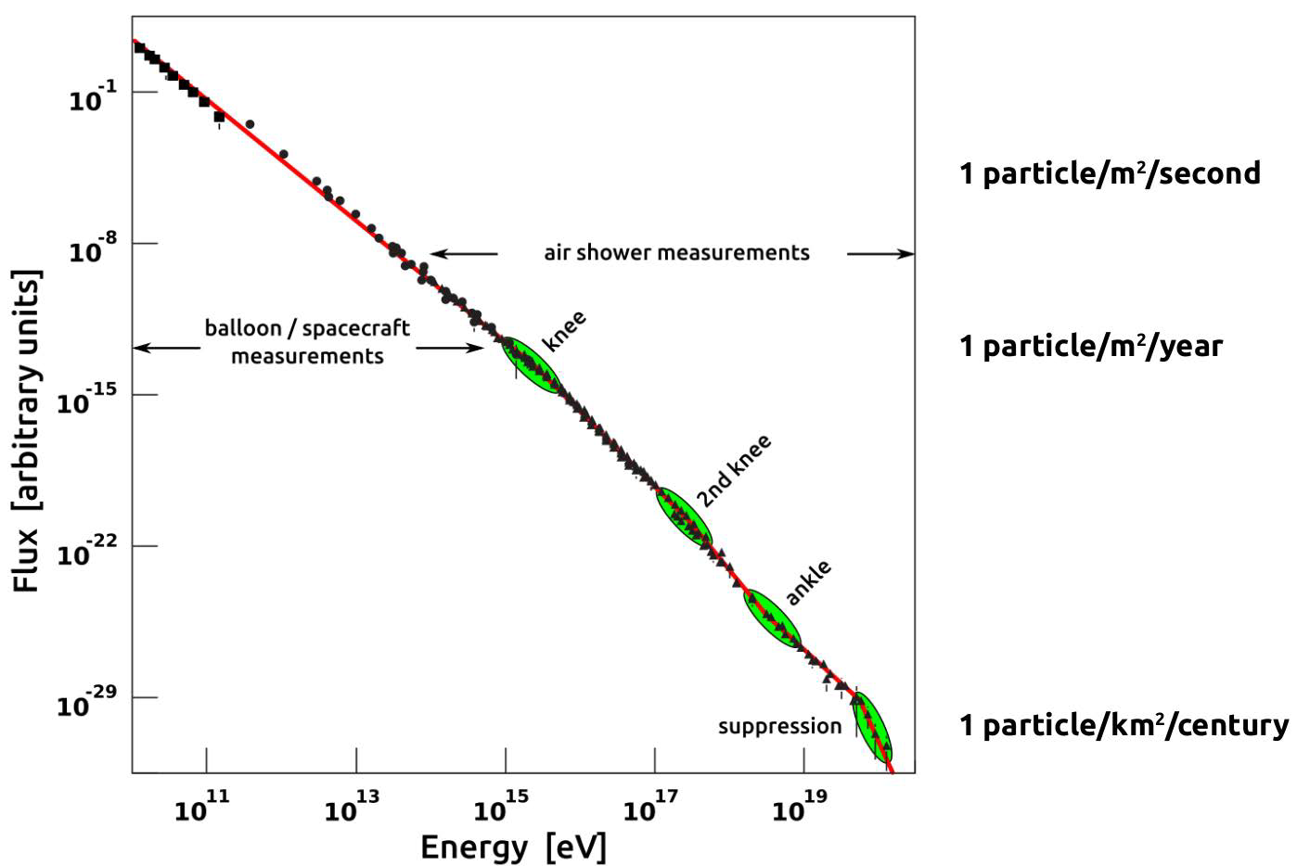
Cosmic rays and their energies
Power law with features
Non-thermal
LHC cms energy
LHC beam
Chemical composition?
What causes suppression?
Transition galactic-extragalactic?

Slide 5

The perimeter of this lecture
Messenger particles:
  Cosmic rays (protons, nuclei)
  Gamma rays
  Neutrinos
Energy per messenger particle: 10 GeV … some 10²⁰ eV
Selected experiments and results

Slide 6
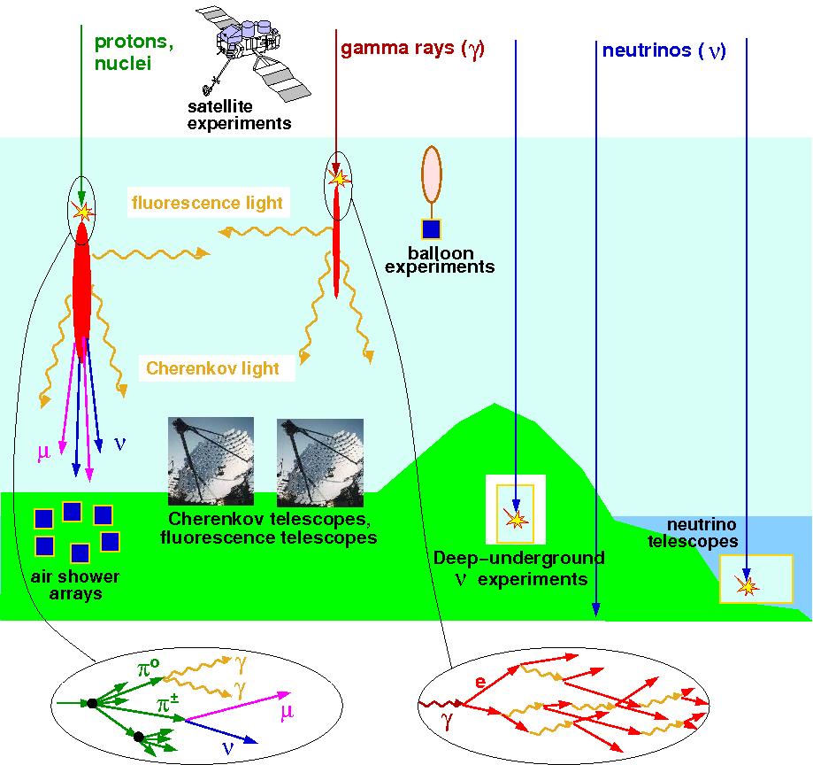
Measuring cosmic particles

Slide 7
Selected experiments
KASCADE(-Grande) (ground)
CR
AMS-02
(space)
Pierre Auger, TA
(ground)
H.E.S.S, MAGIC, Veritas → CTA (ground)
γ
Pierre Auger
(ground)
Fermi (space)
HAWC (ground)
IceCube → IceCube-Gen2 (deep ice)
ν
ANTARES → KM3NeT (deep sea)
Pierre Auger
(ground)
GVD (lake Baikal)
10
12
14
16
18
20
log₁₀(E[eV])

Slide 8
Different messengers → Multi-messenger
The exploration
of the high-energy
Universe requires
multi-messenger studies
including neutrinos!

Slide 9
Cosmic-ray experiments

Slide 10
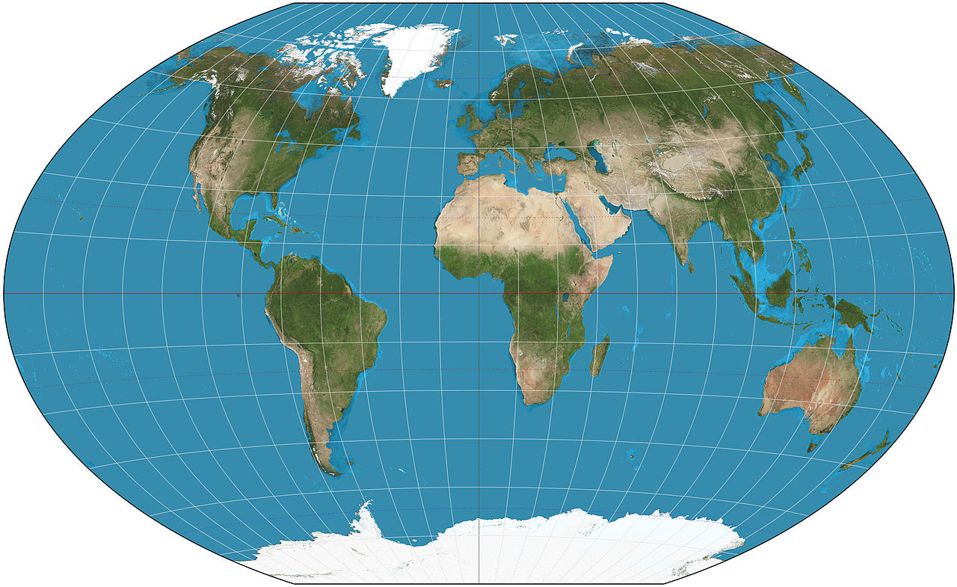

Some hybrids with Cherenkov detectors
AMS-02 (2011 –)
on ISS
space station
KASCADE (1996-2013)
KASCADE-Grande (2000-13)
Central detector + array
Telescope Array (2007 – )
Fluorescence telescopes, Scintillator detector array
Pierre Auger Observatory
(2008 – )
Fluorescence telescopes, Cherenkov detector array

Slide 11
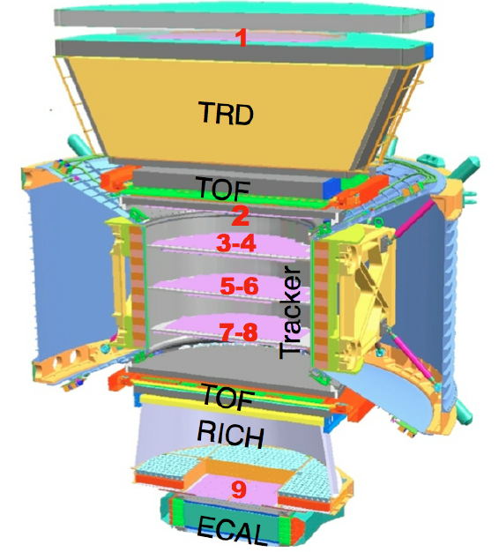
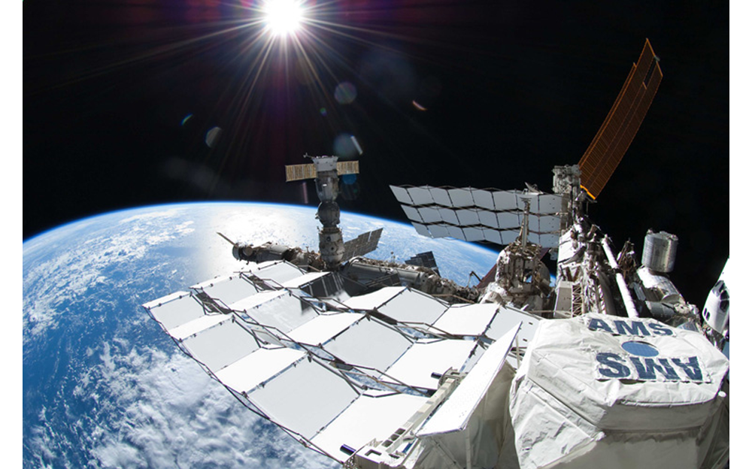
The Alpha Magnetic Spectrometer (AMS)
Particle physics detector on ISS (tracker, calorimeter, PID)
Launched May 2011

Slide 12
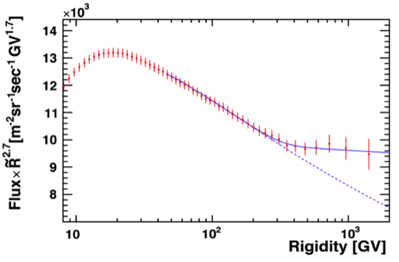
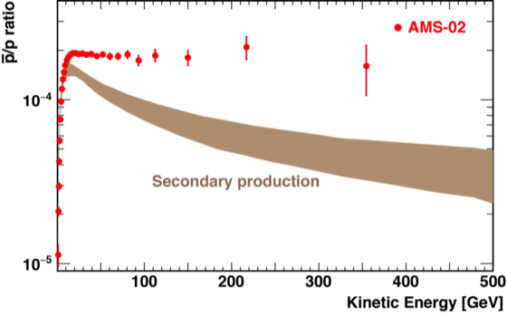
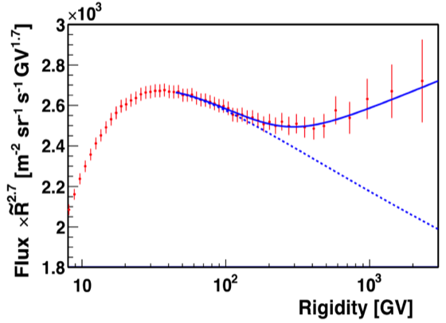
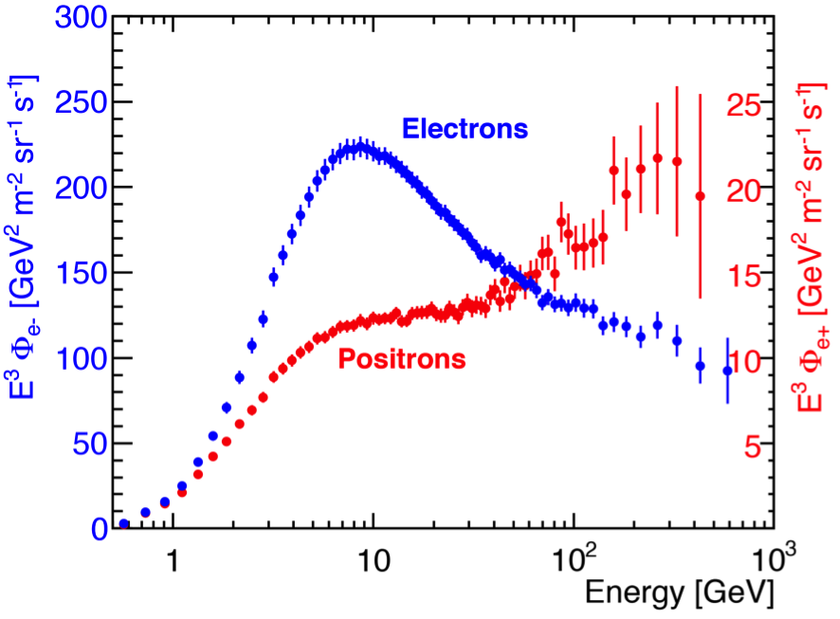
AMS: new results, new questions
3x10⁸ protons
Antiproton/proto ratio
5x10⁷ He nuclei
10⁷ e⁻ and e⁺

Slide 13
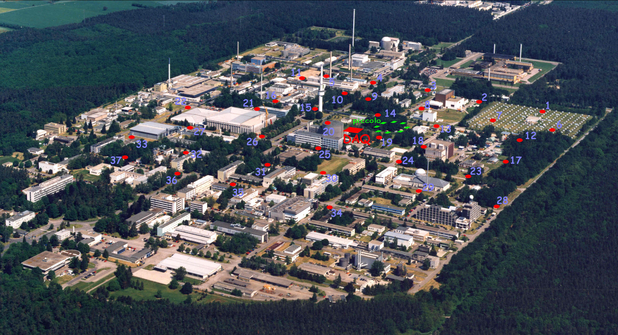
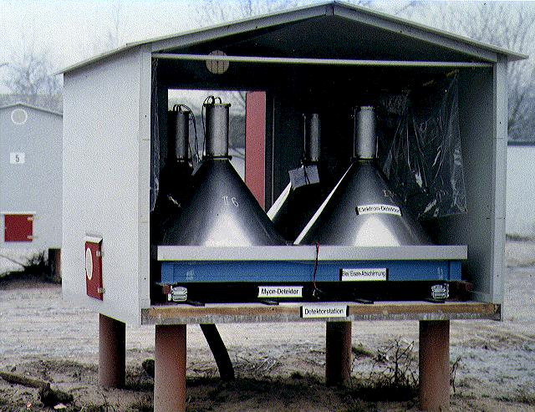
The KASCADE and KASCADE-Grande arrays
KASCADE
● KASCADE-Grande scintillator detectors
KASCADE e/µ detector station

Slide 14
Extended air showers
Primary interaction in
atmosphere
Model/simulate EAS
to derive properties of
primary (E, θ, Z/A) from
measurement result
Measurement on ground
Direction from timing
Separate e/µ components

Slide 15
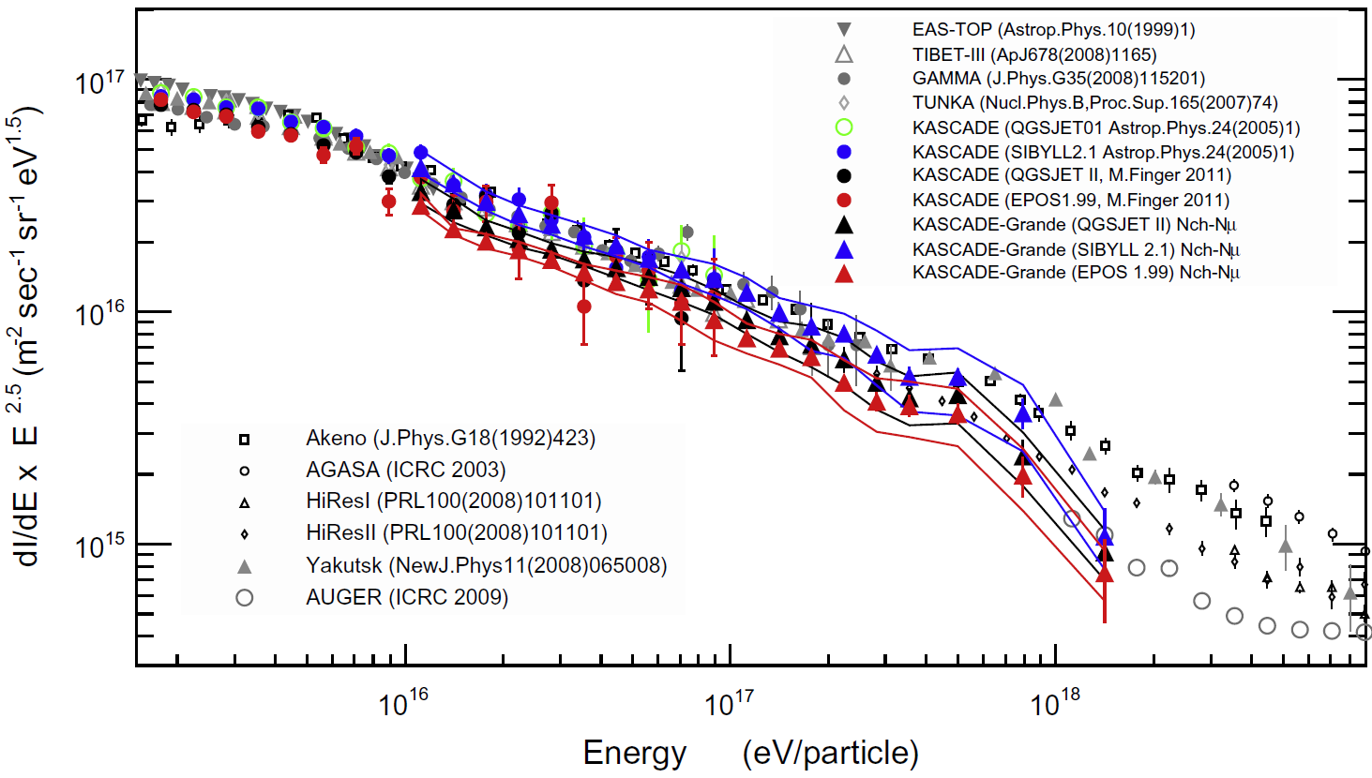
Impact of EAS simulations
EAS modelling not fully understood
Systematic uncertainty on results, in particular chemical composition
Tuning to LHC data helped but did not really solve the problem

Slide 16
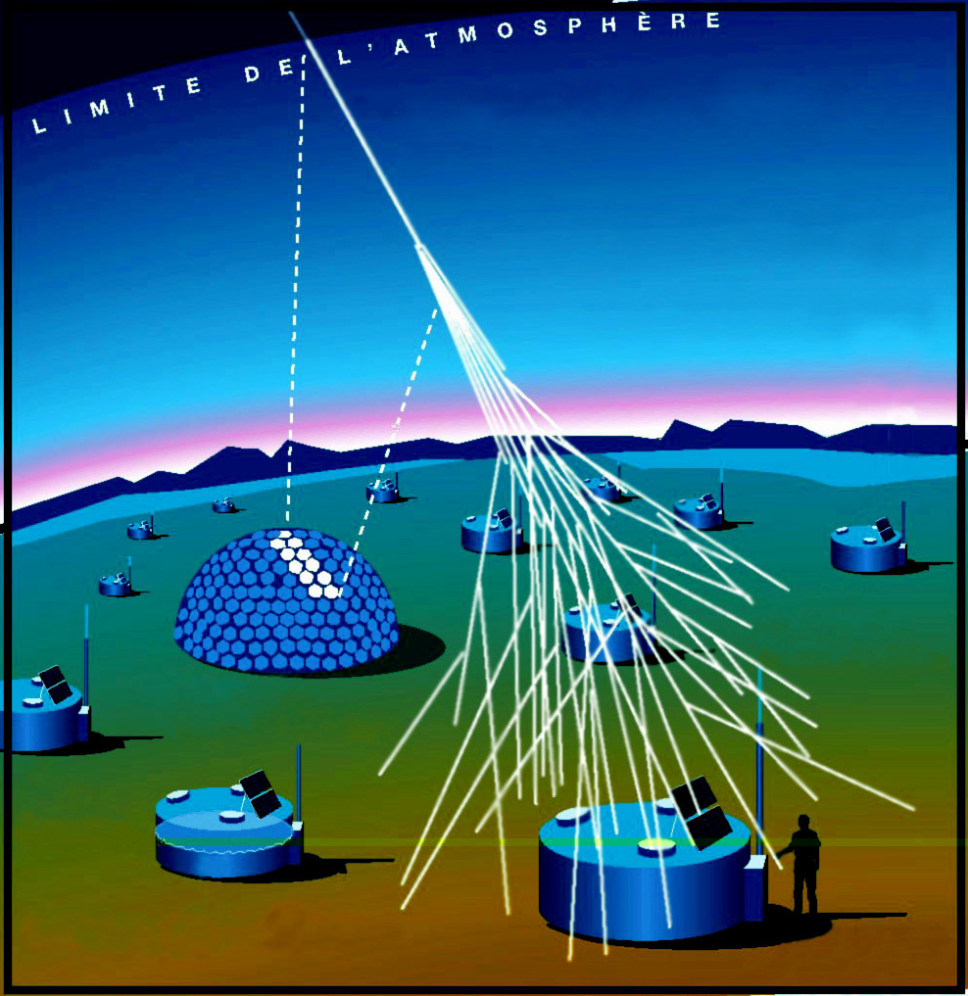
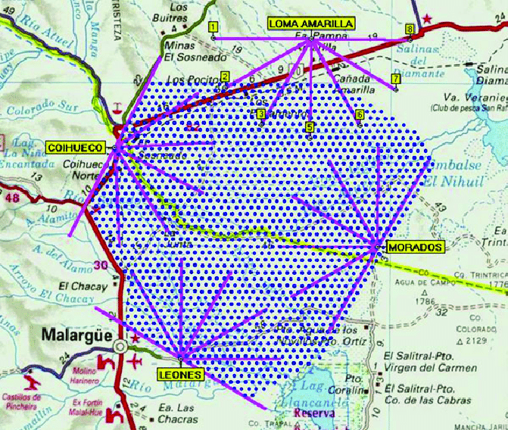
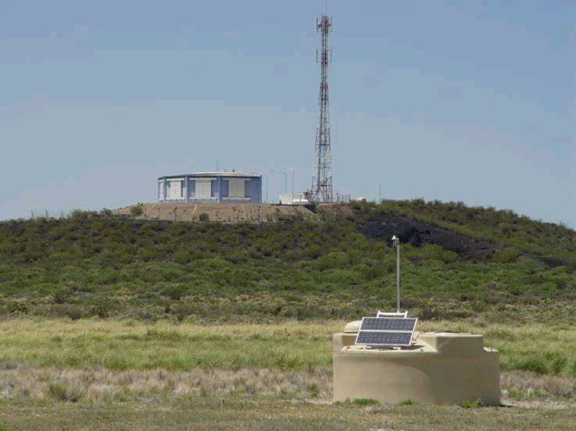
The Pierre Auger Observatory
60 km
1600 water tanks, 3000 km²
24 fluorescence telescopes
Radio array
Upgrade to AugerPrime ongoing
Hybrid
detection

Slide 17
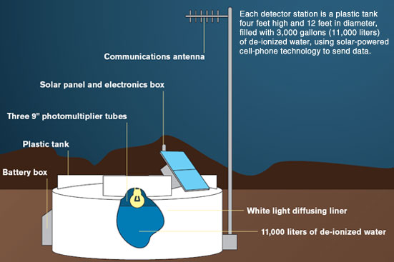
The Cherenkov detector
Calibration signal:
Single vertical muons
Measures amplitude,
wave form (→ time profile)
All communication by radio

Slide 18
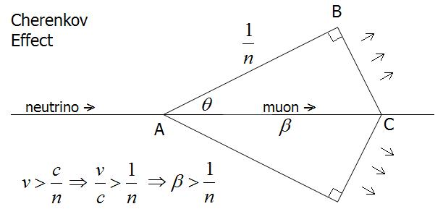
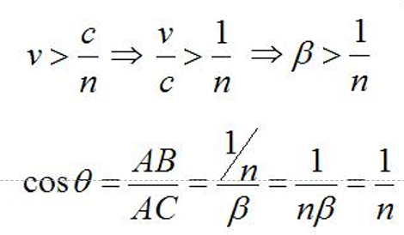
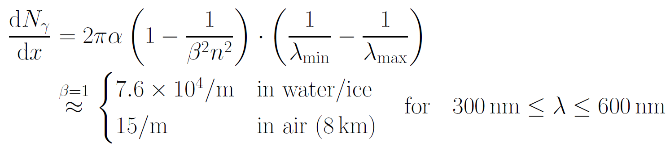
Cherenkov radiation
42°for water/ice
1°for air

Slide 19
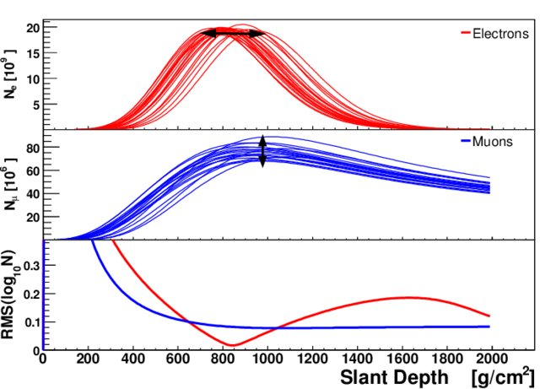
Cherenkov signal and shower age
µ
e
t
Electronic component “takes longer” than muon component
Electronic component dies out sooner → not present for inclined showers
Inclined shower with e component = neutrino

Slide 20
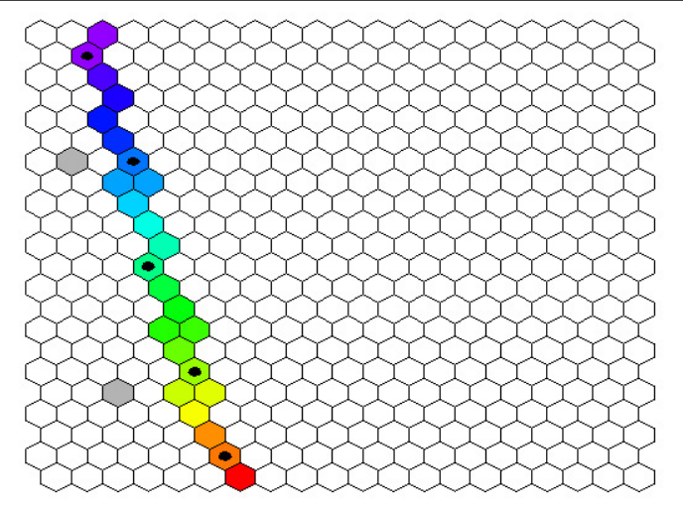
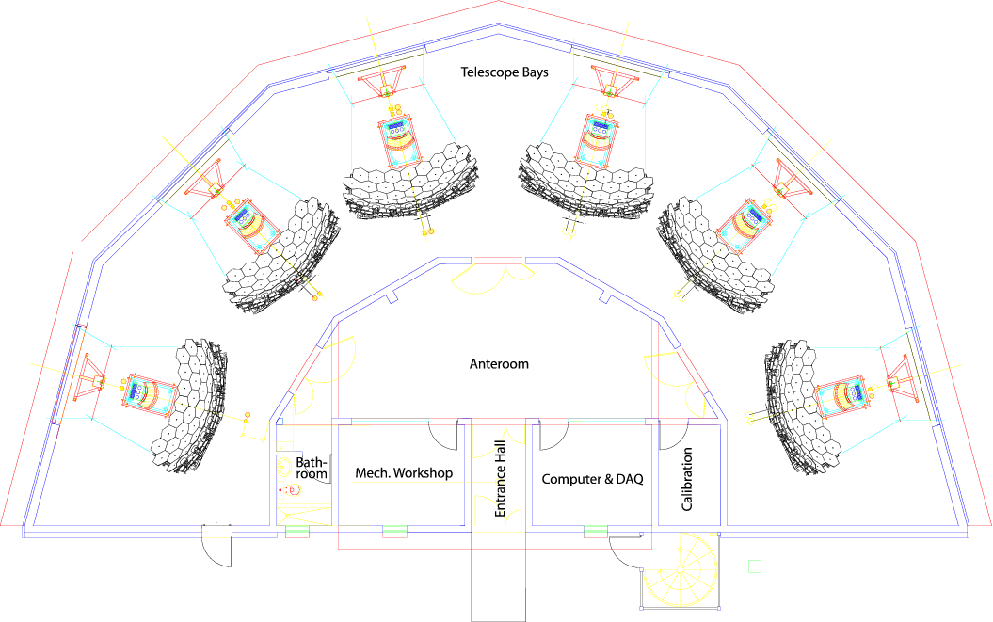
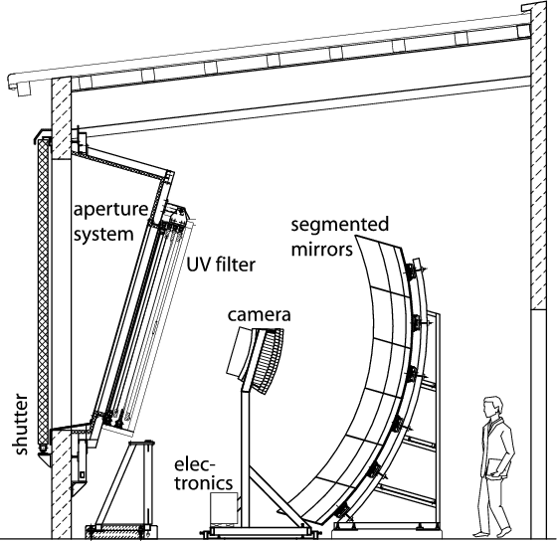
The fluorescence detectors
About 10 µs
from early (●)
to late (●)
24 telescopes + 3 high-elevation telescopes for low E (HEAT)
Record the fluorescence light of N₂ molecules excited in the EAS
Each camera equipped with 440 PMTs
Calibration requires monitoring of atmosphere

Slide 21
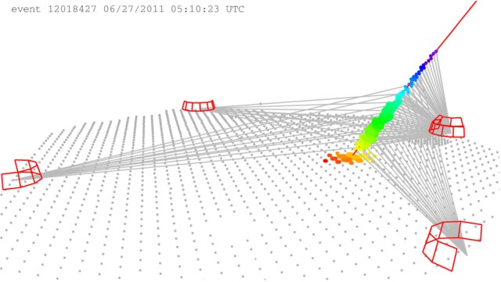
Hybrid events
Stereoscopic measurement → high resolution
Two independent energy measurements → cross-calibration
Fluorescence telescopes have duty cycle of ~10%, but are essential

Slide 22
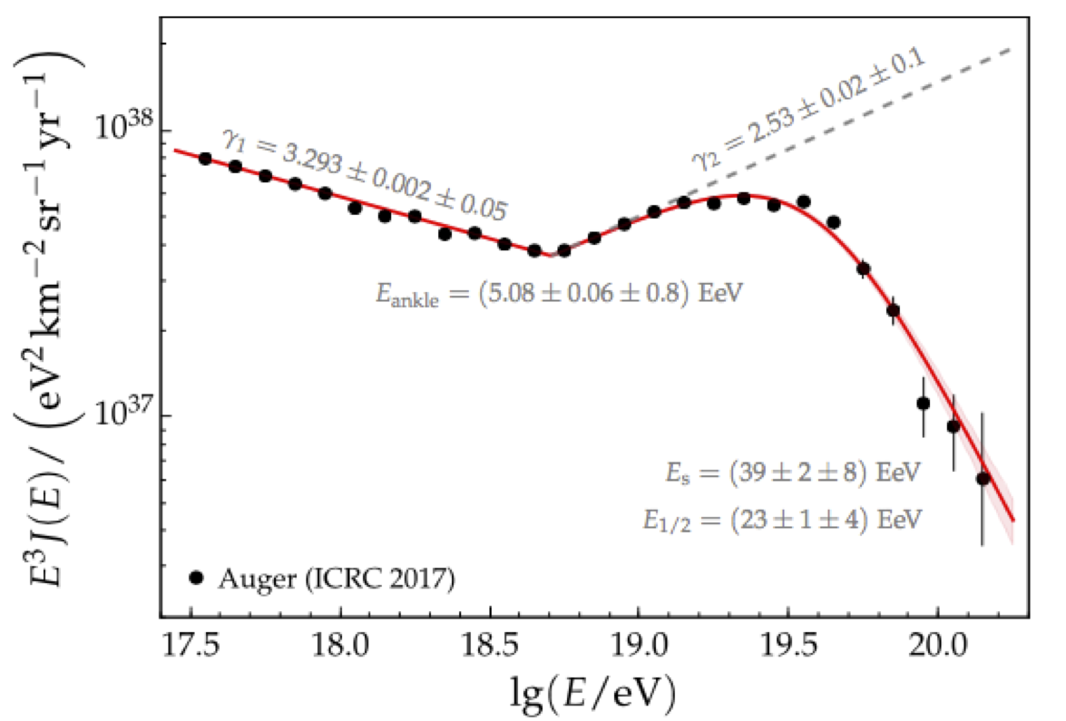
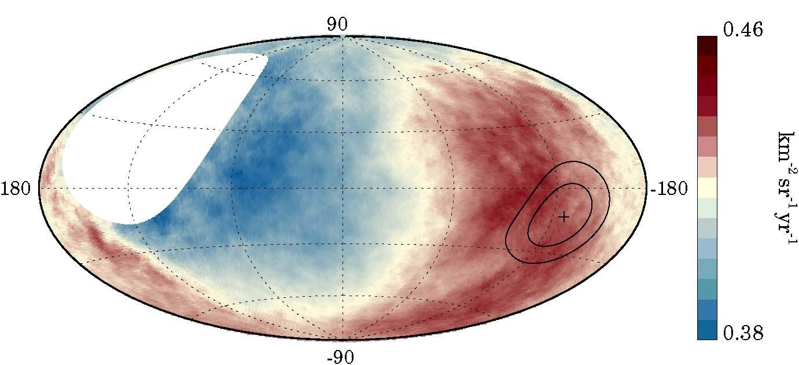
Key results: Energy spectrum, anisotropy
Cosmic ray spectrum up to 10^{20.2} eV
Discovery of large-scale anisotropy of cosmic- ray arrival directions
→ UHECRs do not come from Galactic centre
Open questions:
  Chemical composition?
  Origin of anisotropy?
  CR astronomy?
  GZK photons?
  Neutrinos?

Slide 23
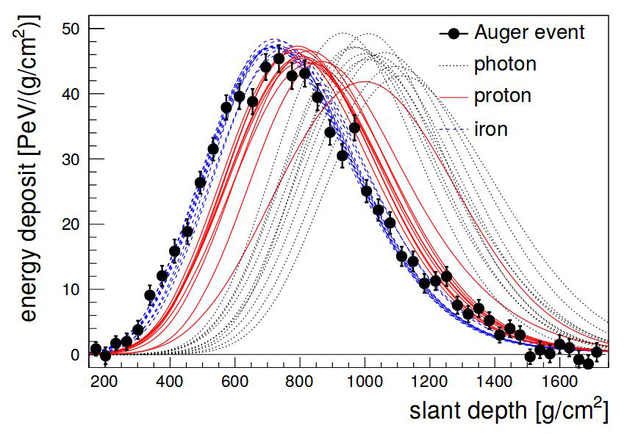
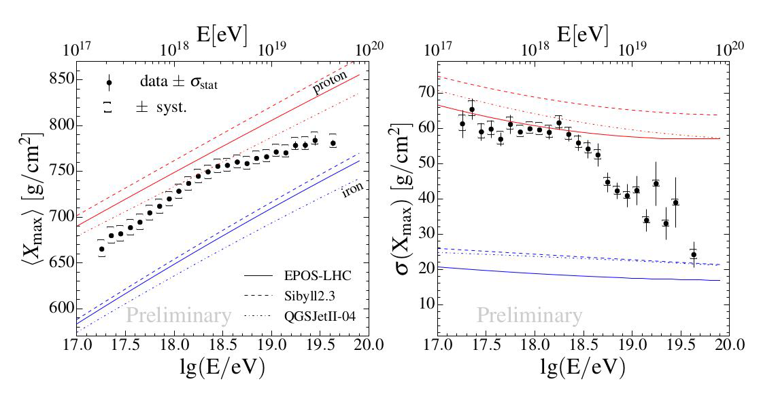
Chemical composition
Shower profile depends on
nuclear mass: heavier →
more primary interactions →
less deep, less fluctuations
Trend towards heavy nuclei
at E >10¹⁸ eV

Slide 24
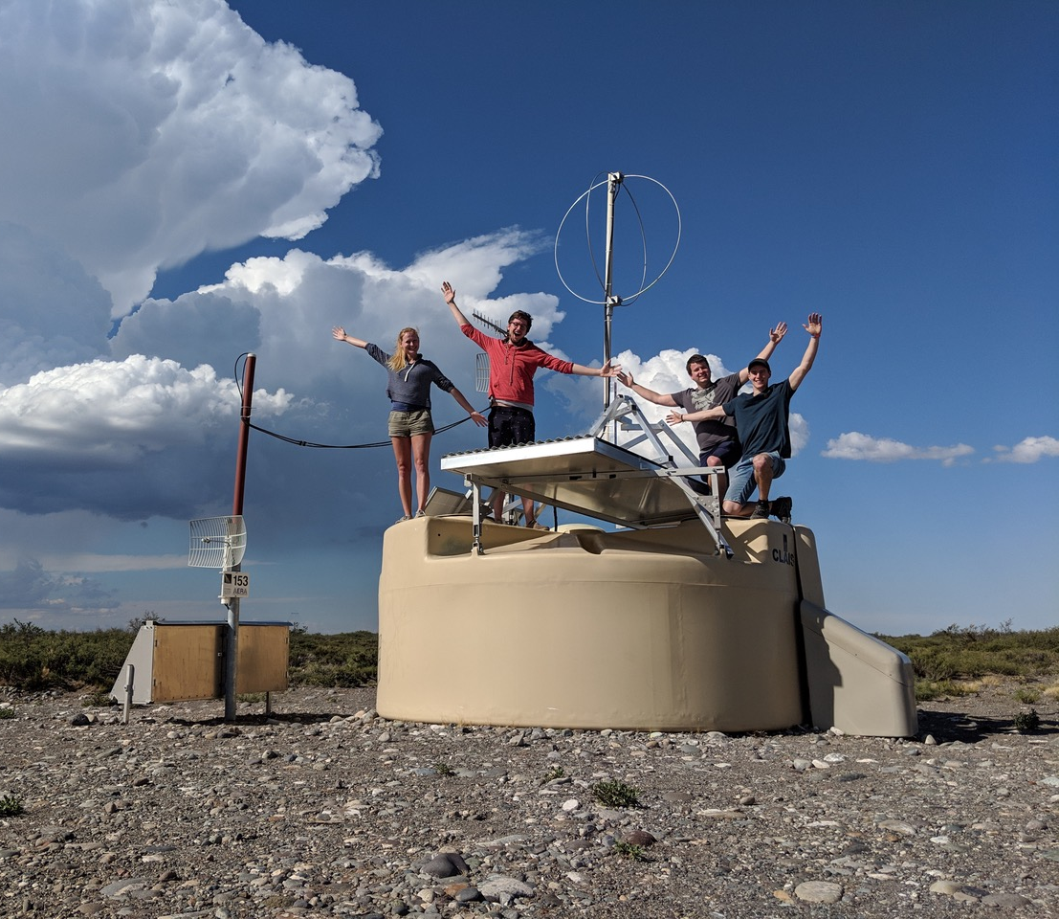
AugerPrime
Cherenkov detectors
equipped with additional
scintillator panels
Improved electronics
A further photomultiplier
(to avoid saturation)
Radioantennas
Under construction for
full Auger observatory
Main goal:
Better e/µ separation

Slide 25
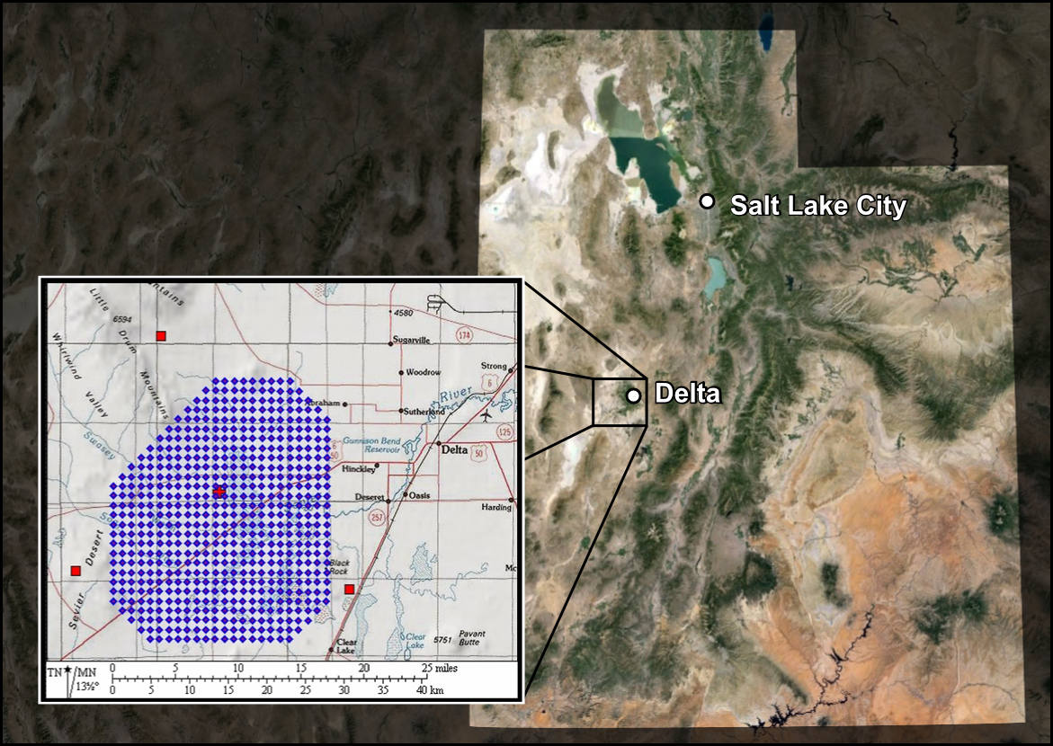
The Telescope Array (TA)
500 scintillator detector stations
3 Fluorescence telescope sites
700 km²

Slide 26
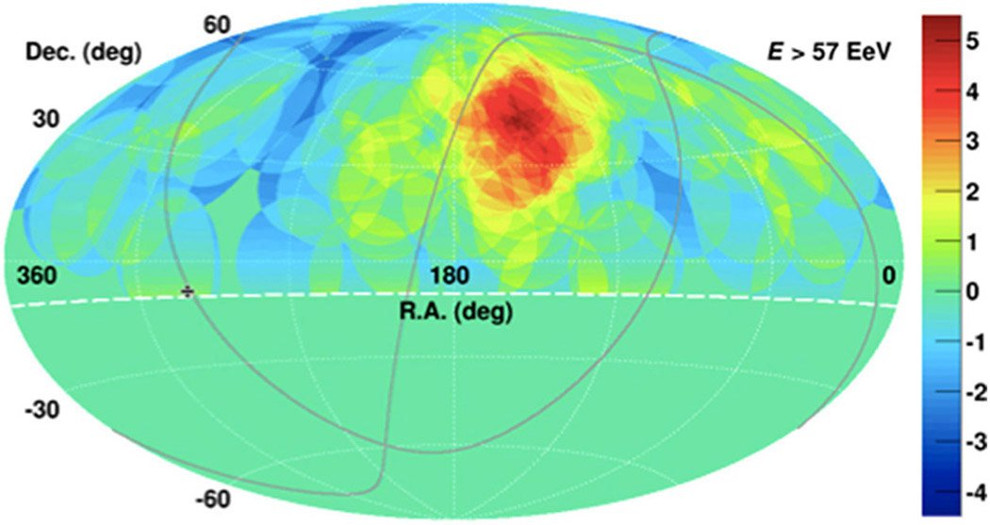
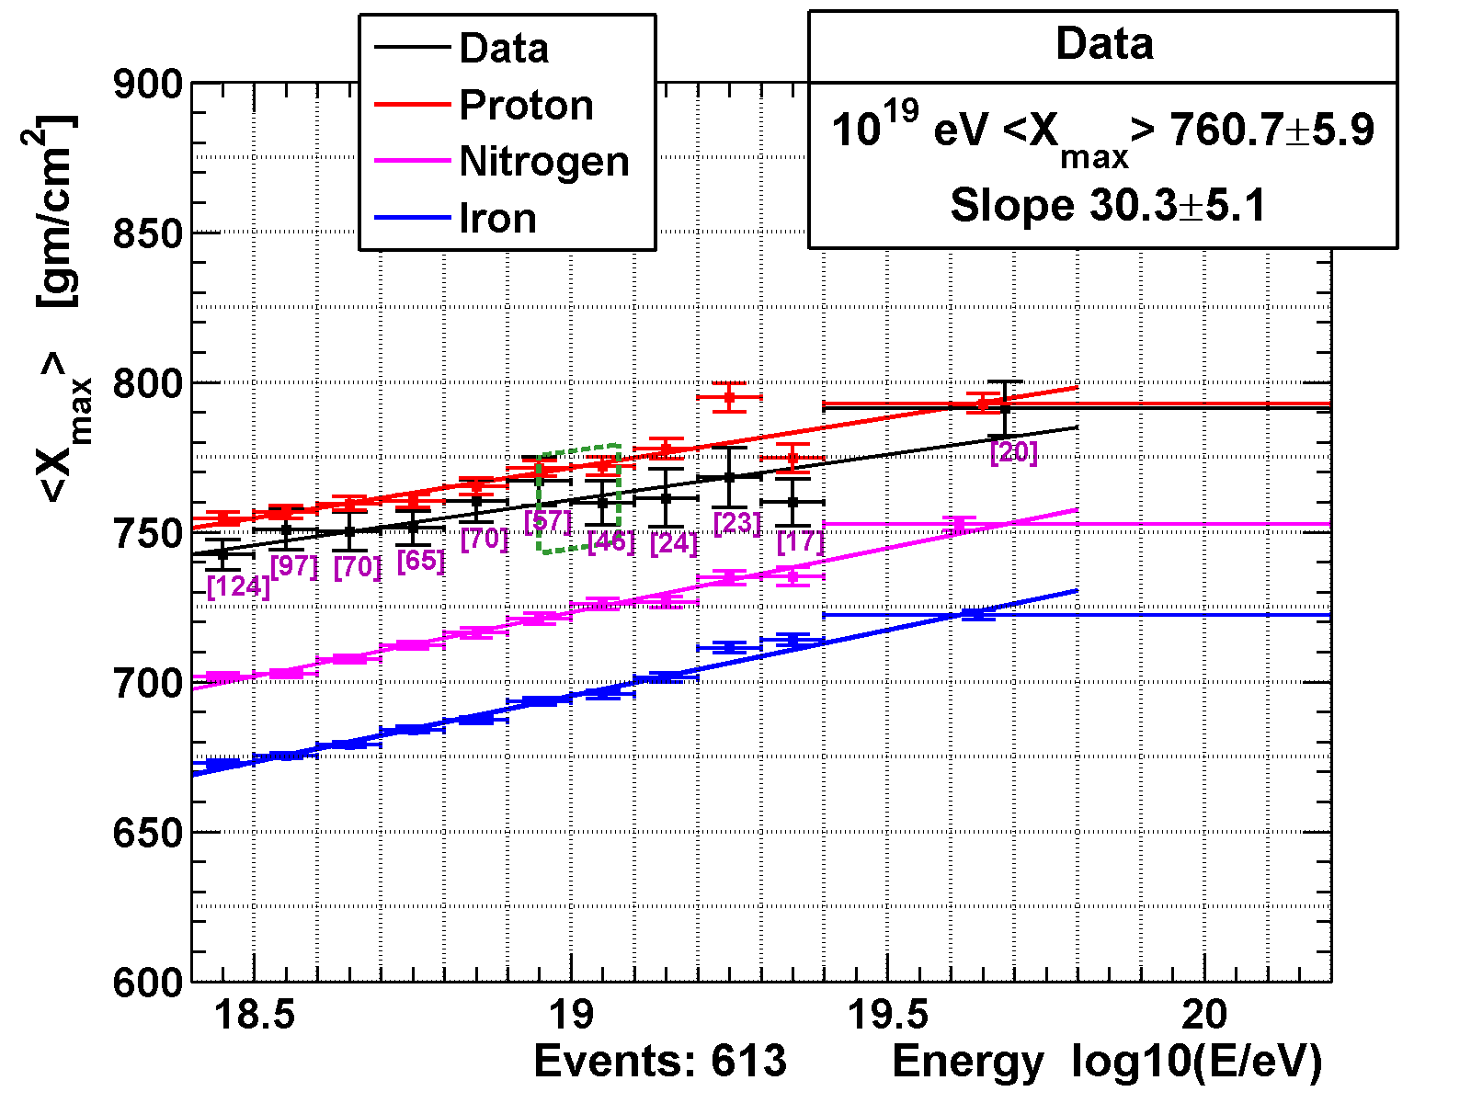
Two key results by TA
High- hot spot in Northern sky
Significance 3.4σ
Chemical composition at
highest energies more
proton-like
Difference to Auger:
Detector effect or
astrophysics?

Slide 27
Gamma-ray observatories

Slide 28
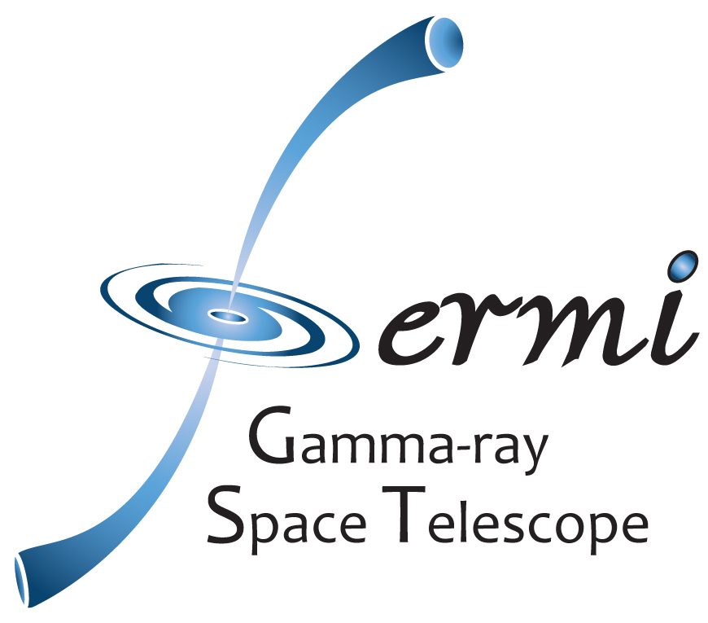




The IACT world map 2018
Fermi-LAT
2008 –
(on satellite)
MAGIC
2004 –
La Palma
Veritas
2007 –
Arizona/USA
CTA
~2021 –
Chile/Paranal + La Palma
H.E.S.S.
2003 –
Namibia

Slide 29
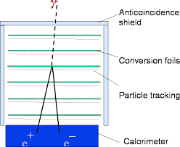
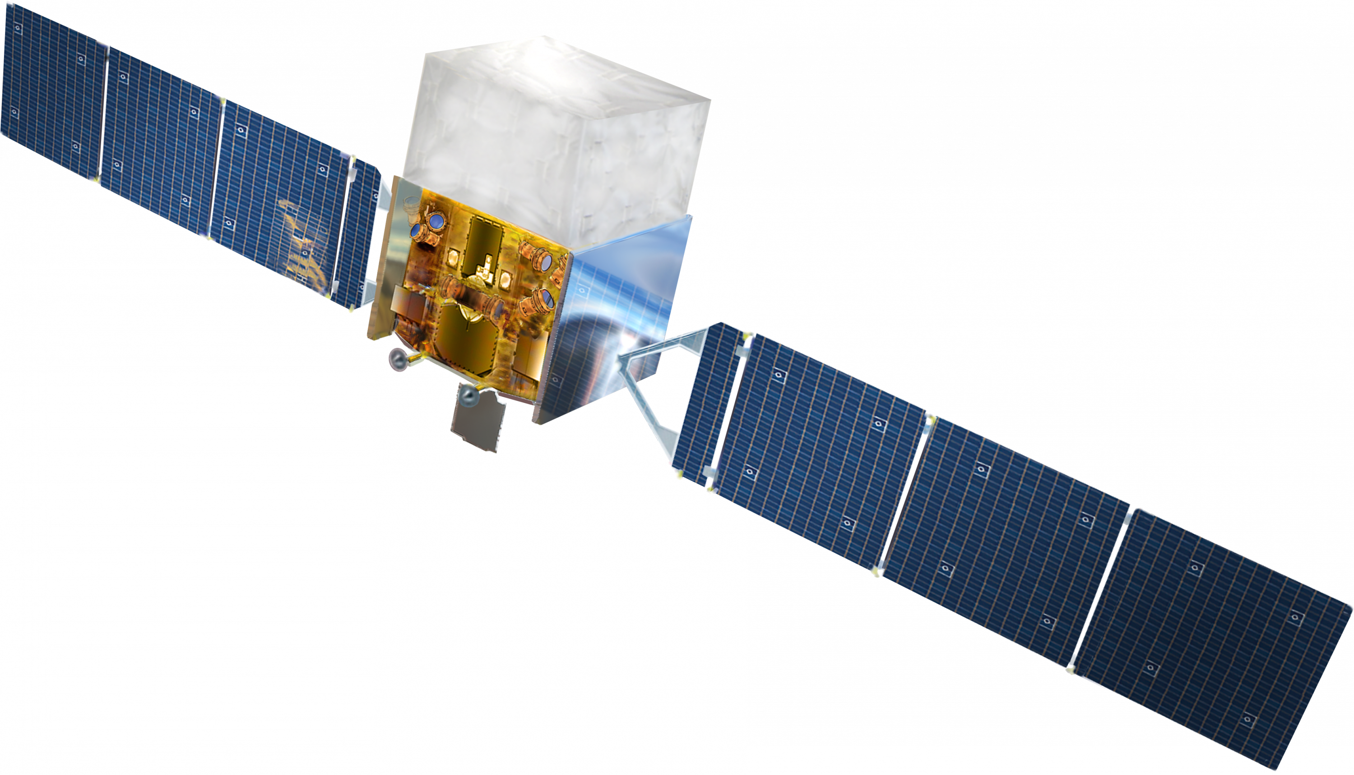
The Fermi Large Area Telescope
16 towers
Energy range 20 MeV – some 100 GeV
Field of view > 2.4 sr
Observes full sky ever 3 hours
Huge collection of results
Indispensable for detecting and following up transient gamma-ray sources

Slide 30
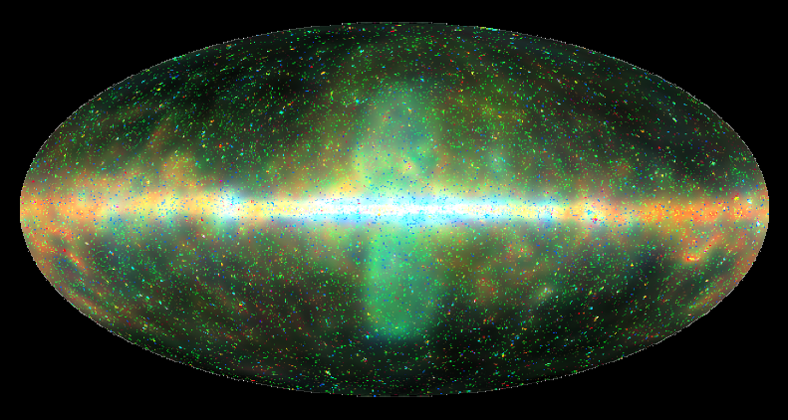
Fermi-LAT sky map
Huge number of sources
Diffuse emission (e.g. from “Fermi bubbles”)
But: Running out of statistics beyond some 100 GeV → IACTs

Slide 31
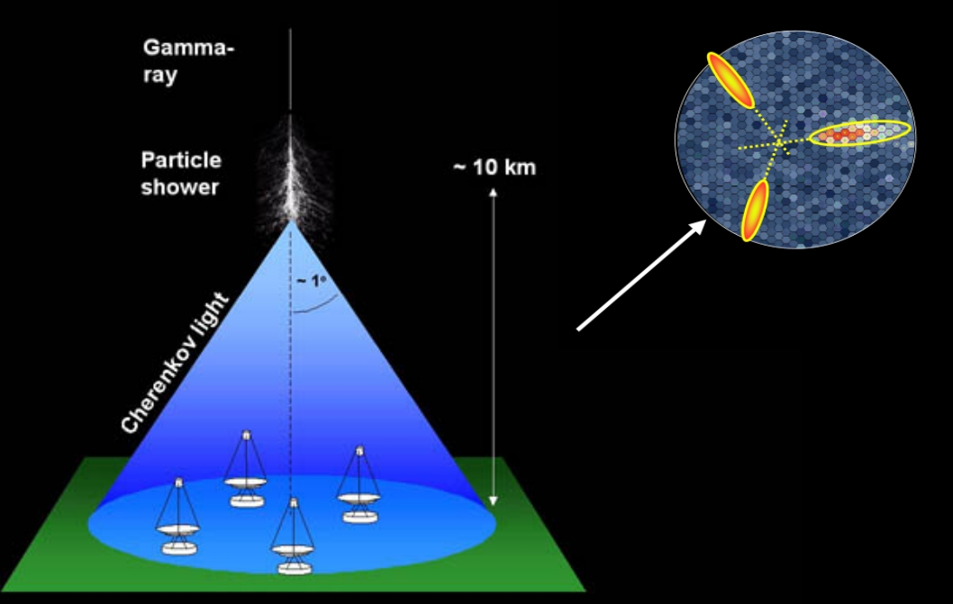
Imaging Atmospheric Cherenkov Telescopes
(IACTs)
Source position
Small θ_{C} (early shower)
Large θ_{C}
(late shower)
Direction and gamma/hadron
separation from geometry.
Energy from intensity.
High elevation to reduce atmospheric absorption

Slide 32
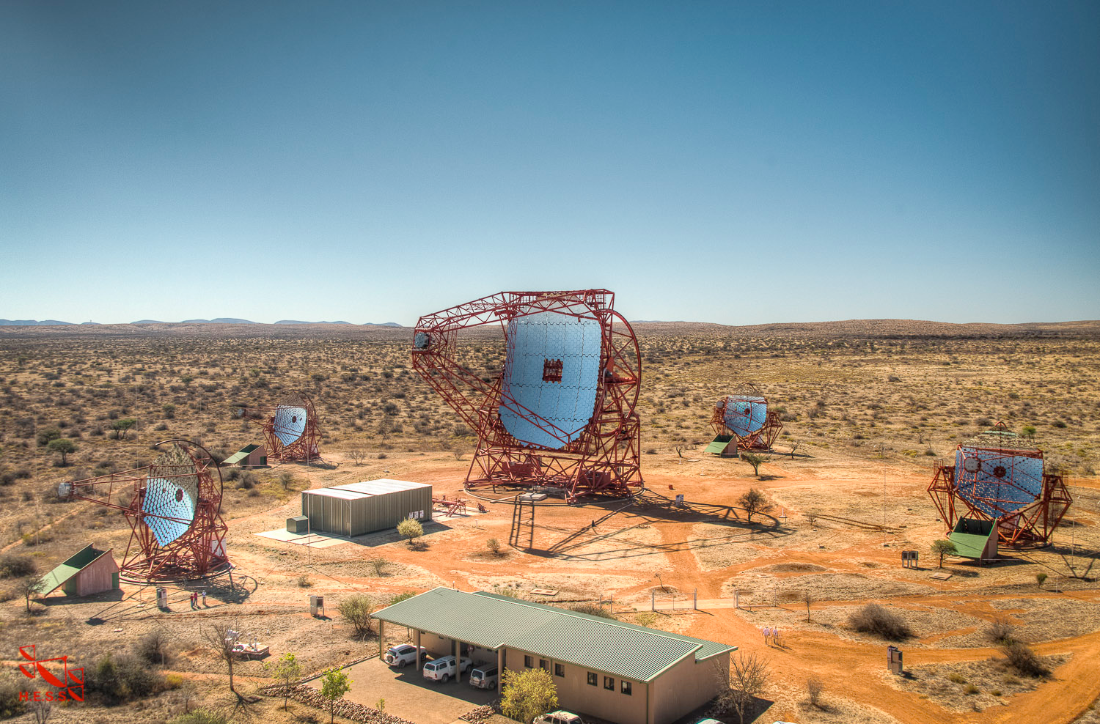
Example: The H.E.S.S. telescope in Namibia
4x 100 m² mirror area (since 2003)
energy threshold ~ 100 GeV
1x 600 m² mirror area (since 2012)
energy threshold ~ 50 GeV
Energy range:
100 GeV – some PeV
(“high-energy”, HE)
120 m

Slide 33
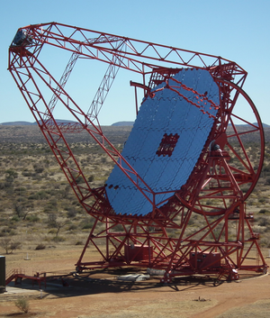
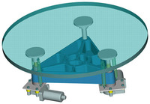
Example: The large H.E.S.S. telescope
Steel frame, total weight 580t
“Alt-az mount” (telescope can be pointed to any direction within minutes)
Faceted mirror, 614 m², focal length 36 m
Facets are focused to
within 1 arcmin

Slide 34
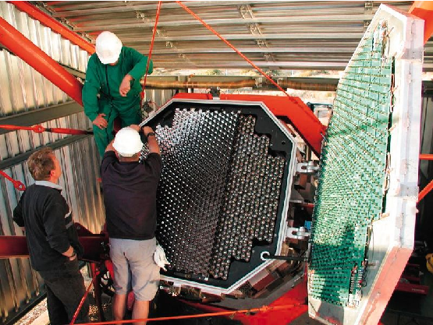
The H.E.S.S. camera (small telescopes)
960 pixel, each one photomultiplier
Dynamic range:
1-2000 photons
Overall 5°field of view
Electronics integrated
Trigger uses coincident hits inside 8x8 pixel sectors; coincidence window ~1.5 ns
(Note: Night-sky background
~100 MHz/pixel)

Slide 35
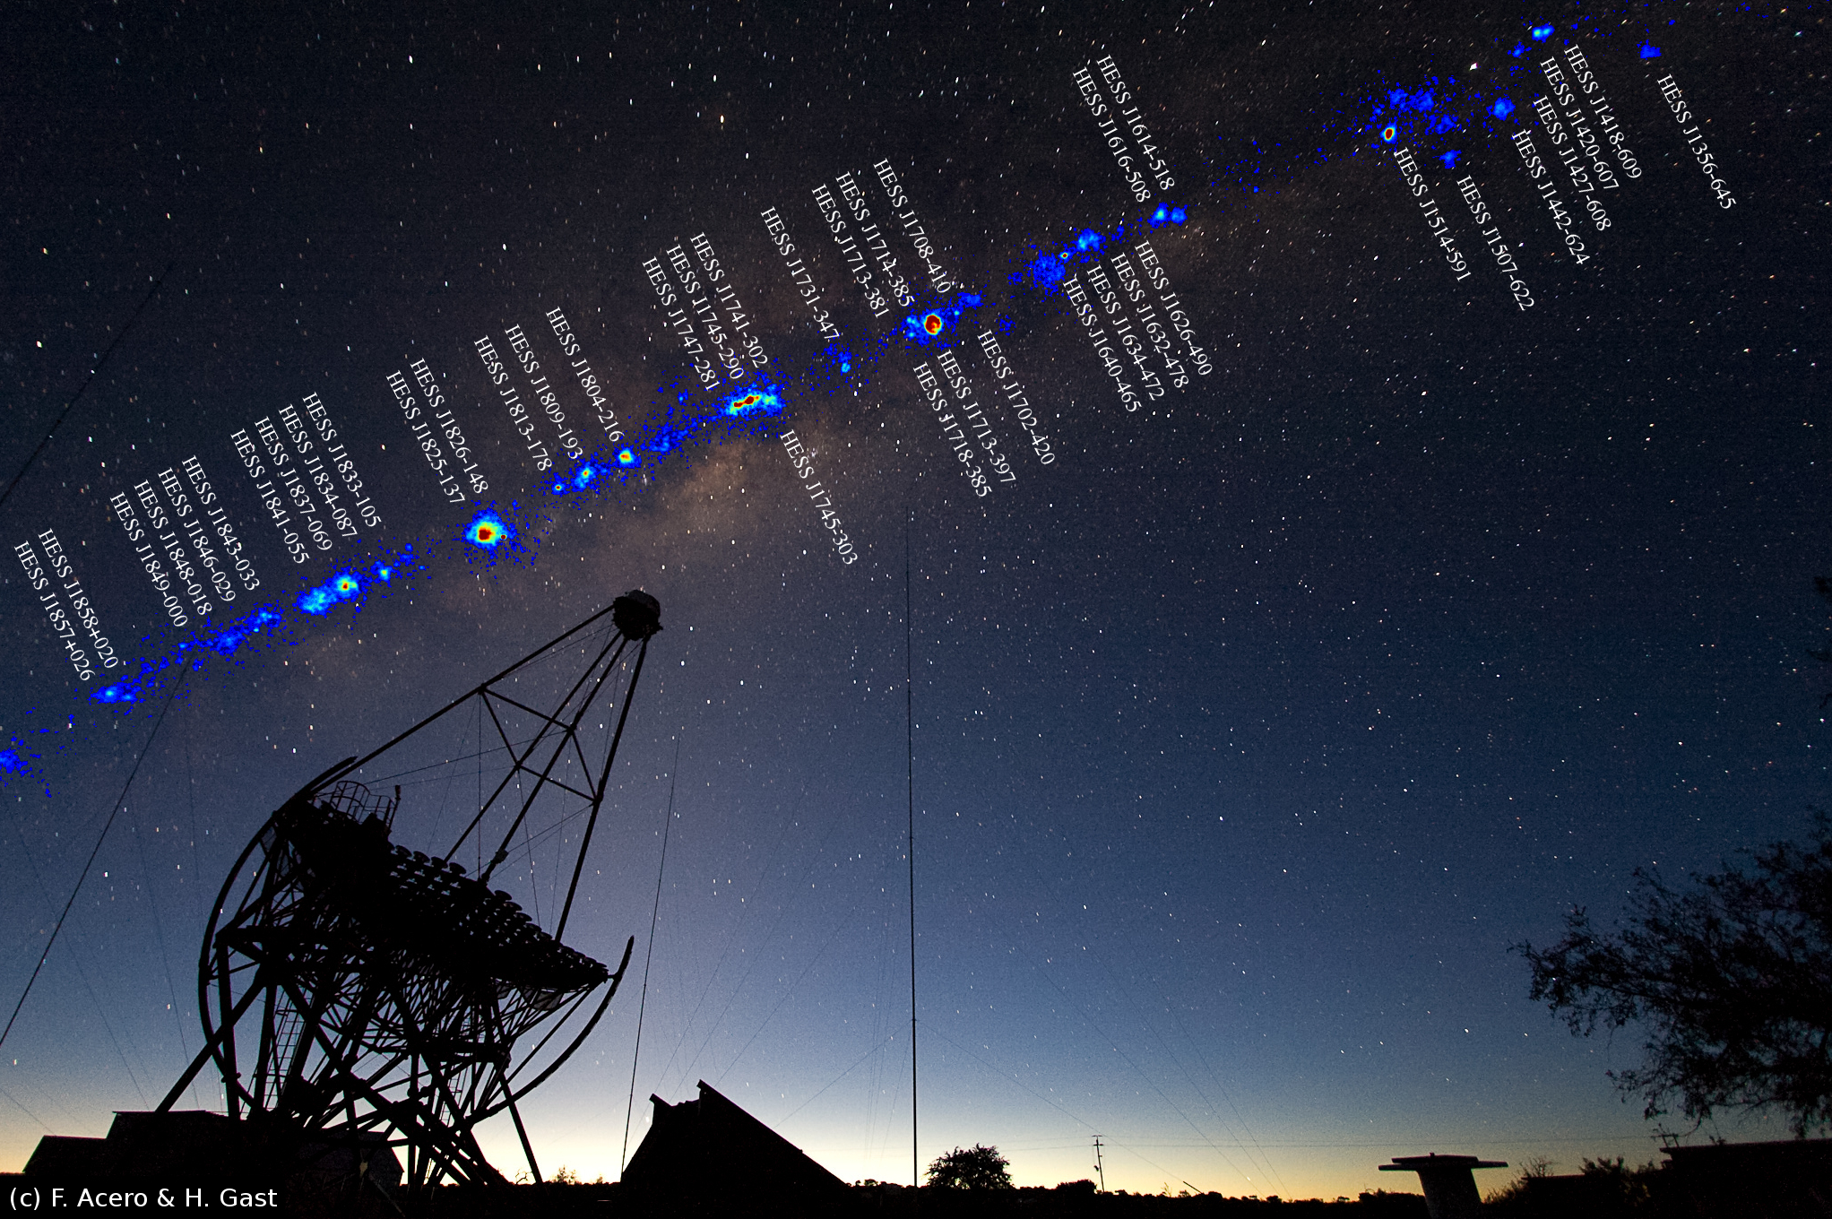
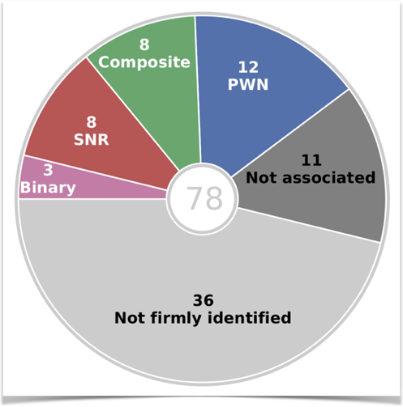
H.E.S.S. survey of the inner Galaxy
Galactic Plane
Galactic Centre
H.E.S.S. legacy project:
3000 h of observations (2004-2013)
survey maps, catalog, population studies
H.E.S.S. Coll. (2018):
Astron. & Astrophys. Special Issue 612 (2018) on
“15 years of H.E.S.S. observations of the Milky Way”
U. Katz: Cherenkov detectors in astroparticle physics RICH 2018, Moscow

Slide 36
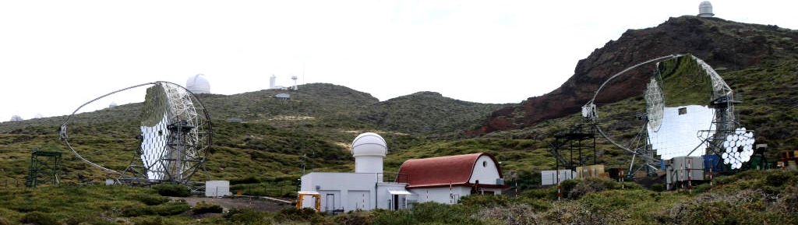
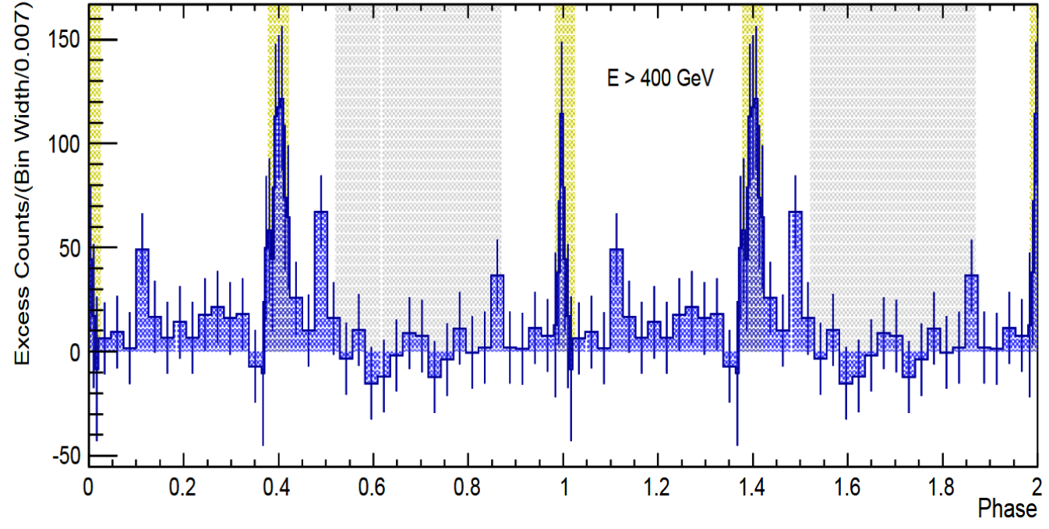
MAGIC on La Palma
Detection of pulsed
TeV gamma-ray
emission from Crab
(2015)
Astron.Astrophys. 585 (2016) A133

Slide 37
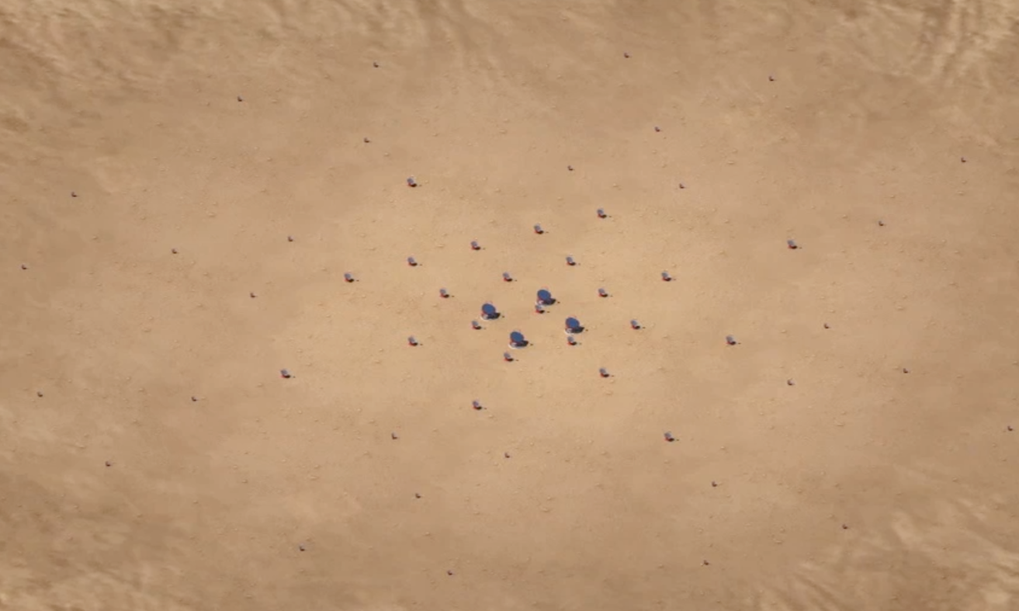
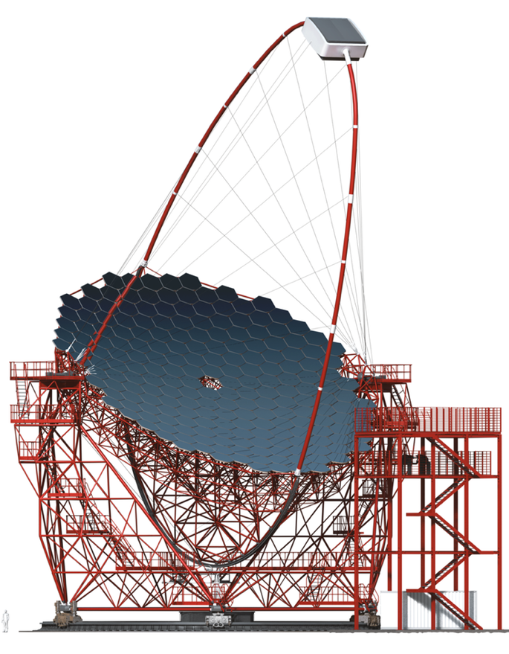
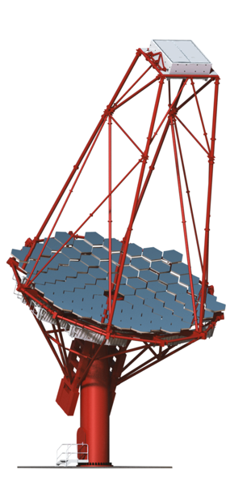
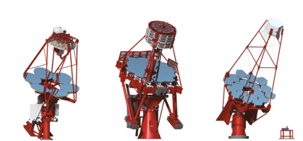
The future: Cherenkov Telescope Array (CTA)
10 GeV 100 GeV 1 TeV 10 TeV 100 TeV
10 GeV 100 GeV 1 TeV 10 TeV 100 TeV
10 GeV 100 GeV 1 TeV 10 TeV 100 TeV
10 GeV 100 GeV 1 TeV 10 TeV 100 TeV
1000 γ / h / km²
10 γ / h / km²
0.1 γ / h / km²
70 x 4 m ∅ Small Size Telescopes (SST) (South only)
25 x 12 m ∅ Medium Size Telescopes (MST) (North: 15)
4 x 23 m ∅ Large Size Telescopes (LST)
Compared to current instruments
up to 10 x better sensitivity
over 4 decades coverage in energy
much larger field of view
better resolution
up to 400 x increased survey speed
Layout optimized
using detailed
simulations –
tens of millions CPU-h
Southern array
of Cherenkov telescopes
- about 3 km across

Slide 38
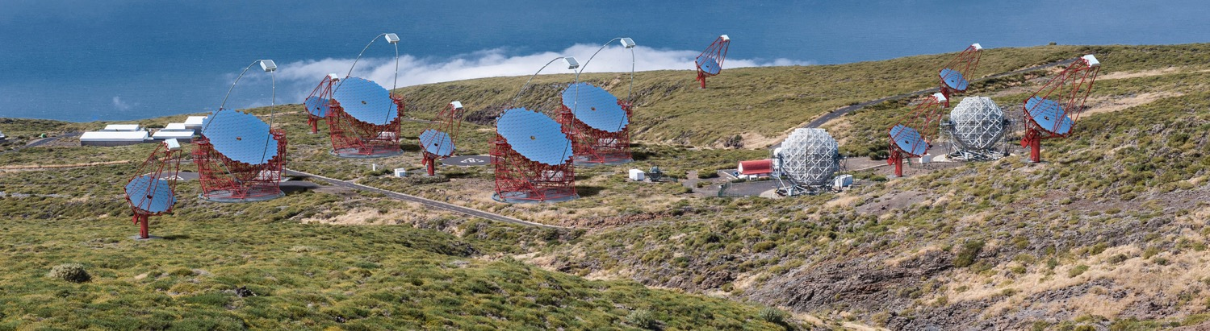

The CTA sites
CTA North (La Palma)
4 LST, 15 MST
CTA South (Chile)
4 LST, 25 MST, 70 SST

Slide 39

CTA sensitivity (steady sources)

Slide 40

Larger acceptance: Timing arrays
For UHE gamma-ray and cosmic-ray detection
Shower must “survive”
→ (very) high altitude
Measurements:
  Direction from timing
  Energy from footprint size
  Gamma/hadron separation from shower geometry
Often combined with additional
detector elements (telescopes, muon chambers, radio antennas)
→ hybrid detectors
Array of ground-based detectors,
ns-timing (precision, synchronisation)

Slide 41


Example: The HAWC detector
50m
7.3m
4100m altitude, near Puebla, Mexico
300 water tanks, 200.000 litres each, observed by 4 PMTs
Direction resolution ~0.1°for E_{γ}>10TeV, good gamma/hadron separation, duty cycle close to 100%.
Wide field of view, but less sensitive than IACTs for any given direction

Slide 42

A recent HAWC result
Extended TeV gamma-ray emission from two pulsars
Topology constrains positron diffusion
Observed positron excess unlikely to come from these pulsars

Slide 43
Neutrino telescopes

Slide 44




The HE neutrino telescope world map 2018
ANTARES
Deep water
0.01 km³
2008 – 2019
Baikal/GVD
Deep water
~1 km³
Construction
KM3NeT
Deep water
1 + 0.006 km³
Construction
IceCube
Deep ice
1 km³
2011 –
IceCube-Gen2
Deep ice
~10 km³
Projected, 1st
phase imminent

Slide 45

How does a neutrino telescope work?
Neutrino interacts in the
(vicinity of the) telescope
Charged secondaries cross the detector volume (water or ice) and stimulate Cherenkov emission
Recorded by a 3D-array of photo-sensors
“Traditional” channel:
Cascades from almost all other reaction channels
Energy range :
10(0) GeV – some PeV

Slide 46
What a neutrino telescope sees
Atmospheric neutrinos from cosmic-ray interactions in atmosphere
  reducible only if accompanying
  muons measured
  important calibration source
  allow us to study oscillations
Atmospheric muons from cosmic-ray interactions in atmosphere above NT
  penetrate to NT
  exceed neutrino event rate by
  several orders of magnitude
Sea water: light from K40 decays and bioluminescence
➔ Sensitivity depends on source position
and neutrino energy spectrum!
p
μ
NT
Earth
ν
ν
Atmosphere
p

Slide 47

IceCube: A km³ detector in the Antarctic ice

Slide 48

IceCube: Most sensitive v telescope to date
86 strings altogether
  125 m horizontal spacing
  17 m vertical distance
  between Optical Modules
  1 km³ instrumented
  volume, depth 2450m
Deep Core
  densely instrumented
  region in clearest ice
Completed in Dec. 2010
Extremely stable and
efficient operation since then

Slide 49

A first glimpse at cosmic ν’s
By Francis Halzen
2013: Discovery of HE cosmic neutrinos
2018: First neutrino source
Big Bird, 2.0 PeV

Slide 50

Systematic search for such events …
Select events interacting
inside the detector only
No light in the veto region
Veto for atmospheric
muons and neutrinos
(which are typically
accompanied by muons)
Energy measurement:
total absorption calorimetry
→ “High-energy starting
events” (HESE)
Meanwhile further analyses

Slide 51


Where do they come from?
HESE 6 years
Absorption in Earth above some 10 TeV
80 events, expected background 25.2/15.6 atmospheric µ/v
No significant clustering or correlation with Galactic Plane
More events from Southern than from Northern sky

Slide 52

What is their energy spectrum?
Extending to PeV
Consistent with
power-law energy
spectrum ~E^{-2.9}
No clear candidate
events for Glashow
resonance
(v_{e} + e⁻ → W)

Slide 53


Trough-going muons
Analysis of up-going
muons (2009-2017)
→ Northern sky
Consistent with
power-law energy
spectrum ~E^{-2.2}
Some tension between
HESE and v_{µ} spectra
  Difference between North
  and South?
  Multi-component spectrum?
  Systematics (background,
  energy reconstruction, …)?
  Statistical fluctuation?

Slide 54

Currently taking data: ANTARES …
The first deep-sea v telescope
Installed near Toulon at a depth of 2475m
12 strings with 25 storeys each,
Instrumented volume ~0.01km³
Data taking in full configuration since 2008
Proof of principle of deep-sea ν telescope
Lots of results – but (too) small for cosmic neutrinos

Slide 55



Does ANTARES see a signal?
Indication of a signal in
track- and shower-like
event samples
Consistent with IceCube
findings

Slide 56
The Baikal GVD
First results from 2016+17 data:
→ Understanding atmospheric muons
→ Seeing atmospheric neutrinos
→ Limits on v flux from GW170817
→ A 157 TeV cascade event
525 m
120 m
700 m
Project to construct a Gigaton (=km³) detector in Lake Baikal
Phase 1 (GVD-1): 8 clusters (see figure), 0.4 km³
3 clusters operational, 1-2 more clusters to be deployed per season
Commissioning, calibration, sensitivity studies in progress
Final goal: 27 clusters, 1.5 km³

Slide 57


GVD construction
Deployment in winter from frozen surface of Lake Baikal
Maintenance & repair operations possible
10-inch Hamamatsu PMTs, in situ digitisation, data transfer via Ethernet

Slide 58



GVD: first data analysed, first v’s …
2016 data: select atmospheric muons (≥6 OMs at ≥3 strings)
Apply quality cuts and boosted decision tree for v/µ separation
… and observe first neutrinos!
Preliminary
data
atm. muons
atm. neutrinos
З3.1 live-days
23 selected events
- - Atm. µ
simulation
After detector
response
• Data

Slide 59

The future in the Mediterranean: KM3NeT
31 3’’-PMTs per optical module
18 modules per string
115 DUs per building block
ARCA: 2 blocks for v astronomy
ORCA: 1 block for v oscillations
Deployment
2018-21

Slide 60

The KM3NeT Digital Optical Module
31 3-inch PMTs in 17-inch glass sphere (cathode area ~3x10-inch PMTs)
Front-end electronics, digitisation,
optical signal → glass fibre
Single penetrator
Advantages:
  Increased photocathode area
  1-vs-2 photo-electron separation
  → better detection of coincidences
  Directionality
  Cost / photocathode area
  Minimal number of penetrations
  → reduced risk

Slide 61


KM3NeT Deployment
← Deploy
to sea bed
Release
by ROV
Unfurl →
Collect
frame

Slide 62


KM3NeT 2.0 = ARCA and ORCA
ARCA =
Astroparticle
Research with
Cosmics in the
Abyss
500m
500m
+
Vertical DOM
distance = 36 m
Phase 1
Deployment
2018-19
KM3NeT 2.0
Deployment
2019-21
time
ORCA =
Phase 1 (fully funded)
Oscillation
Research with
Cosmics in the
Abyss
Phase 2 partially funded
107m
See below
KM3NeT 2.0 Letter of Intent:
arXiv:1601.07459 and
J.Phys. G43 (2016) 084001
Vertical DOM
distance = 9 m

Slide 63


KM3NeT status
ARCA
3 strings deployed Dec 2015 & May 2016
2 out of 3 operated, string #3 with short in power system, recovered
Attempt to power the 2 deployed strings later this year
Full restoration of sea-bed network by mid-2019
ORCA
Successful deployment & operation of first string (Sept 2017)
Cable problem, replacement in summer 2018, resume operations thereafter
Construction
DOM and DU assembly proceeding
Deployment after repairs, consistent with schedule on previous slide
Atmospheric muons

Slide 64


KM3NeT/ARCA angular resolutions
Track-like events: Cascades:
ν_{e} CC events
with containment cut
0.1°
2°
Muon energy: d(log10 E)=0.25-0.3 at E > 10 TeV
Cascade energy: 5-10% at E > some 10 TeV
Good angular resolution helps enormously in source associations

Slide 65

Sensitivities
Detecting a diffuse cosmic neutrino flux as measured by IceCube:

Slide 66

IceCube: next step = Upgrade
IceCube-Upgrade
7 additional strings in Deep Core
domain, densely instrumented
Objectives:
GeV neutrinos:
τ appearance, Dark Matter, …
Improved understanding of ice
properties → better precision, reduced systematic uncertainties
Opportunity to test new
hardware developments
Funding commitment expected
very soon
Array | String Spacing | Module Spacing | Modules / String
IceCube | 125 m | 17 m | 60
DeepCore | 75 m | 7 m | 60
Upgrade | 20 m | 2 m | 125
Deployment
2022/23
time

Slide 67

IceCube Gen2
Next-generation neutrino observatory at South Pole, with
High-energy deep-ice detector
(High-energy array, HEA)
Cosmic-ray and veto surface array (CRA)
Radio array (RA)
High-density core for low-energy
neutrinos (PINGU)
Funding application expected
in NSF MREFC scheme
(~2020)
time
14 km
Deployment
2025-31

Slide 68


IceCube: Sensor developments
  Multi-PMT optical module (mDOM)
  24× 3” PMTs (e.g. Hamamatsu 12199-02)
  14” borosilicate glass vessel rated @ 700 bar
  Based on proven KM3NeT design
  Baseline design for Upgrade
  “D-Egg”
  2 x 8” PMTs
  UV-transparent glass
  and gel
  R&D and production by
  Japanese groups
Further light sensor
technologies under study

Slide 69


IceCube Upgrade: improve data quality
Limiting factor for reconstruction precision and flavour id: Ice properties
Precision calibration with Upgrade (dense instrumentation, additional devices)
Better angular resolution. W/o ice systematics: Cascades 3-5º; tracks 0.1-0.2º
Yields improved multi-messenger capabilities, improved tau identification

Slide 70

IceCube Gen2: high-energy array
  Following up IceCube’s PeV v’s: Detection of neutrinos with 100+ TeV
  Events are huge and produce a vast amount of Cherenkov light
  Sparse instrumentation suffices:
  String distance 240-300 m, 80 DOMs/string, 1.3 km string length
  Test with real IceCube PeV shower event, masking strings:
  Resolution 30º in direction, 10% in energy, 12m in vertex position
PoS(ICRC2017)991
O(10)
PeV events
per year

Slide 71

IceCube Gen2: Radio array
  Detection of neutrinos with 100+ PeV
  Radio technique by far more cost-effective at these energies
  Important input/experience from ARA and ARIANNA projects
  Many open questions on technology and design
  Target: Cosmogenic neutrinos from GZK effect

Slide 72
Multi-messenger results

Slide 73
The multi-messenger world
γ
CR
Delayed arrival
from similar direction (or not)
Simultaneous arrival
from same direction
→ Alerts, common observations
ν
GW

Slide 74

The neutrino from TXS 0506+056 …
Slide copied from Dawn Williams, RICH 2018
Also detected by MAGIC (energies up to 400 GeV)
First compelling evidence for neutrino-source association
Begin of multi-messenger astronomy with neutrinos&gamma-rays !?

Slide 75

… earlier neutrinos from TXS 0506+056
Search in archival IceCube data for neutrinos from same source
Excess of 13±5 events found between Sept. 2014 and March 2015
Background-ony hypothesis excluded at 3.5 σ
But: No flare of the blazar during that period → interpretation difficult

Slide 76

The multi-messenger world
The birth of multi-messenger astronomy with gravitational waves !!

