Slide 1
Non-perturbative effects in
F-Theory compactifications
Max Kerstan
ITP Heidelberg
Work with: Timo Weigand (ITP), Eran Palti (Paris), Thomas Grimm (Munich)

Slide 2
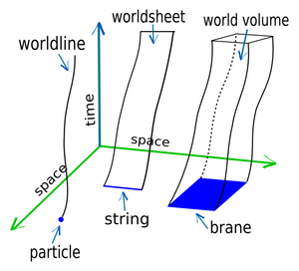
String Theory compactifications
  String Theory defined by 2D
  CFT on worldsheet
Alternative description of
dynamics of massless states
10D Supergravity on M₁₀
Kaluza-Klein reduction on M₁₀ = R^{(1,3)} x M₆
Effective theory in 4D

Slide 3
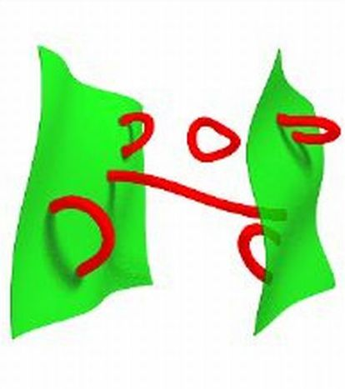
Dp-branes
  Open strings end on Dp-branes
  Described by effective p-dimensional field theory on world-volume
  On a stack of N branes, this is a U(N) gauge theory
  D-branes are charged under closed string fields
  In a compact space, total charge must be cancelled by O-planes

Slide 4
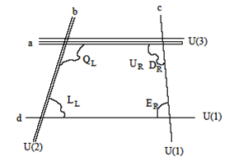
IIB Model building: intersecting Branes
  Several intersecting stacks of branes
  e.g. U(3) x U(2) x U(1) gauge group
  Massless charged matter from strings localized at intersections
  Problems:
  Hard to find examples
  Often unwanted extra matter
  Stabilization of moduli
  ...

Slide 5




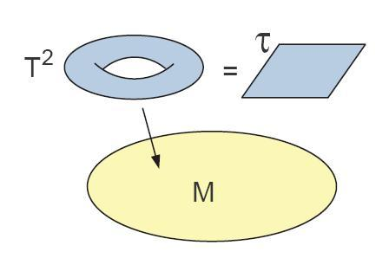
From IIB to F-Theory
  Effective action of Type IIB String Theory involves axio-dilaton field
  Action exhibits symmetry
  , Є
  Idea: Interpret τ as modular parameter of a Torus = elliptic Curve
  τ varies over M₆
  nontrivial elliptic fibration

Slide 6

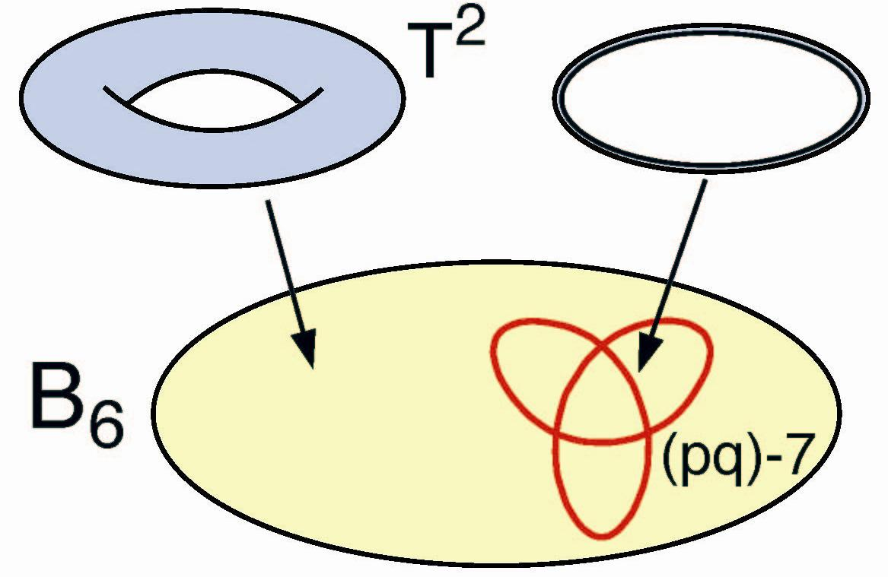
D7-branes in F-Theory
  In IIB theory: D7-branes at u_{i} source τ:
  τ formally goes to infinity on branes
  Identify 7-branes with degeneration locus of the elliptic fiber
  Structure of the singularity determines the gauge group on the brane

Slide 7
F-Theory vs. Type IIB
  F-theory in the limit of vanishing fiber size defines a IIB Theory
  Possible F-Theory gauge groups include SU(N), SO(2N), but also exceptional groups E₆, E₇, E₈
  F-Theory allows GUT model building not possible in Type IIB
  IIB can be seen as a weak coupling limit of F-theory
  Open problem:
  Can all IIB configurations be uplifted to F-theory?
  How does this work for specific effects?

Slide 8
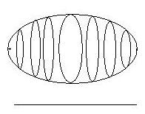
U(1) symmetries in F-Theory
  Natural gauge groups in IIB are U(N) vs. SU(N) in F-Theory
  What is the fate of the „diagonal“ U(1) in U(N)=U(1) x SU(N)?
  Massless U(1) gauge fields arise in an expansion of 3-form-field C₃ into harmonics:
  Cartan U(1)‘s of SU(N) realized via forms at singularities
  Idea: Diagonal U(1) from fibering
  collapsing Torus cycle over a
  chain in the base
  Match couplings of IIB theory

Slide 9
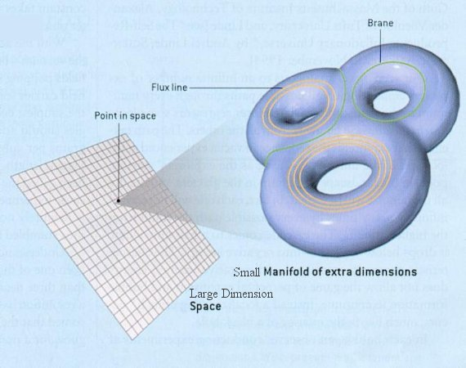
D- and M-brane Instantons
  Instantons = Branes wrapped on purely internal cycles, pointlike in 4D
  Lead to nonperturbatively small corrections to 4D quantities, e.g. Superpotential
  Important in the cases
  where couplings vanish
  perturbatively, e.g. due
  to symmetries

Slide 10
Fluxed instantons
  Gauge flux = topologically nontrivial gauge field configuration
  Instantons can carry gauge flux
  Fluxes change instanton charge under U(1) symmetries
  determines the induced couplings
  Determining instanton partition function in F-theory highly nontrivial
    short cut via matching of IIB effects?

Slide 11
Conclusions / Outlook
  Type II String Theory quite well explored in terms of model building
  F-Theory is nonperturbative „completion“ of IIB
  Important to understand how/if known mechanisms of IIB uplift to F-theory
  In particular: instanton potentials important for moduli stabilization and how they are affected by massless and massive U(1) gauge symmetries
  Massive symmetries Compactifications on Non-Kähler Manifolds?

