Slide 1
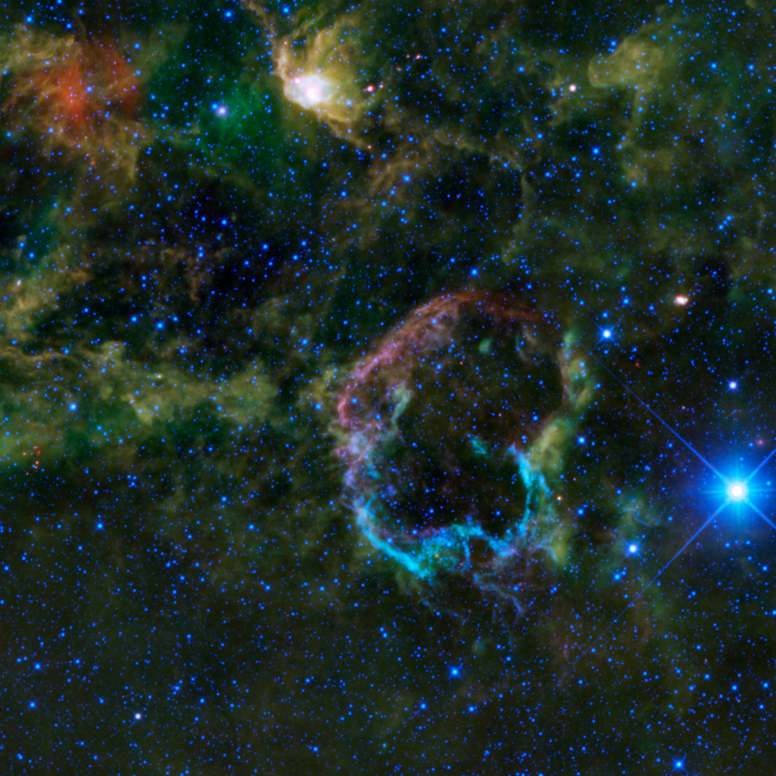
Interactions between supernova remnants and molecular clouds: From TeV to meV
Thierry Montmerle
Institut d'Astrophysique de Paris, France
Cecilia Ceccarelli
Institut de Planétologie et d’Astrophysique de Grenoble, France
IC443 SNR
Notes:
CC: do not forget to change the « LERMA… » in the right bottom corner ;-)

Slide 2
Outline
Introduction: Massive star-forming regions and γ-ray sources
Case studies 1: supernova remnants, molecular clouds, and γ-ray sources - W28 and W51
Massive star-forming regions without detected SNR: putative, but undetected TeV γ-ray sources ? - The Carina nebula
Case studies 2: supernova remnants, molecular clouds, and LECR ionization - W28 and W51
Conclusions

Slide 3
1. Introduction: Massive star-forming regions and γ-ray sources

Slide 4
TeV γ-ray sources
Strong concentration along the galactic plane
So far, only a few cross-identifications between GeV (Fermi) and TeV sources
Majority of identified sources connected with the end stages of massive star evolution:
A few compact X-ray binaries (accreting neutron star + companion)
Many “pulsar wind nebulae” (e.g., Crab nebula; γ-rays from leptons: synchrotron)
Isolated young supernova remants (synchrotron + inverse Compton)
Increasing number of middle-aged supernova remnants (SNRs; ~ 10⁴ yrs) interacting with molecular clouds (extended γ-ray sources: CR hadrons at last ? (See COS-B GeV results: “SNOBs”, Montmerle 1979, etc.)
Here, I focus on two regions: W28 and W51
Still many unidentified sources (“dark accelerators”)

Slide 5
2. Case studies 1: supernova remnants, molecular clouds, and γ-ray sources W28 and W51

Slide 6
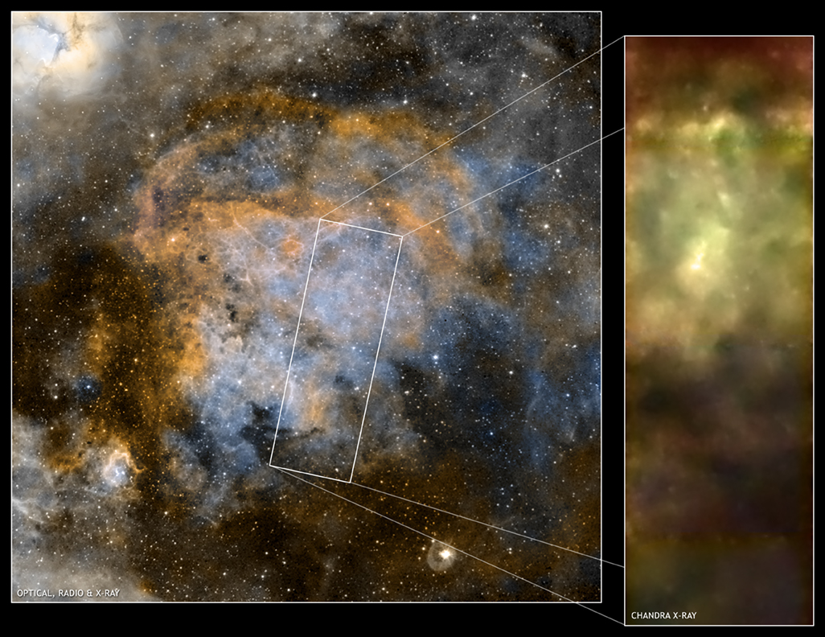
M20
(Trifid)
W28
SNR
d ~ 2-3 kpc
D ≈ 20 pc
Age ~ 35-150,000 yrs

Slide 7
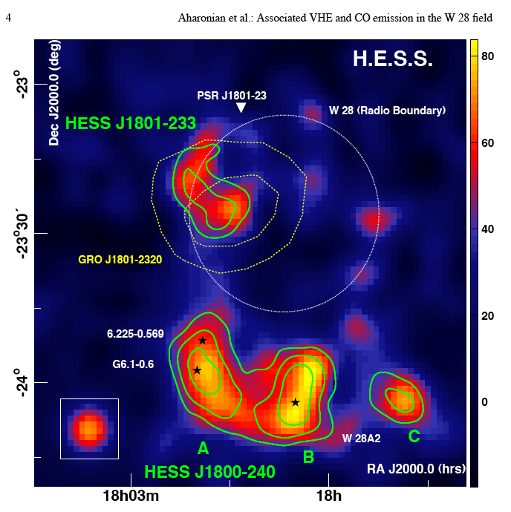
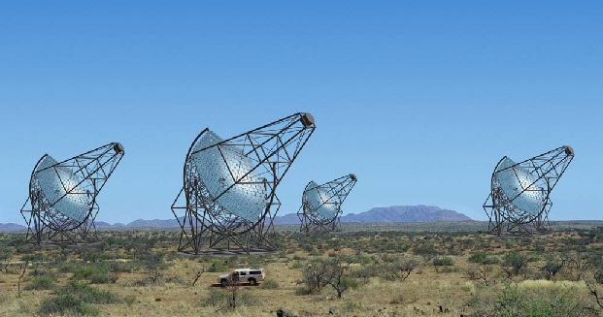
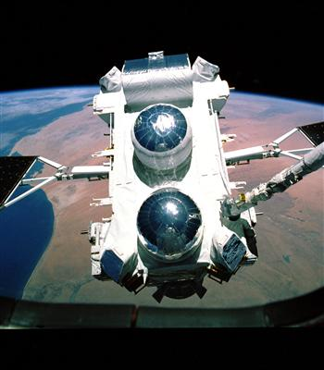
(Namibia)
W28
SNR
TeV
GeV
TeV
TeV
Aharonian et al. 2009

Slide 8
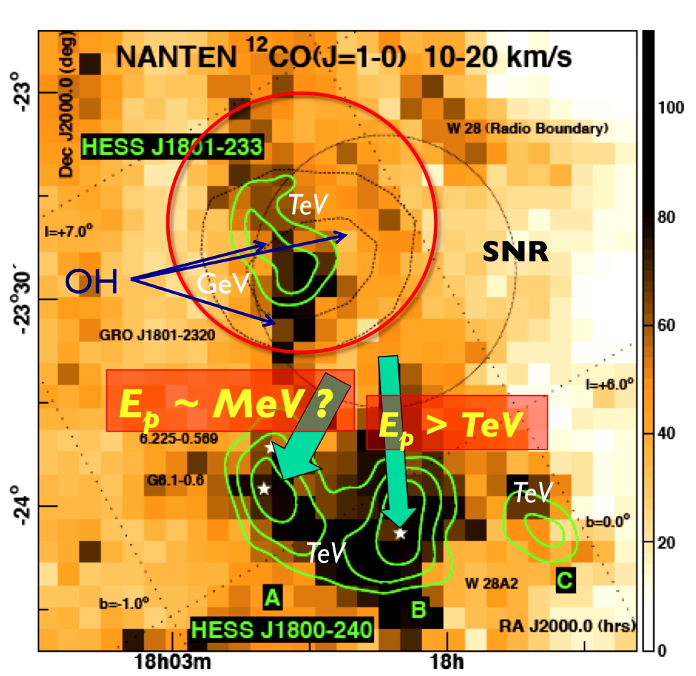
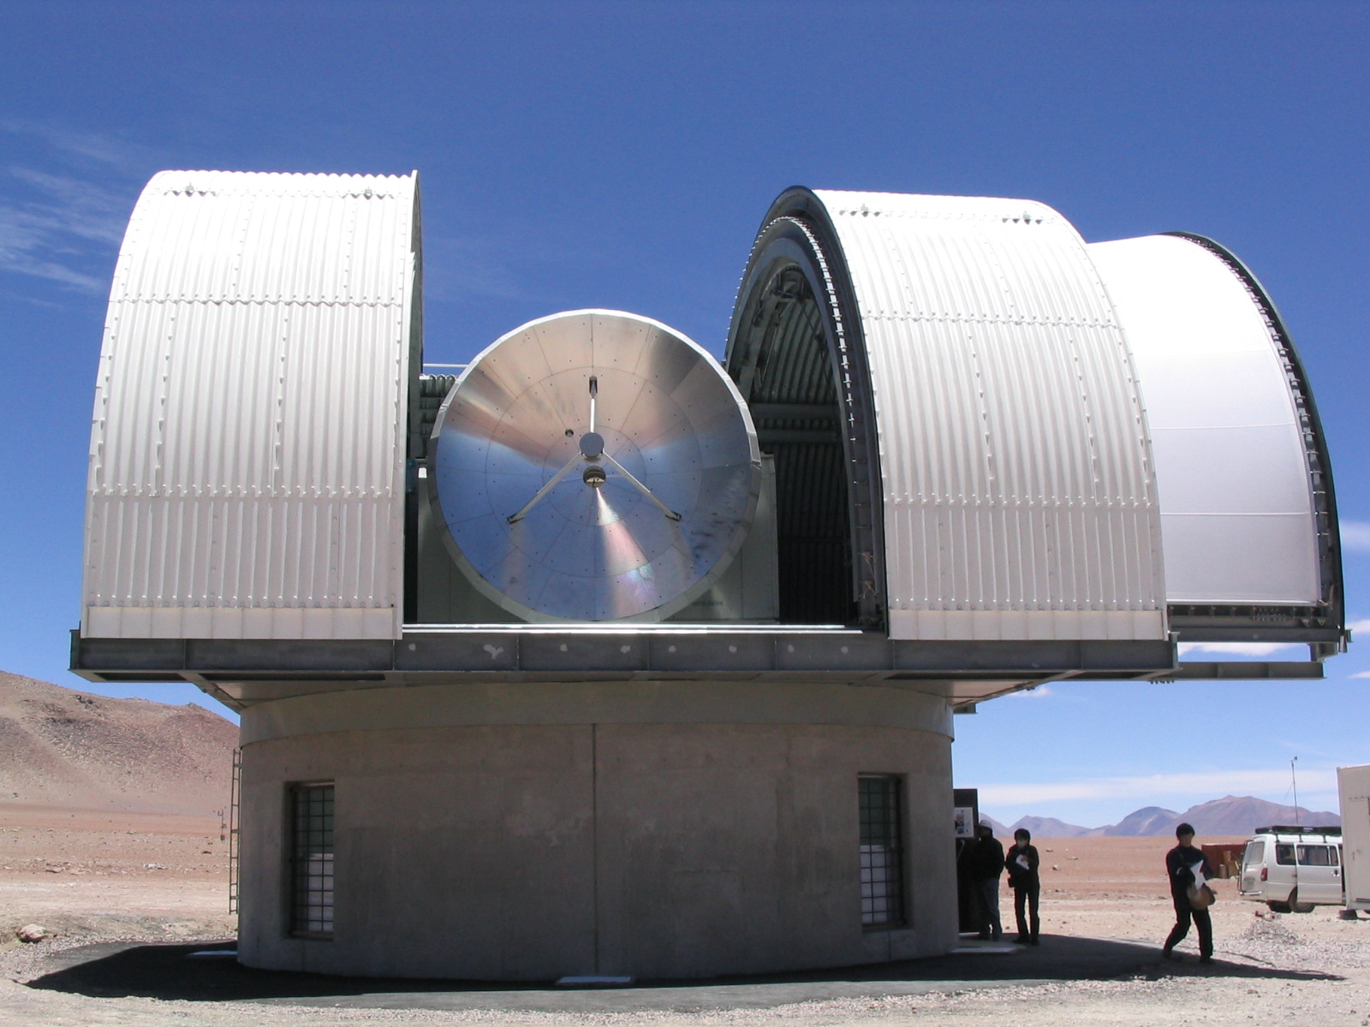
TeV
SNR
GeV
E_{p} ~ MeV ?
E_{p} > TeV
10 pc
TeV
TeV
Aharonian et al. 2009

Slide 9
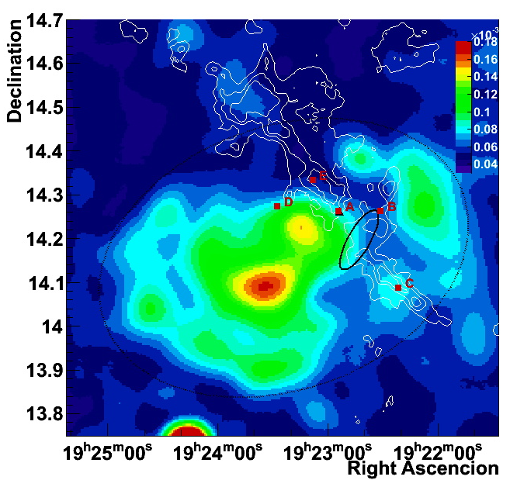
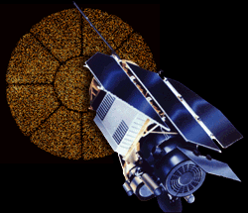
W51 cloud (¹³CO)
W51C SNR
X-rays: ROSAT
d ~ 5.5 kpc
age ~ 30 kyrs
Notes:
CC: include the reference for the map please
Ascencio -> Ascention

Slide 10
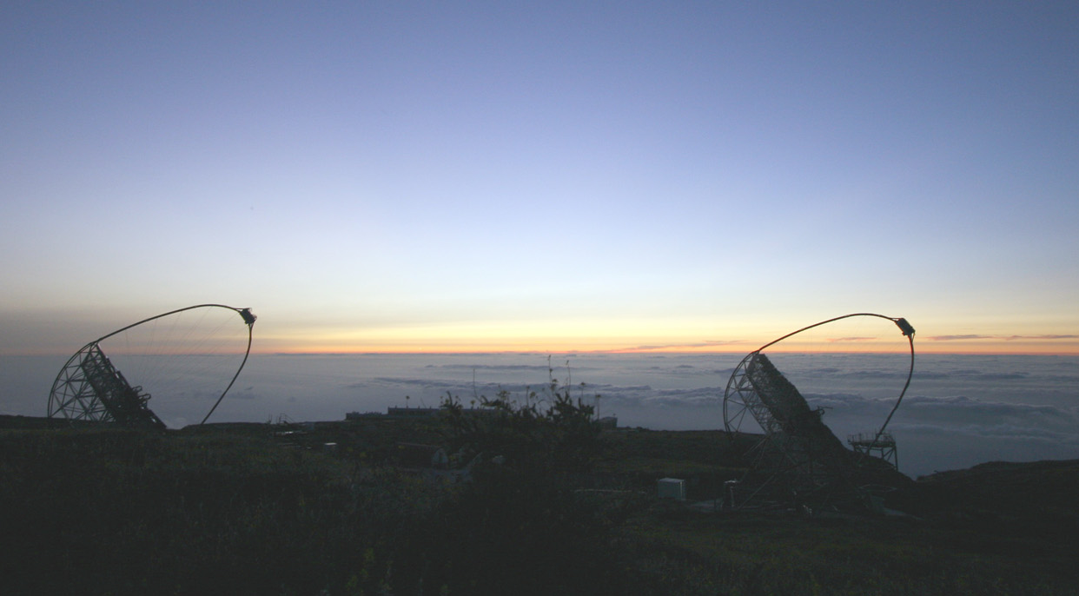
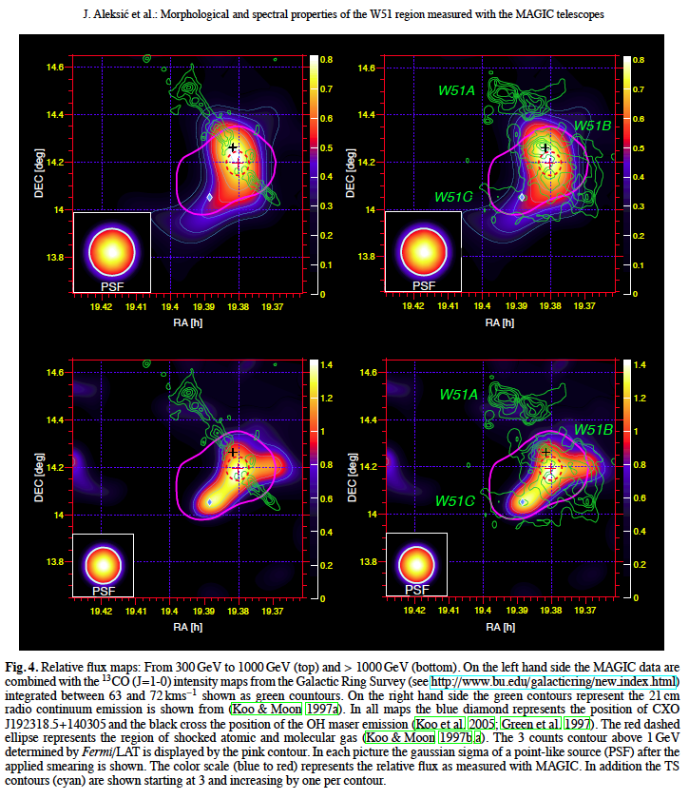
The W51 region
MAGIC
¹³CO
HI
OH
0.3-1 TeV
Fermi
> 1 GeV
> 1 TeV
Chandra source: PWN ?
exp = 53 hrs
Aleksić et al. 2012; see also talk by J. Krause

Slide 11
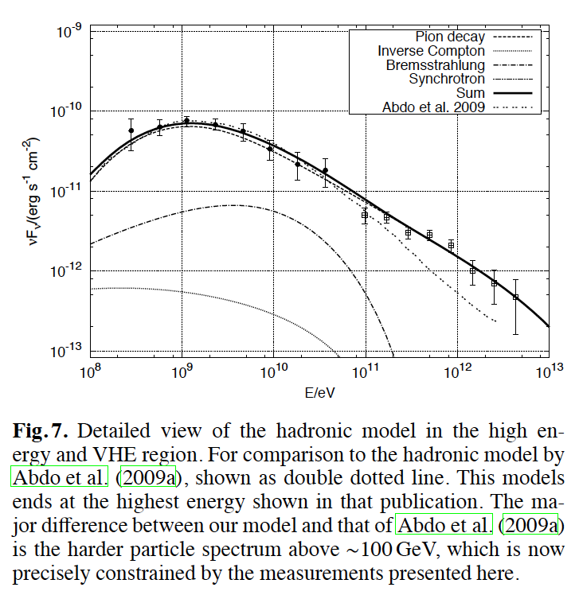
W51 source
π°
CO + HI
Fermi/LAT
MAGIC
B
π°
IC
Aleksić et al. 2012
~16% SNR energy in 10% of molecular cloud (10⁴ M_{a})

Slide 12
3. Massive star-forming regions
without detected SNR: The Carina nebula

Slide 13
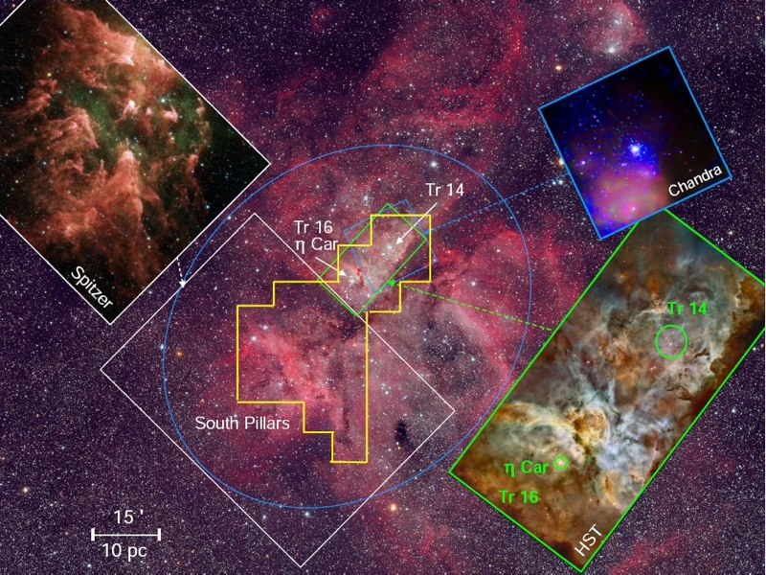
The Carina nebula environment
WR stars
×
Neutron star
VLT/HAWK-I
d = 2.5 kpc
Gamma12 (10/7/12) 13

Slide 14
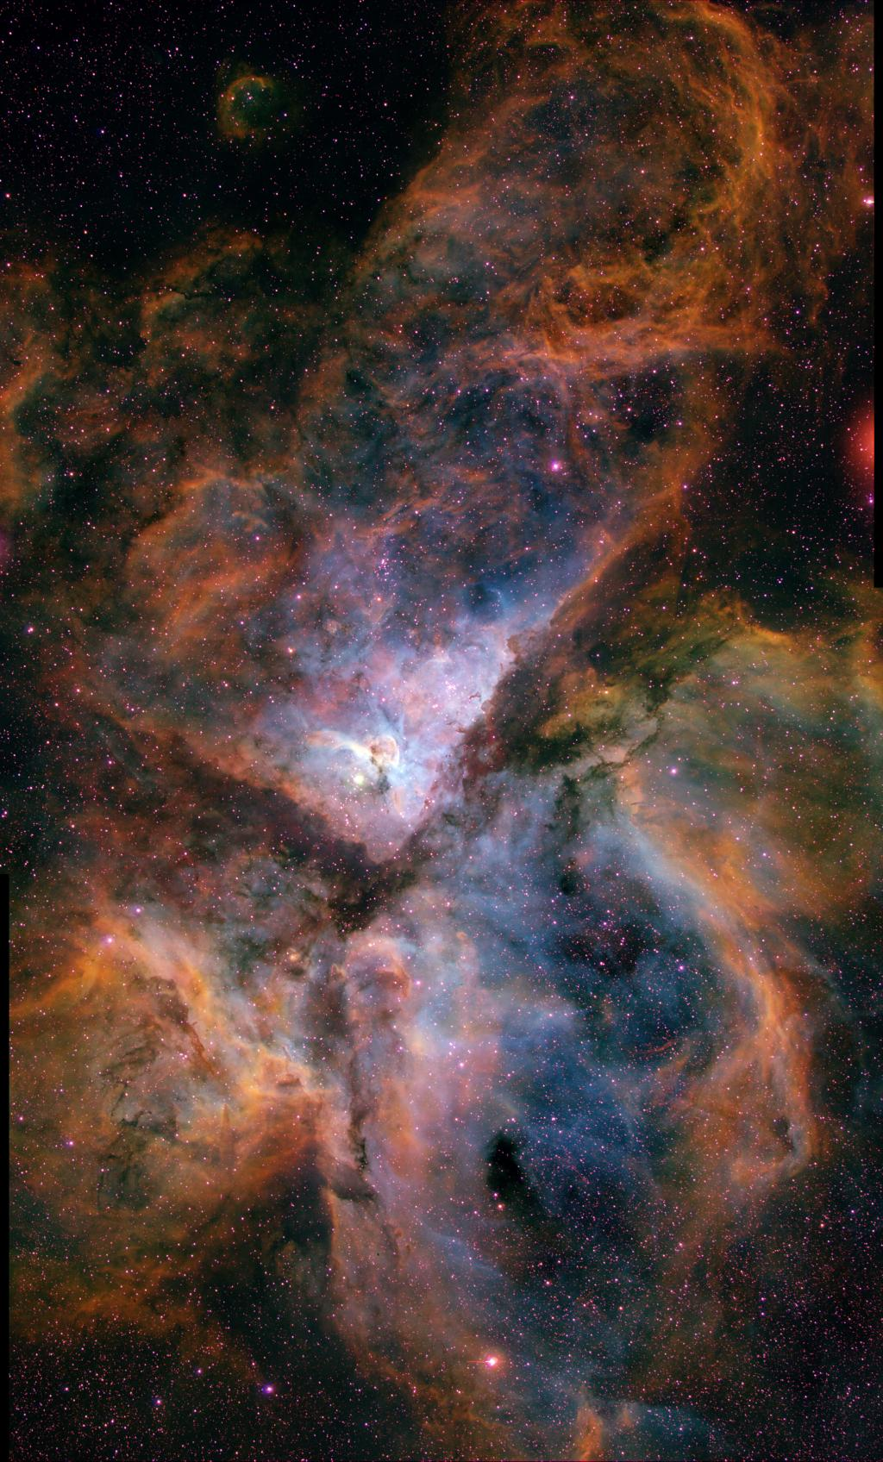
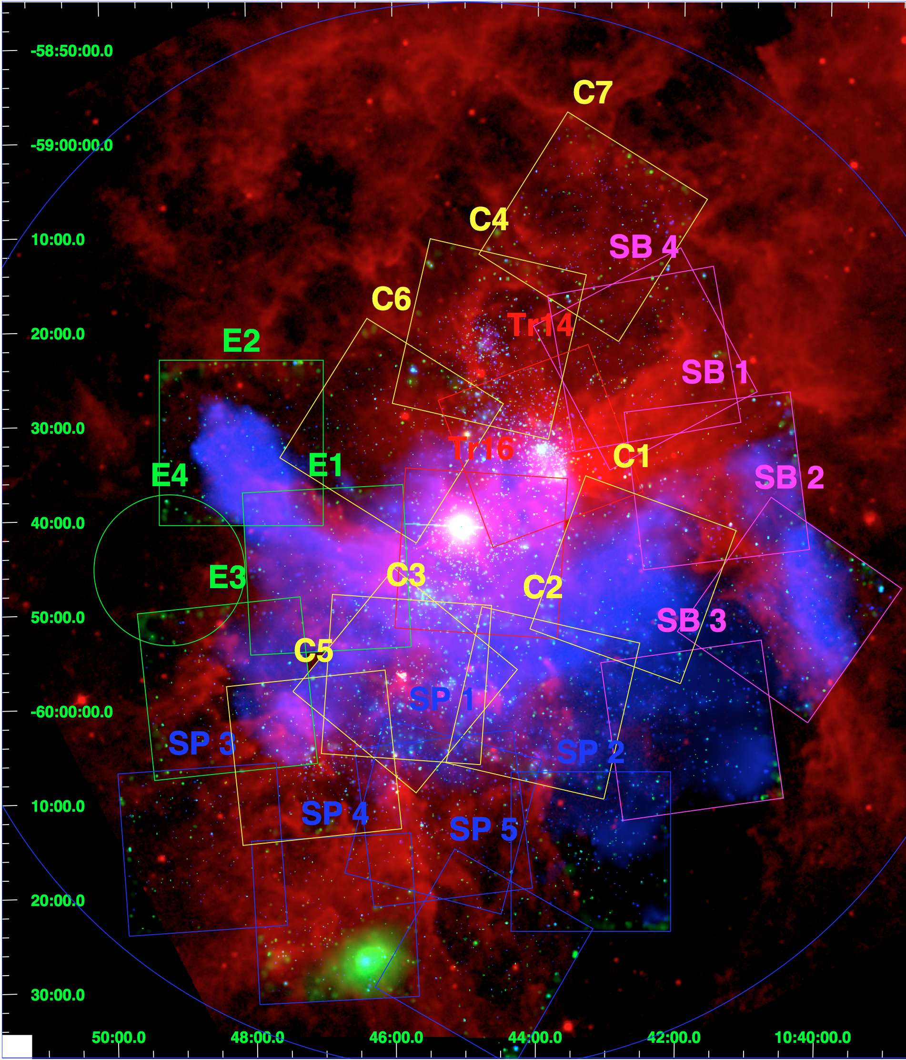
The great Carina X-ray mosaic: winds + SNRs ?
Fe excess
22 Chandra fields
~ 14,000 sources
Orion
Chandra: PI L. Townsley; Montmerle et al. ApJS

Slide 15
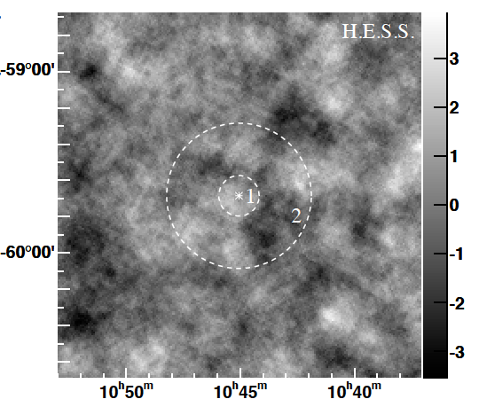
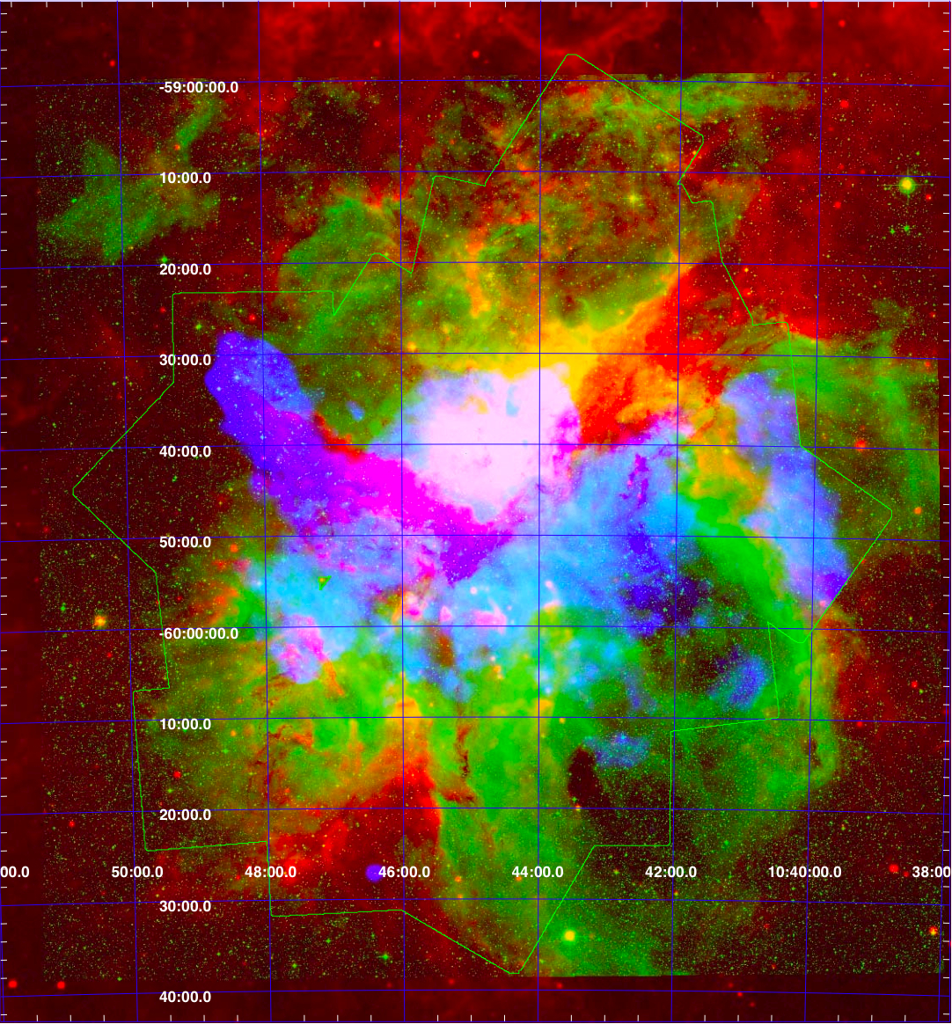
The Carina nebula: HESS TeV observations
η Car
x
40 pc
33.1 h obs
DSS (warm gas)
+ MSX8 (dust)
+ Chandra (hot plasma)
Abramovski, …, Montmerle 2012
See Poster by S. Ohm

Slide 16
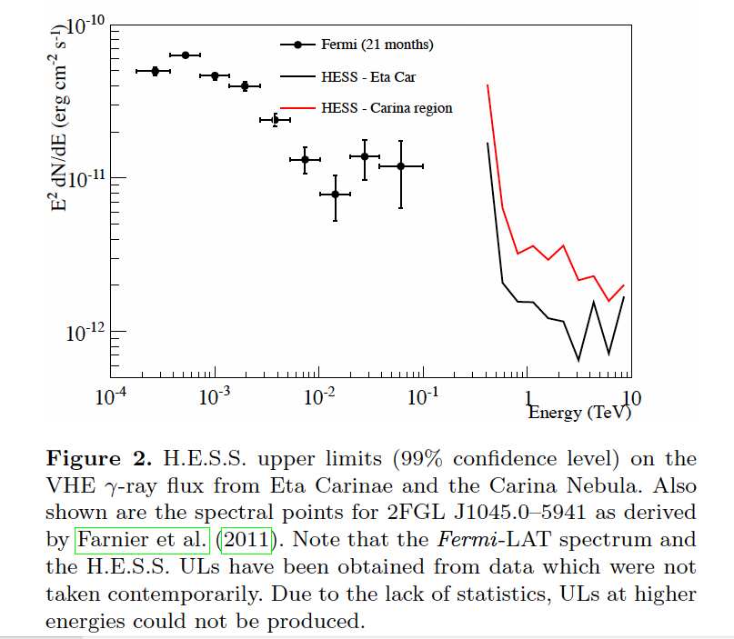
The Carina nebula: GeV-TeV spectrum
(1)
(2)
Abramovski et al. 2012

Slide 17
W51
Carina
Fermi/LAT
MAGIC
HESS
Fermi/LAT
TeV upper limit in CR density
≲ W28 (~ 10-20x GCR);
high-energy cut-off ?

Slide 18
4. Case studies 2: supernova remnants, molecular clouds, and LECR ionization W28 and W51

Slide 19
⬄ Low-energy interactions
General idea: assume TeV γ-rays come from > TeV protons (π° decay) accelerated by the SNR shock
=> Enhanced molecular cloud ionization comes from associated low-energy GCR (≳ 0.1-500 MeV)
=> Link with MeV/GeV/TeV flux
=> Measure ionization degree x_{e}: local CR flux enhancement
Usual value ζ₀ ~ 10⁻¹⁷-10⁻¹⁶ s⁻¹ => for n_{H2} ~ 10⁴-10⁵ cm⁻³,
x_{e} ~10⁻⁸-10⁻⁷ (e.g., Caselli et al. 1998)
=> important chemical effects (=> H₃⁺ ; H₂D⁺ ; radicals…)
=> role in star formation ? (+ magnetic fields: ambipolar diffusion)
Methods to measure the ionization and ζ:
NIR absorption lines (background stars): H₃⁺ (NIR: IC443, Indriolo et al. 2010); N-MIR emission lines (Schuppan et al. 2012): diffuse outer layers (A_{V} < a few)
mm emission lines: DCO⁺/HCO⁺ (mm): deep, dense molecular material (A_{V} > 40-50)
Notes:
CC: some little corrections

Slide 20
E₀ = 450 MeV
100 keV 10 MeV
Mannheim & Schlickeiser 1994

Slide 21
“DCO⁺/HCO⁺ ionization test”: IRAM-30m program (Ceccarelli, Hily-Blant, Dubus, TM, Vaupré, Lefloch)
Sample of TeV sources:
SNOB-like sources (IC443, W28, W51C, Cyg OB1)
mm observations: HCO⁺, DCO⁺, ¹²CO, ¹³CO
CO + H₃⁺ –> HCO⁺ + H₂
CO + H₂D⁺ –> DCO⁺ + H₂
First-order approximation:
= 3 DCO⁺/HCO⁺
^{(e.g., Guélin et al. 1977)}
x_{e} (but requires chemical model if x_{e} too high)
+ cloud T, density and N(H₂) from ¹²CO and ¹³CO measurements
Notes:
CC: little corrections

Slide 22
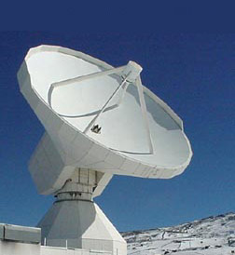
W51C cloud
IRAM 30-m
0.3-1 TeV
W51C SNR
X-rays: ROSAT

Slide 23
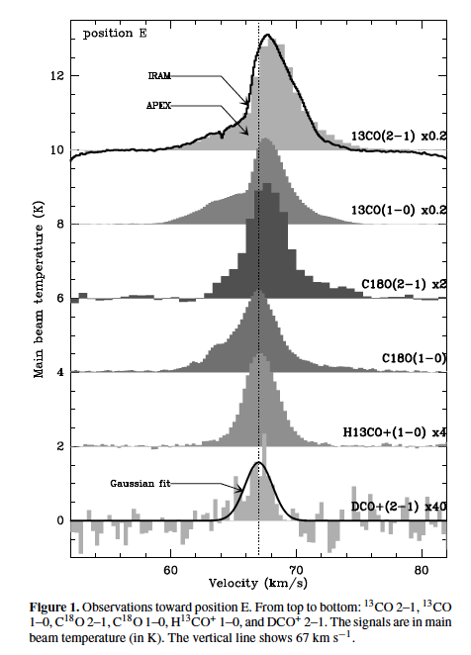
W51C cloud
Ceccarelli, Hily-Blant, Montmerle et al. 2011

Slide 24
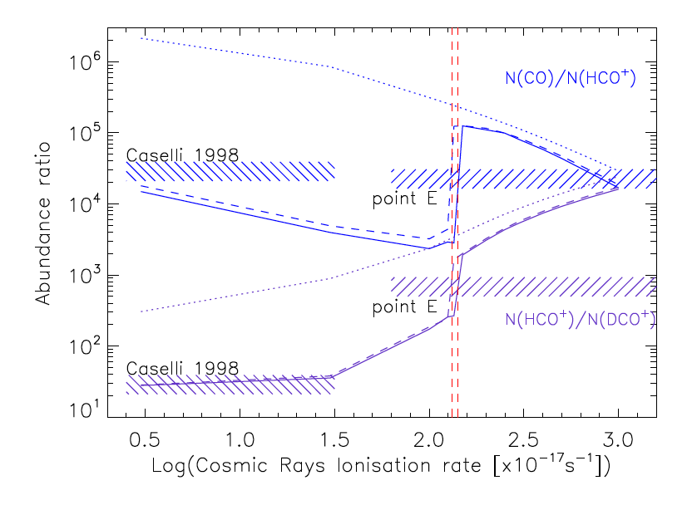
~ 100x ζ₀
Chemical (“Meudon”) model by Le Petit et al. 2006
Ceccarelli, Hily-Blant, Montmerle et al. 2011

Slide 25
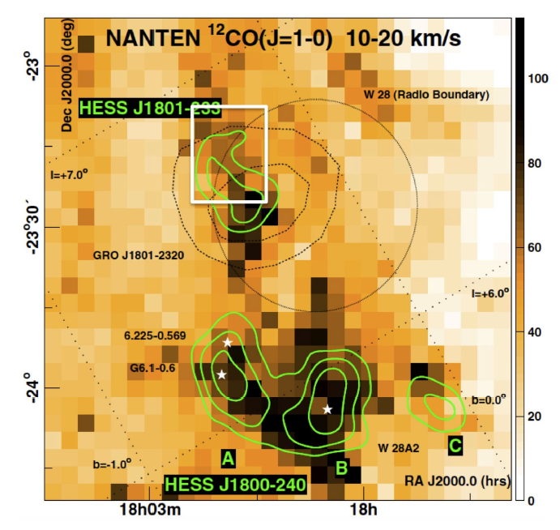
The next step: CR gradients in W28

Slide 26
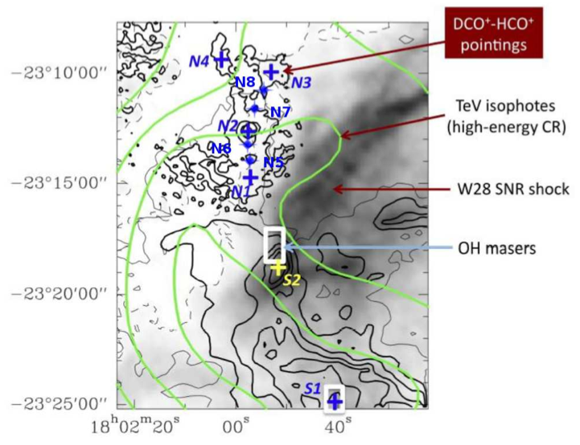
Looking for ionization gradients ⬄ low-energy CR diffusion
~2 pc
10 pc
@ 2.5 kpc
IRAM 30m
observations
(12/11+03/12)

Slide 27
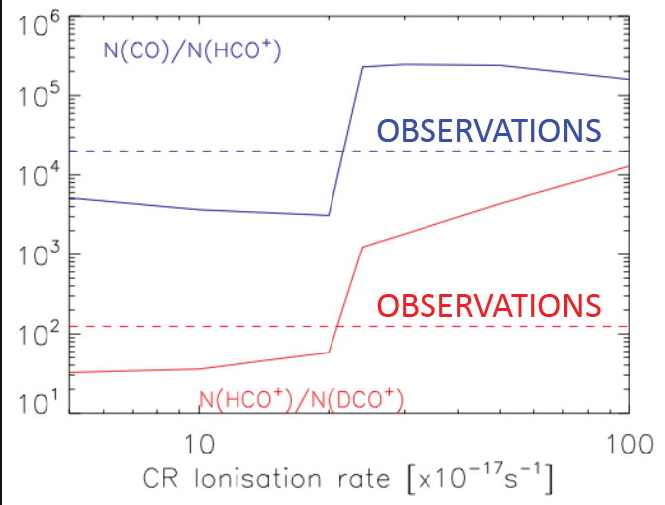
W28-N6
Similar situation in W28-N7
~ 20x ζ₀
⇒ CR ≲ 500 MeV
diffuse out to ~ 2 pc !
Hily-Blant, Ceccarelli, Vaupré, TM et al. in prep.

Slide 28
5. Conclusions
A class of GeV-TeV γ-ray sources is definitely associated with SNRs physically interacting with molecular clouds
“Very active” massive star formation regions without evidence for SNR do not show evidence for TeV γ-ray emission (tbc)
There is mounting evidence that the γ-ray emission is dominated by HECR (≳ 10 GeV/n hadrons: evidence for π°-decay)
This is confirmed by new chemical evidence for ~ x10-100 overionization of the same molecular clouds by LECR (≲ 1-500 MeV)
Such TeV sources are unique chemical laboratories for molecular clouds !
This also demonstrates that LECR can travel ~ a few pc from the SNR shock-acceleration site
Next step: ionization gradients ? In progress ⬄ LECR diffusion=f(E)

Slide 30
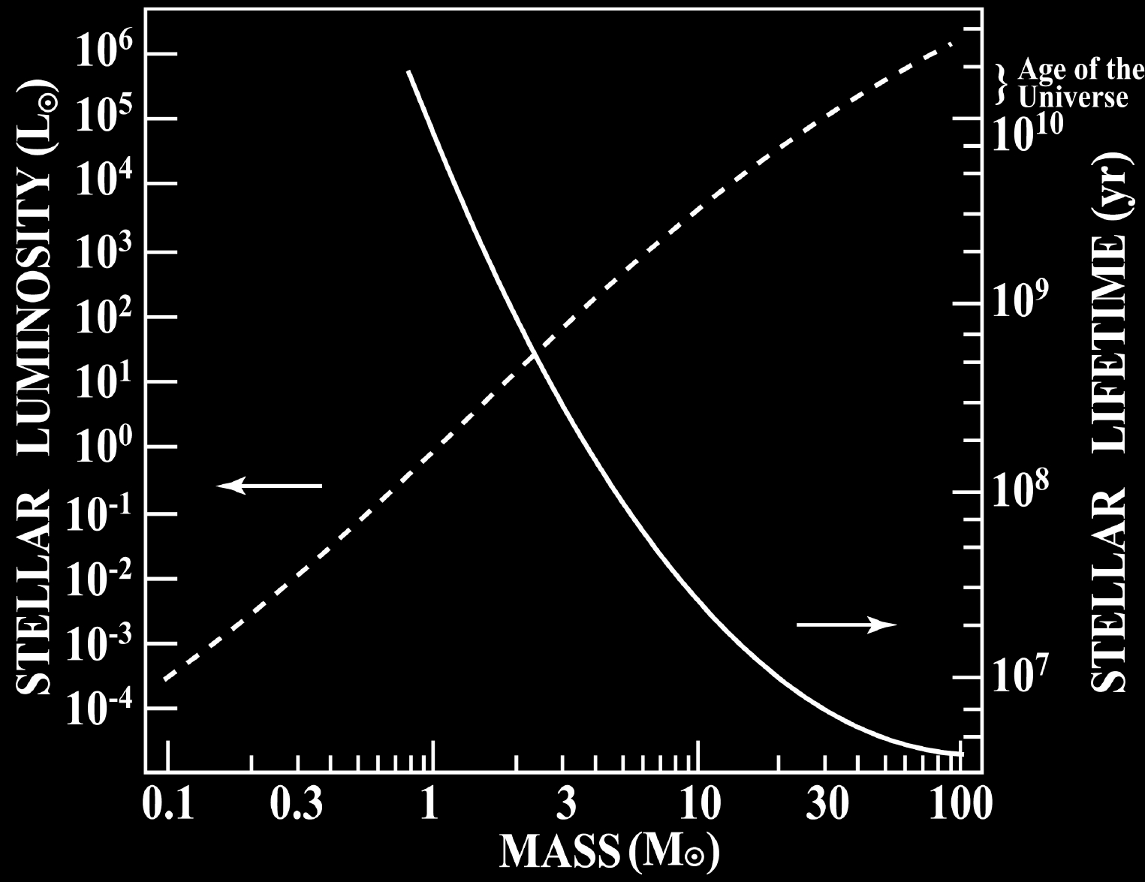
Stellar lifetimes vs. winds & supernovae
Supernovae
Winds (UV)
Notes:
CC: I do not understand the y-axis on the right: the larger the luminosity the lower the stellar lifetime. Is the axis inverted?

Slide 31
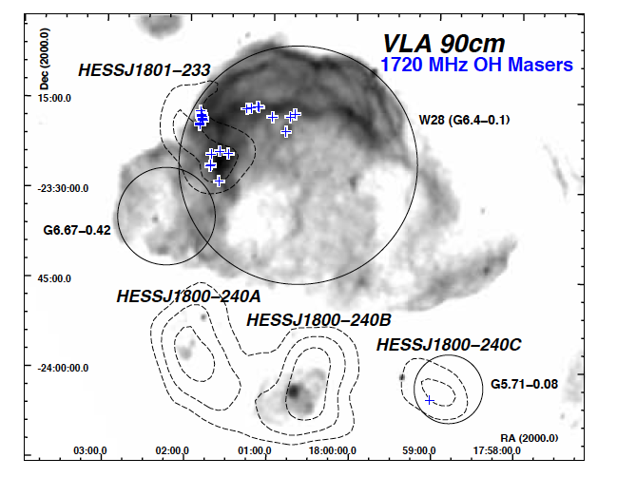
Nicholas et al. 2011

Slide 32
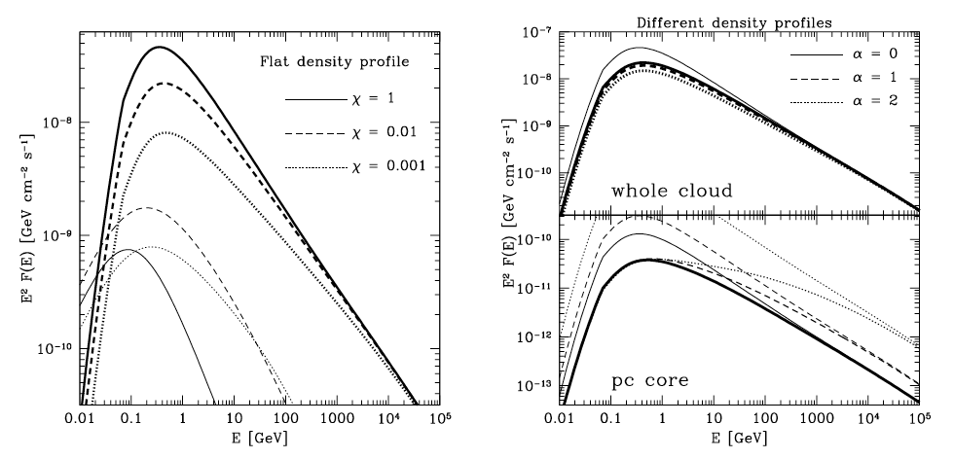
π° γ-rays
Gabici et al. 2006

Slide 33
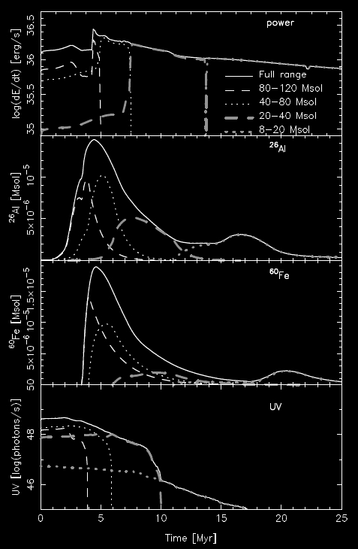
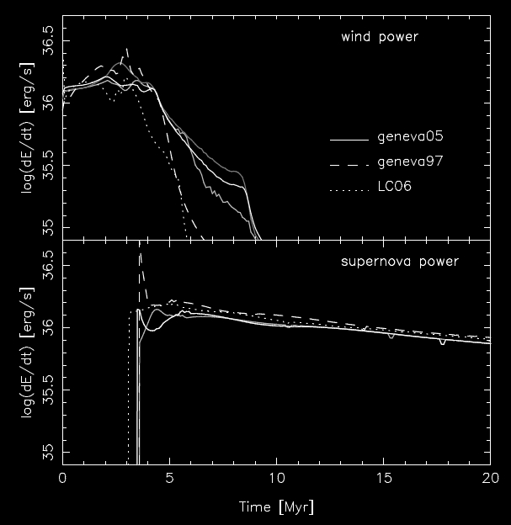
Massive stars:
output of a (coeval)
8-120 M_{a} OB association
Total power
Wind power
²⁶Al
SN power
⁶⁰Fe
UV
0 5 10 15 20
time (Myr)
(Voss et al. 2009)
0 5 10 15 20 25
time (Myr)
Notes:
CC: probably you’re aware that these curves are difficult to read

