Slide 1
GAMMA-RAY COMPACT BINARIES* ASTROPHYSICAL SCENARIOS
Félix Mirabel
CEA-Saclay-France
*Neutron stars & Black holes in stellar binary systems that radiate in gamma-rays.
(Will not refer to other types gamma-ray stellar binaries, e.g. Eta Carina)

Slide 2
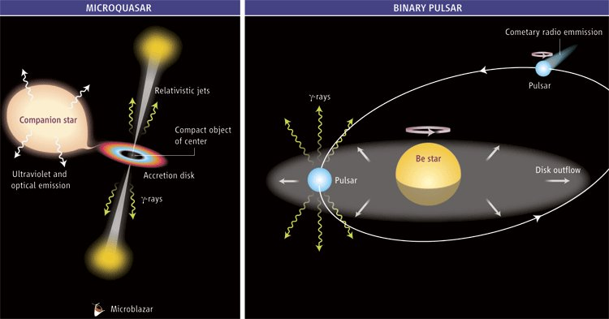
COMPACT GAMMA-RAY BINARIES IN 2006 The only known were PSR B1259-63, LSI +61 303 & LS 5039
M. : Perspective in Science (2006)
PSR B1259-63
γ-rays produced by inverse Compton scattering: relativistic electrons collide with stellar and/or synchrotron photons and boost their energies to HE & VHE ranges.
In PSR B1259-63 the electrons are powered by the rotational energy of the pulsar. In microquasars relativistic electrons would come from accretion-powered jets.

Slide 3
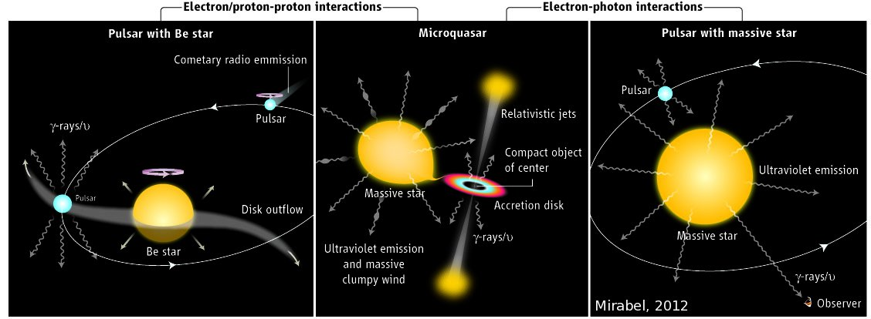
COMPACT GAMMA-RAY BINARIES IN 2012
M.: Perspective in Science (2012) Sp Types of donors: Casares et al. (2012)
HE, E>100 MeV & VHE, E>100 GeV PRODUCED BY LEPTONIC AND HADRONIC INTERACTIONS
HE in superior conjunction
Name γ-ray s Sp Type
LS I +61 303 HE, VHE B0 Ve
PSR B1259-63 HE, VHE O9.5 Ve
AGL J2241? HE B3 IV ne+sh
HESS J0632+057 VHE B0 Vpe
Name γ-ray s Sp Type
Cyg X-3 HE WNE([2,5])
Cyg X-1 HE, VHE ? O7 V
Name γ-ray s Sp Type
LS 5039 HE, VHE O6.5 V((f))
1FGL J1018 HE, VHE? O6 V((f))
γ-RAY BINARIES ARE NEUTRON STARS AND BHs ORBITING MASSIVE STARS

Slide 4
FUTURE CHALLENGES IN THIS AREA OF RESEARCH
Identify as γ-ray sources the dust enshrouded supergiant compact binaries detected by INTEGRAL in the hard X-rays (Chaty et al.)
Confirm the hadronic mechanism that produces high energy gamma-photons (Aharonian+ 2006; Reynoso & Romero, 2009) by the detection high energy neutrinos from the decay of secondary mesons produced at p-p and/or p-γ photon interactions.
CTA may provide the high sensitivity and angular resolution, to reveal a larger populations of gamma-ray sources in the Milky Way.
However, the typical confusion in star formation regions can be overcomed by correlated orbital modulations in the gamma-rays, X-rays, IR, and radio waves. (e.g. Cyg X-3, 1FGL J1018.6-5856).

Slide 5
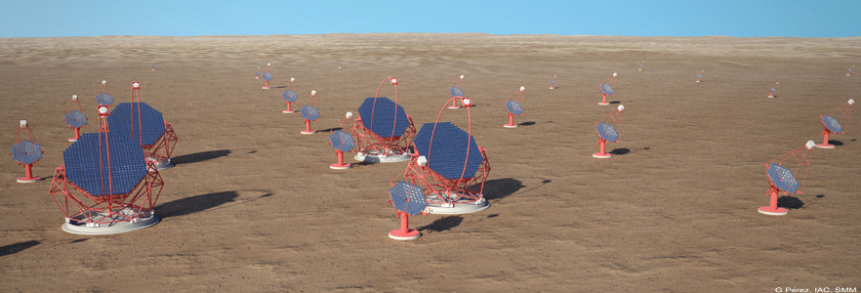
In this context, high photon stadistics at a few tens of GeVs would be an advantage to unambiguously identify compact gamma-ray binaries in the Milky Way,
In this area of research it would be convenient if CTA could have a low energy threshold, as may be the case to make progress in other areas of high energy astrophysics.

