Slide 1
Large-scale components of radio galaxies in gamma rays
Martin Hardcastle
Heidelberg, Gamma2012
Thanks: Judith Croston, Teddy Cheung, Łukasz Stawarz

Slide 2
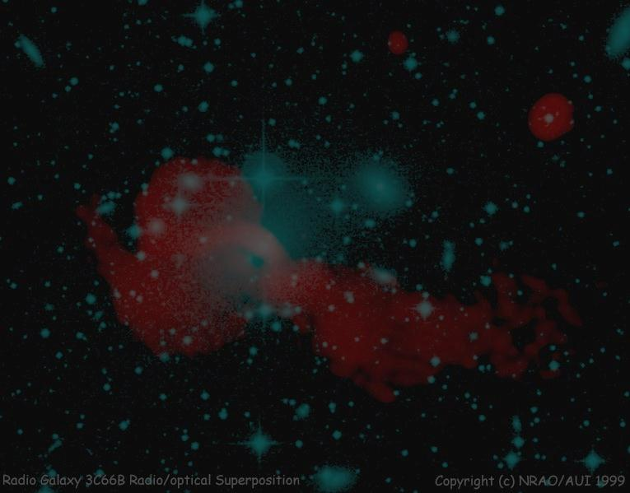
Outline
1) Introduction to physics of RGs on large scales
2) Fermi and GeV gamma rays
3) TeV gamma rays and prospects for CTA
4) Cosmic ray acceleration?

Slide 3
INTRODUCTION
1.
3C66B, MJH+ 97 / A. Bridle

Slide 4
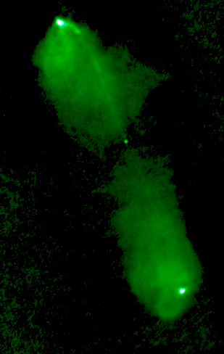
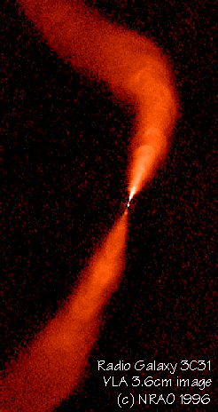
Radio galaxy morphology
Jet
Core
Lobe
Hotspot
Plume
FRII
FRI

Slide 5
How they work

Slide 6
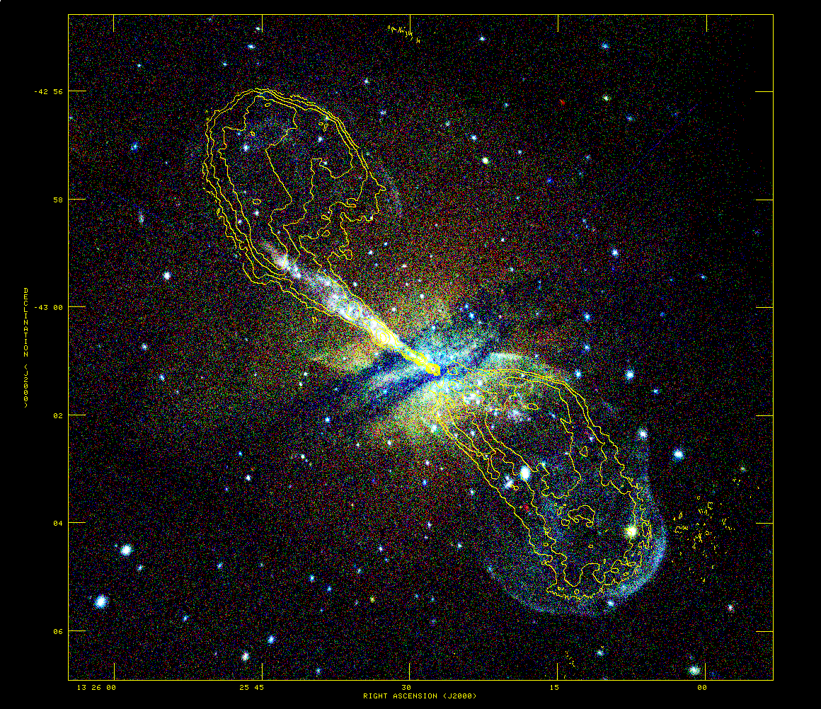
10 kpc

Slide 7
Key questions
What is jet power and in what form is it transported?
What is the composition of the jet? (particle content/field)
What is the composition of the lobes?
Where and how are the high-energy particles accelerated?

Slide 8
Jet power and composition
Estimate jet power from impact on external medium/minimum energy estimates.
Jet powers in the range 10⁴² – 10⁴⁶ erg/s
Nothing rules out energy transport purely by leptons + B field (relativistic bulk speeds) on ~1 kpc scales
E.g. Cen A jet can transport required jet power with no additional protons (Jiraskova+ in prep)

Slide 9
But…
No very good constraints on jet magnetic field strengths (though see later).
FRI jets must decelerate through internal/external entrainment and so there must be some baryons in the jet on ~ 10kpc scales.
What state do these end up in?

Slide 10
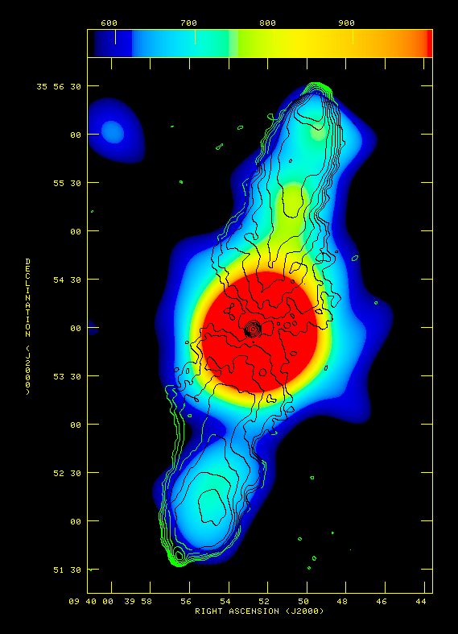
Lobe composition
In many FRII radio galaxies and a few FRIs we can measure magnetic field strengths and leptonic energy densities by combining synchrotron and inverse-Compton observations.
The magnetic fields we measure are close to (but always below) the equipartition value for rel. leptons only.
The lobe pressures are close to pressure balance with ex. medium.
In FRIIs there is no evidence for a dominant energetic contribution from protons/nuclei.
300 kpc
Colour: XMM IC
Contours: radio
Croston et al. 2004
Croston+ 04

Slide 11
But…
In FRIs it is hard to measure the B-field with inverse-Compton X-ray because of strong thermal X-ray emission from the environment.
Equipartition estimates imply that the lobe pressure is << the external value on 100-kpc scales; can’t be true
Some other contribution to the lobe pressure is required, e.g. from non-radiating particles.
Some evidence that this is related to entrainment (e.g. Croston+08, & in prep).

Slide 12
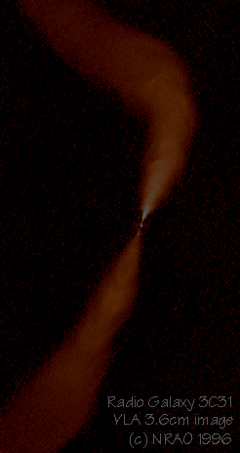
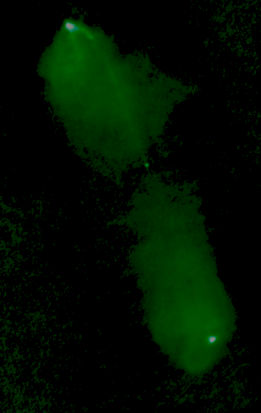
FRI/FRII summary
FRIs have
Lower radio luminosity
Bright, sub-rel jets
Few to no lobe inverse-Compton detections
Evidence for energetically dominant non-radiating population (protons?)
FRIIs have
Higher radio luminosity
Faint, relativistic jets
Routine lobe inverse-Compton detections: B ~ Beq
Observed electrons and field can provide required pressure.

Slide 13
What do gamma rays do for us?
Inverse-Compton from parts that X-rays cannot reach (b/c of other emission processes like thermal brems. or synchrotron) => constraints on B-field
Evidence of proton-proton interactions (via pion decay/synchrotron/IC from secondary electrons) => constraints on particle content, UHECR acceleration? (But NB strict upper limits on density of thermal protons in lobes.)

Slide 14
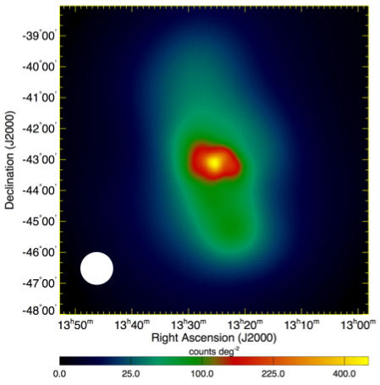
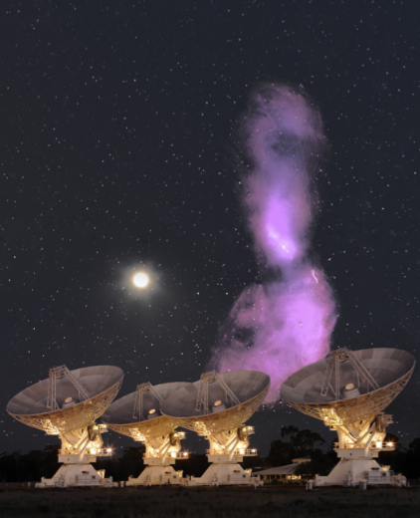
Fermi and GeV gamma rays
2

Slide 15
Fermi-detected radio sources
Most are blazars (=> nuclear jet)
Of the dozen or so non-aligned sources (Grandi; Abdo+ 2010) almost all unresolved – hard to attribute emission to processes unrelated to nuclear jet.
Three cases worth commenting on here…

Slide 16
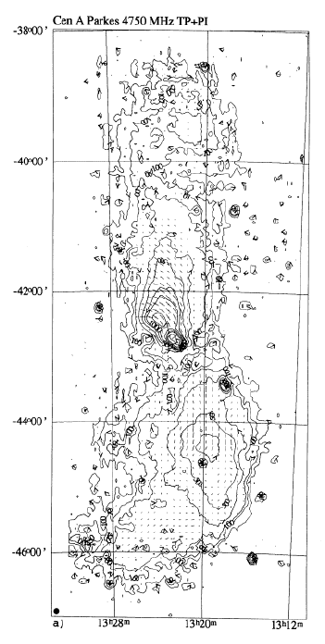
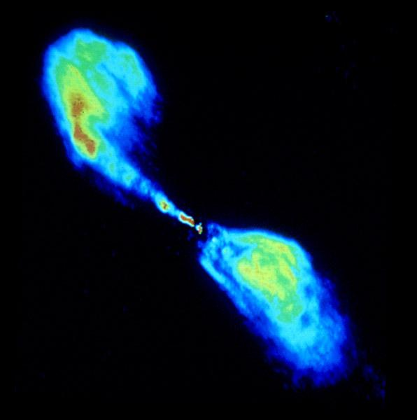
(1) The giant lobes of Cen A
10 kpc

Slide 17
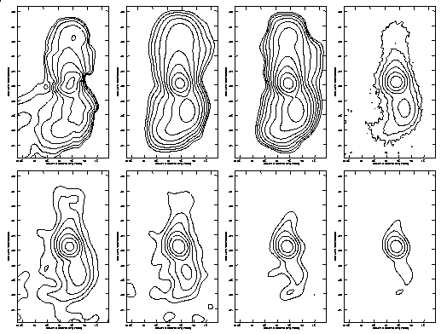
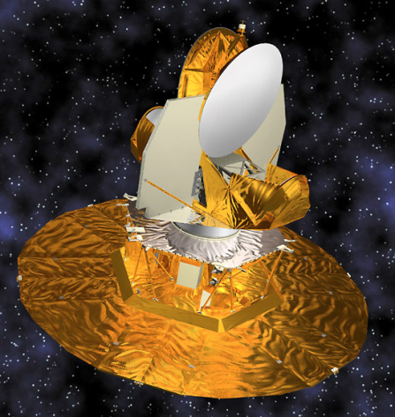
Cen A with WMAP
MJH, Cheung, Stawarz, Feain 2009

Slide 18
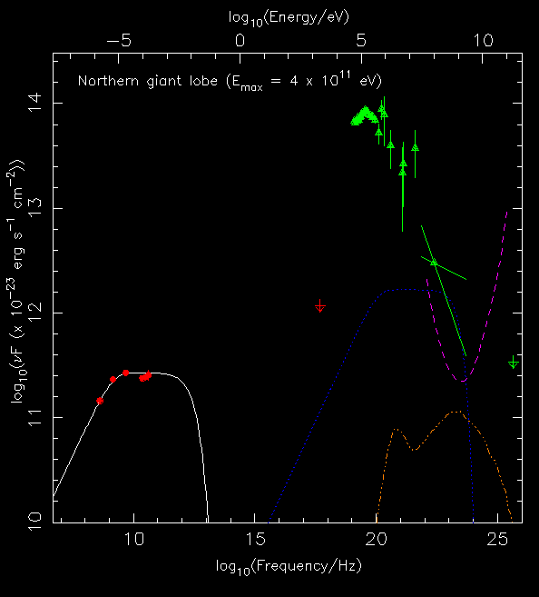
Cen A IC predictions

Slide 19
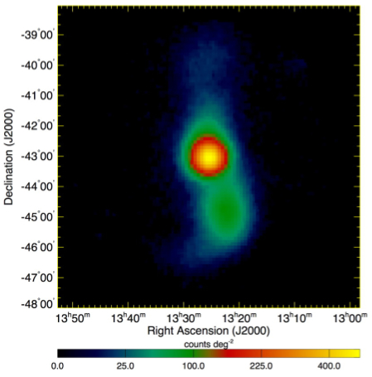
Cen A results
LAT
>200 MeV
WMAP
22 GHz
Background (isotropic and diffuse) and field point sources subtracted
Cheung: Abdo+ 2010 Science

Slide 20
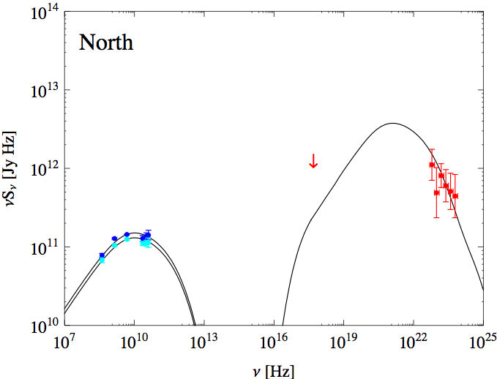
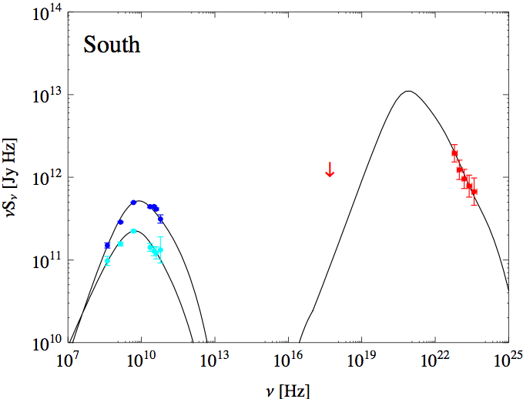
Cen A results
Photon fields include the CMB, EBL and galactic light. Good fits with B ~ 0.1 nT; giant lobes close to equipartition!
See also updated analysis by Yang+(2011) + poster at this meeting.

Slide 21
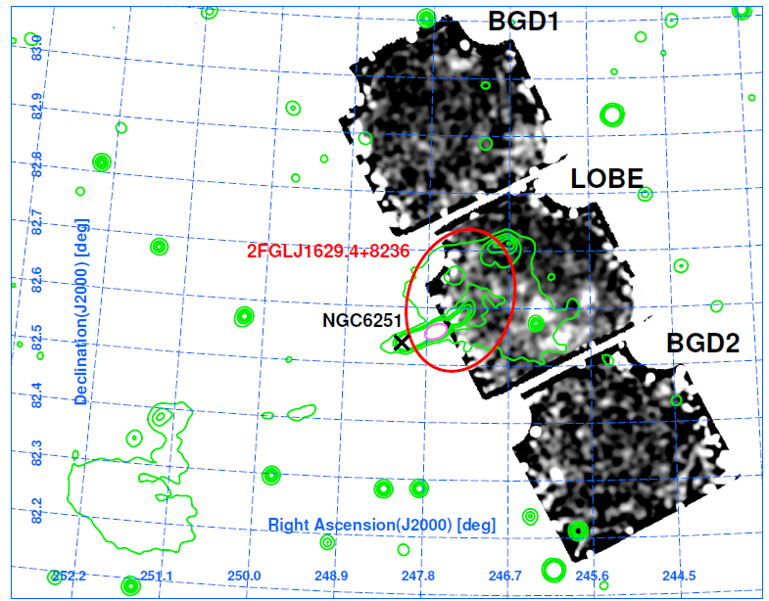
NGC 6251
Takeuchi+ 2012

Slide 22
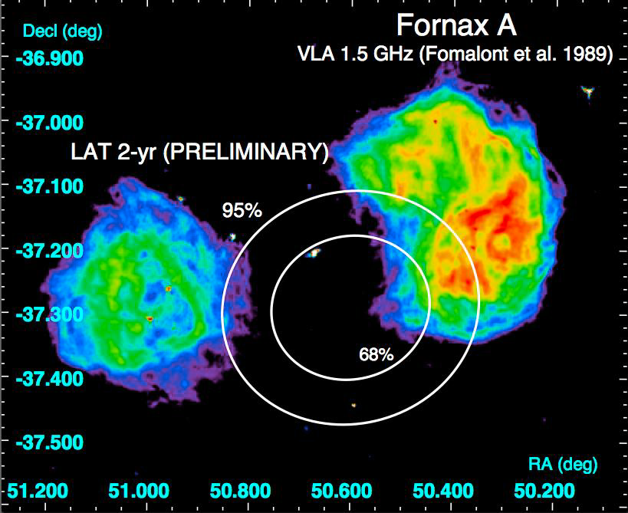
(3) Fornax A – not yet…
Predictions from Georganopoulos+ 08
X-ray inverse Compton known – first to be discovered.
Possibility of constraints on EBL
Probably detected, but not clearly extended… yet

Slide 23
What we’ve learnt
Cen A and, if confirmed, NGC6251 have magnetic field strengths not far from equipartition – puzzle for model in which these lobes are dominated by non-radiating particles!
High-energy leptons must be present in the lobes to do IC scattering => distributed, high-energy particle acceleration processes (maybe like those known to exist in the jets?).
The emission from both lobes is dominantly in gamma rays. ‘Radio galaxy’ is a misnomer.

Slide 24
Fermi bubbles

Slide 25
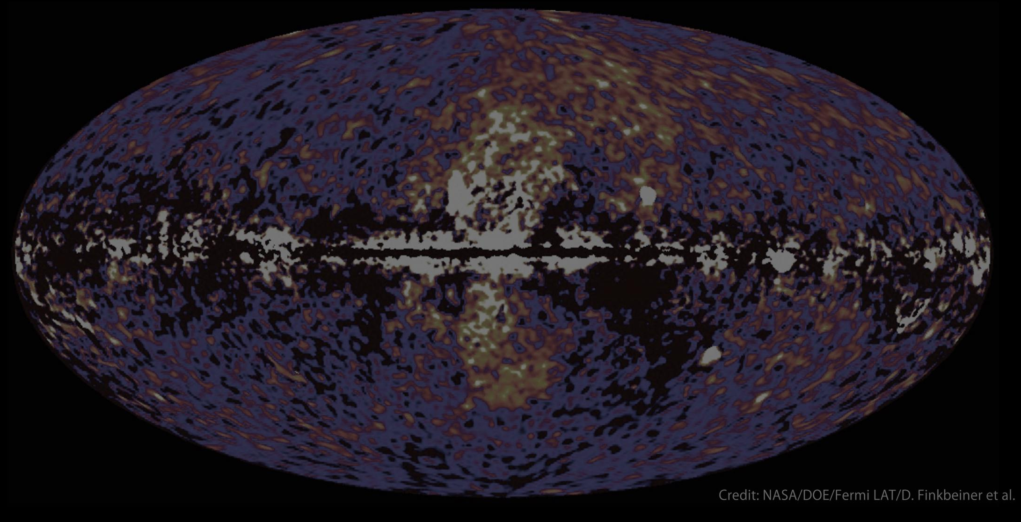
Fermi bubbles
Could these be the relics of a radio-loud AGN in the MW?
Provides straightforward way to supply required CRs for inverse-Compton
Modelling is consistent with this (Su+ 10; Guo & Mathews 11) though with other possibilities too
Several spiral-hosted Seyferts do this sort of thing; compare the nearest ‘RQ’ AGN…

Slide 26
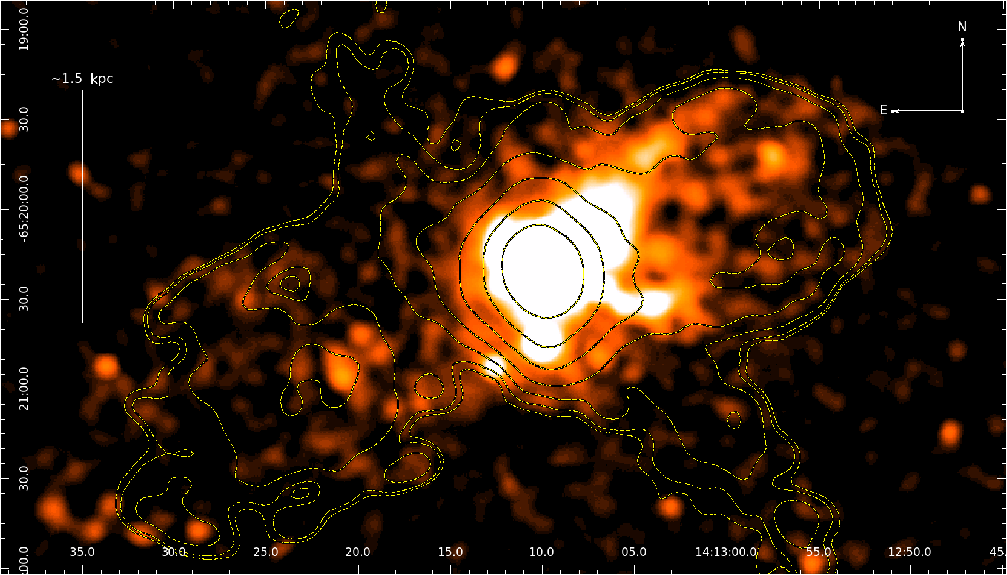
Circinus – nearest ‘RQ’ AGN
Galactic disc
‘Bubbles’
Mingo+ 2012 submitted. Total E ~ 2 x 10⁵⁵ erg

Slide 27
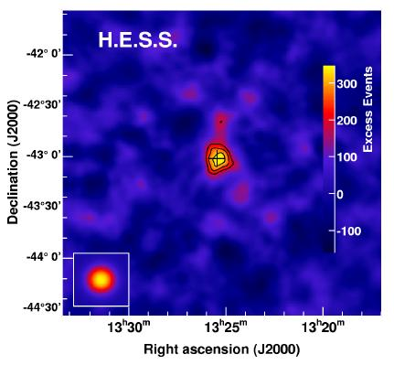
TEV and the CTA
4

Slide 28
Existing TeV sources
Many blazars, plus a total of 5 radio galaxies:
M87: long-standing detection; recent timing analysis shows at least some TeV associated with inner jet (Acciari+ 09)
Cen A: HESS detection (Aharonian+ 09)
3C66B? Confused with blazar 3C66A, but a possible detection (e.g. Tavecchio + Ghisellini 09); non-detected in some observations (Klepser+ 11)
3C84 (Aleksic+12) and IC310 (Aleksic+ 10) – nuclear sources, weak blazars? (see P. Colin talk)
M87, Cen A and 66B have bright X-ray jets (TeV electrons on kpc scales). Can these give rise to observed emission via IC?

Slide 29
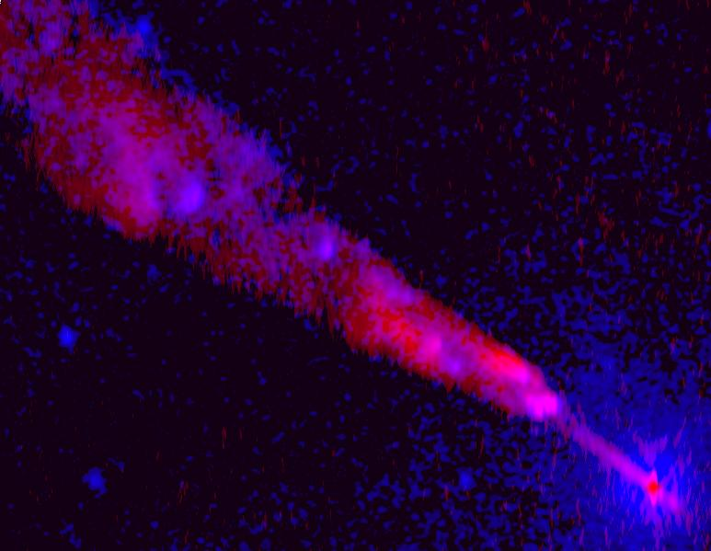
Testing IC models for TeV emission
Key advantage: electron energy distribution constrained via synchrotron observations
But various photon fields must be considered:
Synchrotron photons (SSC)
CMB
Extragalactic background light (EBL)
Starlight (inside host galaxy; inc. dust IR)
Hidden quasar/blazar
Crucial to take Klein-Nishina effects and anisotropy of photon fields, IC emissivity into account.
Multi-zone models required
SR effects must be be considered
All done by our new code (MJH & Croston 11)

Slide 30
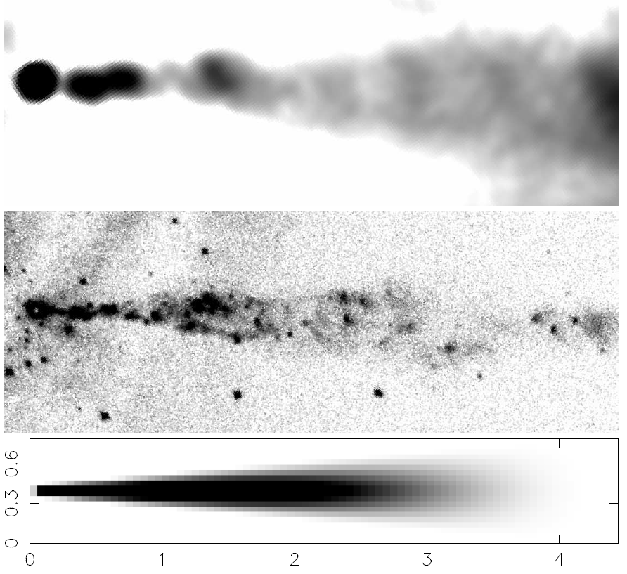
Extended IC modelling (Cen A)
Still require some simplifying assumptions about the jet & host galaxy...

Slide 31
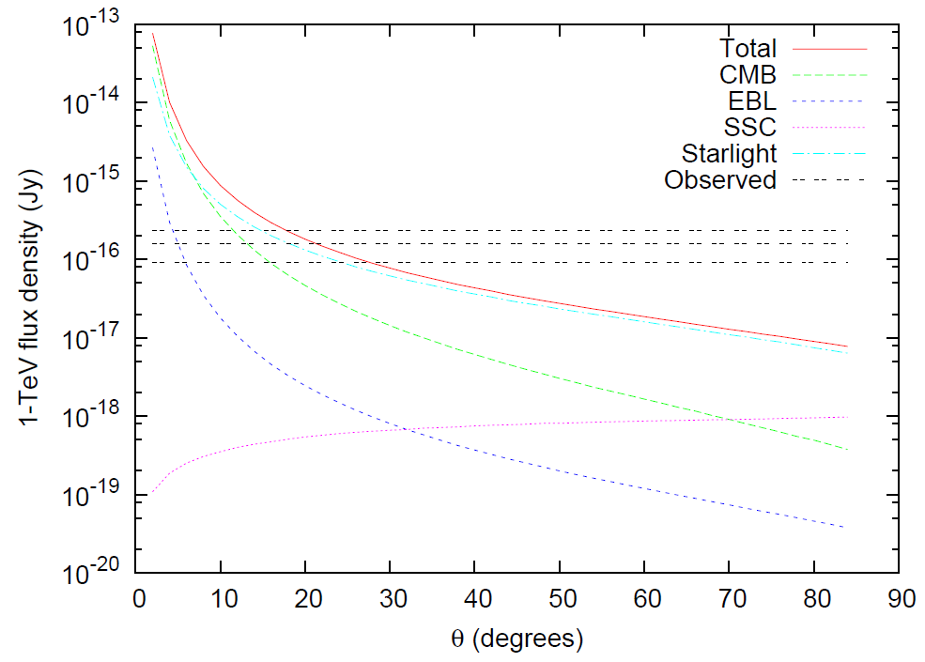
Results (Cen A)

Slide 32
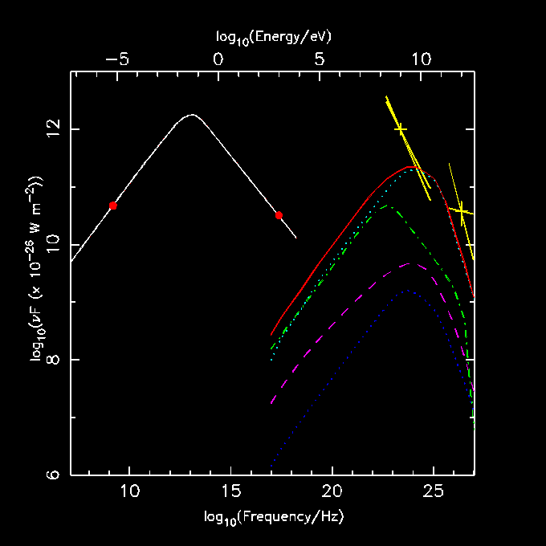
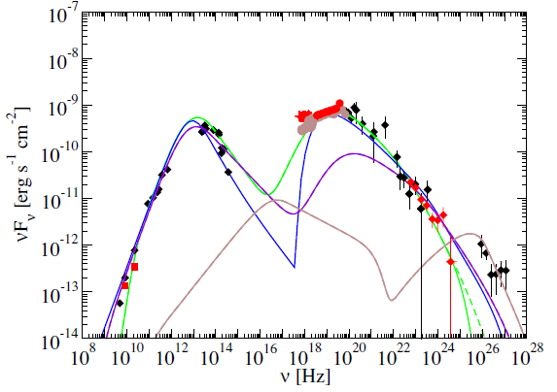
Results (Cen A)

Slide 33
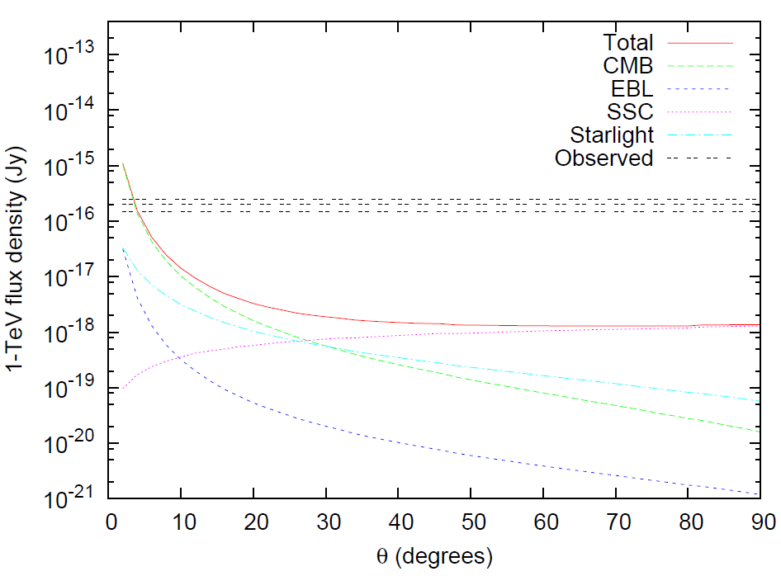
Results (M87)
Using quiescent, non-flaring TeV flux

Slide 34
What have we learnt?
Variability probably points to a nuclear origin for most RG TeV emission (e.g. M87)
But in Cen A at least the existing observations constrain B >~ B_{eq} for the kpc-scale jet… limit only more stringent if some of the observed emission is nuclear.
This is the only way to do this with an X-ray synchrotron jet!

Slide 35
What can the CTA do for us?
Improved sensitivity
Possibility of detecting more sources
Improved spatial resolution
Helps us separate nuclear and off-nuclear components, important for emission mechanism constraints.
Half Cen A’s flux in our models comes from > 1 arcmin…
With improved sensitivity other objects may be possible…

Slide 36
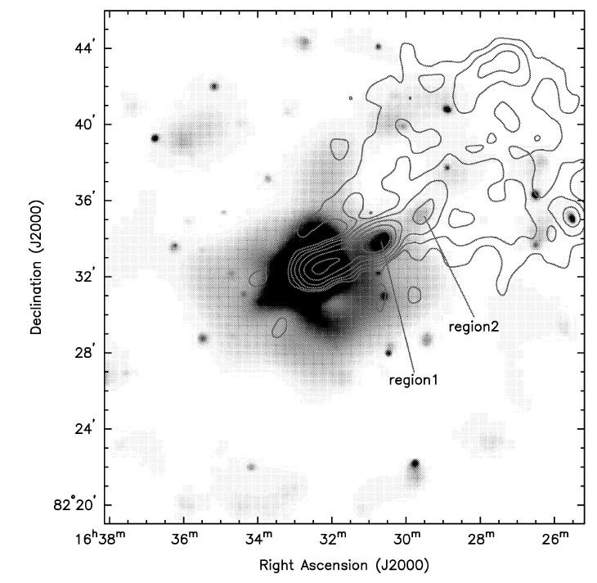
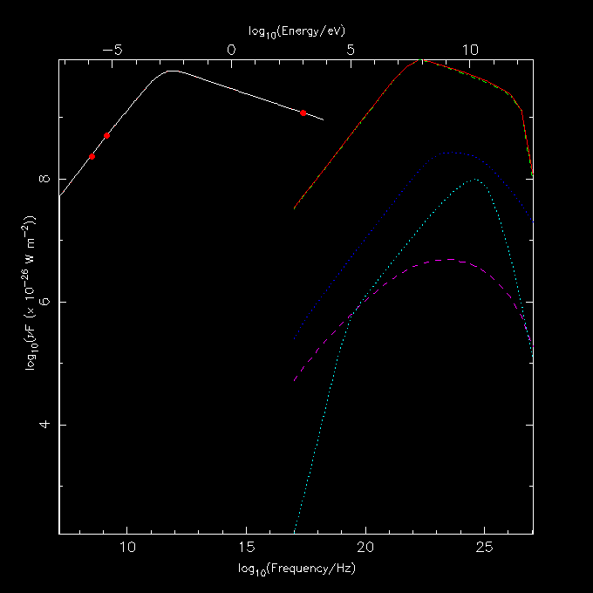
NGC6251
MJH & Croston 2011

Slide 37
UHECR acceleration
4.

Slide 38
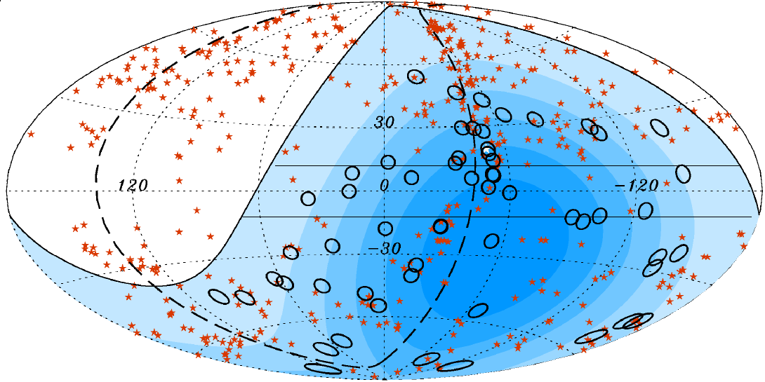
Cosmic ray constraints
RGs can accelerate protons to the highest observed energies in the lobes (MJH+ 09, MJH 10) but:
Must be FRIs (no FRIIs < GZK)
Lobes must be large + luminous (Hillas criterion)
Mag. fields in lobes must be >~ equipartition
Alfven speeds in lobes must be high
Substantial energy in turbulent component of magnetic field.

Slide 39
Progress?
Inverse-Compton detections (e.g. Cen A giant lobes) show that the magnetic field has the required strength for proton acceleration.
Our understanding of entrainment suggests that there will definitely be some protons/nuclei in the lobes.
What actually gets accelerated?

Slide 40
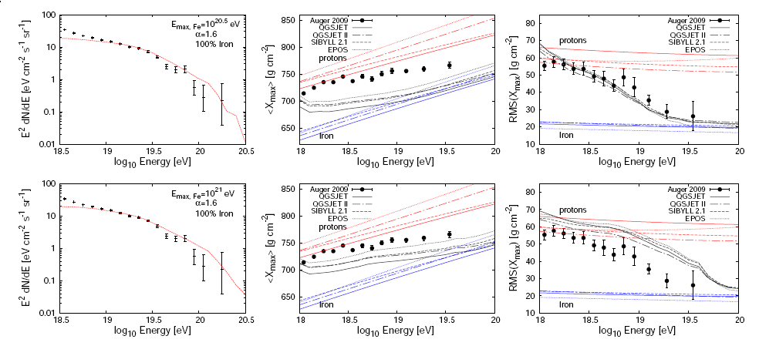
The composition problem
We don’t know the composition of the highest energy UHECR, but some evidence that these are light nuclei, not protons.
As acceleration in lobes is rigidity-dependent it is actually much easier to accelerate light nuclei.
If we turn down the efficiency of acceleration from the max. possible then giant lobes will only accelerate light nuclei.

Slide 41
A plausible (but disappointing) model: MJH 10
RG giant lobes are the main or only sources of UHECR acceleration. They operate below the optimal conditions – protons get up to ~ 10¹⁹ eV and light nuclei to ~10²⁰ eV.
The accelerated particle population is the matter entrained by the jet on kpc scales – significantly metal-enriched by stellar winds.
Light nuclei originating in the giant lobes of Cen A (3.7 Mpc away) will not be excessively deflected and can be detected as an excess (Liu+ 12).
But other sources’ light nuclei at larger distances will be deflected by IG mag fields… no other discrete source will ever be detected.

Slide 42
Summary
GeV gamma rays have great potential to complement X-ray IC and measure B-fields, high-energy electrons, EBL – but Fermi resolution & sensitivity is limiting
TeV gamma-rays give us IC measurements of fields in X-ray synchrotron jets – Cen A already constrained, hope for CTA
Cosmic ray acceleration in RG lobes works, but Cen A may be the only distinct source in the sky!

