Slide 1
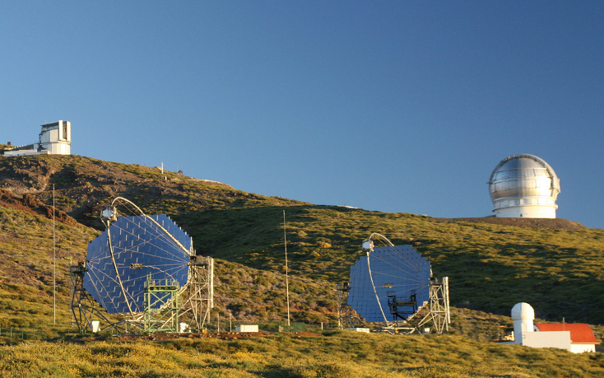


VHE measurements of the
Crab Nebula and Pulsar by the MAGIC Telescopes
Gianluca Giavitto, S. Klepser, M. Lopez, D. Mazin, T. Saito, T. Schweizer, R. Zanin
on behalf the MAGIC Collaboration and K. Hirotani, D. Horns, J. Martin-Rodriguez, M. Meyer
GAMMA 2012 Heidelberg, 9-13 July 2012

Slide 2
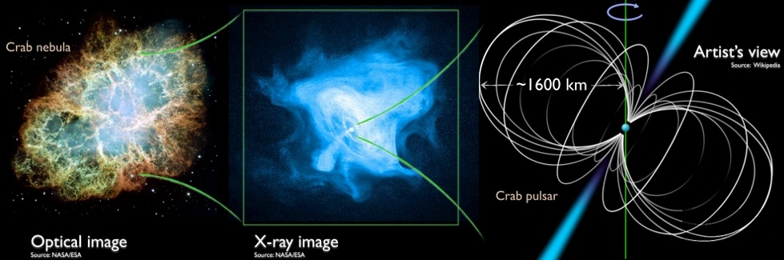
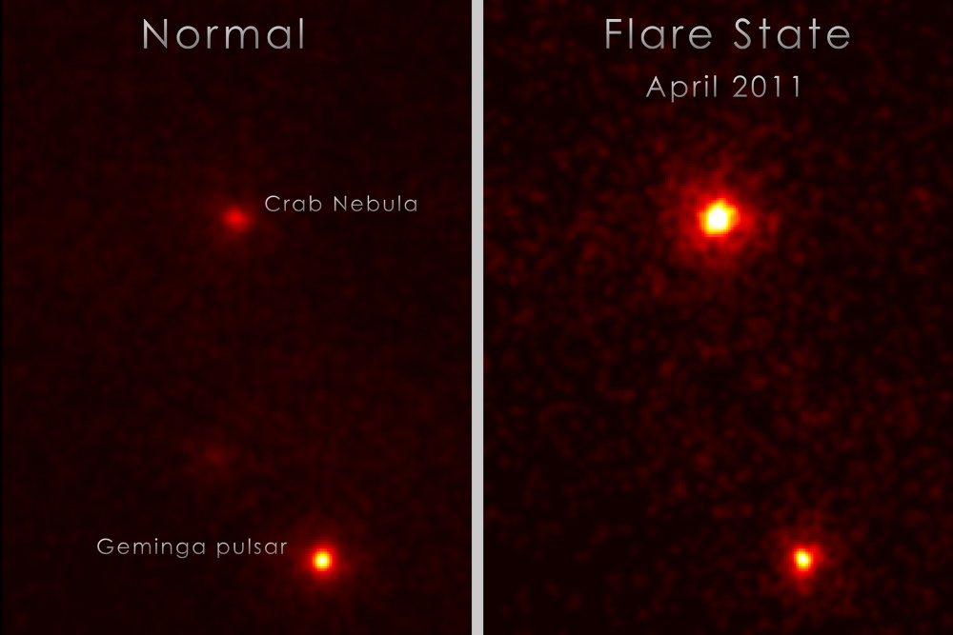
Introduction: the Crab and MAGIC
Crab Pulsar and Pulsar Wind
Nebula well studied from
radio to TeV's
Standard candle of
γ-ray astronomy
Recent (2011) surprises:
  Nebula:
  Discovery of Flares at HE (>100 MeV)
  AGILE (Tavani et. al 2011, Science 331:736)
  Fermi-LAT (Abdo et. al 2011, Science 331:739)
  Pulsar:
  Detection at VHE (>100 GeV)
  VERITAS (Aliu et. al 2011, Science 334:69)
  MAGIC (Aleksić et. al 2011, ApJ 742:43)
  MAGIC (Aleksić et. al 2012,A&A 540:A69)
Fermi-LAT flare of April 2011
(Credit: NASA/DOE/Fermi LAT/R. Buehler)
Notes:
The Crab Pulsar and its Pulsar Wind Nebula are the remnent of the historical supernova of 1054. They have been studied in detail across the whole accessible electromagnetic spectrum, in the top right picture, you can see an optical and a X-ray image of the nebula, and an artist's conception of the pulsar at its center.
Due to its steady, non-thermal emission the Nebula has been used as “standard candle” of X-ray, gamma-ray astronomy.
However, as reported early by Marco Tavani, this old acquaintance of us has given some surprises last year:
- FIRST, The flares of the Nebula seen at HE ( above 100 MeV ) by the satellites AGILE and Fermi

Slide 3
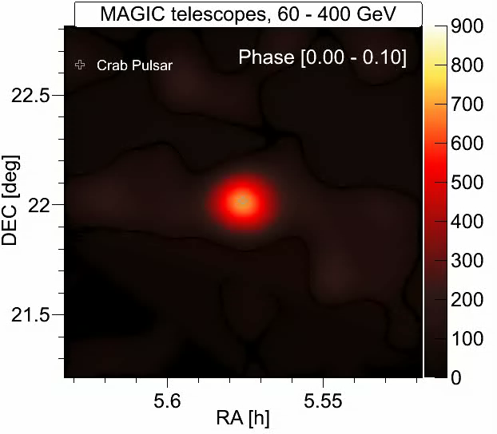
Introduction: the Crab and MAGIC
Crab Pulsar and Pulsar Wind
Nebula well studied from
radio to TeV's
Standard candle of
γ-ray astronomy
Recent (2011) surprises:
  Nebula:
  Discovery of Flares at HE (>100 MeV)
  AGILE (Tavani et. al 2011, Science 331:736)
  Fermi-LAT (Abdo et. al 2011, Science 331:739)
  Pulsar:
  Detection at VHE (>100 GeV)
  VERITAS (Aliu et. al 2011, Science 334:69)
  MAGIC (Aleksić et. al 2011, ApJ 742:43)
  MAGIC (Aleksić et. al 2012,A&A 540:A69)
Crab Pulsar as seen by MAGIC
(skymap of P2)
Notes:
- SECONDLY, The observation of VHE gamma-ray emission above 100 GeV from the pulsar by the two Cherenkov observatories of the northern hemisphere, VERITAS and MAGIC.
MOVIE SLIDE

Slide 4
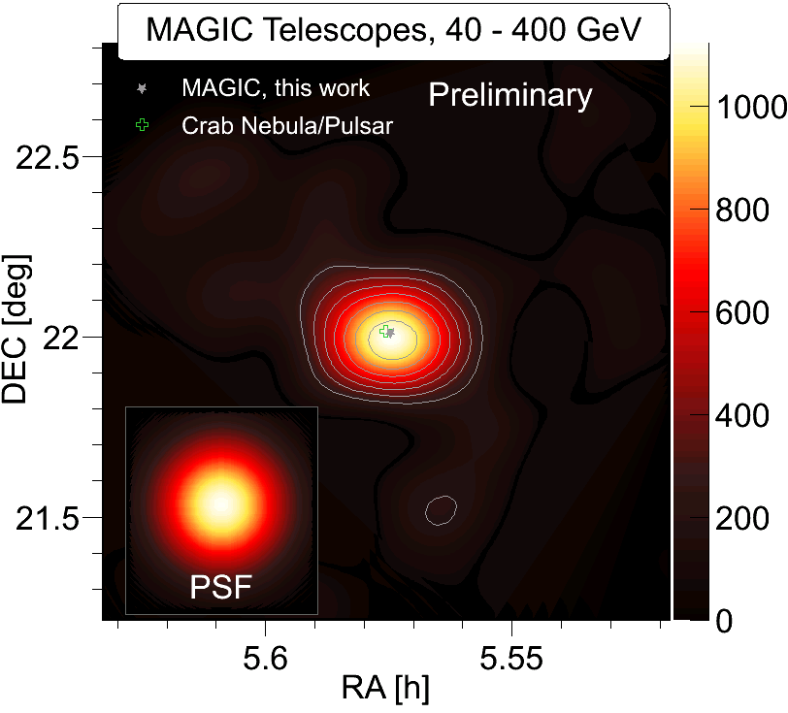
Introduction: the Crab and MAGIC
Crab Pulsar and Pulsar Wind
Nebula well studied from
radio to TeV's
Standard candle of
γ-ray astronomy
Recent (2011) surprises:
  Nebula:
  Discovery of Flares at HE (>100 MeV)
  AGILE (Tavani et. al 2011, Science 331:736)
  Fermi-LAT (Abdo et. al 2011, Science 331:739)
  Pulsar:
  Detection at VHE (>100 GeV)
  VERITAS (Aliu et. al 2011, Science 334:69)
  MAGIC (Aleksić et. al 2011, ApJ 742:43)
  MAGIC (Aleksić et. al 2012,A&A 540:A69)
Crab Pulsar as seen by MAGIC
(skymap of P2)
Notes:
SKYMAP SLIDE

Slide 5
The Crab Nebula
GAMMA 2012 Heidelberg, 9-13 July 2012
Notes:
In the following, I will report about the MAGIC observations of the Crab Nebula

Slide 6
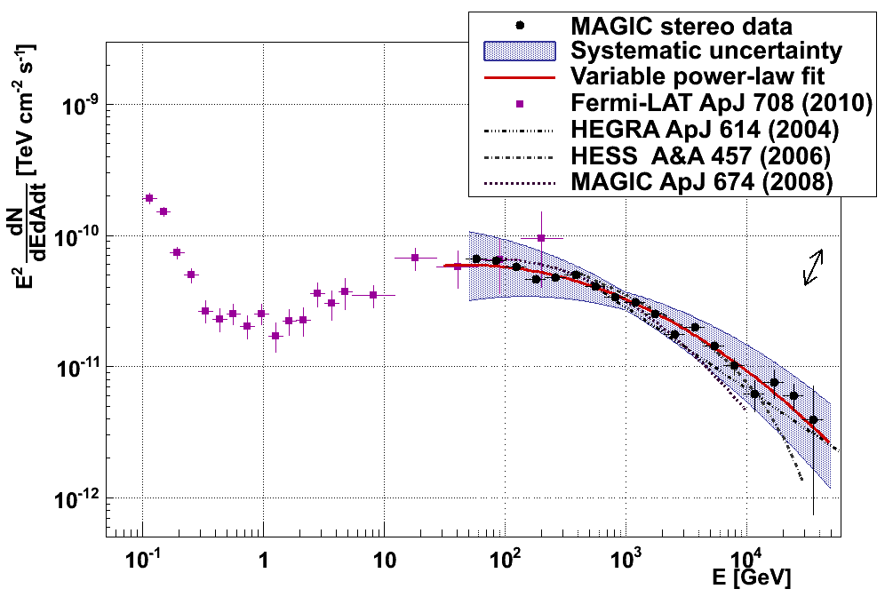
Crab Nebula: spectrum
Crab Nebula Spectral Energy Distribution
PRELIMINARY
Systematic
errors:
Flux = ~15%
Energy = ~15%
Index = ± 0.15
Γ = 2.27±0.02_{stat}
Fermi-LAT
Γ = 2.53±0.02_{stat}
Stereo mode
2009 – 2011
T_{eff} = 48.7 h
Zenith 5°-50°
Log Parabola Fit (only MAGIC data)
Stat. errors
< 5% below 100GeV
3 Decades in E
50 GeV
45 TeV
Notes:
MAGIC observed the Crab Nebula in Stereo mode from 2009 until 2011 for a total of about 50 hours.
The observation spanned a zenith angle between 5 and 50 degrees.
The resulting spectrum spans three decades in energy, from 50 GeV to 45 TeV, and 8 decades in flux.
The spectrum can be fitted to a log-parabola, the photon index varies from around 2.3 at 100GeV to 2.5 at 10TeV.
The statistical errors are small ~ 5% below 100 GeV
However the systematic errors dominate, affecting the flux normalization and the energy scale by about 15% and the photon index by +- 0.15.

Slide 7
Crab Nebula: spectrum
Crab Nebula Spectral Energy Distribution
PRELIMINARY
Systematic
errors:
Flux = ~15%
Energy = ~15%
Index = ± 0.15
Fermi-LAT
Stereo mode
2009 – 2011
T_{eff} = 48.7 h
Zenith 5°-50°
MOST PRECISE IC PEAK
MEASUREMENT SO FAR:
IC_{peak} = 59 ± 6 GeV
(with Fermi-LAT data,
stat. err only)
Where is
the cutoff?
Stat. errors
< 5% below 100GeV
Notes:
If we combine this data with that of Fermi-LAT, it is possible to map most of the IC bump, and fit the IC peak position. In fact, the combination of the two fits returns the most precise IC peak measurement to date:
59 +- 6 GeV (with statistical errors only. ~ +- 10 GeV systematic errors – with Fermi)
Another interesting part of the spectrum is above 10 TeV: here there is a long-standing discrepancy between the previous HEGRA and the HESS measurements, with the latter detecting a cutoff at 14 TeV.
However, due to our systematic uncertainties we cannot at the moment resolve this discrepancy.

Slide 8
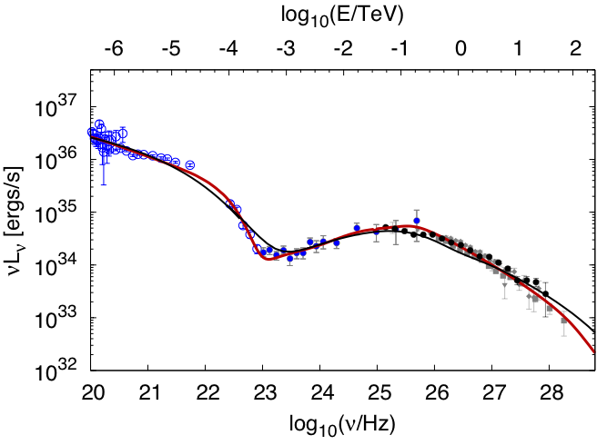
Crab Nebula: modeling
Crab Nebula modelling
Three Models:
Constant B-field
(from Meyer et al. 2010, A&A 523:A2
as in Hillas et al. 1998, ApJ 503:744)
MHD flow model
(from Meyer et al. 2010, A&A 523:A2
as in K&C 1984, ApJ 283:694,
A&A 1996, MNRAS 278:525)
Time-dependent
(as in Martin-Rodriguez et al., in prep.)
PRELIMINARY
– Constant B model
– MHD flow model
· MAGIC stereo
· Fermi-LAT (Abdo et al., 2010)
Stat errors only!
D. Horns & M. Mayer
Notes:
For the modeling of the gamma-ray emission of the Crab Nebula, we took into consideration two models, with the help of external authors:
Mayer and Horns considered two possibilties:
* A phenomenological constant magnetic field model, as proposed by Hillas et al. in 1998 (RED LINE)
* A magnetohydrodynamic flow model, as outlined in Kennels and Coroniti 1984 and revised by Atoyan & Aharonian 1996 (BLACK LINE)
None of them fits well the data within the statistical errors only, both of them do when taking systematic errors into consideration.

Slide 9
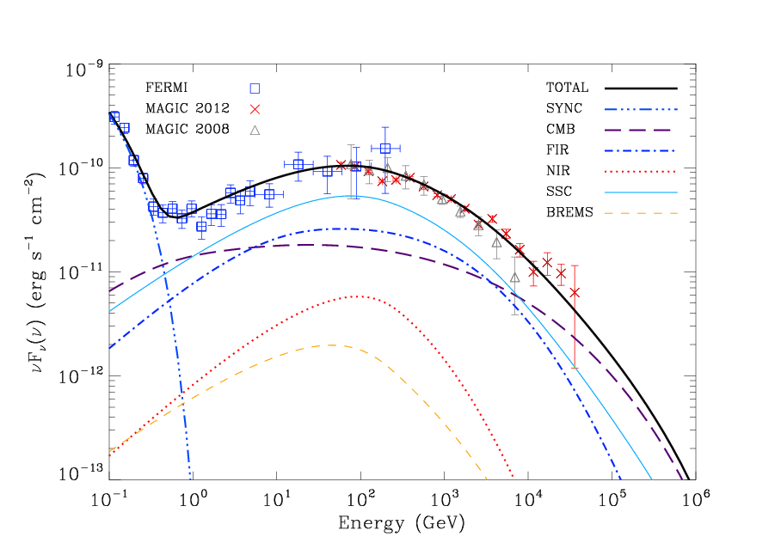
Crab Nebula: modeling
Three Models:
Constant B-field
(from Meyer et al. 2010, A&A 523:A2
as in Hillas et al. 1998, ApJ 503:744)
MHD flow model
(from Meyer et al. 2010, A&A 523:A2
as in K&C 1984, ApJ 283:694,
A&A 1996, MNRAS 278:525)
Time-dependent
(as in Martin-Rodriguez et al.,
in prep.)
VERY
PRELIMINARY
Stat errors only!
J. Martin-Rodriguez, D. Torres, N. Rea
Notes:
Jonatan Martin-Rodriguez, Diego Torres and Nanda Rea formulated a new, very detailed spectral model that takes into account the time and energy evolution of the lepton population. This model is soon to be published, and fits our data quite well as you can see in the plot here.
-> All these models can only be disentangled by more precise measurements of the Crab and of other joung PWN with smaller systematic errors, to be carried on in the future.

Slide 10
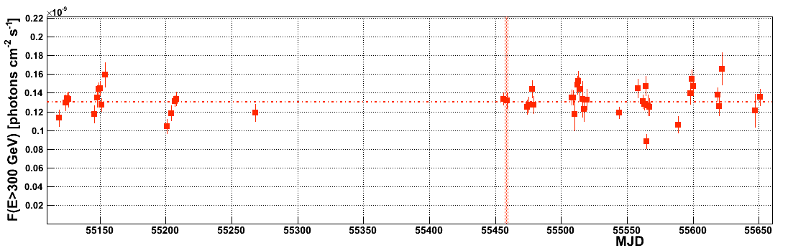
Crab Nebula: variability and flares
Was the Crab nebula also flaring at TeV's?
MAGIC measures constant flux above 300 GeV
within systematic error of 13% to a confidence level of 95%
AGILE/Fermi-LAT
flare Sept. 2010
PRELIMINARY
Flux (E > 300 GeV) = (1.31 ± 0.03_{stat} ± 0.17_{sys} ) × 10⁻¹⁰ ph. cm⁻² s⁻¹
Oct. 2009
Mar. 2011
Notes:
Now to the variability:
The emission above 300 GeV from the CN has been found to be constant within a systematic uncertainty of 13%, and to a CL of 95%.
During the September 2010 flare we did not detect any variability

Slide 11
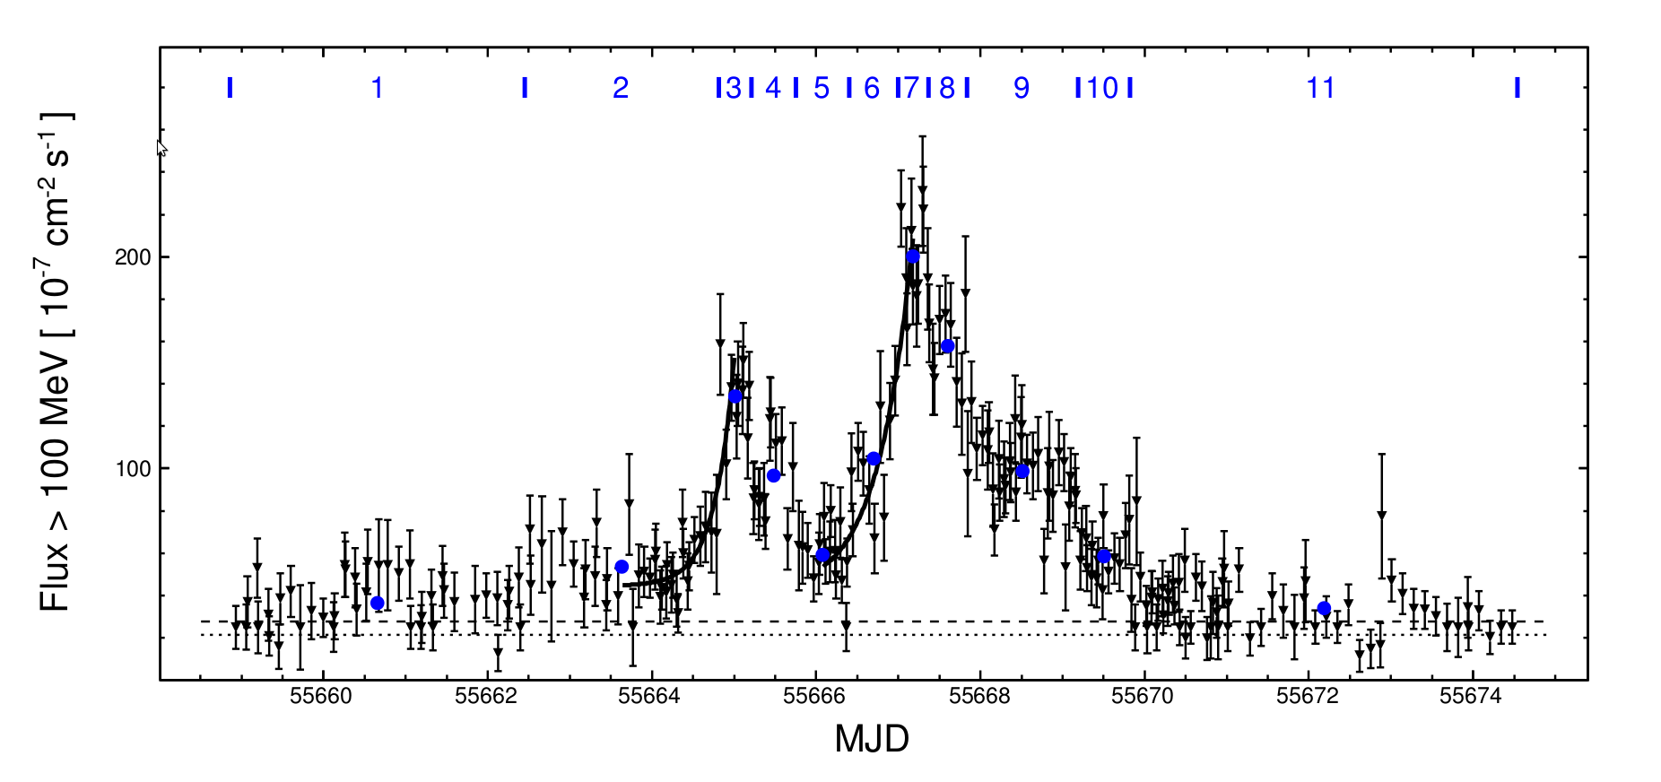
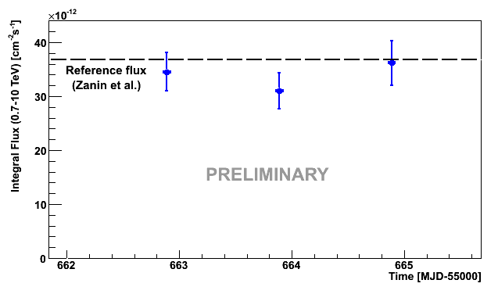
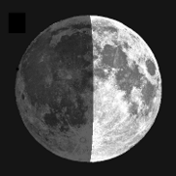
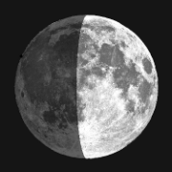
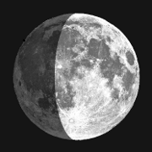
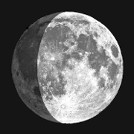
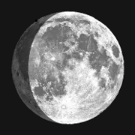
Crab Nebula: variability and flares
A closer look at the April 2011 flare
Start of
Fermi-LAT ToO
Fermi-LAT lightcurve from
Buehler et al.
astro-ph:1112.1979
MAGIC Observations
No evidence of flaring activity!
0.7 < E < 10 TeV
(observation under strong moonlight, reduced HV)
Steady flux
Zanin et al.
ICRC 2011
Moon
Phase
Notes:
We also observed the nebula during the April 2011 flare, whose Fermi-LAT lightcurve is shown above.
Here the observations were rather tricky due to the strong moonlight: we had to operate with reduced HV, and the light conditions were changing from night to night. Nevertheless we can say that we found no evidence of change in the flux between 0.7 and 10 TeV during the first peak of the flare.
( The same measurement was carried on for the Sept. 2010 flare, with the same outcome)
( ARGO measures hint of variability at 2 TeV for Sept 2010, at >10 TeV for April 2011 – in grey lines)
(We did not have data during the second peak because of the full moon. )

Slide 12
The Crab Pulsar
GAMMA 2012 Heidelberg, 9-13 July 2012
Notes:
Now, to the MAGIC observations of the Crab Pulsar

Slide 13
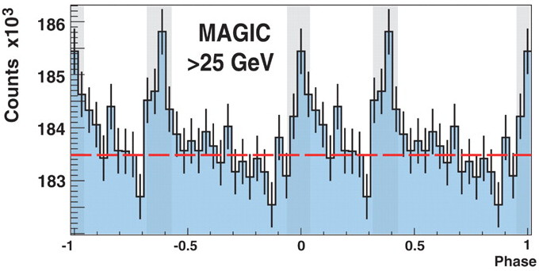
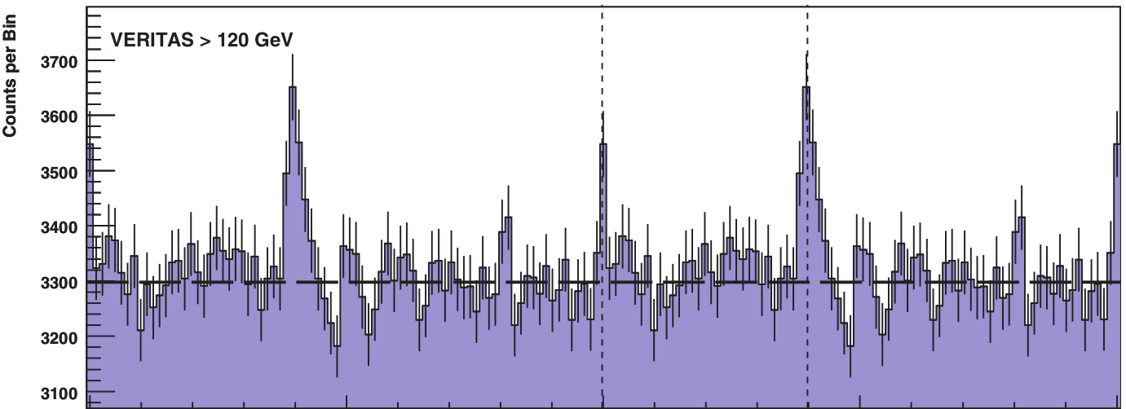
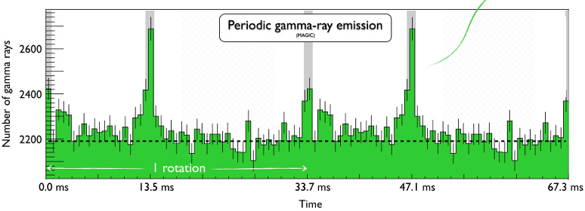
Crab Pulsar: recent VHE history
2008:
MAGIC mono: discovery at E > 25 GeV rules out Polar Cap model,
exp. cutoff at ~ 17 GeV
(Aliu et. al 2008, Science 322:1221)
2011 – 2012:
VERITAS: pulsed emission + spectrum
at E > 100 GeV
(Aliu et. al 2011, Science 334:69 )
MAGIC mono: phase-dep. spectrum
25 < E < 100 GeV
(Aleksić et. al 2011, ApJ 742:43)
MAGIC stereo: phase-dep. spectrum 50 < E < 400 GeV
(Aleksić et. al 2012, A&A 540:A69)
Breakthrough VHE measurements exclude exp. cutoff and challenge all existing models!
MAGIC MONO
E > 25 GeV
VERITAS
E > 120 GeV
MAGIC STEREO
E > 50 GeV
Notes:
Prior to 2008, no pulsar was detected by means of ground-based Cherenkov Telescopes. The EGRET, pulsars showed spectra with cutoffs at a few GeV, consistent with the prediction of the models.
In 2008, MAGIC published a firm detection of the Crab Pulsar at 6.4 sigma above 25 GeV. That detection alone ruled out the Polar Cap model, and found the position of the exp cutoff to be at around 17 GeV, and a hint of emission extending above 60 GeV.
In 2009 Fermi published very detailed phase-resolved spectra of the Crab, also assuming a PL+exp cutoff shape, for some phases the cutoff values were exceeding 10 GeV. (The phase-averaged cutoff was around 6 GeV, and most if not all the highest energy spectral points were above the fit)
During the last year, both operating Cherenkov Telescopes in the northern hemisphere, VERITAS and MAGIC, reported the detection of pulsed gamma-ray emission from the Crab Pulsar, from 25 up to 400 GeV.
MAGIC in particular published results with phase-resolved spectra from
- its monoscopic observations, carried on in 2007-2009, in the energy range from 25 to 100 GeV
- its stereoscopic observations carried on in 2009-2010. between 50 and 400 GeV. (here we can see the stereo phase histogram)
In the following I'll overview these results in more detail.

Slide 14
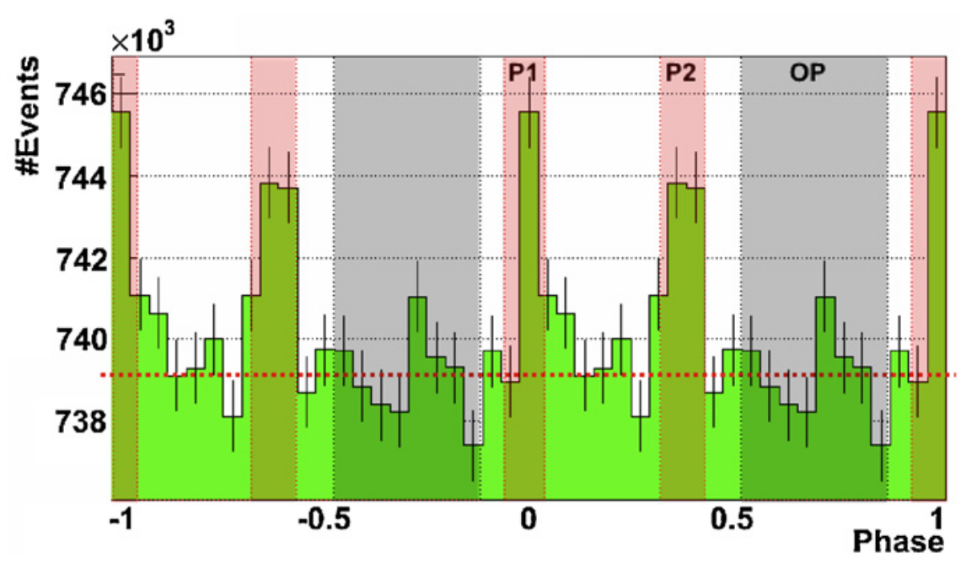
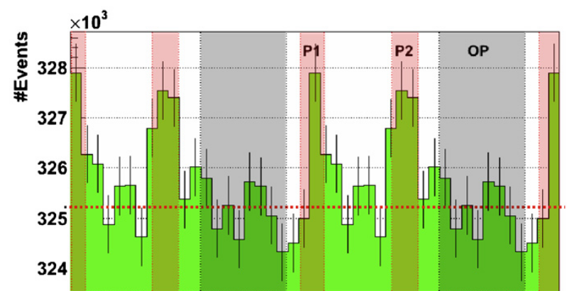
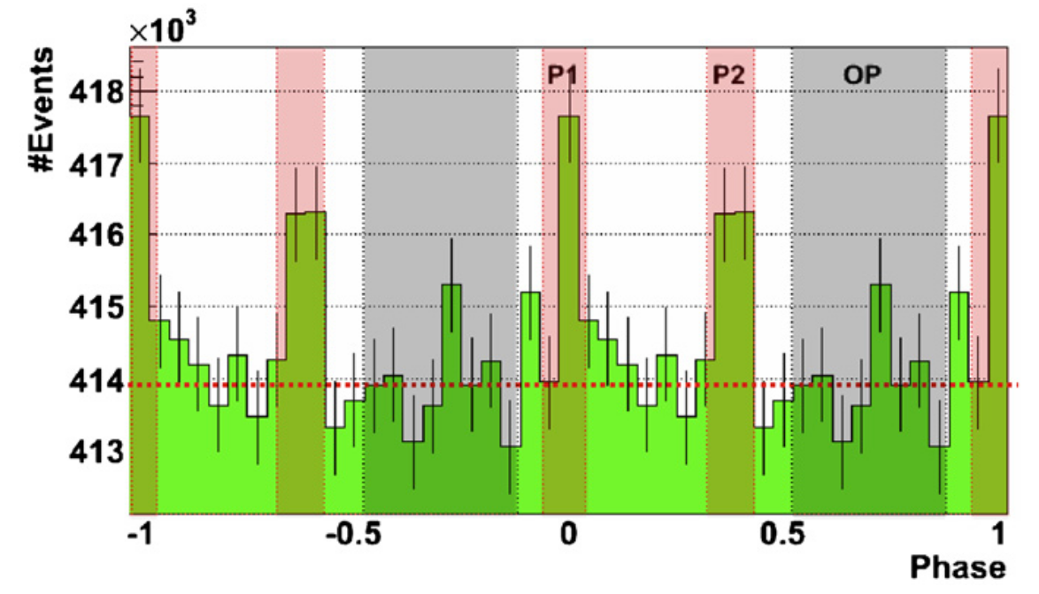
Crab Pulsar: mono observations
59 hrs of data (Oct. 2007 - Feb. 2009)
(Aleksić et. al 2011, ApJ 742:43)
Sum-trigger: threshold at 25 GeV
EGRET – era peak definitions:
(from Fierro et al., 1998, ApJ 494:734)
21% of the whole phase
Pulsation detected at 7.5σ (P1+P2)
Energy range: 25 < E < 100 GeV
Indication that peaks become narrower than at MeV energies
No significant inter-peak emission, no other significant peaks
No significant yearly variablility
Crab Phase Histogram 25 < E < 100 GeV
Winter 2007/2008
Winter 2008/2009
Notes:
The mono observations were carried on between 2007 and 2009, for a total of 59 hours of good-quality Crab Pulsar.
For these observations we used a special trigger, called sum-trigger, that allowed us to reach a threshold of 25 GeV, the lowest obtained with Cherenkov Telescopes.
To test the presence of a pulsation, and later measure the phase-dependent spectrum, we used a-priori EGRET-era definitions of the main peak P1, the interpeak P2, and the so-called “off-peak” region.
With these definitions, P1 and P2 are covering 21% of the phase.
With these definitions the pulsation was detected at 7.5σ significance when taking both peaks into account ( individually P1 was detected at 4.3σ and P2 at 7.4σ,). The energy range of this detection was from 25 to 100 GeV.
The lightcurve shows an indication of the narrowing of the peaks w.r.t. MeV energies (e.g. if we consider only 1 bin, P1 is much more significant: 7.0σ), no significant inter-peak (or bridge) emission, no other significant peak.
We did not found any significant variability when considering separately the data from two different periods of observation.

Slide 15
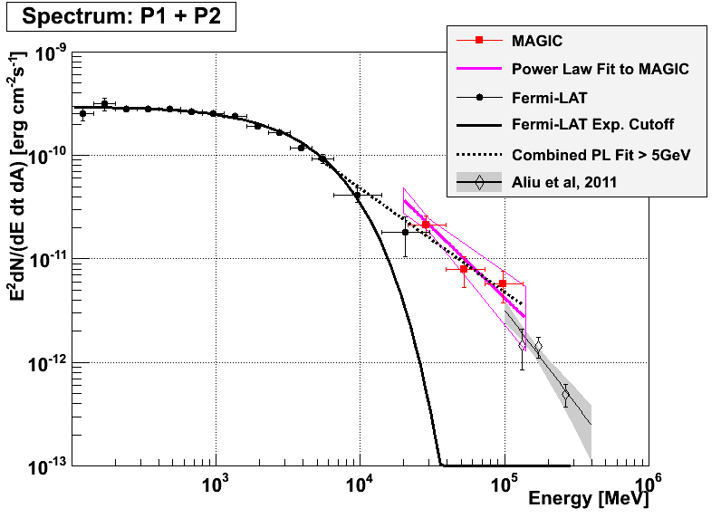
Crab Pulsar: mono observations
MAGIC MONO phase-averaged spectrum (P1+P2)
Γ_{P1+P2} = 3.4 ± 0.5_{stat}
Systematic
errors:
Flux = ~20%
Energy = ~16%
Index = ± 0.3
5.8σ
Notes:
The phase averaged (P1+P2) spectrum is shown here.
In the MAGIC energy range, it can be well described by a power law with index -3.4 ± 0.5 (magenta lines)
The systematic errors of this measurement about 20% on the flux normalization, about 16 % in the energy scale, plus or minus 0.3 on the index.
The excess at these energies rules out an exponential-cutoff spectrum obtained by Fermi-LAT data alone with a CL of 5.8 sigma, assuming a systematic errors in energy scale only, on both datasets (Fermi systematic is 7%)
( When fitting together MAGIC and Fermi-LAT points above 5 GeV we obtain a PL with Γ = -3.0 ± 0.1)
For the phase-resolved P1 and P2 spectra we have comparable results in terms of photon index, with P2 being about twice as strong as P1.

Slide 16
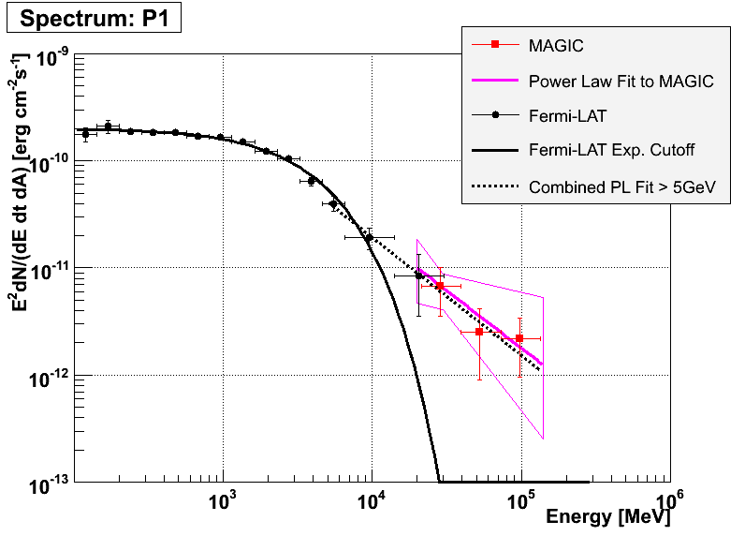
Crab Pulsar: mono observations
MAGIC MONO phase-averaged spectrum (P1)
Γ_{P1} = 3.1 ± 1.0_{stat}
Systematic
errors:
Flux = ~20%
Energy = ~16%
Index = ± 0.3
2.5σ
Notes:
The phase resolved P1spectrum is shown here.
In the MAGIC energy range, it can be well described by a power law with index Γ = 3.1 ± 1.0
The excess at these energies rules out an exponential-cutoff spectrum obtained by Fermi-LAT data alone with a CL of 2.5 sigma, assuming a systematic errors in energy scale only, on both datasets (Fermi systematic is 7%)
When fitting together MAGIC and Fermi-LAT points above 5 GeV we obtain a PL with Γ = 3.1 ± 0.2

Slide 17
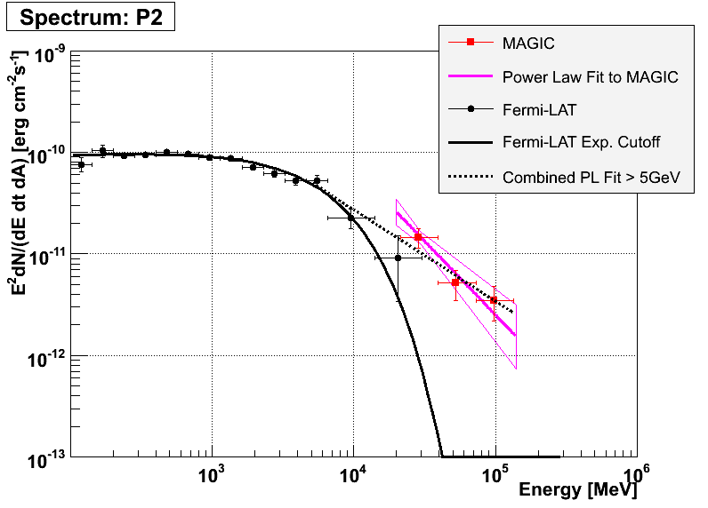
Crab Pulsar: mono observations
MAGIC MONO phase-averaged spectrum (P2)
Γ_{P1} = 3.4 ± 0.5_{stat}
Systematic
errors:
Flux = ~20%
Energy = ~16%
Index = ± 0.3
4.7σ
Notes:
The phase resolved P2 spectrum is shown here.
In the MAGIC energy range, it can be well described by a power law with index Γ = 3.4 ± 0.5
The excess at these energies rules out an exponential-cutoff spectrum obtained by Fermi-LAT data alone with a CL of 4.7 sigma, assuming a systematic errors in energy scale only, on both datasets (Fermi systematic is 7%)
When fitting together MAGIC and Fermi-LAT points above 5 GeV we obtain a PL with Γ = 2.9 ± 0.1

Slide 18
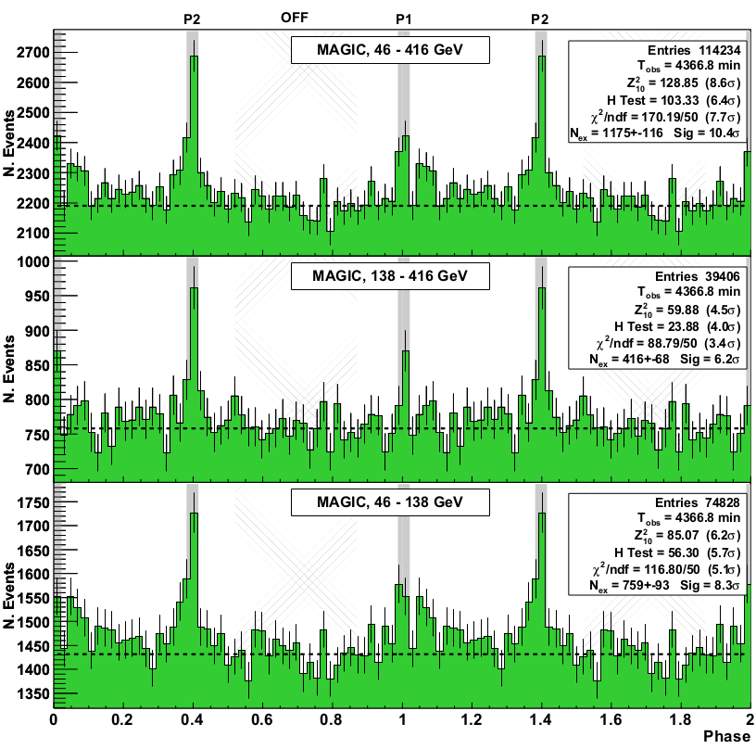
Crab Pulsar: stereo observations
73 hrs of data (Oct. 2009 - Mar. 2011)
(Aleksić et. al 2012, A&A 540:A69)
Stereo: less background,
smaller systematics.
Pulsation firmly detected
H test (unbinned) : 6.4σ
χ2 test : 7.7σ
EGRET-peaks (a-priori) : 7.7σ
Peaks get narrower w/energy
New peak definitions ±2σ_{FIT}:
a posteriori, 8.8% of the whole phase
LE: Possible 3.4σ hint
at TW₁ [ 0.04 : 0.14 ]
(Fermi-LAT spectrum is
harder here too)
Crab Pulsar Stereo Phase Histograms
Full
Energy
Range
46 < E_{est} < 416 GeV
<E_{true}> ~ 100 GeV
High
Energy
Range
138 < E_{est} < 416 GeV
<E_{true}> ~ 180 GeV
Low
Energy
Range
46 < E_{est} < 138 GeV
<E_{true}> ~ 80 GeV
Notes:
Now to the MAGIC stereo observations of the Crab Pulsar.
They were taken between 2009 and 2011 for a total of 73 hours.
The stereo, or coincidence mode between two telescopes is much better in terms of background rejection, but has a higher threshold than the monoscopic sum-trigger measurements.
The energy range in this case is between around 50 and 400 GeV.
As you can see in the phase histograms on the right, the pulsation was firmly detected. Using an unbinned test such as the H-test, its significance is 6.4 sigma. Using the EGRET-era bins is 7.7 sigma.
As in the MONO case, we noted that the peaks were much narrower than at MeV energies, so we proposed new phase definitions, fitting the peaks with gaussians and taking the +- 2 sigma intervals. These cover only 8.8 percent of the full phase.
For these new phase definitions, the significance surpasses 10 sigma for the whole energy range.
The pulse profile is quite similar below 150 GeV and above it, except for the hint of a feature in the trailing wing region of P1, seen at low energies only.

Slide 19
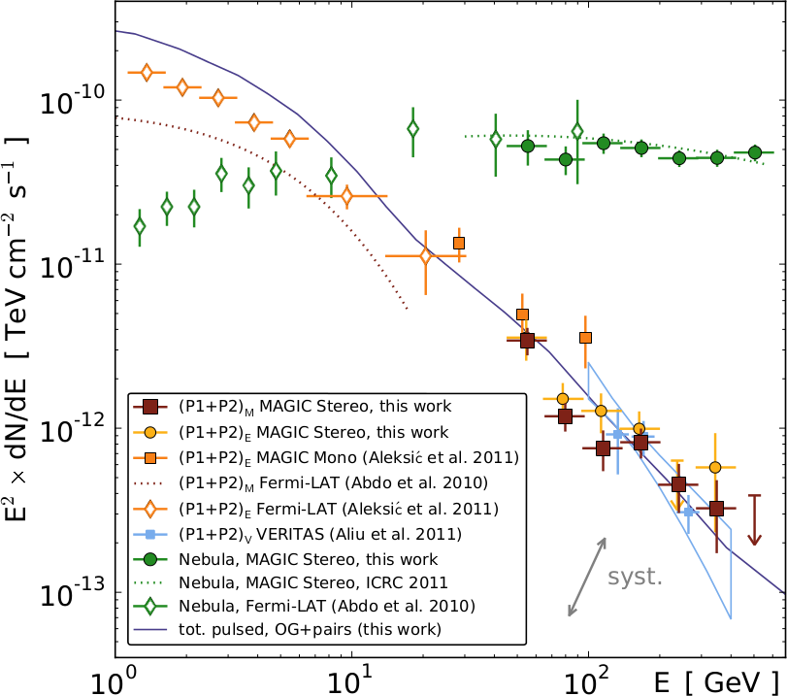
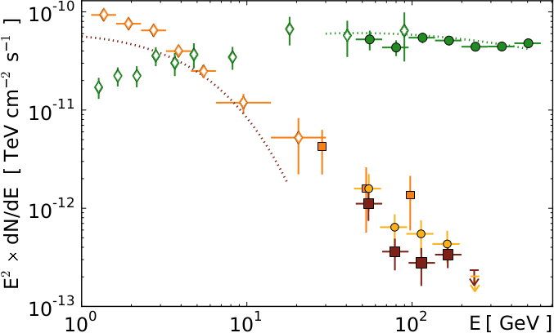
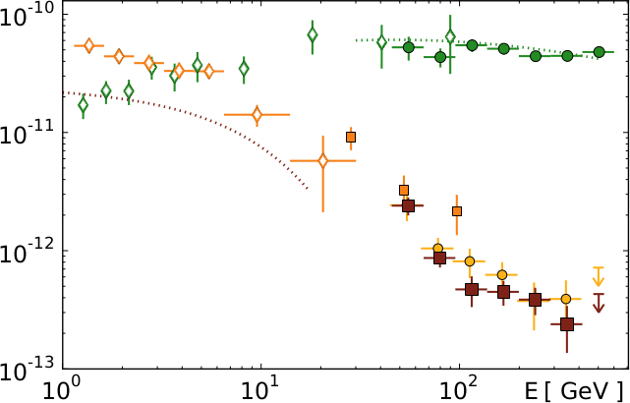
Crab Pulsar: stereo observations
Fermi-LAT
MAGIC
Stereo spectrum:
Power law, joins Fermi-LAT,
MAGIC mono and VERITAS
P2 is twice as strong as P1
Spectra for MAGIC (a posteriori)
and EGRET (a priori)
phase definitions match
No significant yearly variability
Pulsar (Fermi-LAT)
Nebula (MAGIC)
Nebula (Fermi-LAT)
MAGIC MONO
MAGIC STEREO
Γ = 3.6 ± 0.3_{stat}
P1+P2
VERITAS
Systematic
errors:
Flux = ~17%
Energy = ~19%
Index = ± 0.20
MAGIC STEREO
Γ = 4.0 ± 0.8_{stat}
MAGIC STEREO
Γ = 3.4 ± 0.8_{stat}
P1
P2
Notes:
The phase averaged spectrum was found to have a has a power-law shape, with index 3.6, a value compatible with the photon index found for P1 and P2 separately. The systematics of these measurements are lower than mono, but slightly higher than in regular obs. stereo-mode (as the Crab Nebula before)
The MAGIC stereo spectral points are shown in the SED plot here as RED squares together with the MAGIC mono (ORANGE squares), Fermi-LAT (empty orange diamonds) and VERITAS points (BLUE squares).
Also the nebula is shown in green.
In the bottom you can see similar plots for the two different peaks, P1 and P2.
The spectra were also derived for the a-priori EGRET-era phase definitions, and found to be consistent with the one for the a-posteriori ones.
No significant yearly variability was observed.
Systematic uncertainties:
17% energy scale
19% flux normalization
0.2 photon index
Double-check with Nebula spectrum: ok down to 50 GeV

Slide 20
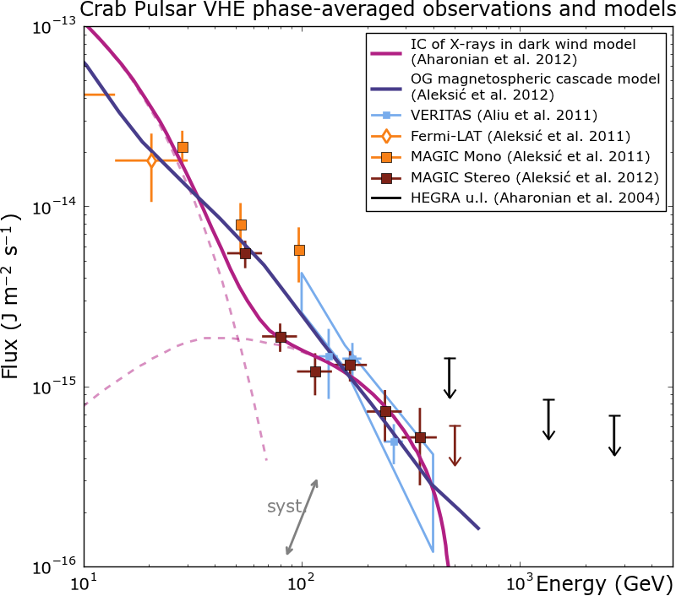
Crab Pulsar: models
New evidence → new models:
older ones cannot explain
emission up to 400 GeV
Extension of OG model:
(as in Hirotani, K. 2006, Mod. Phys. Lett. A, 21:1319)
  Magnetospheric cascade:
  VHE pulsed γ-rays are produced
  via SSC by secondary and tertiary pairs
Other possiblities:
  IC upscattering of pulsed X photons
  in “Dark wind region” outside the LC
  (Aharonian et al. 2012, Nature letters)
  Synchrotron emission or Curvature emission by ultra-relativistic particles @ LC
  (Chkheidze et al., 2011,ApJ 730:62)
  (Bednarek W., 2012,arXiv:1205.4855, accepted MNRAS )
  IC of secondary pairs in Annular gap
  (Du et al., 2012 ApJ 748:84)
P1+P2
Is there a 2nd component or a cutoff?
crucial points now
structures at ~100 GeV
emission at > 500 GeV
see T.Saito's poster
Notes:
The new evidence prompted theoretician to develope new models, since the old ones could not explain the emission up to 400 GeV.
In our papers we propose an extended outer gap model, formulated by affiliated scientist K. Hirotani, in which the VHE gamma-rays emission comes from SSC of secondary and tertiary pairs cascading in the outer magnetosphere, beyond 0.5 light cylinder (LC) radii.
( Self-consistent 3D solution of Poisson and Radiative Transfer: non-vacuum gaps in magnetosphere! )
This model it is shown in the plot to the right as a blue line. The plot is a zoom of the one shown in the previous slide.
Other possibilities exist: for example, Aharonian et al. proposed that the observed emission comes from IC scattering of X-rays in the dark wind region outside the light cylinder (this model is shown as a magenta line)
Chkheidze et al. and Bednarek explain it as Synchrontron or Curvature radiation from ultra-relativistic particles at the very light cylinder,
Du et. al instead assume IC from secondary pairs in the so-called Annular Gap as the cause.
It is clear that the topic is still hot. MAGIC can help discriminate the models by measuring structures at around 100 MeV or a possible emission above 500 GeV. Work on this is ongoing, as explained in T. Saito's poster "Follow-up observations of the Crab pulsar with MAGIC and re-analysis of archival data

Slide 21
Wrap-up and Conclusion
MAGIC has measured VHE gamma-ray emission from both
the Crab Nebula and Pulsar with an unprecedented accuracy:
  Nebula IC peak measured: IC_{peak} = 59 ± 6 GeV
  No evidence of flaring during the two HE flares of 2010 and 2011
  First VHE Pulsar phase-resolved spectrum, from 25 to 400 GeV
  Power law extension of Crab pulsar spectrum confirmed!
Surprises from old friend: still a lot to learn, many open questions!
Completion of upgrade (new cameras, new readout, new stereo-sumtrigger) will allow MAGIC to answer some of them.
Notes:
So, to conclude:
MAGIC has measured VHE gamma-ray emission from both the Crab Nebula and the Pulsar with an unprecedented accuracy, highlights include
for the Nebula:
The IC peak measurement at 59 ± 6 GeV and no evidence of enhancements during the two HE flares of 2010 and 2011
for the Pulsar:
the first VHE Pulsar phase-resolved spectrum, confirming its Power-law like extension from 25 to 400 GeV.
All these surprises came from an old friend of VHE astronomy: after 20 years there is still a lot to learn, and many open questions about the Crab.
In the near future, the completion of the upgrade (new cameras, new readout, new stereo-sumtrigger) will allow MAGIC to answer some of them, and to possibly raise new ones.

Slide 22
Backup slides
GAMMA 2012 Heidelberg, 9-13 July 2012

Slide 23
Crab Nebula: spectrum
Crab Nebula Spectral Energy Distribution
PRELIMINARY
Systematic
errors:
Flux = 15%
Energy = 17%
Index = ± 0.15
Γ = -2.27±0.02_{stat}
Fermi-LAT
Γ = -2.53±0.02_{stat}
Stereo mode
2009 – 2011
T_{eff} = 48.7 h
Zenith 5°-50°
MOST PRECISE IC PEAK
MEASUREMENT SO FAR:
IC_{peak} = 59 ± 6 GeV
(with Fermi-LAT data,
stat. err only)
Log Parabola Fit (only MAGIC data)
Where is
the cutoff?
Stat. errors
< 5% below 100GeV
3 Decades in E
50 GeV
45 TeV
Notes:
MAGIC observed the Crab Nebula in Stereo mode from 2009 until 2011 for a total of about 50 hours.
The observation spanned a zenith angle between 5 and 50 degrees.
The resulting spectrum spans three decades in energy, from 50 GeV to 45 TeV, and 8 decades in flux.
The spectrum can be fitted to a log-parabola, the photon index varies from around -2.3 at 100GeV to -2.5 at 10TeV.
The statistical errors are small ~ 5% below 100 GeV
However the systematic errors affect the flux normalization by 15%, the energy scale by 17% and the photon index by +- 0.15.
If we combine this data with that of Fermi-LAT, it is possible to map most of the IC bump, and fit the IC peak position. In fact, the combination of the two fits returns the most precise IC peak measurement to date:
59 +- 6 GeV (with statistical errors only. +- 16 with systematic and stat. errors)
Another interesting part of the spectrum is above 10 TeV: here there is a long-standing discrepancy between the previous HEGRA and the HESS measurements, with the latter detecting a cutoff.
However, due to our systematic uncertainties we cannot at the moment neither confirm nor reject the possiblity of a cutoff there.

Slide 24
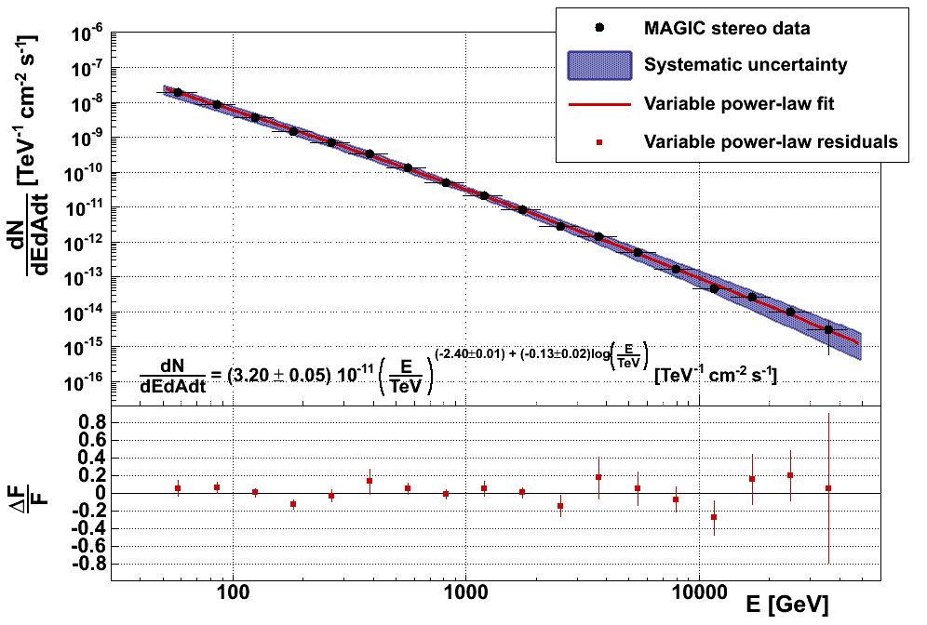
Crab Nebula: spectrum
Crab Nebula Differential Energy Spectrum
PRELIMINARY
8 decades in flux
Systematic
errors:
Flux = 15%
Energy = 17%
Index = ± 0.15
Log Parabola Fit (only MAGIC data)
Stereo mode
2009 – 2011
T_{eff} = 48.7 h
Zenith 5°-50°
3 Decades in energy
50 GeV
45 TeV

Slide 25
Crab Nebula: modeling
Crab Nebula modelling
Two Models:
(from Meyer et al. 2010, A&A 523:A2)
Constant B-field
(as in Hillas et al. 1998, ApJ 503:744)
MHD flow model
(as in K&C 1984, ApJ 283:694,
A&A 1996, MNRAS 278:525)
No model matches
well the data within
statistical errors
(both do within system. errors)
Need for more precise measurements with less systematic errors
PRELIMINARY
– Constant B model
– MHD flow model
· MAGIC stereo
· Fermi-LAT (Abdo et al., 2010)
Stat errors only!
D. Horns & M. Mayer
Model | Parameter | Value
– Constant B | Average mag. field | B = 126 ± 6 μG
– MHD flow | Magnetization of flow at shock | σ = 4.5 ± 0.3 × 10⁻³
Notes:
For the modeling of the gamma-ray emission of the Crab Nebula, we took into consideration two models, with the help of external authors:
* A phenomenological constant magnetic field model, as proposed by Hillas et al. in 1998 (RED LINE)
* A magnetohydrodynamic flow model, as outlined in Kennels and Coroniti 1984 and revised by Atoyan & Aharonian 1996 (BLACK LINE)
None of them fits well the data within the statistical errors only, both of them do when taking systematic errors into consideration.
-> They can only be disentangled by more precise measurements with smaller systematic errors, to be carried on in the future.

Slide 26
Crab Nebula: spectrum
Observations:
Stereo mode
T_{eff} = 48.7 h
Zenith 5°-50°
New analysis method
(sum cleaning)
Spectrum:
Energy range:
50 GeV < E < 45 TeV
Log-parabola fit:
Γ = -2.27±0.02_{stat} (E=100GeV)
Γ = -2.53±0.02_{stat} (E=10TeV)
Statistical errors
~ 5% below 100 GeV
Crab Nebula Differential Energy Spectrum
8 decades in flux
PRELIMINARY
3 Decades in energy
50 GeV
45 TeV
Systematic errors:
Flux = 15%
Energy scale = 15 – 17%
Photon index = ±0.15

Slide 27
Crab Nebula: spectrum
IC peak position fit
combines MAGIC &
Fermi-LAT points
(Abdo et. al 2010, ApJ 708:1254)
Impossible to confirm
or reject cutoff
at E >10 TeV
Dominated by
systematic errors
Crab Nebula Spectral Energy Distribution
PRELIMINARY
MOST PRECISE IC PEAK
MEASUREMENT SO FAR:
IC_{peak} = 59 ± 6 GeV
(stat. err only)
IC_{peak}
HEGRA / HESS
discrepancy @ E > 10 TeV
could not be resolved!
Where is the cutoff?

Slide 28
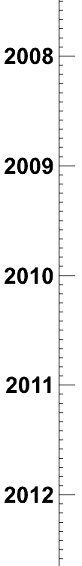
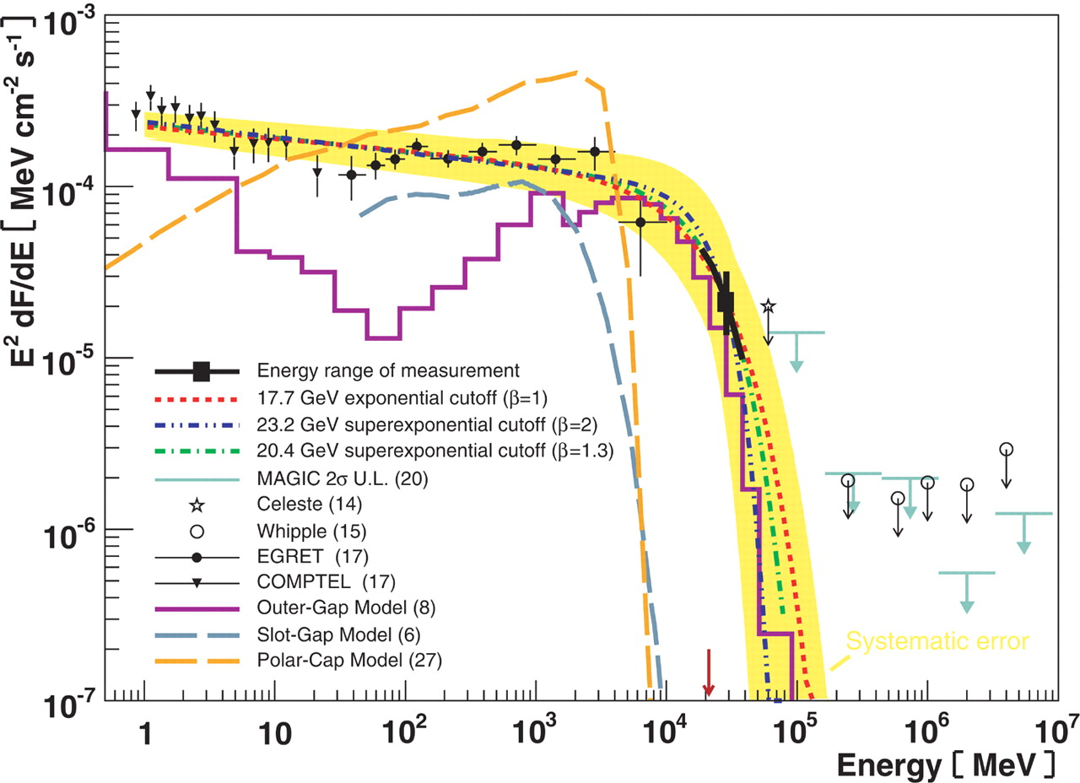
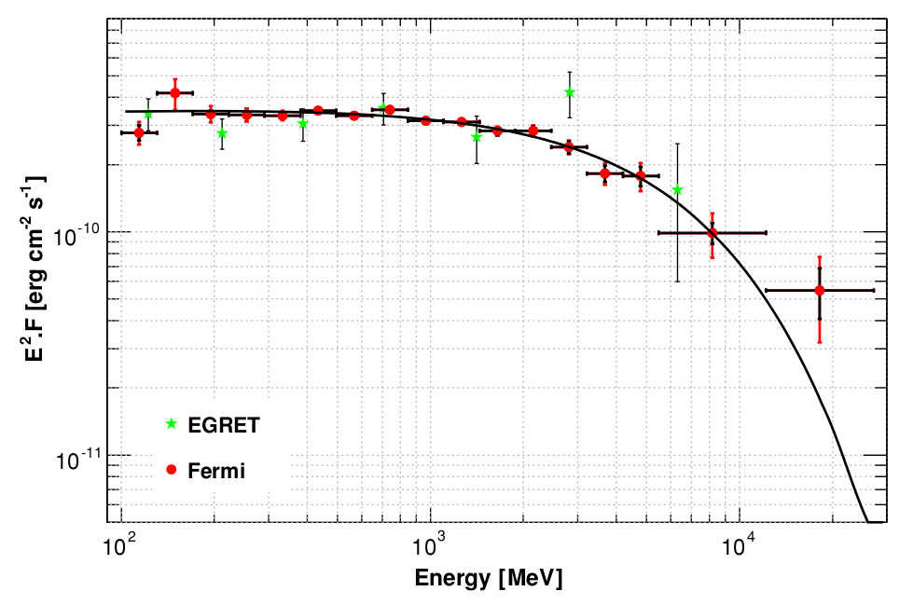
Crab Pulsar: recent VHE history
MAGIC (mono) discovery at E > 25 GeV: rules out Polar Cap model
(Aliu et. al 2008, Science 322:1221)
Fermi-LAT: P1+P2 cutoff at E ~ 6 GeV, around P2 cutoff is up to E > 10 GeV
(Abdo et. al 2010, Science 322:1221)
VERITAS: pulsed emission at E > 100 GeV,
excludes exponential cutoff
(Fermi Symposium, Rome 2011,
Aliu et. al 2011, Science 334:69 )
MAGIC mono: phase-dep. spectrum
25 < E < 100 GeV, excludes exp. cutoff
(ICRC, Beijing 2011,
Aleksić et. al 2011, ApJ 742:43)
MAGIC confirms detection up to
400 GeV, measures phase-dependent spectrum
(Aleksić et. al 2012, A&A 540:A69)
MAGIC MONO w/ SUM-trigger
Cutoff at ~17 GeV
W 07-08
FERMI-LAT
6.4σ E>25 GeV (3.4σ P2 at E>60GeV)
W 08-09
Phase-averaged spectrum with exponential cutoff at ~ 6 GeV
however last point is systematically higher!!
W 09-10
MAGIC STEREO
VERITAS
E > 120 GeV
Breakthrough VHE measure-ments
Exclude cutoff
Challenge all existing theoretical models
W 10-11
MAGIC
E > 50 GeV
W 11-12
Notes:
Taka comment:
* Slide 8: "MAGIC mono confirms exclusion", Let's not say like this. We
know that VERITAS knew MAGIC mono result 10 months before the Fermi
symposium (because I gave Nepomuk my thesis... shit.)
Can't you omit this time axis and state in a better way? We don't need
to emphasize that
"MAGIC is after VERITAS" (also stereo).

Slide 29
Crab Pulsar: recent VHE history
2008 – 2010:
MAGIC (mono) discovery at E > 25 GeV: rules out Polar Cap model
(Aliu et. al 2008, Science 322:1221)
Fermi-LAT: P1+P2 cutoff at E ~ 6 GeV, around P2 cutoff is up to E > 10 GeV
(Abdo et. al 2010, Science 322:1221)
2011 – 2012:
VERITAS: pulsed emission at E > 100 GeV, excludes exponential cutoff
(Aliu et. al 2011, Science 334:69 )
MAGIC mono: phase-dep. spectrum
25 < E < 100 GeV
(Aleksić et. al 2011, ApJ 742:43)
MAGIC stereo: phase-dependent spectrum up to 400 GeV
(Aleksić et. al 2012, A&A 540:A69)
The above results exclude exp. cutoff!
Cutoff at ~17 GeV
6.4σ E>25 GeV (3.4σ P2 at E>60GeV)
Phase-averaged spectrum with exponential cutoff at ~ 6 GeV
however last point is higher!!
VERITAS
E > 120 GeV
Breakthrough VHE measure-ments
Challenge all existing theoretical models
MAGIC
E > 50 GeV

Slide 30
Crab Pulsar Peak Definitions
 | EGRET | MAGIC | VERITAS
P1 | [ -0.06 : 0.04 ] | [ -0.017 : 0.026 ] | [ -0.013 : 0.009 ]
P2 | [ 0.32 : 0.43 ] | [ 0.377 : 0.422 ] | [ 0.375 : 0.420 ]
OP | [ 0.52 : 0.88 ] | [ 0.52 : 0.87 ] | [ 0.43 : 0.94 ]
(P1+P2) % | 21.0 % | 8.8 % | 6.7 %
 | P1+P2 | P1 | P2 | P1/P2 ratio
Mono (EGRET) | 7.5σ | 4.3σ | 7.4σ | ~0.5
Stereo (MAGIC) | 10.4σ | 5.5σ | 9.9σ | 0.5±0.1

Slide 31
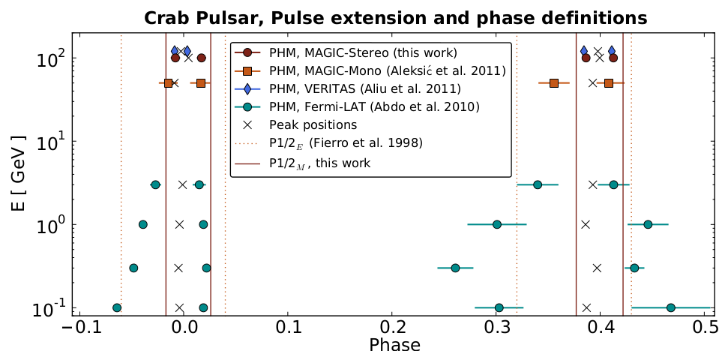
Crab Pulsar: stereo observations
73 hrs of data (Oct. 2009 - Mar. 2011)
(Aleksić et. al 2012, A&A 540:A69)
Stereo obs: less background,
less systematics.
Energy range: 50 < E < 100 GeV
Pulsation firmly detected
H-Test (unbinned) : 6.4σ
EGRET-peaks (a-priori) : 7.7σ
Peaks get narrower w/energy
New peak definitions ±2σ_{FIT}:
8.8% of the whole phase
Possible LE 3.4σ hint
at TW₁ [ 0.04 : 0.14 ]
<E_{true}> ~ 100 GeV
<E_{true}> ~ 180 GeV
<E_{true}> ~ 80 GeV
P1+P2 | P1 | P2 | P1/P2 ratio
10.4σ | 5.5σ | 9.9σ | 0.5±0.1
MAGIC
Fermi-LAT
Collection of pulse half-widths
vs. energy
P1
P2

