Slide 1


Rapid high-energy emission variability in relativistic pair plasma reconnection
Benoît Cerutti
University of Colorado, USA.
Reference: Cerutti et al. (2012b), accepted in ApJLetters, arXiv:1205.3210
In collaboration with G. R. Werner, D. A. Uzdensky, & M. C. Begelman.

Slide 2
Motivations
Study particle acceleration in relativistic collisionless pair plasma reconnection, and its radiative signature for an external observer.
+B₀
Observer
δ
E₀
Current layer
photons
-B₀
We want to characterize the particle distribution function f(r,p):
Energy distribution
Spatial distribution
Angular distribution
Solve Vlasov equation via Particle-In-Cell simulations (VORPAL code)
[Nieter & Cary 2004]

Slide 3
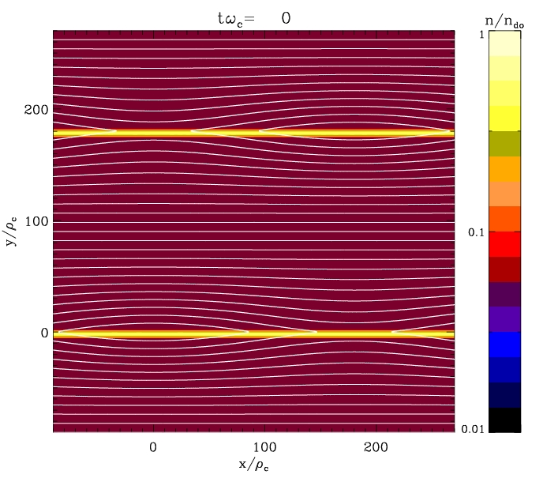
Initial setup: relativistic Harris equilibrium
2D & No guide field
Layer thickness: δ
+B₀
Drifting particles:
kT’_{drift}=0.3 mc²
Current: -J₀
L_{y} = 360 ρ_{c}
-B₀
Upstream σ ≈ 10
Background particles:
kT_{bg}=0.15 mc²
Current: +J₀
+B₀
L_{x} = 360 ρ_{c}
with ρ_{c}=mc²/eB₀
Double periodic boundary conditions

Slide 4
Time evolution of reconnection
The layer is tearing unstable and breaks up into a chain of magnetic islands separated by secondary reconnection layers

Slide 5
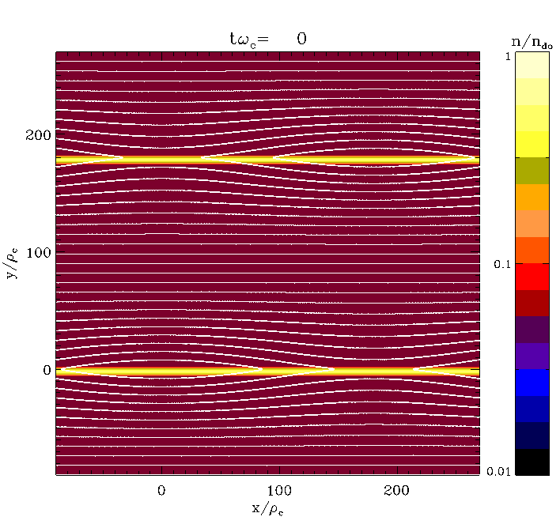
Time evolution of reconnection
Particles are accelerated at X-points along the ±z-direction, and deflected along the ±x-directions by the reconnected field B_{y}

Slide 6
Particle energy, spatial and angular distributions

Slide 7
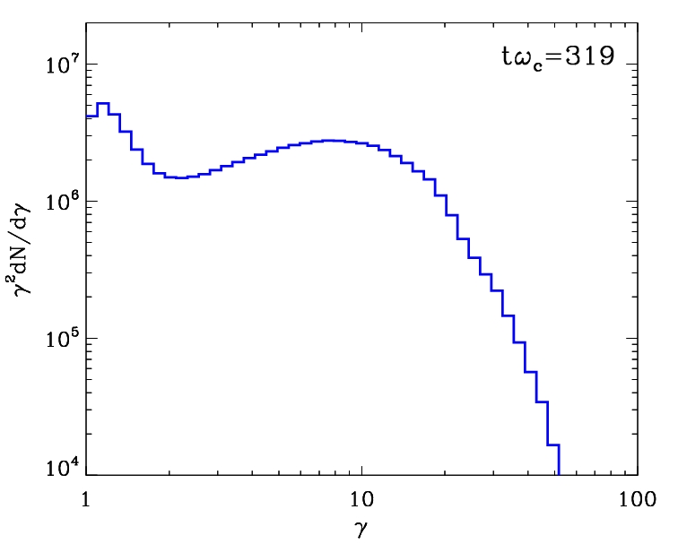
Particle’s energy distribution function
Initial cool kT_{bg}= 0.15 mc² background particles
dN/dγ ~ γ^{-1/2} exp(-γ/5)
Quasi-thermal distribution
No clear evidence of non-thermal particle acceleration.
➔ May require a larger separation of scales (bigger box size)

Slide 8
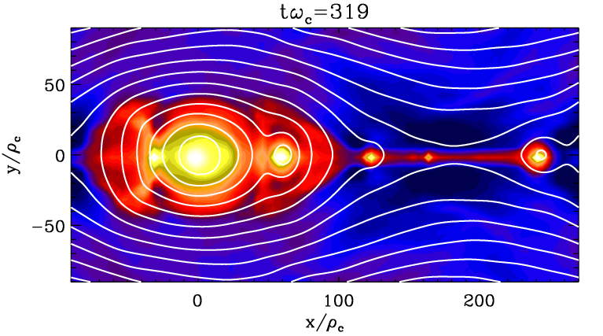
Particles’ spatial distribution
All particles, bottom layer:
Where are the high-energy particles located?

Slide 9
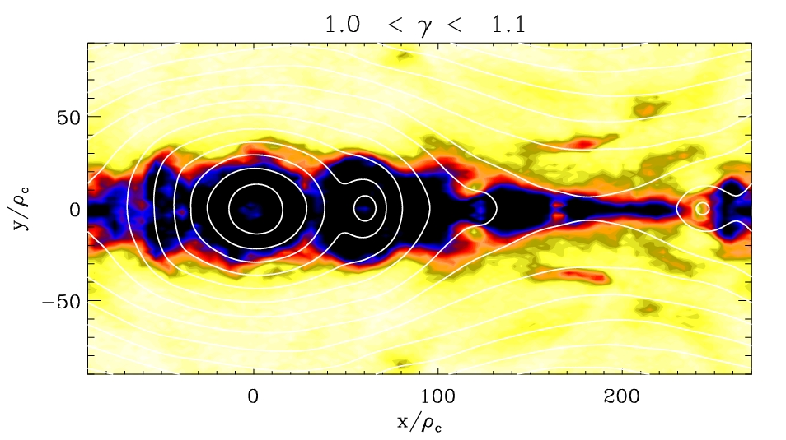


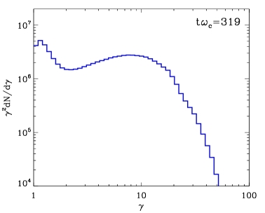
Energy-resolved particles’ spatial distribution
@ t = 319 ω_{c}⁻¹
Filling factor of 50% of all the particles
f_{e,50%} = 0.35

Slide 10
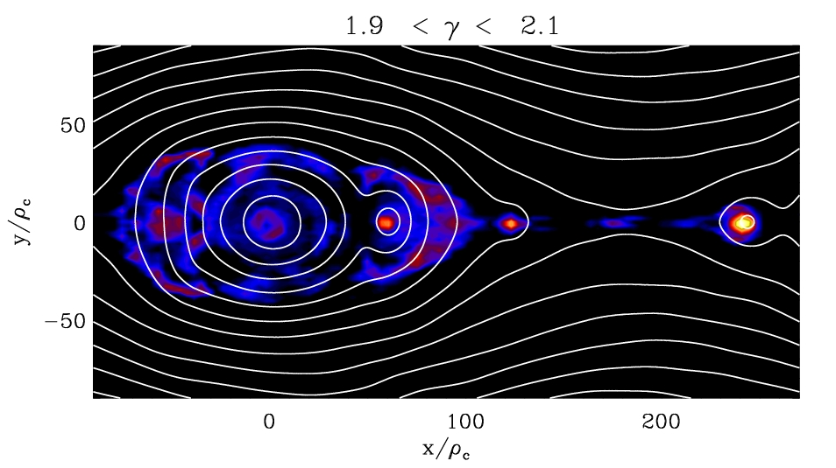

Energy-resolved particles’ spatial distribution
@ t = 319 ω_{c}⁻¹
f_{e,50%} = 0.11

Slide 11
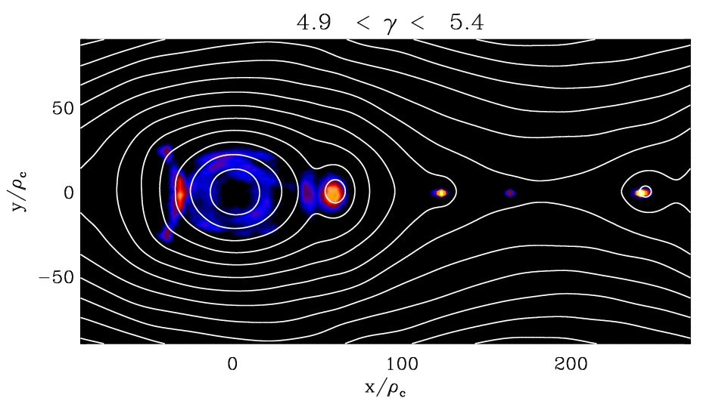

Energy-resolved particles’ spatial distribution
@ t = 319 ω_{c}⁻¹
f_{e,50%} = 0.05

Slide 12
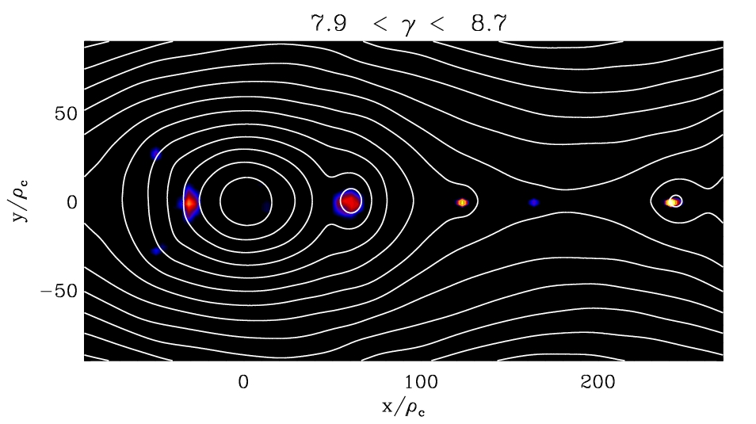

Energy-resolved particles’ spatial distribution
@ t = 319 ω_{c}⁻¹
f_{e,50%} = 0.04

Slide 13


Energy-resolved particles’ spatial distribution
@ t = 319 ω_{c}⁻¹
f_{e,50%} = 0.04

Slide 14

Energy-resolved particles’ spatial distribution
@ t = 319 ω_{c}⁻¹
f_{e,50%} = 0.01

Slide 15
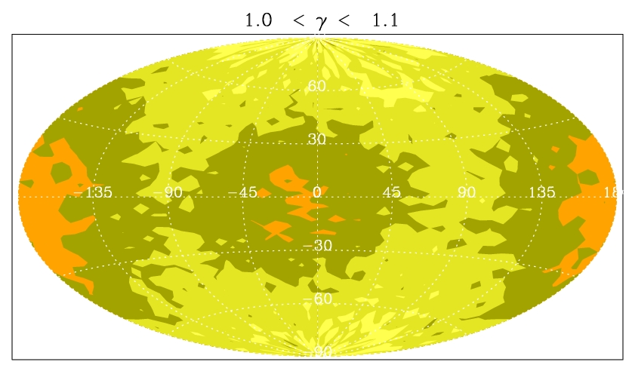
Energy-resolved particles’ angular distribution
Using the Aitoff projection:
@ t = 319 ω_{c}⁻¹
+y
-z
-x
+z
+x
-z
-y
Solid angle containing 50% of all the particles
Ω_{e,50%}/4π = 0.49

Slide 16
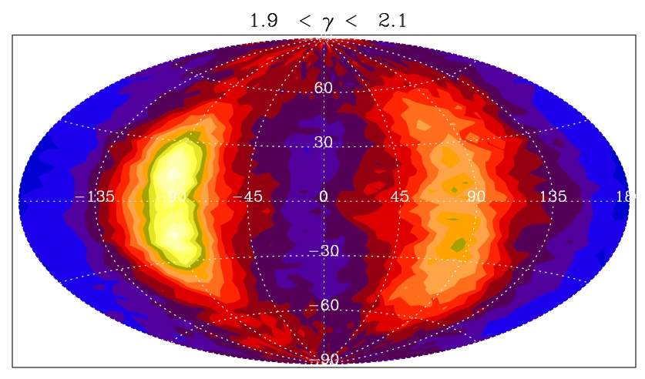
Energy-resolved particles’ angular distribution
@ t = 319 ω_{c}⁻¹
Ω_{e,50%}/4π = 0.37

Slide 17
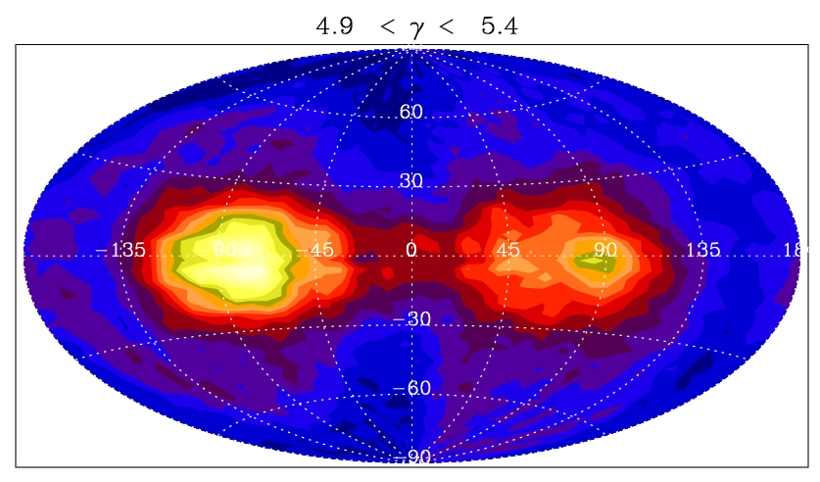
Energy-resolved particles’ angular distribution
@ t = 319 ω_{c}⁻¹
Ω_{e,50%}/4π = 0.32

Slide 18
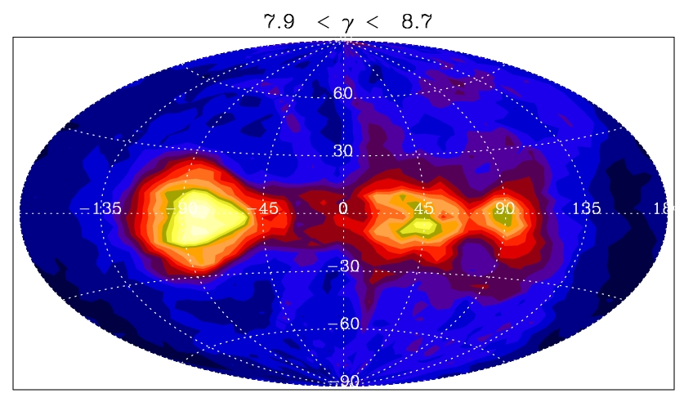
Energy-resolved particles’ angular distribution
@ t = 319 ω_{c}⁻¹
Ω_{e,50%}/4π = 0.28

Slide 19
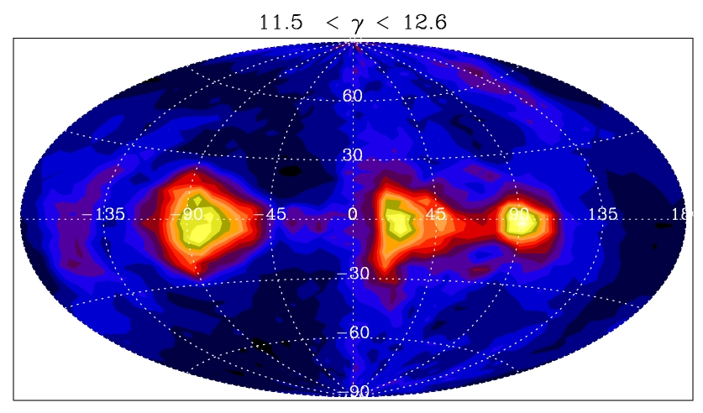
Energy-resolved particles’ angular distribution
@ t = 319 ω_{c}⁻¹
Ω_{e,50%}/4π = 0.26

Slide 20
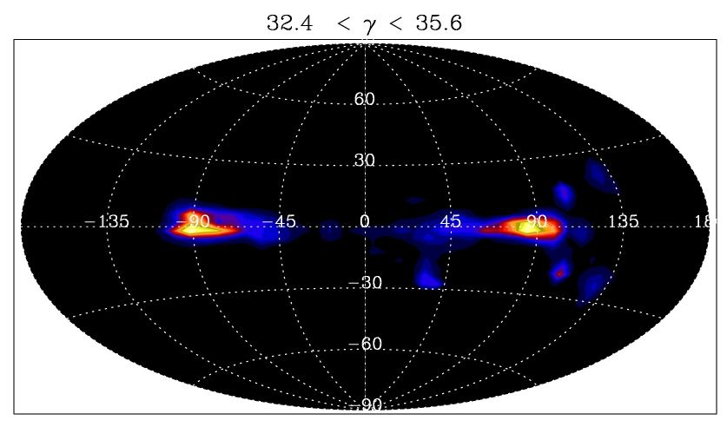
Energy-resolved particles’ angular distribution
@ t = 319 ω_{c}⁻¹
Ω_{e,50%}/4π = 0.02

Slide 21
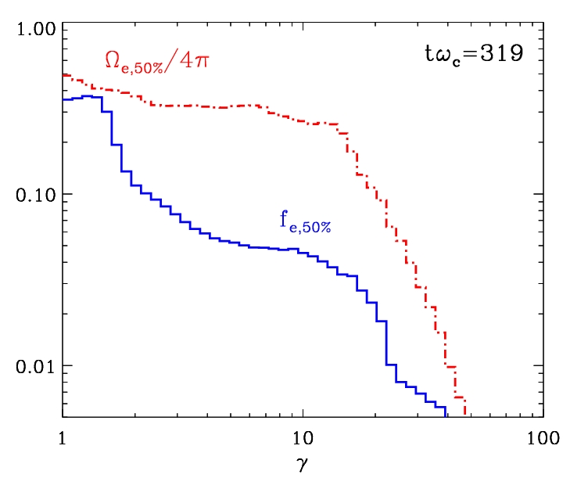
Strong energy-dependent anisotropy and inhomogeneity
- HE particles are anisotropic and bunched inside magnetic islands
- Ω_{e,50%}/4π and f_{e,50%} are time-dependent functions
- HE anisotropy/inhomogeneity disappear at the end of reconnection

Slide 22
Radiative signature of reconnection

Slide 23
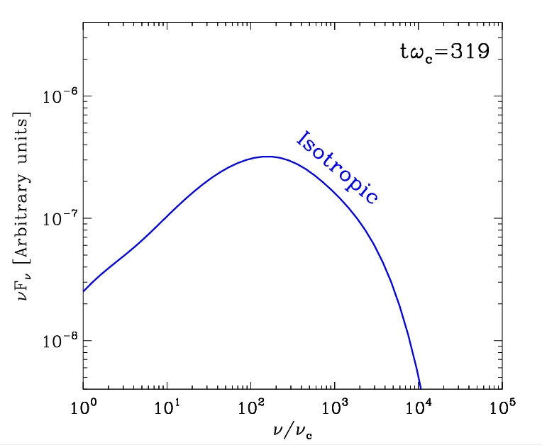
Synchrotron radiation energy distribution
Pure synchrotron radiation
The plasma is optically thin
Photons are boosted in the particle’s direction of motion
Energy losses negligible
Assumptions:
All particles, isotropic-averaged
flux
where ν_{c} = 3eB₀(γ²=1)/4πmc

Slide 24
The high-energy radiation flux is highly anisotropic
High-energy particle angular distribution

Slide 25
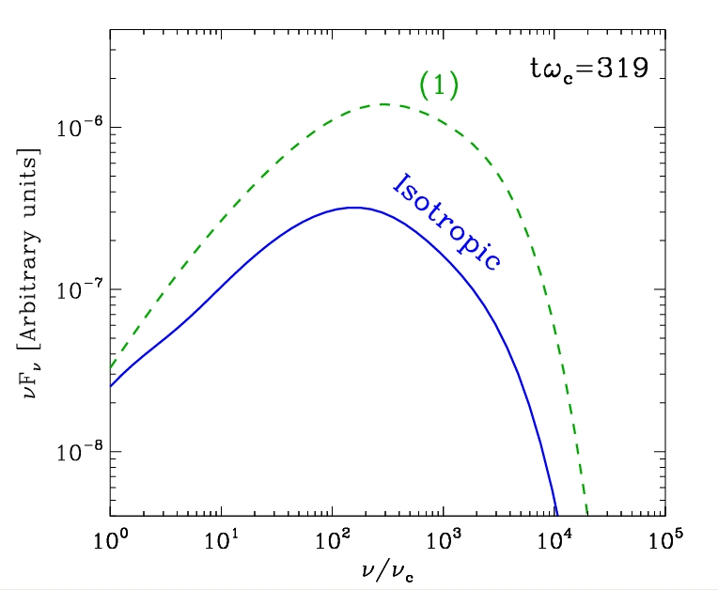
The high-energy radiation flux is highly anisotropic
Apparent HE flux INCREASED!
High-energy particle angular distribution
(1)
ΔΩ ≈ 0.3 sr

Slide 26
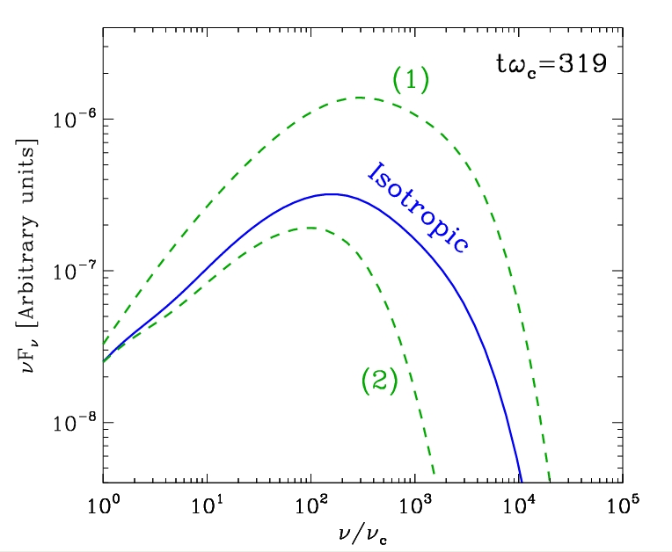
The high-energy radiation flux is highly anisotropic
Apparent HE flux INCREASED!
High-energy particle angular distribution
(2)
(1)
ΔΩ ≈ 0.3 sr
Apparent HE flux SUPPRESSED!
« Kinetic beaming »: apparent beaming of the radiation due to the strong energy-dependent anisotropy of the particles.
≠ signature than Doppler beaming, energy-independent boosting.

Slide 27
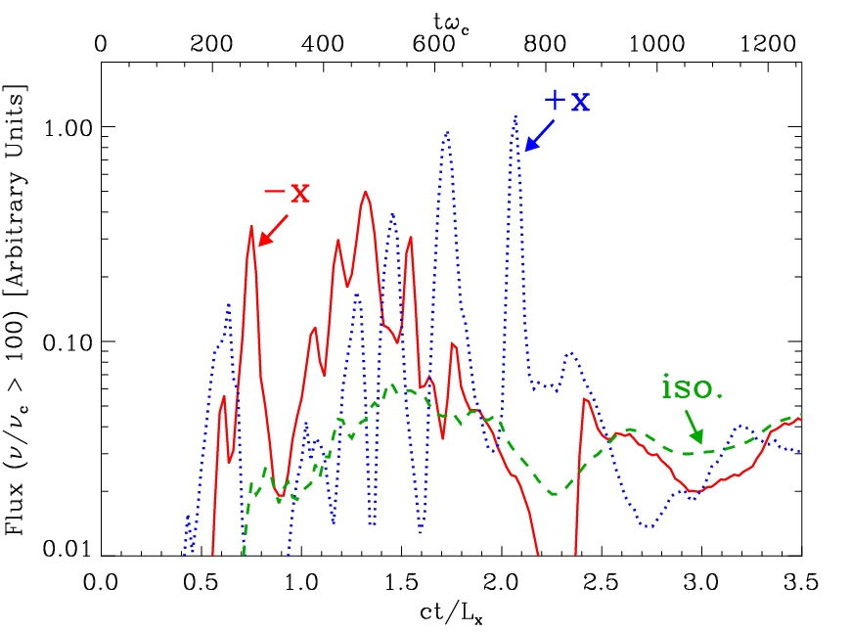
High-energy lightcurves
Symmetric shape Δt<< L_{x}/c
-x
+x
Reconnection naturally generates bright, ultra-rapid, symmetric sub-flares of radiation

Slide 28
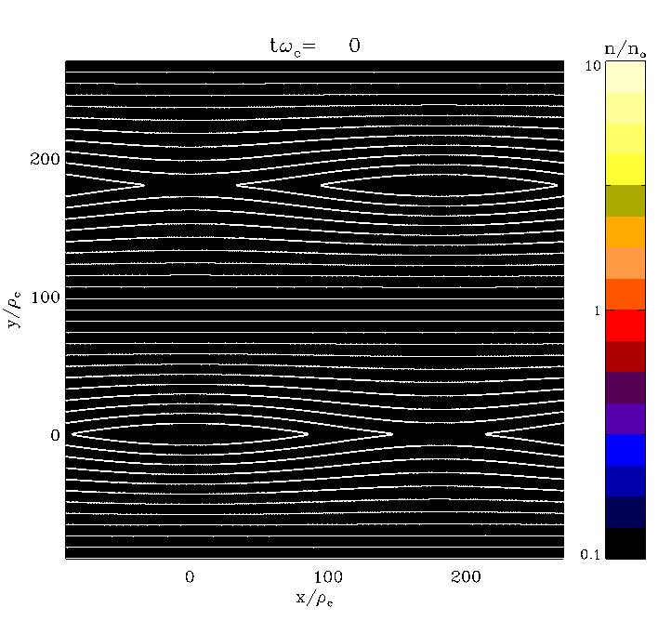
High-energy particle bunching
Density of particles γ >10
Ultra-short varibility is caused by HE particle bunching into compact regions inside islands

Slide 29
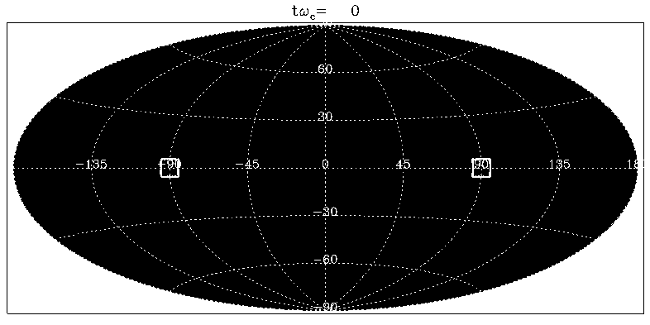
High-energy particle anisotropy
Density of particles γ >10
The beam of high-energy particles sweeps across the line of sight intermittently: bright symmetric flares.

Slide 30
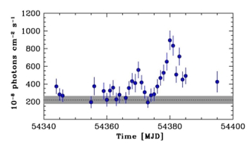
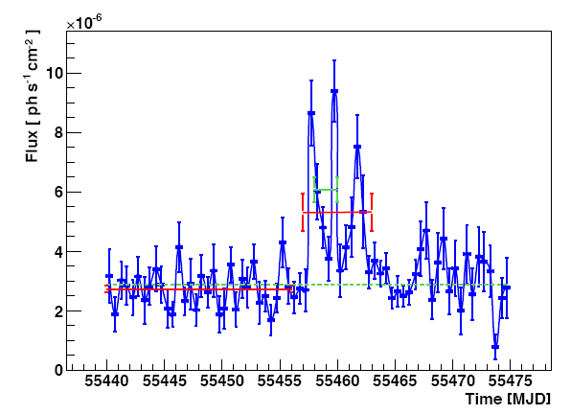
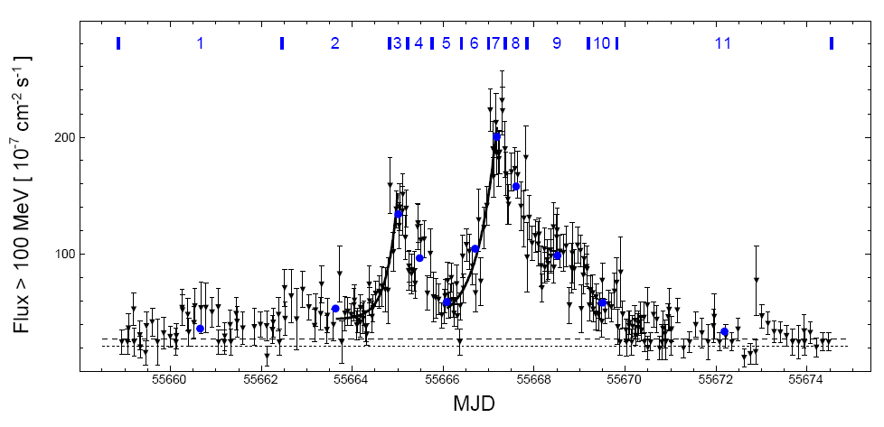
Application to Crab flares?
The anisotropy and inhomogeneity of energetic particles can explain the puzzling properties of the Crab flares:
Alleviates energetics and statistics requirements
Ultra-rapid variability is expected (emitting region << system size)
Nearly symmetric sub-flares are expected (sweeping beam)
Observed lightcurves
Expected lightcurve
Sep. 10
Oct. 07
[Tavani et al. 2011]
[Balbo et al. 2011]
Apr. 11
[Cerutti et al. 2012b]
[Buehler et al. 2012]

Slide 31
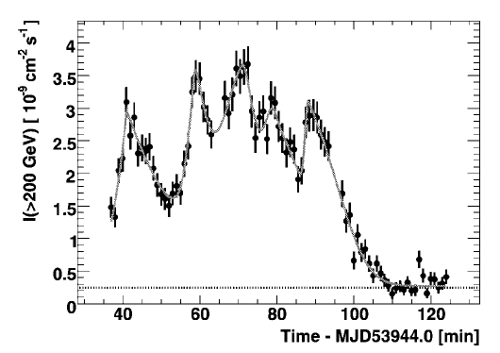
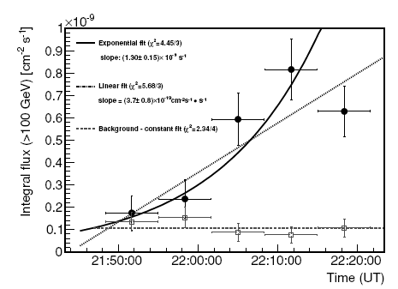
Application to TeV blazar flares?
PKS 2155-304 (BL Lac): short-time variability ~200 s << R_{black-hole}/c.
➔ Requires high Doppler factor δ_{dopp} > 50.
“Doppler factor crisis” [Henri & Saugé 2006]
PKS 1222+216 (FSRQ): ~10 minutes, compact emitting source, far from the central engine (avoid γ-ray absorption).
Severe energetics constraints.
[Nalewajko et al. 2012]
Expected lightcurve
PKS 1222+216
PKS 2155-304
[Aharonian et al. 2007]
[Aleksić et al. 2011]
[Cerutti et al. 2012b]
Kinetic beaming and particle bunching can alleviate these severe constraints on the emitting regions.

