Slide 1
Extreme TeV Blazars and
InterGalactic Magnetic Fields
Timothy C. Arlen, Vladimir V. Vassilev University of California-Los Angeles

Slide 2
THE MAIN MESSAGE OF MY TALK:
The B_{IGMF} = 0 hypothesis cannot be invalidated based on the existing VHE and HE data of extreme blazars when uncertainties in the source model and cosmological environment (such as EBL, etc) are taken into account.
  OUTLINE
EM cascades in the presence of IGMF
Recent results claiming B_{IGMF} > 0
Full 3D Monte Carlo code as a tool to investigate B_{IGMF} = 0 hypothesis and systematic uncertainties
Conclusion
Notes:
(40sec)
Say something like:
“The main message of my talk is that unlike the conclusion of Andrew Taylor’s excellent summary talk this afternoon, I will try to convince you that the I.G.M.F.=0 hypothesis cannot be ruled out based on the existing HE and VHE data of extreme blazars when uncertainties in the source model and cosmological environments are taken into account.”
“Here is my outline, I will quickly go over the background (I and II) and the majority of the talk will be spent on using our recently developed 3D M.C. code which we’ve tested to death, to test the I.G.M.F. = 0 hypothesis.”

Slide 3
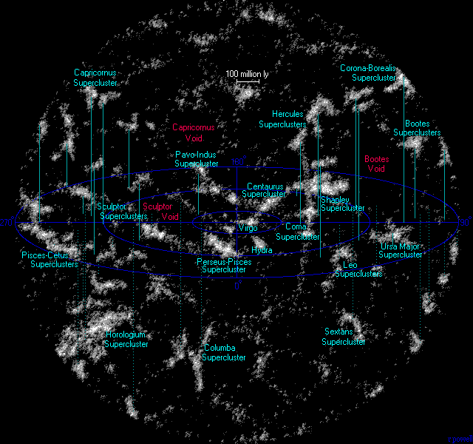
InterGalactic Magnetic Fields
D ~ 300 Mpc
z ~ 0.1
Spiral galaxies ~ 1-10 μG fields (large scale L_{coh}~ Galactic disk + small scale)
Elliptical, barred, and irregular galaxies ~ 0.1-1 μG (small scale)
Galaxy clusters ~ 0.1-10 μG fields (L_{coh}~ 1Mpc scale of galaxies in clusters)
No observations in filaments and voids (primordial seed field for MHD dynamo amplification?)
  CMB Anisotropy constraint: For B component over Hubble radius: B(z ≈ 1000) < 10⁻³ G. => B(z=0) < 10⁻⁹ G
  Faraday Rotation Measure (within z ≈ 3.6):
http://www.atlasoftheuniverse.com/superc.html
Reviews: Widrow L.M., Rev. Mod.Phys., 74, 775, (2002);
D. Grasso and H. R. Rubinstein, Phys. Rept. 348, 163 (2001)
P.P.Kronberg, Rep.Progr.Phys. 57, 325 (1994);
Kulsrud, R. M., & Zweibel, E. G., Rept. Prog. Phys., 71, 0046091 (2008)
Notes:
(45 sec)
“Since this afternoon there was already a nice intro to IGMF, I will only highlight a couple things: 1) IGMF in Voids occupy a special place, because they are least contaminated by the evolutionary dynamics of the collapse and formation of the Large Scale Structure and therefore provide a sensitive cosmological tool to speculate about the origins of the primordial MF, unlike the MF in galaxies and clusters. 2) It is also important to note that if the source resides in a filament or large cluster which could be as large as 10 -100 Mpc, the results of the cascading process may dramatically depend on whether the source emits along the filament or transverse to it.”

Slide 4
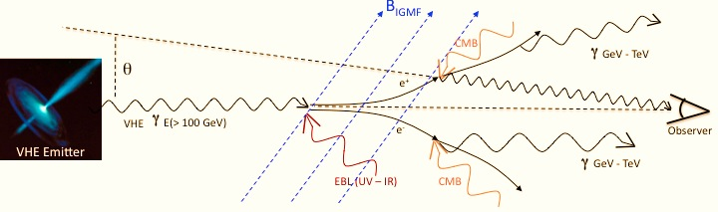
EM Cascading in Intergalactic Space
Photon:
Eγ (TeV) | ~<L_{EBL}> (Mpc)
100 | 2-3
10 | 75-100
1 | 150-200
0.1 | 500
“Secondary Photons”
Spectrum (B_{IGMF})
Halo (B_{IGMF})
Time Delay (B_{IGMF})
Electron:
E_{elec}(TeV) | ~<L_{IC}> (Mpc)
10 – 100 | 0.01 – 0.1
1 | 1
0.1 | 10
Spectrum (B_{IGMF}=0) – strongly modified by secondary emission
Halo (B_{IGMF}=0) – much less than PSF (point source)
Time Delay (B_{IGMF}=0) – few hrs to few tens of hrs (“contemporaneous” to prompt flux)
Notes:
Highlight 2 things: (1:15 min)
of photons of highest energies relevant to the cascading propagate around several hundred Mpc from the source before Pair Prod. The environment within this spatial scale is of critical importance. Ex: a Void may or not be located at this position. Once Pair Production occurs, the scale over which the electrons lose energy to IC scattering is much smaller.
Result of cascading has imprint on properties of source of spectrum, angular distribution, time delay. (as discussed extensively by A.M. Taylor). Since most of the focus of this talk will be on the assumption of B=0, for this specific case, go through spectrum, halo, time.

Slide 5
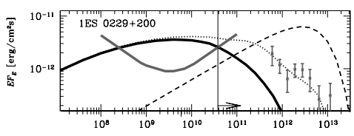
Recent Results
(semi-analytic modeling of spectrum)
Neronov A., Vovk Ie., Science, 328, 73 (2010).
“Minimum Flux”
direct, EBL de-absorbed
HESS data, F. A. Aharonian et al., Astron. Astrophys. 475, L9 (2007)
Fermi/LAT
Upper limit
Energy (eV)
Cascade emission, assuming B_{IGMF}=0
Conclusion: Non-detection of GeV emission by Fermi shows that cascaded emission must be “swept away” by IGMF (to scatter the electrons) with a lower bound of B_{IGMF} ≥ 3 x 10⁻¹⁶G.
Confirmed by
Tavecchio F., et al., MNRAS, 406, L70 (2010)
Dolag, K., et al., ApJ, 727, L4 (2011)
Initial discussion of importance of
secondary cascading:
Aharonian, F., et al. ApJ, 423, L5 (1994)
Plaga, R. Nature 374, 400 (1995)
Notes:
(45 – 60 sec)
FIRST STATEMENT: Important work by Neronov which argued for a lower limit on BIGMF
The way the constraint is done is illustrated in this figure, which shows the energy flux vs. energy of blazar 1ES 0229+200, and they found a model which fit the VHE data and minimized the flux of cascading emission…
Explain logic of B constraining and their conclusion, do it in a positive way (nice connection between HE-VHE which seemingly allows constraint on IGMF, because resolved VHE emission should produce large amount of secondary flux in GeV)

Slide 6
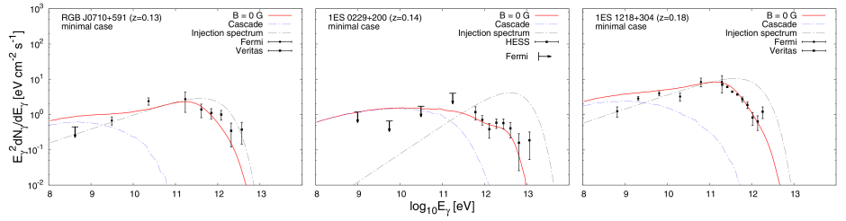
Relaxed VHE Duty Cycle Assumption
Time considerations are important! This conclusion would only be valid if the VHE activity time (duty cycle) was larger than the time to build up the cascade flux (~10⁶ yr)
Dermer, et al., ApJ, 733, L21 (2011)
If VHE flux from 1es0229 has only been steady over T~3-4 yrs, then limit reduces to: B_{IGMF} ≥ 10⁻¹⁸G
Plots from Taylor, A.M., et al (2011):
RGB J0710+591 (z=0.13)
1ES 0229+200 (z=0.14)
1ES 1218+304 (z=0.182)
Analysis repeated:
Taylor, A. M., Vovk, I., & Neronov, A., A&A, 529, A144 (2011)
Huan, H., Weisgarber, T., Arlen, T., & Wakely, S., ApJ, 735, L28+ (2011)
Essey, W., Ando, S., Kusenko, A., Astropart. Phys, 35, 135 (2011)
B_{IGMF} ≥ 10⁻¹⁷G
These three sources provided the best and seemingly coherent lower bound on the IGMF, consistent with Dermer, et al (2011).
Notes:
However, the time domain is important to consider, because the time delay for the cascade flux to arrive relative to the prompt flux as pointed out in Dermer, et al 2011 is approximately [this expression]. Re-analyzing 1ES 0229+200, under the assumption of a steady VHE flux over a few years decreases the lower limit to 10^-18 G. This analysis was repeated by Taylor, et al who included 2 other source [name then and point to them] deriving a lower limit of 10^-17 G. This was further confirmed by 2 other groups in a combination of Monte Carlo and semi-analytic codes.
These three source provided the best and seemingly coherent lower bound on the IGMF, consistent with Dermer (2011). [FACE THE AUDIENCE AND SAY CONFIDENTLY:] It is this conclusion that I will be arguing against for the remainder of my talk (including myself-make a joke about that here?).

Slide 7
Research Goal
Re-examine B_{IGMF} = 0 hypothesis based on HE and VHE spectral data
Assume: IACT measurement is representative of the VHE activity over duration of Fermi mission until now (~4 years)
Evaluate effects of multiple systematic uncertainties utilizing full 3D simulation code which makes nearly no simplifications.
Notes:
(20 sec)

Slide 8

Simulation Code and Source Model
Full 3D, relativistic QED, expanding Universe, tracks each particle (Arlen, T., et al (2012) in prep.)
Intergalactic Medium Parameters
  EBL: generic, arbitrary shape SED; default model used is close to that of Dominguez, et al. MNRAS, 410, 2556, (2011)
  IGMF: constant B_{IGMF} within spatial domain of size L_{coh}
Highlights
  EBL is used as seed photons for IC scattering
  K-N regime in IC
  Multiple generation cascading
  Extreme care is given to time calculations
Source Model: Broken Power Law Plus Exponential Cutoff
θ_{jet} ∼ 1/Γ
Parameters
  Source: F₀ , α, ε_{C}, ε_{B}, β, T_{on}/Duty Cycle,…
  Geometry: Γ, θ_{v}
Observer
θ_{v}
In jet r.f. power-law with break energy. In host galaxy r.f. boosted by Γ and exp cutoff introduced due to galaxy absorption
Notes:
And we have a recently developed fully 3 dimensional code incorporating all relativistic QED processes, set within an expanding universe, and tracks each particle in the cascade. Our EBL model uses a generic shape of the SED, allowing us to test a wide variety of shapes and normalizations, but a default model used in our computations is close to that of Dominguez, et al (2011). The IGMF is assumed to be constant with random orientation within spatial domains of size L_coh which we take to be 1 Mpc in our standard computations. Some highlights of our code: the EBL is used as seed photons in addition to the CMB, the KN regime is always included in our computations, multiple generation of cascading is implemented, and extreme care is given to time calculations.
We stress that an “IMPORTANT DIFFERENCE” in the source model in our study as opposed to previous works is that we use more generic model for the blazar source, in line with currently accepted understanding of blazars. We assume a blob of isotropic photons randomly distributed in its own frame, with broken power law spectrum. We think there is no reason to believe that a single power law should describe the spectrum of this object over more than 5 orders or magnitude in energy from the HE to the VHE regime. (All blazars point to a non-power law model over a sufficiently large energy range). Then this blob is boosted into ref frame of jet with doppler factor gamma. Because of presence of photon field of galaxy, the highest energy photons will not be able to exit from the surrounding medium, due to pair production, so we assume an exponential cutoff in the ref frame of host galaxy. The model is described by the index in the VHE, cutoff energy, index in HE, break energy. Geometry, normalization factor.

Slide 9
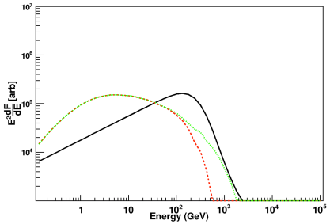
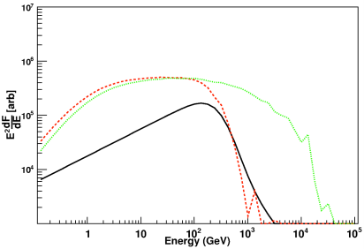
Monte Carlo Simulation Code
Full 3D, relativistic QED, expanding Universe, tracks each particle
Intergalactic Medium Parameters
  EBL: SED model
  IGMF: B_{IGMF}, L_{coh}
Highlights
  EBL is used as seed photons for IC scattering
  K-N regime in IC
  Multiple generation cascading
  Extreme care is given to time calculations
Example α=1.5, e_{cut}=5 TeV
B_{igmf}=10⁻¹⁶G, z=0.3
Example α=1.5, e_{cut}=30 TeV
B_{igmf}=10⁻¹⁶G, z=0.3
With and without multiple generation cascading

Slide 10

Source Model
θ_{jet} ∼ 1/Γ
Observer
Parameters
  Source: F₀ , α, E_{cut},…, T_{on}/Duty Cycle
  Geometry: Γ, θ_{v}
θ_{v}
In jet r.f. power-law with break energy. In host galaxy r.f. boosted by Γ and exp cutoff introduced due to galaxy absorption
Example of Γ variations
Example of θ variations

Slide 11
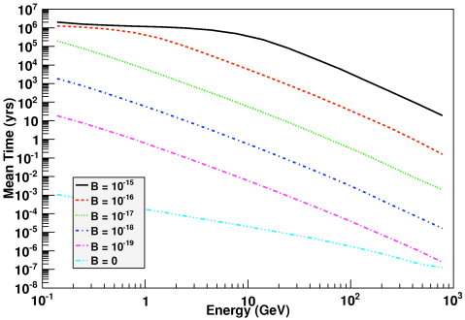
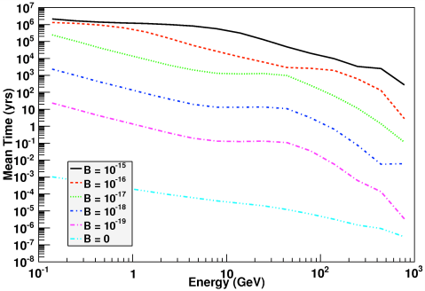
Mean time delay
QED delay
Mean time delay of a mono-energetic 100 TeV beam at z=0.13 for range of B_{igmf} and with EBL included (right) and not included (left)

Slide 12
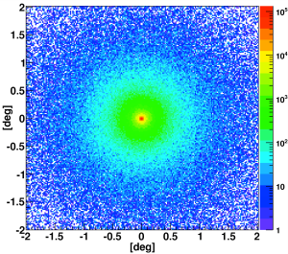
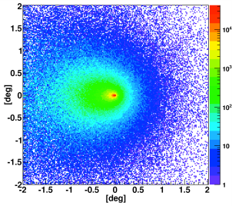
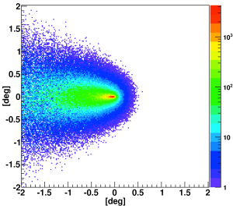
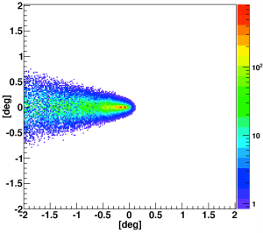
Skymap
Example: z=0, α=1.5, e_{cut}=30 TeV B_{igmf}=10⁻¹⁵ G
θ=0 deg
θ=2 deg
θ=5 deg
θ=10 deg

Slide 13
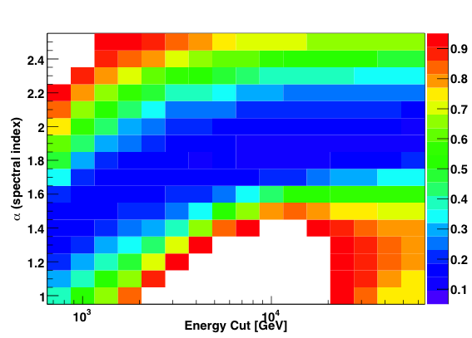
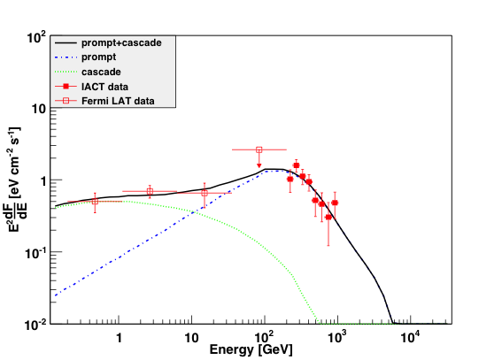
Compute χ² to Test IGMF=0 Hypothesis
H2356-309 (z=0.165)
Simultaneously fit HE-VHE data, form total χ² dependent on all model parameters: θ_{v}, Γ, F₀, α, Ecut, β, Ebreak. (Assume default values of θ_{v} = 0, and Γ = 10)
For a given (α, Ecut), overall Luminosity (F₀) determined by VHE data χ²_{VHE} =>
χ²_{HE} is a function of β, Ebreak.
total χ²(α, Ecut)= χ²_{VHE} + χ²_{HE}.
Notes:
To simultaneously fit VHE/HE data we form total chi^2 dependent on all model parameters. We assume default vaues of thetav=0 and Gamma=10. Changing these parameters for B=0 has relatively small effect.
Remaining parameters are these…explain chi^2
Explain axes and how each point represents a given (Ecut, alpha) model.
Transition: With this framework, we re-analyze the data of Taylor, et al 2011

Slide 14
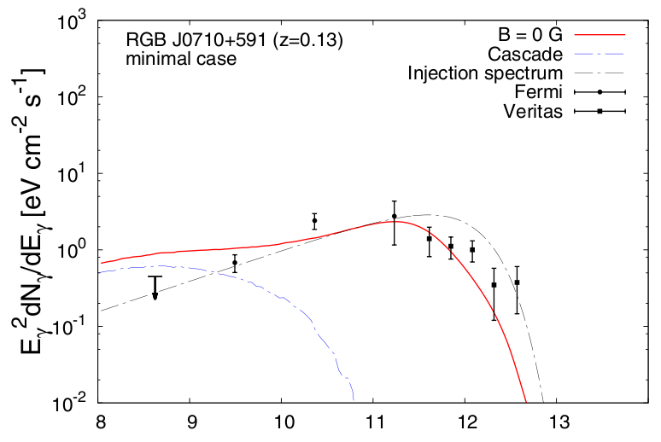
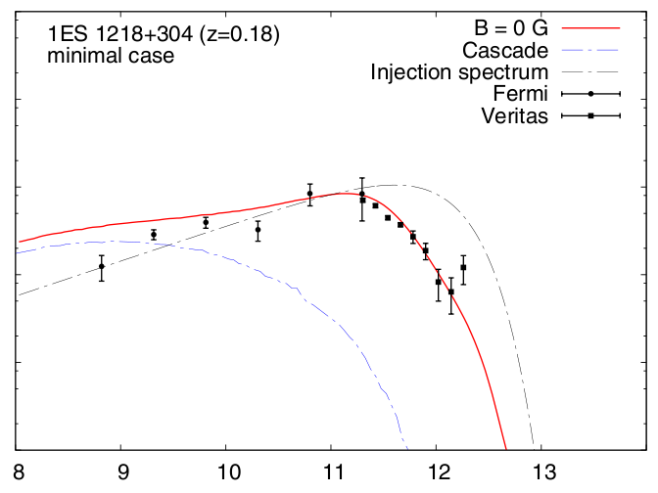
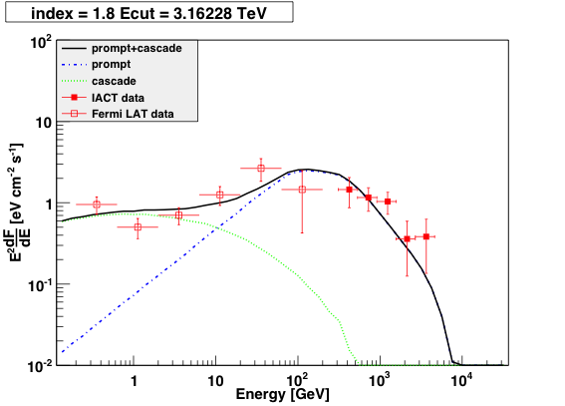
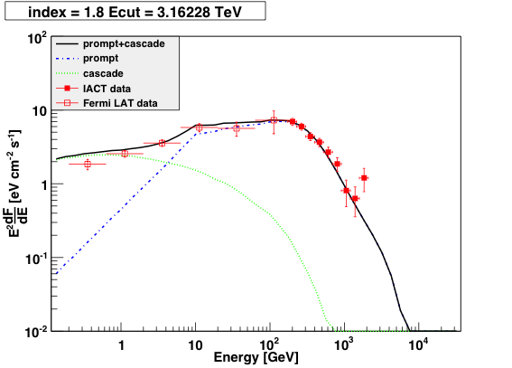
Apply Fits to 2 Blazars: RGB J0710+591 and 1ES 1218+304
RGB J0710+591 (z=0.125)
1ES 1218+304 (z=0.182)
Analysis of Taylor, et al. (2011)
Analysis of Taylor, et al. (2011)
“B_{IGMF} = 0” incompatible at 98.8% C.L.
“B_{IGMF} = 0” incompatible at >99.99 % C.L.
B_{IGMF} = 0 “incompatible” at ≤ 90% C.L.
B_{IGMF} = 0 “incompatible” at ≤ 80% C.L.
Possible Reasons for Discrepancy?:
Pass 7 data + 1 yr more data: Upper Limit −> detection in lowest energy bin
Broken Power Law model more general
Use simulated-predicted spectrum to fix index in each bin to determine GeV flux points
Possible Reasons for Discrepancy?:
Broken Power Law allows softer spectrum in VHE
Use simulated-predicted spectrum to fix index in each bin to determine GeV flux points
Notes:
Rgbj0710: 90% fitting model: alpha = 1.8, ecut=3.16TeV, delta = 1.2, ebreak = 75 GeV
1es1218: 80% fitting model: alpha = 1.8, ecut=3.16 TeV, delta = 1.0, ebreak = 10 GeV

Slide 15
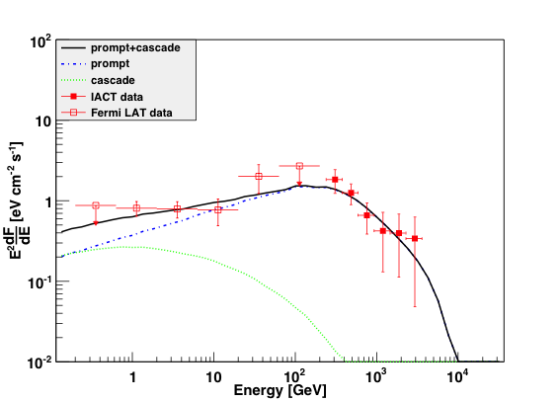
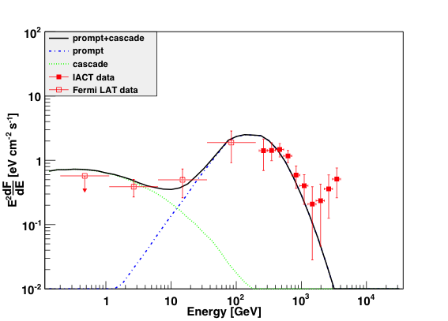
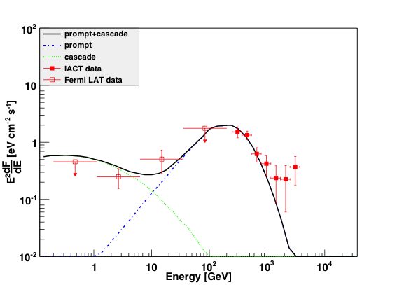
Other Sources
1ES 0347-121 (z=0.186)
1ES 1101-232 (z=0.188)
[In Neronov & Vovk (2010) and Essey, et al. (2011) used to argue incompatibility of B_{IGMF} = 0 hypothesis]
B_{IGMF} = 0 “incompatible” at ≤ 90% C.L.
B_{IGMF} = 0 “incompatible” at ≤ 30% C.L.
H2356-309 (z=0.165)
RGB J0152+017 (z=0.080)
B_{IGMF} = 0 “incompatible” at ≤ 10% C.L.
B_{IGMF} = 0 “incompatible” at ≤ 10% C.L.
Notes:
“We find that none of these sources constrain the IGMF at the 95 % C.L.”
1ES 0347: alpha = 1.3, ecut = 0.75 TeV with delta = 0.8, and ebreak = 100 GeV (86 % level)
1ES 1101: alpha = 1.5, ecut=1 TeV with delta = 0.6, ebreak = 75 GeV (30 % level)
H2356: alpha = 1.8, ecut=4.22 TeV, with ? (10%)
RGBJ0710+017: alpha = 1.9, ecut=3.16 with ? (>10%)

Slide 16
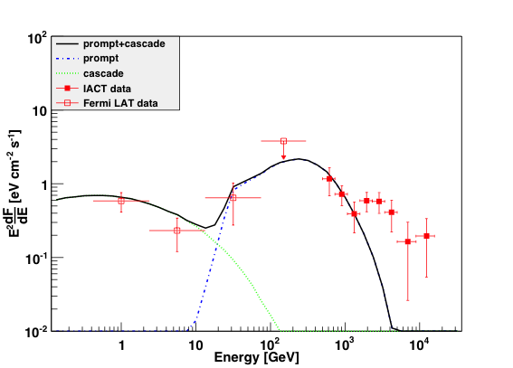
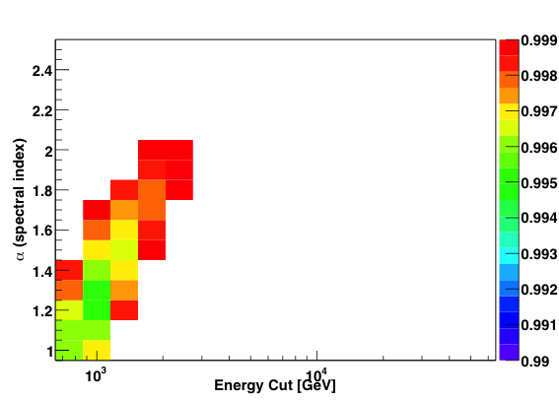
1ES 0229+200
99.9 % C.L.
B_{IGMF} = 0 incompatible at 99.5% C.L.
99 % C.L.
Best fit model, (α = 1.3, Ecut = 1 TeV) excludes B_{IGMF} = 0 hypothesis at 99.5 % level, confirming Dermer, et al. (2011), Taylor, et al. (2011), etc.
(assuming standard assumptions of default EBL model, duty cycle = 1, and generic broken power law model)
Notes:
As Taylor, et al (2011) argued, B = 0 hypothesis is irreconcilable with the data under the normal assumptions.

Slide 17
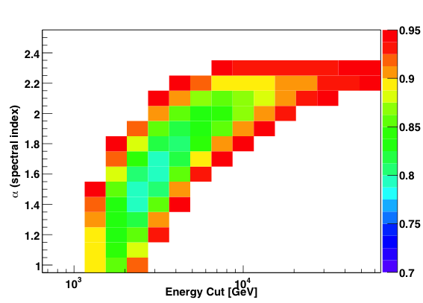
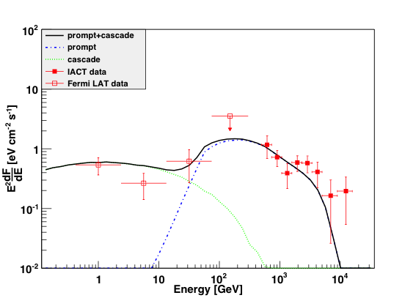
1ES 0229+200-Vary EBL Model
95 % C.L.
With EBL Model 3 – Low Stellar Peak
With EBL Model 3 – Low Stellar Peak
B_{IGMF} = 0 “incompatible” at ≤ 80% C.L.
70 % C.L.
EBL Model 1 – standard model, close to Dominguez, et al (2011)
EBL Model 2 – Low dust peak
EBL Model 3 – Low stellar peak, at lower limits of resolved galaxy counts in the near-IR
Notes:
Spectral model:
alpha = 1.6, delta = ?, ecut = 3.16 TeV, ebreak = 50 GeV (<80 %)
alpha = 1.3, delta = 1.3, ecut = 2.4 TeV (at 90%)
MENTION: EBL Model 2 – with values close to the lower limit on the dust peak has no effect, because it is below the kinematic threshold for Pair Production.

Slide 18
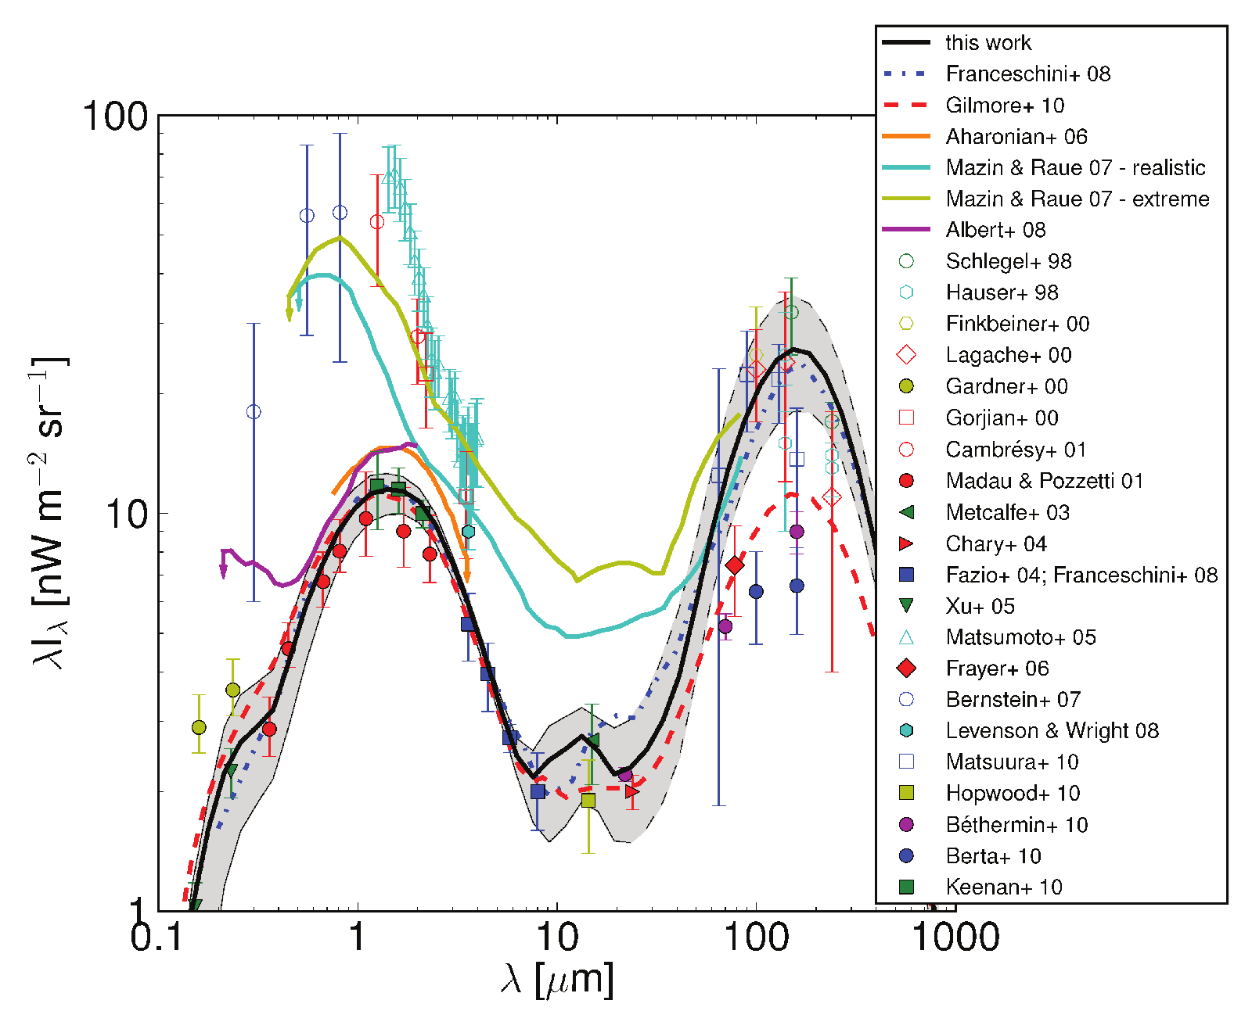
EBL Models and Lower Limits

Slide 19
1ES 0229+200-Lower EBL Model
Why no agreement with Vovk, Ie, et al., ApJL, 747, L14, (2012)?
From Vovk, et al. 2012: “We also assume that the intrinsic source spectrum has a high-energy cutoff at Ecut = 5 TeV. As it was shown by Taylor et al. (2011), this choice minimizes the strength of the cascade contribution in the Fermi/LAT energy band.”
Restriction of Ecut = 5 TeV is no longer valid when lower EBL models are considered.
(α=1.5, E_{cut}=5 TeV)
Range of models
Considered in
Vovk, Ie, et al.
ApJL 747, L14 (2012)
Energy Cut [GeV]
(α=0, E_{cut}=5 TeV)
3 possible reasons in order of importance:
  wider range of cutoff energy (2 d.o.f. in source model)
  Variation of near-IR EBL model (2 d.o.f.-normalization & slope)
  Different GeV fitting procedure for flux determination

Slide 20
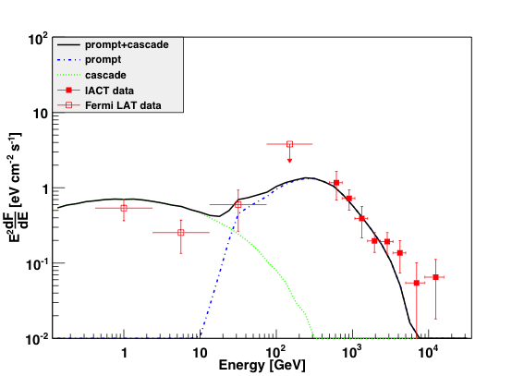
1ES 0229+200 Duty Cycle + Void
Scenario #1: Reduced Duty cycle:
  Due to “snapshot” monitoring of VHE data, true time-averaged VHE spectra (duty cycle) is unknown.
  Reducing the flux in each of the last 5 bins by 2/3, allows fits at ~80% C.L.
  Hints of variability? (Perkins + VERITAS collaboration…)
Scenario #2: Lack of Voids/Contamination due to structure with increased local MF
  Lack of voids in the ~few hundred Mpc region along the line of sight, so that pair produced e⁺/e⁻ would be isotropized and underproduce secondary cascade flux.
Fermi-LAT: Continuous Monitoring
IACT: Sporadic Monitoring

Slide 21
Conclusions
None of the extreme TeV blazars currently used to set lower limit on B_{IGMF} provide definitive evidence that B_{IGMF} > 0.
In most cases more generic source spectral model (broken power law) allows simultaneous explanation of HE and VHE data (albeit HE spectrum is dominated by secondary radiation in several cases).
1ES 0229+200 represents a challenge, however, and requires either nearly lowest possible near IR EBL or reduced to <50% duty cycle in VHE (above a few TeV) to be compatible with B_{IGMF} = 0 hypothesis
Spectral HE&VHE evidence for a non-zero B_{IGMF} based on a single source can always be questioned if morphology of voids in the ~0.3Gpc vicinity of the source is unknown.

