Slide 1

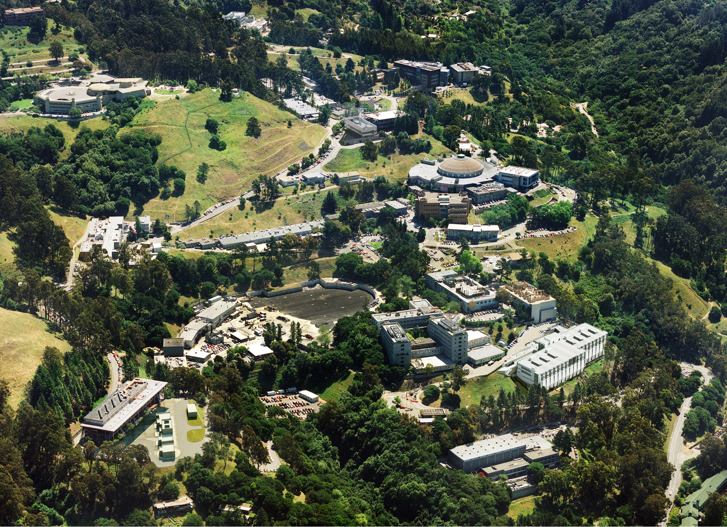
“Extreme High-Intensity Laser Physics” (ExHILP) Conference,
Max Planck Institute for Nuclear Physics (MPIK) in Heidelberg, Germany, 21-24 July 2015
High-Intensity Particle Physics
at PW-class Lasers
and beyond
Stepan Bulanov
BELLA Center, ATAP Division, LBNL

Slide 2
In Collaboration with
BELLA Facility, LBNL
E. Esarey
Q. Ji
T. Schenkel
C. B. Schroeder
S. Steinke
W. P. Leemans
Moscow Engineering
Physics Institute
V. D. Mur
N. B. Narozhny
University of Michigan
A. Maksimchuk
J. Nees
A. G. R. Thomas
ELI Beamline Facility
G. Korn
D. Margarone
Kansai Photon Science Institute, JAEA
T. Zh. Esirkepov
M. Kando
J. K. Koga
S. V. Bulanov
Institute of Theoretical
and Experimental Physics
V. S. Popov
Pisa University
F. Pegoraro
The Graduate School for the Creation
of New Photonics Industries
Y. Kato
Osaka University
A. G. Zhidkov
Taiwan University
P. Chen

Slide 3
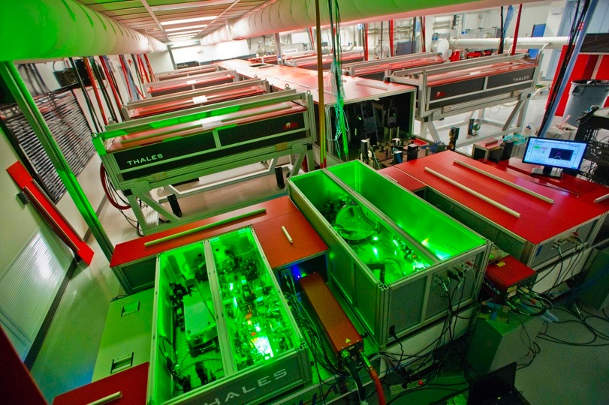
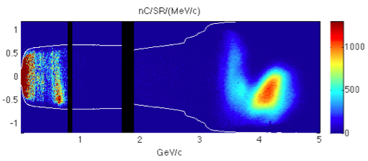
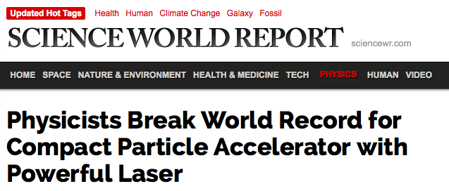
BELLA: the highest rep rate PW-laser in the world for laser plasma acceleration experiments
Unique tool for development of 10 GeV laser plasma accelerator and other collider relevant concepts
Electron beam spectrum
Angle (mrad)
Top 10 American Physical Society 2014 News
Top 20 Scientific American 2014 list
NERSC 2015 Award for High Impact Scientific Achievement
1 2 3 4 5
Beam energy [GeV]
W.P. Leemans et al.,PRL 2014
First commercial Petawatt laser operating at > 42 J in ~30 fs at 1 Hz

Slide 4
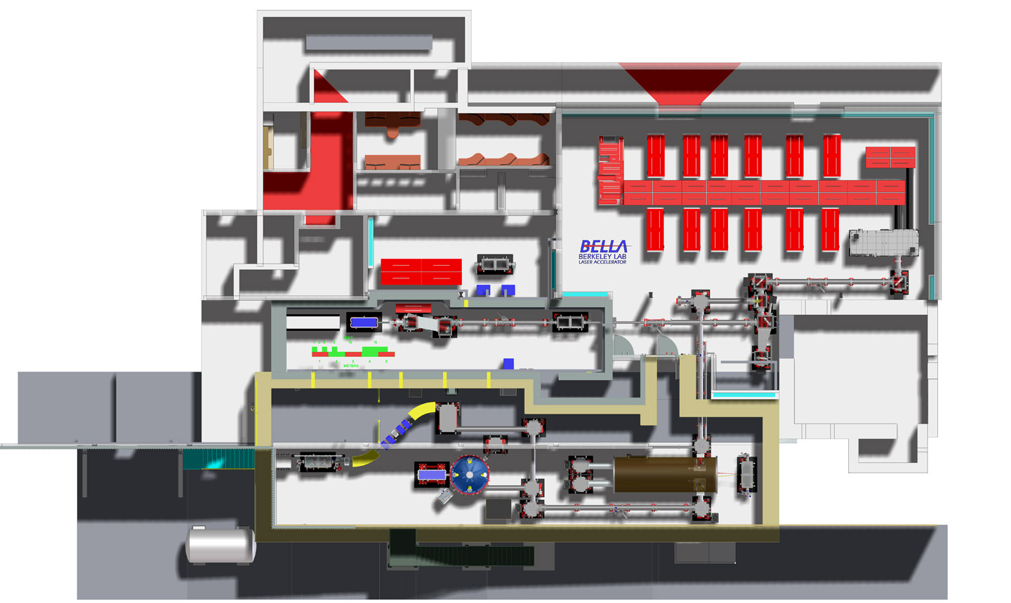
BELLA-i beamlines: expand the facility by adding short focal length capability – ultra-high intensity
BELLA-i beamlines

Slide 5
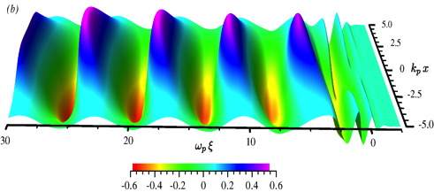
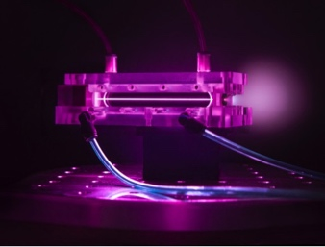
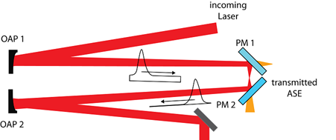
For electron acceleration, BELLA is focused with long focal length. For ions (etc.) it requires short focal length and plasma mirrors
Electron acceleration
Intensity ~1.5x10¹⁹ Wcm⁻²
Acc. fields ~10-50GV/m
13.5m
55 micron spot
High Intensity physics
Plasma mirror technology for contrast clean-up
Intensity ~3-5x10²¹ Wcm⁻²
Acc. fields ~TV/m
<1m
+
4-5 micron spot

Slide 6
BELLA-i beamlines: expand the facility by adding short focal length capability – ultra-high intensity
Superconducting magnet transport
Target chamber 2
Probe beam
BELLA Laser main beam
Target chamber 1
Sample chamber
Betatron backlighter
Plasma mirror system
Beam routing
Operations-EQU funds
MIE funds
Notes:
Mention Project and Operations

Slide 7
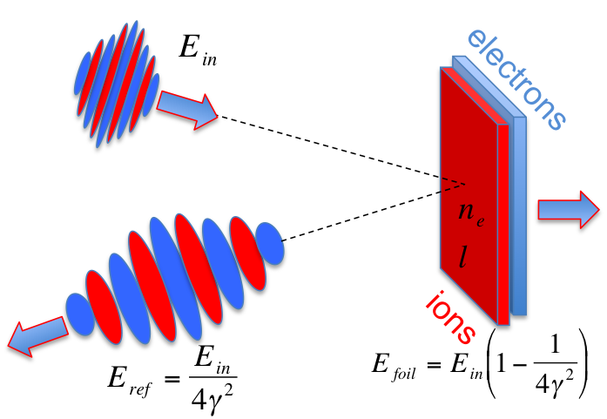
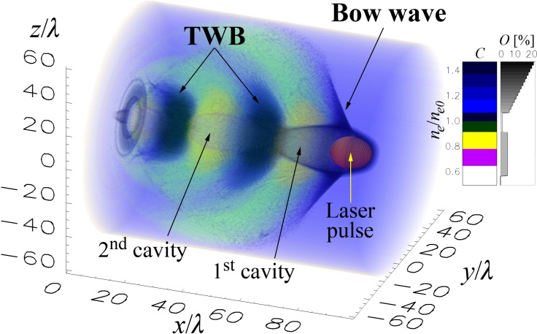
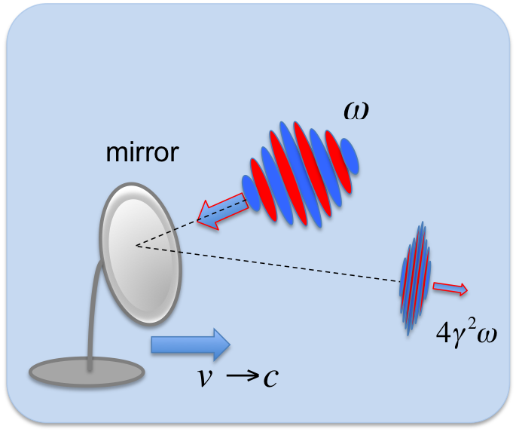
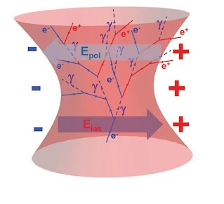
PW-class Lasers:
Accelerator Science + Applications
Ion Acceleration
Electron Acceleration
Relativistic Flying Mirrors
High Intensity Particle Physics
Double Doppler Effect

Slide 8
PW-class Lasers: Ion Acceleration
Ion Acceleration
Electron Acceleration
Relativistic Flying Mirrors
High Intensity Particle Physics
Double Doppler Effect

Slide 9
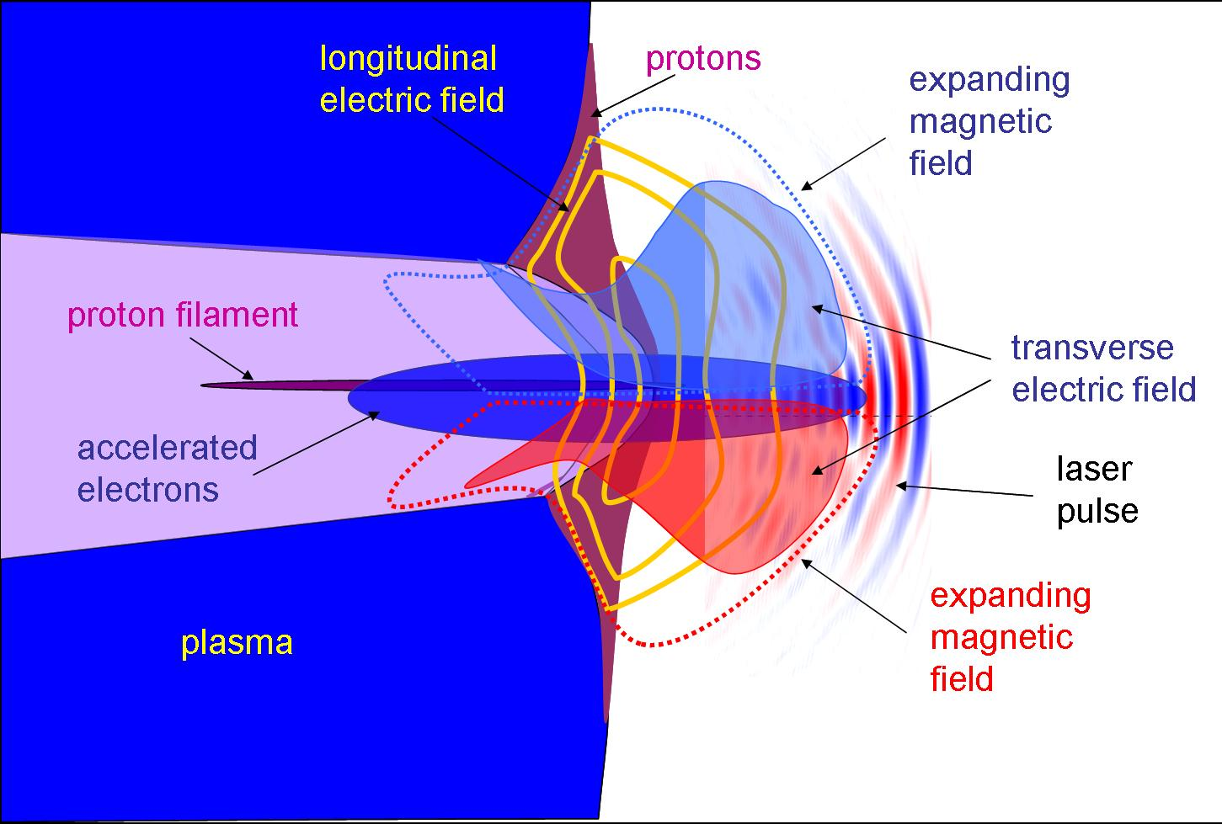
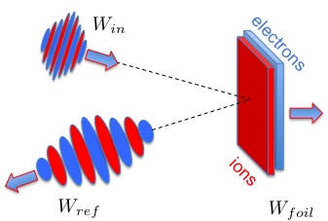
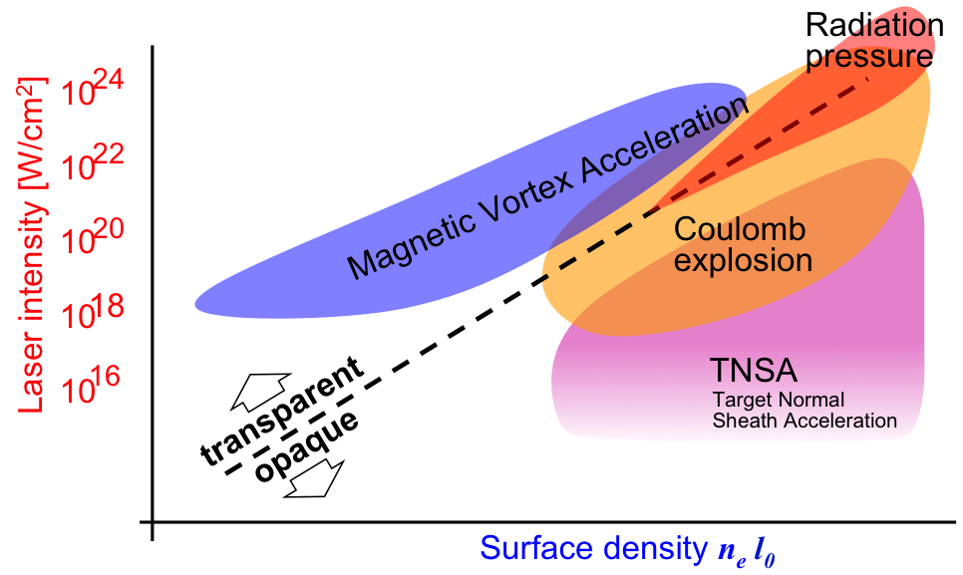
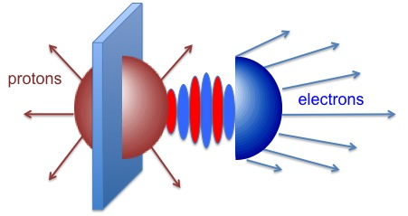

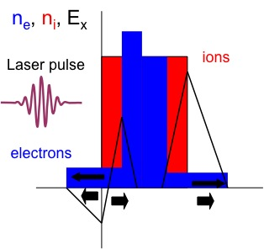
High intensity BELLA-i allows study of different ion acceleration mechanisms
MVA
Laser: High Intensity
Target: Near Critical Density slab
Ion Energy: hundreds of MeV to GeV
RPA & CE
Laser: High Intensity
Target: Thin solid density foils
Ion Energy: hundreds of MeV
TNSA
Laser: Low Intensity
Target: Thick solid density foils
Ion Energy: ~100 MeV
Applications: Radiography, Deflectometry, Cancer Therapy, Injection into conventional accelerators, Fast Ignition, Isochoric heating of matter, Positron Emission Tomography, Nuclear Physics…

Slide 10
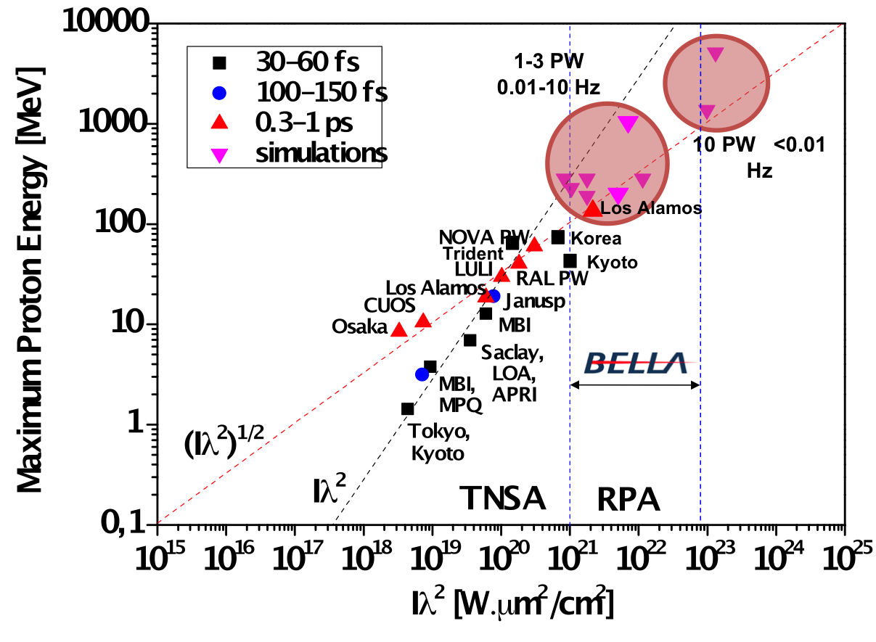
High intensity BELLA allows study of different of ion acceleration mechanisms: up to 1 GeV
MVA
Laser: High Intensity
Target: Near Critical Density slab
Ion Energy: hundreds of MeV to GeV
RPA & CE
Laser: High Intensity
Target: Thin solid density foils
Ion Energy: hundreds of MeV
TNSA
Laser: Low Intensity
Target: Thick solid density foils
Ion Energy: ~100 MeV
S. S. Bulanov, et al., PRL 114, 105003 (2015)
S. S. Bulanov, et al., PR STAB 18, 061302 (2015)
J. Fuchs et al., C. R. Physique 10 (2009)

Slide 11
PW-class Lasers: Relativistic Flying Mirrors
Ion Acceleration
Electron Acceleration
Relativistic Flying Mirrors
High Intensity Particle Physics
Double Doppler Effect

Slide 12
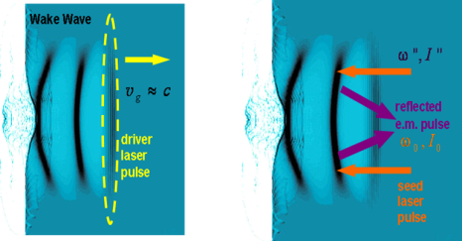
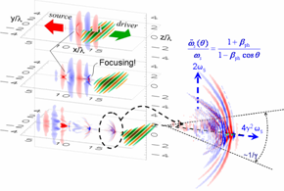
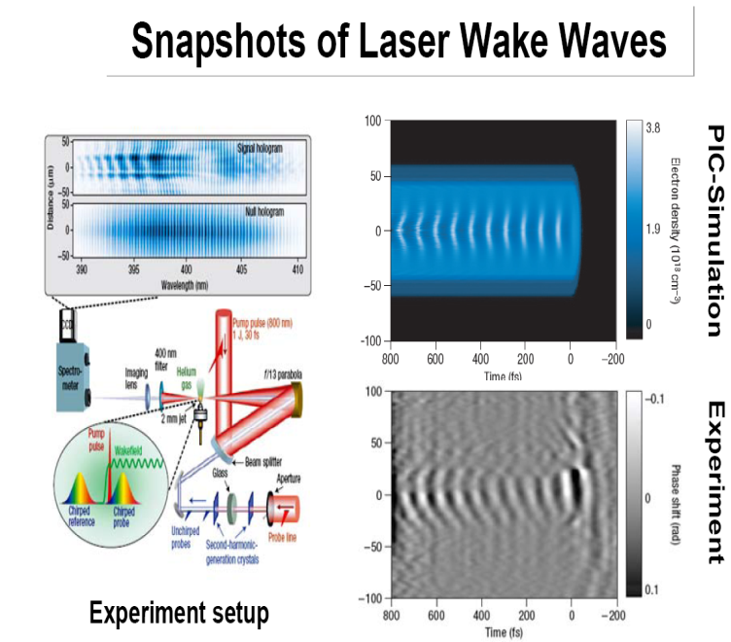
Electromagnetic Pulse Intensification and Shortening by Flying Mirror formed in laser-plasma interaction
Double Doppler Effect
A. Einstein, Ann. Phys. (Leipzig) 17, 891 (1905)
…
Paraboloidal relativistic mirrors are formed by the wake wave left behind the laser driver pulse
S.V.Bulanov, T. Esirkepov, T. Tajima, Phys.Rev.Lett. 91, 085001 (2003)
mirror
Theory
Experiment
M. Kando, et al.,
Phys. Rev. Lett. 99, 135001 (2007)
A. S. Pirozhkov, et al.,
Phys. Plasmas 14, 080904 (2007)
M. Kando, et al.,
Phys. Rev. Lett., 103, 235003 (2009)
λ_{x} = 14.3 nm
Δλ_{x} = 0.3 nm, Δλ_{x} /λ_{x} = 0.02
Reflected pulse duration:
τ_{x} ~ 1.4 fs
(femtosecond pulse)
N. H. Matlis et al, Nature Phys. (2006)

Slide 13
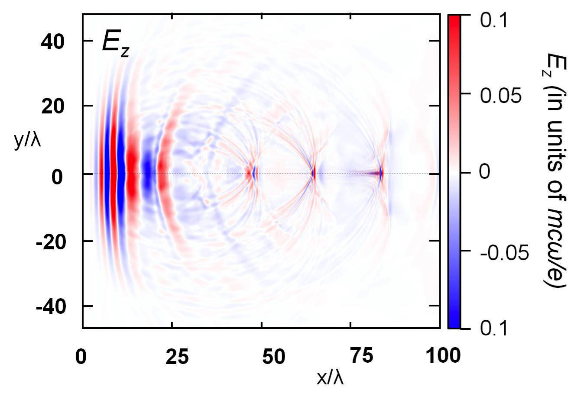
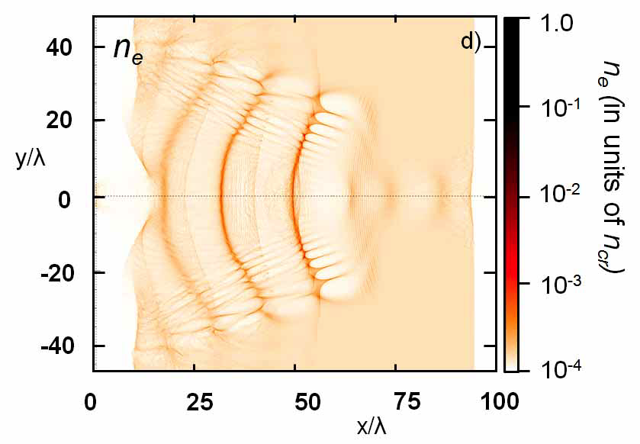
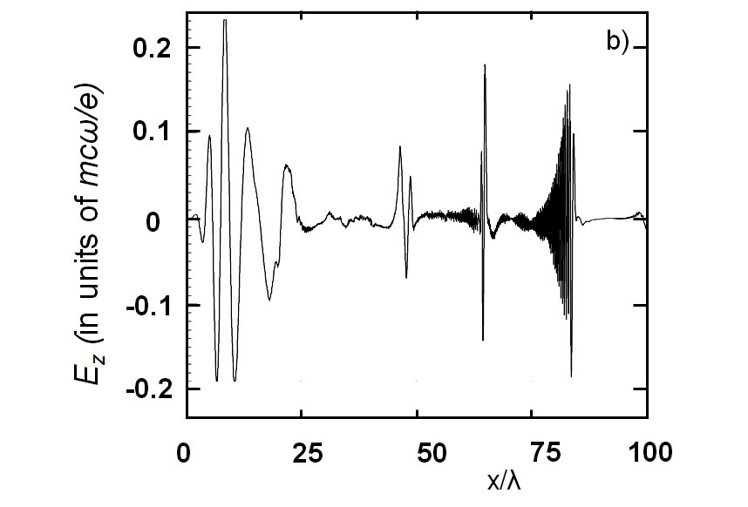
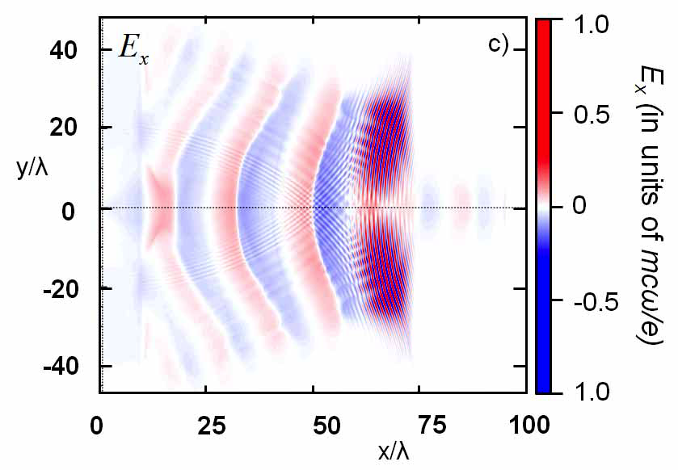
Spherical Plasma Wave Acting as a Spherical Flying Mirror
Focuses the Intensified Pulse
is the Lorentz factor of the spherical plasma wave
LBNL: S. S. Bulanov, et al., Physics of Plasmas 19, 020702 (2012)
S. V. Bulanov, et al., Physics of Plasmas 19, 113102 (2012); ibid, Physics of Plasmas 19, 113103 (2012)

Slide 14
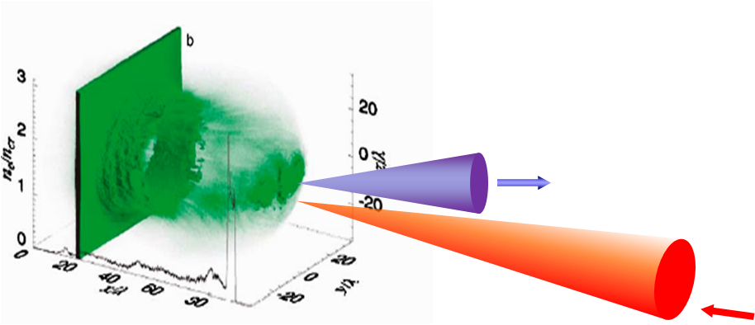
Flying Mirrors are Generated using the Laser Driven Ion Acceleration Setup
Flying Mirror from Coulomb Explosion
electrons
V.V. Kulagin, et al., Phys. Rev. Lett. 99, 124801 (2007);
D. Habs, et al., Appl. Phys. B 93, 349 (2008);
J. Meyer-ter-Vehn, H.-C. Wu, Eur. Phys. J. D 55, 433 (2009);
H.-C. Wu, et al., Phys. Rev. Lett. 104, 234801 (2010).
protons
Flying Mirror from Radiation Pressure Acceleration
T.Zh. Esirkepov, et al., Phys. Rev. Lett. 103 (2009) 025002.
Flying Mirror from multiple electron layers
(Directed Coulomb Explosion)
S. S. Bulanov, et al., Phys. Lett. A 374, 476 (2010).

Slide 15
PW-class Lasers: High Intensity Particle Physics
Ion Acceleration
Electron Acceleration
Relativistic Flying Mirrors
High Intensity Particle Physics
Double Doppler Effect

Slide 16
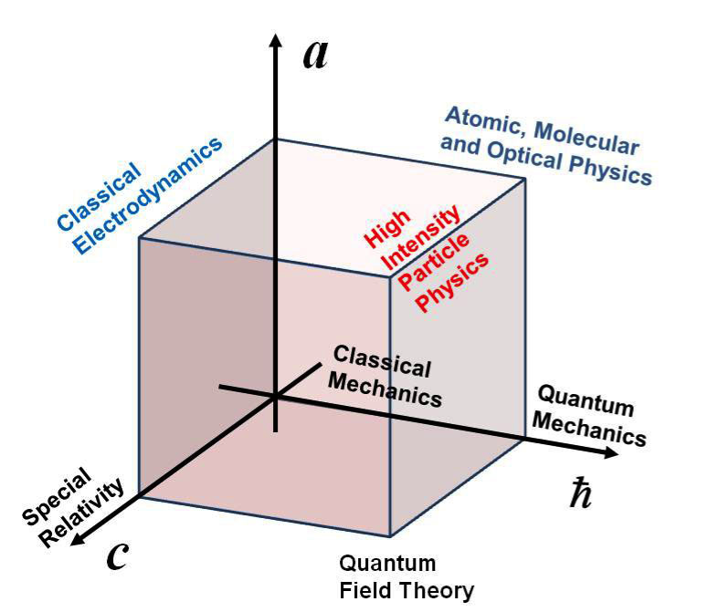
LBNL Workshop: High Intensity Particle Physics
High Intensity Particle Photon Interactions
- Nonperturbative Quantum Field Theory
Workshop on
"Nonlinear QED Phenomena
with Ultra-Intense PW-class Lasers”
LBNL, May 2012
- Matter in extreme conditions
Electromagnetic
Cascades
Electromagnetic
Avalanches
Ultimate Laser
Intensity Limit
- Future γγ colliders
- Next generation lasers:
- Future lepton colliders
day-to-day operation
new laser-matter interaction applications
- Various astrophysical phenomena

Slide 17
Principal schemes of the experiments for the study of extreme field limits.
Colliding laser pulses
Colliding laser pulse and an electron beam
Wake wave
LWFA
e⁻
e⁻
e⁻
e⁻
γ
electron
bunch
Laser pulse
e⁺
Laser pulse
Laser pulse
e⁺
e⁺
e⁺
Gas jet
Radiation effects become dominant
QED effects become dominant
Schwinger limit
Radiation effects become dominant
QED effects become dominant
QED cascade

Slide 18
Probing nonlinear vacuum
Electron-positron pair production from vacuum
by the Schwinger process
Electromagnetic “avalanche”
Constant field
Time-varying
electric field
F. Sauter (1931)
W.Heisenberg, H.Euler (1936)
J. Schwinger (1951)
E.Brezin, C.Itzykson (1970)
V. S. Popov (1971)
N. B. Narozhny and A. I. Nikishov (1974)
V.I.Ritus (1979)
A. Ringwald (2001)
e⁻
e⁻
Laser pulse
e⁻
Focused laser pulse
Colliding laser pulses
e⁺
Laser pulse
e⁺
e⁺
Optimal quantum control
of pair production
by laser pulse
temporal shaping
N. B. Narozhny, S. S. Bulanov, V .D. Mur, and V. S. Popov,
Phys. Lett. A 330, 1 (2004)
S. S. Bulanov, A. M. Fedotov, and F. Pegoraro, Phys. Rev E 71, 016404 (2005)
S. S. Bulanov, N. B. Narozhny, V .D. Mur, and V. S. Popov,
JETP, 102, 9 (2006)
A. Di Piazza et al., Phys. Rev. Lett. 103, 170403 (2009)
R. Schutzhold et al., Phys. Rev. Lett. 101, 130404 (2009)
G. V. Dunne et al., Phys. Rev. D 80, 111301(R) (2009)
A. Di Piazza et al., Phys. Rev. Lett. 103, 170403 (2009)
C. K. Dumlu, G. V. Dunne, Phys. Rev. Lett. 104, 250402 (2010)
Multiple colliding laser pulses
Optimally Focused Laser Pulses
S. S. Bulanov, N. B. Narozhny, V .D. Mur, J. Nees,
and V. S. Popov., Phys. Rev. Lett. 104, 220404 (2010)
A. Gonoskov, et al., Phys. Rev. Lett. 111, 060404 (2013)

Slide 19
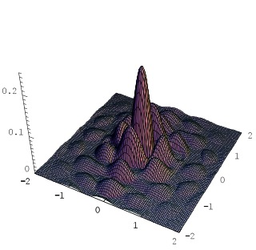
A Way to Lower the Threshold of Pair Production from Vacuum
Multiple Colliding EM pulses:
pulses | N_{e} at W=10 kJ | W_{th}(kJ) to produce one pair
2 | 9.0 x 10⁻¹⁹ | 40
4 | 3.0 x 10⁻⁹ | 20
8 | 4.0 | 10
16 | 1.8 x 10³ | 8
24 | 4.2 x 10⁶ | 5.1
S. S. Bulanov, V. D. Mur, N. B. Narozhny, J. Nees, V. S. Popov, Phys. Rev. Lett. 104, 220404 (2010)

Slide 20
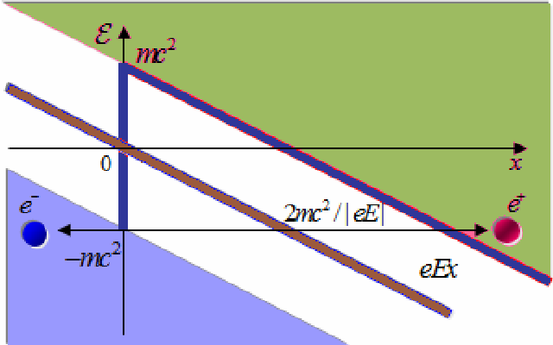
Electromagnetic avalanche
- Ultimate laser intensity limit
e⁺e⁻ pair production
from vacuum
e⁺
e⁻
e⁺
e⁺
e⁻
e⁺
e⁻
e⁺
e⁻
e⁻
A. R. Bell and J. G. Kirk, “Possibility of Prolific Pair Production with High-Power Lasers ” Phys. Rev. Lett. 101, 200403 (2008)
A. M. Fedotov, N. B. Narozhny, G. Mourou, G. Korn, “Limitations on the Attainable Intensity of High Power Lasers” Phys. Rev. Lett. 105, 080402 (2010)
S. S. Bulanov, T. Zh. Esirkepov, A. G. R. Thomas, J. K. Koga,S. V. Bulanov, “On the Schwinger limit attainability with extreme power lasers” Phys. Rev. Lett., 105, 220407 (2010)
E. N. Nerush, I. Yu. Kostyukov, A. M. Fedotov, N. B. Narozhny, N. V. Elkina, and H. Ruhl, “Laser Field Absorption in Self-Generated Electron-Positron Pair Plasma” Phys. Rev. Lett. 106, 035001 (2011)
N. V. Elkina, A. M. Fedotov, I. Yu. Kostyukov, M. V. Legkov, N. B. Narozhny, E. N. Nerush, H. Ruhl “QED cascades induced by circularly polarized laser fields”, Phys. Rev. ST Accel. Beams 14, 054401 (2011)

Slide 21
Interaction of a laser pulse with an ultra relativistic electron beam
Colliding laser pulse and an electron beam
Radiation effects become dominant
QED effects become dominant
QED cascade
Wake wave
LWFA
e⁻
γ
electron
bunch
Laser pulse
e⁺
Gas jet
G. Breit and J. A. Wheeler (1934)
H. R. Reiss (1962)
L. S. Brown and T. W. B. Kibble (1964)
A. I. Nikishov and V. I. Ritus (1964)
C. Harvey, T. Heinzl, and A. Ilderton (2009)
A. Di Piazza, K. Z. Hatsagortsyan, and C. H. Keitel (2010)
I. V. Sokolov, J. Nees, V. P. Yanovsky, N. M. Naumova, and G. Mourou (2010)
F. Mackenroth and A. Di Piazza (2011)
A. I. Titov, H. Takabe, B. Kampfer, and H. Hosaka (2012)
K. Krajewska and J. Z. Kaminski (2012)
S. S. Bulanov, C. B. Schroeder, E. Esarey, W. P. Leemans (2013)

Slide 22
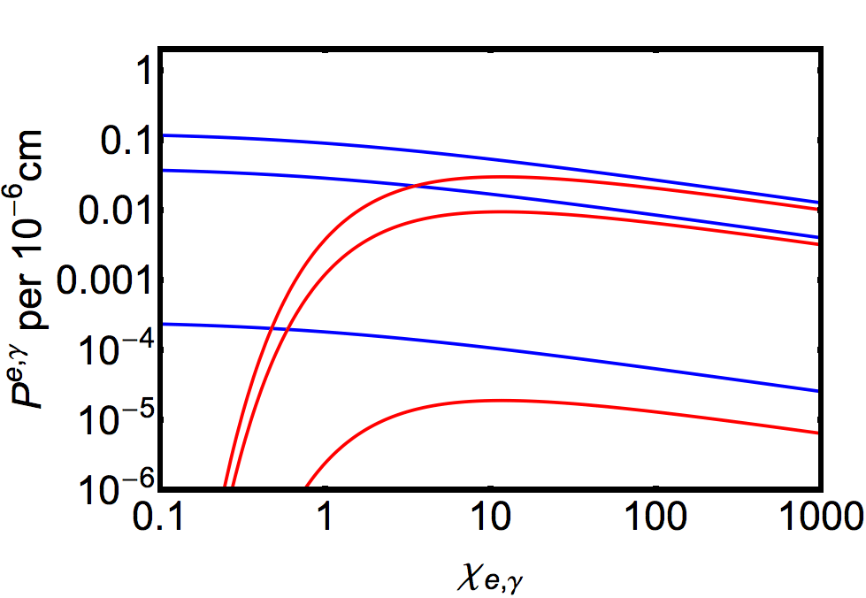
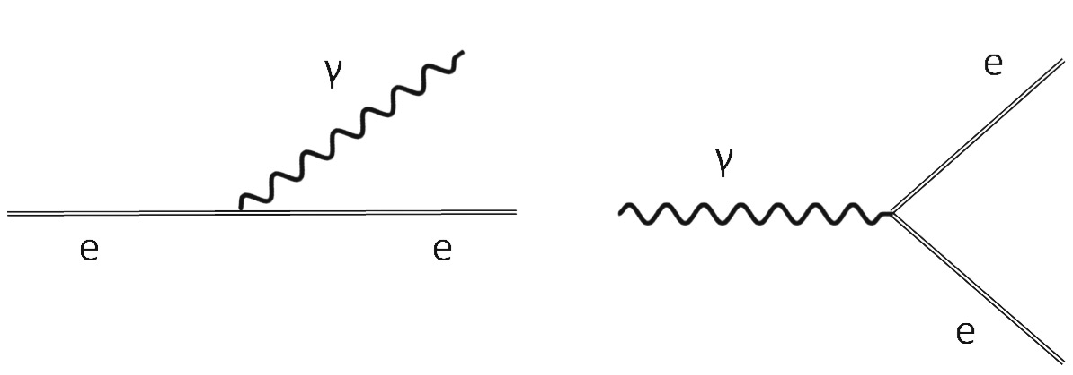
Electromagnetic cascades: high event rates for PW lasers colliding with e-beams
LBNL: S. S. Bulanov, et al., Phys. Rev. A 87, 062110 (2013)
Multiphoton
Compton effect
ELI(10 GeV)
BELLA(0.5 GeV)
BELLA(10 GeV)
Multiphoton
Breit-Wheeler effect
SLAC E144
e⁺
e⁻
e⁻
electron
bunch
e⁺
e⁻

Slide 23
BELLA-i facility will provide high intensity laser beamlines enabling a wide range of frontier plasma science
Build a short focal length beamline on BELLA with plasma mirror and diagnostics to enable high intensity laser-matter experiments
  Complements present long focal length beamline for electron acceleration experiments
  Plasma mirror technology is routinely used on staging experiment and will enable access to unprecedented clean interaction physics
Enables laser-driven frontier plasma science
  Ion acceleration in various regimes
    RPA: compete acceleration of very thin foils (>100 MeV)
    MVA: acceleration in near-critical plasmas (approach 1 GeV)
  Ion beams for warm dense matter, medical applications, etc.
  Nonlinear plasma wakes, bow waves, high harmonics, flying mirrors
  Nonlinear QED, lab astrophysics, etc…
User facility open to frontier plasma science community
  LBNL Workshop on science with BELLA-I (Dec’15 – Jan’16)

Slide 24
Thank you!

