Slide 1
The generation of gravitational waves by
Laser-plasma interaction Hedvika Kadlecová ª, S. Weber ª, G. Korn ª
ª Institute of Physics, v.v.i. ASCR, Na Slovance 1999, Prague, Czech Republic;
Conference on Extremely High Intensity Laser Physics, Heidelberg, Germany 21-25 July 2015

Slide 2
The generation of gravitational waveS By Laser plasma interaction
Connection of two research fields:
High energy Laser – plasma interactions (energy ranges PW, EW)
Gravitational theory
New laser facilities enable applications to other fundamental research fields:
Generation of gravitational waves with sensitivity h ~ 10⁻⁽³⁸⁻⁴⁰⁾
Problems with detection – still did not happen! (2014 South Pole BICEP)

Slide 3
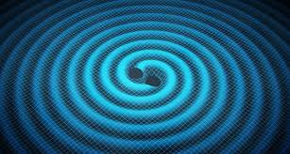
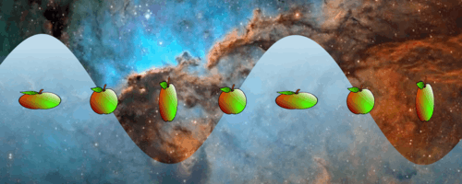
WHAT IS a gravitational wave
Are the perturbations of spacetime – ripples
of spacetime ( waves in Minkowski flat space)
Waves travel with speed of light: (mass changes)
carry energy, angular momentum
influences geometry of spacetime and affects
all mass
two independent polarization states (ellipse)
We can measure:
Polarization of the wave
Amplitude, frequency
The direction of propagation

Slide 4
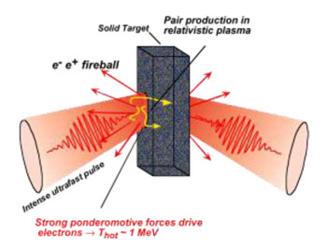
The PW lasers
ELI - Beamlines project ( operational 2017 → future)
the intensity 10 petawatt (10 ¹⁶ watts)
repetition rate of 0.01 Hz, pulse lasting 150 fs.
explore both theoretically and experimentally
the ultra-relativistic (above 10²³ W/cm²) regime of
laser-matter interaction (exotic physics)
Other experiments: PW
APOLLON (France), APRI-GIST (S. KOREA),
OMEGA-EP(ROCHESTER)

Slide 5
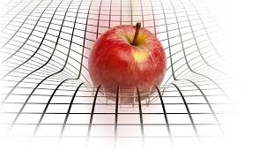
The gravitaTional WAVES
We assume gravitational waves in
linear approximation:
sources in very large distances (stars), small motion
Waves are generated by:
singular events or periodic events of mass
motion
Einstein equations: The wave equation:

Slide 6
The gravitaTional WAVES
The dominant component in multipole expansion:
Quadrupole moment:
where
for neutron star:
h ~ 10⁻²⁴
Luminosity of gravitational radiation:
The resulting expected orders
L ~6 * 10⁻⁽¹⁷⁻¹⁹⁾ (erg/s)

Slide 7
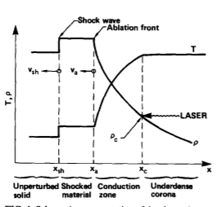
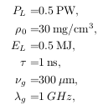
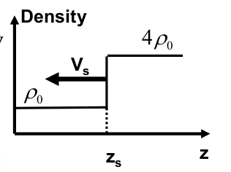
Models OF GW generation
The Shock wave model: laser points on thin foil, the mass is accelerated, has a
velocity and quadrupole moment
For experimental values:
frequency range in GHz domain

Slide 8
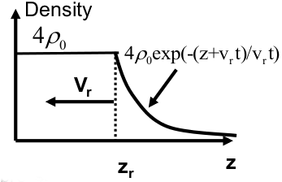
Models OF GW generation
The Ablation rarefaction model:
For experimental values:

Slide 9
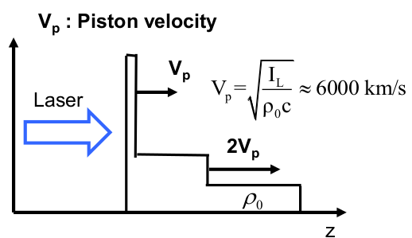
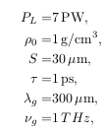
Models OF GW generation
The Piston model: hole boring
For experimental values:
leads to frequencies in THz range

Slide 10
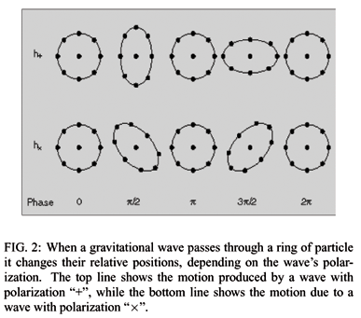
Polarization of GW radiation
The plane wave solution:
Transverse Traceless gauge
where the projector has a form: n_{j} wave vector
Two modes of polarization:

Slide 11
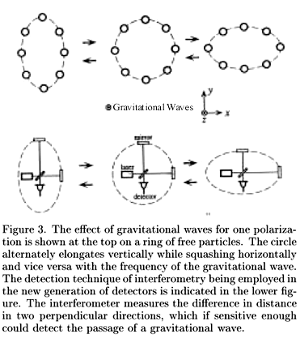
Polarization in models
Results for the shock wave model:
Wave vector oriented in z-direction
For ansatz z :
The radiation is vanishing in the direction of
propagation.
The wave vector oriented in x-direction:

Slide 12
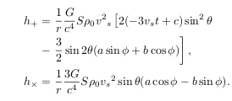
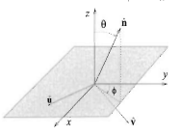
Polarization in models
The general direction of the wave vector:
The radiative characteristics of GW:
the distribution of radiation in space

Slide 13
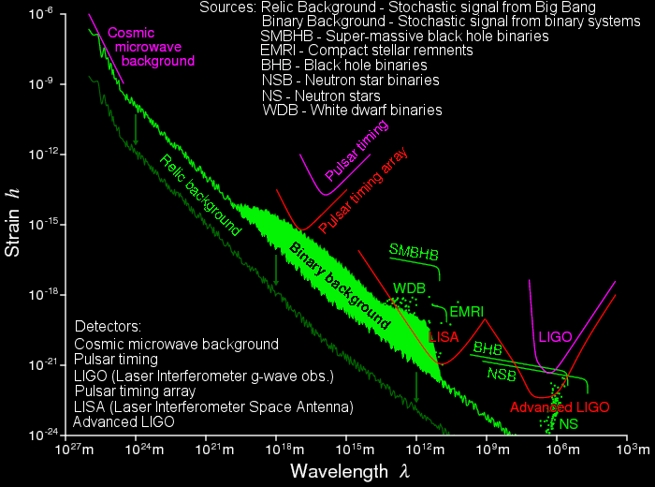
Detectors of LOW frequency GW

Slide 14
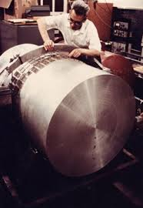
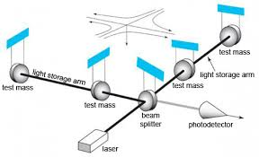
Detectors of LOW frequency GW ( < 100 Hz)
Weber detectors: h ~ 10⁻¹⁶ tube resonant detector (1960’s)
First experiments measured systematic mistakes in experiment.
Today’s Weber detectors have sensitivity h < 10⁻¹⁹
MiniGrail, Auriga(Padova)
Interferometers LIGO(USA), VIRGO (IT-FRA)
Laser system with two arms, arm length 4 km
L-shaped ultra high vacuum, h < 10⁻²³
Time of wave travel in milliseconds.
Joined observatories:
Livingstone (Lousiana), Hanford (Washington)

Slide 15
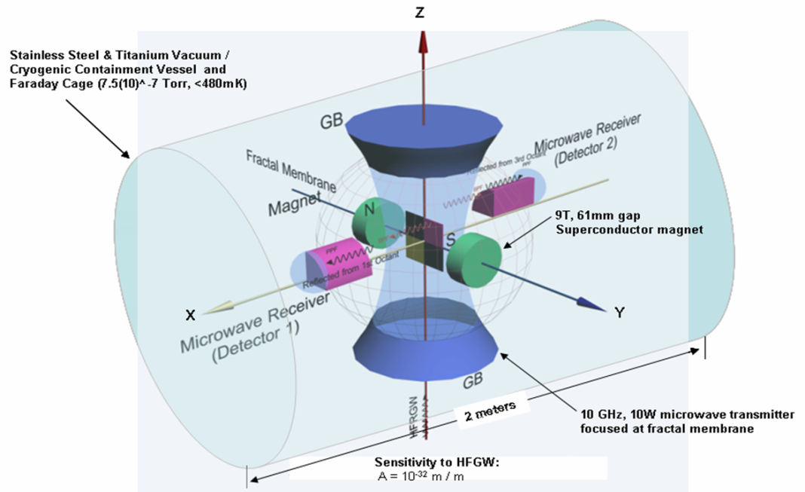
Detectors of High frequency GW
Li-Baker detector – suggested project in 2011
Final Cost: approx. 6 Million US
Expected sensitivity: h_{min}=10⁻³²
Generation by two x-ray lasers
(760 nm, 20 fs, rep. rate 100 MHz)
Detection based on a coupling
between EM and gravitational waves
synchro-resonance solution
different from Gertsenshtein effect

Slide 16
Acknowledgements
This research has been supported by ELI-Beamlines (CZ.1.05/1.1.00/483/02.0061) .
/483/02.0061) .
References
[1] X. Ribeyre and V. T. Tikhonchuk, "Possible Experimental tests of General Relativity and Gravity on LMJ-PETAL", IZEST -- ELI-NP Conference in Paris, (2014).
[2] M. Maggiore, "Gravitational Waves: Volume 1: Theory and Experiments", Oxford University Press, New York, (2008).
[3] R. Fabbro et al., “Planar laser--driven ablation: Effect of inhibited electron thermal conduction”, Phys. Fluids 25, (1984).
[4] N. Naumova et al.,"Hole Boring in a DT Pellet and Fast--Ion Ignition with Ultraintense Laser pulses", Physical Review Letters 102, 025002 (2009).

