Slide 1


IAP RAS
Subexawatt laser project XCELS
A.Bashinov, E.Efimenko, A.Gonoskov, E.Khazanov, A.Kim,
I.Kostyukov, A.Muravjov, A.Sergeev, A.Shaykin
Institute of Applied Physics, Russian Academy of Sciences
Nizhny Novgorod, Russia
ExHILP, Heidelberg, 2015

Slide 2
IAP RAS
OUTLINE
Toward sub-exawatt laser power
From PEARL
PEARL X
XCELS-Proto
to XCELS
Maximization of field intensity
Field structures and new possibilities for extreme light physics

Slide 3
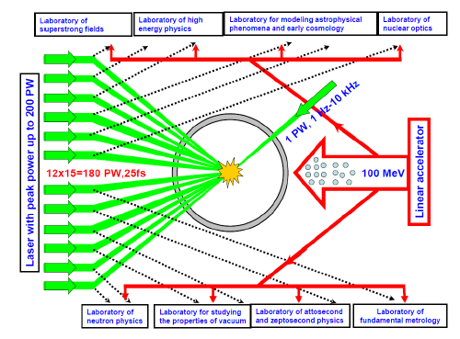
IAP RAS
XCELS
XCELS- EXawatt Center for Extreme Light Studies –
is a new research infrastructure selected by the Russian government
among 6 mega science projects to be constructed by 2020.
XCELS is based on a new laser facility comprising of 12 amplification channels,
each of them providing 400 J, 25 fs pulses, with the total pulse power of
almost 200 PW. A new research institute will be built around this laser facility.
12 channels
15 PW each
400 J, 25 fs, 910 nm
Quality: 3 divergence limits
Intensity 10²⁴-10²⁵ W/cm²

Slide 4
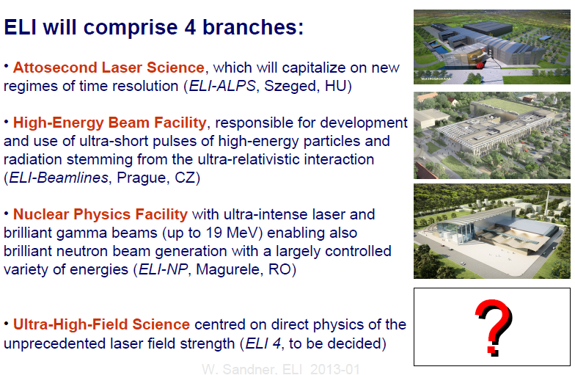
IAP RAS
XCELS versus ELI
Extreme Light Infrastructure
Courtesy of W. Sandner
XCELS satisfies requirements for 4th Pillar of ELI

Slide 5
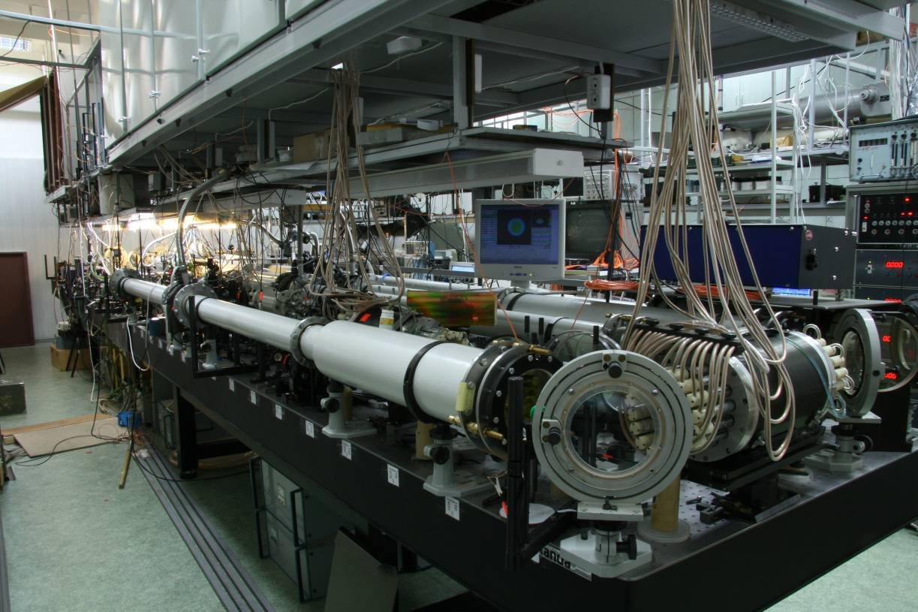
IAP RAS
PEARL – PEtawatt pARametric Laser
was launched at IAP in 2006
3 cascades of parametric amplification in DKDP crystals (the final stage
with aperture D=10 cm) provides 10¹¹ total amplification gain

Slide 6
IAP RAS
Optical Parametric Chirped Pulse Amplification (OPCPA)
Nanosecond pump pulse
Chirped femtosecond signal

Slide 7

Superbroadband synchronism e = o+o in DKDP crystal
IAP RAS
ω₃ ,k₃ – narrow band pump (ns pulse) – frequency ω₃ = const
ω₁ ,k₁ and ω₂ ,k₂ – broadband signal and idler – variables, Δω₁=−Δω₂=Ω
r
r
v
v
1
ϕ
12
(
)
r
2
ψ
12
Ω
k
Z
10
ϕ
13
ϕ
(
Ω
)
r
12
r
k
k
r
2
20
k
3
Рис 1

Slide 8
Superbroadband synchronism e = o+o in DKDP crystal
IAP RAS
ω₃ ,k₃ – narrow band pump (ns pulse) – frequency ω₃ = const
ω₁ ,k₁ and ω₂ ,k₂ – broadband signal and idler – variables, Δω₁=−Δω₂=Ω
=0
phase-matching
r
r
v
v
1
ϕ
12
(
)
r
2
ψ
12
Ω
k
Z
10
ϕ
13
ϕ
(
Ω
)
r
12
r
k
k
r
2
20
k
3
Рис 1

Slide 9
Superbroadband synchronism e = o+o in DKDP crystal
IAP RAS
ω₃ ,k₃ – narrow band pump (ns pulse) – frequency ω₃ = const
ω₁ ,k₁ and ω₂ ,k₂ – broadband signal and idler – variables, Δω₁=−Δω₂=Ω
=0
phase-matching
=0 broadband phase-matching
r
r
v
v
1
ϕ
12
(
)
r
2
ψ
12
Ω
k
Z
10
ϕ
13
ϕ
(
Ω
)
r
12
r
k
k
r
2
20
k
3
Рис 1

Slide 10
Superbroadband synchronism e = o+o in DKDP crystal
IAP RAS
ω₃ ,k₃ – narrow band pump (ns pulse) – frequency ω₃ = const
ω₁ ,k₁ and ω₂ ,k₂ – broadband signal and idler – variables, Δω₁=−Δω₂=Ω
=0
phase-matching
=0 super-broadband phase-matching
=0 broadband phase-matching
At pumping with second harmonic of Nd:glass laser (λ₃ = 527 nm) in DKDP crystal with 85% deuterization, superbroadband synchronism takes place for :
λ₁ = 910 nm, λ₂ = 1250 nm, θ ₃=37,5⁰ , ϕ₁₃ = 0.7⁰
1/527=1/910+1/1250
r
r
v
v
1
ϕ
12
(
)
r
2
ψ
12
Ω
k
Z
10
ϕ
13
ϕ
(
Ω
)
r
12
r
k
k
r
2
20
k
3
Рис 1

Slide 11
IAP RAS
The scheme of PEARL
Front-end system, 2Hz
Synchronization
system
Cr:Forsterite
fs-laser
λ=1250nm
CW Yb:fiber pump 10W
λ=1077nm
2nJ
40fs
Nd:YLF
laser
λ=1054nm
Stretcher
λ=910nm
0.5mJ
0.6ns
1nJ
0.6ns
OPA I
KD*P
OPA II
KD*P
10mJ
12ns
0.8J
1.5ns
λ=527nm
1mJ
2ns
2J
1.5ns
λ=1250nm
Pulse shaper
Nd:YLF
amplifier
SHG
λ=910nm
50mJ
0.6ns
0.1J
1.5ns
Power system
λ=910 nm
38J
0.6 ns
λ=910 nm
24J
43 fs
λ=527nm
180J
1.2ns
OPA III
KD*P
Nd:glass
amplifier
300J
1.3ns
SHG
Compressor

Slide 12
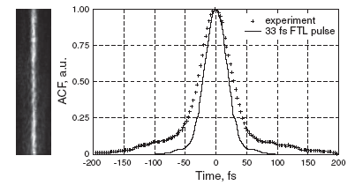
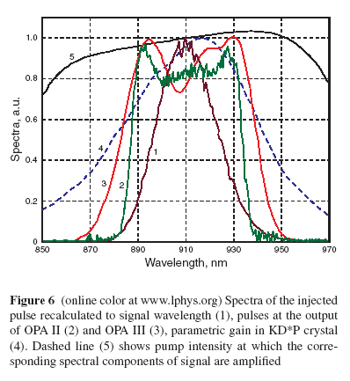
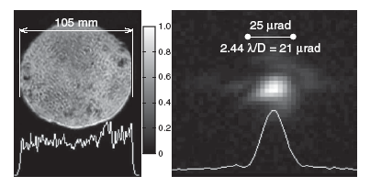
IAP RAS
PEARL parameters
24J/43fs=0.56PW
Focusable to
10²² W/сm²
Contrast: 10⁸ (0.5ns window)
10⁴ (1ps window)

Slide 13
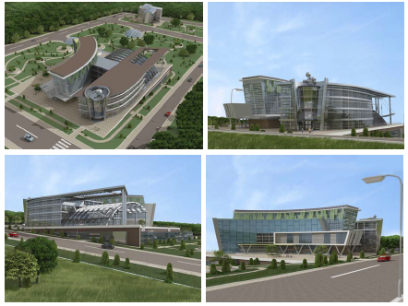
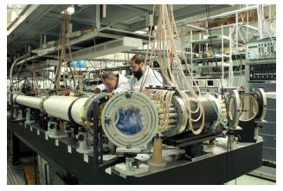
IAP RAS
From PEARL to XCELS
PEARL | 0.5 PW | Front-end for XCELS-Proto | 2006
PEARL X | 5 PW | Technological upgrade of PEARL | 2014-2015
XCELS - Proto | 2 x 10 PW | Scaling of PEARL to d30 cm DKDP | 2017
XCELS | 12 x 15 PW | Final | 2020

Slide 14
IAP RAS
From PEARL to PEARL X
 | PEARL | PEARL X | Growth rate
Pulse duration | 45 fs | 25 fs | 2
Pump laser 2ω (527 micron, 2 ns) | 180 J | 270 J | 2 cascades
Crystal size | 10x10 cm² | 12.5x12.5 cm² | 1.5
Efficiency (compressed) | 15% | 25% | 1.6
0.56 PW x 2 x 2 x 1.5 x 1.6 = 5 PW
PEARL X: Increasing OPCPA power of
PEARL facility in 10 times

Slide 15
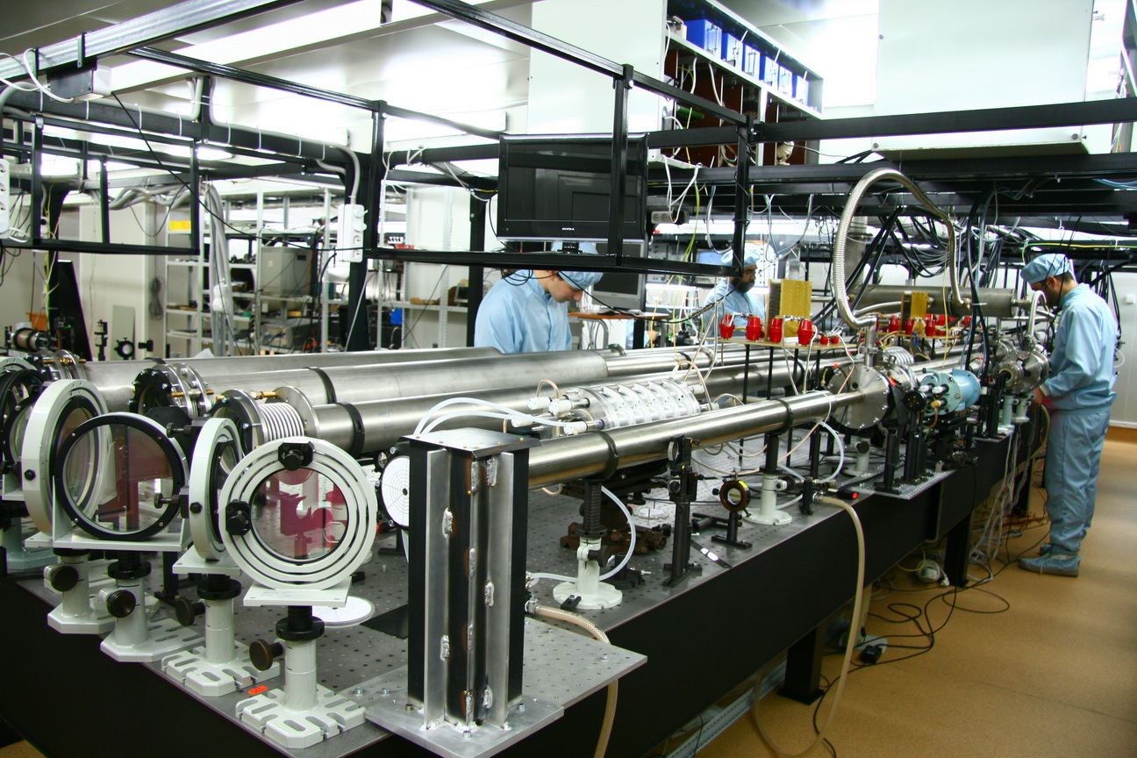
IAP RAS
From PEARL to PEARL X
4 cascades of parametric amplification in DKDP crystals (2 final stages
with aperture D=12.5 cm) to provide 10¹² total amplification gain
Repetition rate to be increased from 1/30min to 1/(1-3)min

Slide 16
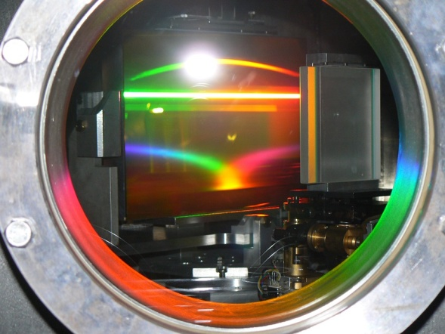
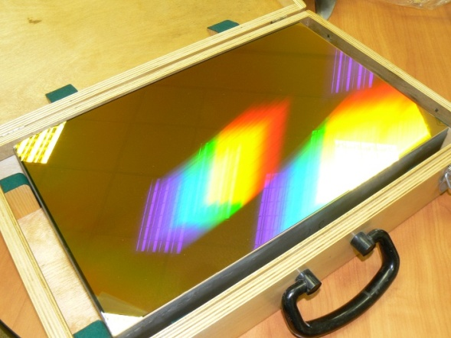
IAP RAS
Laser complex PEARL-X is under construction
pump energy
OPCPA efficiency
pulse duration
compressor efficiency
70J
1,5ns
140J
1,5ns
210J
1,5ns
320J
2ns
OPA III
KD*P
10cm dia
OPA IV
KD*P
15cm dia
OPA V
KD*P
20cm dia
Compressor
1.5ns & 30fs
Nd:glass
amplifier
2ω
210J
2ns
150J
30fs
5PW
210J
2ns
210J
2ns
320J
2ns
2ω
2ω
Nd:glass
amplifier
Nd:glass
amplifier
320J
2ns
3 additional OPCPA stages

Slide 17
IAP RAS
From PEARL to XCELS
PEARL | 0.5 PW | Front-end for XCELS-Proto | 2006
PEARL X | 5 PW | Technological upgrade of PEARL | 2014-2015
XCELS – Proto | 2 x 10 PW | Scaling of PEARL to d30 cm DKDP | 2017
XCELS | 12 x 15 PW | Final | 2020

Slide 18
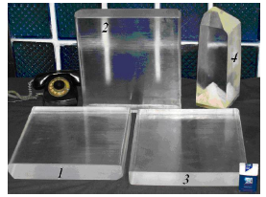
IAP RAS
Available Technologies
Crystals 1-3 with 365×400×50 mm size were grown by the high-rate growth
technique for about 40 days. KDP crystal 4 with 140×140×300 mm size was grown by
a conventional technique for about a year

Slide 19
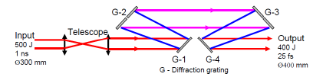
IAP RAS
Available Technologies
Schematic diagram of the compressor. Gratings G-2 and G-3 are composite here
For normal operation of the 15 PW compressor diffraction gratings
of appropriate size (500 mm × 800 mm) are required. For the radiation
energy of a pulse arriving at the compressor of 500 J, the energy density
in a 40 cm beam will be a little more than 0.4 J/cm2.

Slide 20
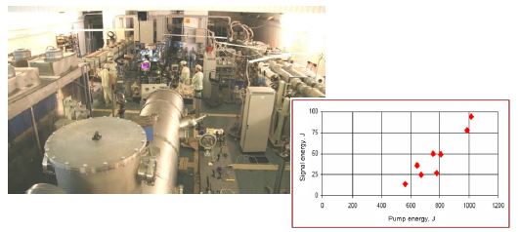
IAP RAS
Available Technologies
"LUCH" facility with parametric amplifier FEMTA at VNIIEF (Sarov) and record characteristics of parametric amplification of femtosecond pulses

Slide 21
PW OPCPA laser complex FEMTA
Sarov – N.Novgorod
IAP RAS
Cr:Forsterite
fs-laser
2nJ
40fs
Stretcher
Synchr. system
0.5mJ
0.6ns
λ=910nm
1nJ
0.6ns
2J
1.5ns
λ=1054nm
OPA II
MO& Pump laser system
0.8J
1.5ns
λ=527nm
OPA I
SHG
λ=1250nm
30mJ
0.6ns
λ=910nm
Front-end system
38J
0.6ns
Pump booster system
300J
1.3ns
SHG
180J
1.3ns
OPA III
Compressor 1
24J
43fs
Power pre-amplifier
500TW
“LUCH”
2kJ
1.5ns
1kJ
1.5ns
OPA IV
100J
0.6ns
Compressor 2
70J
70fs
SHG
Final power amplifier
1PW

Slide 22
IAP RAS
XCELS
Main Technological Issues:
Scaling of PEARL to 30 cm aperture DKDP crystal
2-3 kJ Nd:glass pump lasers
12 separate amplifying chains with shared front-end
Adaptive optics to provide beam quality and coherent combining
First prototyping stage - XCELS-Proto -
two channel laser facility to be built at IAP RAS

Slide 23
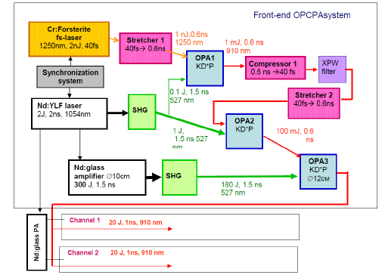
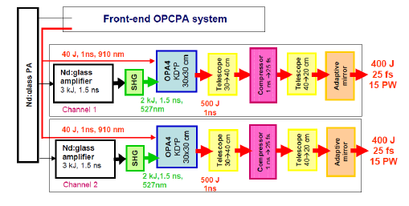
IAP RAS
XCELS-Proto
PEARL architecture
FEMTA & UFL-2M
architectures
(Sarov)

Slide 24
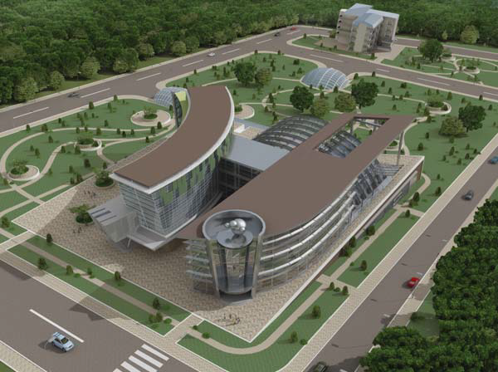
IAP RAS
XCELS Layout

Slide 25
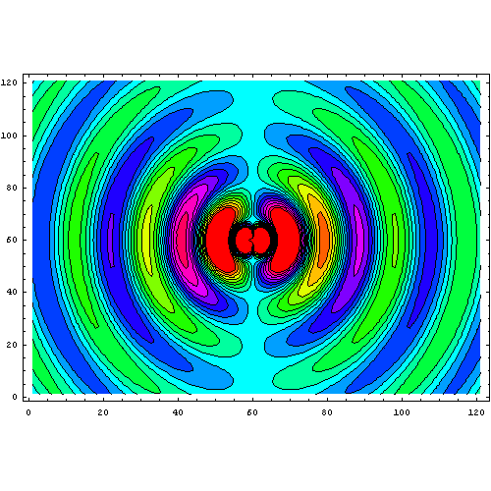
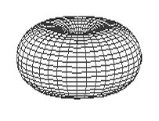
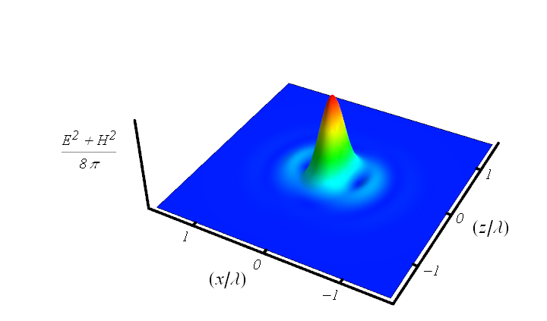


IAP RAS
How to maximize field intensity at given power ?
Rule of thumb for coherent combining of several beams:
To maximize the electric field at focusing point,
radiation of several combining beams should reproduce
configuration of phase conjugated dipole radiation field
I. Gonoskov, A. Aiello, S. Heugel, and G. Leuchs, Phys. Rev. A (2012)
z
x
Minimum focusing volume:
Minimum focusing volume:
Converging dipole wave as an exact solution of Maxwell equations:

Slide 26
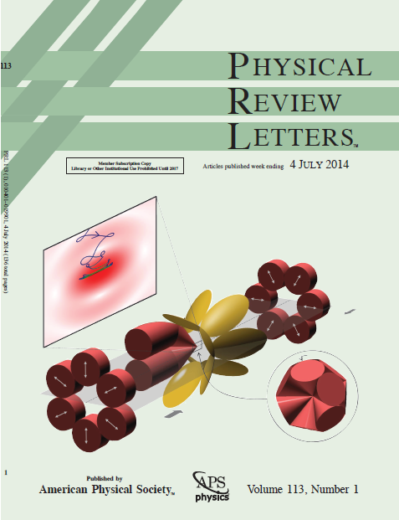
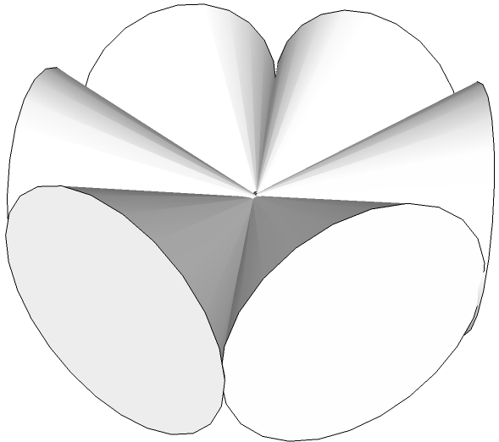
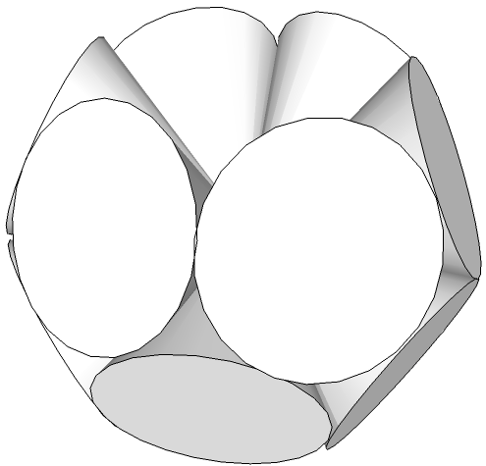
IAP RAS
Coherent combining to mimic a converging dipole wave
Belt-6
Double-Belt-12
Geometry | Power per channel | Intensity, ×10²⁵W/cm² | I/I(f=1.2) | Equivalent power (f=1.2)
Single beam (f=1.2) | P₀=200 PW | 1.2 | 1 | 200 PW
Double-Belt-12 12× (f=0.96) | P₀/12 | 13.4 | 11.2 | 2.2 EW
Dipole-Wave | - | 16.7 | 13.9 | 2.8 EW
A. Gonoskov, A. Bashinov, I. Gonoskov,C. Harvey, A. Ilderton, A. Kim, M. Marklund, G. Mourou,,A. Sergeev, PRL (2014)

Slide 27
IAP RAS
Belt and Double-Belt approximation of dipole wave
Dipole-wave (ideal)
1.5×10²⁶ W/cm²
P_{total} = 180 PW
Intensity, 10²⁶ W/cm²
1.2×10²⁶ W/cm²
single beam (f = 1)
1.3×10²⁵ W/cm²
Number of beams
Number of beams
Belt-6
Double-Belt-12

Slide 28
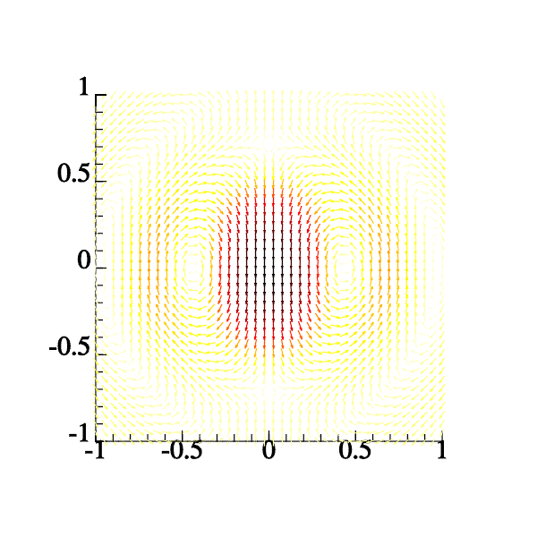
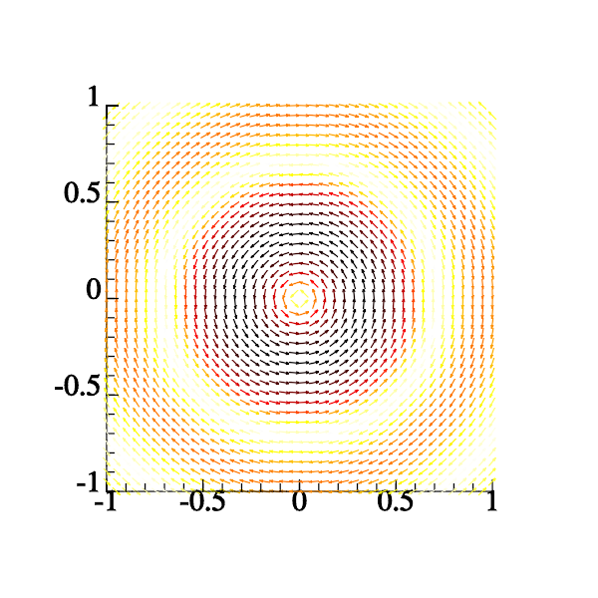
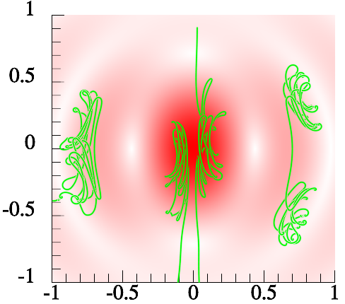
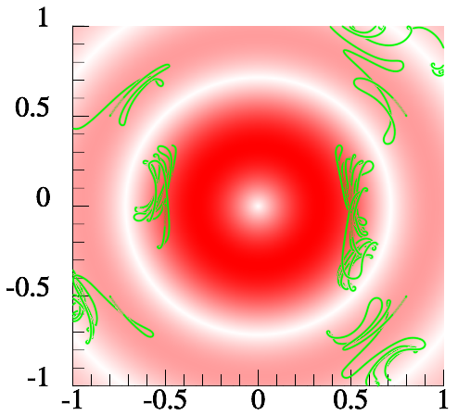
IAP RAS
Field Structures
E-dipole
H-dipole
Z
Z

Slide 29
IAP RAS
Converging E-dipole wave – Evgeny Efimenko (poster)
Nonlinear regimes of pair plasma generation
Gamma-ray source
Giant quasistatic magnetic field generation in
colliding laser pulses – Alexander Muraviov (poster)

Slide 30

IAP RAS
Thank you for your attention
For XCELS information:
www.xcels.iapras.ru

