Slide 1


Quantum vacuum optics:
An Overview
Tom Heinzl
Extremely High Intensity Laser Physics
Heidelberg
22 July2015
With T. Cowan, V. Dinu, A. Ilderton, M. Marklund, R Sauerbrey, U. Schramm,
O. Schroeder, H-P. Schlenvoigt, H. Schwoerer, G. Torgrimsson, A. Wipf

Slide 2
Outline
Introduction
Light-by-light scattering
Vacuum birefringence
  Theory
  Experiment
Summary and outlook

Slide 3
1. Introduction

Slide 4
ExHILs provide…
Large photon density
  Laser = external background field
    But: Radiation (back) reaction
  Laser = classical field
    Nonlinear classical physics
  Quantum regime: (strong-field) QED
    difficult to access
Strong fields
  Alternating and pulsed
  Near null (plane waves)
  Effects can be elusive
Goal: probe via
  Matter
  Light (this talk)
    Large flux/intensity
    Small X-sections

Slide 5
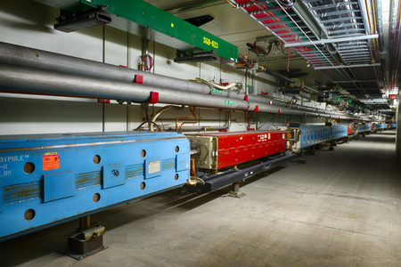
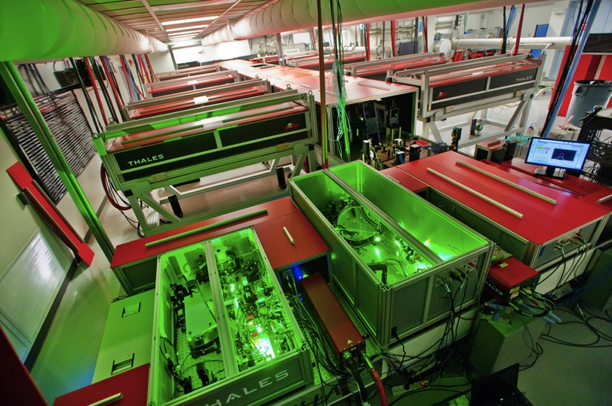
Intensity frontier
Small cross sections require large intensity
Example 1: Neutrino Physics
  World record proton beam
  @ Fermilab (08-08-2015)
  P = 521 kW
Example 2: Photon physics
  ExHILs
  P > 1 PW
fnal.gov/pub
newscenter.lbl.gov

Slide 6
Parameters I
Classical intensity parameter
  Photon density:
Quantum energy parameter
Quantum efficiency parameter
= rms laser field
= probe momentum

Slide 7
Parameters II
Energy vs. intensity
E-144
χ= 1
HIBEF I
(XFEL+opt)
HIBEF II
(XFEL+OPT)
All-optical

Slide 8
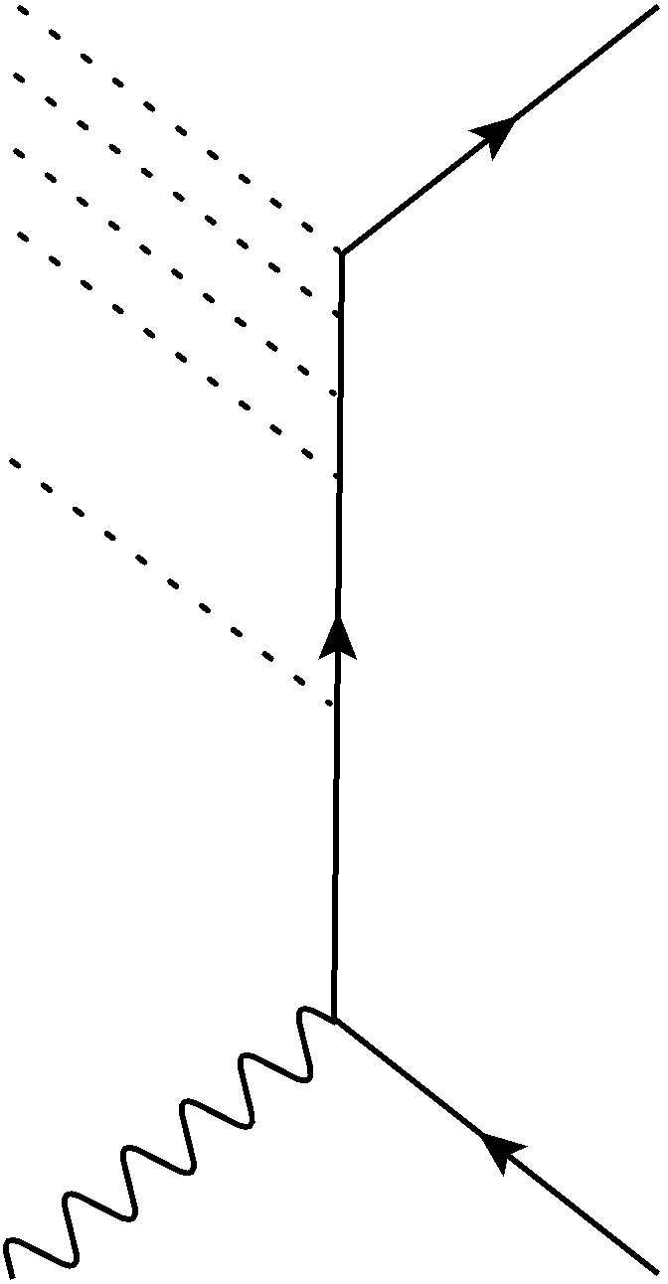
Moral
Quantum regime ( ) difficult to reach
  Energy thresholds
  Lack of high energy probes
  Recall SLAC E-144: !
Way out: leave tree level
  Quantum loops
  ‘Price’: suppression in
  Example:
  low-energy light-by-light
  (LBL) scattering

Slide 9
2. Light-by-light (LBL) scattering

Slide 10
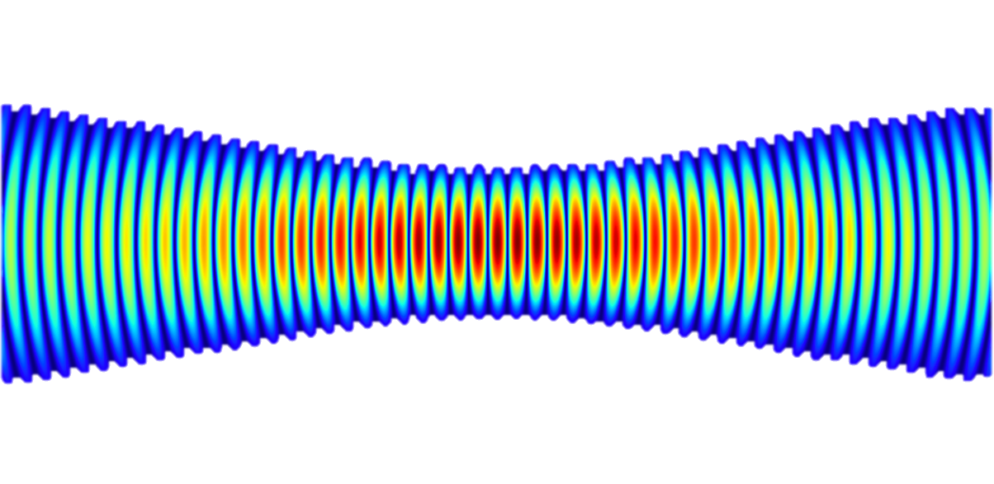


Idea
purely photonic probes and targets
  Target: ultra-intense optical laser focus
    “infinitely many” photons
  Probe: suitable photons (XFEL)
    High flux, so still “many” photons
  Result: very “few” scattered photons
Detect!

Slide 11
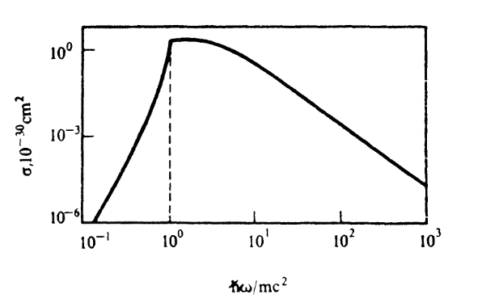
LBL scattering in QED
Feynman diagram:
Cross section:
Berestetskii, Lifshitz, Pitaevskii, 2nd ed., 1982

Slide 12
A word on rates and X-sections
X-sections
  depend only on
    Characteristics of interaction (coupling)
    Energy momentum & spin/polarisation transfer
  are independent of beam characteristics: flux/intensity
Rates do depend on flux/intensity
Formula:

Slide 13
Observation?
LBL scattering with real photons never observed
only for virtual photons – Delbrück scattering (off nuclei, ) (Jarlskog et al., PRD 1973; Schumacher et al., PLB 1975)
Difficulty:
  Low energy: flux large, but cross section too small
  High energy: cross section larger, but flux too small
  Current bound (laser regime) (Bernard et al., Eur. Phys. J, 2000)

Slide 14
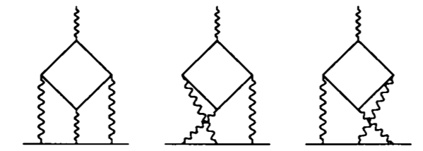
Remark
Indirect evidence for LBL scattering from anomalous magnetic moments (g – 2, virtual sub-diagrams)
Deviation from Dirac value 2 known to NNNLO (including 891 4-loop diagrams)
At NNLO: LBL diagrams contribute 30% of 1.18124…!
Jegerlehner, Nyffeler, arxiv:0902.3360
Laporta, Remiddi, PLB 1991

Slide 15
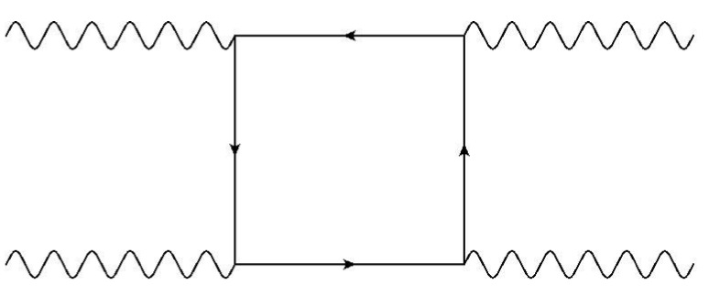
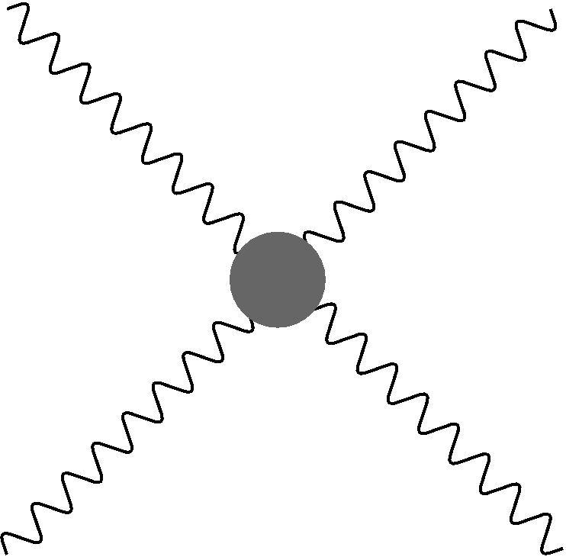
Effective Lagrangian
ExHIL +XFEL: Low energy
Use LO Heisenberg-Euler Lagrangian (1936)
With basic invariants:
: field strength tensor and its dual
HE vertex:
,
,

Slide 16
Low-energy X-section & rate
HE X-section for
Photon density
Rate (per time & volume)
Independent of !
( )
( )
Independent of

Slide 17
Signal estimate
Number of scattering events:
Use parameters:
Result:
  So 1 scattered photon per shot !
  So 10 events per second @ rep rate = 10 Hz !

Slide 18
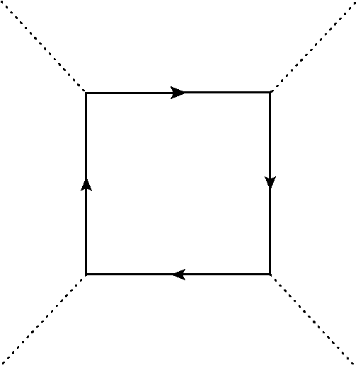
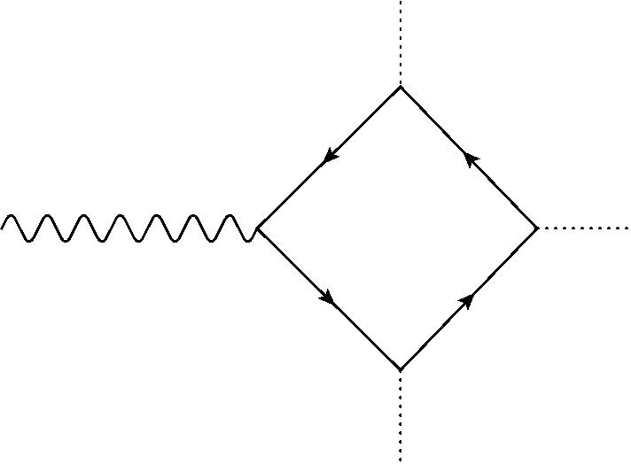
List of basic processes I
Vacuum persistence
Vacuum emission (aka 3-wave mixing)
Zero for PW
Nonzero for
Gaussian beam,
Standing wave, …
Schwinger 1951
ditto
Lundström et al., 2005
Monden, Kodama, 2011
Karbstein et al., 2014/15

Slide 19
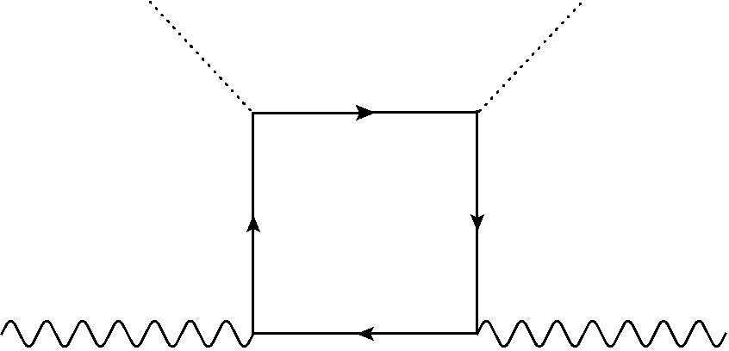
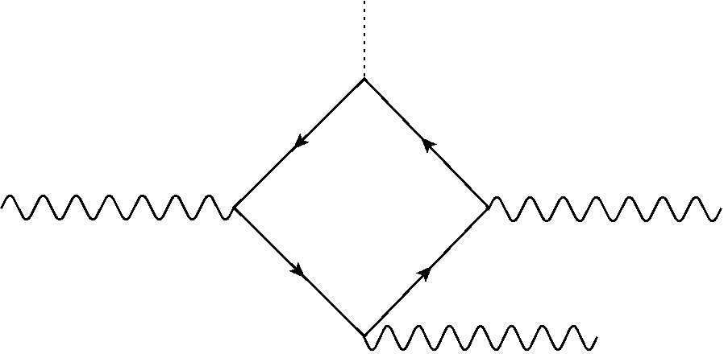
List of basic processes II
Photon laser scattering
Photon splitting
Generally nonzero
Toll 1952, …
Ditto
Adler 1971
Adler, Schubert 1996
Di Piazza, Milstein, Keitel 2007

Slide 20
“Quantum vacuum optics”
Although effects purely quantum (fermion loop)…
…phenomena similar to light-matter interactions
  Reflection (Gies, Karbstein, Seegert, New. J. Phys. 15, 2013; 17, 2015 )
  Refraction and birefringence (Toll, thesis, 1952)
  Diffraction (di Piazza et al., PRL 2006; King, di Piazza, Keitel, Nature Photon. 4, 2010)
  Light bending or aberration (De Lorenci, Klippert, PRD 2002)
  Absorptive effects due to PP (Toll, thesis,1952)
  Nonlinear (optics) effects
    photon splitting (Adler, Ann. Phys. 1971)
    wave mixing (Moulin, Bernard, Opt. Commun. 1999, Lundström et al., PRL 2006)
  …

Slide 21
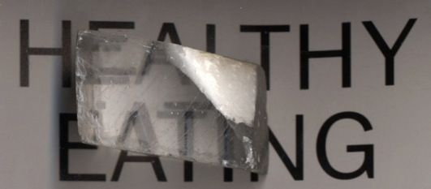
3. Vacuum Birefringence
(“double vision”)
Calcite crystal

Slide 22
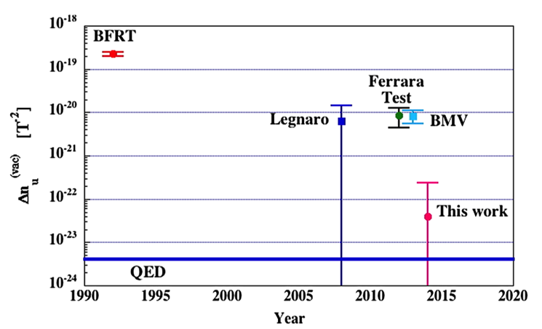
Mature subject – (Some) references
Theory
  J. Toll, PhD thesis, Princeton, 1952
  R. Baier and P. Breitenlohner, Nuovo Cim., 1967
  N. Narozhny, JETP, 1968
  E. Brezin, C. Itzykson, PRD, 1970
  TH, B. Liesfeld, K.-U. Amthor, H. Schwoerer, R. Sauerbrey and A. Wipf, Opt. Commun., 2006
  G. Shore, NPB, 2007
  V. Dinu, TH, A. Ilderton, M. Marklund and G. Torgrimsson, PRD, 2014 (I & II): FS effects
  …
Experiment
  Zavattini et al., PRD 90, 2014
  Rizzo et al., BMV, Eur. Phys. J. D 68, 2014
  (all with static B field)
  Laser: HIBEF @ DESY (in preparation)

Slide 23
3. Vacuum birefringence
3.1 Theory

Slide 24
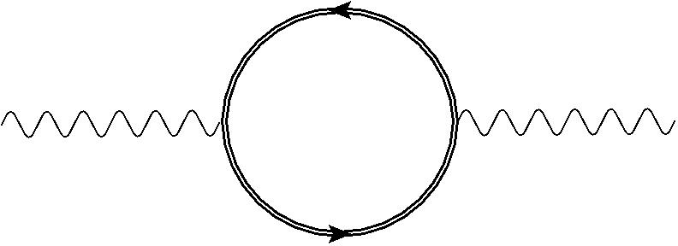
‘Traditional’ analysis (Toll 1952)
VacPol tensor
  Two nontrivial eigenvalues
  with energy momentum tensor
  Two dispersion relations (‘deformed LC’)
  Two indices of refraction (Toll 1952; Narozhny 1968; Brezin, Itzykson 1970)

Slide 25
Scattering analysis I
(Dinu, TH, Ilderton, Marklund, Torgrimsson, PRD 89, 2014)
Lowest order LBL scattering (off BG)
Vacuum birefringence: polarisation flip – forward amp nonzero:

Slide 26
Scattering analysis II
Standard Feynman rules yield equivalent rep.s:
with polarisation tensor
Formalism: Davila, Schubert, Trejo, Int. J. Mod. Phys. 2014

Slide 27
Scattering analysis III
Non-flip amplitude:
Flip amplitude:
Ellipticity:
Observable: fraction of photons with flipped pol^{n}
0 for Born-Infeld !
Phase shift
Intensity ratio

Slide 28
3. Vacuum birefringence
3.2 Experiment

Slide 29
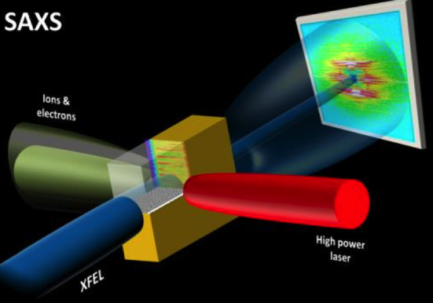
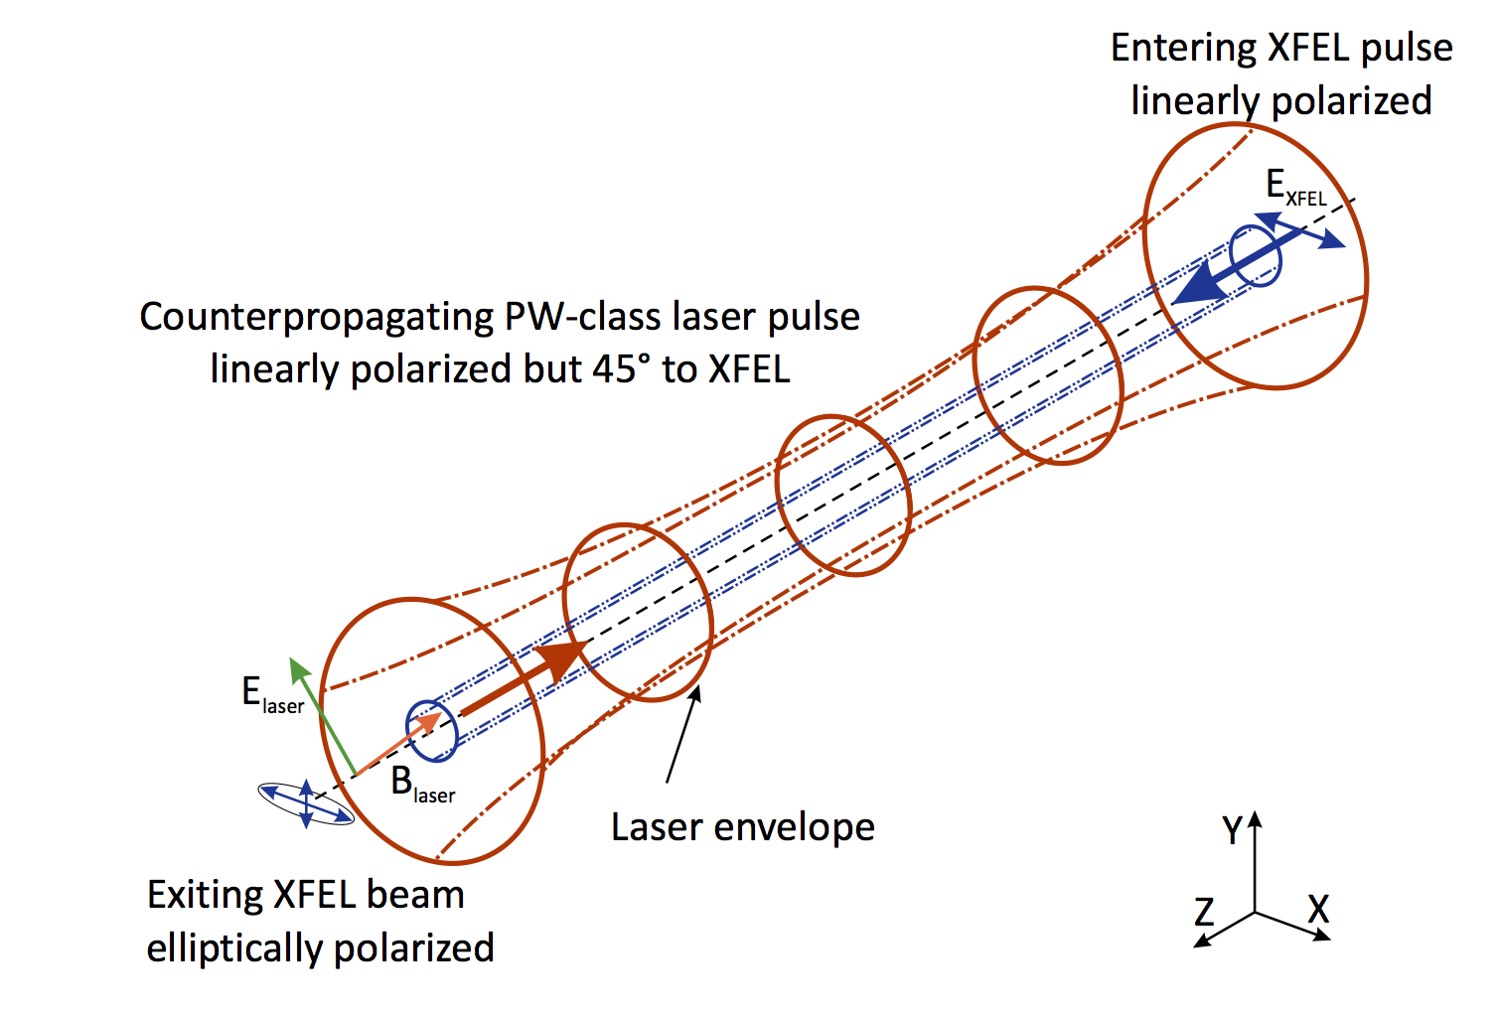
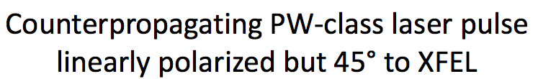
Experiment: HIBEF @ DESY
HIBEF @ DESY
Avoid debris:
Use light rather than matter target
Setup:
Cowan, TH, Sauerbrey, Schlenvoigt, Schramm, to appear, 2015

Slide 30
Exp. feasibility (TH et al., Opt. Commun., 2006)
Rewrite ellipticity
Optimal scenario: XFEL ( ) & HP laser
  HIBEF ( ):
  ELI ( ):
  X-ray polarimetry:
    Current record in polarisation purity: @ 6.5 keV ( @ 12.9 keV) (Marx, Uschmann, Paulus et al., PRL 110, 2013)
feasibility limit

Slide 31
Influence of BG
Non-constant BG, e.g. pulsed PW: finite duration
Non-forward (reflection, deflection,…)
  momentum transfer
  F.T. of :
  ‘intensity form factor’
  Enlarged phase space:
(Karbstein, Gies,…
MPIK group)

Slide 32
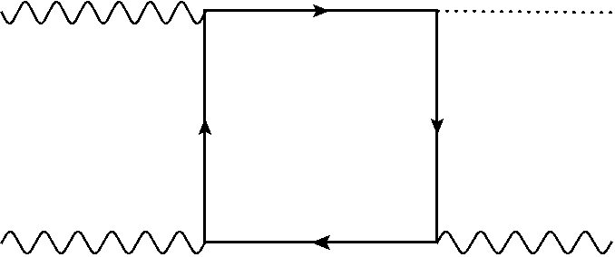
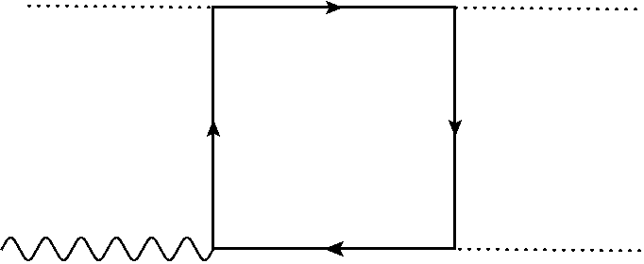
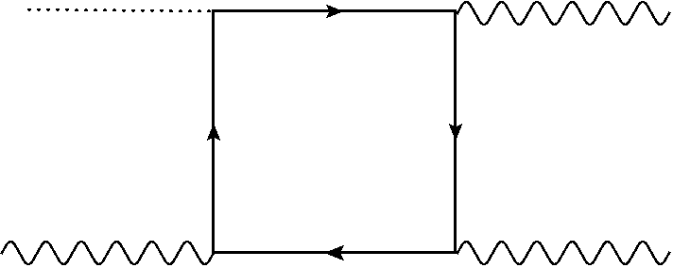
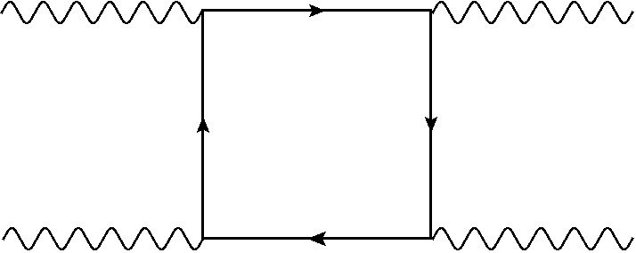
Additional contributions
QM: need to sum over all ‘histories’
= Transition amplitudes
Should be suppressed compared to XL scattering
X-photon splitting
L-photon merging
X-photon merging
XX scattering

Slide 33
Additional effects
Finite size:
Dinu, TH, Ilderton, Marklund, Torgrimsson, PRD 90, 2014
B. King, C. Keitel, New. J. Phys 14, 2012
talk by F. Karbstein
High energy:
Dinu, TH, Ilderton, Marklund, Torgrimsson, PRD 89, 2014
Higher orders in field strength (or ):
TH, O. Schroeder, J. Phys. A 39, 2006
talk by B. King
Experimental background/noise/issues:
T. Cowan, TH, R. Sauerbrey, H.-P. Schlenvoigt, U. Schramm, to appear, 2015
poster by H.-P. Schlenvoigt

Slide 34
Summary and Outlook

Slide 35
Summary & Outlook
Light-by-light scattering:
  Low-energy quantum regime
  small cross sections:
  but within reach!
  Wealth of effects: quantum vacuum optics
  Perform systematic theoretical study (form factors!)
  Perform experiments (e.g. @ DESY-HIBEF)
    Vacuum birefringence
    Vacuum reflection
    …

Slide 36
Thank you very much…
…for your attention!

Slide 37
Appendix

Slide 38
Some history
Halpern 1934:
Euler, Kockel 1935:
    “Halpern (1934) and Debye (in a discussion with Prof. Heisenberg) have pointed out that according to Dirac’s theory there must be scattering of visible light by light. Namely, there are processes in which two light quanta virtually produce a pair (electron and positron) which annihilates immediately afterwards. These processes … can happen even if there is not enough energy to produce a real pair.”
…

Slide 39

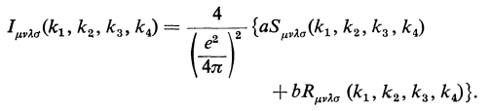
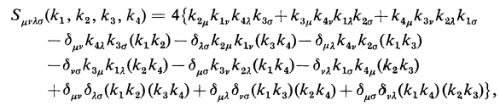
LO Textbook theory I (Akhiezer and Berestetskii)
Ingredients: 4 wave and 4 polarisation vectors, so 4th rank tensors…

Slide 40
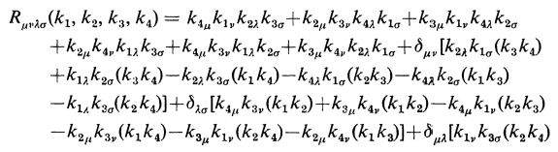
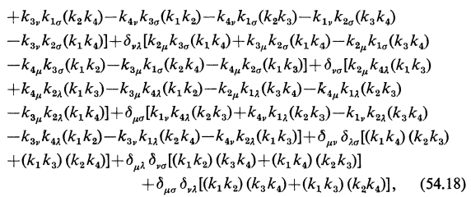
LO Textbook theory II (Akhiezer and Berestetskii)

Slide 41
Finite size effects: Gaussian beams
finite longitudinal and transverse size ( , ):
  Rayleigh length and waist:
  Small parameter: beam divergence
  Paraxial approximation:
  New phase shift:
  Dependence on impact parameter
  Most realistic: finite space-time extent
  Dependence on pulse duration
L
X

Slide 42
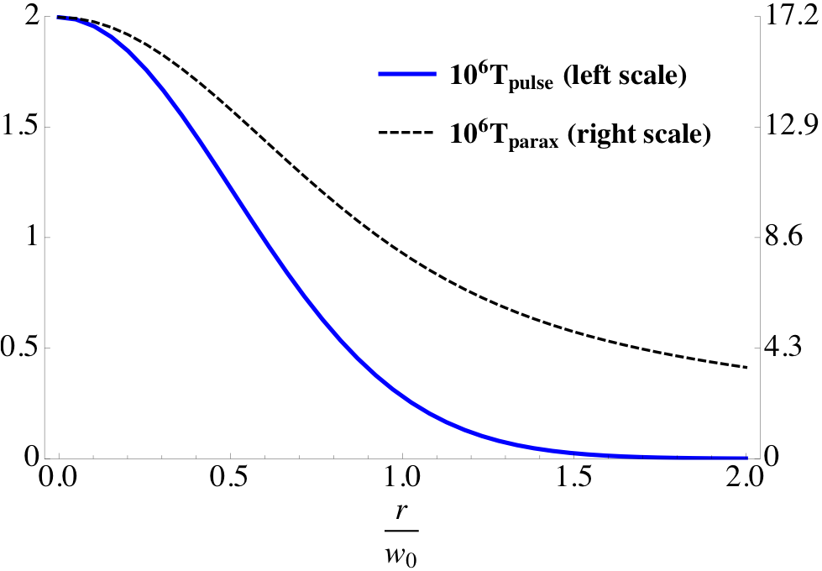
Finite pulse effects
Graph (Dinu, TH, Ilderton, Marklund, Torgrimsson, PRD 89, 90, 2014)
    Flip amp. A₁₂ – paraxial vs. pulsed Gaussian beam
Pulse
Parax.
10⁶ A₁₂
b/w₀

Slide 43
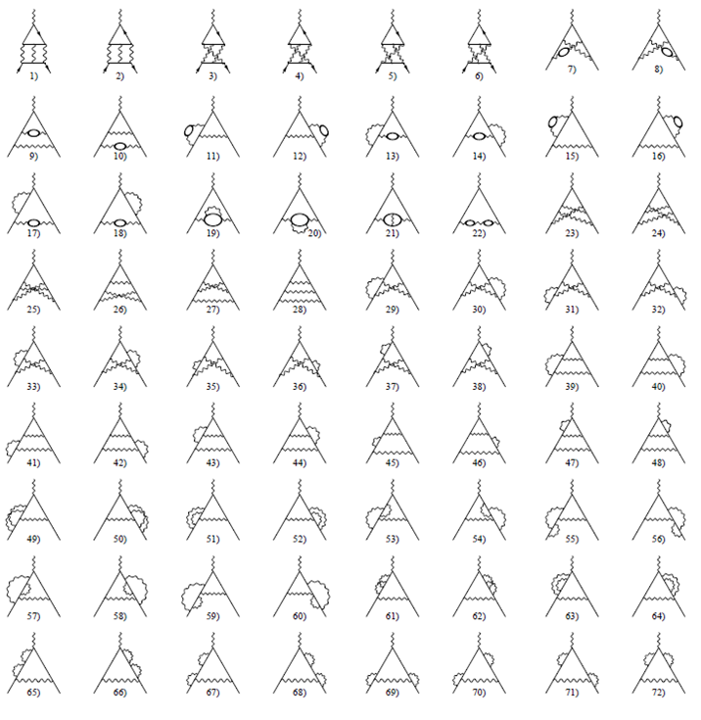
g – 2: NNLO

Slide 44
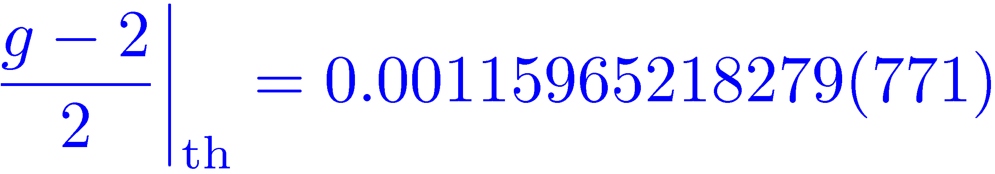
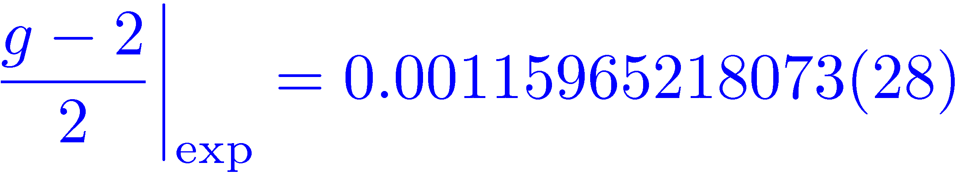
LBL and g – 2
Numerical values:
  NB: additional LBL terms at (numerically known) NNNLO
(Th: Kinoshita et al., 2008)
(Exp: Gabrielse et al., 2008)
(LBL contribution = 0)
2
3
4

Slide 45
Vacuum Emission
(work in progress)

Slide 46
Scattering amplitude I
LO Feynman diagram:
Scattering amplitude:

Slide 47
Scattering amplitude II
Feynman rules yield:
Zero for plane waves where invariants
Use e.g. Gaussian beams instead…

Slide 48

Gaussian beams
recall parameter: beam divergence
Field strength tensor = “deformation” of PW
Invariants nonzero:

Slide 49
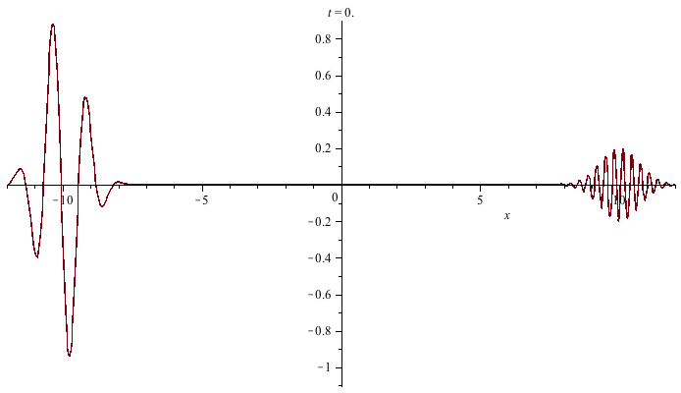
Colliding pulsed plane waves
Eternal lifetime – unrealistic !

Slide 50
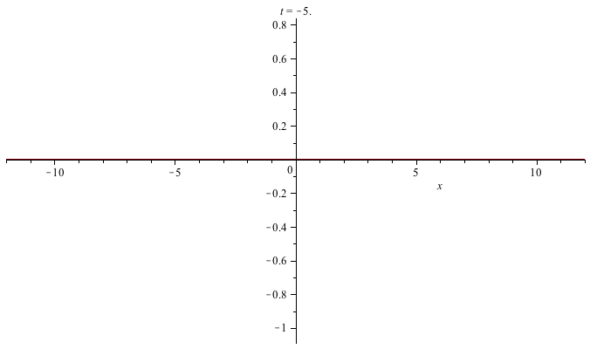
Colliding Gaussian beams I
Good space-time overlap

Slide 51
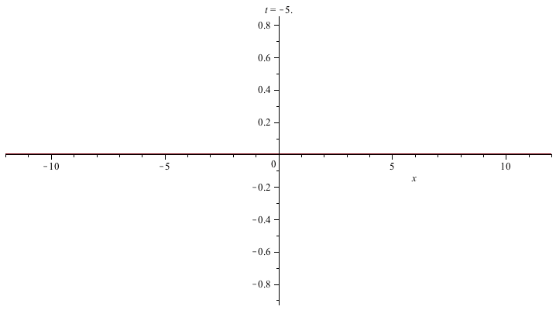
Colliding Gaussian beams II
Bad space-time overlap – jitter !

