Slide 1
Technology development for OPCPA multi-PW laser system
Marco Galimberti
Central Laser Facility
Science and Technology Facilities Council
Rutherford Appleton Laboratory

Slide 2
Summary
Vulcan 10PW (now 20PW) Project
Technology Development Plan
Conclusion

Slide 3
Vulcan 10PW Project
Target area Petawatt
TAP 10
1 PW + 10 PW
Existing Vulcan beam lines
10 PW Front End
1J, 910nm, 150nm BW 3ns
kJ OPCPA amplification stages
Beam propagation to TAP 10
Seed generation
KD*P
Compressor
300 J , 30 fs
Stretch
OPCPAs (LBO) 1J amplification
KD*P
KD*P
>500 J
Beam propagation to HIA
High Intensity Area
HIA
10 PW + KJ long pulse
OPCPA Pump laser
Additional Vulcan
2 x 1.2 kJ 3 ns
208 beam lines
1x 30J small beamline
SHG
527 nm
600 J
Based on a combination of LBO and KD*P using OPCPA
Crystal- KD*P, Largest available
Meets aperture requirement BW >150 nm
Implies 910 nm operation
SHG
527 nm
600 J
SHG
527 nm 12J
I. N. Ross et al., Opt. Commun. 144, 125 (1997)
A. Dubietis et al., Opt. Commun. 88, 437 (1992)

Slide 4
K*DP - Small Signal Gain
10PW
Non-colinear
20PW
colinear

Slide 5
DKDP 80%
Three stages simulations
Shortest pulse achievable:
FWHM = 11.4 fs

Slide 6
20PW Specifications
Partially Deuterated KDP (80%)
Central wavelength: 957nm
Bandwidth: 220nm
Pulse Length: 20fs
Final Energy: 400J

Slide 7
Technology Development Plan
Gratings
Coatings
Component Test Lab
High deuterated DKDP Crystals
High Repetition Rate Disk Amplifier
Coherent Beam Recombination

Slide 8
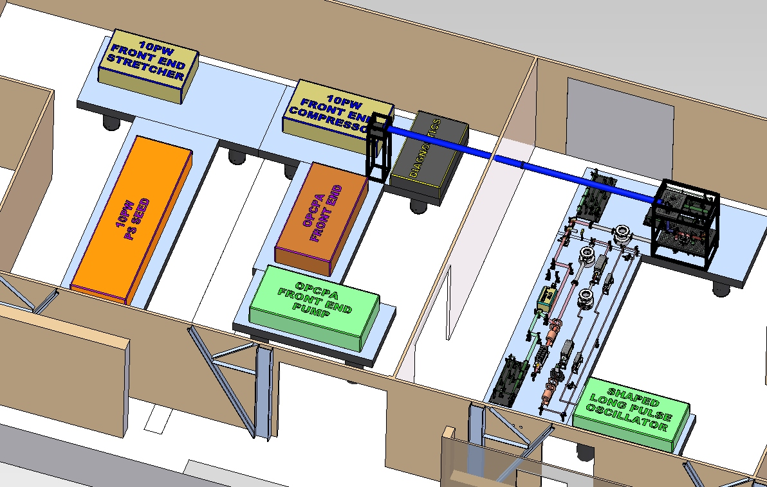
Component Test Lab
Existing 10 PW Front End
OPCPA stages based on LBO
New Amplification stage based on DKDP
Pump: 15J
λ_{P}=527nm
∆T=3 ns
Output: ~6J
λ_{S}=910nm
Δλ ~150nm
Broad band Seed pulse ~1 J λ=910nm
Frequency Doubling and OPCPA
Layout Scalable to Large Aperture

Slide 9
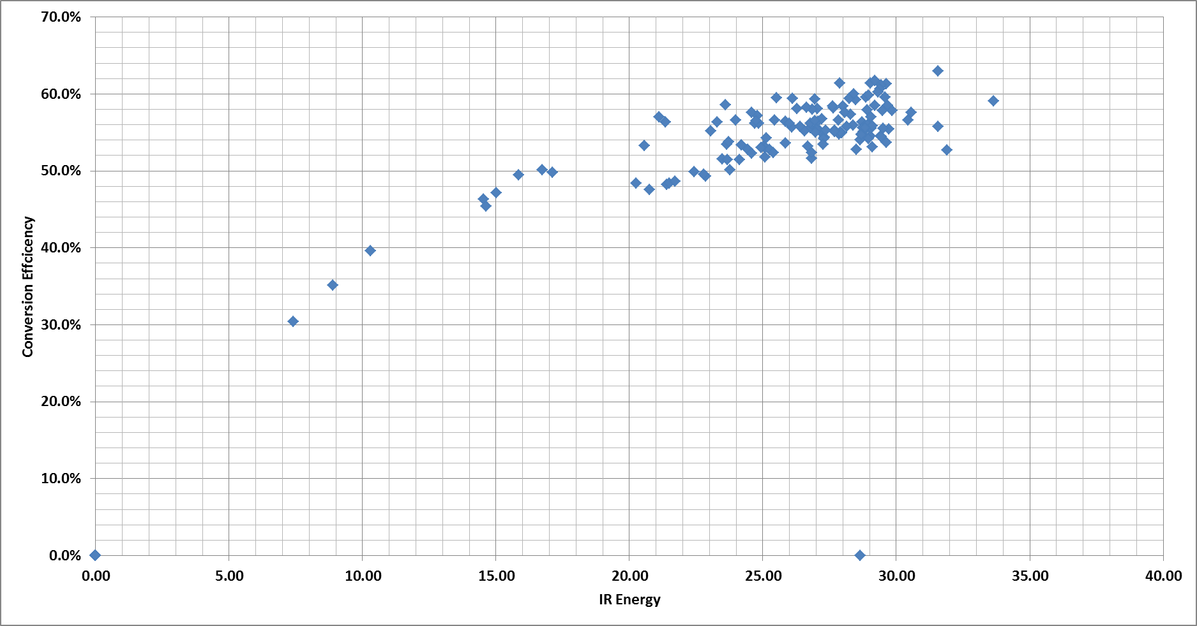
SHG Conversion Efficiency
Referred to Green Energy on the OPCPA Crystal

Slide 10
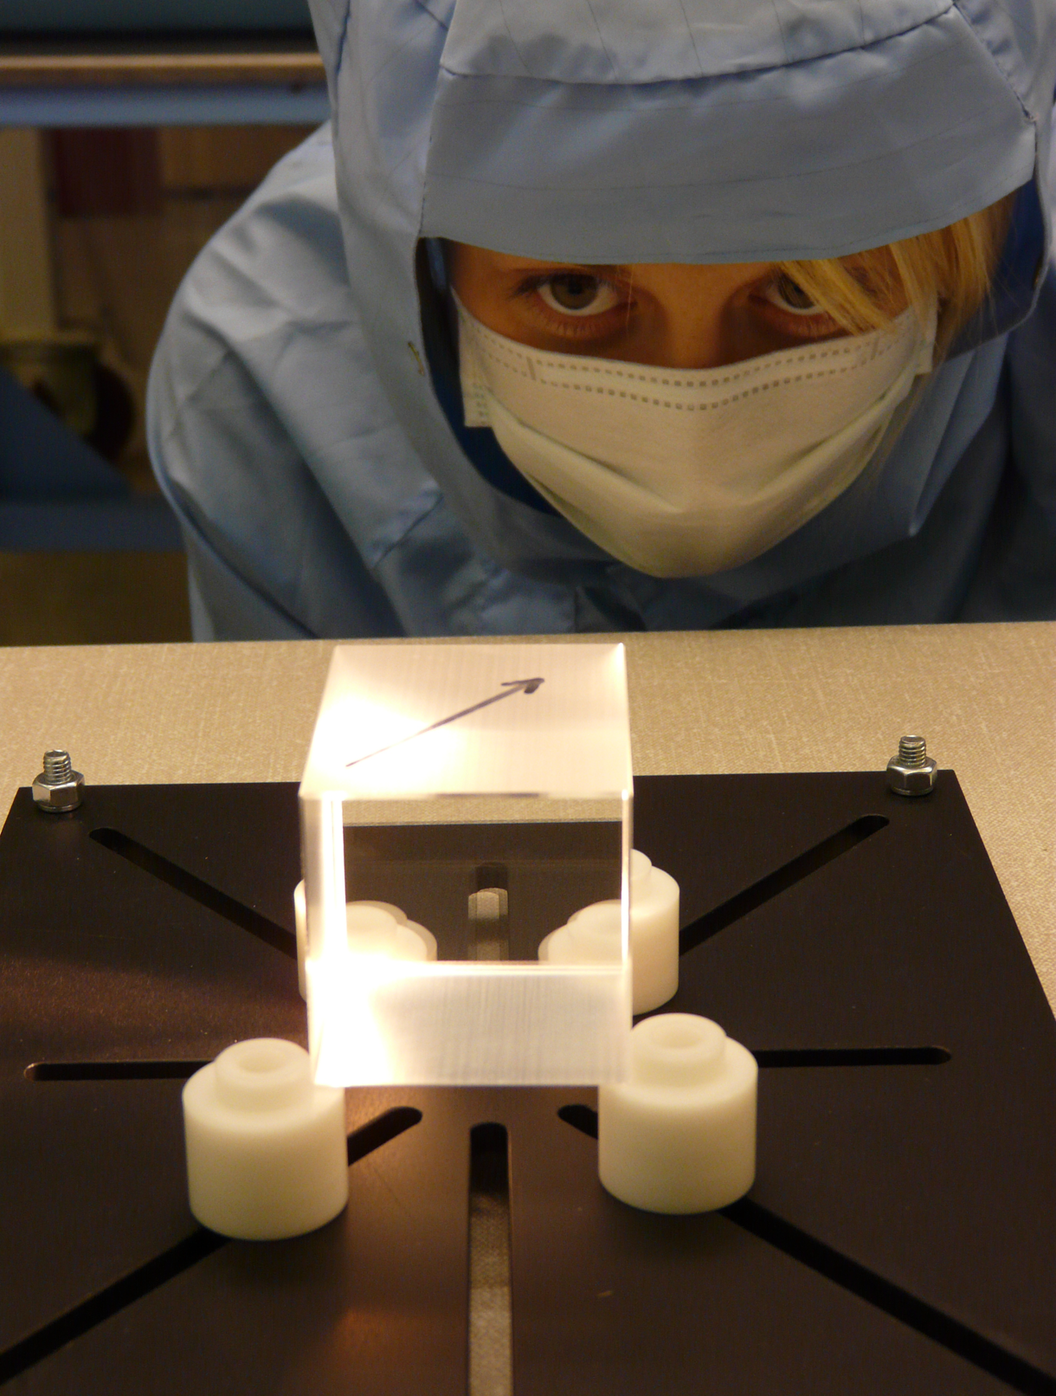
Small DKDP Crystal Tests
Will test three crystals
80% deuteration - Slow grow method
87% deuteration
100% deuteration
80% deuteration DKDP Crystal spec
Deuteration level | 80(+/- 1)%
Transmitted measured wavefront | <Lambda/10
TWF Gradients | <Lambda/4/cm
Dimensions | 50x50x64 mm

Slide 11
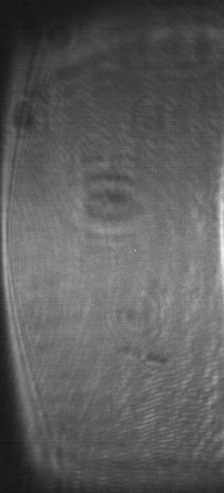
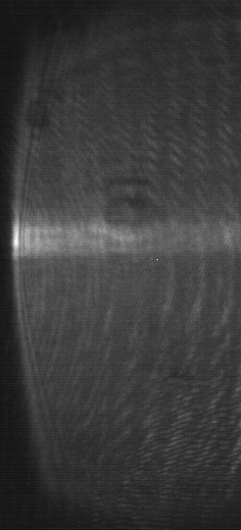
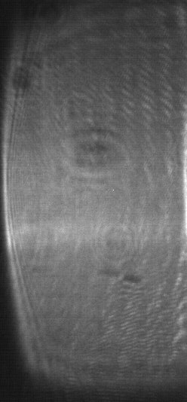
Phase Matching K*DP 80%
Signal Near Fields
Used cylindrical lens on both the signal and pump beams to find the phase matching angle.
Position of stripe moves with crystal angle, phase matching achieved when stripe is in centre of near field.

Slide 12
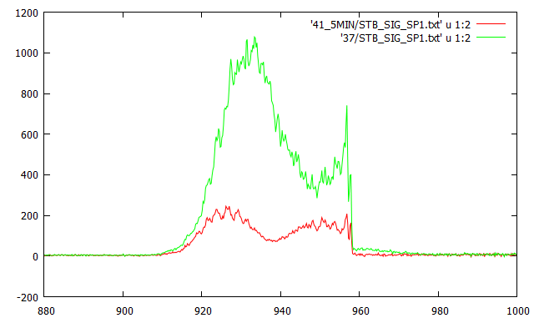
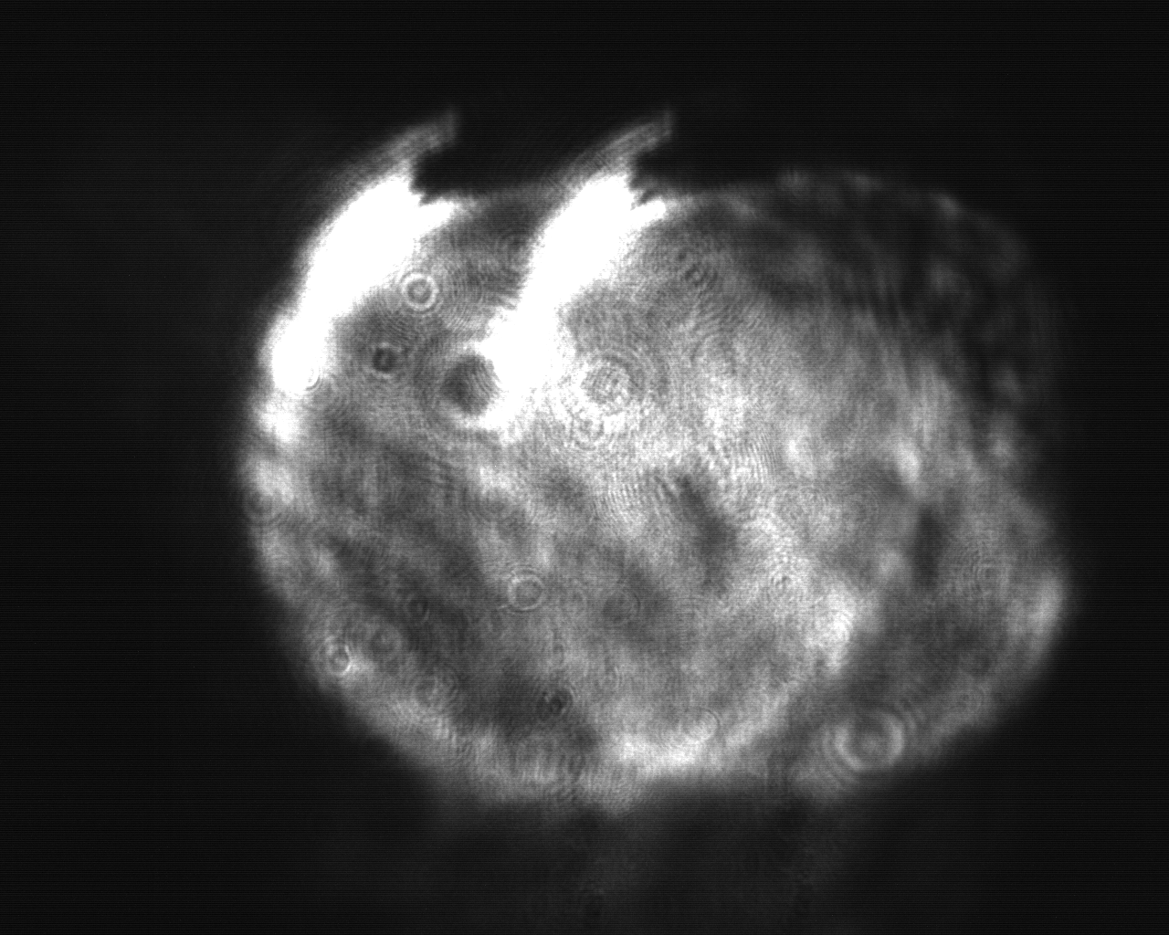
Amplification
With 40mJ incident have achieved 0.9J with 16J in the green.
Green trace amplified
Red trace seed
Intensity [A.U.]
Wavelength [nm]
Near-field image of signal.
Double image due to coatings.
Can see some damage to mirrors at top

Slide 13
Coherent beam recombination

Slide 14
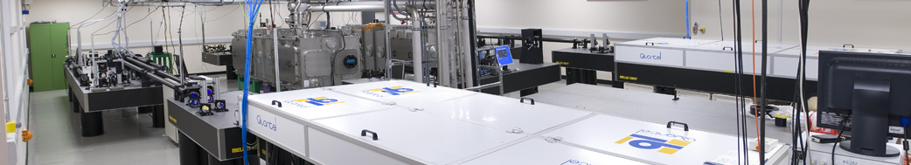
Gemini laser facility
Two synchronised CPA beams, independently configurable
    Energy on Target 15 J
    Pulse Duration on Target 30 fs
    Focal Spot Size 2 μm
    On Target intensity 10²¹ W/cm²
    Shot Repetition Rate 20 seconds
    Pulse contrast (ASE) 10¹⁰

Slide 15
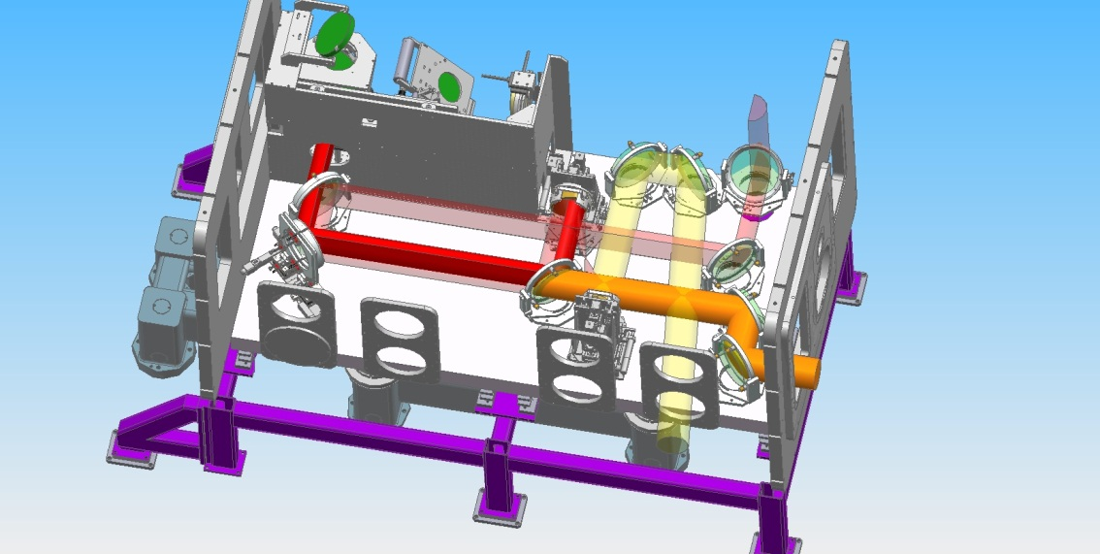
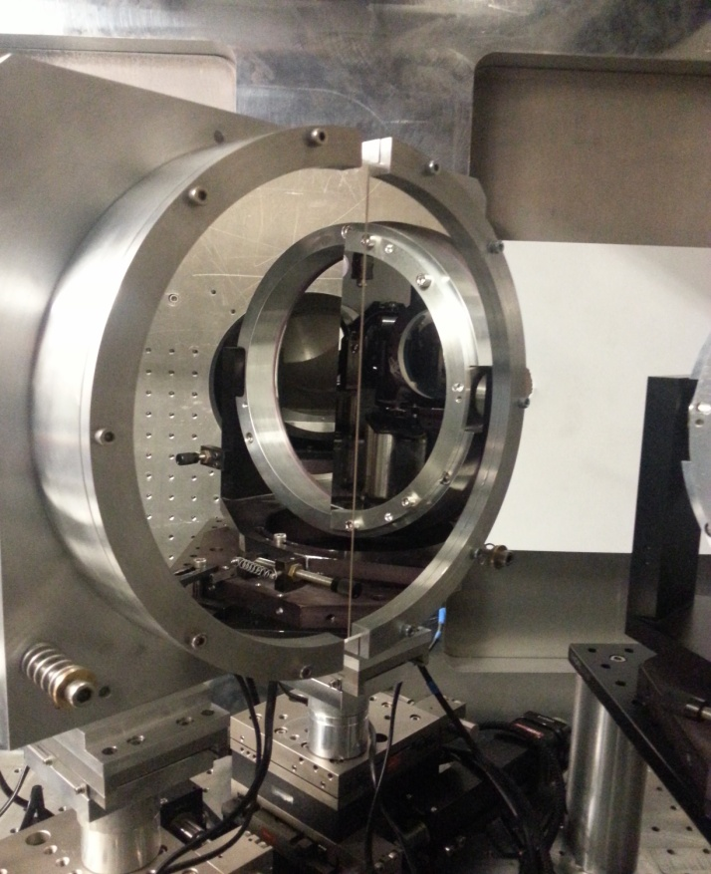
Gemini Experiment
Beam 2
Beam 1
150mm
OAP 1
OAP 2
Diagnostics
Serrated D-Shaped apertures installed before VSF to compressors

Slide 16
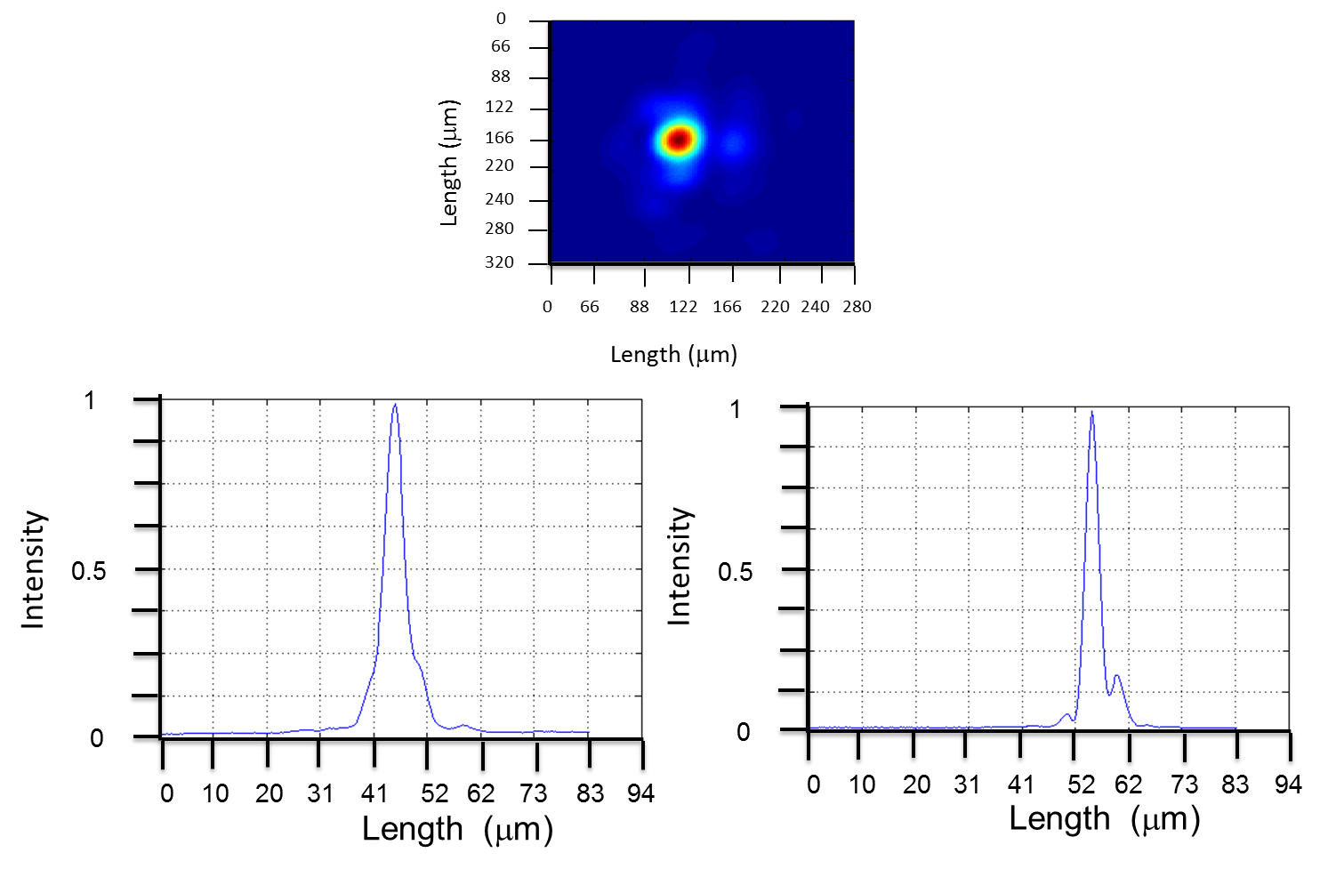
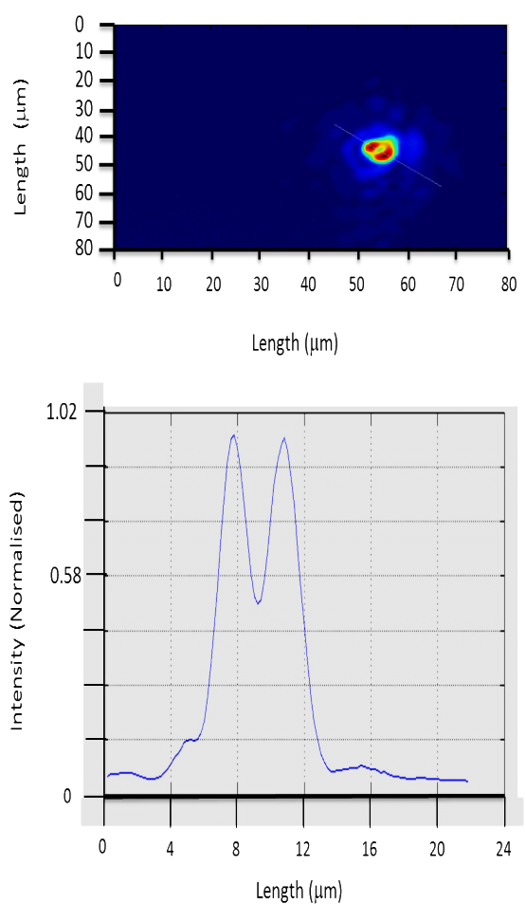
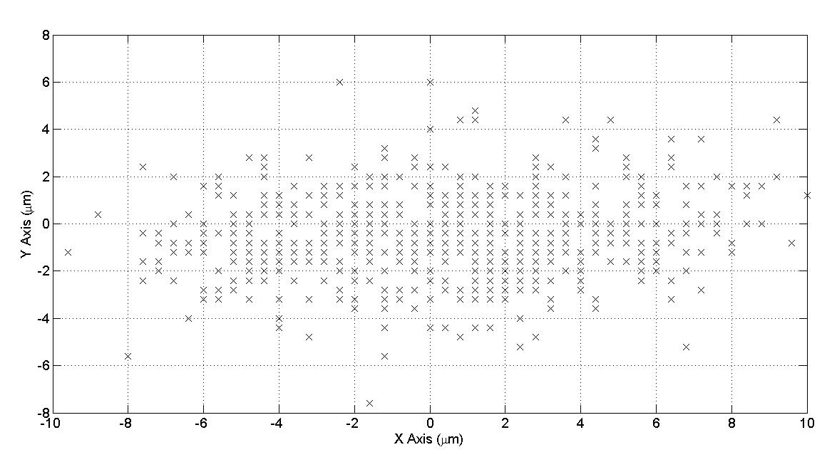
Results
In Phase
Problem identified on the experimental campaign:
Beam pointing stability need to be improved;
Relative phase between the two beam need to be stabilized actively;
Alternative relative phase measurement should be investigated.
Beams 1 and 2 pointing stability
π Phase

Slide 17
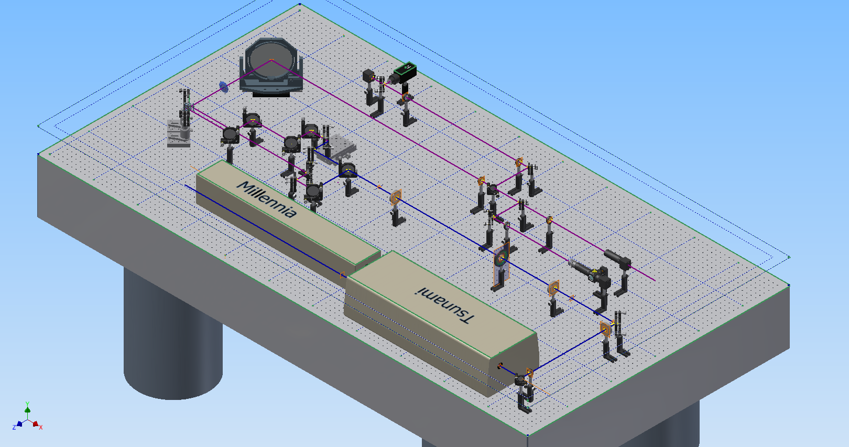
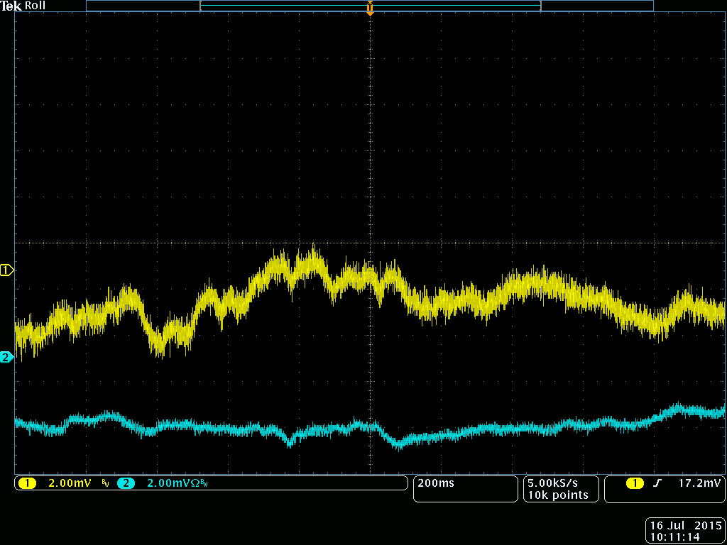
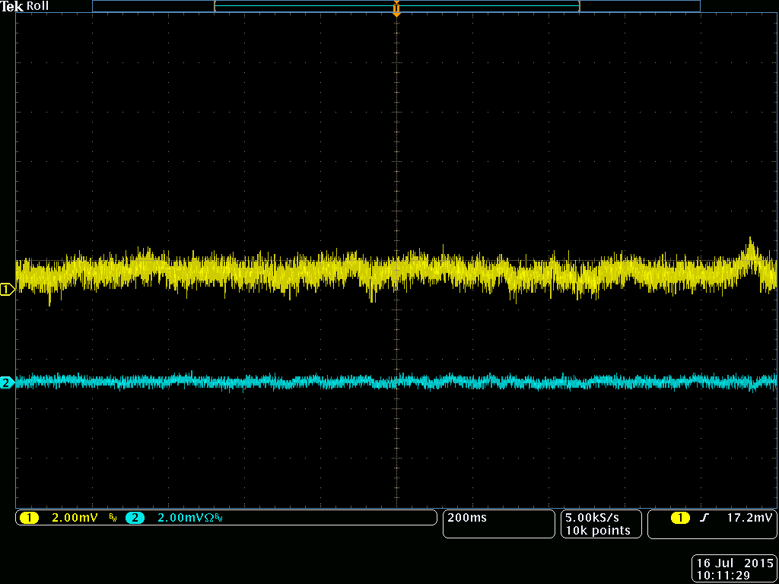
Current development
A new laboratory has been setup.
The layout is more similar to the Gemini experiment.
Develop relative phase measurement and stabilization loop between the beams
Loop Off
Loop On
Develop fast beam pointing stabilisation using relatively large (50mm) piezo driven mirror
2s
2s

Slide 18
Conclusion
With the work done so far we are confident to be able to achieve 20PW
Currently under testing different partial deuterated crystals
We are working on the technology for the 100PW class lasers

