Slide 1
Neutrinos theory session summary
Walter Winter
DESY, Zeuthen, Germany
WIN 2015
MPIK Heidelberg, Germany
June 8-13, 2015
TexPoint fonts used in EMF: AAA

Slide 2
Contents
Lepton mixing, and the “vicious” phases
Theory of neutrino mass and flavor
Sterile neutrinos
Particle physics with cosmic neutrinos & new ideas

Slide 3

Lepton mixing, and the vicious phase(s)
(… which are an artefact of baryogenesis,
something divine?)
K. Scholberg

Slide 4
Can the devil have interfered with baryogenesis or EWSB?
The Creation of the World
(Genesis 1)
1 In the beginning, God created the heavens and the earth.
2 The earth was without form and void, and darkness was over the face of the deep
“who is called the devil and Satan … was thrown down to the earth”
(Revelation 12:7-9)
Must have happened after Genesis 1:1!
Conclusion: The devil cannot have interfered with baryogenesis
(in his role as devil)
0 Inflation, Baryogenesis, EWSB
CMB,
structure
formation?
K. Scholberg

Slide 5
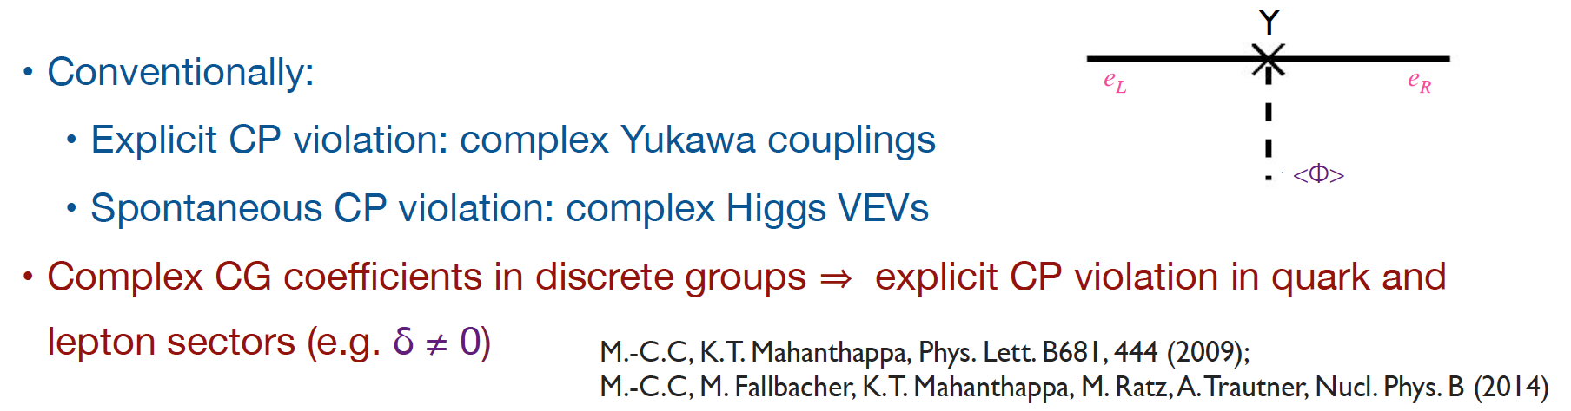
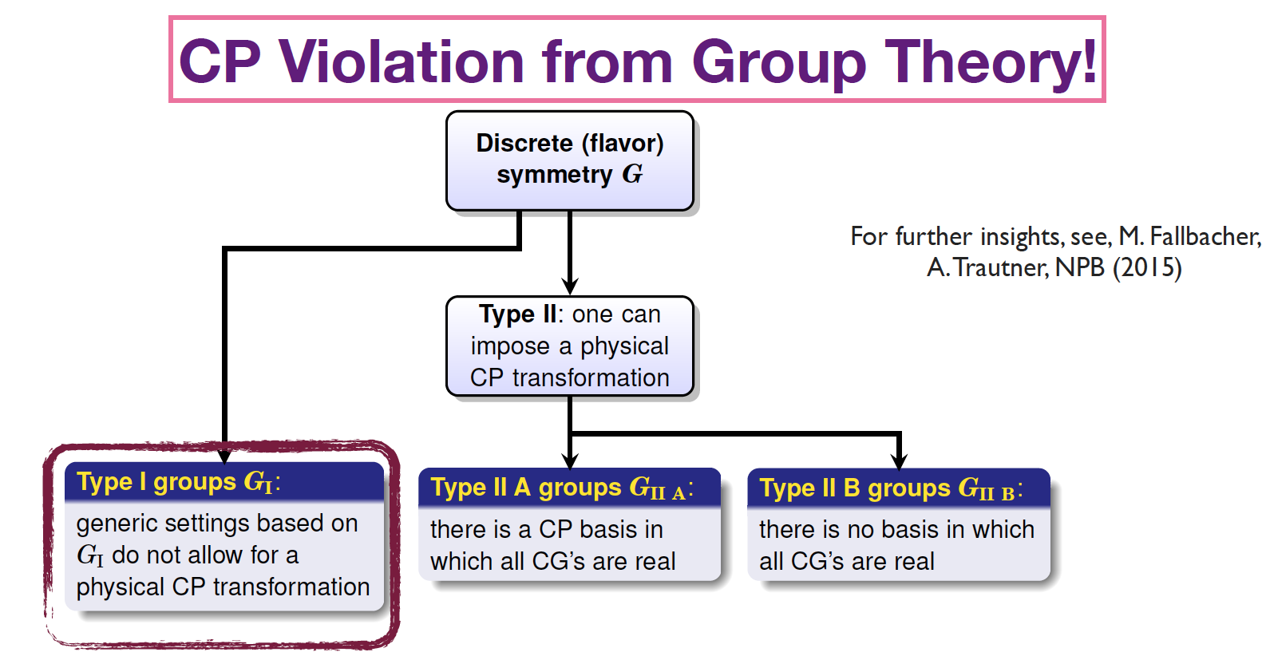
Where does CP violation actually come from?
…
Aka “geometric CP violation”?
Example discussed based on Δ(27)
Physical
CP violation
(all groups)
M.-C. Chen

Slide 6


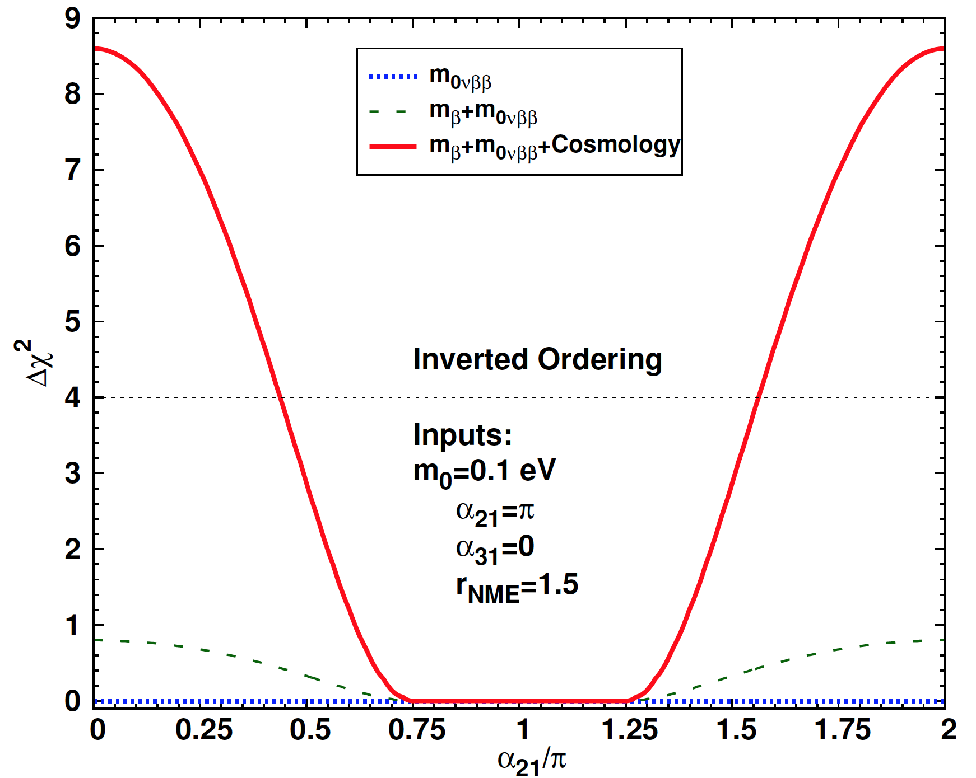
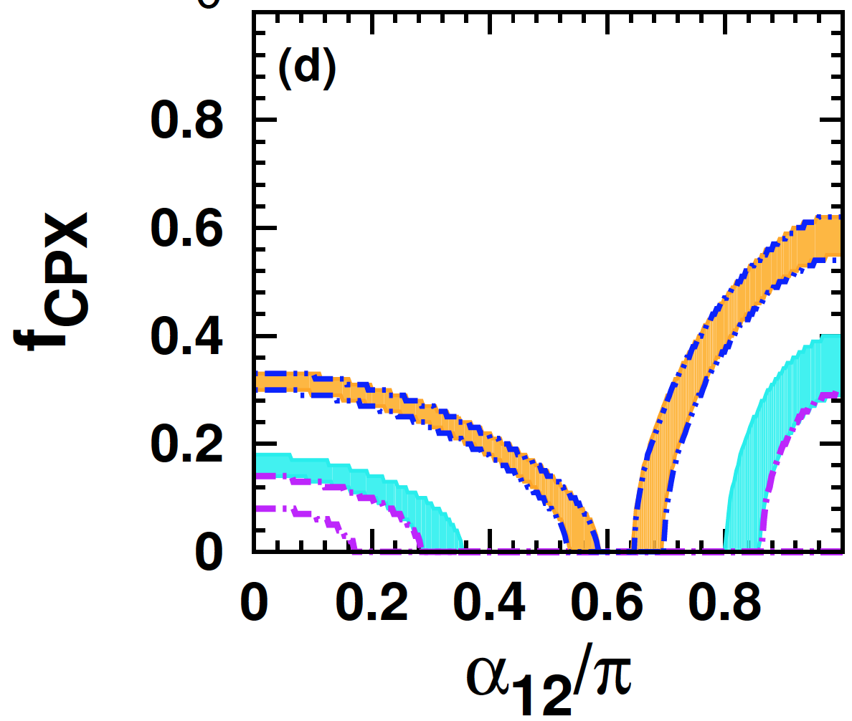
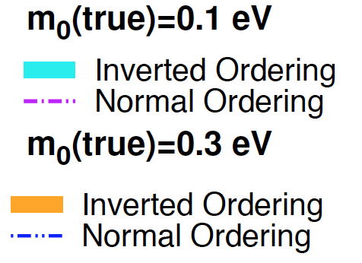
Are the Majorana CP phases accessible?
The potentially interesting phase
The “no go” phase
(attached to θ₁₃)
Need:
  Very good 0νββ measurement (1t Xe?)
  Optimistic error on nuclear matrix
  elements (at least 50%?)
  Precise neutrino mass measurenent
  from cosmology (at least 0.05 eV)
r_{NME}=2.0, from
arXiv:1402.6014
H. Minakata

Slide 7
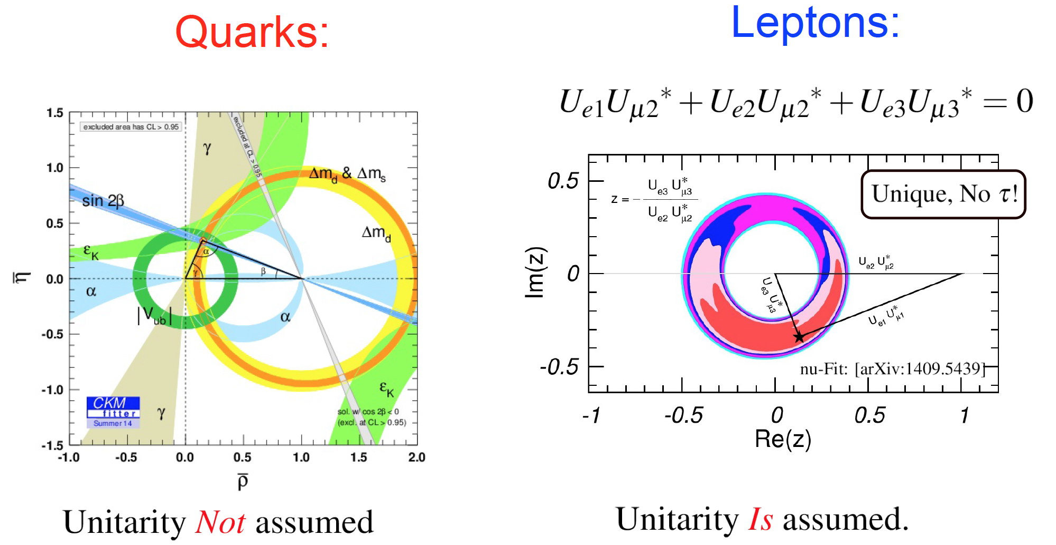
Unitarity triangles
…
S. Parke

Slide 8
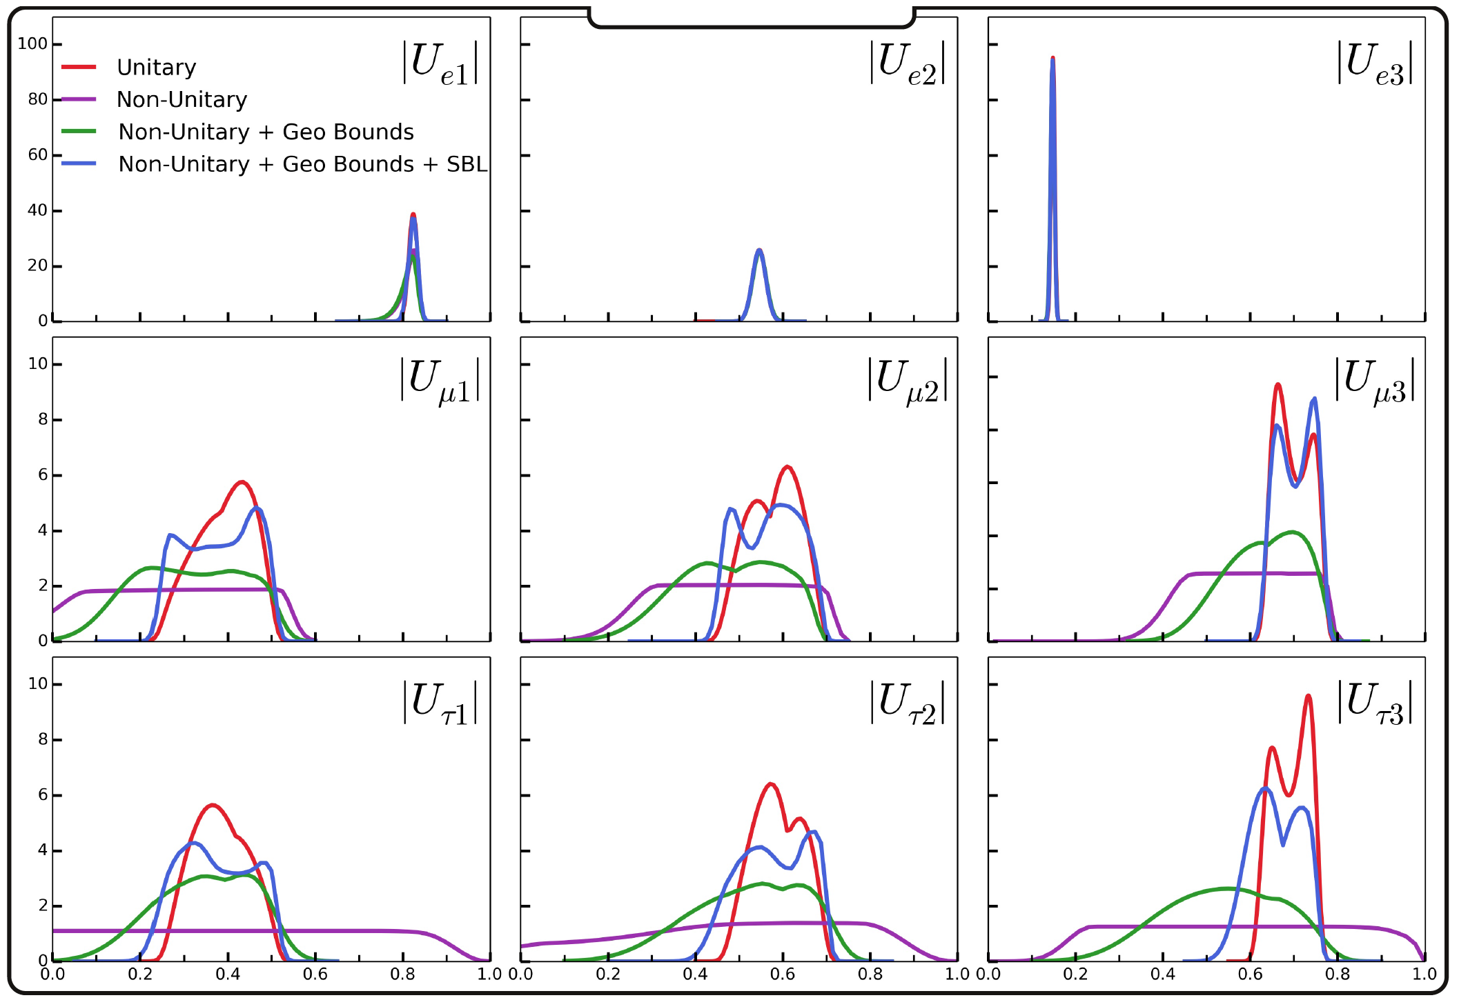
Unitarity, abandoned?
…
S. Parke

Slide 9
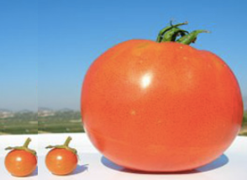
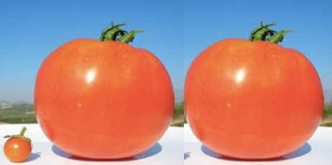
Theory of neutrino mass and flavor
… or: how to predict
vs.
K. Scholberg

Slide 10
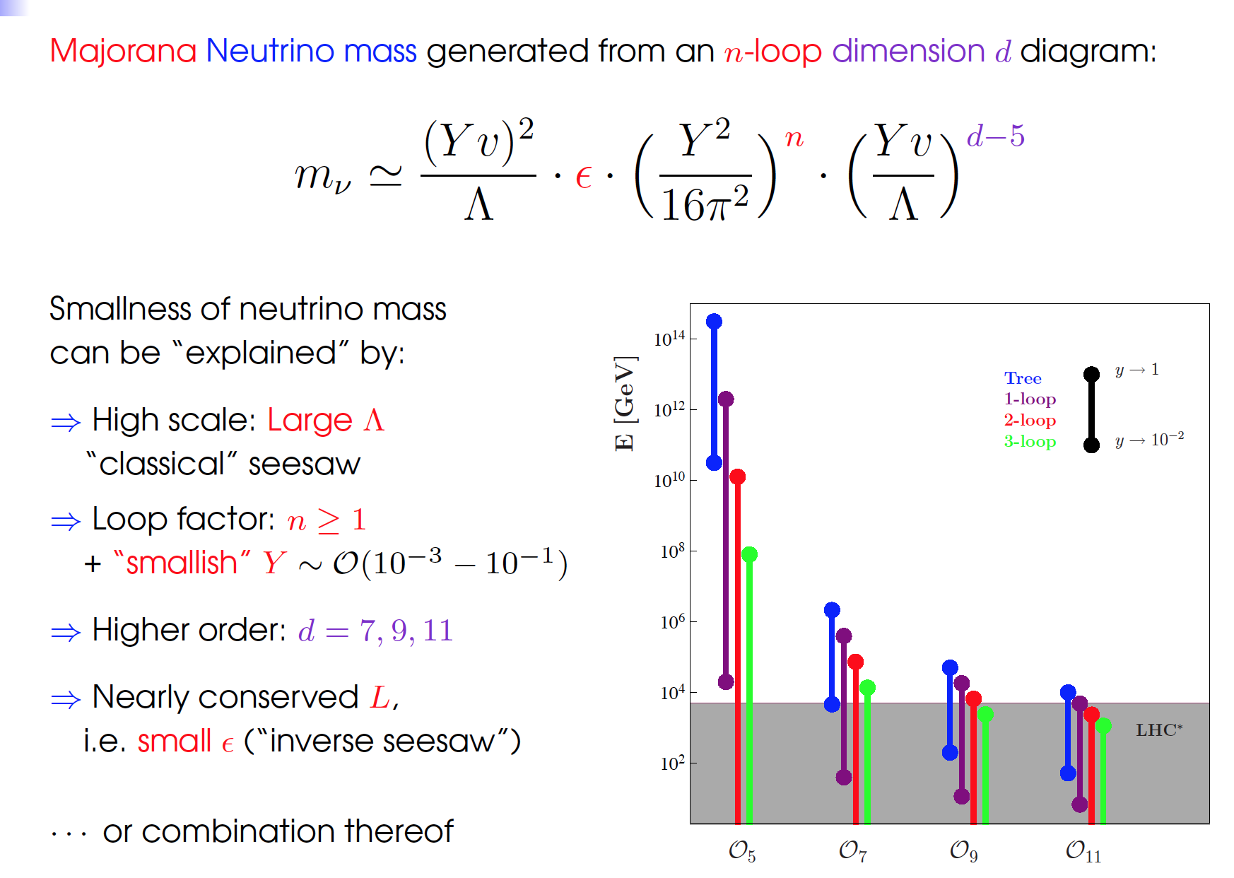
How to make the neutrinos extremely light
See plenary by
M. Hirsch
See talks by J. Smirnov, S. Patra

Slide 11
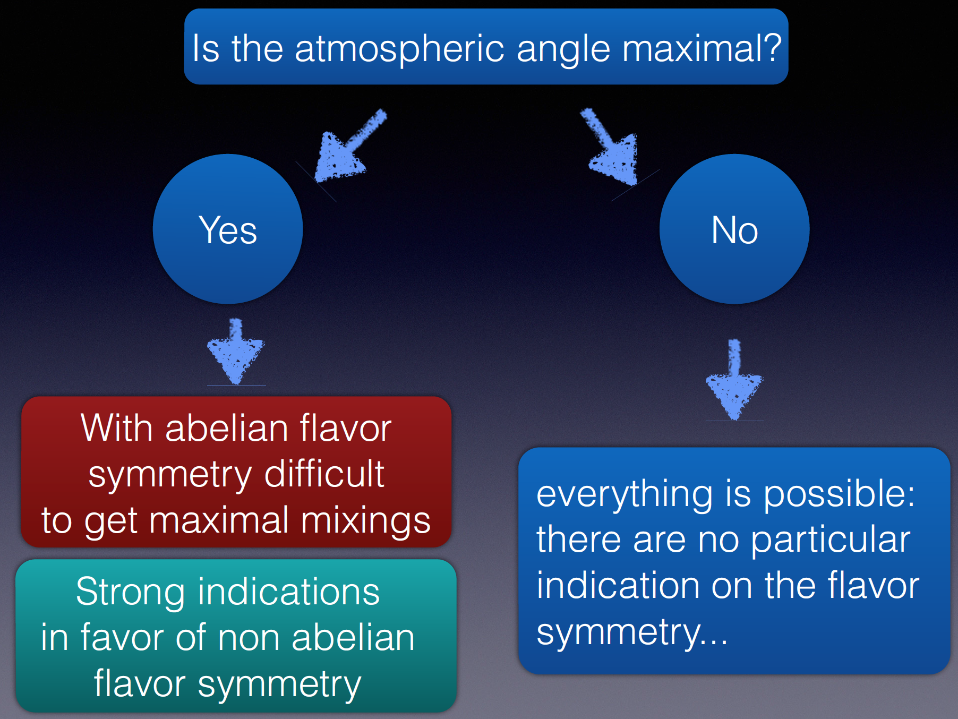
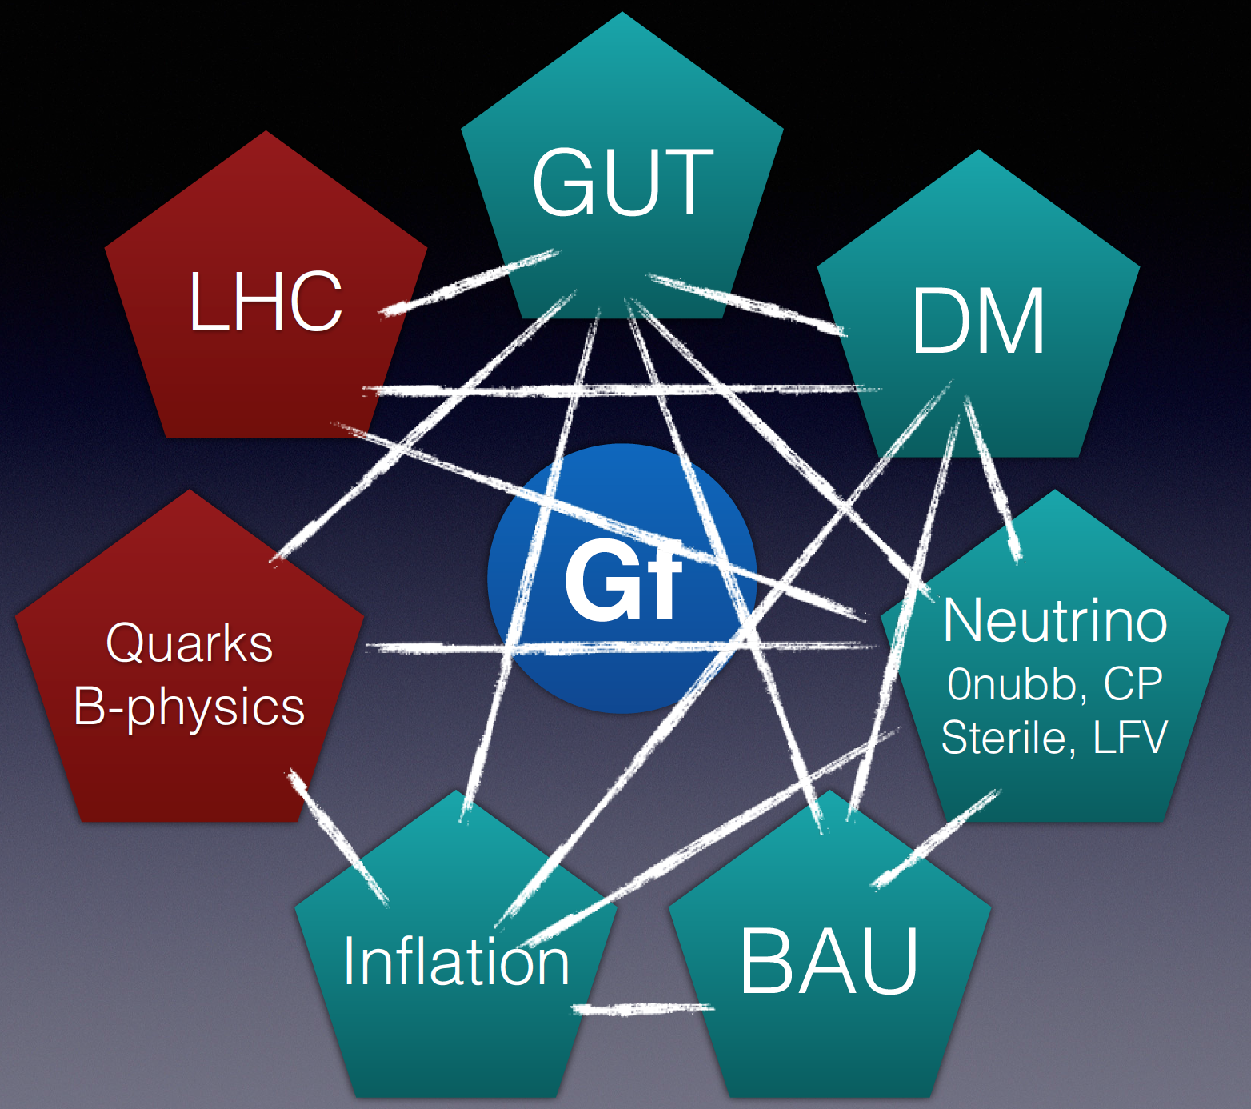
Quo vadis, neutrino flavor models?, ??
…
Anarchy?
S. Morisi

Slide 12
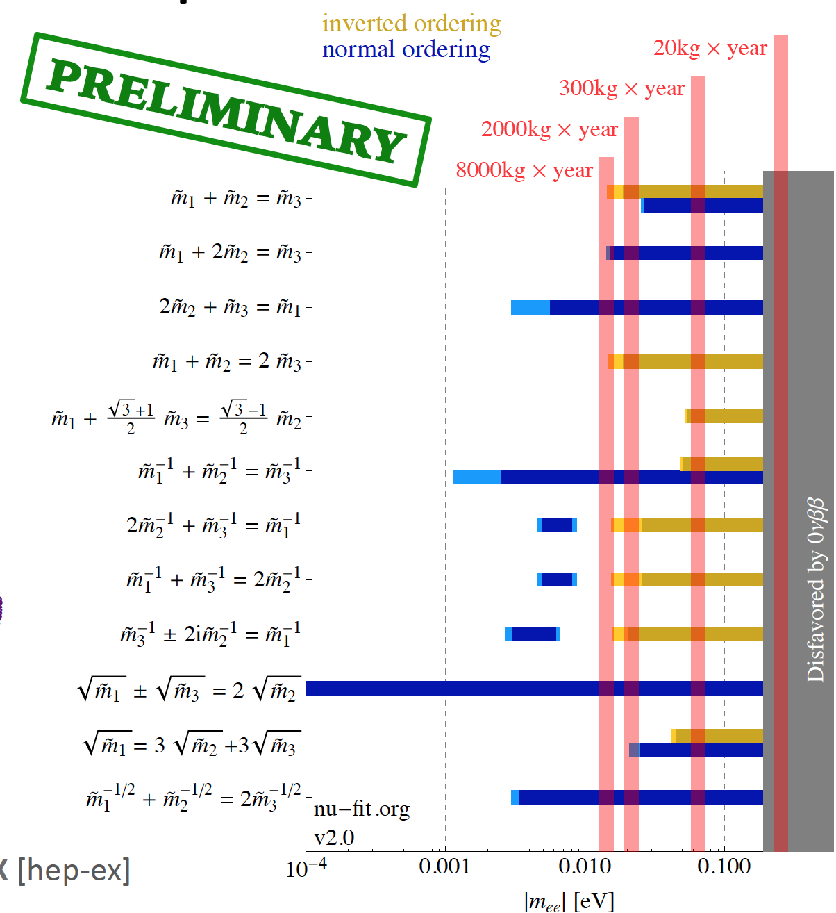
Testing (classes of) flavor models by sum rules… 0νββ
There is a 1:N relationship between sum rules and flavor models
These sum rules involve complex masses/phases
Future 0νββ bounds will constrain these sum rules and rule out classes of models
A. Merle, S. Morisi

Slide 13
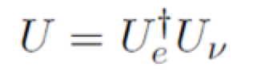
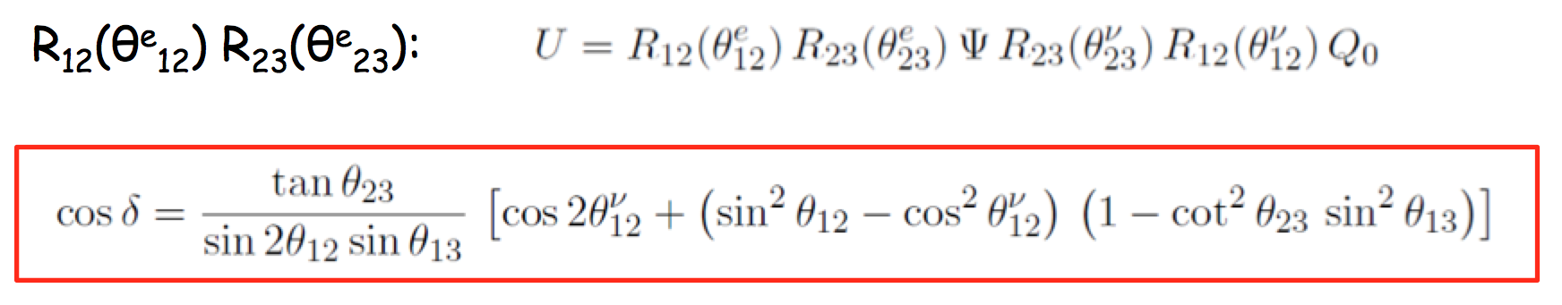
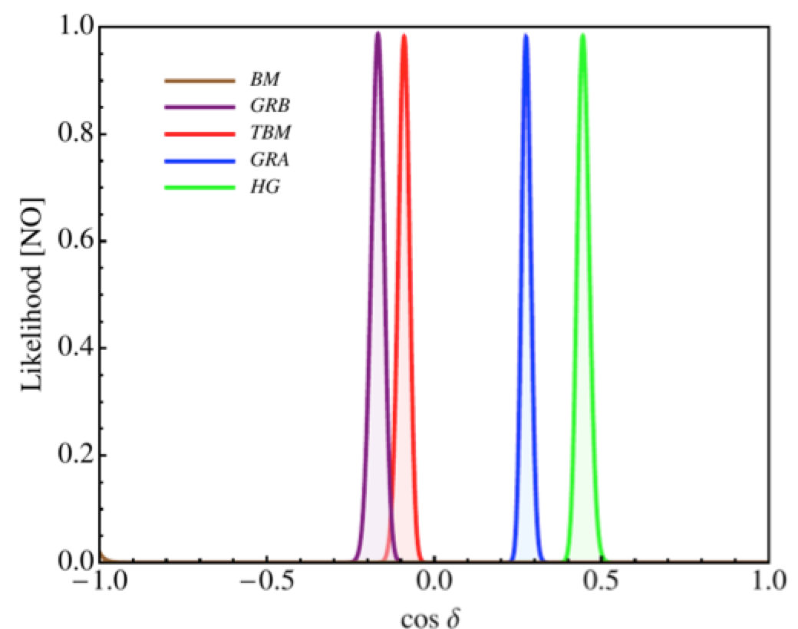
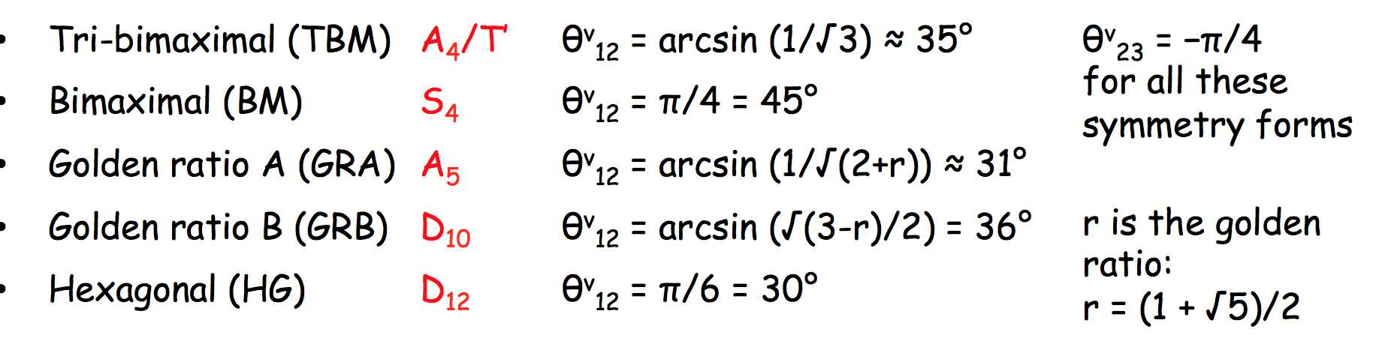
Testing (classes of) flavor models by sum rules… δ_{CP}
Correction from CL sector
From symmetry (fixed), θ₁₃=0
Sum rules can be also derived for quark sector and connected with leptons
M. Tanimoto
Assume a certain charged lepton correction scheme:
Sum rule
A. Titov

Slide 14
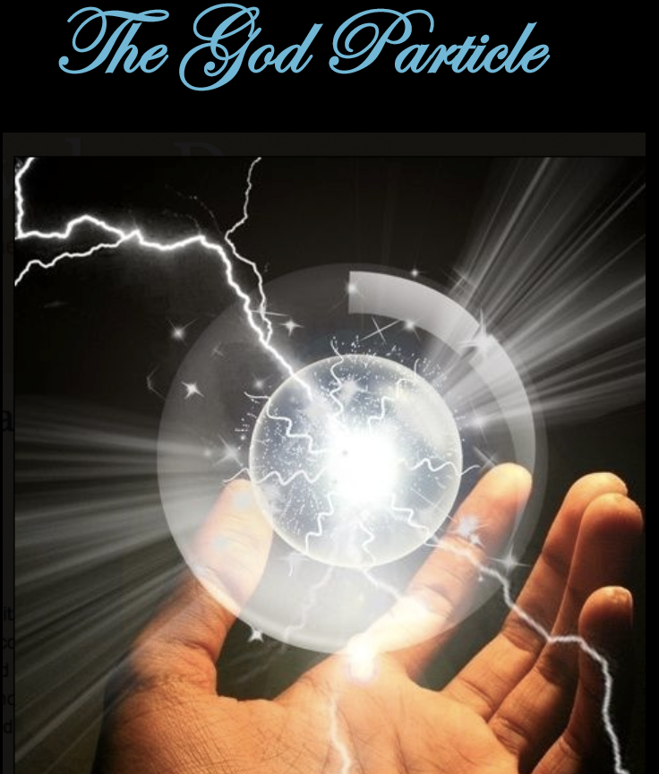
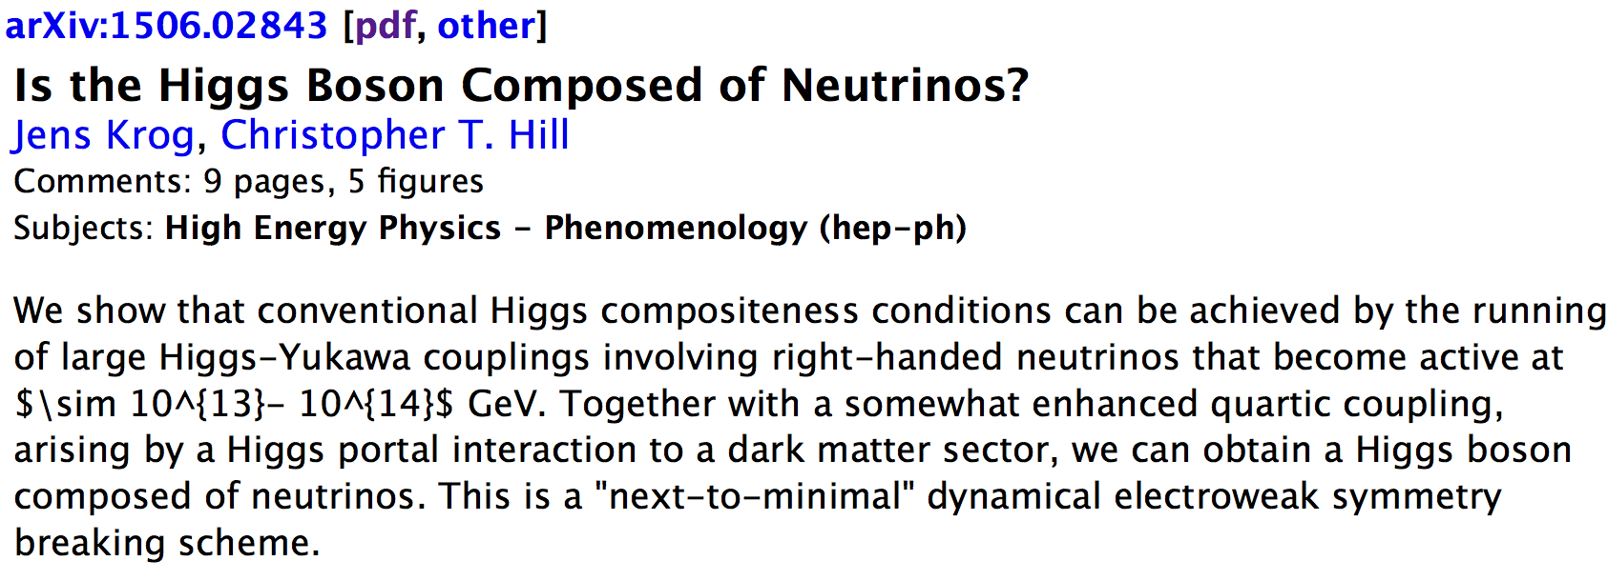
Sterile neutrinos
real
?
ν_{S}
June 10, 2015
K. Scholberg, interpreted

Slide 15
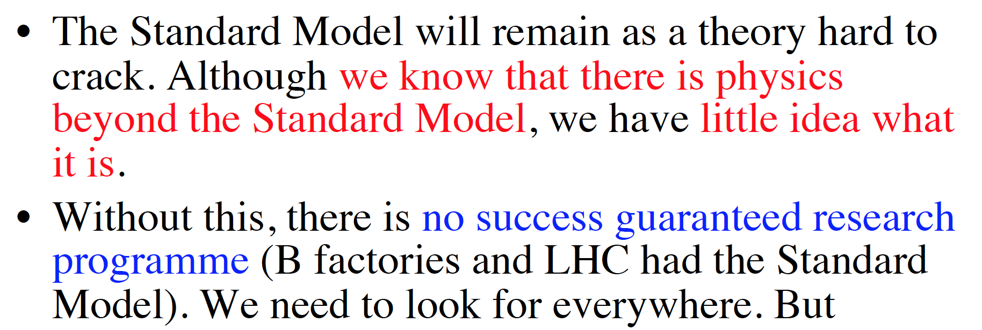
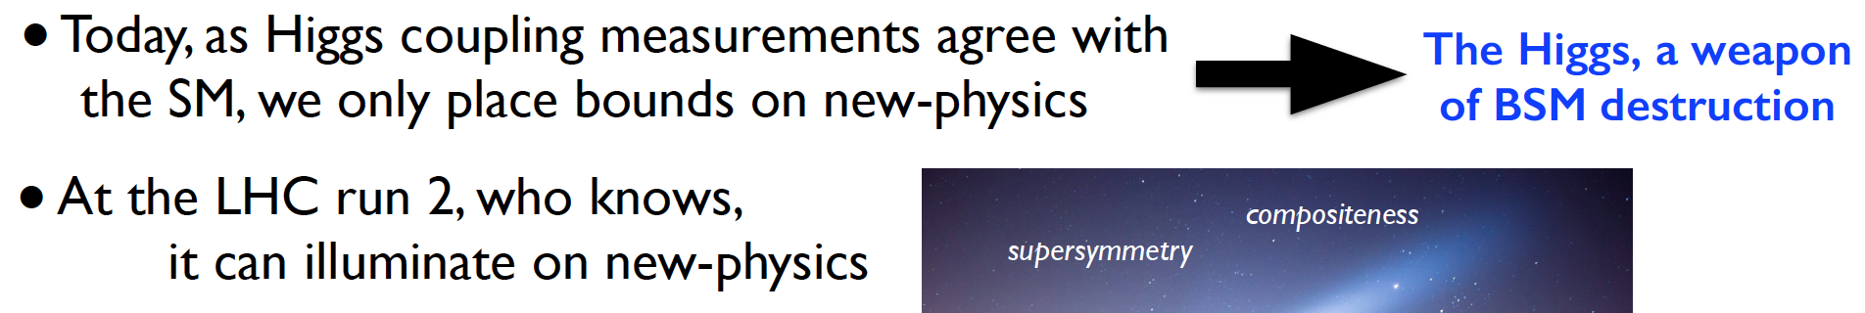
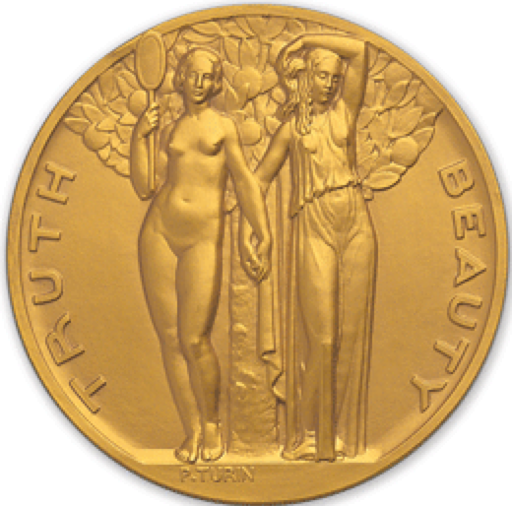
Where do we expect physics beyond the Standard Model?
Flavor physics overview,
T. Nakada
EWSB and Higgs overview,
A. Pomarol
Theory model building 101:
Beauty = Simplicity
(… and we don’t like “Truth”)
What is the simplest model that works?
IAS

Slide 16
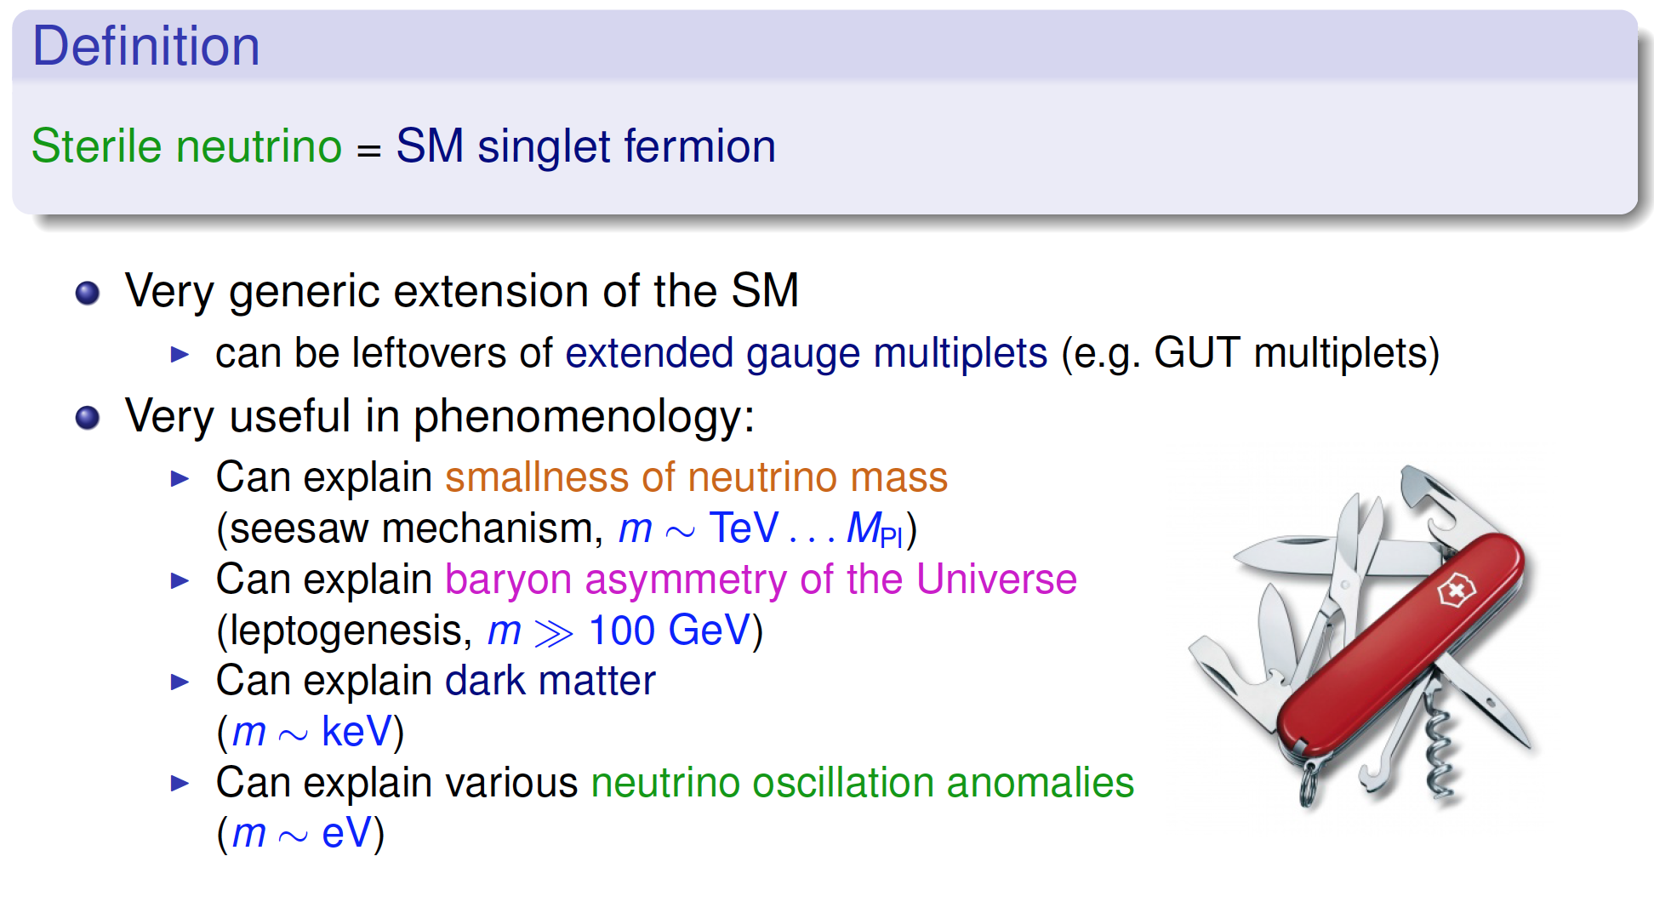
Sterile neutrinos for multiple purposes
…
(Garny)
From J. Kopp

Slide 17
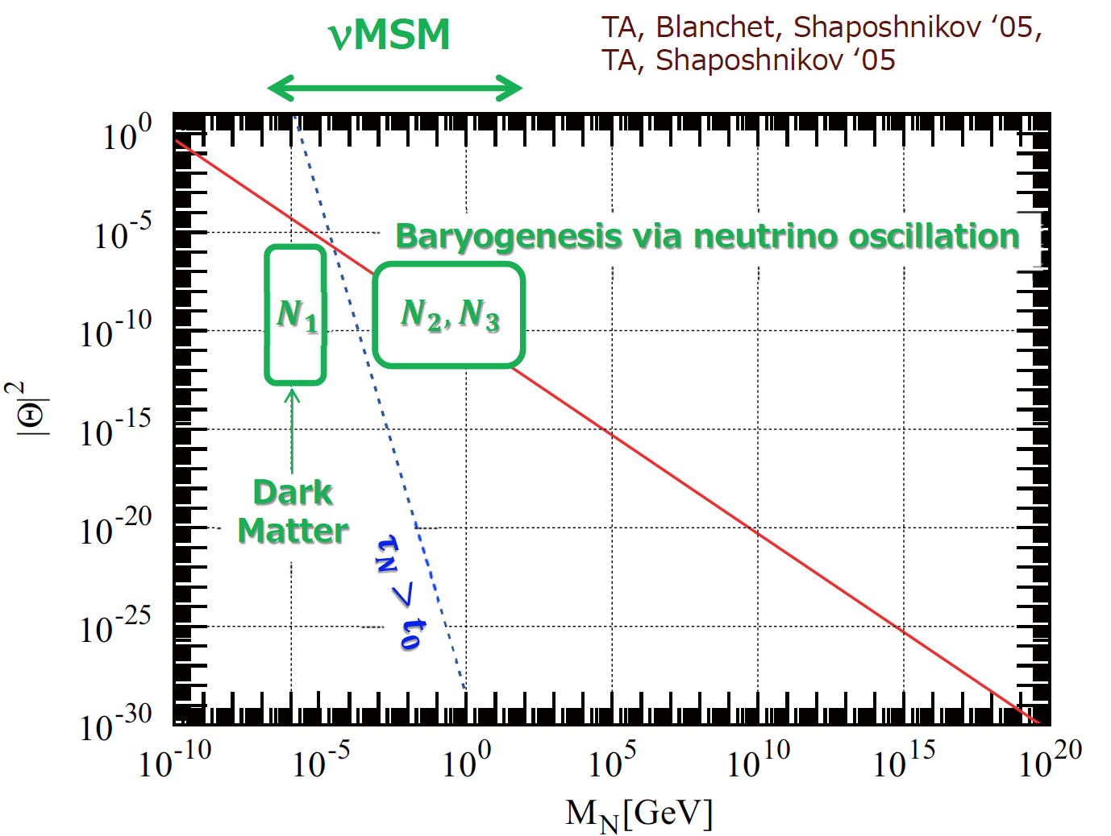
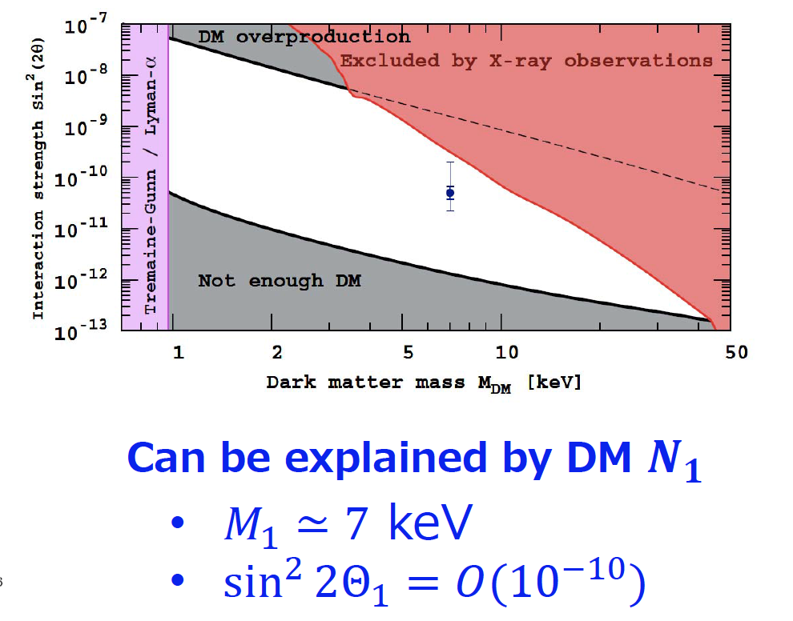
The νTOE (Theory of [almost] Everything), aka νMSM
Baryogenesis
Dark matter
Neutrino mass
(via seesaw)
3.5 keV line
T. Asaka
Search for these in proposed SHiP experiment

Slide 18
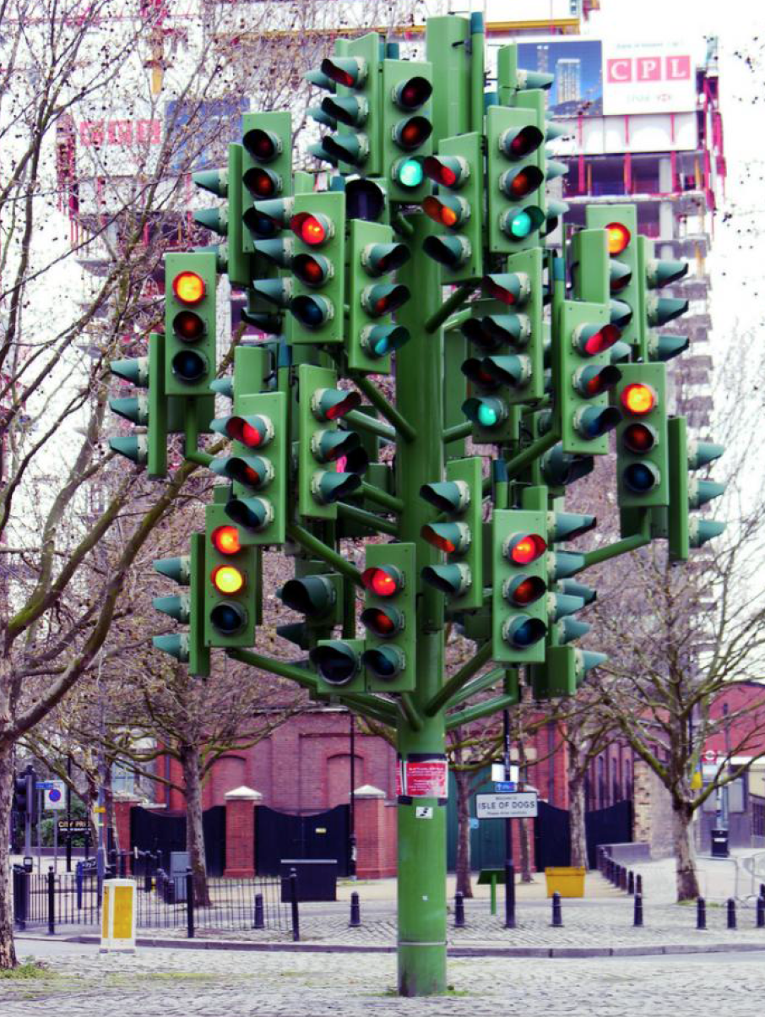


Light (~eV) sterile neutrinos?
Severe tension between LSND/MiniBooNE appearance, and disappearance data
J. Kopp, G. Collin
Correct no. of d.o.f. with backgrounds for parameter goodness of fit test? G. Collin
Cosmology disfavors additional light sterile neutrinos R. Durrer
However: There are theoretical ways out, e.g. coupling to a new MeV gauge boson
(neutrino self-energy
creates MSW-like
potential which suppresses
active-sterile mixings at
large temperatures)
Status of 3+N fits
J. Kopp
J. Kopp

Slide 19
eV-steriles have effects at long baselines
Even though fast oscillations are
averaged, non-standard phases will appear in long baseline experiments
E. g. Interpretations of δ_{CP} obscured
If short-baseline hints to be taken seriously, they will have more widespread consequences
T2K versus reactors
A. Palazzo

Slide 20
Particle physics with cosmic neutrinos
& new ideas

Slide 21
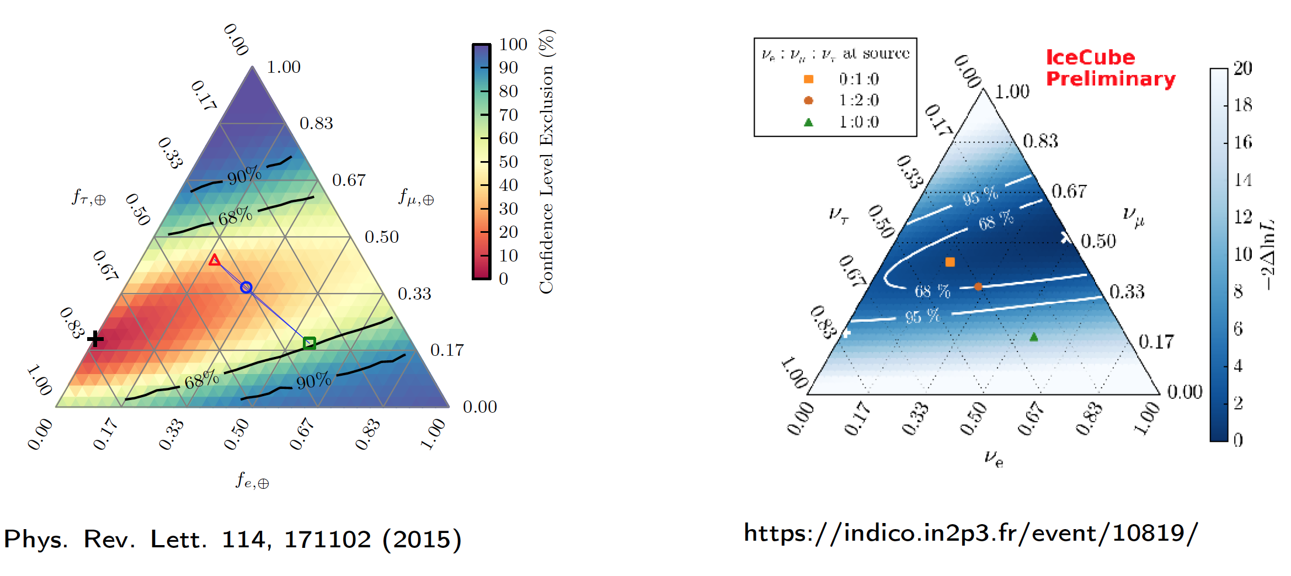
Flavor composition of astrophysical neutrinos
Many talks during this conference (Halzen, Arguelles, Päs [cancelled] A. Palladino)
Current experimental observations:
New analysis, more data
C. Arguelles, F. Halzen

Slide 22
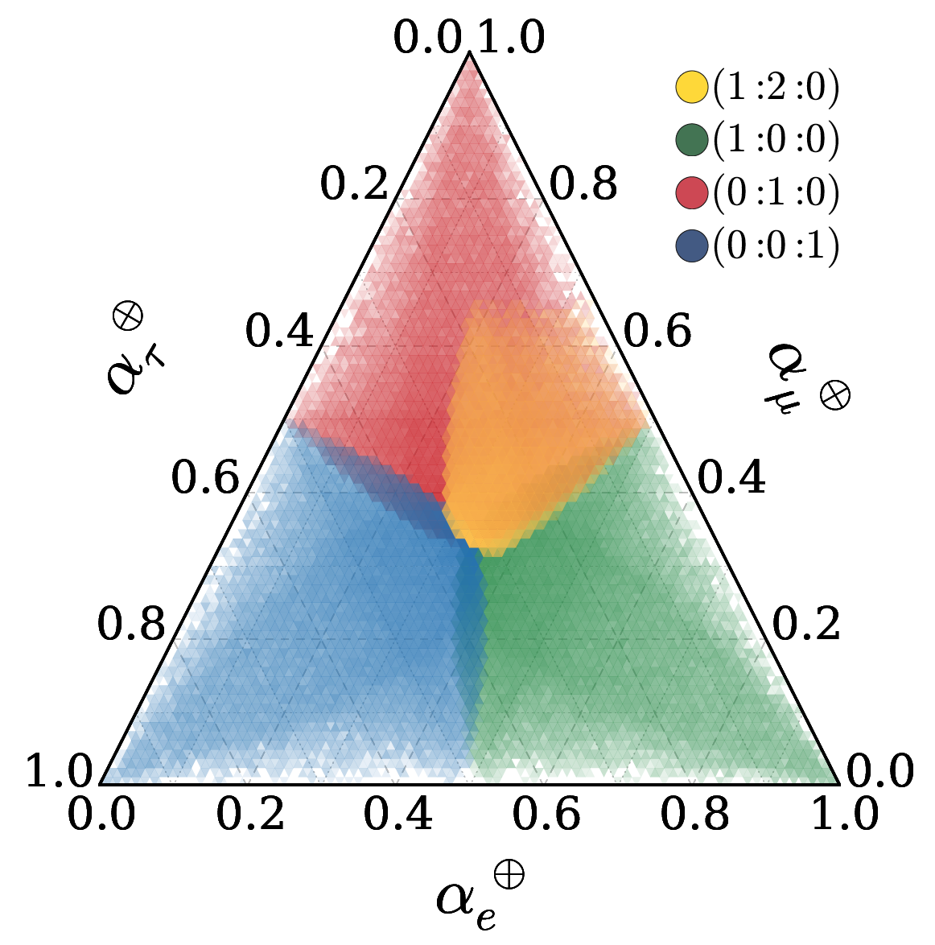
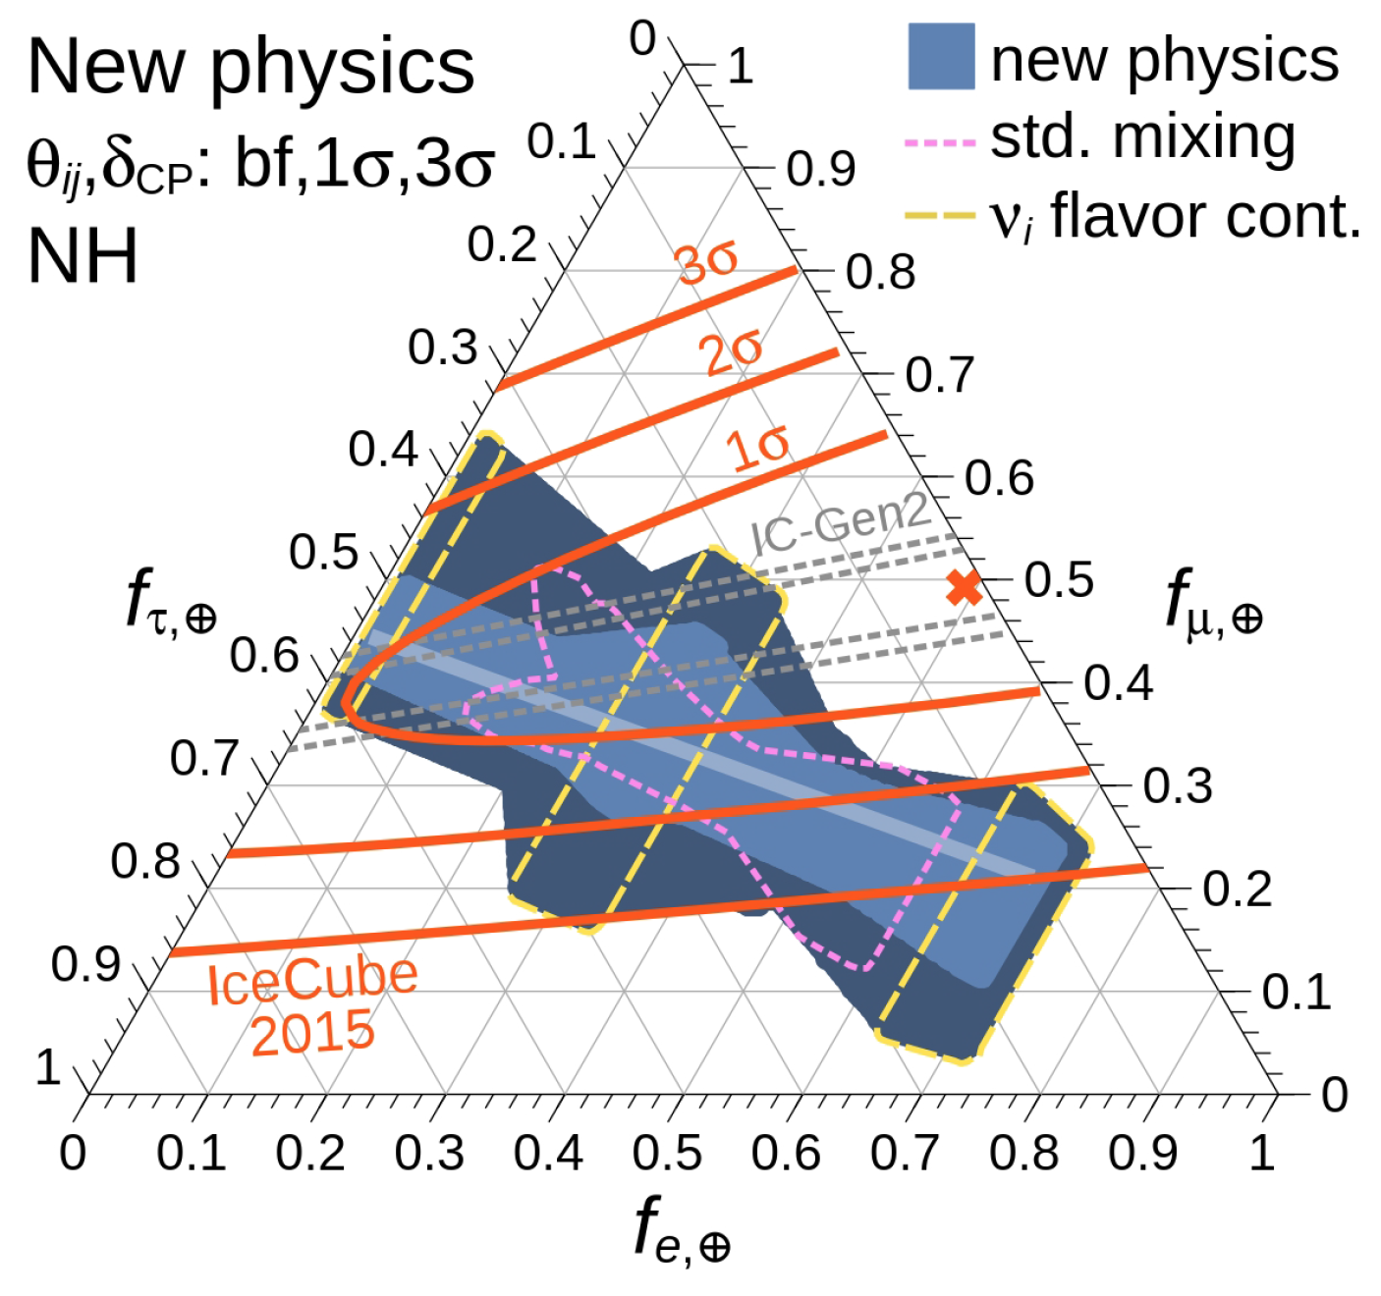
Theoretical expectations in presence of new physics
(only results from this Tuesday: arXiv:1506.02043, arXiv:1506.02624, arXiv:1506.02645)
Effective operators (CPT violation) at current limit
Known models (e.g. neutrino decays)
ν₃
ν₂
SM
ν₁
Only ν₁ stable ruled out at 2σ
From Bustamante, Beacom, WW, 2015; see also Paper/Talk bei A. Palladino et al!
Arguelles, Katori, Salvado, 2015; Talk bei C. Arguelles

Slide 23
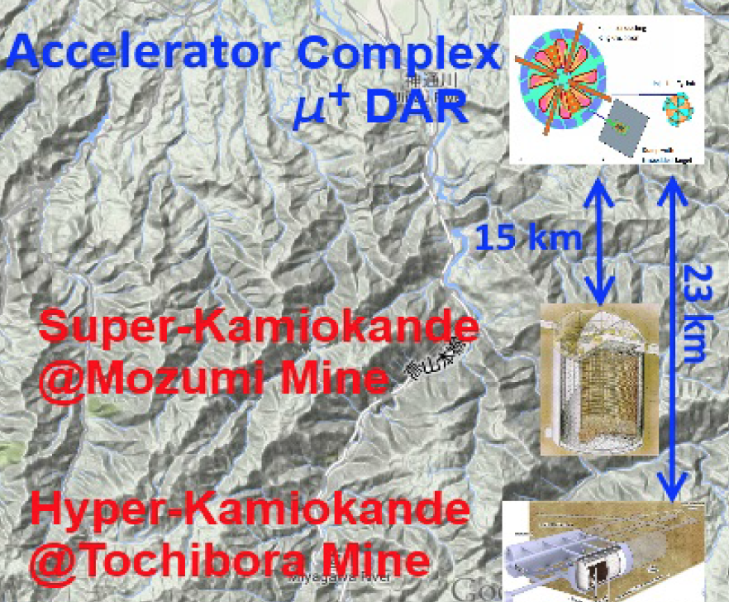
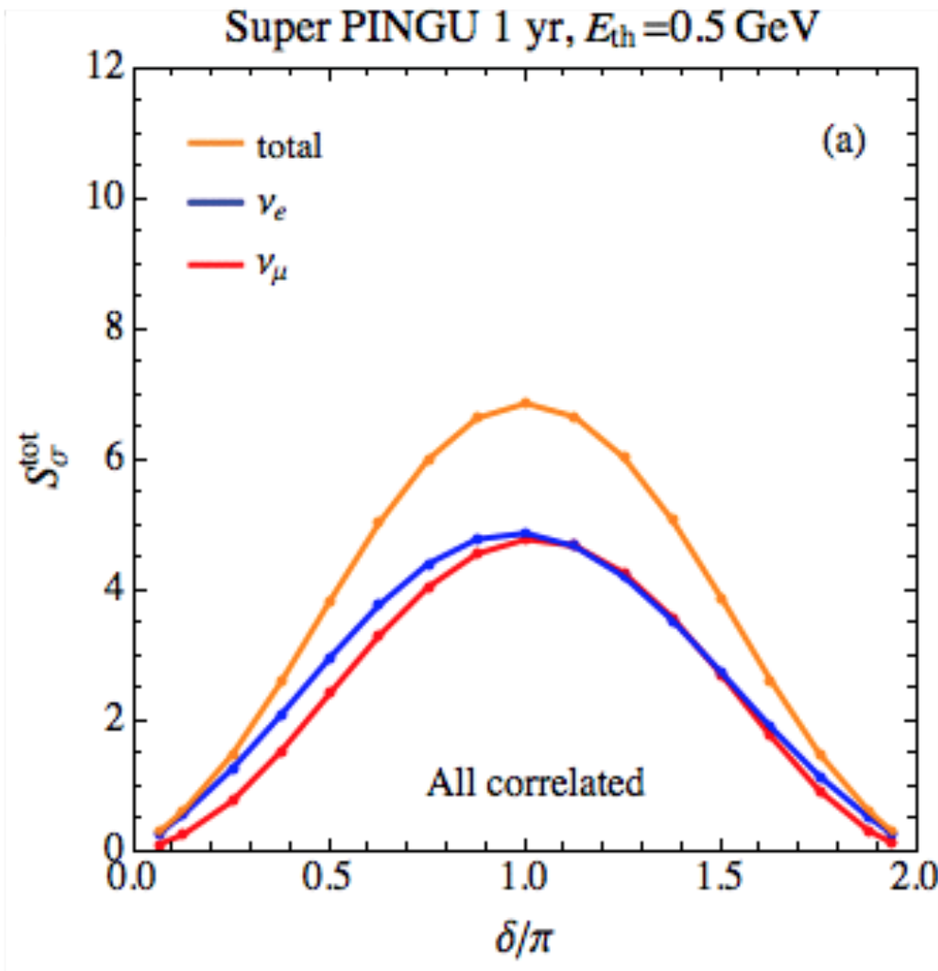
New ideas to measure δ_{P} ? [inexpensive source, high effort detector]
Idea: DAR of μ⁺ (cyclotron complex) to produce muon-antineutrinos
Compared to DAEδALUS:
one source, multiple detectors
Higher duty cycle (inverse beta decay cannot measure direction)
Idea: lower threshold than PINGU (0.5-1 GeV)
About factor three denser strings
CP sensitivity, in principle
Systematics?
S. Razzaque
J. Evslin

Slide 24
Summary
Origin and implications of leptonic CP violation are major challenges. [Connection to leptogenesis: pass the buck to my astroparticle fellow conveners …]
Sterile neutrinos with different masses can solve many of the unresolved problems of the Standard Model (smallness of neutrino mass, dark matter, baryogenesis)
The observational evidence for eV-sterile neutrinos is on weaker grounds. Especially, there are few contradictions (appearance-disappearance, cosmology, …). Theorists find ways out for you!
Cosmic neutrinos are a new player in town. New ways to test particle physics in extreme environments, at extreme distances, or extreme energies
Models for neutrino mass and flavor: Connection with other disciplines/problems/observables important.
The “anarchy community” attracts fans.
Thanks to the WIN organizers, session chairs, and all speakers!

Slide 25

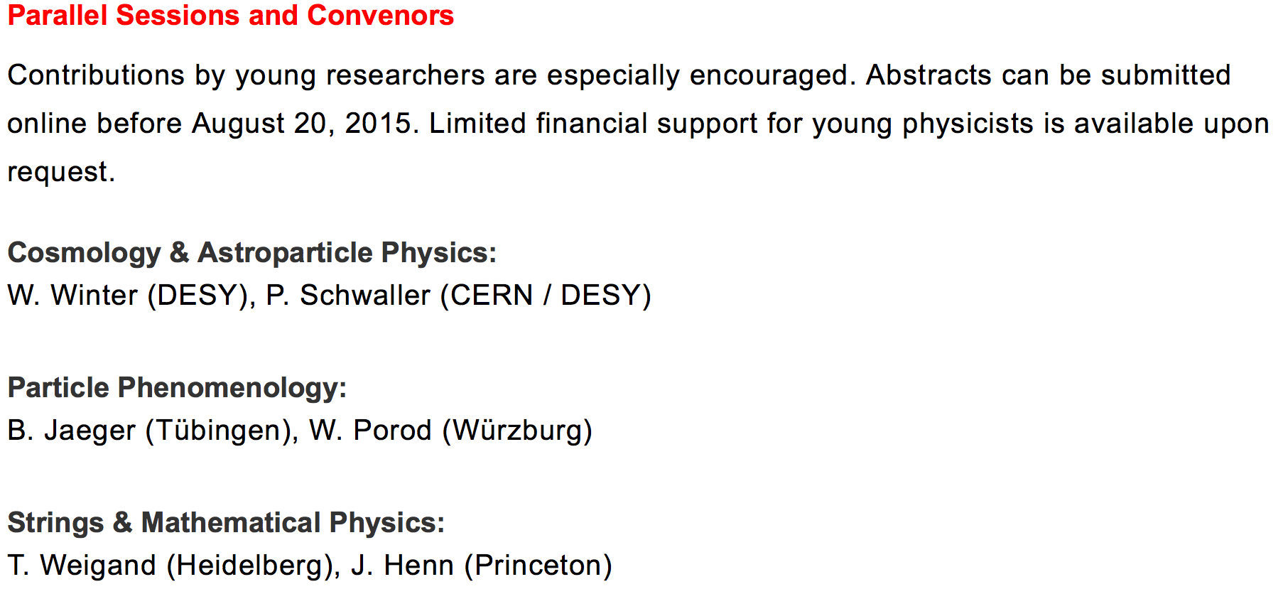
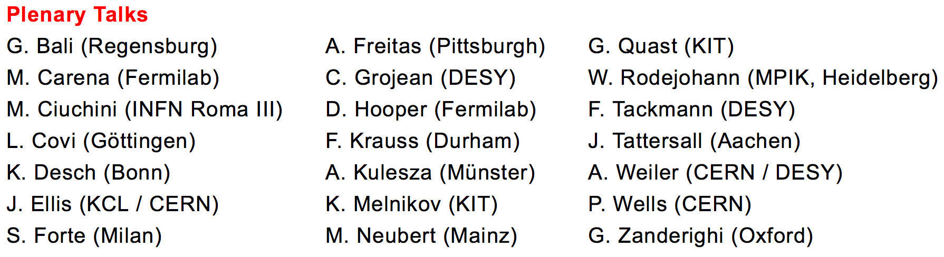
…
http://th-workshop2015.desy.de/

