Slide 1
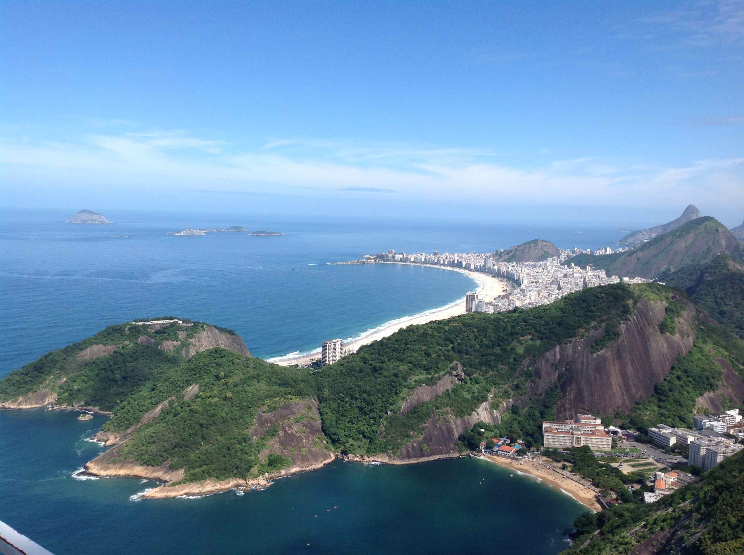
Majorana CP phase: reachable?
Hisakazu Minakata (U. Sao Paulo), based on work done in Rio !

Slide 2
Being well educated by Kate, Josef and others
I don’t need any introduction
But isn’t it too early to ask if Majorana phase can be observed before 0νββ decay is discovered?
Yes, you are completely right..
So let’s assume 0νββ decay will be seen soon
Let me start from a burning question

Slide 3
Neutrinos: Dirac or Majorana ?
Meaning of the question

Slide 4
Lepton KM phase vs Majorana phase
ν_{α}=U_{αi} ν_{i}
Lepton Kobayashi-Maskawa phase
Majorana phase
Technically similar (non-rotated away phase)
But, probably different origin: Majorana nature of neutrinos
Simplest realization: L = (1/M_{NP}) φφνν

Slide 5
Obviously interesting question, many people worked on that. But, pessimism prevailed..
For example, in 2002..
In abstract they say … under optimistic assumption about the sensitivity of future experiments, …. It will be impossible to detect neutrino CP violation arising from Majorana phases.

Slide 6
Everybody knows mass mechanism of 0νββ decay

Slide 7
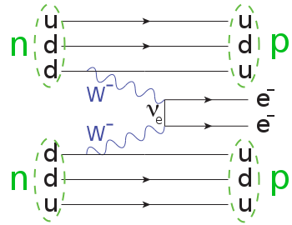
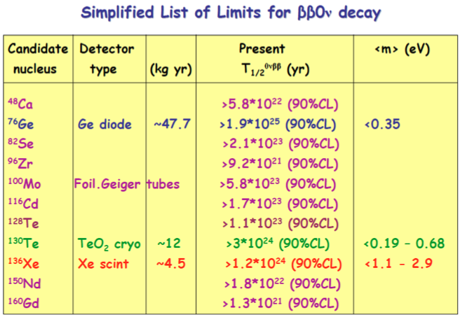
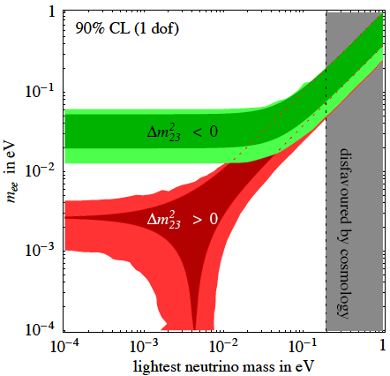
Majorana vs. Dirac: double β decay
If inverted !

Slide 8
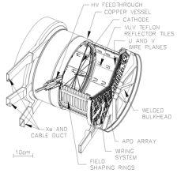
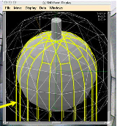
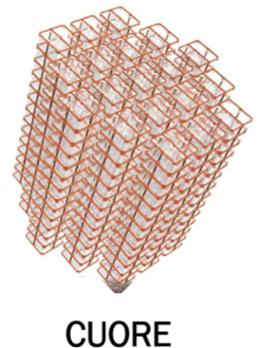
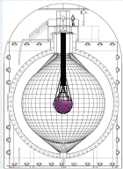
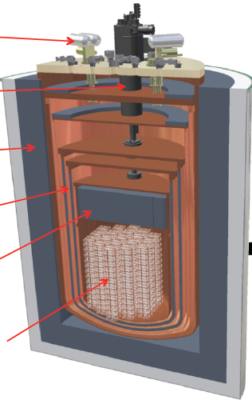
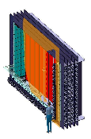
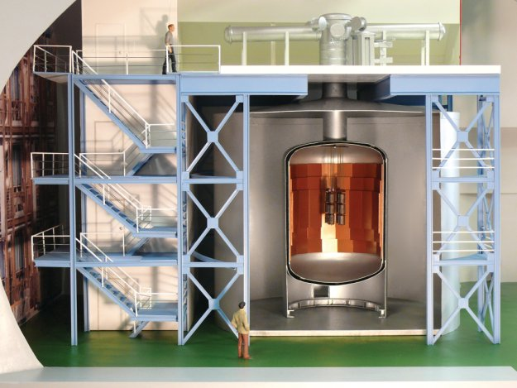
Several double beta decay experiments are either ongoing or coming

Slide 9
Stronger tie between cosmology and neutrino physics

Slide 10
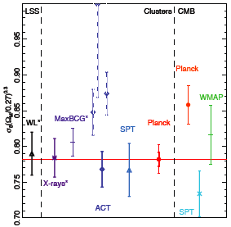
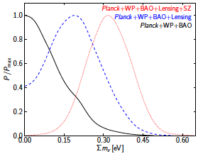
After Planck, cosmology sheds light on absolute neutrino masses
Discrepancy between CMB and SZ σ₈ leads to finite neutrino mass !?
Planck: Neff = 3.30 +/- 0.27
Σm_{ν} < 0.23 eV
Sunyaev-Zel’dvich cluster count (Planck 2013)
Battye-Moss, ArXiv:1308.5870

Slide 11
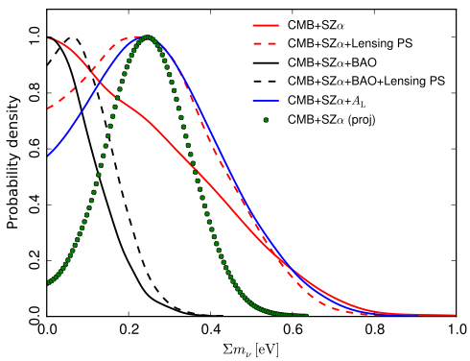
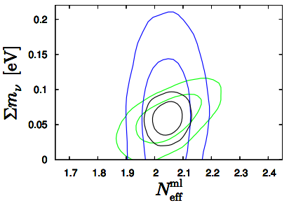
Planck w/wo Euclid-like survey forecast
Planck 2015 XXIV
T. Bassea, O. E. Bjældea, J. Hamannb, S. Hannestad, Y.Y.Y. Wong JCAP14

Slide 12
Important: key to measure Majorana phase

Slide 13
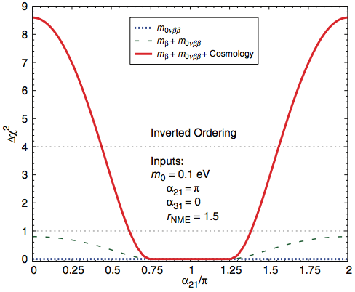
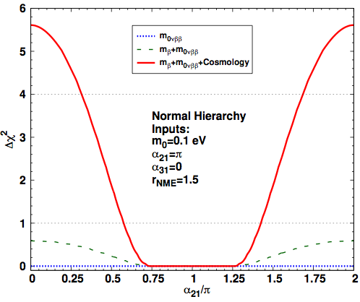
Absolute ν mass has to be known by an independent way
α₃₁= α₃₁^{PDG} – 2δ
Inverted ordering
Normal ordering

Slide 14
KATRIN will be followed by new technologies: calorimetry and Program 8

Slide 15
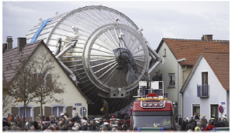
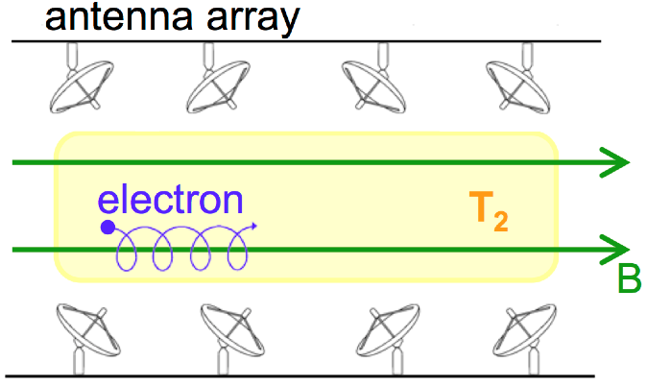
Need not be cosmology, of course
A new idea “Project 8”: detecting radiation from orbitting electron, Monreal and Formaggio PRD09
¹⁶³Ho electron capture decay (HOLMES, ECHO..)

Slide 16
Revisiting Majorana phase analysis with precision cosmology
HM, H. Nunokawa, & A.A. Quiroga, PTEP 2015

Slide 17
We consider 3 observables
Sum of neutrino masses (cosmology)
Single beta decay (KATRIN)
0νββ decay
By assuming no background in 0νββ decay exp.
α₃₁= α₃₁^{PDG} – 2δ
~ 1 ton

Slide 18
Analysis procedure
Essentially following Pascoli-Petcov-Schwetz 05
Also use σ_{Σ}=0.02 eV
Planck+Euclid+LSST

Slide 19
f_{CPX}: CP exclusion fraction
f_{CPX} is defined as a fraction of the CP phase space that can be excluded at a certain CL (we use 2σ) for a given set of input parameters.
Essentially no sensitivity to α₃₁
So I present α₂₁ vs f_{CPX} figure
α₃₁= α₃₁^{PDG} – 2δ

Slide 20
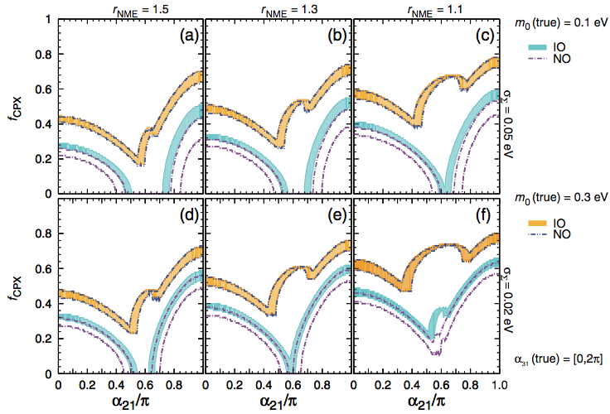
Sensitivity given by f_{CPX}
σ_{Σ}=0.05 eV
σ_{Σ}=0.02 eV
HM, H. Nunokawa, & A.A. Quiroga, arXiv:1402.6014

Slide 21
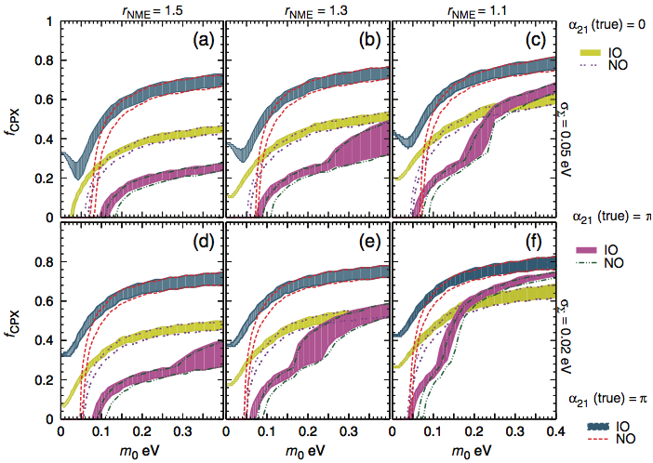
f_{CPX}: CP exclusion fraction
σ_{Σ}=0.05 eV
σ_{Σ}=0.02 eV

Slide 22
Conclusion
We didn’t succeed to overturn the prevailing pessimism of measuring the Majorana phase
But, we set up our analysis tools such that what is crucial to the better sensitivity to Majorana phase is illuminated
Our results are not totally pessimistic, ~40% of phase space can be excluded albeit under optimistic assumptions

Slide 23
Conclusion-2
Since a great amount of experimental efforts are devoted to a number of double beta decay experiments, as well as KATRIN + calorimetry + Project 8 (not mentioning cosmological observations), we (theorists) must work hard in seeking NO “No go”!

