Slide 1
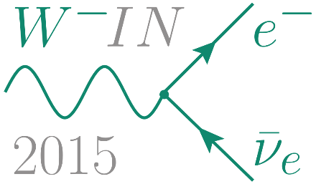
Determining the Dirac CP Violation Phase in the PMNS Matrix from Sum Rules
Arsenii Titov
in collaboration with I. Girardi and S.T. Petcov
SISSA and INFN, Trieste, Italy
25th International Workshop on Weak Interactions and Neutrinos
10 June 2015, MPIK Heidelberg, Germany

Slide 2
Outline
3-Neutrino Mixing
General Setup
Sum Rules
Predictions for the Dirac Phase
Conclusions
Based on I. Girardi, S.T. Petcov, A.T., NPB 894 (2015) 733 [arXiv:1410.8056]
I. Girardi, S.T. Petcov, A.T., arXiv:1504.00658

Slide 3
3-Neutrino Mixing
U is the Pontecorvo-Maki-Nakagawa-Sakata neutrino mixing matrix
 | Best fit | 3σ range
sin² θ₁₂ | 0.308 | 0.259 ÷ 0.359
sin² θ₂₃ (NO) | 0.437 | 0.374 ÷ 0.626
sin² θ₂₃ (IO) | 0.455 | 0.380 ÷ 0.641
sin² θ₁₃ (NO) | 0.0234 | 0.0176 ÷ 0.0295
sin² θ₁₃ (IO) | 0.0240 | 0.0178 ÷ 0.0298
δ/π (NO) | 1.39 | 0 ÷ 2
δ/π (IO) | 1.31 | 0 ÷ 2
θ₁₂ ≈ π/4 – 0.20
θ₂₃ ≈ π/4 – 0.06
θ₁₃ ≈ 0 + 0.15
Symmetry?
F. Capozzi et. al., PRD 89 (2014) 093018

Slide 4
General Setup
M_{e} is the charged lepton mass matrix
M_{ν} is the neutrino Majorana mass matrix
Ũ_{e} and Ũ_{ν} are CKM-like 3×3 unitary matrices
Ũ_{ν} is assumed to have a symmetry form which is dictated by, or associated with, a flavour (discrete) symmetry, e.g., A₄, S₄, A₅, T’

Slide 5
General Setup
Symmetry forms of Ũ_{ν} : bimaximal, tri-bimaximal, golden ratio, hexagonal…
where
Tri-bimaximal (TBM) A₄/T’ θ^{ν}₁₂ = arcsin (1/√3) ≈ 35°
Bimaximal (BM) S₄ θ^{ν}₁₂ = π/4 = 45°
Golden ratio A (GRA) A₅ θ^{ν}₁₂ = arcsin (1/√(2+r)) ≈ 31°
Golden ratio B (GRB) D₁₀ θ^{ν}₁₂ = arcsin (√(3-r)/2) = 36°
Hexagonal (HG) D₁₂ θ^{ν}₁₂ = π/6 = 30°
θ^{ν}₂₃ = −π/4 for all these symmetry forms
r is the golden ratio: r = (1 + √5)/2

Slide 6
General Setup
Charged lepton corrections:
1 rotation
2 rotations
1 rotation + 3 rotations from the neutrino sector
=> sum rules for cos δ, i.e., cos δ as a function of the observable mixing angles θ₁₂, θ₂₃, θ₁₃ and the angles θ^{ν}_{ij}, whose values are fixed

Slide 7
Sum Rules
1 rotation from the charged lepton sector
R₁₂(θ^{e}₁₂):
R₁₃(θ^{e}₁₃):

Slide 8
Sum Rules
2 rotations from the charged lepton sector
R₁₂(θ^{e}₁₂) R₂₃(θ^{e}₂₃):
S.T. Petcov, NPB 892 (2015) 400
R₁₃(θ^{e}₁₃) R₂₃(θ^{e}₂₃):

Slide 9
Sum Rules
1 rotation from the charged lepton sector + 3 rotations from the neutrino sector
R₁₂(θ^{e}₁₂):
R₁₃(θ^{e}₁₃):

Slide 10
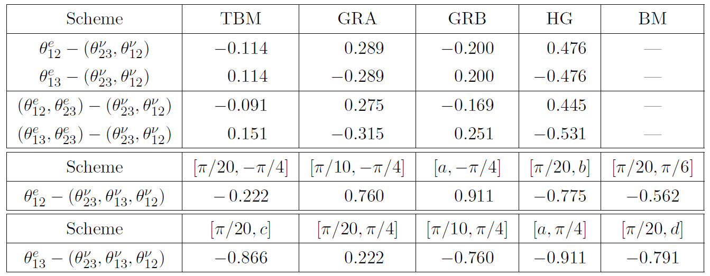
Predictions for cos δ
Using best fit values of mixing angles for NO neutrino mass spectrum
θ^{ν}₂₃ = −π/4 [θ^{ν}₁₃, θ^{ν}₁₂]
a = arcsin (1/3) b = arcsin (1/√(2+r)) c = arcsin (1/ √3) d = arcsin (√(3-r)/2)
Non-zero values of θ^{ν}₁₃: F. Bazzocchi, arXiv:1108.2497 R.d.A. Toorop et. al., PLB 703 (2011) 447 W. Rodejohann and H. Zhang, PLB 732 (2014) 174

Slide 11
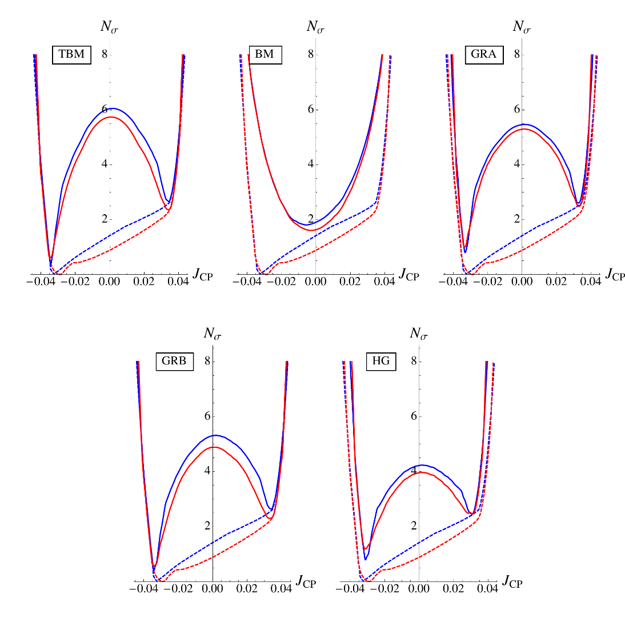
Predictions for J_{CP}
R₁₂(θ^{e}₁₂) R₂₃(θ^{e}₂₃):
J_{CP} determines the magnitude of CP-violating effects in neutrino oscillations
P.I. Krastev and S.T. Petcov, PLB 205 (1988) 84
NO scheme
IO scheme
NO global fit
IO global fit
Relatively large CP-violating effects in neutrino oscillations in the cases of TBM, GRA, GRB, HG: J_{CP} ≈ -0.03, |J_{CP} | ≥ 0.02 @ 3σ
and suppressed ones in the case of BM: J_{CP} ≈ 0
Using latest results on sin² θ_{ij} and δ, obtained in global analysis of neutrino oscillation data in F. Capozzi et. al., PRD 89 (2014) 093018

Slide 12
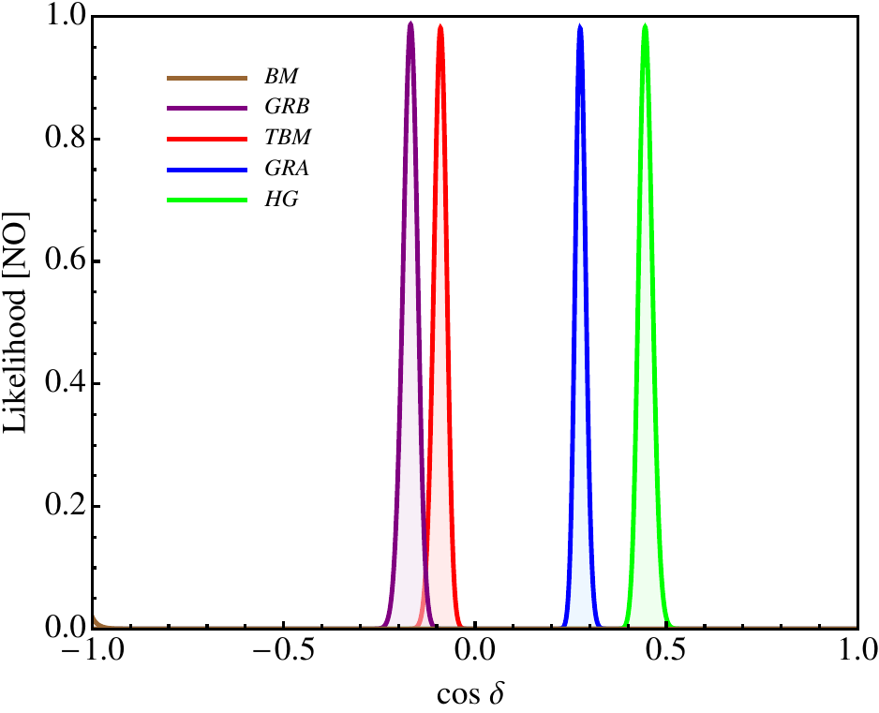
Predictions for cos δ
Statistical analysis: likelihood function
R₁₂(θ^{e}₁₂) R₂₃(θ^{e}₂₃):
Precision with which δ can be determined is discussed in J. Evslin’s talk
Using prospective 1σ uncertainties on sin² θ_{ij}: 0.7% for sin² θ₁₂ (JUNO), 3% for sin² θ₁₃ (Daya Bay), 5% for sin² θ₂₃ (NOvA and T2K) + Gaussian approximation

Slide 13
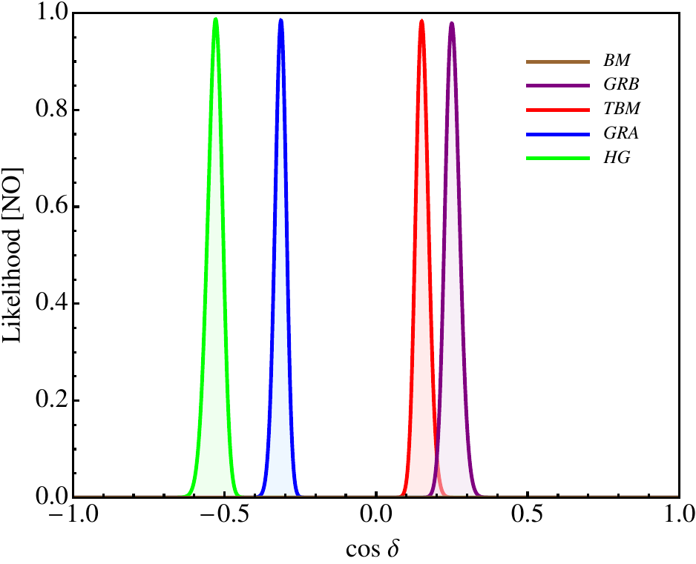
Predictions for cos δ
Statistical analysis: likelihood function
R₁₃(θ^{e}₁₃) R₂₃(θ^{e}₂₃):
Using prospective 1σ uncertainties on sin² θ_{ij}: 0.7% for sin² θ₁₂ (JUNO), 3% for sin² θ₁₃ (Daya Bay), 5% for sin² θ₂₃ (NOvA and T2K) + Gaussian approximation

Slide 14
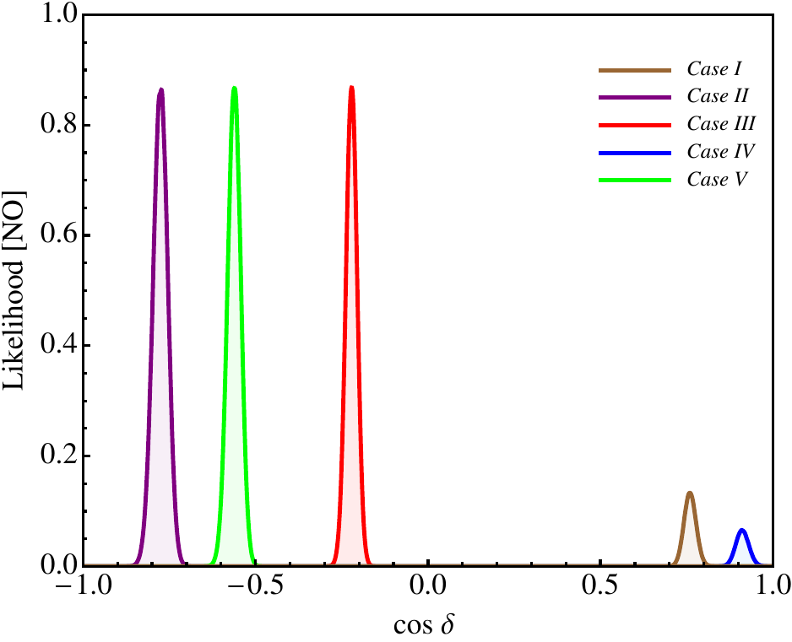
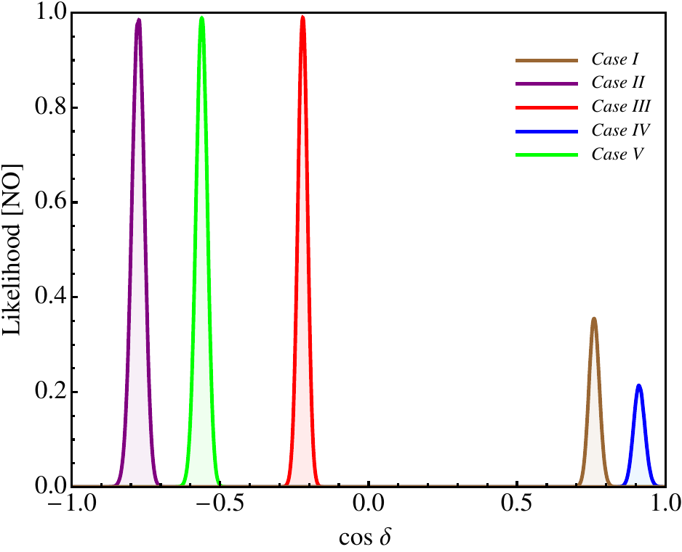
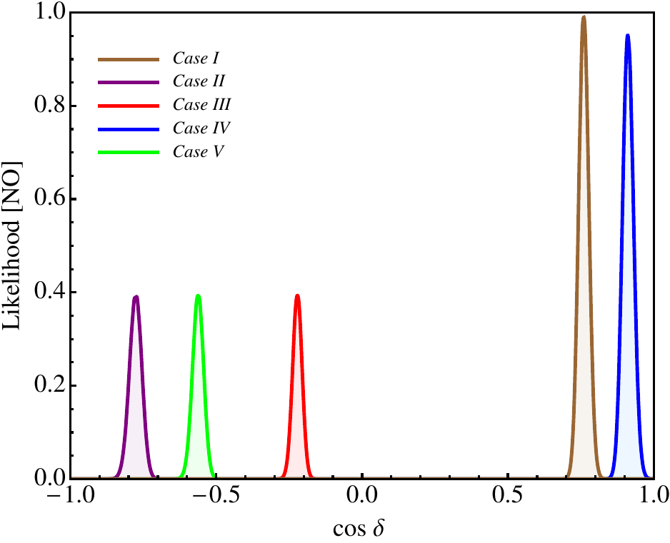
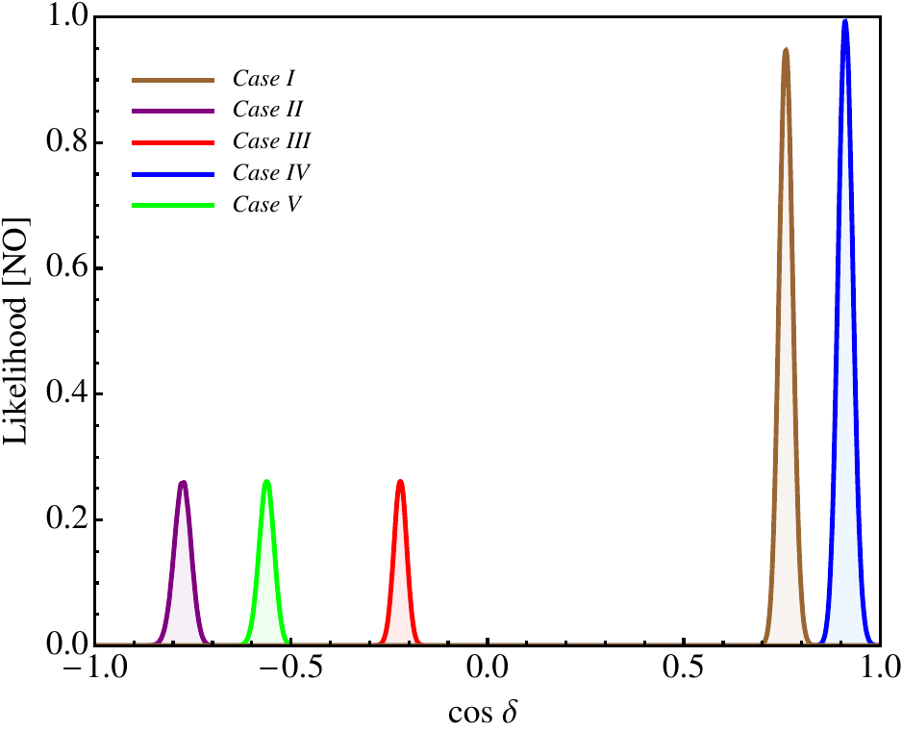
Predictions for cos δ
R₁₂(θ^{e}₁₂):
(sin² θ₂₃)_{pbf} = 0.488
θ^{ν}₁₃ = 0
(sin² θ₂₃)_{pbf} = 0.501
θ^{ν}₁₃ = π/20
(sin² θ₂₃)_{pbf} = 0.537
θ^{ν}₁₃ = π/10
(sin² θ₂₃)_{pbf} = 0.545
θ^{ν}₁₃ = arcsin (1/3)
[θ^{ν}₁₃, θ^{ν}₁₂]: Case I = [π/10, -π/4] Case II = [π/20, arcsin (1/√(2+r))] Case III = [π/20, -π/4] Case IV = [arcsin (1/3), -π/4] Case V = [π/20, π/6]

Slide 15
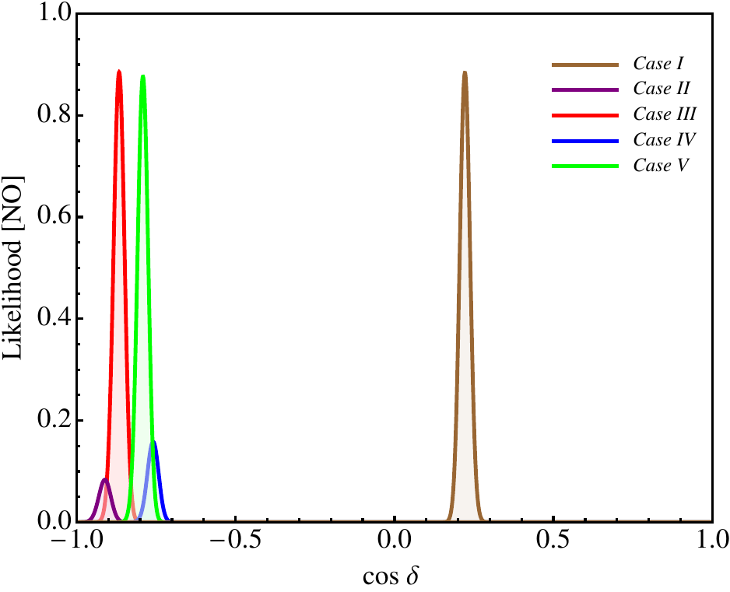
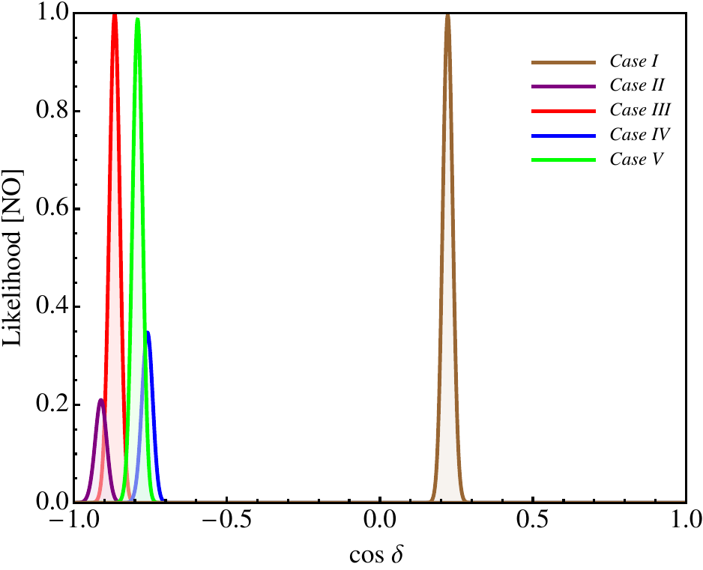
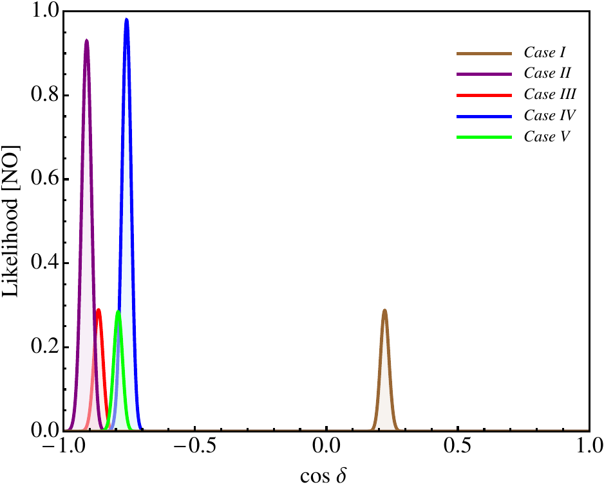
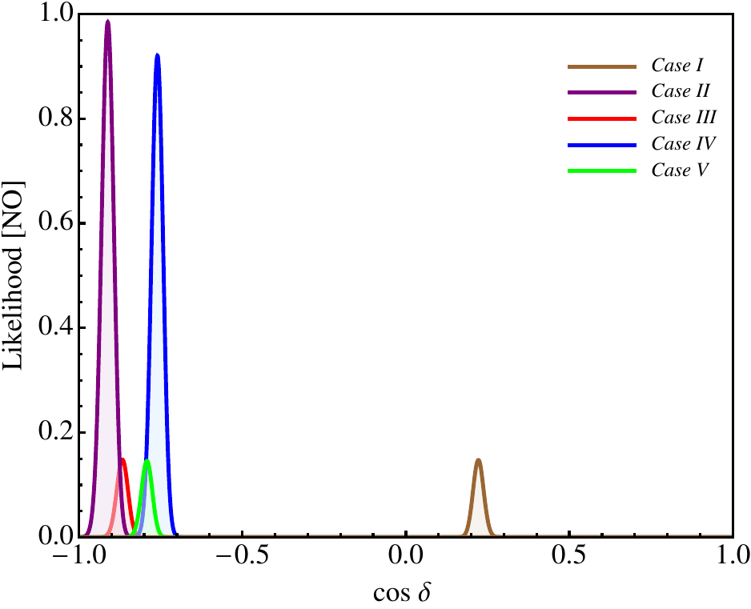
Predictions for cos δ
R₁₃(θ^{e}₁₃):
(sin² θ₂₃)_{pbf} = 0.512
θ^{ν}₁₃ = 0
(sin² θ₂₃)_{pbf} = 0.499
θ^{ν}₁₃ = π/20
(sin² θ₂₃)_{pbf} = 0.463
θ^{ν}₁₃ = π/10
(sin² θ₂₃)_{pbf} = 0.455
θ^{ν}₁₃ = arcsin (1/3)
[θ^{ν}₁₃, θ^{ν}₁₂]: Case I = [π/20, π/4] Case II = [arcsin (1/3), π/4] Case III = [π/20, arcsin (1/√3)] Case IV = [π/10, π/4] Case V = [π/20, arcsin (√(3-r)/2)]

Slide 16
Conclusions
Exact (within the schemes considered) sum rules for cos δ
Relatively large CP-violating effects in neutrino oscillations in the cases of TBM, GRA, GRB, HG and suppressed ones in the case of BM
Measurement of δ along with an improvement of the precision on the neutrino mixing angles can provide an indication about the charged lepton mass matrix

Slide 17
Conclusions
Sufficiently precise measurement of δ combined with prospective precision on the neutrino mixing angles can provide information about the existence of a new type of fundamental symmetry in the lepton sector

Slide 18
Backup

Slide 19
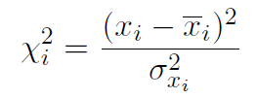
Statistical Details
χ_{i}² being extracted from F. Capozzi et. al., PRD 89 (2014) 093018
Gaussian approximation:
Future:
and
are b.f.v. and 1σ uncertainties
are parameters of the scheme

Slide 20
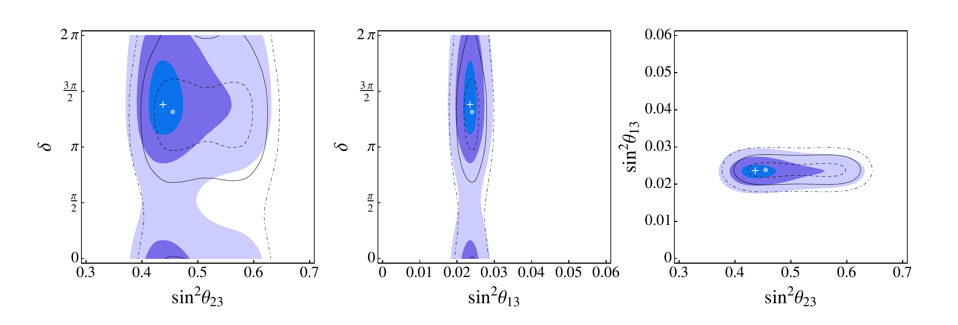
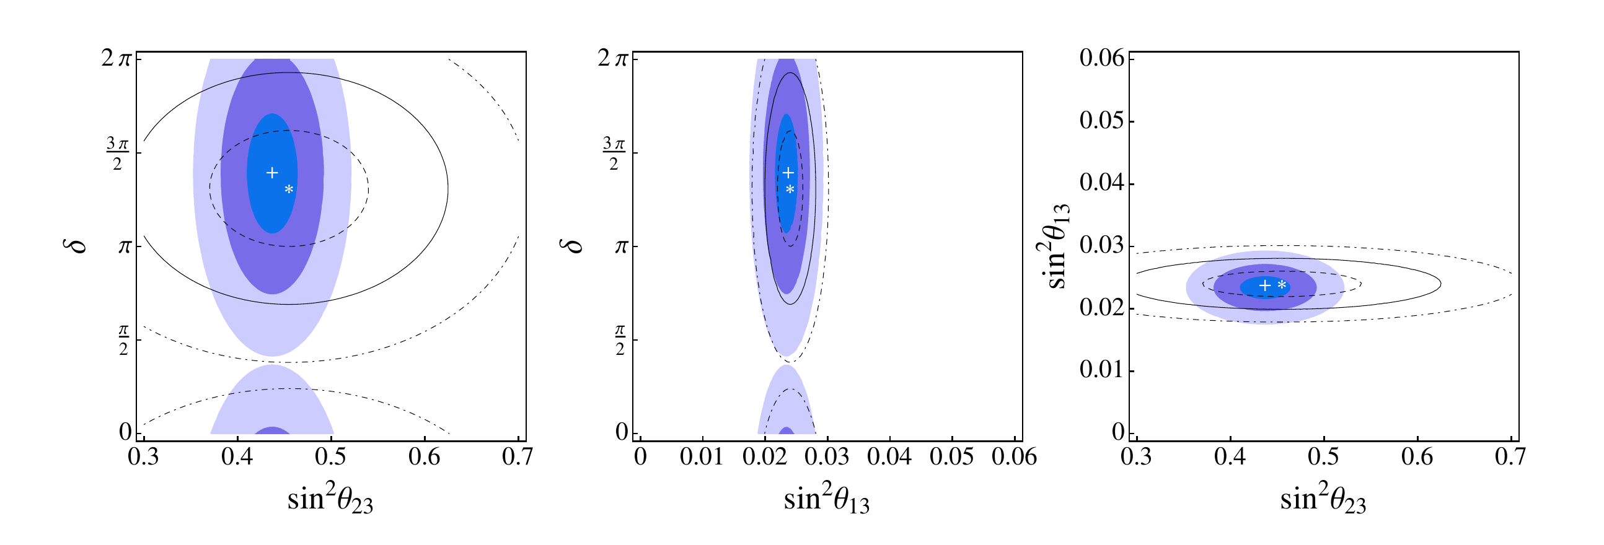
Statistical Details: Comparison
1)
2)

Slide 21
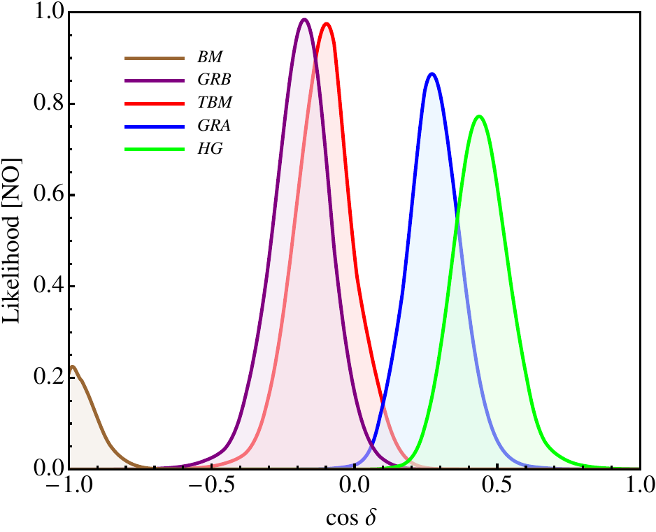
Predictions for cos δ
Statistical analysis: likelihood function
R₁₂(θ^{e}₁₂) R₂₃(θ^{e}₂₃):
Using latest results on sin² θ_{ij} and δ, obtained in global analysis of neutrino oscillation data in F. Capozzi et. al., PRD 89 (2014) 093018
Using prospective 1σ uncertainties on sin² θ_{ij}: 0.7% for sin² θ₁₂ (JUNO) 3% for sin² θ₁₃ (Daya Bay) 5% for sin² θ₂₃ (NOvA and T2K) + Gaussian approximation

Slide 22
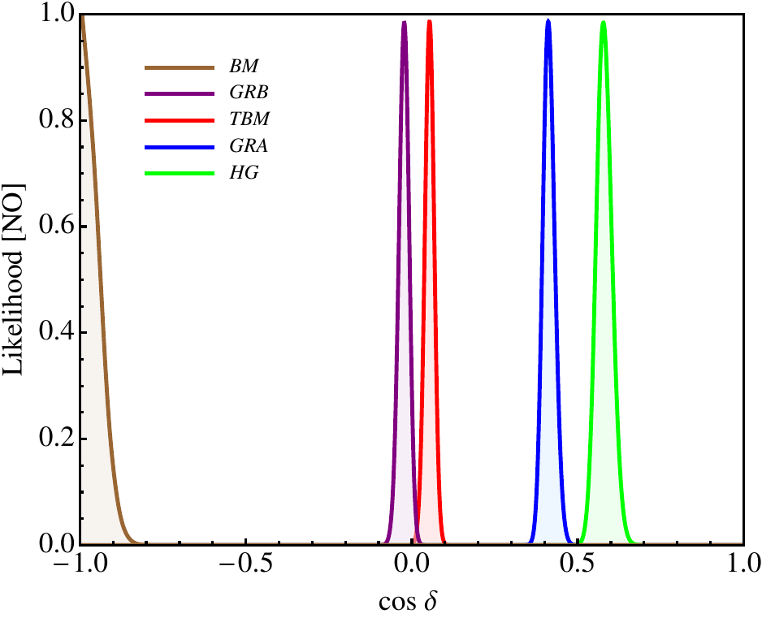
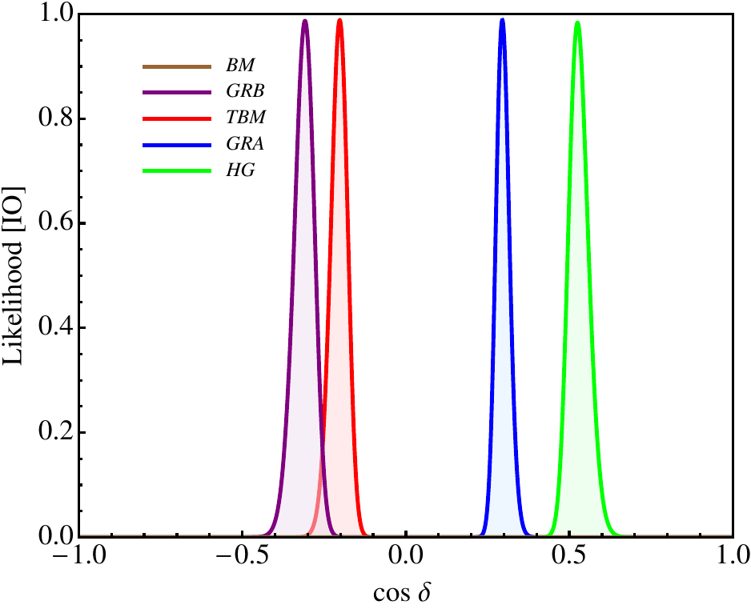
Dependence on Best Fit Values
Statistical analysis: likelihood function
R₁₂(θ^{e}₁₂) R₂₃(θ^{e}₂₃):
(sin² θ₁₂)_{bf} = 0.332
(sin² θ₂₃)_{bf} = 0.437
(sin² θ₁₃)_{bf} = 0.0234
(sin² θ₁₂)_{bf} = 0.304
(sin² θ₂₃)_{bf} = 0.579
(sin² θ₁₃)_{bf} = 0.0219
IO neutrino mass spectrum
M.C. Gonzalez-Garcia et. al., JHEP 1411 (2014) 052

Slide 23
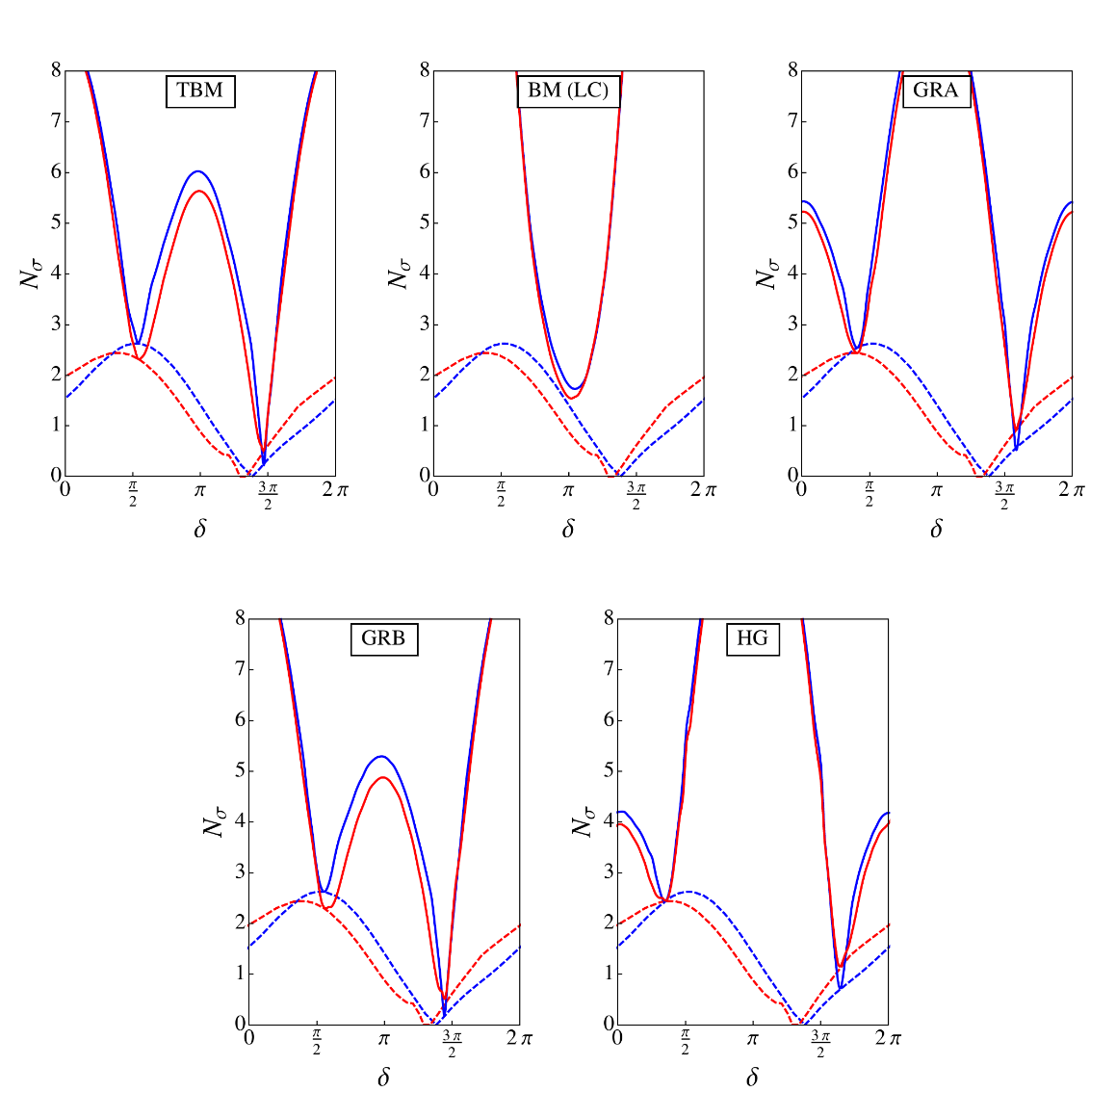
Predictions for δ
R₁₂(θ^{e}₁₂) R₂₃(θ^{e}₂₃):
NO scheme
IO scheme
NO global fit
IO global fit
Using latest results on sin² θ_{ij} and δ, obtained in global analysis of neutrino oscillation data in F. Capozzi et. al., PRD 89 (2014) 093018

Slide 24
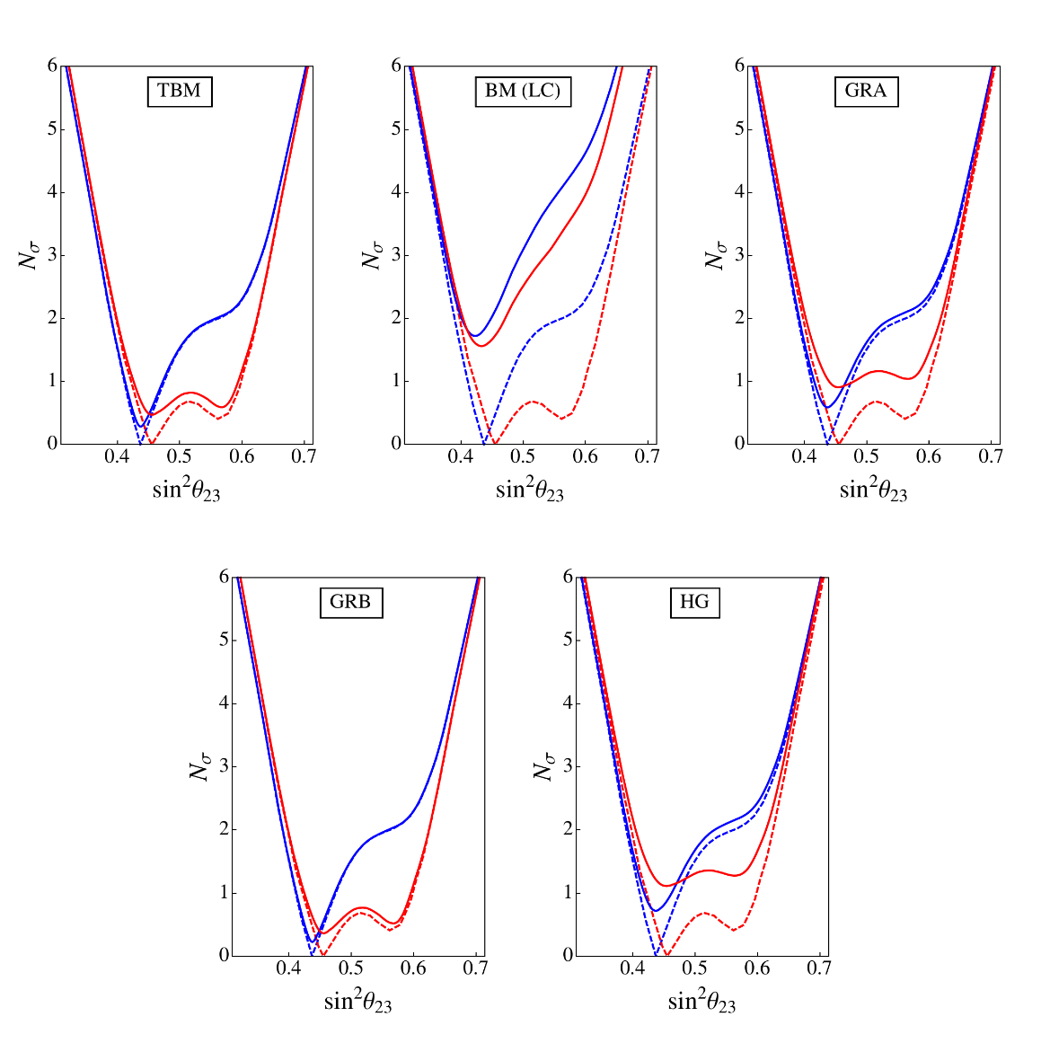
Results for sin² θ₂₃
R₁₂(θ^{e}₁₂) R₂₃(θ^{e}₂₃):
NO scheme
IO scheme
NO global fit
IO global fit
Using latest results on sin² θ_{ij} and δ, obtained in global analysis of neutrino oscillation data in F. Capozzi et. al., PRD 89 (2014) 093018

Slide 25
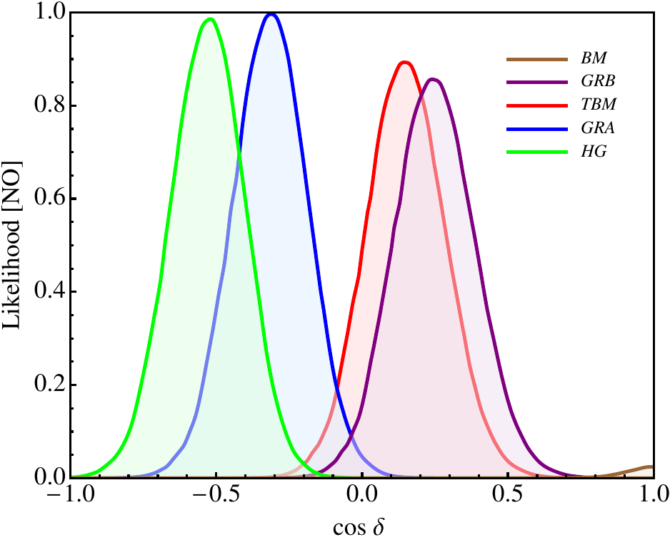
Predictions for cos δ
Statistical analysis: likelihood function
R₁₃(θ^{e}₁₃) R₂₃(θ^{e}₂₃):
Using latest results on sin² θ_{ij} and δ, obtained in global analysis of neutrino oscillation data in F. Capozzi et. al., PRD 89 (2014) 093018
Using prospective 1σ uncertainties on sin² θ_{ij}: 0.7% for sin² θ₁₂ (JUNO) 3% for sin² θ₁₃ (Daya Bay) 5% for sin² θ₂₃ (NOvA and T2K) + Gaussian approximation

Slide 26
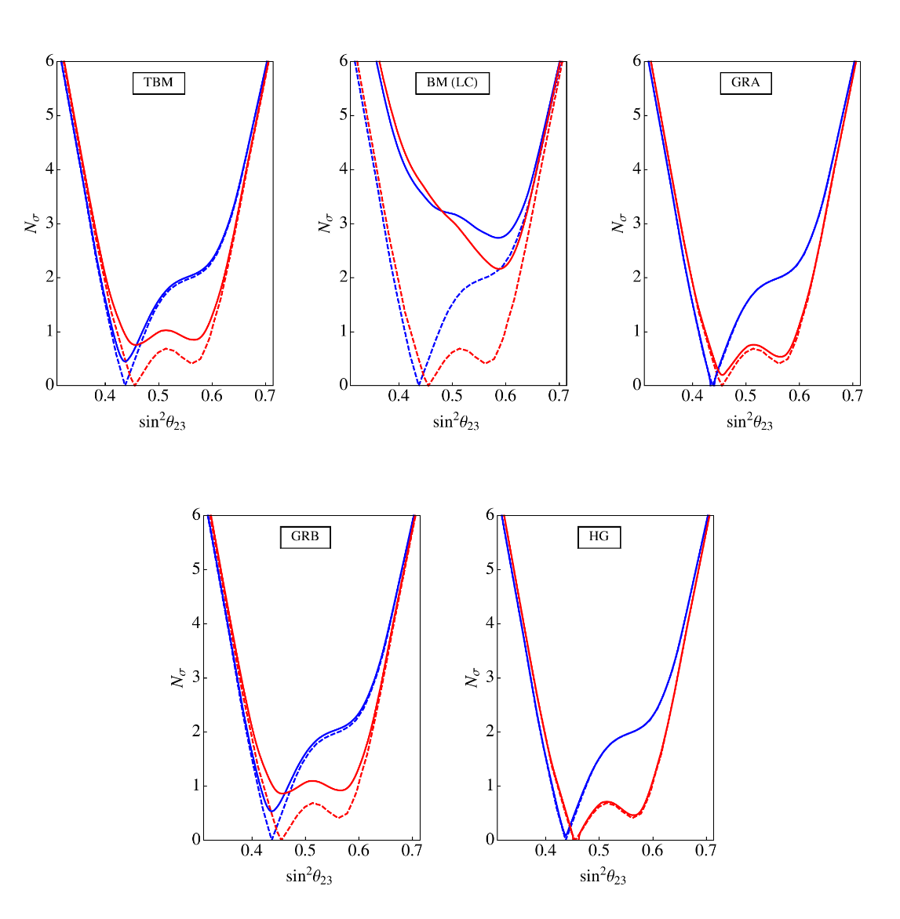
Results for sin² θ₂₃
R₁₃(θ^{e}₁₃) R₂₃(θ^{e}₂₃):
NO scheme
IO scheme
NO global fit
IO global fit
Using latest results on sin² θ_{ij} and δ, obtained in global analysis of neutrino oscillation data in F. Capozzi et. al., PRD 89 (2014) 093018

Slide 27
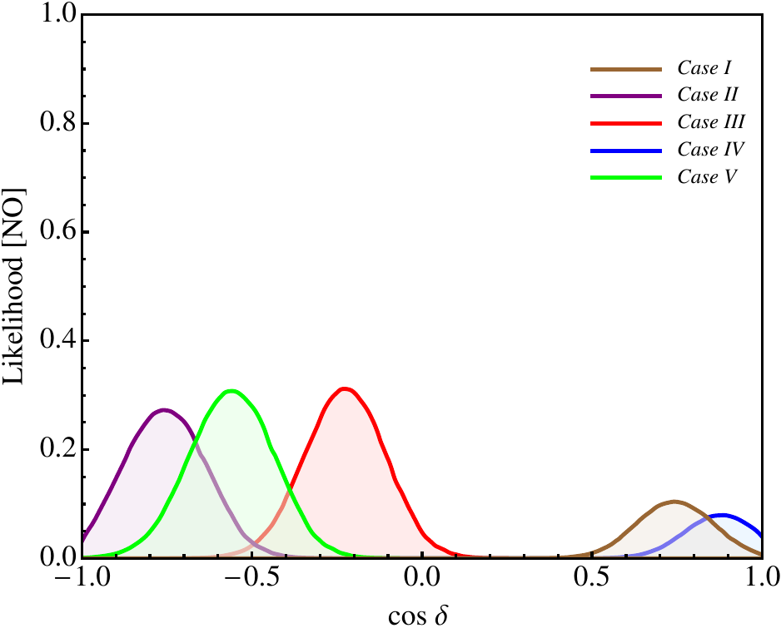
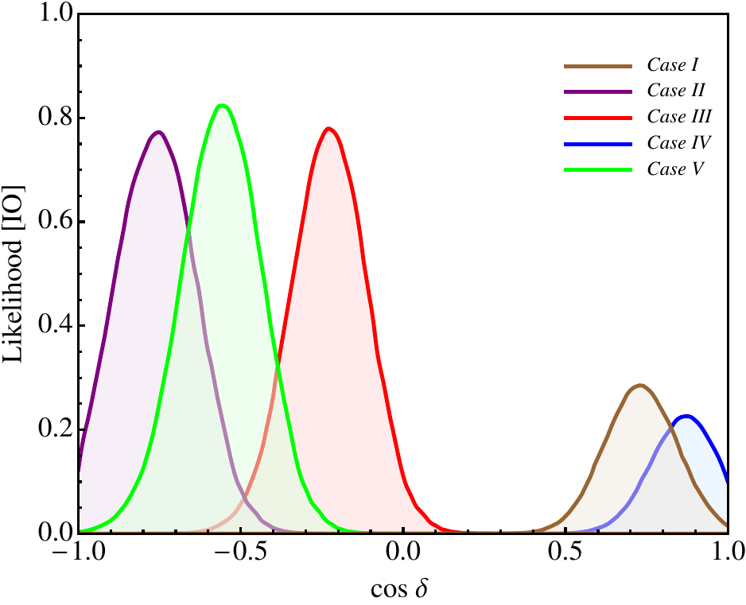
Predictions for cos δ
Statistical analysis: likelihood function
R₁₂(θ^{e}₁₂):
Using latest results on sin² θ_{ij} and δ, obtained in global analysis of neutrino oscillation data in F. Capozzi et. al., PRD 89 (2014) 093018
[θ^{ν}₁₃, θ^{ν}₁₂]: Case I = [π/10, -π/4] Case II = [π/20, arcsin (1/√(2+r))] Case III = [π/20, -π/4] Case IV = [arcsin (1/3), -π/4] Case V = [π/20, π/6]

Slide 28
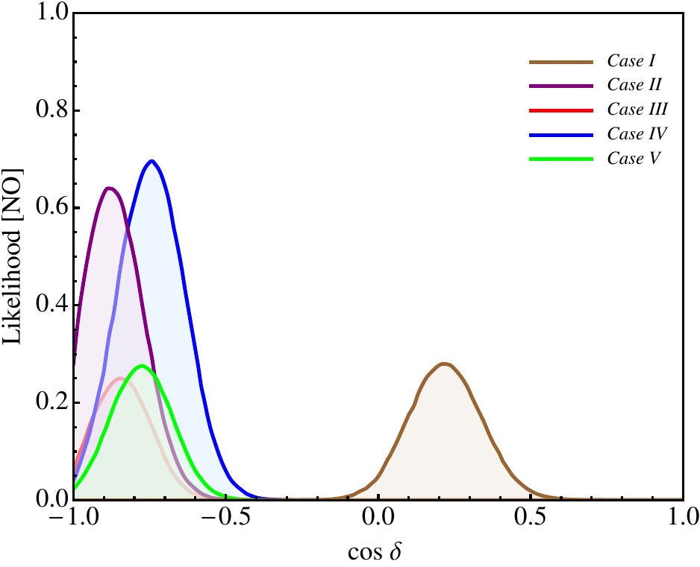
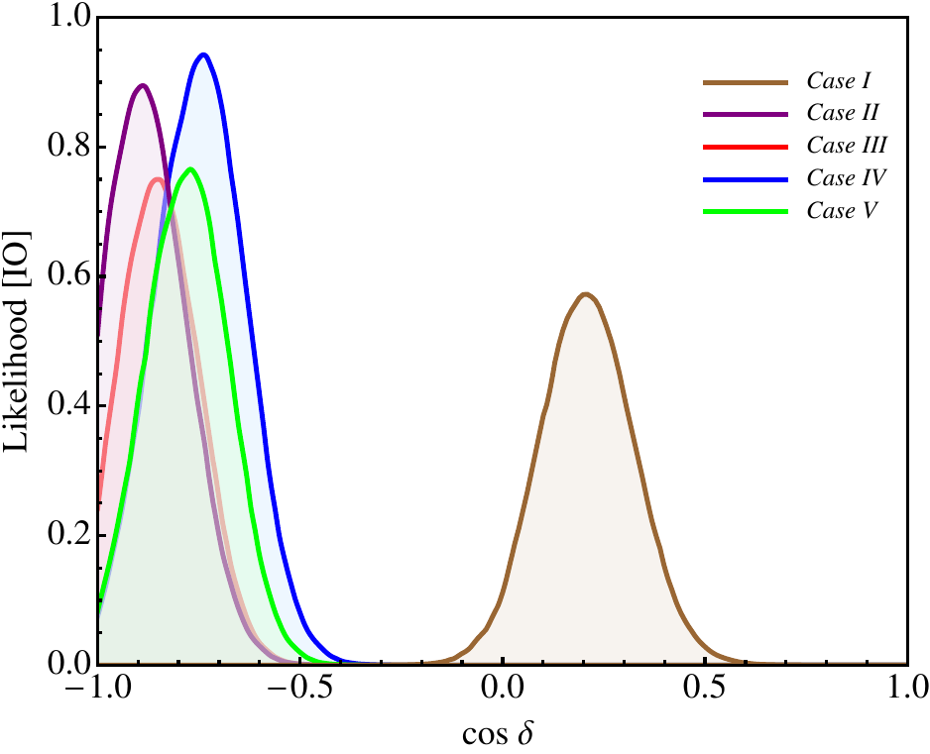
Predictions for cos δ
Statistical analysis: likelihood function
R₁₃(θ^{e}₁₃):
Using latest results on sin² θ_{ij} and δ, obtained in global analysis of neutrino oscillation data in F. Capozzi et. al., PRD 89 (2014) 093018
[θ^{ν}₁₃, θ^{ν}₁₂]: Case I = [π/20, π/4] Case II = [arcsin (1/3), π/4] Case III = [π/20, arcsin (1/√3)] Case IV = [π/10, π/4] Case V = [π/20, arcsin (√(3-r)/2)]

