Slide 1
Recent Results from Belle
Prafulla K. Behera
IIT Madras,
(on behalf of Belle Collaboration)
@25th International Workshop on Weak Interactions and Neutrinos (WIN2015)
9th June 2015

Slide 2
Outline
Dr. Prafulla Kumar Behera, IIT Madras
9th June 2015

Slide 3
KEKB and Belle
Dr. Prafulla Kumar Behera, IIT Madras
9th June 2015

Slide 4
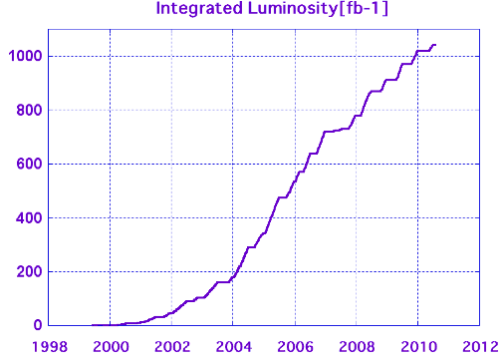
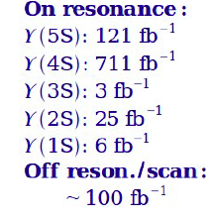
Integrated luminosities
Belle recorded more than 1 ab⁻¹!
fb⁻¹
772 X 10⁶ BB pairs
Dr. Prafulla Kumar Behera, IIT Madras
9th June 2015

Slide 5
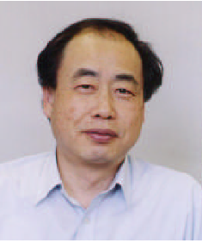
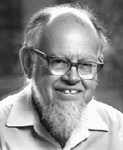
N. Cabibbo
M.Kobayashi
T.Maskawa
Amplitudes and Phases in the Weak Interaction
L. Wolfenstein
Dr. Prafulla Kumar Behera, IIT Madras
9th June 2015
Notes:
Let’s now discuss amplitudes and phases in the weak interaction. Weak interaction eigenstates are rotated versions of flavor eigenstates. Cabibbo et al realized that upper left portion of the mixing matrix is a rotation matrix. However, to accommodate CP violation, which was first observed 50 years ago,
Kobayashi and Maskawa realized that one needed three generations of quarks (only two were known at the time).
Wolfenstein provided a phenomenological parameterization of the mixing matrix. His version makes it crystal clear that the complex parts, which give raise to CP violation are in the corners (V_td and V_ub). N.B. that V_ts does NOT have a complex phase

Slide 6
Three Angles: φ₁,φ₂,φ₃
B⁰ → π⁻ π⁺
Unitarity implies that the weak couplings and phases form a triangle in the complex plane.
ICHEP 2014: New Belle result on π⁰ π⁰
B⁰→Ψ K_{s},Ψ K_{L}
B⁻ →D_{CP} K⁻
Big Questions: Are determinations of angles consistent with determinations of the sides of the triangle ? Are angle determinations from loop and tree decays consistent ?
Dr. Prafulla Kumar Behera, IIT Madras
9th June 2015

Slide 7
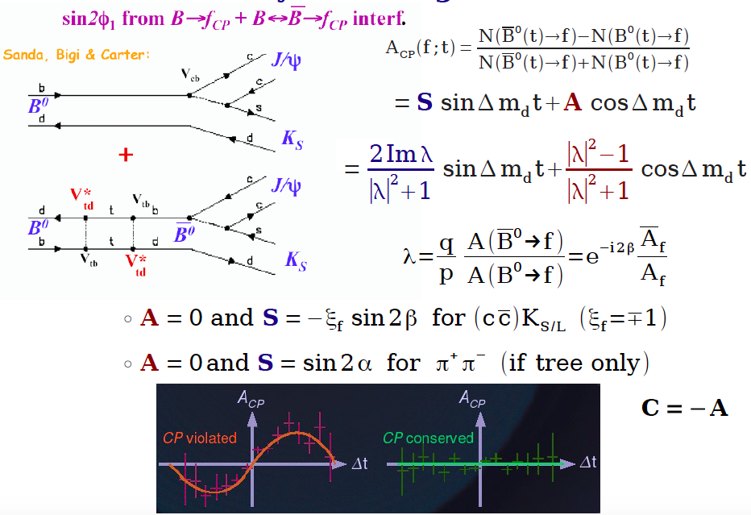
Time- dependant CP Asymmetrie in decays to CP eigenstates
ϕ₁
ϕ₂
Dr. Prafulla Kumar Behera, IIT Madras
9th June 2015

Slide 8
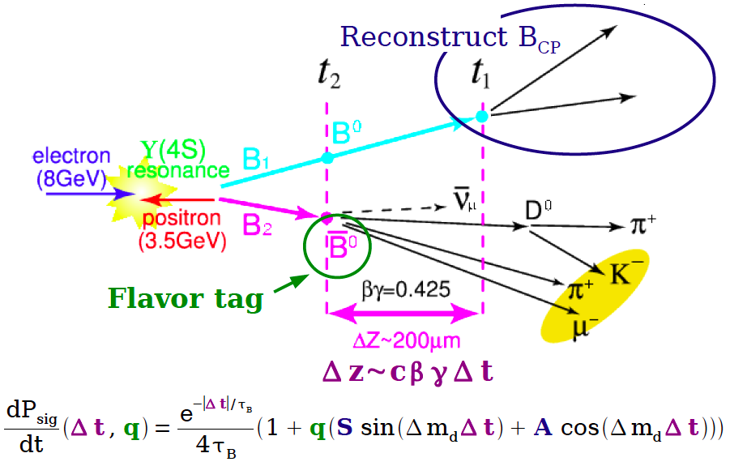
Measuring the CP parameters S and A
Dr. Prafulla Kumar Behera, IIT Madras
9th June 2015
Notes:
Clean environment, excellent tracking, vertexing and tagging with good particle identification.

Slide 9
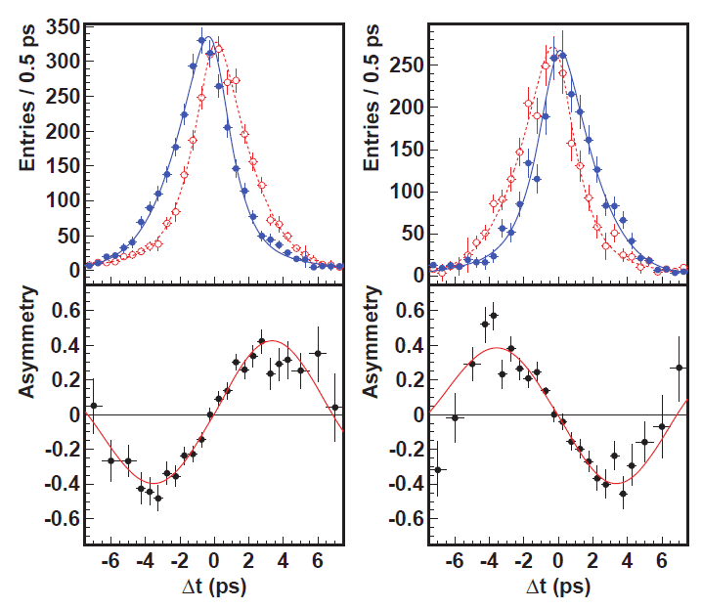
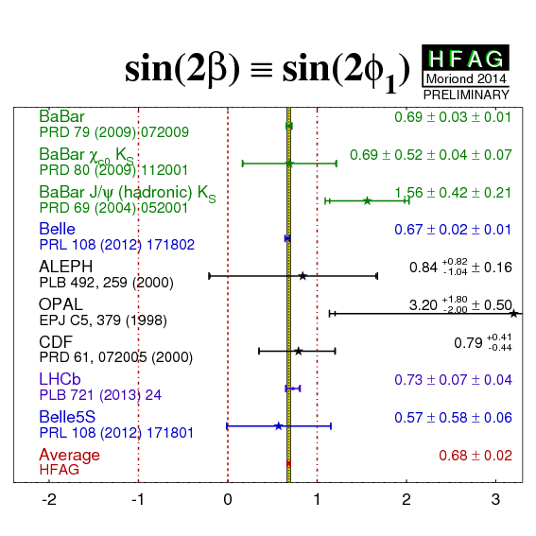
Measurement of sin(2φ₁) in Charmonium K⁰ modes
sin(2φ₁)=0.667±0.023±0.012
A_{f}=0.006±0.016±0.012
PRL108,171802 (2012)
J/ψK_{S}
J/ψK_{L}
Overpowering evidence for CP violation (matter-antimatter asymmetries). >>>> The phase of V_{td} is in good agreement with Standard Model expectations
Dr. Prafulla Kumar Behera, IIT Madras
9th June 2015
~25 Institutes in India, about 100 collaborators
~25 Institutes in India, about 100 collaborators
~25 Institutes in India, about 100 collaborators

Slide 10
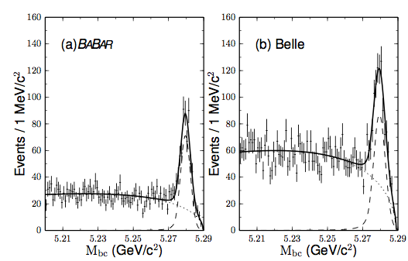
CP violation in B⁰ D_{cp}^{(*)} h⁰
D = D_{cp}, CP eigenstates as K⁺K⁻, K_{s} π⁰ , K_{s}ω
h⁰ = π⁰, ηω
CP violation measurement
performed using
Indices i and j denotes the event
reconstructed from BABAR and
Belle data respectively.
arXiv:1505.04147
Submitted to PRL
Dr. Prafulla Kumar Behera, IIT Madras
9th June 2015

Slide 11
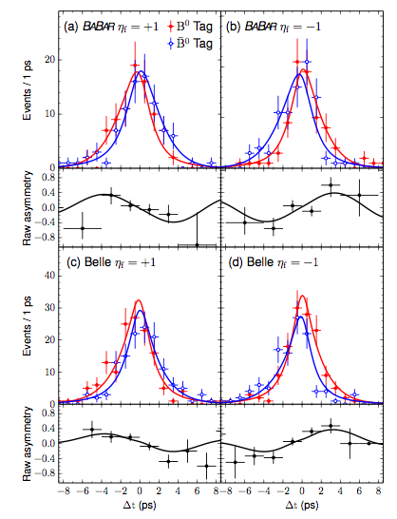
CP violation in B⁰ D_{cp}^{(*)} h⁰
Purity= 63%
sin(2ϕ₁) = 0.66 ± 0.10 ± 0.06
The measurement is
consistent with
measurement from
Purity= 55%
J/ψK⁰
Dr. Prafulla Kumar Behera, IIT Madras
9th June 2015

Slide 12
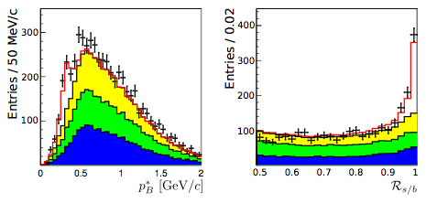
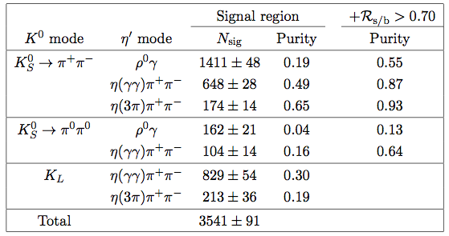
CPV in b sqq decays B⁰ η’K⁰
JHEP 10 (2014) 165
Dr. Prafulla Kumar Behera, IIT Madras
9th June 2015

Slide 13
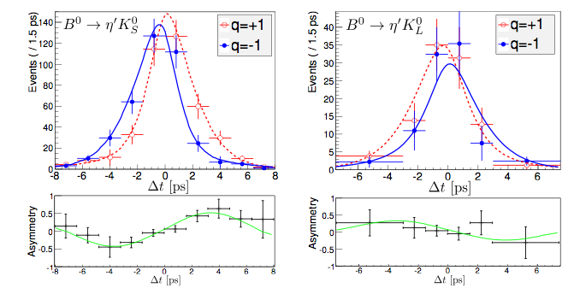
CPV in b sqq decays B⁰ η’K⁰
JHEP 10 (2014) 165
Dr. Prafulla Kumar Behera, IIT Madras
9th June 2015

Slide 14
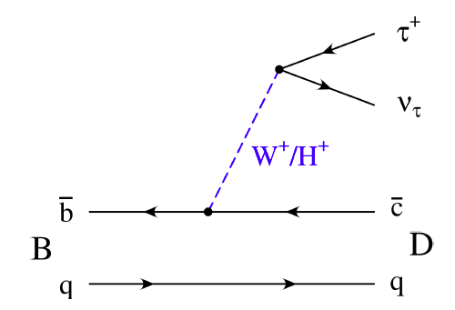
Process with third generation quarks and leptons
New physics could change:
Branching fraction
Tau polarization
Effect could be different
for D and D*
Experimental Challenge: 2 ( hadronic tau decay) or
3 (leptonic tau decay) undetected neutrinos
Dr. Prafulla Kumar Behera, IIT Madras
9th June 2015

Slide 15
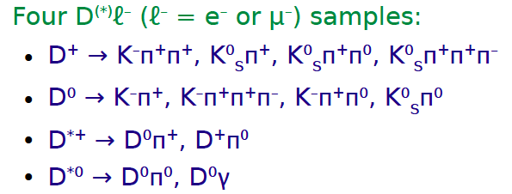
Signal Reconstruction
Dr. Prafulla Kumar Behera, IIT Madras
9th June 2015

Slide 16
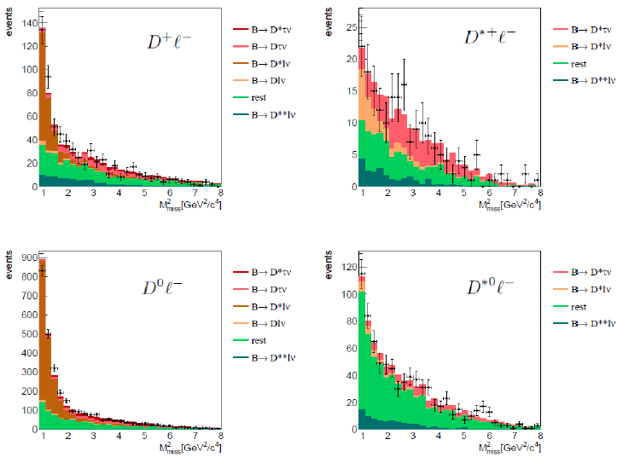
Fit Projections High M²_{miss}
Dr. Prafulla Kumar Behera, IIT Madras
9th June 2015

Slide 17
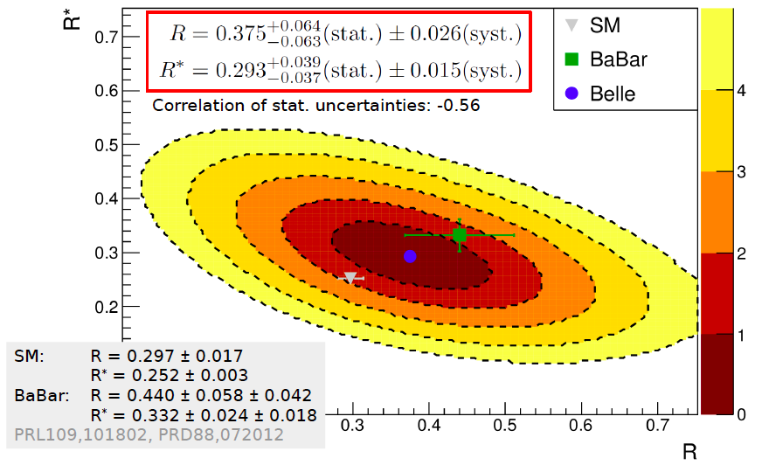
Result
Dr. Prafulla Kumar Behera, IIT Madras
9th June 2015

Slide 18
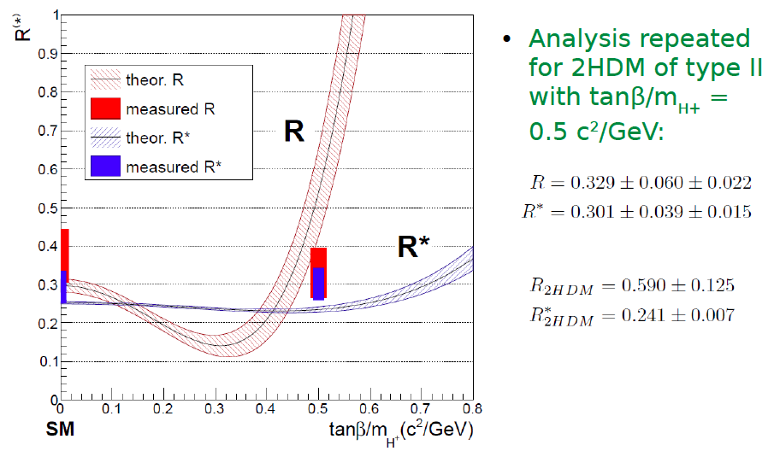
How About New Physics?
Consistent with 2HDM of type at tanβ/m_{H+} ≈ 0.5 c²/GeV
Dr. Prafulla Kumar Behera, IIT Madras
9th June 2015

Slide 19
Search for the dark photon and dark Higgs boson
Dark photon A’ and dark Higgs boson h’ hypothetical constituent in
proposed Dark sector Models P. Fayet, Phys. Lett. B95, 285 (1980).
Production and Decay:
Dr. Prafulla Kumar Behera, IIT Madras
9th June 2015

Slide 20
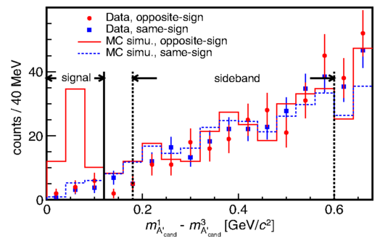
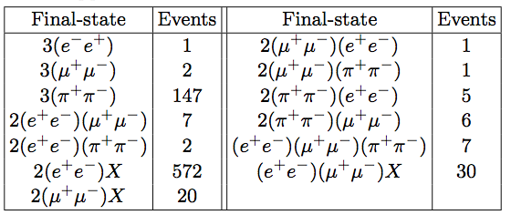
Candidate Selection
Final Events summary after final selection
and
are the
dark photon candidates with highest
and lowest mass.
Dr. Prafulla Kumar Behera, IIT Madras
9th June 2015

Slide 21
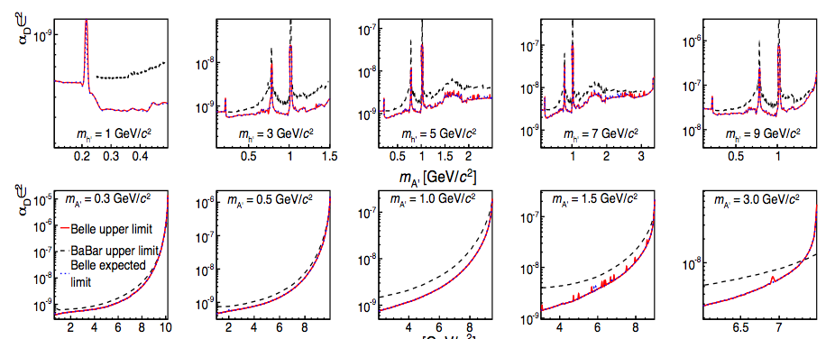
No significant Signal
α_{D} : Dark photon coupling to dark Higgs boson: ε² = α’/α_{em}
dark photon mass
Dark Higgs mass
90%CL upper limit on the product α_{D} ×ε²
Dr. Prafulla Kumar Behera, IIT Madras
9th June 2015

Slide 22
branching fraction
B-decay constant from lattice calculation
is given by
From unitarity constrained
Expected to be highest for leptonic decay
Eur. Phys. J. C 41, 1-131 (2005)
Dr. Prafulla Kumar Behera, IIT Madras
9th June 2015

Slide 23
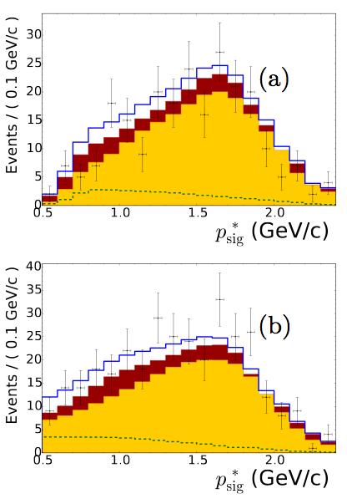
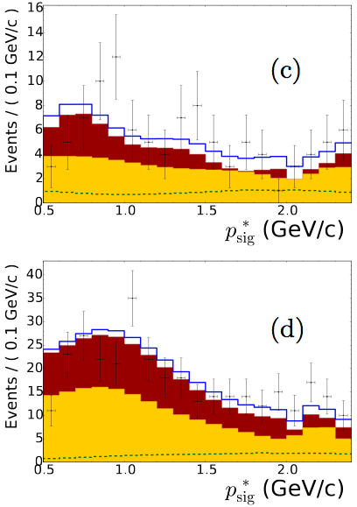
Result
arXiv:1503.05613 )
Dr. Prafulla Kumar Behera, IIT Madras
9th June 2015

Slide 24
B→π⁰ π⁰
Proceeds via b u tree and ( EWP + QCD ) penguin
B π⁰π⁰ needed to remove “penguin pollution”
Theory (QCD fact.) B≤ 1×10⁻⁶ Nucl. Phys. B675 333(2003)
Dr. Prafulla Kumar Behera, IIT Madras
9th June 2015

Slide 25
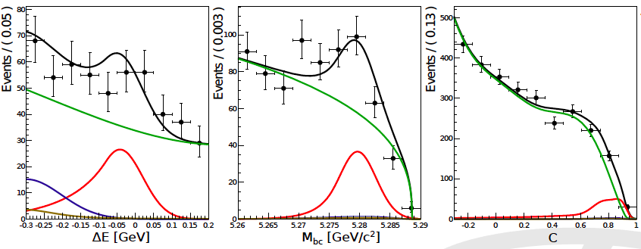
B→π⁰ π⁰ Results (preliminary)
B( B⁰ π⁰ π⁰ ) = (0.90 ± 0.12 ± 0.10 ) × 10⁻⁶
Dr. Prafulla Kumar Behera, IIT Madras
9th June 2015

Slide 26
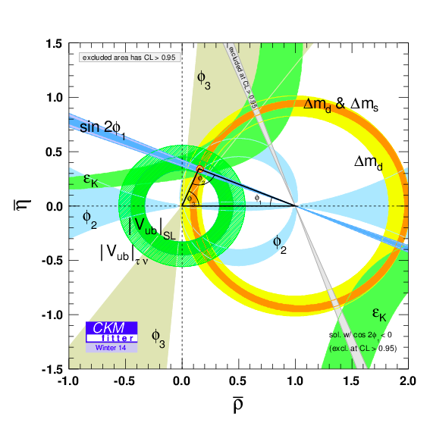
Conclusion
Measured angles and phase are consistent with SM.
But 10- 20% NP effects are consistent with data.
Dr. Prafulla Kumar Behera, IIT Madras
9th June 2015

Slide 27
Conclusion
Consistent with 2HDM of type at tanβ/m_{H+} ≈ 0.5 c²/GeV
No significant signal for dark photon and dark Higgs
Measured branching ratio for B decays τνis consistent with SM
Measured branching ratio for B decays to π⁰ π⁰ is consistent with SM
Dr. Prafulla Kumar Behera, IIT Madras
9th June 2015

