Slide 1
Microscopic Gravity and Particle Physics
Gia Dvali
CERN Theory Division
& Max Planck Institute for Physics
& CCPP, New York University

Slide 2
Outline
1) The Hierarchy Problem and the Role of Gravity
2) Quantum Gravity (Extra Dimensions, Strings and Black Holes)
at TeV ?
3) The Role of Particle Species
4) Some General Properties of Macroscopic Black Holes
5) Lesson from the Black Hole Physics:
Existence of Species (Flavors) Affects Short-Distance Gravity.
6) What About the Microscopic Black Holes?
7) Phenomenological and Fundamental Implications
8) Conclusions

Slide 3
THE SEARCHES OF THE NEW (BEYOND THE STANDARD
MODEL) PHYSICS AT THE LARGE HADRON COLLIDER
ARE (Mainly) MOTIVATED BY THE HIERARCHY PROBLEM,
AN INEXPLICABLE STABILITY OF THE WEAK INTERACTION
SCALE (M_{W} = 10² GeV) VERSUS THE PLANCK MASS
(M_{P} = 10¹⁹ GeV),
WHY IS M²_{W}/M²_{P} = 10⁻³⁴ ?

Slide 4
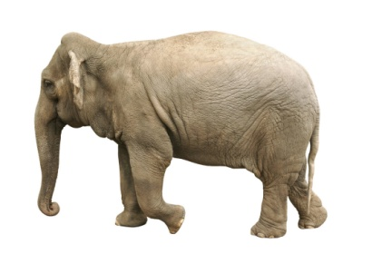
THE HIERARCHY PROBLEM IS NOT ABOUT BIG/SMALL NUMBERS!
THERE ARE PLENTY OF BIG/SMALL NUMBERS IN NATURE THAT ARE OF NO MYSTERY.
L
L
10¹²
ELEPHANTS (OR HUMANS) ARE BIG, BECAUSE THEY CARRY A HUGE BARYON NUMBER.

Slide 5
THE HIERARCHY PROBLEM IS ABOUT THE UV STABILITY OF THE VERY SMALL NUMBER
M²_{W}/M²_{P} = 10⁻³⁴

Slide 6
STANADARD MODEL
GAUGE FORCES: SU(3)xSU(2)xU(1)
MATTER:
QUARKS : (u,d) (c,s) (t,b), LEPTONS: (e,ν_{e}) (μ, ν_{μ}) (τ, ν_{τ})
HIGGS: H
The weak scale is set by the vacuum expectation value of the Higgs
field, which is related to the mass of the Higgs boson, m_{H} .
This mass is UV-unstable!

Slide 7
UV-instability of the Higgs mass
H
t
H
H
+
+
t
H
H
δm²_{H} ≈ Λ² !
The natural cutoff is the gravity scale Λ = M_{P}

Slide 8

Without gravity the problem could have been less severe, but with gravity there is no way out:
The particles running in the loop cannot have arbitrarily
high energies without becoming big black holes!
H
H

Slide 9
Thus, unless some measures are taken, any correction
to the Higgs mass would be cutoff at the Planck scale,
and it’s a mystery what keeps it lighter.
THUS, THERE MUST BE SOME NEW PHYSICS, NOT
FAR ABOVE THE WEAK SCALE , WHICH STABILIZES
THE HIGGS MASS,
AND LHC SHOULD PROBE IT.
WHAT IS THIS NEW PHYSICS?

Slide 10
It may be something with no observed analog in physics:
An extra dimension with anti-commuting coordinates - SUSY
{ θ_{α}θ_{β}} = 0
θ
t, x,y,z
Bosons and Fermions
The superpartners are analogs of KK excitations in θ-dimension.

Slide 11
But,
* Translations in θ - dimension are broken at low energies:
SUSY is not an exact symmetry of nature.
WHY?
* Generic breaking of SUSY would violate flavor. So, whatever dynamics
broke SUSY, it cared to conserve the flavor.
WHY?
* Generic SUSY would violate baryon (and lepton) number already at the
renormalizable level. Again, some underlying mechanism took care
of B-conservation.
WHY?
The list goes on and on

Slide 12
Great thing about low energy SUSY:
Once the boundary conditions are specified in UV,
computations can be done in a weakly-coupled
theory, largely avoiding cutoff sensitivities.
E.g., prediction of the gauge coupling unification
(Dimopoulos, Raby, Wilczek; Einhorn & Jones; Marciano & Senjanovic)
There are other little beautiful things.
E.g., electroweak symmetry breaking can be
triggered radiatively.

Slide 13
There are ways in which nature is known
to have already worked.
Some approaches to the Hierarchy
Problem employ the generalizations of
such known phenomena of nature, which
are taking place at different energies.

Slide 14
Approaches we discussed so far share the philosophy of the ``Standard Paradigm” ‘74
E
Planck mass M_{P} =10¹⁹GeV
Quantum Gravity (String) Scale
SUSY / New Strong Force
Weak Scale M_{W} = 10² GeV

Slide 15
There is an alternative approach that makes use of a known
phenomenon in Einstenian (or Newtonian) gravity.
As said above, in Einstein’s gravity M_{P} is the scale where
gravitational interactions of elementary particles become
strong.
In any sensible theory of gravity, which at large distances
reduces to Einstein’s GR, a point-like elementary particle
heavier than M_{P} makes no sense.

Slide 16
In fact we know very well what such an object is:
Because its gravitational Schwarzschild radius exceeds its Compton wavelength,
R = m/M²_{P} > 1/m ,
it is a macroscopic classical black hole!
And becomes more and more classical with the growing
mass.
R

Slide 17
This is an exceptional power of gravity, it provides us with a
shortest distance scale, beyond which things again become
classical!
So, in SM + GR if Higgs had a mass of order M_{P} , nobody
would ask the question, why it’s not even heavier. Because, if it
were heavier, it would stop to be a particle and become
something fuzzy and classical.

Slide 18
Now, given that we know that strong gravity scale is an universal regulator of particle masses, let’s ask:
How do we know that gravity is waiting all the way till M_{P} energies for becoming strong?
Well, we don’t.
So why not at TeV?

Slide 19
’98 Quantum Gravity at TeV Idea:
Weak scale is stable, because the quantum gravity scale M* ≈ TeV !
(Arkani-Hamed, Dimopoulos, GD;
Antoniadis, Arkani-Hamed, Dimopoulos, GD)
But, if gravity becomes strong around the TeV scale, why is the large distance gravity so much weaker than all the other forces of nature?
For example, gravitational attraction between the two protons at 1 m distance is 10³⁷ times weaker of their Coulomb repulsion!
Original Realization: Extra Dimensions

Slide 20
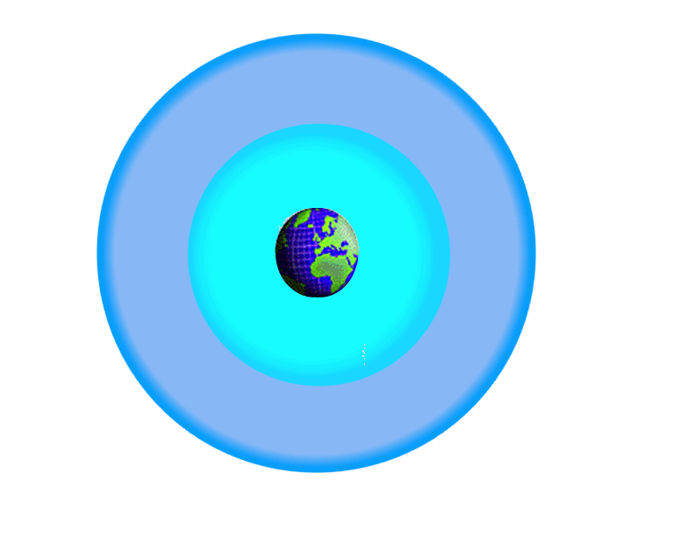

Slide 21
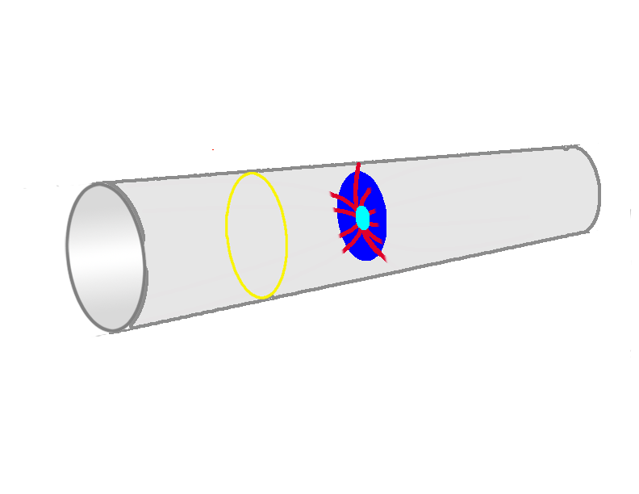

Slide 22
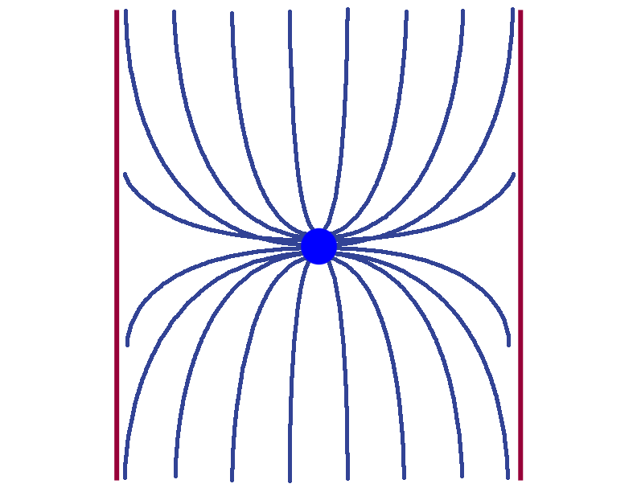

Slide 24
As a result of the dilution, there is a simple relation between the true quantum gravity scale and the Planck mass measured at large distances:
M²_{P} = M²* (M*R)^{n}
Volume of extra space

Slide 25
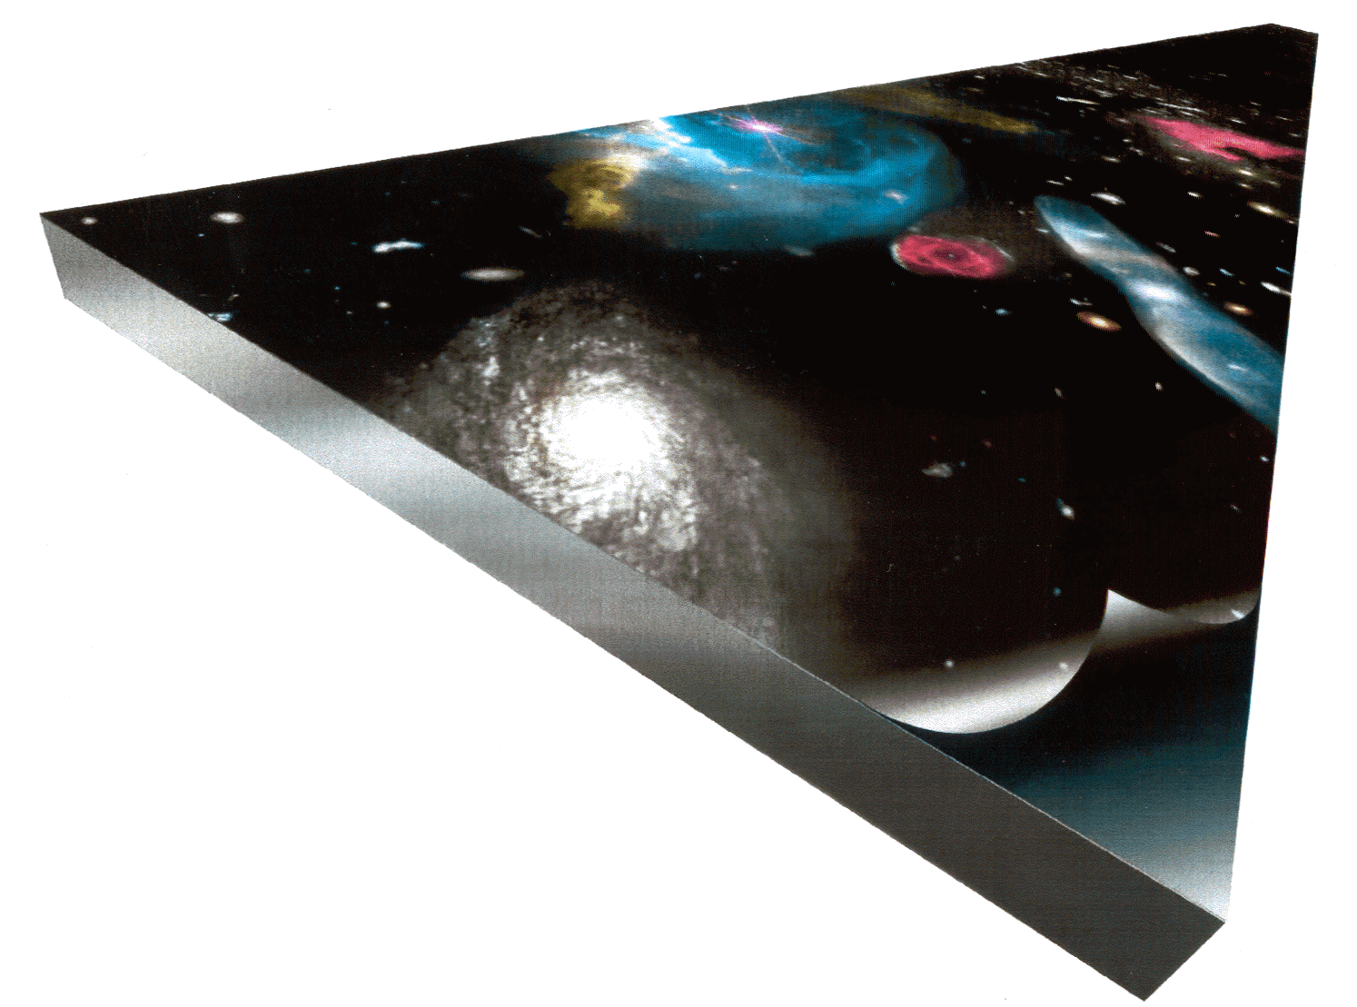

Slide 26
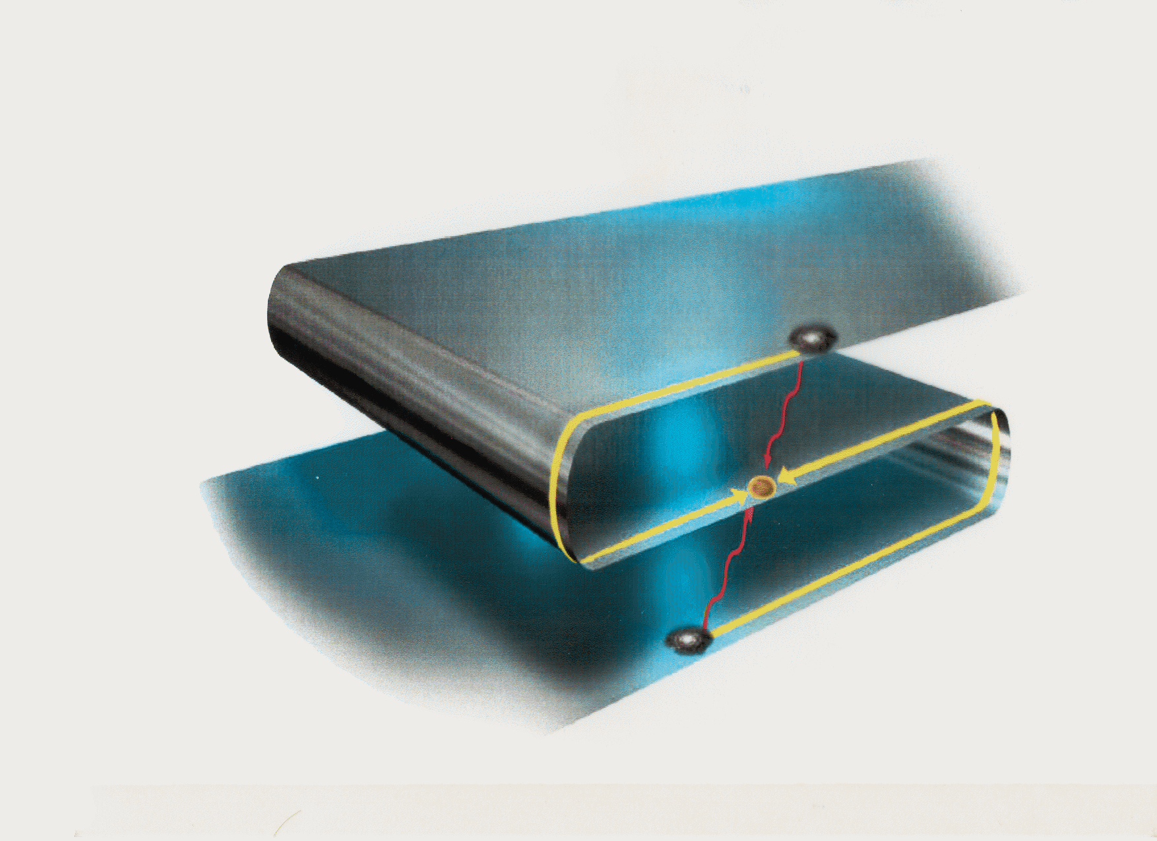
Gravitational shortcut

Slide 27
STRING THEORY PICTURE
closed
strings
open
strings
ordinary
particles
gravity

Slide 28


Slide 29
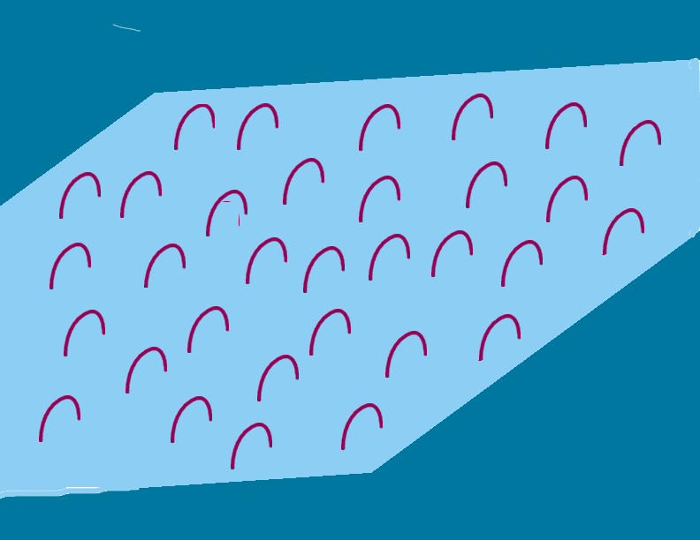

Slide 30


Slide 31
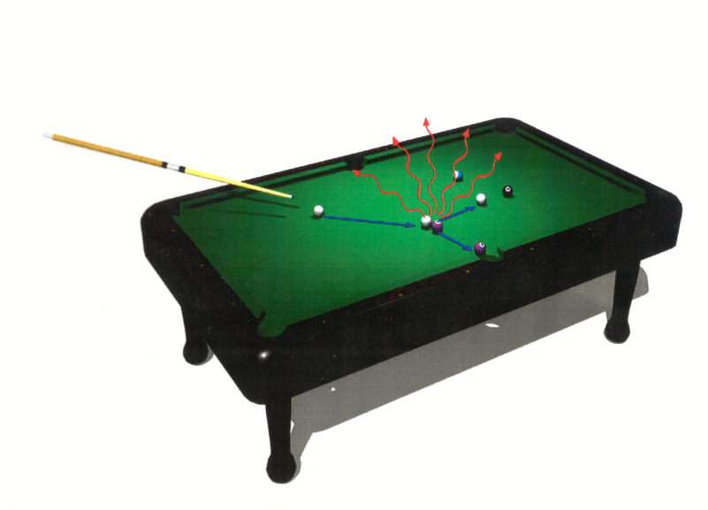

Slide 32
Experimental signatures of low scale quantum gravity are pretty spectacular.
These include formation of mini black holes, Kaluza-Klein
gravitons, and string vibrations in particle collisions
(e.g., high spin recurrences of ordinary particles).
(For a recent detailed study of string production within type II strings see work by, Lust, Stieberger, Taylor; ... )

Slide 33
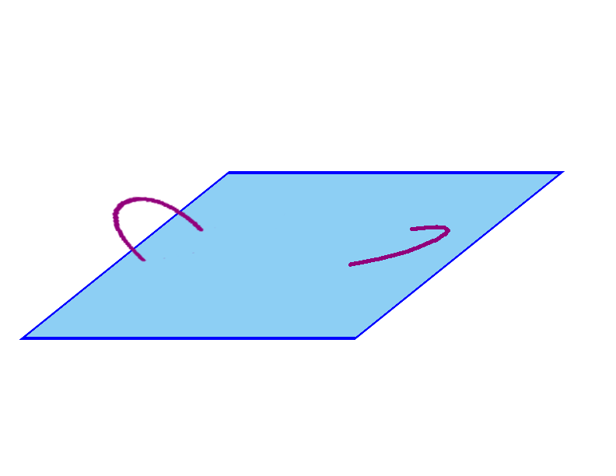

Slide 34
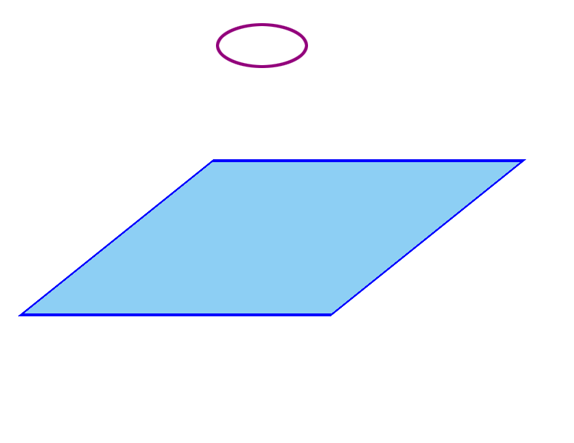

Slide 35
The Role of Particle Species in Lowering Gravity Scale.
M²_{P} = M²* (M*R)^{n}
Volume of extra space
Notice, that the above relation can be rewritten as,
M²_{P} = M²* N,
Where N is the number of Kaluza-Klein species . This very important, because the latter expression turns out to be more general than the former:
What matters is the number of species!

Slide 36
It follows from the consistency of Black Hole physics that in any theory with N species the scale of quantum gravity is inevitably lowered, relative to the Planck mass
M²* = M²_{P} /N !
The fundamental length scale at which classical gravity is getting strong is
L* = M⁻¹* = √N / M_{P} .
This can be proven by black hole thought experiments.
[GD; GD & Redi ’07; GD & Lüst ‘08]

Slide 37
Hawking flux with T = 1/R
R
In Einstein’s GR Black holes are strongly gravitating objects with escape
velocity at the horizon > speed of light. Therefore, classically, they are
absolutely black.
However, quantum mechanically Black Holes evaporate with the
Hawking temperature
T = 1/ R

Slide 38
Evaporation of Einsteinian Black Holes is thermal and is fully democratic in all the particle species (flavors).
The rate of mass change is:
dM/dt = T⁴ R² N = T² N ,
where N is the number of particle flavors.
The condition of quasi-classicality: The rate of temperature-change is slower than the temperature-squared,
dT/dt < T² .
The Black Holes that violate this condition cannot be quasi-classical, because they half-evaporate faster than their size!

Slide 39
Hawking flux of N species with T = 1/R
The black holes of size
R < L* = √N / M_{P}
cannot afford to be semi-classical, because they half-evaporate
Faster than their size!
Equivalently, the rate of temperature-change is faster than the
temperature-squared
dT/dt > T²

Slide 40
Thus, the fundamental length scale below which
no semi-classical black holes can exist in any
consistent theory with N species is
L* = √N / M_{P}
and the corresponding mass scale marks the cutoff.
M²* = M²_{P} /N

Slide 41
Alternative proof of the bound comes from species resolution experiments
[G.D., Gomez, `08]
N species exist as long as we can distinguish them by physical measurements.
What is the minimal space-time scale L on which we can decode species
identities?
Any decoder contains samples of all N species in each pixel .
So the space-time resolution is set by the size of the pixel.
How small can this size be?

Slide 42
Message encoded in a green flavor
Pixel of size L, with all the sample flavors

Slide 43
Without gravity, there is no limit to the smallness of L.
But with gravity there is, because localization of species costs energy,
E > N/L ,
which gravitates and eventually will collapse into a black hole.
We must have L > √N / M_{P} , or else the processor itself collapses into a black hole!
(By the way, this sets the lower bound on any particle detector that an arbitrarily advances civilization may construct.)

Slide 44
Strength of Gravity as Function of Distance
mr_{g}
M⁻¹_{P}
√N/M_{P}
R
m⁻¹

Slide 45
The black hole arguments show, that the class of theories which solve the Hierarchy Problem by TeV quantum gravity scale, is much larger.
In particular, any theory with N = 10³² particle species, will do this.
The role of these 10³² species, can equally well be played by 10³² Kaluza-Klein gravitons from large extra dimensions, or by 10³² copies of the Standard Model!

Slide 46
Einsteinian Black Holes carry no hair
Such Black Holes can only be distinguished by exactly conserved quantum
numbers measurable at infinity.
For example, such numbers are the mass of a Black Hole and its electric
charge.
On the other hand, quark and lepton flavors in the Standard Model are not
exactly-conserved quantum numbers of nature, and are impossible to
measure outside the Black Hole horizon.

Slide 47
Flavor -violation by Black Holes can be visualized by the following
thought experiment.
In Standard Model we can produce a large classical black hole by colliding
particles of a given flavor , e.g., electron-positron. If the Hawking
Temperature of this Black Hole is sufficiently high, it will evaporate in all three
lepton generations (and in other possible species) fully democratically,
τ⁺
e⁺ + e⁻
μ⁻
Everything possible
e⁺
e⁻
Thus, macroscopic Black Holes violate flavor maximally.

Slide 48
What about the microscopic Black Holes
that may be produced at LHC?
It turns out that story for them is different:
The small black holes must carry memory
about their origin, and are non-democratic!

Slide 49
The species (label) flavor exhibits locality properties.
Picture is such as if species are separated in true extra dimensions!
Consider a microscopic black hole of mass ~ M * , produced in a particle-anti- particle annihilation of i-th flavor of species at energies ~ M *. .
By unitarity decay rate of such a black hole back to i-th species is
Γ ~ M *
And the decay rate into all other flavors j ≠ i must be suppressed by 1/N.
i
j
BHi
i
j
So the species label (i,j) behaves like a coordinate!

Slide 50
Flavors are displaced in extra dimension (space of species)
R_{db}
d
b
Extra D
Probability to produce b-quarks in a decay of a small (quantum)
black hole produced at the d-quark site is exponentially suppressed.
Processes mediated by such Black Holes will be flavor-conserving.
However, a quasi-classical Black Hole of R > R_{db,} will violate the flavor
Maximally.

Slide 51
The low energy decoupling of processes mediated by quasi-classical Black Holes of mass M, are very different from the ones mediated by quantum particles of the same mass:
b
b
1
bd bd
M²
d
d

Slide 52
An analogous process mediated by a virtual quasi-classical black hole
of mass M = M* (M*R)^{n+1} would be exponentially suppressed
at least by the factor
exp (- S_{B} )
Where S_{B} = (M*R)^{n+2} is the Beckenstein entropy of a (4+n) - dimensional
Black Hole.
This decoupling is due to he fact that large Black holes are quasi-classical
objects.
However, unlike other quasi-classical objects (e.g. solitons) at high energies
the black hole mediated processes sharply catch up.

Slide 53
In particular, for center of mass energies
E > M_{db} = M* (M*R _{db} )^{n+1} ,
d-b transition processes become order one.
s
b
d
d
The number of quanta emitted N_{final} = (E/M* )^{(n+2)/(n+1)}

Slide 54
Generic features:
Exponentially sharp increase of flavor-violation in the final states at
high energies.
2) Softening of the final state momenta:
p_{final} / E = (M* /E)^{n+2}
Total number of flavors produced democratically :
N_{final} = (E/M* )^{(n+2)/(n+1)}

Slide 55
This physics resonates with some old ideas about the origin of the
quark masses and mixing CKM mixing angles:
Nearest neighbor mixing idea
Fritzsch
 | b
b |  | a
 | a | 1

Slide 56
The hierarchy of Quark and Lepton masses may be explained by separation of Standard Model families in extra dimensions.
The hierarchy of masses then can originate from:
1) A small overlap of the left and right handed wave functions (Arkani-Hamed, Schmaltz `99) ,
or
localization of different families at different distances from the ``Higgs brane’’ (G.D., Shifman `00)
Higgs VEV
Extra D
Families

Slide 57
Conclusions
This is an exciting time for the particle physics community.
LHC will directly probe the mechanism which is responsible for generating the weak interaction scale and masses of the elementary particles.
And, there is a strong theoretical indication, that LHC will also probe physics that is behind the stability of the above scale.
If the ideas presented in this talk have anything to do with nature, LHC has an exceptional chance of experimentally discovering and studying the nature of quantum gravity.

