Slide 1
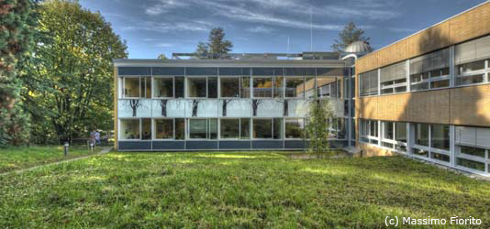
The Backreaction Conjecture
to explain Dark Energy
Thomas Buchert, CRALyon
MPIK
May 26, 2014

Slide 2
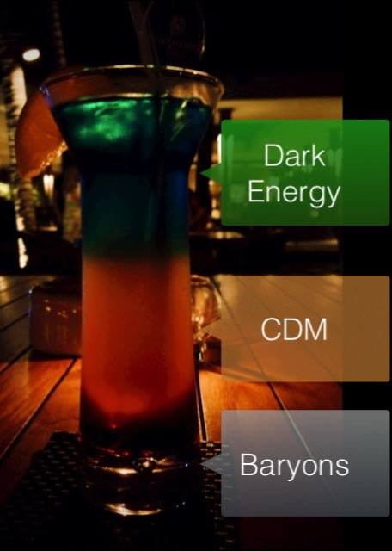
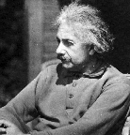
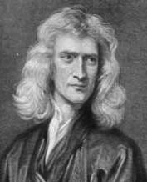
The Standard Model
G_{μν} = κ T_{μν}
_{t}
₂
_{α(t) δij}
?

Slide 3

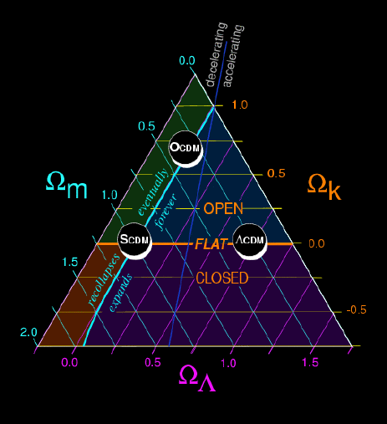
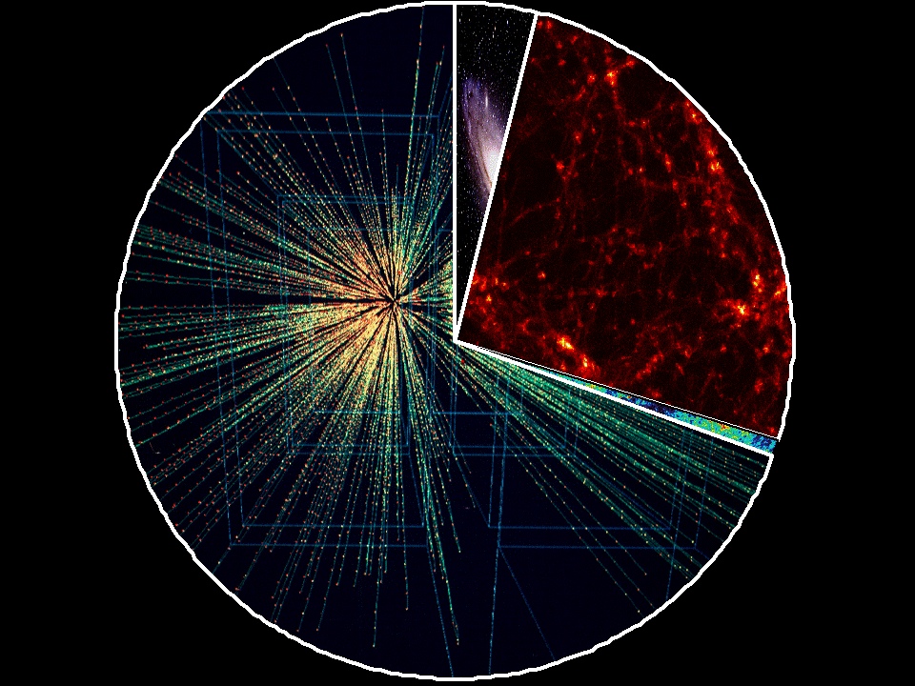
The Standard Model works !
Baryons
~ 5%
Dark Matter
~ 27%
Dark Energy
~ 68 %
Radiation
~ 0.01%
Astier et al. 2006

Slide 4
The Standard Model does not work !
Baryons
~ 5%
fundamental scalar field / new particles ?
Dark Matter ~ 27%
other laws of gravitation ?
effect of geometrical
inhomogeneities ?
Dark Energy
~ 68 %
Radiation
~ 0.01%
backreaction
conjecture

Slide 5

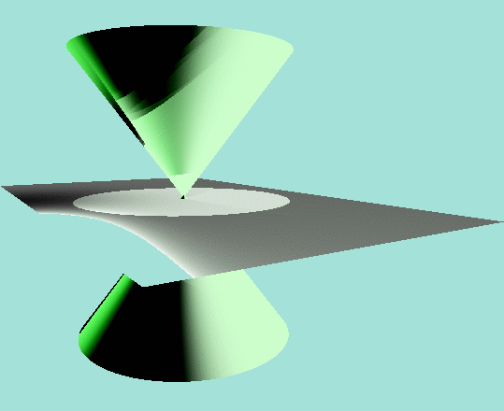
Acceleration in the Standard Model
local acceleration
⅓
_{α(t) =V (t)}
global acceleration
apparent acceleration
_{t}
₂
_{α(t) δij}
Λ

Slide 6
Generalizing the Standard Model
1/3
⁴g = - dt² + g_{ij} dX^{i} dX^{j}
a_{D}= V_{R}
a(t)
Einstein
Spacetime
t
t
g_{ij}

Slide 7
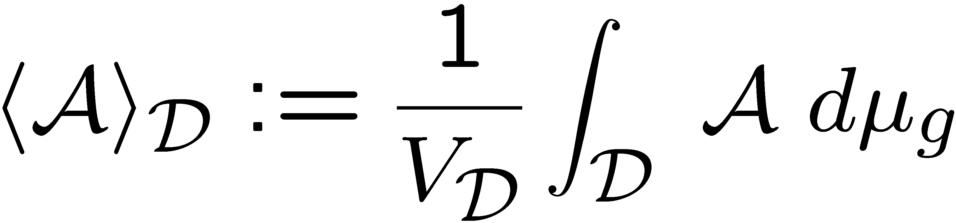
Averaging Einstein’s Equations
Spatial Average on a compact domain :
Restmass conservation on the domain D

Slide 8

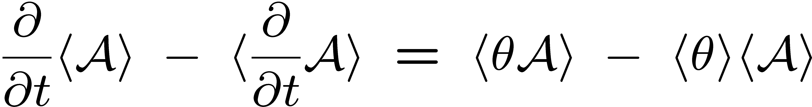
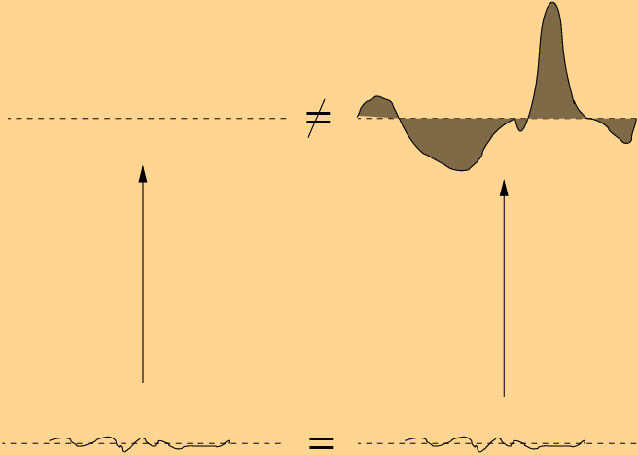
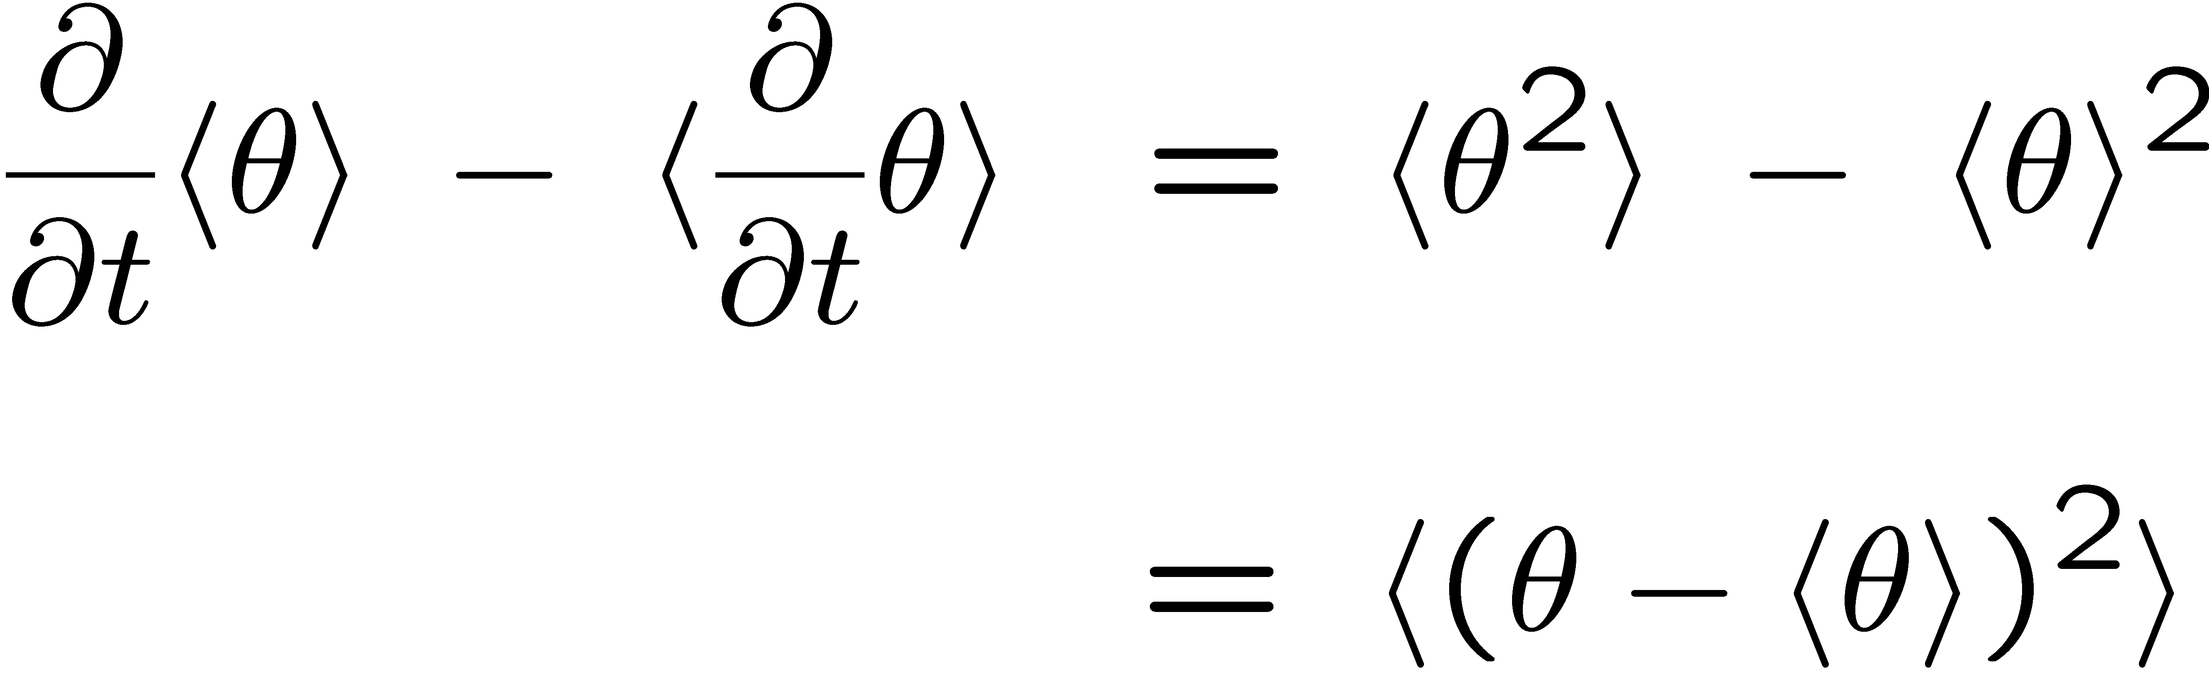
Non - Commutativity

Slide 9






Kinematical Backreaction
Acceleration Law :
Expansion Law :
Conservation Law :
Integrability :

Slide 10
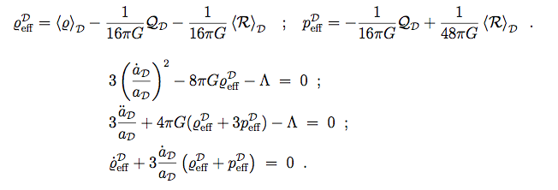


Effective Friedmann Equations
Effective Scalar Field :`Morphon´
Buchert, Larena, Alimi
arXiv: gr-qc / 0606020

Slide 11
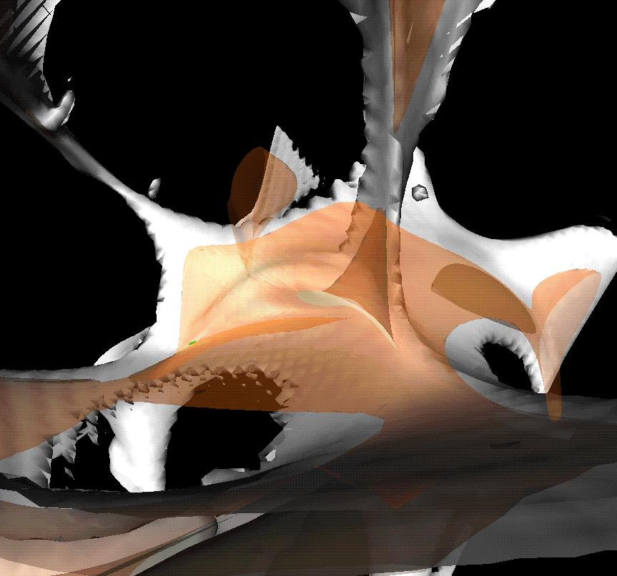
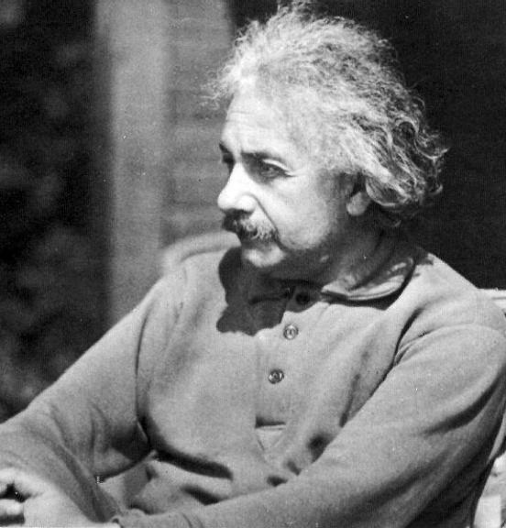
G_{μν} = κ T_{μν}
ρ_{m} + ρ_{φ}
P_{m} + P_{φ}
=
ρ_{m} + ρ_{φ}
P_{m} + P_{φ}
=

Slide 12
Volume Partitioning

Slide 13
Volume Partitioning
D
M

Slide 14
Volume Partitioning
D
M
υ
E
=
D
M

Slide 15
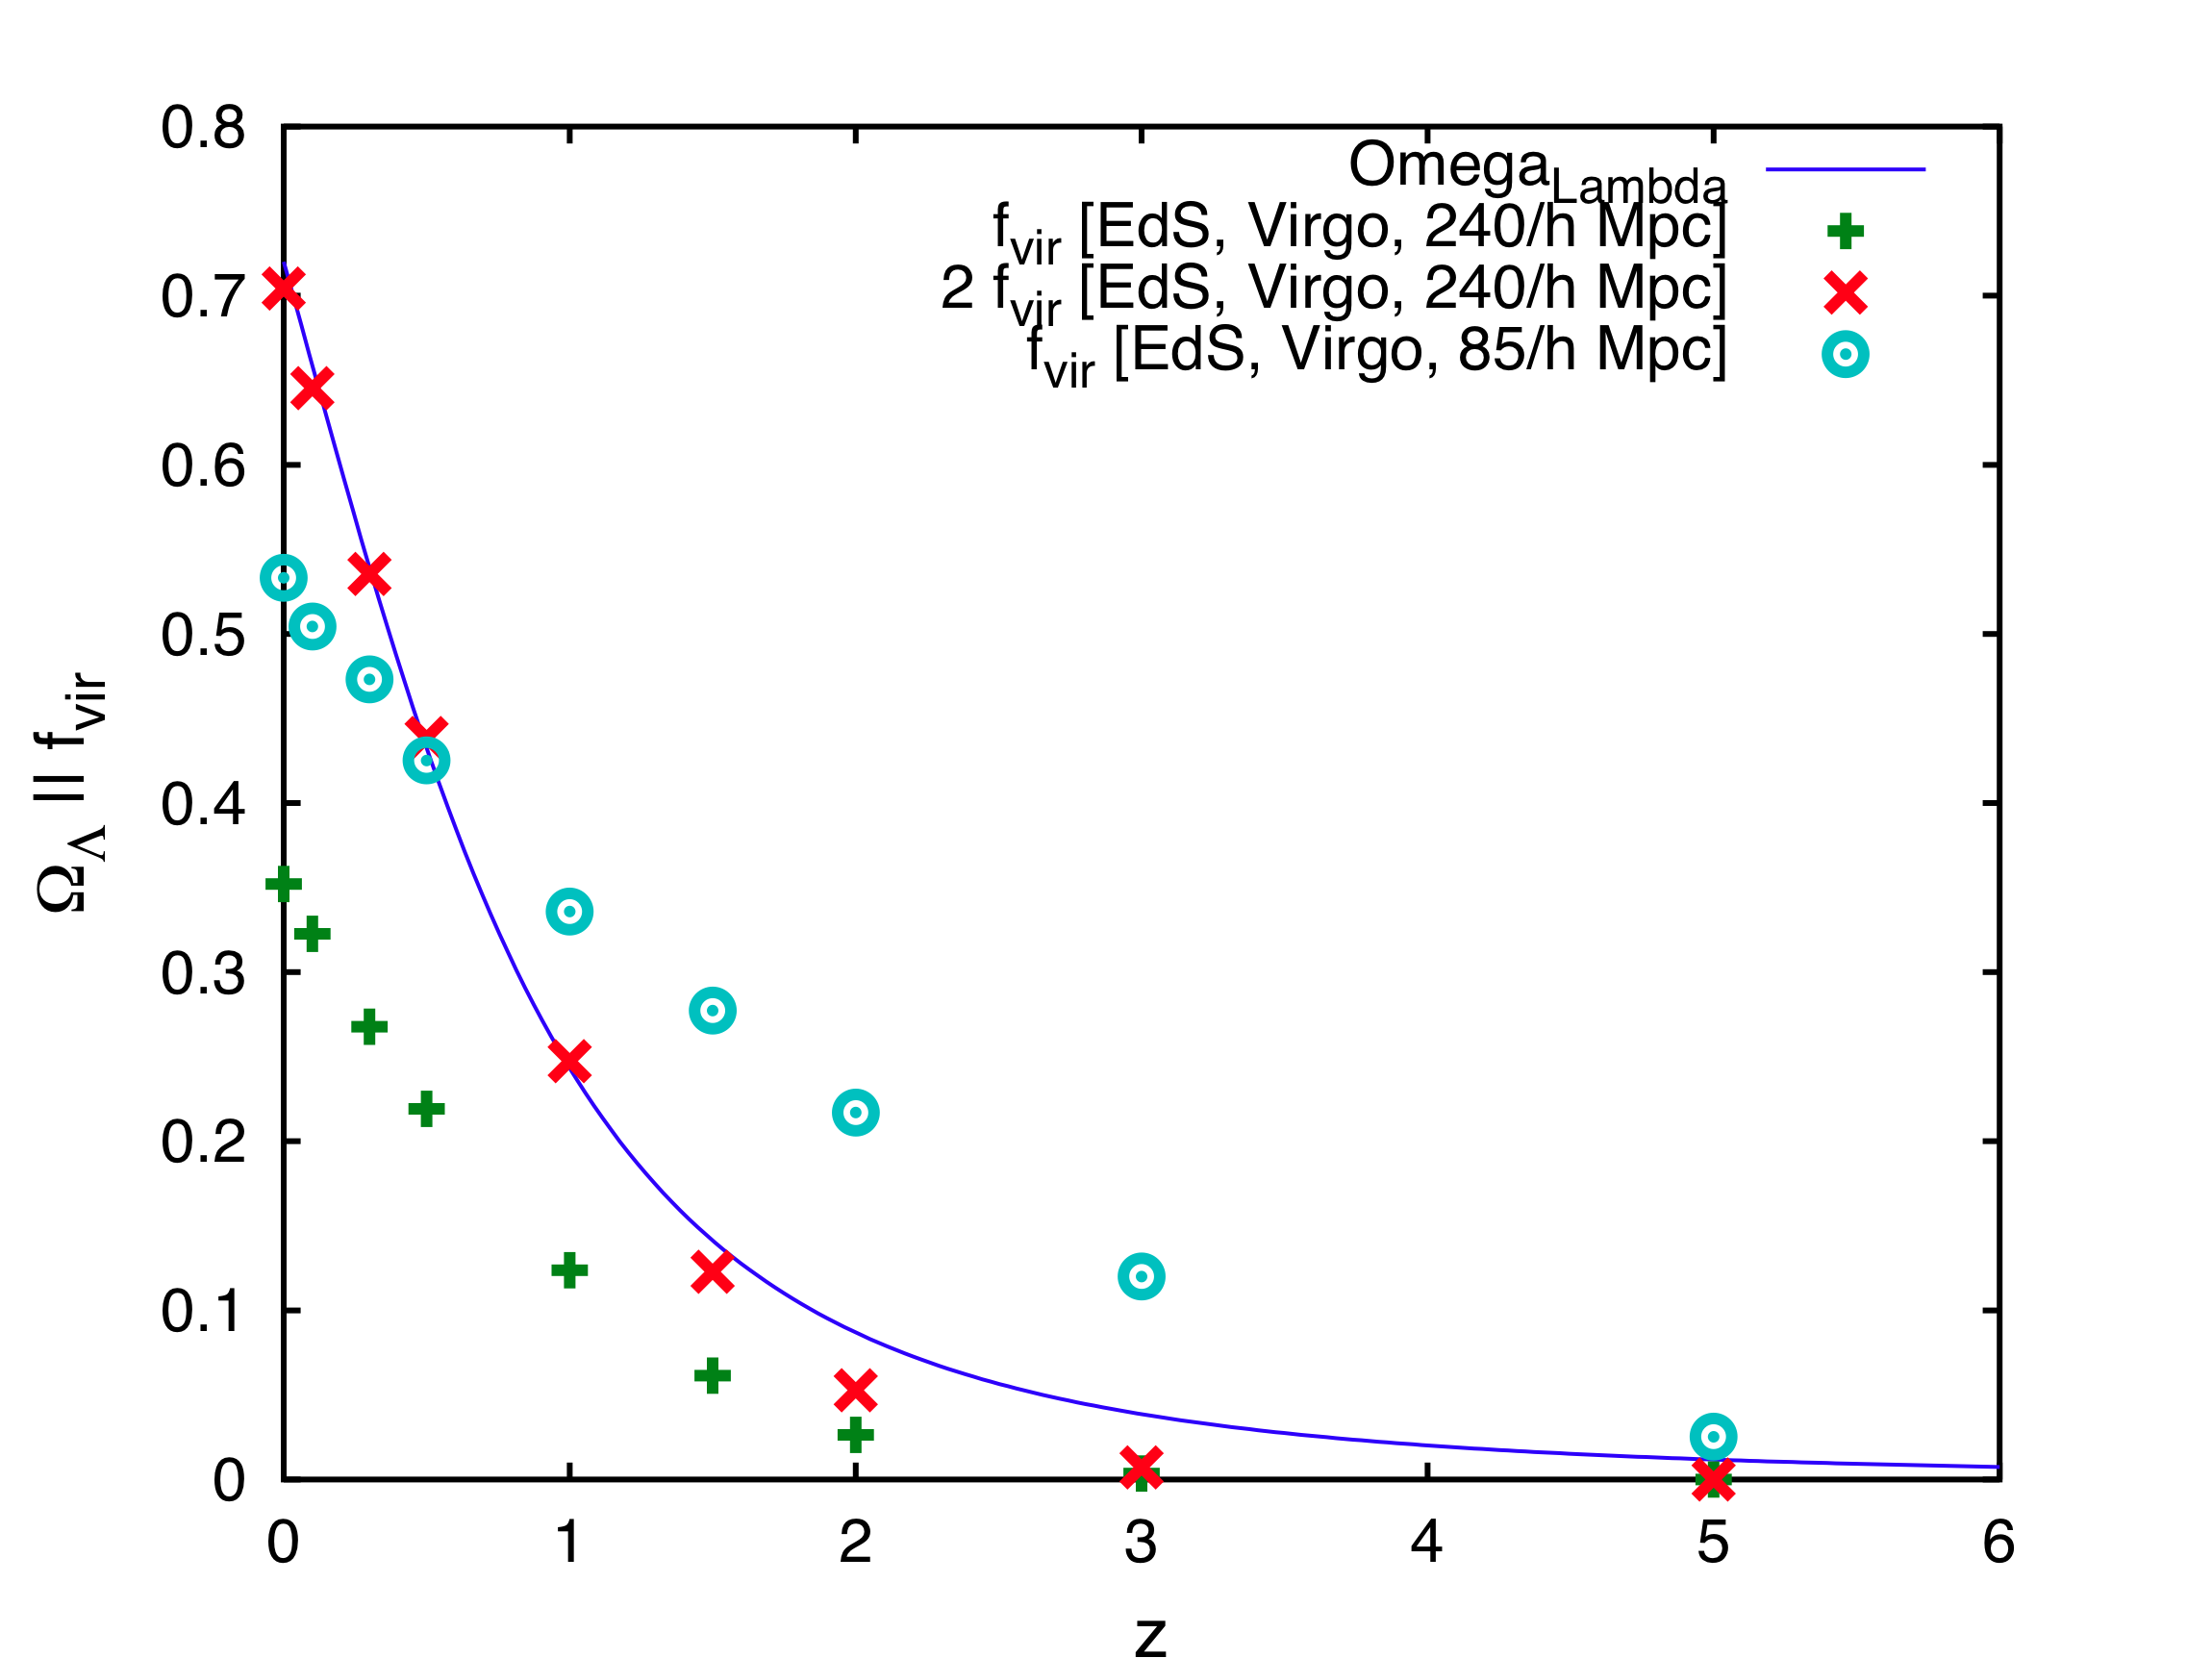
Structure formation and Dark Energy
Roukema, Ostrowski, Buchert
arXiv: 1303.4444

Slide 16

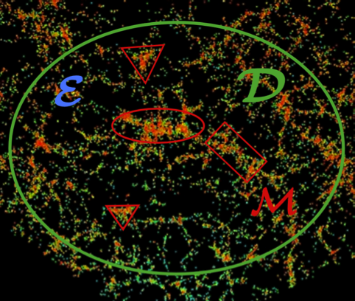
Acceleration in the Multiscale Model
Q
D

Slide 17
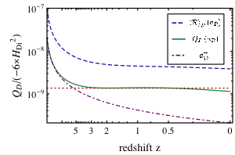
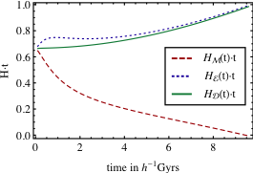
Acceleration in the Multiscale Model
Wiegand, Buchert
arXiv: 1002.3912

Slide 18


Integral Properties of Relativistic Models
Average is non-friedmannian :
generic scaling solutions : n = p
relativistic perturbation theory : n = p = -1
Average is friedmannian for :
Locally isotropic models (homogeneous)
Special LTB models with homogeneous curvature

Slide 19

Global Gravitational Instability
Averaged Cosmologies
Near FRW Cosmologies: Q small
Unstable Sectors :
Q < 0 and <R> > 0
Q > 0 and <R> < 0
Buchert, Larena, Alimi arXiv: gr-qc / 0606020
Roy, Buchert, Carloni, Obadia arXiv: 1103.1146

Slide 20
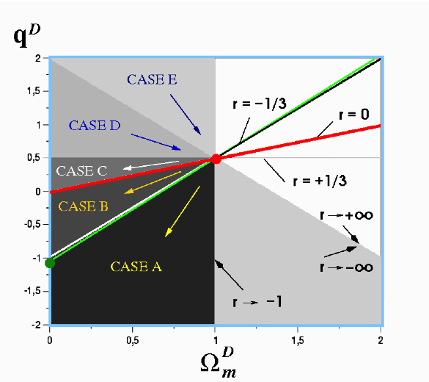
Phase Space for Λ = 0

Slide 21
Unstable Sectors Λ = 0
DM
DE

Slide 22
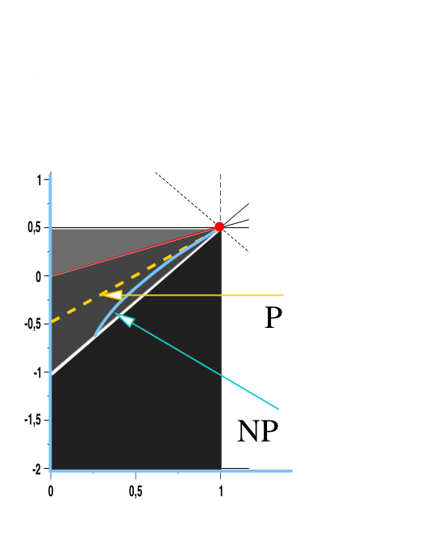
Dark Energy Sector Λ = 0
Q > 0 and <R> < 0
2
1/aD
1
1/aD
0
1/aD

Slide 23
Volume-dominance of Voids
Q_{D} ≈ 0 <ρ> ≈ 0 :
<R>_{D} - 2 Λ ≈ – 6 H_{D}²

Slide 24
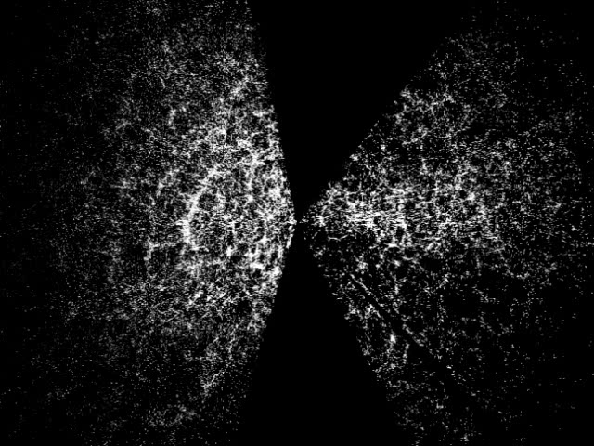
Sloan Digital Sky Survey - slices
E u c l i d e a n
Todai, Tokyo
150000 galaxies

Slide 25
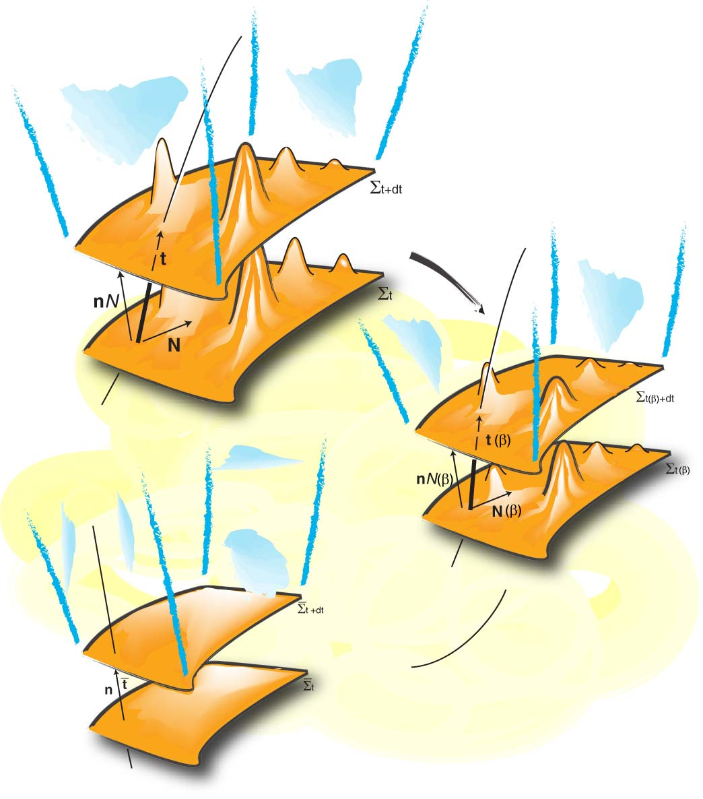
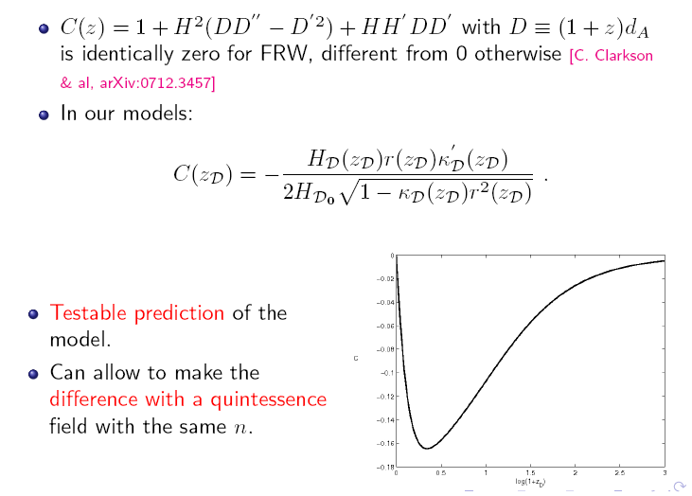
Observational Strategies
C
Template
Metrics
log(1+z)
Larena, Alimi, Buchert, Kunz, Corasaniti arXiv: 0808.1161
Euclid

Slide 26
Conclusions
structure formation changes the geometry of
the average cosmology
Dark Energy and Dark Matter exist in terms of
“curvature energies“
qualitative understanding of the mechanism
is completed and it works in the right direction
quantitative understanding in terms of
non-perturbative models is in progress
→ reinterpretation of observations !

Slide 27
Further Reading :
arXiv:
gr-qc/0001056
0707.2153
1103.2016
1112.5335

