Slide 1
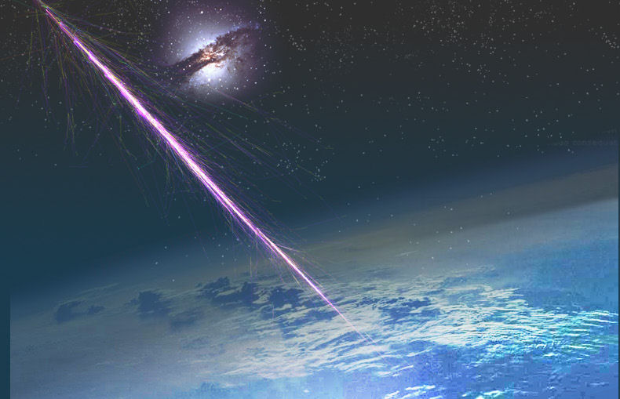
Surprises at the
Highest Energies
Angela V. Olinto
The University of Chicago

Slide 2
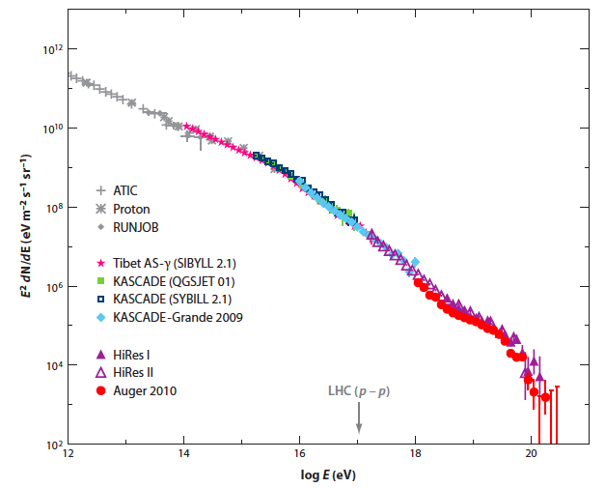
Cosmic Ray Flux x E²
knee
ankle
GZK?
Kotera, AO 2011

Slide 3
Cosmic Ray Flux x E²
Ultra High Energy
Extragalactic
Sources
knee
ankle
GZK?
Kotera, AO 2011

Slide 4
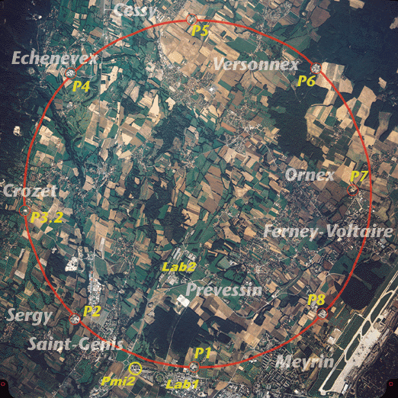
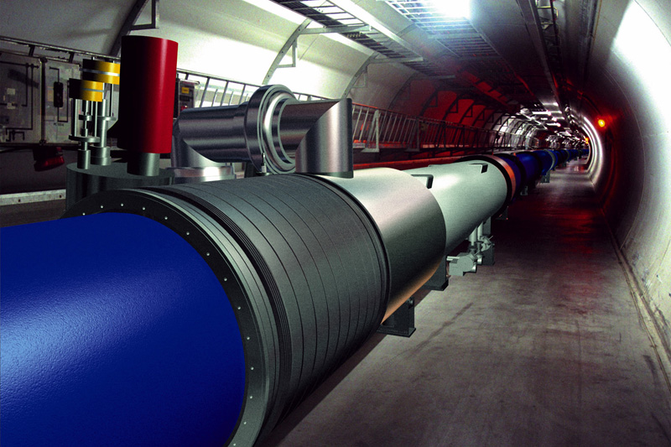
Challenging Accelerators
to reach 10²⁰ eV
LHC magnetic field,
radius ~ 10⁷ km (Sun - Mercury)
or 10 GT fields!
Notes:
LHC = 8.36 Tesla = 8.4 10^4 G
G = 10^-4 T

Slide 5
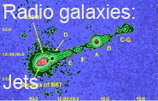
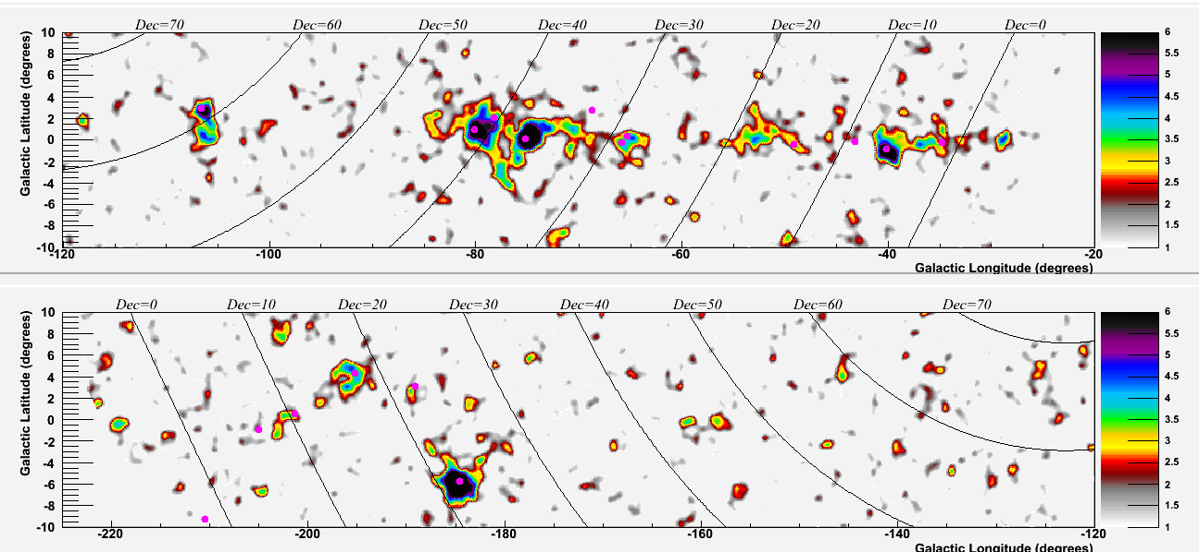


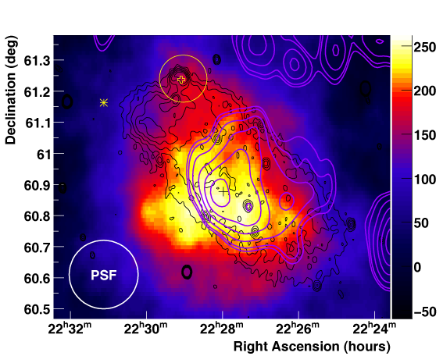

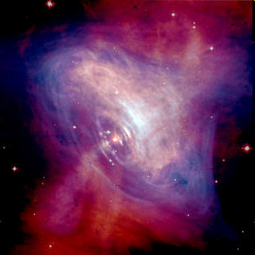

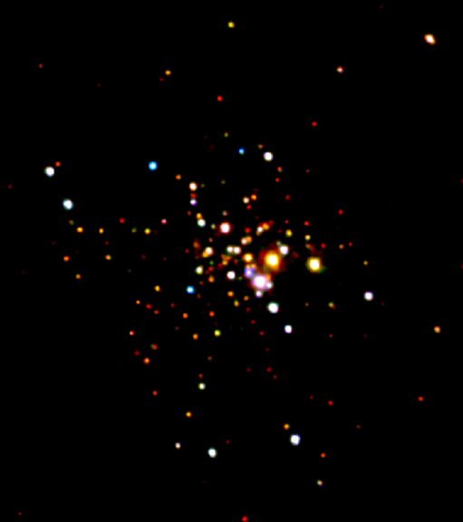
High Energy Accelerators
Astrophysical
Extragalactic
  Supernova
  remnants
Galactic
  Pulsar wind
  nebulae
PSR J2021+3651
0FGL J0634+1745
GR Pulsars
Unidentified
γ-ray sources
  Stellar
  clusters
Notes:
radio, X-ray, Gamma-ray, ...

Slide 6
“Known unknown”
Cosmic Magnetic Fields
R_{L} = kpc Z⁻¹ (E / EeV) (B / μG)⁻¹
R_{L} = Mpc Z⁻¹ (E / EeV) (B / nG)⁻¹
1 EeV = 10¹⁸ eV
γ
Extra-galactic B?
B < nG
weak deflection
E > 10¹⁹eV
Galactic B deflection
<< 10º Z (40 EeV/E)
anisotropic in sky
Halo B?
strong deflection
E < 10¹⁸eV
Milky way
B ~ μG
kpc
10 kpc

Slide 7
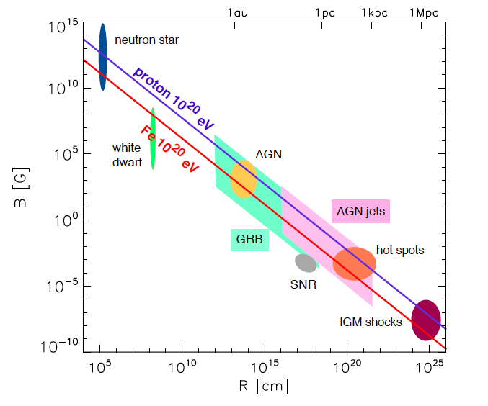
Hillas Plot: Maximum Energy
R_{L} < R_{source}
B/μG > (E_{max}/ Z EeV) (1.1kpc/R_{source})
LHC
LHC
white
dwarf
white
dwarf
Kotera & AO‘11
Notes:
Easier for Iron
LHC = 8.36 Tesla = 8.4 10^4 G, 27 km = 2.7 10^6 cm
G = 10^-4 T

Slide 8
High Energy Cosmic Rays
OBSERVABLES:
Spectrum
Composition
Sky Distribution

Slide 9
High Energy Cosmic Rays
OBSERVABLES:
Spectrum
Composition
Sky Distribution

Slide 10
Cosmic Ray Flux x E²
knee
Extragalactic
Sources
ankle
GZK?
Kotera, AO 2011

Slide 11
Cosmic Ray Flux x E²
Galactic
Sources
knee
Extragalactic
Sources
ankle
GZK?
Kotera, AO 2011

Slide 12
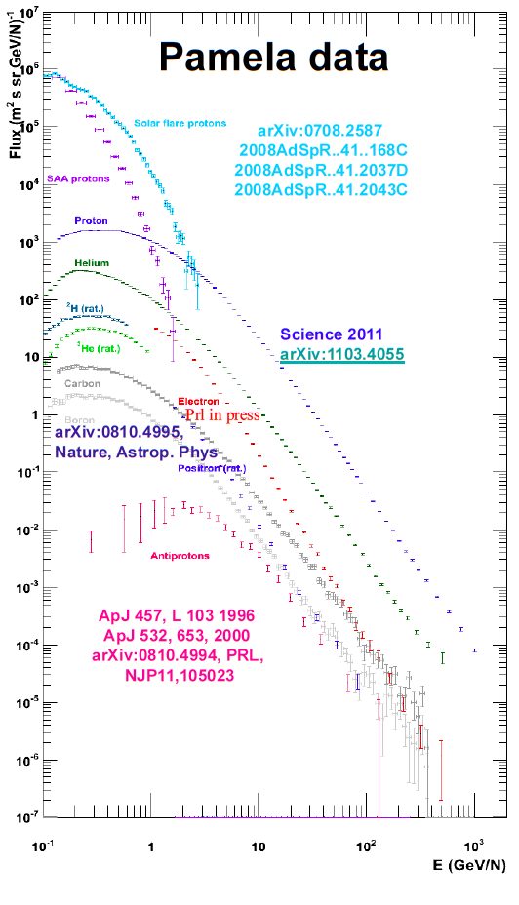
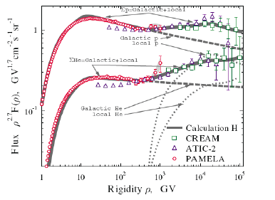
Direct Detection:
Things are getting interesting...
proton
He
1 TeV/N

Slide 13
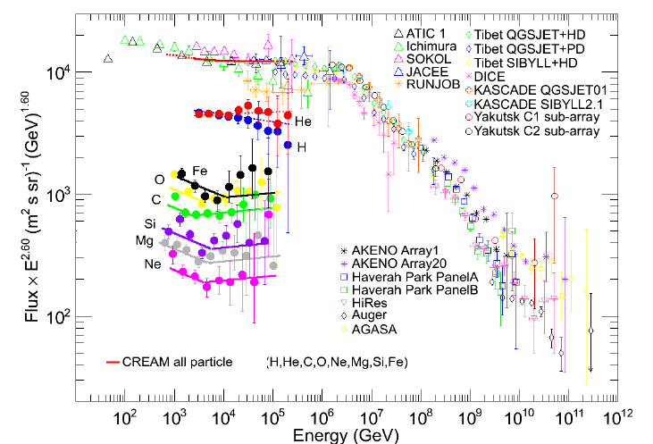
Just Below the Knee...

Slide 14
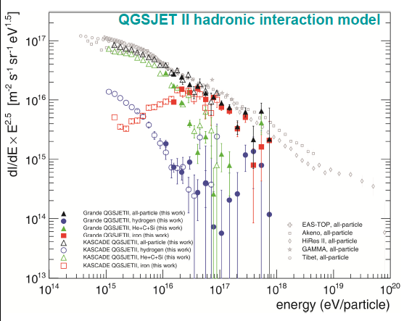

Above the Knee...
KASCADE + K-Grande

Slide 15
Above the Knee...
KASCADE + K-Grande
LHC

Slide 16
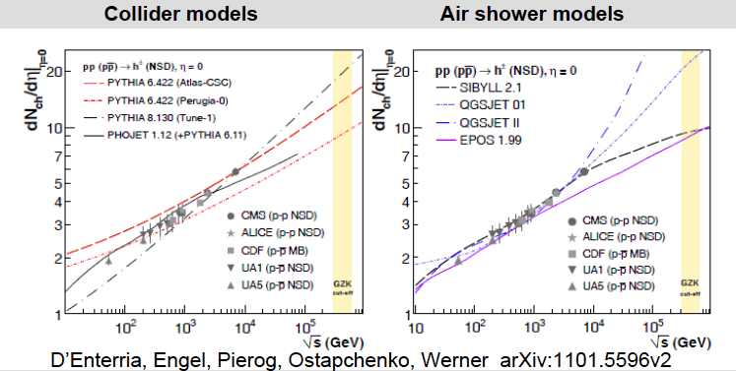
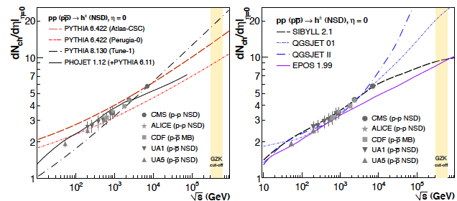
LHC tests of Hadronic Models
Notes:
Collision-energy dependence of the midrapidity charged hadron invariant yields in non single-diffractive
(NSD) p-p collisions predicted by different tunes of pythia and by phojet (left panel) and by qgsjet01 and II,
sibyll, and epos (right panel) MCs up to the GZK cutoff energies.

Slide 17
Cosmic Ray Flux x E²
Galactic
Sources?
knee
Extragalactic
Sources
ankle
GZK?
Kotera, AO 2011

Slide 18
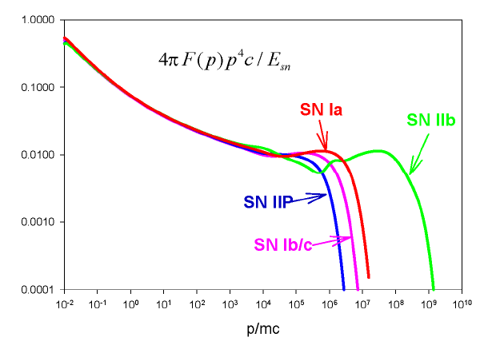
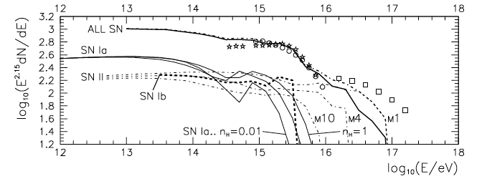
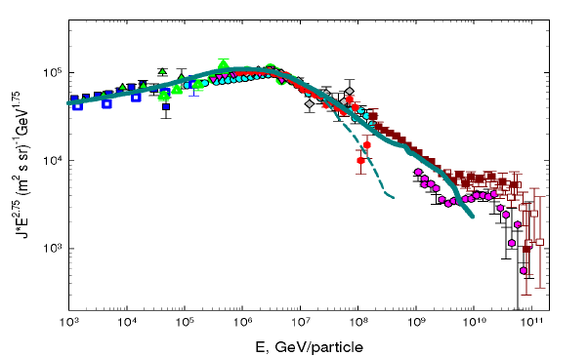
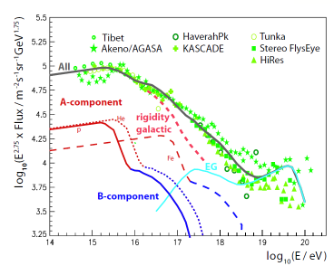
Ptuskin, Zirakashvili, Seo ‘10
A. Hillas 2005

Slide 19
Cosmic Ray Flux x E²
knee
warning: turbulent waters underneath
ankle
GZK?
Kotera, AO 2011

Slide 20
Cosmic Ray Flux x E²
knee
Extragalactic
Sources
ankle
GZK?
Kotera, AO 2011

Slide 21
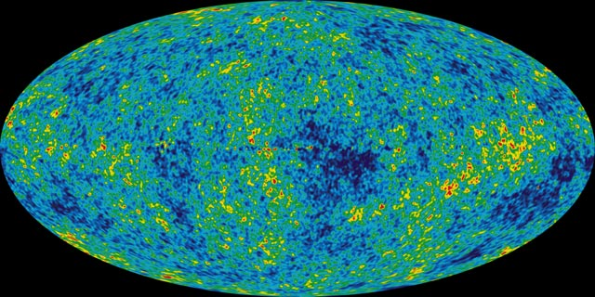
“Cosmologically Meaningful Termination”
p+γ_{cmb}→ Δ⁺ → p + π⁰
→ n + π ⁺
Proton Horizon
~10²⁰ eV
GZK Cutoff
Greisen, Zatsepin, Kuzmin
1966

Slide 22
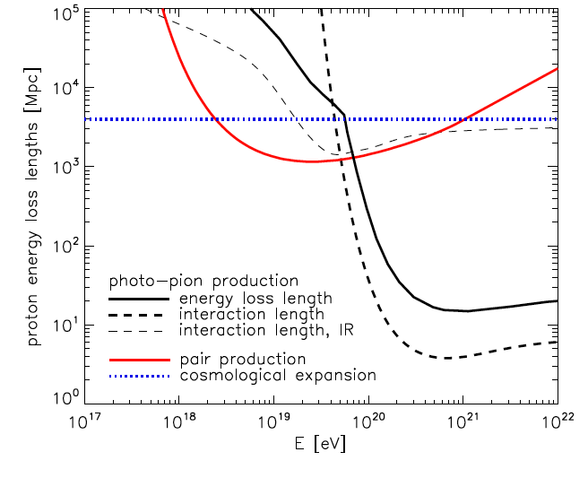
Greisen-Zatsepin-Kuzmin cutoff

Slide 23
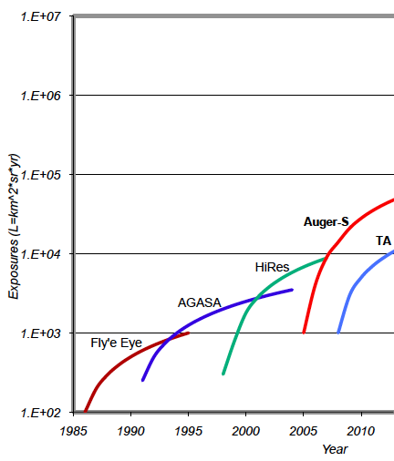
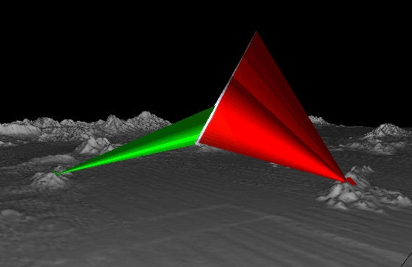
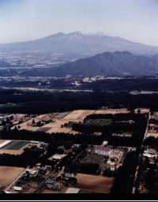
High Resolution Fly’s Eye (1997-2006)
2 fluorescence telescopes
Last Century’s question:
GZK or No GZK?
AGASA (1984-2003) 100 km² area,
111 scintillators, 1km spacing

Slide 24
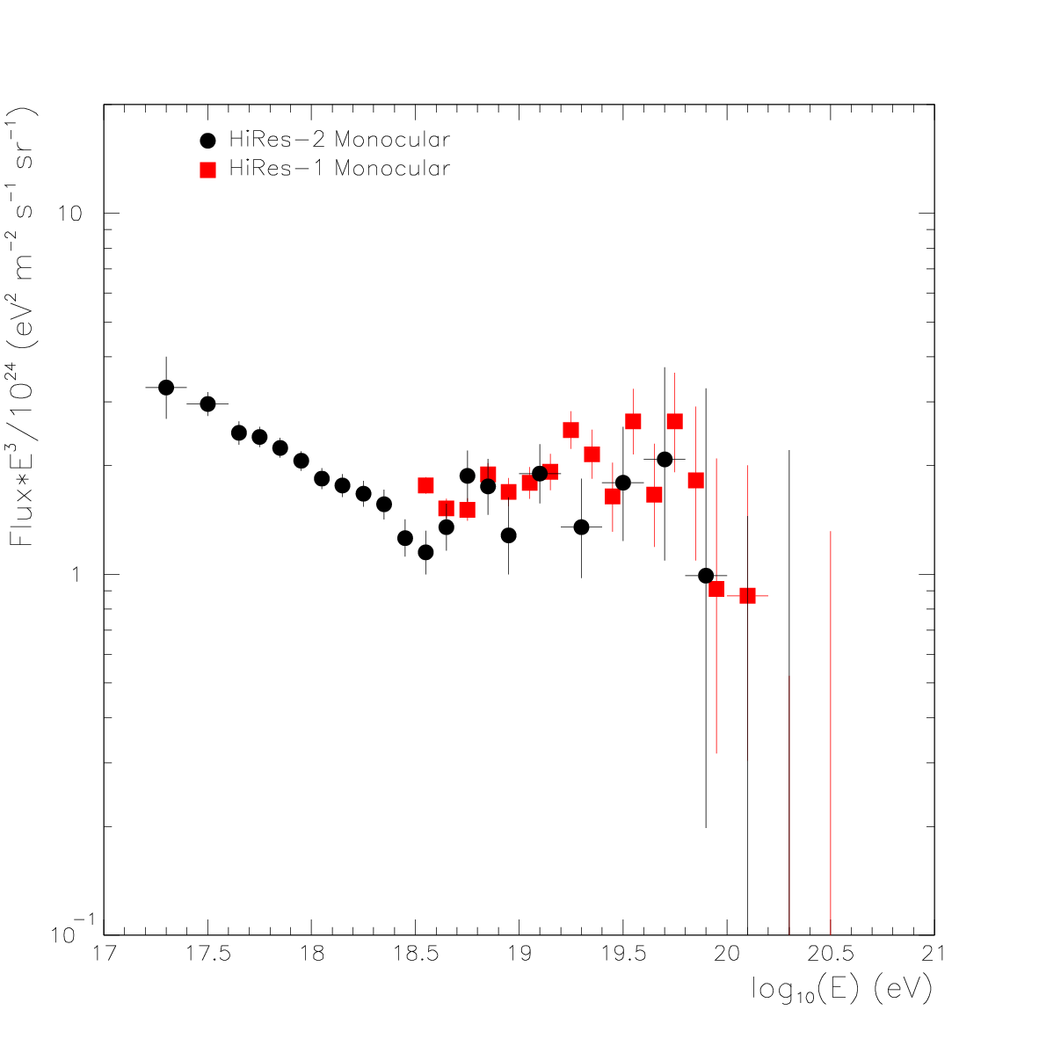
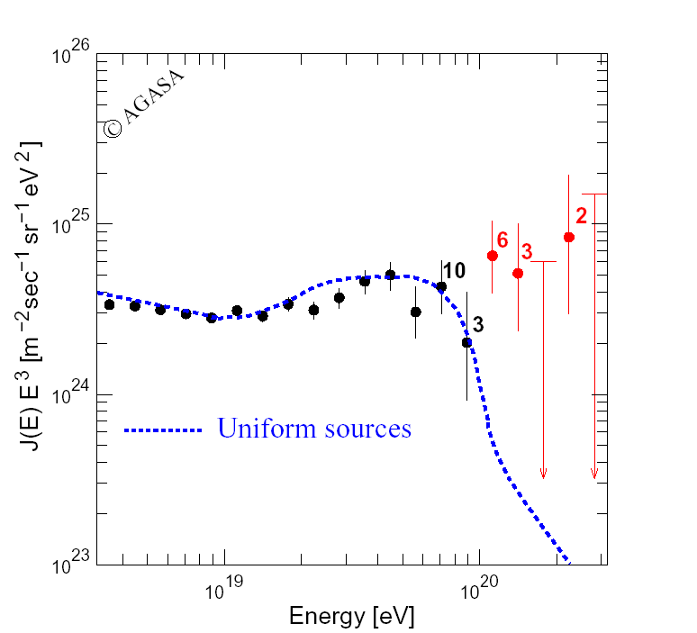
Cosmic Ray Flux x E³
High Resolution Fly’s Eye
(1997-2006)
Last Century’s question:
GZK or No GZK?
Consistent w/ GZK cutoff
AGASA (1984-2003)
100 km² area
No GZK cutoff

Slide 25
Cosmogenic (GZK) Neutrinos & Photons
p+γ_{cmb}→ Δ⁺ → p + π⁰ → γγ
→ n + π ⁺
n → p + e⁻ + ν_{e}
π⁺ → μ⁺ + ν_{μ}
μ ⁺ → e⁺ + ν_{e} +ν_{μ}

Slide 26
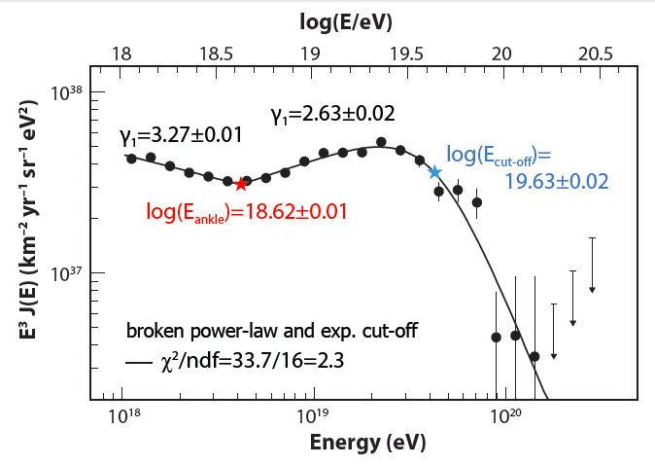
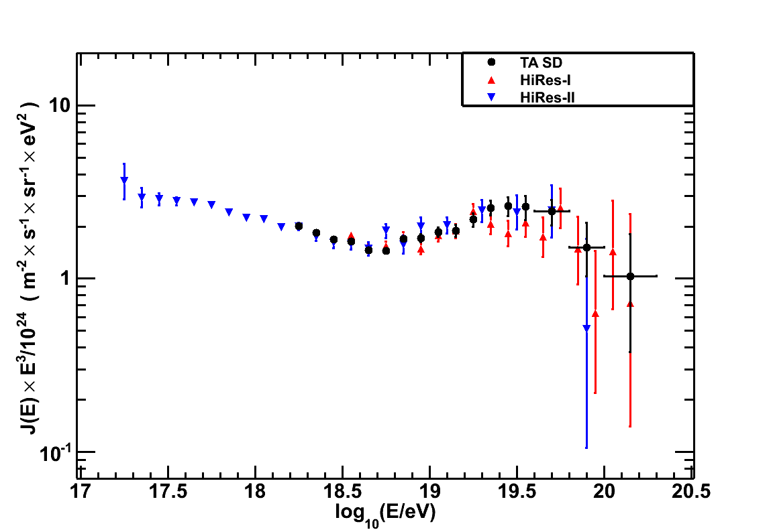
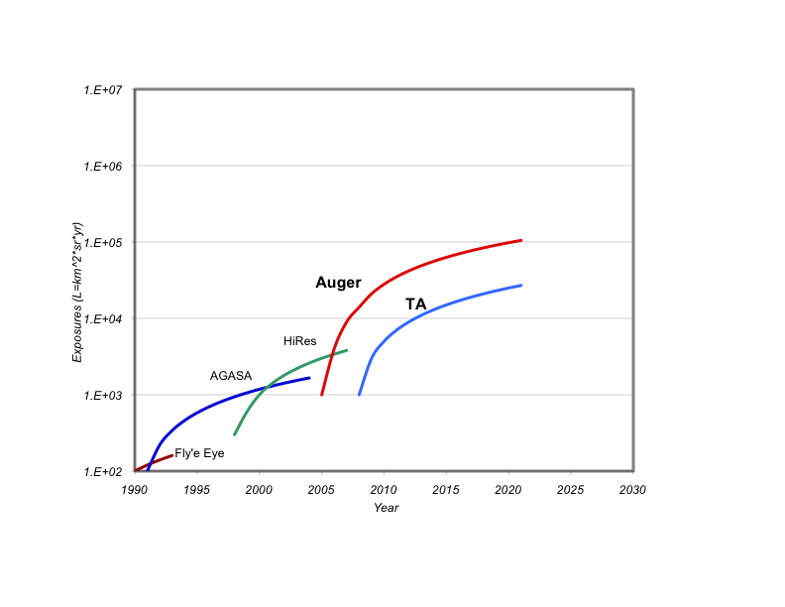
Last Century’s question:
GZK or No GZK?
Observed Spectra are Consistent w/ GZK effect
TA
ICRC11

Slide 27

Ultrahigh Energy Cosmic Rays
Current Observatories
Telescope Array
Utah, USA
680 km² array
3 fluorescence sites
Pierre Auger
Observatory
Mendoza, Argentina
3 000 km² array
4 fluorescence sites

Slide 28
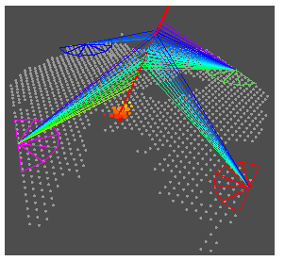
The Pierre Auger Observatory
Argentina
Australia
Brasil
Bolivia*
Croatia
Czech Rep.
France
Germany
Italy
Mexico
Netherlands
Poland
Portugal
Romania*
Slovenia
Spain
UK
USA
Vietnam*
*Associate Countries
3,000 km² water cherenkov detectors array
4 fluorescence Telescopes
Malargue, Argentina
Notes:
19 countries, truly international

Slide 29
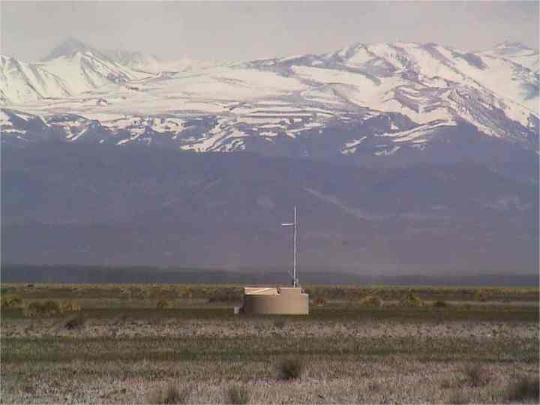
surface detector

Slide 30
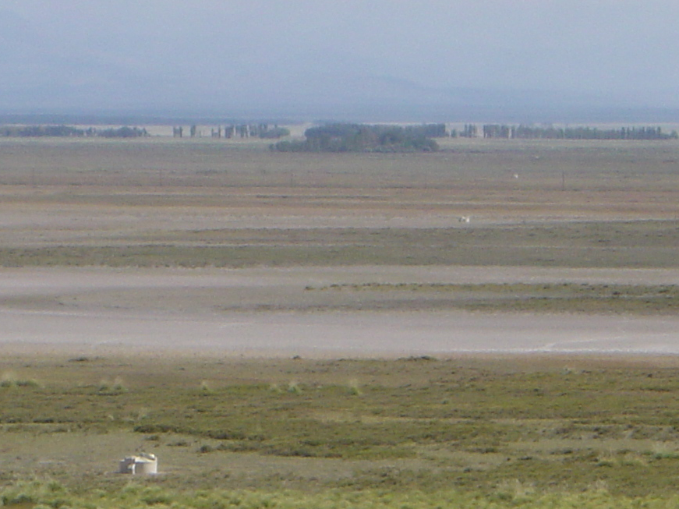
tanks aligned seen from Los Leones

Slide 31
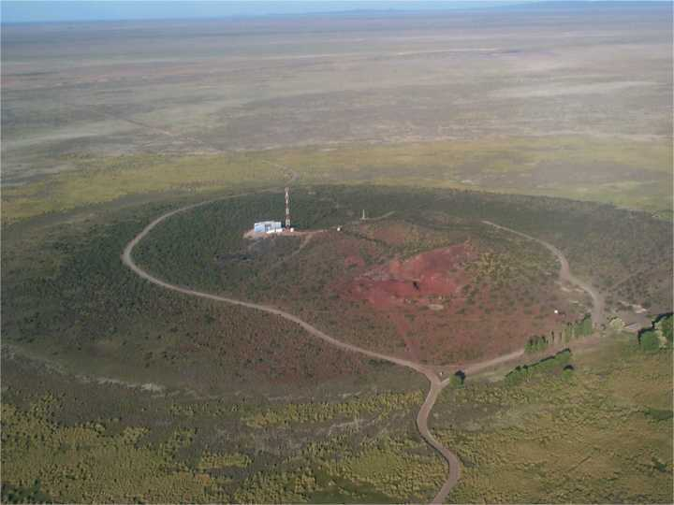
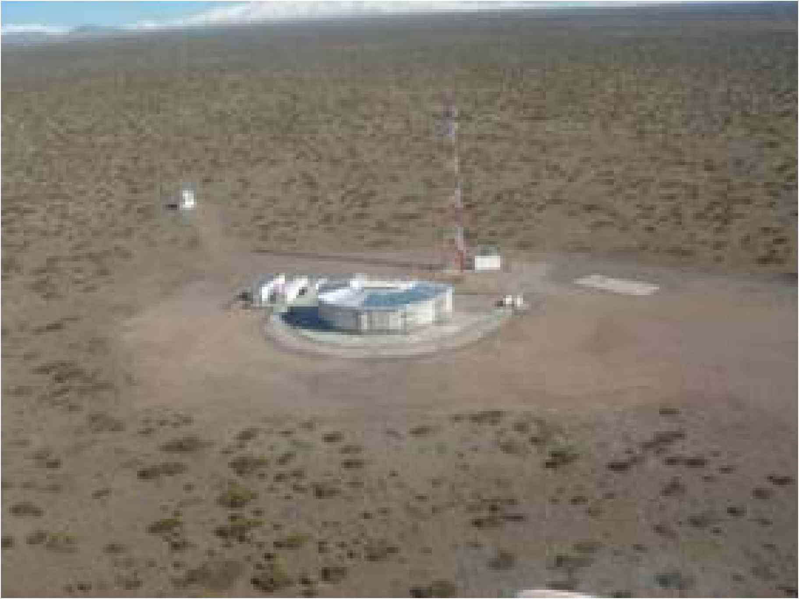
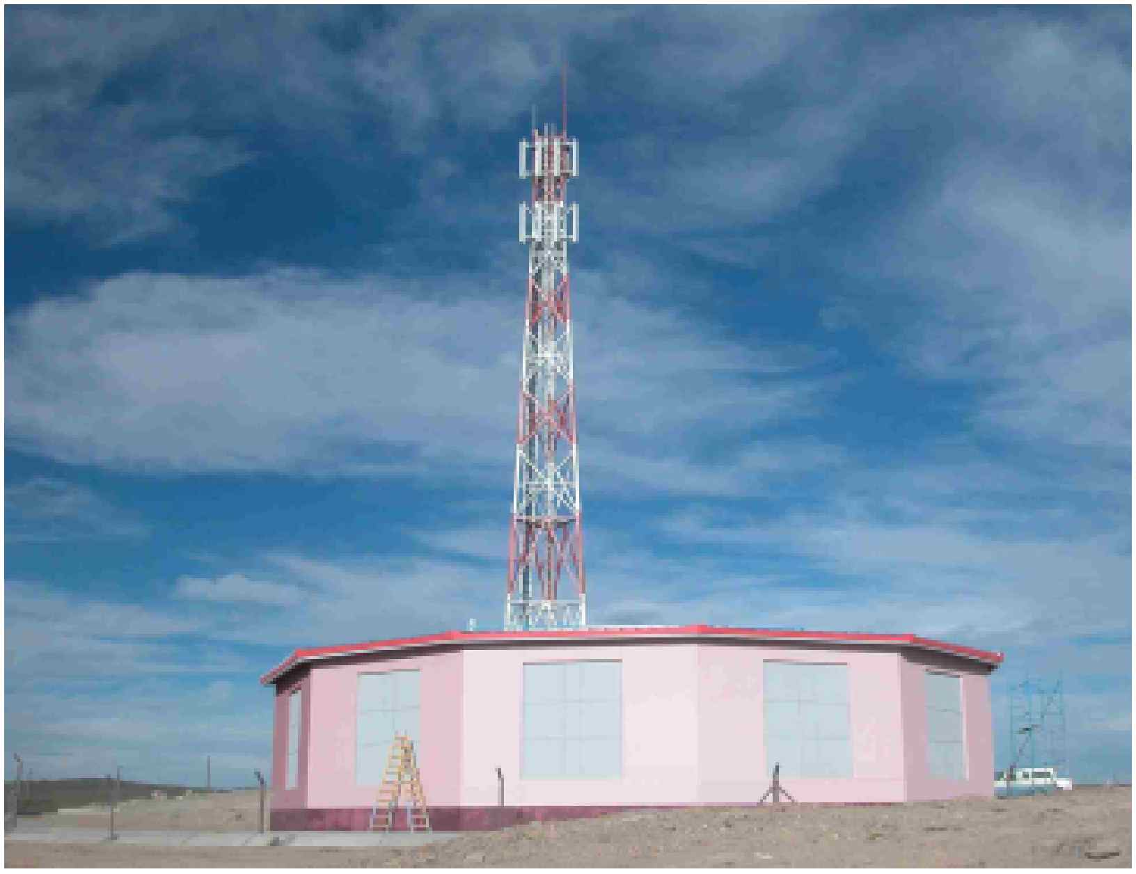
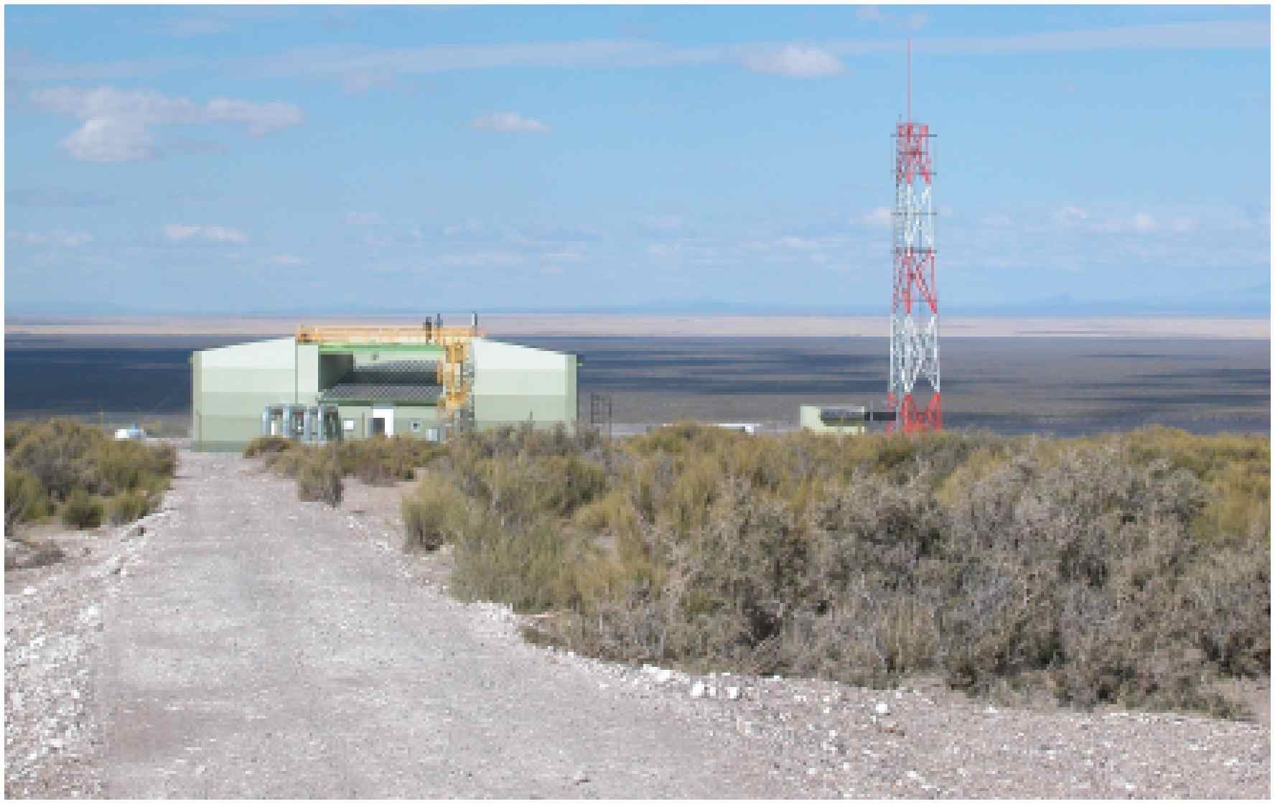
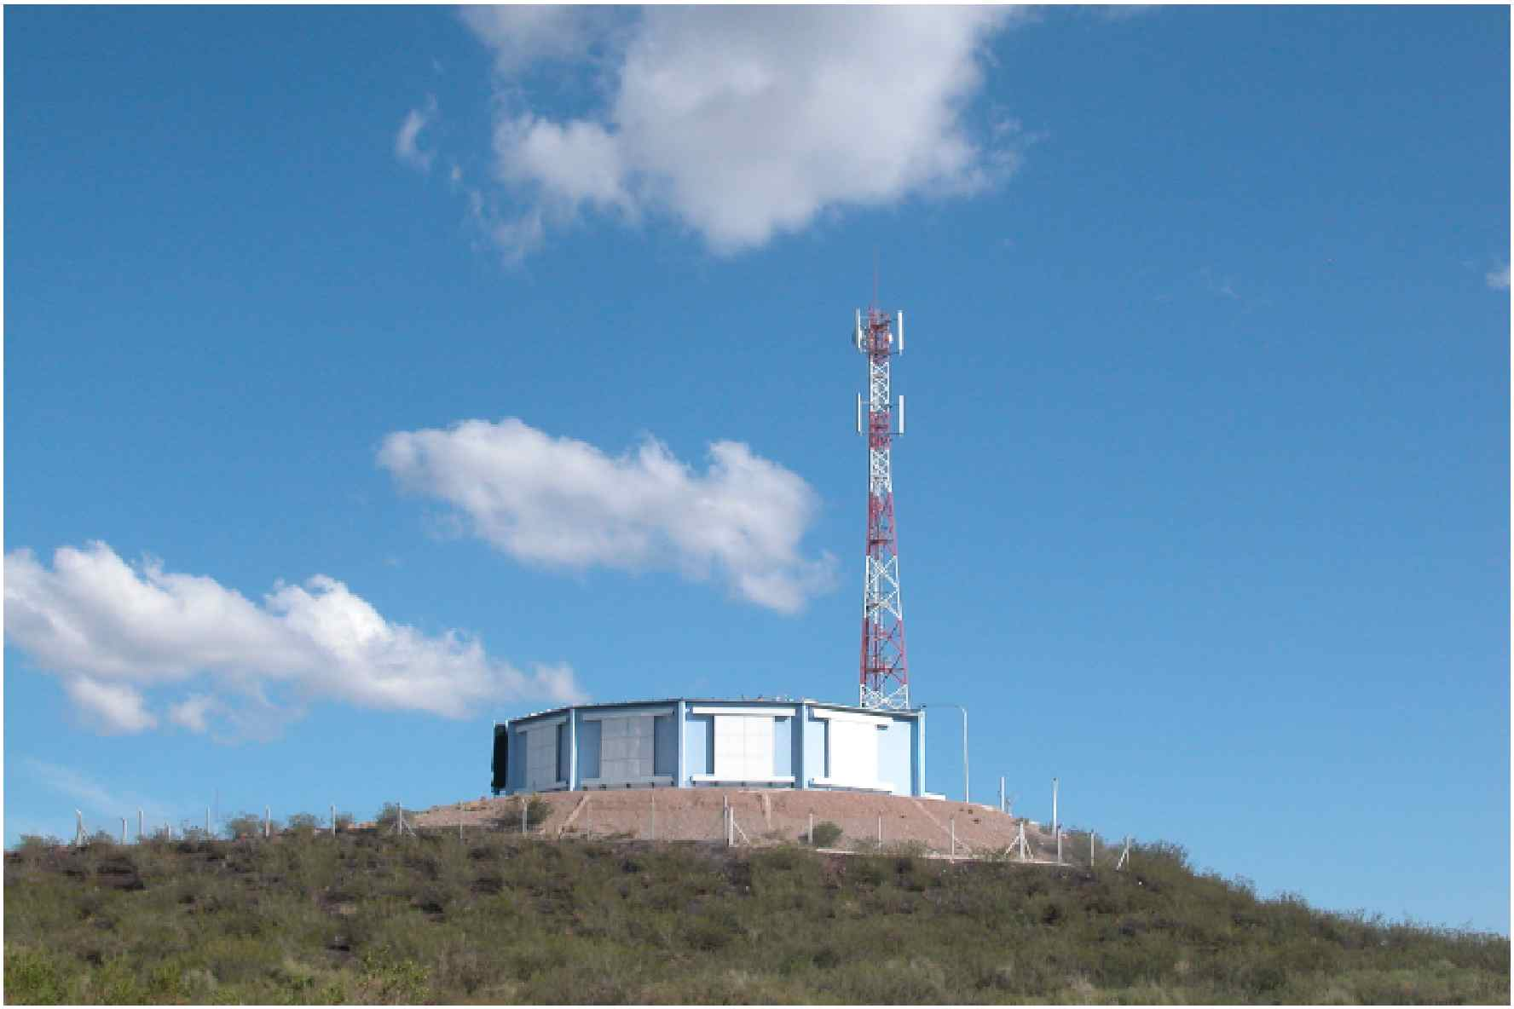
4 times 6 telescopes overlooking the site

Slide 32



Slide 33
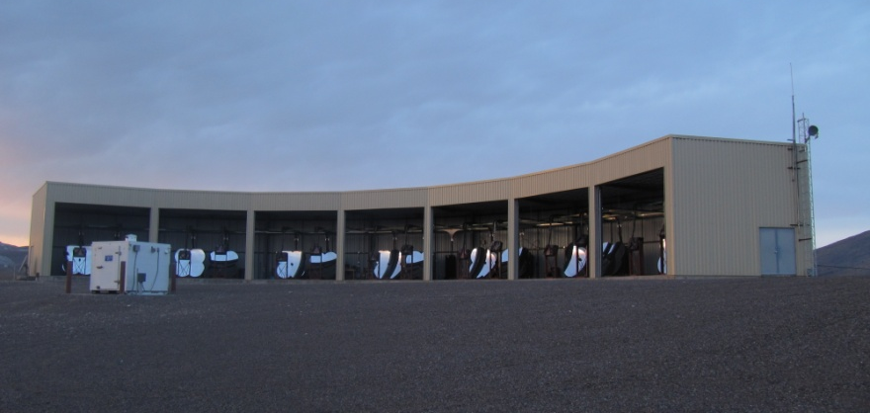
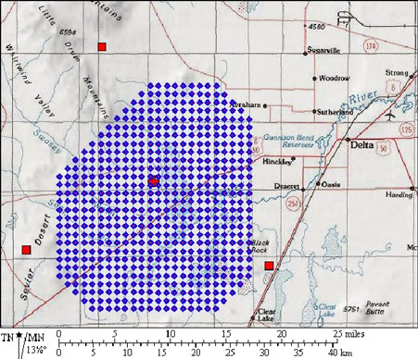
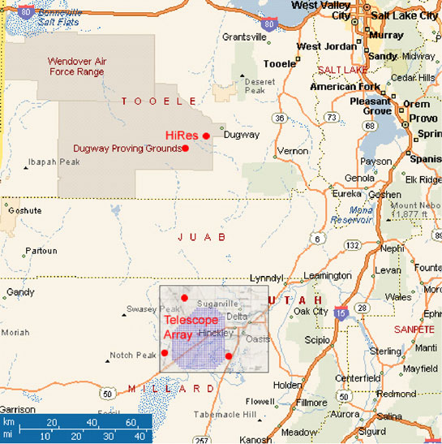
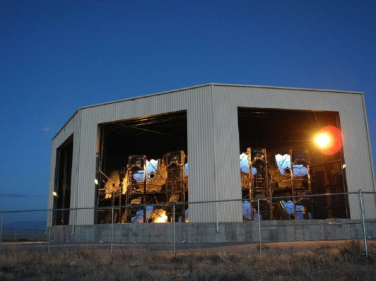
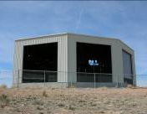
Telescope Array
Belgium
Japan
Korea
Russia
USA
Area: 680 km²
3 FD stations overlooking an array of
507 scintillator surface detectors (SD)
complete and operational as of ~1/2008.

Slide 34
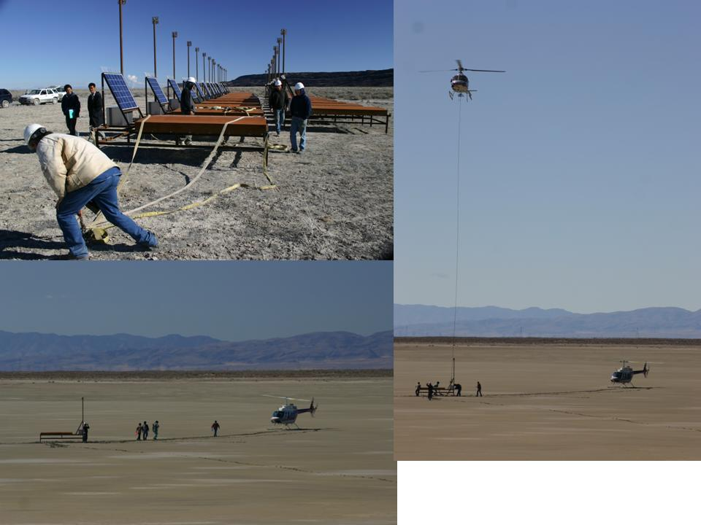
Deployment (up to 50/day) 485 SDs: 10/2006 - 3/2007

Slide 35

Telescope Array SD spectrum
ICRC2011

Slide 36
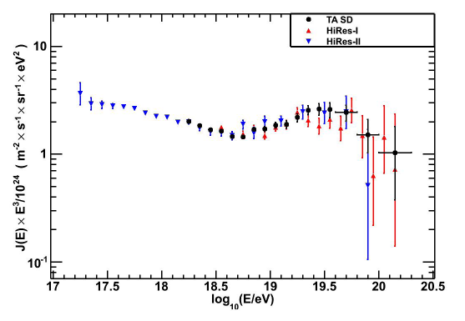
20 % “absolute” energy shift

Slide 37
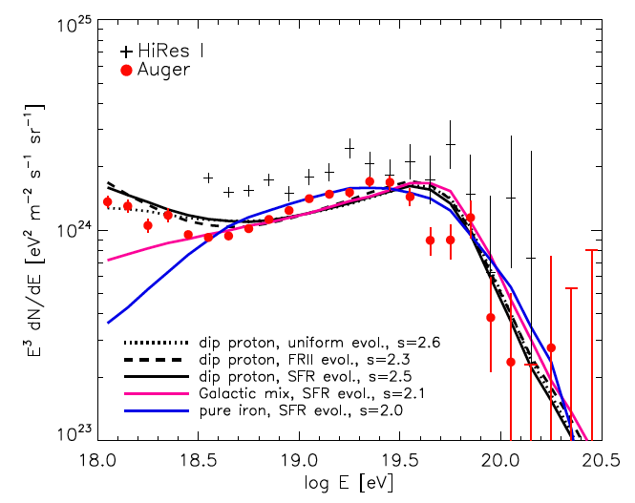
(Abbasi et al. 2009)
(Abraham et al. 2010)
Kotera, AO 2011

Slide 38
To fit the spectrum, need:
injection spectrum: E^{-s}, E_{max}
injection composition
Transition Gal/Extragal model
Source evolution: FRII, SFR, uniform
Kotera, AO 2011

Slide 39
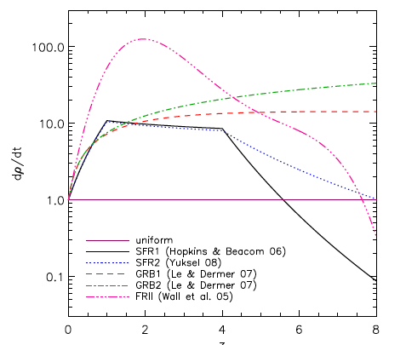
Kotera, AO 2011

Slide 40
To fit the spectrum, need:
injection spectrum: E^{-s}, E_{max}
injection composition
Transition Gal/Extragal model
Source evolution: FRII, SFR, uniform
Kotera, AO 2011

Slide 41
To fit the spectrum, need:
injection spectrum: E^{-s}, Emax
injection composition
Transition Gal/Extragal model
Source evolution: FRII, SFR, uniform
MANY WAYS TO FIT THE SPECTRUM!
Kotera, AO 2011

Slide 42
High Energy Cosmic Rays
OBSERVABLES:
Spectrum
Composition
Sky Distribution

Slide 43
CR arrival directions
E < 6 10¹⁹ eV
Isotropic!

Slide 44
“Known unknown”
Cosmic Magnetic Fields
R_{L} = kpc Z⁻¹ (E / EeV) (B / μG)⁻¹
R_{L} = Mpc Z⁻¹ (E / EeV) (B / nG)⁻¹
1 EeV = 10¹⁸ eV
γ
Extra-galactic B?
B < nG
weak deflection
E > 10¹⁹eV
Galactic B deflection
<< 10º Z (40 EeV/E)
anisotropic in sky
Halo B?
strong deflection
E < 10¹⁸eV
Milky way
B ~ μG
kpc
10 kpc

Slide 45
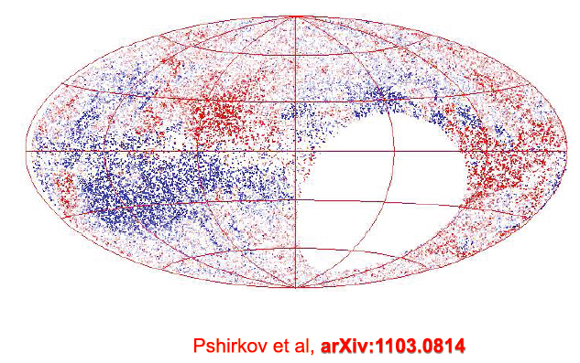
Galactic Magnetic Field:
Rotation Measures

Slide 46
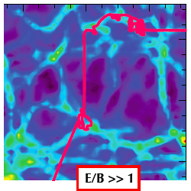
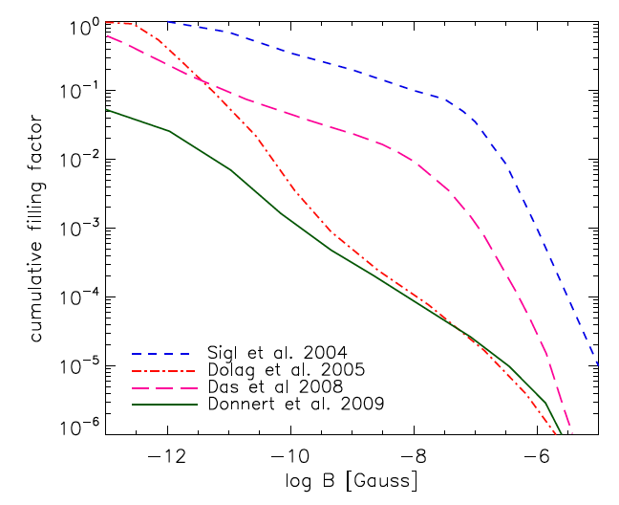
Large Scale Structure Simulations with Magnetic Fields
Extragalactic B deflection
< ~ 1º to 10º Z (40 EeV/E)
Kotera, AO 2011
Notes:
Large Scale Structure Simulations with Magnetic Fields

Slide 47

Expected angular deflection (degrees)
for protons E > 6 10¹⁹ eV (PSCz catalog)
Kotera & Lemoine’08; Kotera & A.O. ‘11

Slide 48
GZK Effect
⇒ Spectral Feature
+ LSS
⇒ Anisotropic Sky Distribution
E > 60 EeV

Slide 49

GZK Horizon

Slide 50
Horizons:
10¹⁹ eV ~ 1 Gpc
Gpc
100 Mpc
10²⁰ eV < 100 Mpc

Slide 51

Inhomogeneous
Galaxy/Matter Distribution
2MASS - Two Micron All Sky Survey

Slide 52




Pierre Auger: consistent with Anisotropy
AGN catalog test
Notes:
12 out of 15 events (3.2 expected)
prescription
8 out of 13 (2.8 expected)
passed 99% isotropy rejection – 3 sigma

Slide 53
Pierre Auger: consistent with Anisotropy
AGN catalog test
12 out of 15 events (3.2 expected)
prescription
8 out of 13 (2.8 expected)
passed 99% isotropy rejection: 3σ
Notes:
12 out of 15 events (3.2 expected)
prescription
8 out of 13 (2.8 expected)
passed 99% isotropy rejection – 3 sigma

Slide 54
Pierre Auger: consistent with Anisotropy
AGN catalog test

Slide 55


Pierre Auger : consistent with LSS
Anisotropy
Density Maps 2MRS
Cross-correlation d<200 Mpc
(Astropart. P. 34 (2010) 314)
Notes:
Cross-correlation

Slide 56

Centaurus A region

Slide 57

Centaurus A

Slide 58

Centaurus A
1st id’ed UHECR source?
Notes:
3.8 Mpc

Slide 59


Slide 60



Separating Populations – 1,000 events
Kalli, Lemoine, Kotera ‘10

Slide 61
At current rate ~ 30 events/yr
with E>60 EeV
need over 30 years!
Need Significant Increase in Statistics at the highest energies.

Slide 62
High Energy Cosmic Rays
OBSERVABLES:
Spectrum
Composition
Sky Distribution

Slide 63

Composition observable:
shower maximum

Slide 64

Composition observable:
shower maximum
Expectations from different hadronic models

Slide 65
Composition observable:
shower maximum
Expectations from different hadronic models
SURPRISE!!!!

Slide 66


Auger Composition

Slide 67

Telescope Array Composition

Slide 68

Consistent within quoted errors!

Slide 70
X_{max} in the atmosphere
X_{max} in the detector
Notes:
low statistics – cannot do fiducial cuts as in auger

Slide 71

Auger Composition
SD
Muon Production Depth
SD
Risetime Asymmetry
FD
FD

Slide 72



Slide 73
GZK Horizon

Slide 74

Heavy Composition at UHEs
Unexpected Astrophysics:
Sources are very Iron rich: 4x Fe Galactic CRs!
and have low E_{max} (protons) < E_{GZK}
E_{max}
Allard et al 09
Notes:
c

Slide 75





My Favorite Model:
Birth of fast spinning Pulsars
Newborn Pulsar with: and
At the light cylinder:
Magnetic wind can accelerate particles up to E_{max} , where
Plasma in the wind has Goldreich-Julian density:
Crab Pulsar wind
Maximum Energy? ✔
Blasi, Epstein, AVO ‘00

Slide 76



My Favorite Model:
Birth of fast spinning Pulsars
Newborn Pulsar with: and
At the light cylinder:
Spectrum?
Spin down in a year:
Maximum Energy? ✔
Spectrum is too hard ~ E⁻¹
Blasi, Epstein, AVO

Slide 77

But Pulsars are born in Supernovae!
the escape from SN remnant
softens the spectrum
and selects heavy
elements above
10 EeV!!!

Slide 78



Escape from Supernova Remnant:
Monte-Carlo CR propagation:
hadronic Interactions
with EPOS + CONEX
Supernova ejecta Mas: 10 M
Energy ejecta: 10⁵² ergs
maximum 10^{4.2}/s
maximum 10^{4.2}/s
Fang, Kotera, AVO ‘11

Slide 79
Escape from Supernova Remnant:
maximum 10^{4.2}/s
softens the spectrum ~ E⁻²
maximum 10^{4.2}/s
Fang, Kotera, AVO ‘11

Slide 80

Escape from Supernova Remnant:
maximum 10^{4.2}/s
selects heavy elements > 10 EeV!!!
softens the spectrum ~ E⁻²
maximum 10^{4.2}/s
Fang, Kotera, AVO ‘11

Slide 81
Heavy Composition
Unexpected Astrophysics:
Sources are very Iron rich
and have low E_{max}
Interesting Particle Physics:
Hadronic Models do not represent well UHE interactions
young pulsars?
Very Bad News for Neutrino Detectors
Higher Cross Sections, Elasticities, Multiplicities...

Slide 82
Cosmogenic (GZK) Neutrinos & Photons
and UHECR composition
p+γ_{cmb}→ Δ⁺ → p + π⁰ → γγ
→ n + π ⁺
n → p + e⁻ + ν_{e}
π⁺ → μ⁺ + ν_{μ}
μ ⁺ → e⁺ + ν_{e} +ν_{μ}

Slide 83

Kotera, AO 2011

Slide 84
3 o.o.m
Large Range
Flux Predictions
Kotera, AO 2011

Slide 85
THERE IS A BOTTOM!
Kotera, AO 2011

Slide 86
Rice
IceCube 40
ARA
Kotera, AO 2011

Slide 87
Cosmogenic (GZK) Neutrinos & Photons
and UHECR composition
p+γ_{cmb}→ Δ⁺ → p + π⁰ → γγ
→ n + π ⁺
n → p + e⁻ + ν_{e}
π⁺ → μ⁺ + ν_{μ}
μ ⁺ → e⁺ + ν_{e} +ν_{μ}

Slide 88

The UHE Gamma Ray Astronomical Window
Photon attenuation length 10 Mpc for E > 2 EeV

Slide 89


GZK/Cosmogenic Photons
Low E_{max}
Decerprit & Allard 11

Slide 90

Auger Photon Limits
ICRC11
Auger
TA consistent (ICRC11)

Slide 91
Puzzling Composition*
Unexpected Astrophysics:
Sources are very Iron rich
and have low E_{max}
Interesting Particle Physics:
Hadronic Models do not represent well UHE interactions
Very Bad News for Neutrino Detectors
Higher Cross Sections, Elasticities, Multiplicities...

Slide 92


LHC data!!
Pierog, Engel ICRC11

Slide 93


UHECRs return favor

Slide 94


UHECRs return favor

Slide 95


UHECRs return favor

Slide 96
More Statistics at the Highest energies
The primary composition can be
determined Astrophysically
at higher energies (above 60 EeV):
through ANISOTROPIES or
Secondary Neutrinos & Photons
then hadronic models can be tested
E > 100 TeV CM
knowing the primary composition.

Slide 97
Scratching the Surface
Increase Exposure!
Antares, ANITA, Rice
HE neutrinos
IceCube
UHE cosmic rays
Cen A??
Auger, TA
JEM –EUSO or GcrA!!!
ARA, ARIANNA, KM3Net

Slide 98
Exposure History

Slide 99

Exposure History

Slide 100
JEM-EUSO
JAXA, ESA, NASA
Japanese Experiment Module of ISS in 2017
Extreme Universe Space Observatory

Slide 101




Nadir (2 yrs)
35º tilt (3 yrs)
- 3 x area
E_{th} ~ 10²⁰ eV
Fluorescence only
~ 20% duty cycle

Slide 102

Future Wishes...

Slide 103
Future Wishes...
G?A
Giant ???? Array

Slide 104














Radio, Microwave, Radar...
R&D Efforts:

Slide 105
AstroParticle Physics
at Ultrahigh Energies:
to discover the Origin of
Extragalactic Cosmic Rays
to study UHE Neutrinos,
UHE Gamma-rays,
and UHE particle interactions

Slide 106
Need Significant Increase in
Statistics at the highest energies.
Large-Scale International Efforts
can solve this mystery!

Slide 107
Need Significant Increase in
Statistics at the highest energies.
Large-Scale International Efforts
can solve this mystery!
VIELEN Dank!

