Slide 1
Tracing CP-violation in low energy Lepton Flavor Violating processes
YASAMAN FARZAN
IPM, Tehran

Slide 2
This talk is based on
Y. F., JHEP 0707 (07) 54 ;
Ayazi and Farzan, JHEP 0901:022,2009;
Y.F. , PLB677;
Y.F. And Saereh Najjari, arXiv: 1001.3207 , to appear in PLB

Slide 3



Plan of my talk
LFV and CP in the SM and BSM
  Standard methods to search for LFV and CP-violation
  Tracing CP in LFV processes
  and

Slide 4
Plan of my talk
in general framework
in R-parity Violating MSSM
Feasibility of measurement
Conclusions

Slide 5


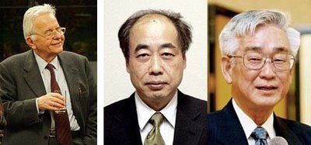



Flavor violation in the SM
Reminder: but
the famous CKM mixing
or
Or at one loop level to FCNC
(observed)

Slide 6





Flavor violation in lepton sector
In the SM:
We can go to a basis that the charged lepton mass matrix ( ) is diagonal.
No mixing between flavors
In the SM, LFV processes are strictly forbidden:
NO
NO
NO
…..

Slide 7


Neutrino oscillation
Recent neutrino observation:
Standard explanation: Neutrino mass and mixing
where

Slide 8
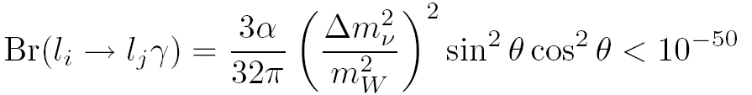

Neutrino oscillation
The only evidence so far for physics BSM comes from observation of neutrino oscillation.
Contribution of neutrino masses to LFV processes:
Petcov Sov J. NP25; Bilenky et al, PLB67; Altarelli et al, NPB125
PDG
Positive signal in future Physics BSM
Banerjee, hep-ex/0702017

Slide 9

CP-violation in the SM
The CKM mixing matrix contains one nonzero CP-violating phase.
CP-violation: Jarlskog invariant
CP-violation in the systems of K and B mesons has been observed and measured.

Slide 10

CP-violation in the lepton sector
Neutrino mass matrix contains one (or more) CP-violating phase.
CP-violation in the neutrino mixing matrix:
Superbeam
Nu-factory

Slide 11




EDM and MDM under CP
CP:
CP:
MDM conserves CP but EDM violates CP.

Slide 12






Present bound and prospects for improvement
Present bound: [PDG]
Near future:
DeMille et al
Foreseeable future:
Lamoreaux, nucl-ex/0109014
(employing solid state techniques; Shapiro’s old idea)
The phase of CKM:
The phases of PMNS:
de Gouvea, Gopalakrishna, PRD72
Positive signal New Physics

Slide 13


Summary
Detection of nonzero rate for LFV processes such as
or conversion as well as nonzero electron EDM would indicates NEW PHYSICS BSM.

Slide 14

Tantalizing hints for BSM
Observational hints:
Dark matter
Deviation of from SM prediction
…
Theoretical hints:
Hierarchy problem
Quest for unification

Slide 15
Models predicting heavy states
SUSY models
Extra dimensions
various Higgs models
…
Minimal Supersymmetric Standard Model
(MSSM) arguably is the most popular one and is the focus of my talk.
All these models predict heavy particles to be directly produced at LHC….

Slide 16
Limitations of LHC
In general, the small LFV parameters of the MSSM cannot be measured by LHC.
See however, kaneko et al., Measuring Lepton Flavor Violation at LHC with Long-Lived Slepton in the Coannihilation Region, PRD78.

Slide 17
Limitations of LHC
Suppose SUSY (or some other BSM) is discovered
at LHC. Little or none can be learned about the
the CP-violating phases in the lepton sector at LHC (see however, Godbole Czech J Physc 55; Heinemeyer and Velasco, hep-ph/0506267; Kittel, hep-ph/0504183 ).
ILC
Measuring CP-violation
Low energy experiments
Searches for EDMs can teach us about the CP-violating phases

Slide 18
Degeneracy
To solve degeneracies among the parameters of the underlying theory, any low energy experiment sensitive to CP-violating phases is welcome.

Slide 19
Importance of CP-violation
Sakharov’s conditions
for dynamically creating
the Baryon asymmetry of the universe

Slide 20
Interplay of LFV and CP-violation
Conventional wisdom as well as tradition say to look for LFV parameters we should focus on the LFV processes and to learn about the CP-violation we should study the EDMs.
Can we learn about the CP-violation from LFV processes ?
Synergies of EDM and LFV searches

Slide 21

Can we derive information on CP-violation from
?

Slide 22



Prospects of improvement
Present bound:
MEG experiment : (meg.web.psi.ch/index.html)
First preliminary results: arXiv:0908.2594
If the present bound is saturated, MEG will have lots of data.
Muons at MEG experiment are produced by decay of pions at rest so they are almost 100% polarized.

Slide 23


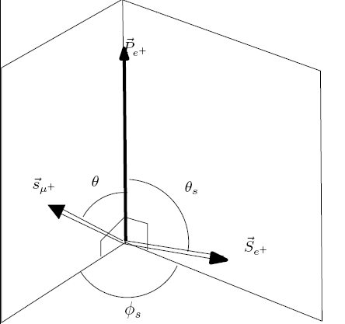



Effective Lagrangian leading to
=Polarization of the muon

Slide 24




Parity violation in
Angular distribution of
positron relative to
Discriminating between models
Kuno and Okada, Rev. Mod. Phys. 73 (01) 151;
Feng, hep-ph/0101122;
Kuno and Okada, Phys Rev Lett77 (96) 434

Slide 25




Question
Thus, the absolute values of and can be measured.
CP
CP
Can we also measure their relative phase which violates CP?

Slide 26



Polarization of final particles
Y. F., JHEP 0707 (07) 54
Relative phase appears here

Slide 27

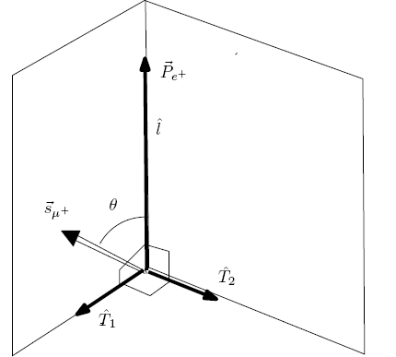


Polarization of the final particles
Summing over the polarization of the photon in
,
Summing over the
polarization of the positron

Slide 28


Correlation of spins of the final particles
To extract information on the CP-violating phase, spins of the photon and positron have to be simultaneously measured.

Slide 29


Ayazi and Farzan, JHEP 0901:022,2009
Maximal effect occurs at

Slide 30
Practical point
Established techniques to measure the
transverse polarization of the emitted positron.
Michel parameters
Burkard et al., Phys Lett B 160 (85) 343.
Measuring transverse polarization of photon at
E=50 MeV ???
However,
Bloser et al., astro-ph/0308331; Adamyan et al., NIMA 546 (05) 376.

Slide 31


The conversion
CP-violating phases from the polarization of the electron in the conversion:
Davidson, arXiv:0809.0263;
Ayazi and Farzan, JHEP 0901(2009) 22

Slide 32



Prospects of improvement
Present bounds on conversion
Bertl et al., Euro Phys J C 47 (06) 337.
PRISM/PRIME experiment
Kuno NPB (Pro. Suppl.) 149 (05) 376
NO technical limitation for improvement?

Slide 33




Advantages and disadvantages
Advantage of over :
No need for photon polarimeter.
Disadvantage:
At MEG, but at PRISM
Evseev, in Muon Vol III Physics Chemistry and Solids,
(1975) p. 236.

Slide 34

Muon Polarization in
There are ways to re-polarize the muon.
Nagamine and Yamazaki, Nucl Phys A 219 (74) 104;
Kuno et al., Nucl. Phys. A 475 (87) 615.
If bounds are saturated,
PRISM/PRIME may collect lots of data.
For our analysis we take

Slide 35

Effective Lagrangian leading to conversion
In principle, the effective terms of form can also contribute to
conversion but in the context of R-parity conserving MSSM these terms are suppressed.

Slide 36



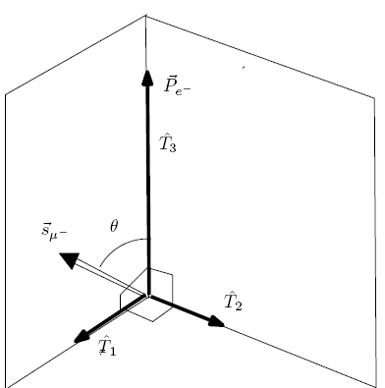


Decay rate
Conversion rate on nuclei of proton and neutron numbers of and :
Hisano et al, PRD 53 (96) 2442

Slide 37







Extracting information
Angular distribution of electrons ,
Let us define
Can we also extract the relative phase of and ?

Slide 38

Polarization

Slide 39


Polarization of the final electron
Ayazi and Farzan, JHEP 0901(09) 22
Maximal polarization:

Slide 40
From General Beyond SM
MSSM with R-parity

Slide 41
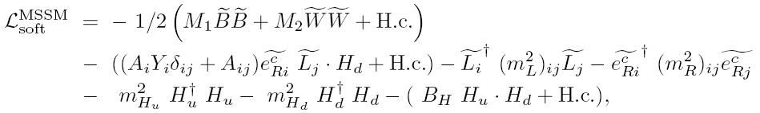





R-Parity conserving MSSM
Bounds on
Bound on

Slide 42



Assumptions
We set to avoid the bounds from .
We concentrate on the effects of
and take them such that
Ayazi and Farzan, JHEP 0901 (2009) 022

Slide 43






Reminder

Slide 44








CP and LF conserving parameters: LHC
Parameters entering
LFV parameters:
CP-violating phases: Phases of the above LFV
parameters
Set of observables

Slide 45





Let us suppose LFV sources are large:
MEG:
, PRISM/PRIME:
Let us suppose that and are measured and found to be in a favorable range:
This means the transverse polarization is sizeable.
Let us suppose and are measured and found to be nonzero.

Slide 46


Can we solve the degeneracy?
For example: 0
Can we say rather than
is responsible for it?

Slide 47
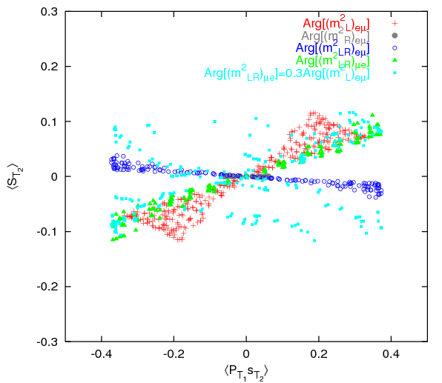
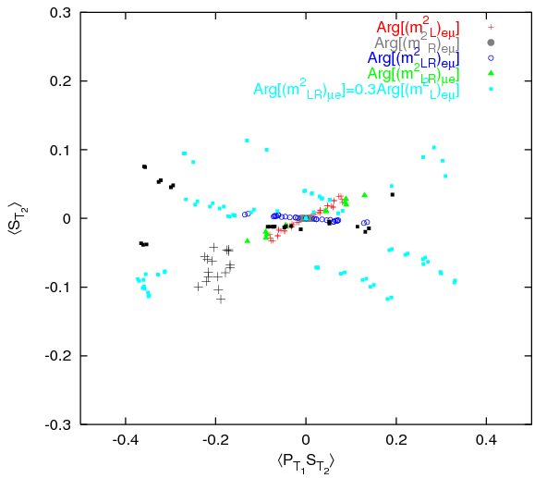



Colored points
Black points:

Slide 48






Experimental bound:
Contrast :
If new particles appear only in even numbers in each vertex, both processes can happen only at loop level:
(e.g., R-parity conserving MSSM)
Three body decay is suppressed by

Slide 49



Toy model for three level

Slide 50
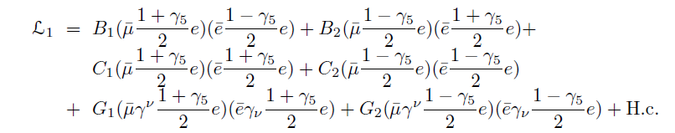



Effective Lagrangian
Under parity:
Under CP:

Slide 51






Energy distribution of the final particles
Kuno and Okada, Rev Mod Phys 73

Slide 52



Angular distribution
CP-violating phases
Kuno and Okada, Rev Mod Phys 73

Slide 53

Other phases
How about ??
Measuring the transverse polarization of the final particles
Y.F. , PLB677

Slide 54




Muon versus anti-Muon
Case of :
Polarization of :
Polarization of :
Similar discussions apply to
Case of :
Polarization of :
Polarization of :

Slide 55

R-Parity violating MSSM
Y.F. and Saereh Najjari,
Extracting CP-violating phases
of trilinear R-parity violating couplings from
arXiv: 1001.3207
To appear in PLB

Slide 56



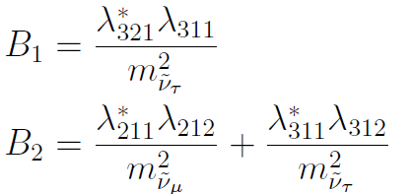
R-Parity violating term

Slide 57

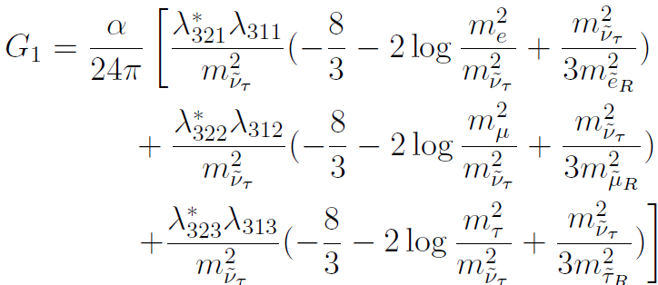
One loop level correction
De Gouvea
et al. PRD63

Slide 58
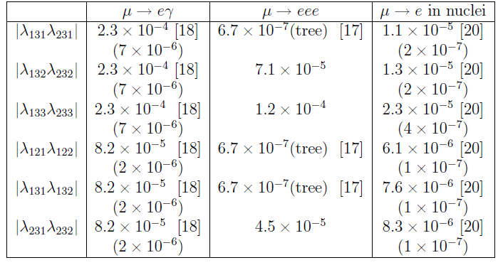
A. De Gouvea et al., PRD63

Slide 59
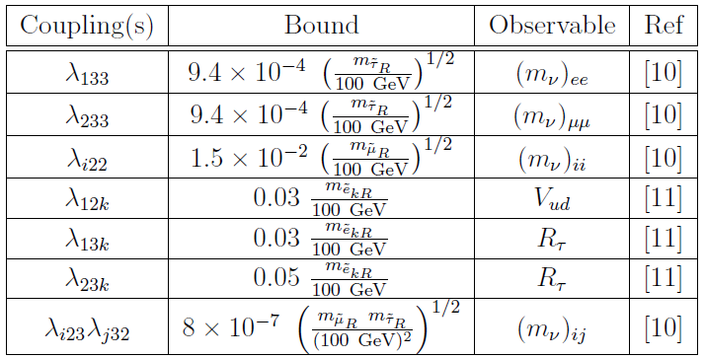
Other bounds

Slide 60

Baryogenesis
Erasing Baryon asymmetry
Barbier et al., Phys Rept 420
But
CP-violating phases in the R-parity violating coupling
can create their own Baryon asymmetry!
e.g., see Masiero and Riotto, PLB 289

Slide 61






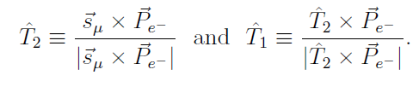
Observables

Slide 62

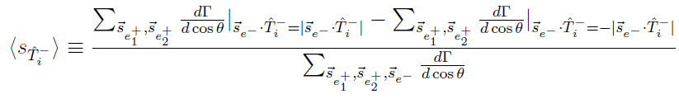
Observables
Transverse polarization of in

Slide 63

Phases entering at tree level
After rephasing the leptons,

Slide 64


Input

Slide 65
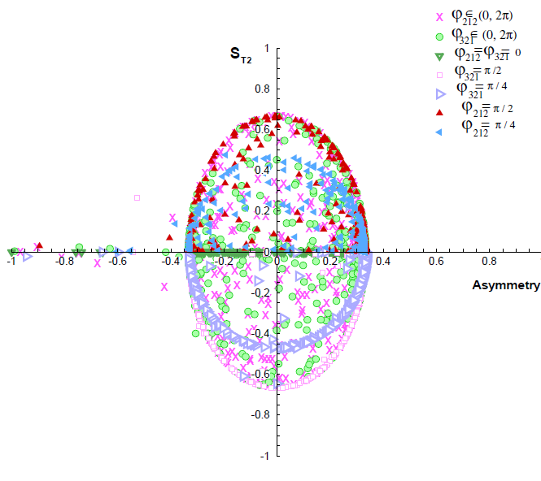


Slide 66



Explaining the oval shape
For
Keeping only

Slide 67
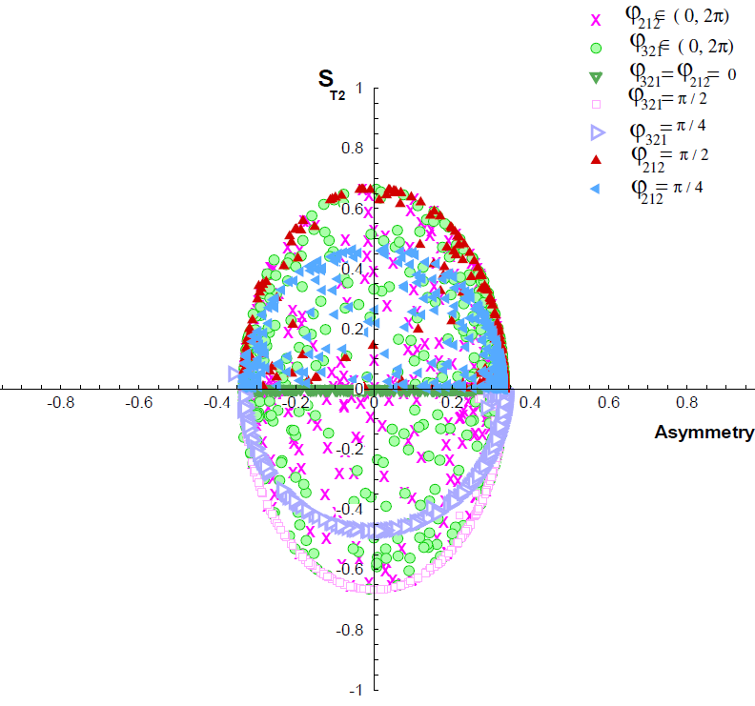

Slide 68






For
+ and

Slide 69


Technical issue
in target
Azimuthal distribution of the photons The transverse polarization of
the positron.

Slide 70
Moller scattering
in target
Azimuthal distribution of the final electrons
The transverse polarization of the electron.
Our paper, new version

Slide 71
Conclusions
By measuring the transverse polarizations of the emitted particles in the conversion and experiments, one can extract information on the CP-violating phases of the underlying theory.
Information from and experiments are complementary
Combining information from and can help us to solve the degeneracy of the parameters.
Adding information from Electron EDM searches can be also helpful to reduce the degeneracy further.

Slide 72



Conclusion
The traverse polarization of the final particles in
yield information on the CP-violating phases of the effective Lagrangian leading to these processes.
R-parity violating MSSM:
Degeneracy between and
Input from accelerators solving the degeneracy

Slide 73
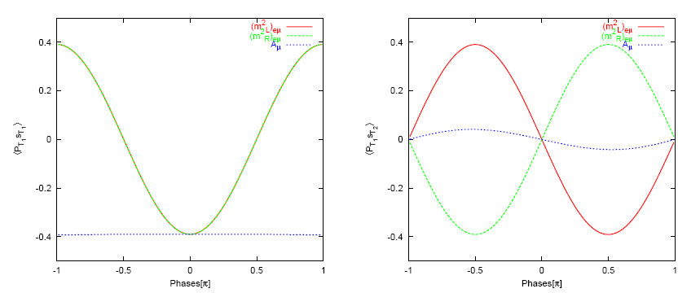




Slide 74
