Slide 1
The effect of a soft X-ray source near the compact object in LS 5039
Workshop on “Variable Galactic Gamma-ray Source”
Heidelberg December 3, 2010
Masaki Yamaguchi, F. Takahara
Theoretical Astrophysics Group
Osaka University, Japan

Slide 2
outline
Gamma-ray binary, LS 5039
Results of MSY & F. Takahara 2010
Model with a soft X-ray source
Discussion
Summary

Slide 3
Orbital parameters of LS5039
supc
Compact object (CO) + Massive star (MS, O6.5)
Period : 3.9 days
Separation
at periastron… ~2Rstar
at apastron…~4Rstar
(Rstar~ cm)
CO
periastron
CO
MS
apastron
CO
infc
CO
observer
Orbit of LS 5039(head on)

Slide 4
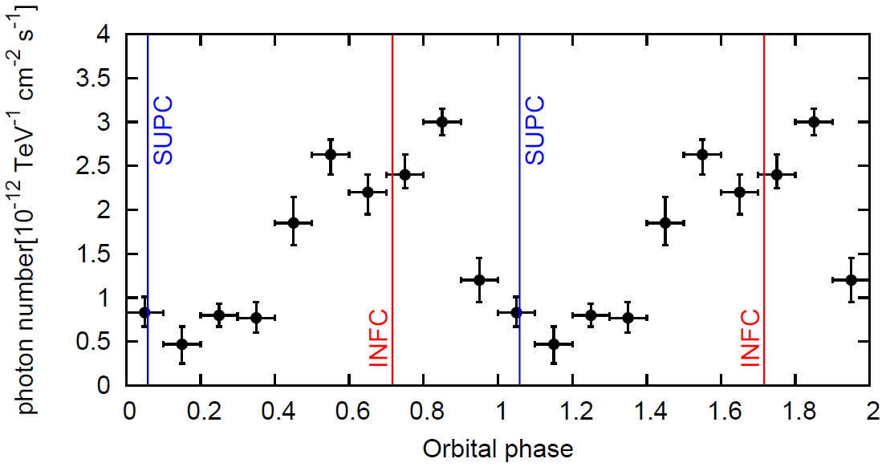
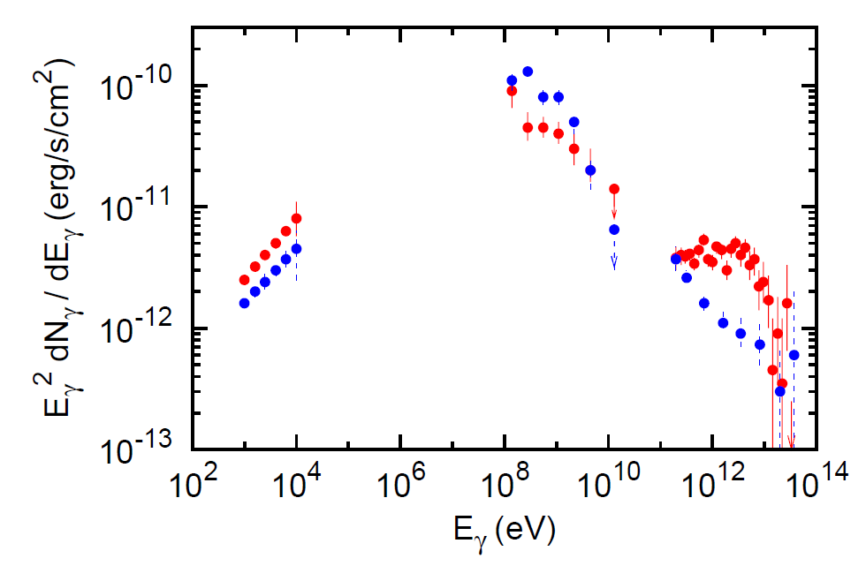
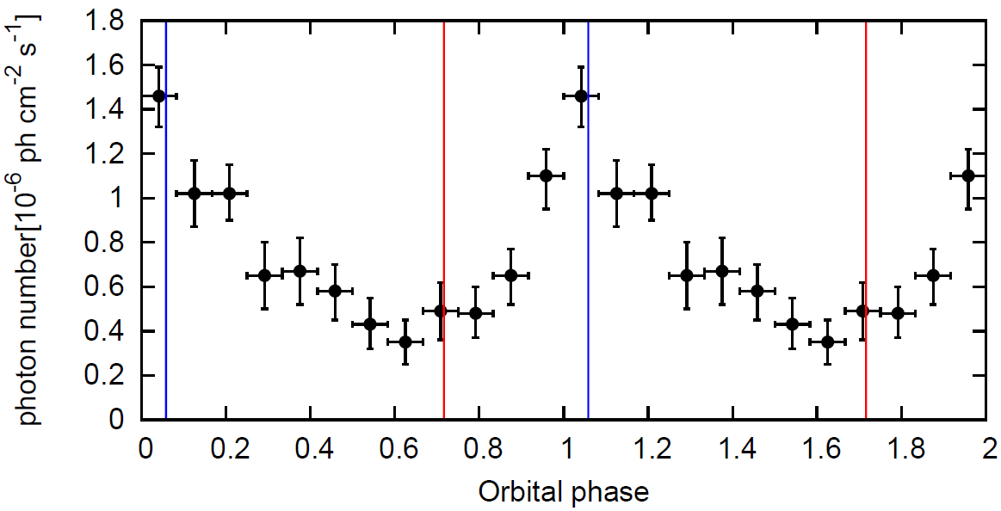
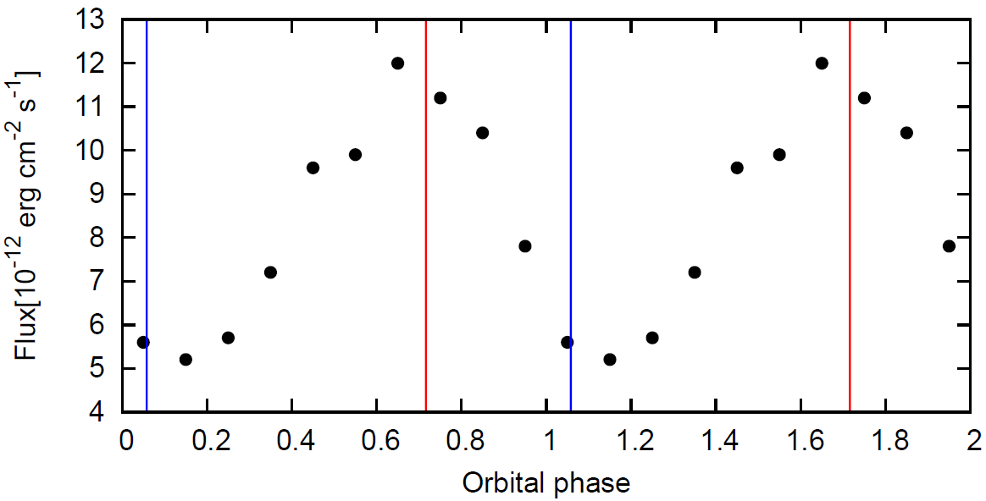
Observations of LS 5039
F. Aharonian, et al., 2006, A&A, 460, 743
A. A. Abdo, et al., 2009, ApJL, 706, 56
superior
inferior
T. Takahashi, et al., 2009, ApJ, 697, 592
Fermi
HESS
INFC
SUPC
Suzaku
HESS
Fermi
SUPC
MS
INFC
Suzaku
Photon energy (eV)
Phase-averaged spectra
・TeV & GeV anticorrelate
・TeV & X correlate
Orbital phase
Light curves

Slide 5
Model (Msy & F. Takahara 2010)
Constant and isotropic injection of electrons at CO (power-law distribution)
Cooling only by IC process → cascade
Electrons radiate photons at
the injection or creation sites
The uniform magnetic field
observer
×
×
×
CO
MS
×
We calculate spectra and light curves by ①the cascade process with Monte Carlo method (GeV to TeV)
②the synchrotron emission using the e± distribution for B = 0.1 G (X-ray)
×: annihilation position
→：IC photon path
→：MS photon path
(parameters： the inclination angle &
the power-law index of injected electrons)

Slide 6
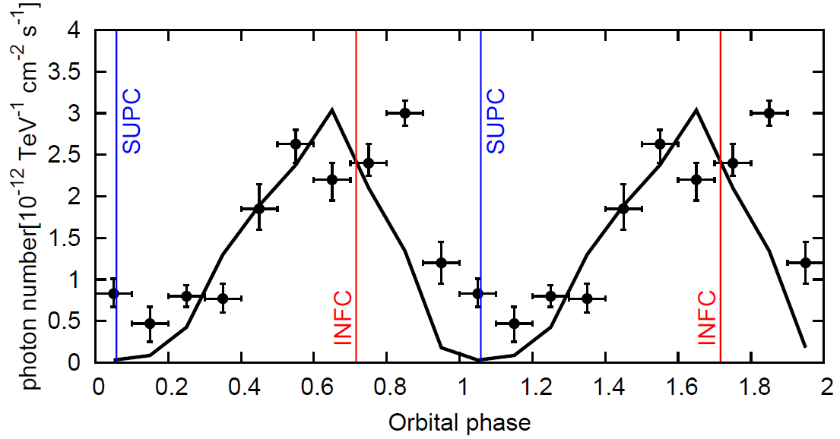
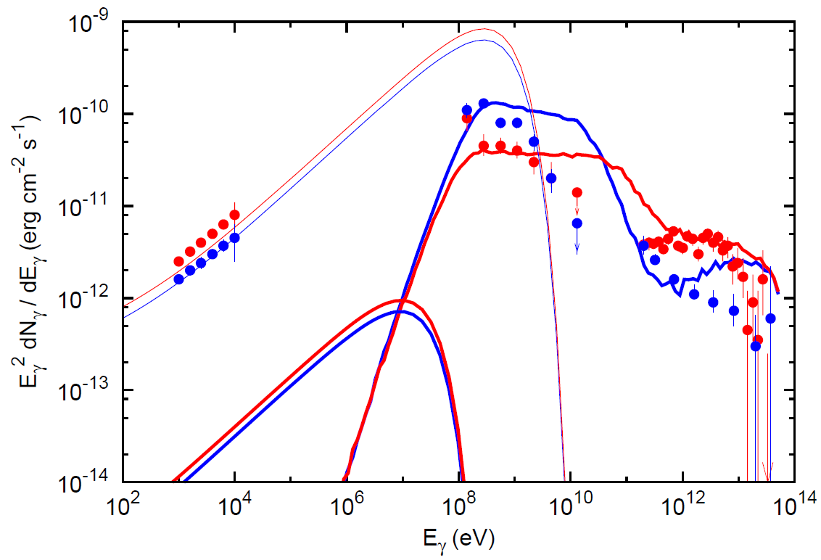
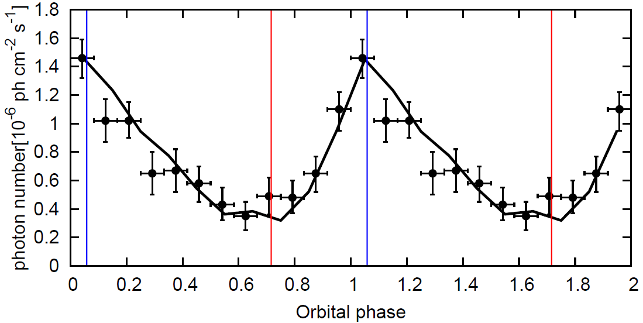
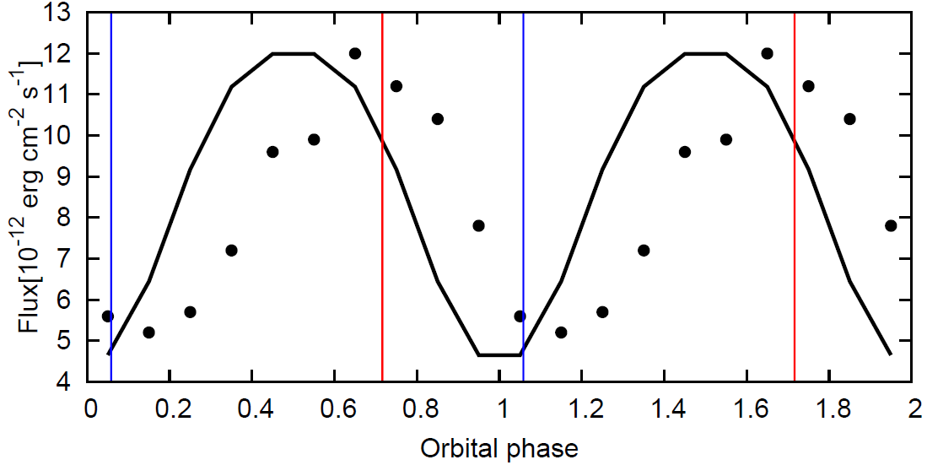
Comparison with observations (i: 30°, index: 2.5)
TeV: absorption dominant
MSY & F. Takahara, 2010, ApJ, 717, 85
synchrotron
_
_
INFC
SUPC
3G
GeV: anisotropy of IC dominant
0.1G
IC cascade
X: e± number variation by IC cooling
Orbital phase
Photon energy (eV)
Consistent with B=3G
(syn. cooling is required)
Excess at 10 GeV
Orbital phase

Slide 7
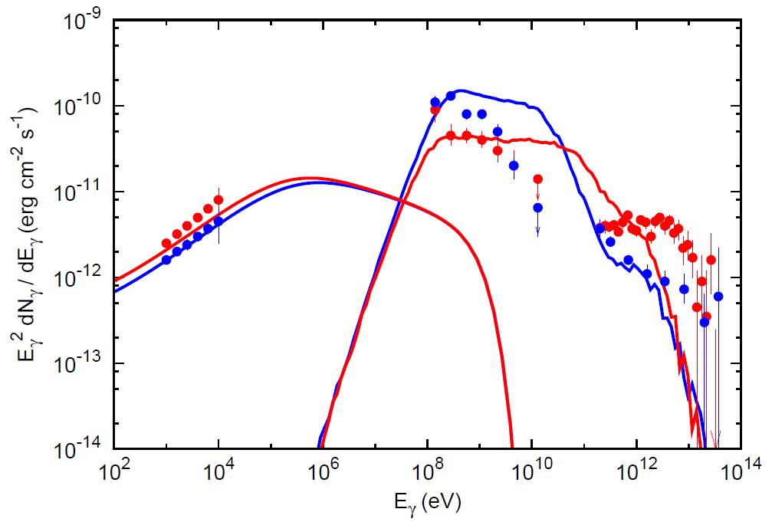
Discussion on problems of spectra
B=3G → the syn. cooling dominates IC more than 1TeV
→ spectra never match the obs of HESS (>1TeV)
Uniform magnetic field is inconsistent with obs of HESS and Suzaku → 2-area model (B=0.1G & 3G) is required
Excess at 10GeV
→ absorption by photons
with higher energy (~100eV)?
We construct the 2-area model
with 100eV photons
Spectra including syn cooling

Slide 8
2-area model with 100eV photons
e± are accelerated up to 1TeV and radiate in the area (1) where B=3G
e± are accelerated from 1 to 50TeV and radiate in the area (2) where B=0.1G
Area(1) is filled with photons
with 100eV
→ we calculate cascade with 100eV photons in the area(1), and with stellar photons in the area(2)
About 100eV source
B=0.1G
isotropic
B=3G
O star
CO
for consistency with Suzaku
(if thermal, )

Slide 9
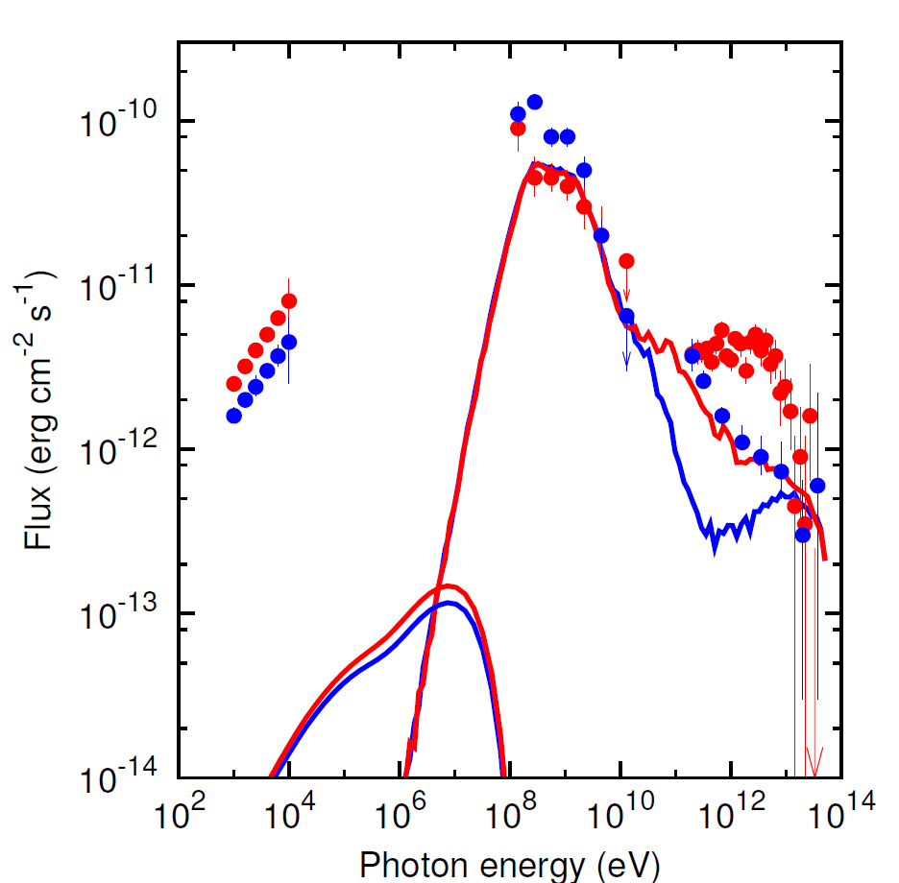
Results
GeV spectra match the Fermi data
But…
X-ray spectra is terribly underestimated
TeV spectra is also underestimated
No orbital variation in GeV & X-ray band

Slide 10
Discussion 1
Underestimation in X-ray band
Target photons are changed to 100eV photons, so photon density increases → IC cooling time becomes short → the number of e± decreases
No variation in GeV & X-ray band
In Y&T 2010, e± scattered off stellar photons → each flux modulates by the anisotropy of IC scattering
In this study, they scatter off isotropic photons → emerging photons with GeV & keV have isotropic distribution → No modulation in GeV & X-ray band

Slide 11
Discussion 2
Underestimation at TeV
We assume that 100eV photons are isotropic
→ The flux by IC scattering is large compared with anisotropic photon field
TeV flux is underestimated
→ GeV flux is overestimated
Anisotropic photon field
Isotropic photon field
O star
Photons through head-
on collision are seen
from any direction
HEe± source

Slide 12
summary
We introduce…
100eV photon source to reproduce 10GeV spectra
2 areas different in energy of injected e± and B (and IC target photon) to reproduce X-ray & TeV spectra
10GeV spectra match Fermi obs but…
X-ray flux is underestimated (by large photon density)
X-ray & GeV have no variation (by isotropy of 100eV)
TeV flux is relatively underestimated

Slide 13
prospect
With 100eV source, we will introduce orbital variation of injection (as in Owocki et al. 2010, proceeding)
→ the problem is the deficiency of X-ray flux
→ IC scattering origin?
Without 100eV source, we will regard GeV cutoff as high energy cutoff of injected e±
→ the problem is the origin of TeV emission
→ the hadronic process? (e.g. p-p or p-γ)

Slide 14
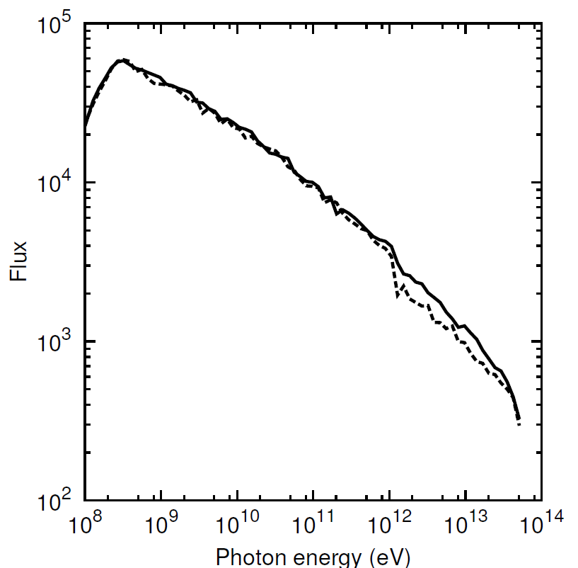
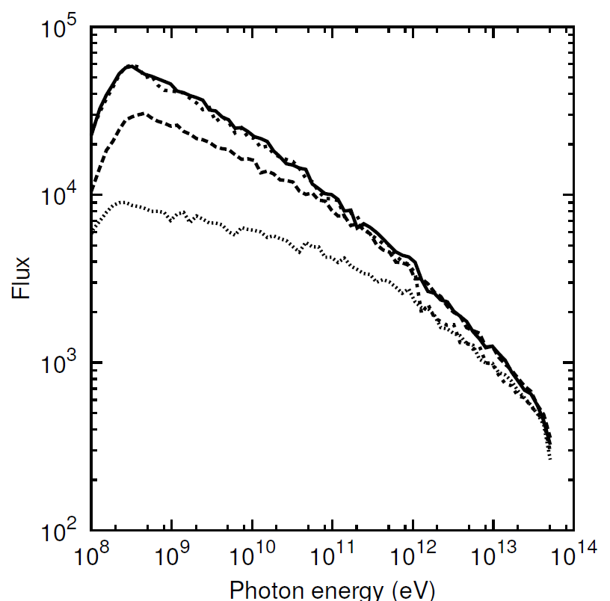
Spectra only with inverse Compton
2-area model
2-area model & 1-area model
SUPC
SUPC
INFC
INFC
Flux in the 2-area model is larger than the other
→the anisotropy of target photons is important
Independent of photon density and target photon

Slide 15
Modulation mechanism in TeV, GeV and X-ray
TeV: absorption is dominant
At supc, flux is smaller than infc by the large density of stellar radiation field
GeV: IC anisotropy is dominant
At supc, flux is larger than supc by head-on collision of IC scattering
X-ray: e± number variation by IC cooling
At periastron, the e± number in steady state is smaller than apastron by IC cooling in the large density of stellar radiation field, so emissivity by synchrotron is smaller, therefore flux is smaller
TeV
Binary axis
CS(superior)
MS
CS(inferior)
GeV
CS(superior)
MS
CS(inferior)
X-ray
CS(pariastron)
MS
CS(apastron)

Slide 16
2-area model (without 100ev photon)
e± are accelerated up to 1TeV and radiate in the area (1) where B=3G
e± are accelerated from 1 to 30TeV and radiate in the area (2) where B=0.1G
We inject e± with energy
e± with
are injected in area(1) and IC
photons cascade in the stellar radiation field
e± with
are injected in area(2) and IC photons
cascade in stellar radiation field
we count the escaped photons
Calculation method
B=0.1G
B=3G
O star
CO

Slide 17
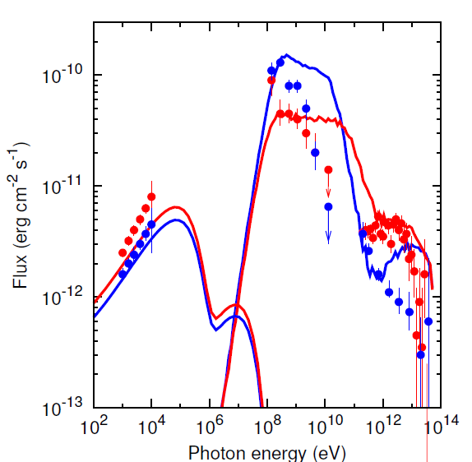
Results of 2-area model without 100eV
Inclination angle: 30°
INFC
ー
ー
30TeV photons are emitted and X-ray flux match obs
Problem
10GeV spectra do not match obs
As well, 10TeV (SUPC)
SUPC

